Slide 1
Stage 3
36 Months to 6th Birthday

Slide 2
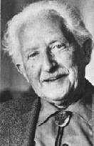
Emotional health
Love and affection
Erikson’s third stage of development
Industry v. inferiority
The desire to be separate but not alone
Children begin to resist closeness with sporadic times of seeking it out.
What are some typical parental responses one might witness during these times?
Good and Bad

Slide 3
Unconditional love
What is unconditional love?
AKA sensitive and responsive care.
What are the ramifications of not receiving this?
Problems forming and maintaining relationships in preschool
Lower levels of school achievement, even into adolescence
Greater chances of requiring special education classes
Increased behavioral problems
More likely to turn to drugs and alcohol in adolescence
Hawley, 1998
What types of responses to behaviors might you recommend to parents?
Is there a sensitive period for unconditional love?
First few years of life

Slide 4
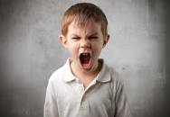
Joy and Anger
Expressions of joy begin to _________________.
Why?
Although anger remains, a child’s expression of physical aggression should ________.
Why?
Three steps to controlling anger
Accept it as natural and normal
Verbalize feelings of anger
Learn acceptable ways of dealing with anger

Slide 5
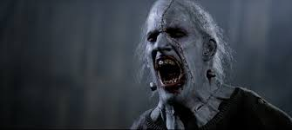
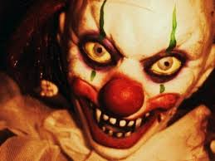
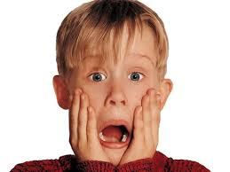
fear
How does fear during this age differ from the preschooler?
From where to fears develop?
Experiences
Experiences of others
The unknown
How should a parent help a child deal with their fears?

Slide 6
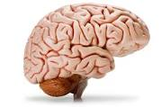
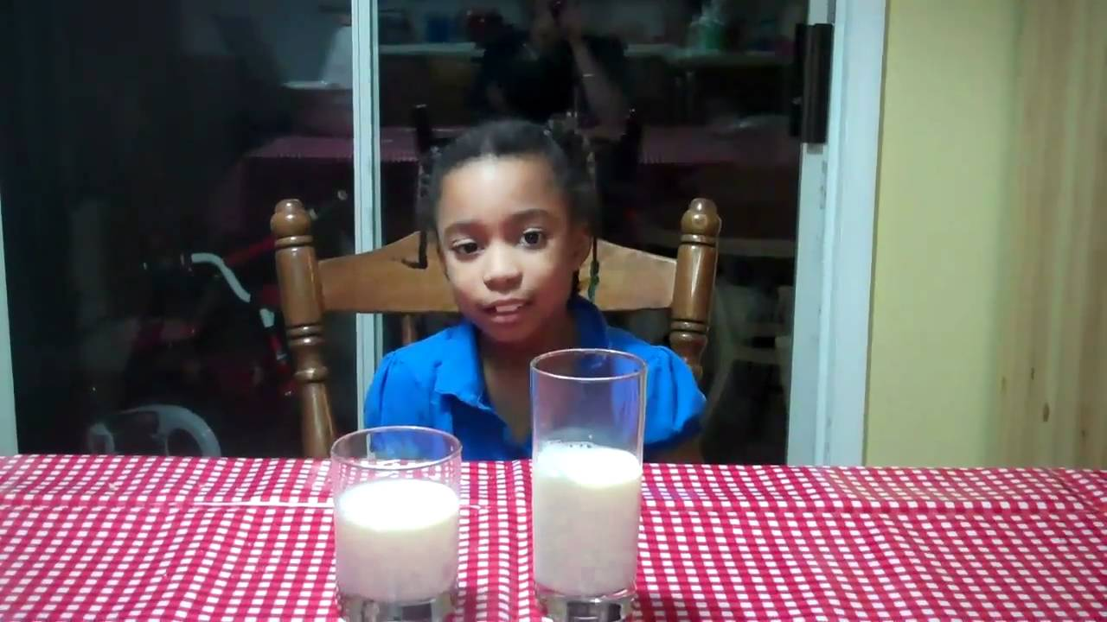
Cognitive Development
Brain development
Remains rapid
Problem solving
Transductive reasoning
seriation
Conservation
Appearance v. reality
Irreversibility
Egocentrism
animism
2 rules for promoting problem solving
Don’t solve problems
Ask questions

Slide 7
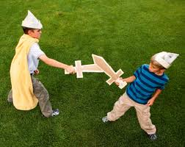
Play and imagination
When does stretching the truth become lying?
What about imagining violent interactions?
Video games?
How should a parent respond?
Why?

Slide 8
Language expectations
36 months: up to 900 words
Self talk
Tenses
Pronouns
Differentiation of nouns
Age 4: 1500 words
Age 5: 2000 Words
Age 6: 2500 Words

Slide 9
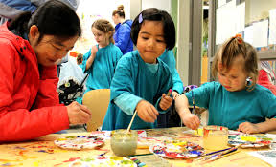
Family and peer relationships
So preschoolers need to develop friendships?
How might you try to do this to increase the chances of success?
When does interactive play begin?
Routines
Bed time
Dinner time

Slide 10
Types of Parenting (Baumrind)
Authoritarian
Authoritative
Permissive indulgent
neglectful

Slide 11
Personal growth and character formation
sense of self
Physical attributes
Possessions
Preferences
Overt behaviors in comparison to others

Slide 12
Character formation
Values and morals/conscience
Experiential learning (Preconventional moral reasoning – Kohlberg
Observational learning
Imitation
Role-playing
manners
Rude or neurologically impaired?
How can you tell the difference?
How best can you respond?
How best can you teach good manners”

