Slide 1
Stage 1
18 – 36 Months

Slide 2
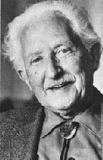
Emotional health
Nature V. Nurture
Love and affection
Erikson’s First stage of development?
Trust v. Mistrust
How can trust be developed?

Slide 3
Attachment
What is Attachment?
Strong emotional bond between a __________ and a __________.
During what age Are children completely reliant on their caretaker?
What are the ramifications of this on attachment during this time?
How else does your text suggest the building of a strong parent child bond?
Is there a sensitive period for the development of attachment?

Slide 4
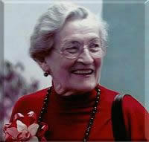
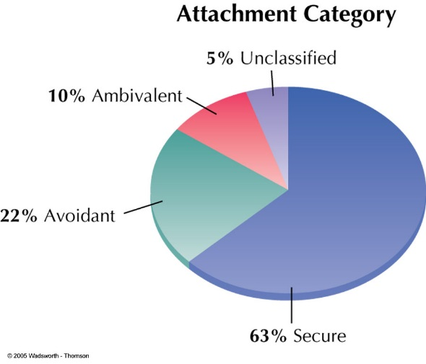
Types of Attachment (Ainsworth)
Secure Attachment
Separation Anxiety
Social Referencing
Insecure Avoidant
Insecure Ambivalent
Insecure Disorganized
Results of Insecure Attachment

Slide 5
Joy, Anger and Fear
When do these emotions begin to develop?
What are the appropriate responses to them?

Slide 6
Cognitive Development
Brain development
80 billion to ten trillion Neurons
Connections are what is important
So what increases the connections for infants?
As a parent, how can you increase the connections for your child?

Slide 7
Language Development
Birth Communication Type?
1 – 3 Months Cooing
2 – 7 months Vocal experimentation
4 – 8 months Babbling
8 – 12 months babbling with intonation
1 year First word
12 – 18 months Parroting

Slide 8
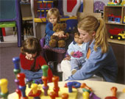
Family and peer relationships
So infants need to develop friendships?
How might you try to do this?
What about family structure, rituals and routines?
When can these begin? Why?
When should these begin? Why?
What is the value of routines for the infant?

Slide 9
Personal growth and character formation
Erikson’s second stage?
Stage Two: Autonomy versus Shame and Doubt (1-3)
Autonomy: Doing things for themselves
Teach values and morals
But how? (i.e. gentleness, kindness, etc…)

