Slide 1
Chapter 11
Aggression

Slide 2
Is This an Act of Aggression?
Accidentally injuring someone.
Working tenaciously to try to sell a product to a customer.
Biting someone on the neck.
Swinging a stick at someone but missing.
Hurling insults at someone.
Deliberately failing to prevent harm.
Murdering for money.
Hiring someone to break a competitor’s kneecaps.
Hitting others while in a rage.

Slide 3
What Is Aggression?
Aggression is defined as behavior that is intended to harm another individual
How do we know someone’s intentions?
Aggressive behavior can come in many different forms.

Slide 4
Language of Aggression
Violence refers to extreme acts of aggression.
Anger consists of strong feelings of displeasure in response to a perceived injury.
Hostility is a negative, antagonistic attitude toward another person or group.

Slide 5
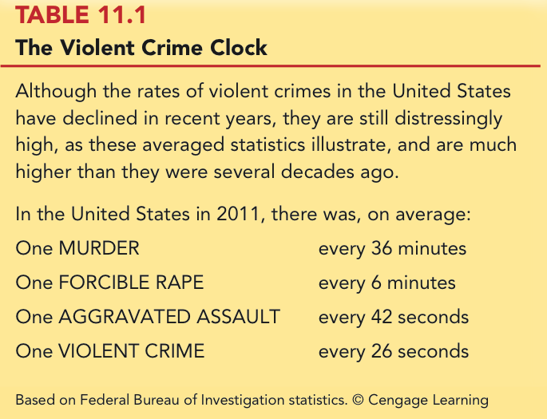
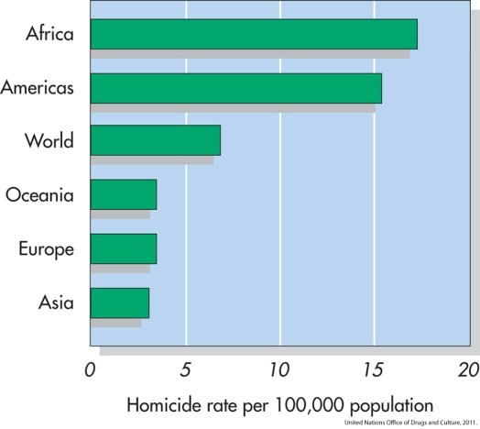
Types of Aggression
Instrumental/Proactive Aggression: Harm is inflicted as a means to a desired end.
Emotional/Reactive Aggression: Harm is inflicted for its own sake.
Are these distinct categories or endpoints on a continuum?

Slide 6
Bullying Around the World
One form of aggression that is prevalent across virtually all cultures is bullying.

Slide 7
Gender and Aggression
Universal findings that men are more violent than women.
Differences stable over time and place.
Challenges to the notion that men are more aggressive than females.
Boys tend to be more overtly aggressive.
Girls often are more indirectly, or relationally, aggressive.

Slide 8
Is Aggression Innate? Evolutionary Psychology
Uses principles of evolution to understand both the roots and contemporary patterns of human aggression
Emphasis placed on genetic survival rather than survival of the individual.
Accounts for inhibition of aggression against genetically related others.
Why gender differences?
Males aggress to achieve and maintain status.
Females aggress to protect offspring.

Slide 9
Is Aggression Innate? Behavior Genetics
Is an aggressive personality type due to genes?
Mixed overall results on heritability of aggression
But trend in research supports heritability of human aggressiveness to at least some degree

Slide 10
Is Aggression Innate? The Role of Testosterone & Serotonin
Are there specific biological factors that influence aggression?
Strong positive correlation between testosterone levels and aggression.
But correlation is not causation!
The neurotransmitter serotonin appears to restrain impulsive acts of aggression.
Low levels of serotonin associated with high levels of aggression.
Boosting serotonin can dampen aggressiveness.

Slide 11
Is Aggression Innate? Brain and Executive Functioning
Structure of frontal lobe linked to aggression and violent behavior
Impaired prefrontal cortex in particular can disrupt executive functioning
Variance in brain activity of teens in
relation to aggression

Slide 12
Is Aggression Learned?
Aggressive behavior is strongly affected by learning.
Aggression can be positively as well as negatively reinforced.
Positive reinforcement: Aggression produces desired outcomes.
Negative reinforcement: Aggression prevents or stops undesirable outcomes.

Slide 13
Punishment and Aggression
Punishment is most likely to decrease aggression when it:
Immediately follows the aggressive behavior
Is strong enough to deter the aggressor
Is consistently applied and perceived as fair and legitimate by the aggressor
Problems with using punishment to reduce aggressive behaviors.

Slide 14
Social Learning Theory
Behavior is also learned through the observations of others.
Bandura et al.’s (1961) inflatable doll study.
By watching aggressive models, people:
Learn specific aggressive behaviors
Develop more positive attitudes and beliefs about aggression in general
Construct aggressive “scripts”
Nonaggressive models decrease aggressive behavior.

Slide 15
Gender Differences and Socialization
Males and females are rewarded differently for aggression.
Also have different models
Social roles have a strong influence on gender differences in physical aggression.

Slide 16
Situational Influences on Aggression

Slide 17
Frustration: Aggression as a Drive
Frustration-Aggression Hypothesis:
Frustration always elicits the motive to aggress.
All aggression is caused by frustration.
The motive to aggress is a psychological drive that resembles a physiological drive.
Can lead to displacement.
Catharsis is the reduction of this motive.

Slide 18
Frustration-Aggression Hypothesis: Does the Research Support It?
Frustration is related to aggression.
But frustration does not always produce aggressive inclinations.
There are other causes of aggression besides frustration.
Is displacement a valid concept?

Slide 19
Catharsis
Viewed as a two-step sequence
Aggression reduces the level of physiological arousal.
Because arousal is reduced, become less angry and less likely to aggress further.
Sounds logical, but is it a myth?

Slide 20
Problems with Catharsis
Imagined aggression or the observation of aggressive models is more likely to increase arousal and aggression than reduce it.
Actual aggression can lower arousal levels.
But if aggressive intent remains, “cold-blooded” aggression can still occur.
Also, if it feels good, more likely to act aggressively again.

Slide 21
Frustration-Aggression Hypothesis Revised
Frustration is but one of many unpleasant experiences that can lead to aggression by creating negative, uncomfortable feelings.
It is the negative feelings, not frustration itself, that can trigger aggression.
Negative feelings can also result from a wide variety of noxious stimuli.

Slide 22
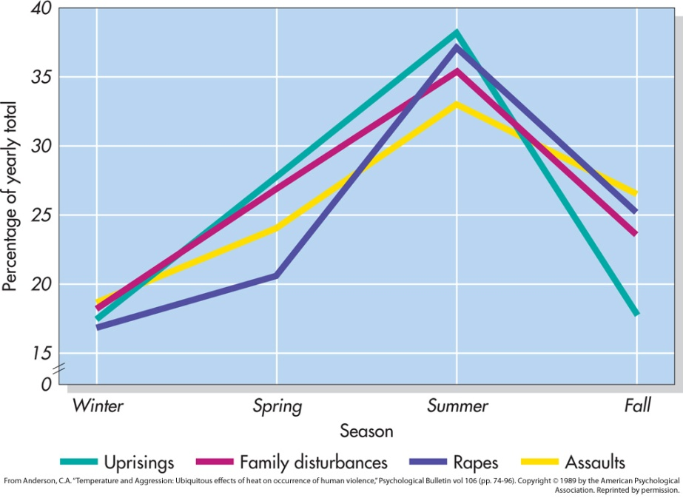
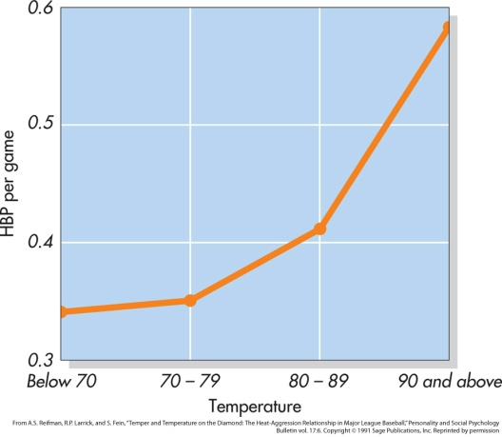
Negative Affect
Heat and Aggression
People lose their cool more often in hot temperatures
More violent crimes occur in summer, hotter years, and hotter cities
Positive Affect
Seems to reduce aggression

Slide 23
The General Aggression Model
Notes:
This figure represents key aspects of an early version of the General Aggression Model (it has since been updated to include more factors, but the basics are the same). Unpleasant experiences and situational cues can trigger negative affect, high arousal, and aggression-related
thoughts. Due to individual differences, some people are more likely than others to experience these feelings and thoughts. Higher-order thinking then shapes these feelings and thoughts into more well-defined emotions and behavioral intentions. Depending on the outcome of this
thinking (which can occur beneath the individual’s conscious awareness and can be affected by factors such as alcohol or
stress), the individual may choose to aggress. From Anderson, C. A., Anderson, K. B, and Deuser, W. E., “Examining and affective framework: weapon and temperature effects on aggressive thoughts, affect, and attitudes,” Personality and Social Psychology Bulletin vol 22 (pp. 366–376). Copyright © 1996 Sage Publications, Inc. Reprinted by permission.

Slide 24
Media Effects

Slide 25
Violence in TV, Movies, Music Lyrics, and Video Games
Violence depicted in the media has been a target of attack and counterattack for decades.
If consumers didn’t enjoy violence in TV, film, music, videos, and video games, these media would not be featuring it.

Slide 26
Linking Media Violence to Real-World Violence
If you ask people whether exposure to media violence causes real aggression, most would probably say that they doubt that it does or that there has never been clear evidence one way or another on this question.

Slide 27
Immediate Effects of Media Violence
Aggressive models increase aggressive behavior among children and adults.
Models can be live or on film.
Violent imagery in the music industry associated feelings of hostility and aggressive thoughts.
Playing violent video games can increase aggressive thoughts and behaviors.

Slide 28
Long-Term Effects of Media Violence
Exposure to TV violence at ages 6-9 positively correlated with aggression as adults.
No gender difference
Cross-cultural study found relationship between early viewing of TV violence and later aggression.

Slide 29
How Does Exposure to Media Violence Have Long-Term Effects?
Influences values and attitudes toward aggression.
Through habituation become desensitized to violence.
Depictions of violence can change values and attitudes through cultivation.

Slide 30
Violent TV Viewing and Aggression 15 Years Later
Notes:
A longitudinal study tracked individuals over a 15-year
period. Based on how much TV violence they viewed as 8
year olds, individuals were categorized as having viewed
low (lower 20%), medium (middle 60%), or high (upper
20%) levels of TV violence. Their aggressiveness as adults
was measured 15 years later. For both females and males,
those who tended to watch the greatest amount of violent
TV as children tended to be the most aggressive as adults.
Based on Huesmann et al., 2003. © Cengage Learning

Slide 31
Violent Video Games as Risk Factors for Several Outcomes
Notes:
A recent meta-analysis of more than 136 research papers, involving more than 130,000 participants in several countries found strong relationships between playing violent video games and a number of outcomes, including higher levels of aggressive behavior, aggressive cognition, aggressive affect, and physiological arousal, along with reduced levels of prosocial behaviors and empathy (and an associated increase in desensitization). (The sizes of the bars in this graph represent the magnitude of the relationships between violent video games and these other variables; bars in a positive direction indicate a positive relationship; bars in a negative direction indicate a negative relationship.)
Based on Anderson et al., 2010; Anderson & Prot, 2011. © Cengage Learning

Slide 32
Can Media Cause Positive, Prosocial Effects?
Early research is encouraging
Positive effect associated with prosocial television shows and children’s prosocial behavior
Some games feature positive helpful, cooperative behaviors

Slide 33
Pornography and Aggression
Positive correlation for men between exposure to pornography and reported sexually aggressive behaviors and attitudes.
But what is pornography?
Often a matter of personal opinion.
Pornography refers to explicit sexual material, regardless of its moral or aesthetic qualities.

Slide 34
Nonviolent Pornography
Arousal-affect model revisited.
Nonviolent pornography can increase men’s aggression against women.
But only when restraints that ordinarily inhibit male-to-female aggression are reduced.
Little support for direct causal link between pornography use and sexual aggression.
Though men who are predisposed to sexually offend are most likely to be affected by pornography

Slide 35
Violent Pornography
Adding violence to pornography increases possibility of harmful effects.
Brings together high arousal, negative emotional reactions, and aggressive thoughts.
Male-to-female aggression is markedly increased after exposure to violent pornography.

Slide 36
Reducing Violence

Slide 37
Changing How We Think and Feel
Enhanced education, intelligence, and reasoning helped cause the decline in violence over the past several centuries.

Slide 38
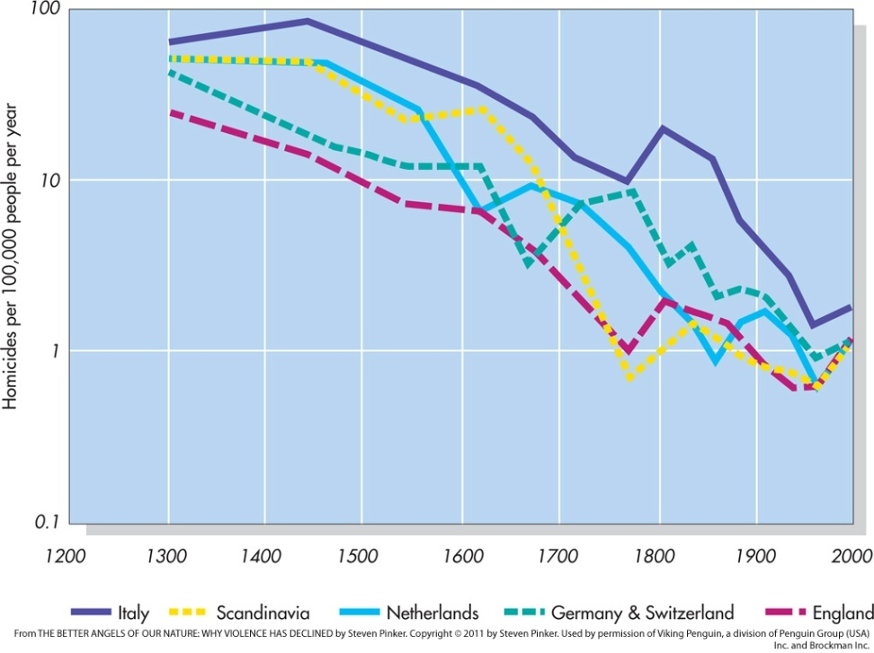
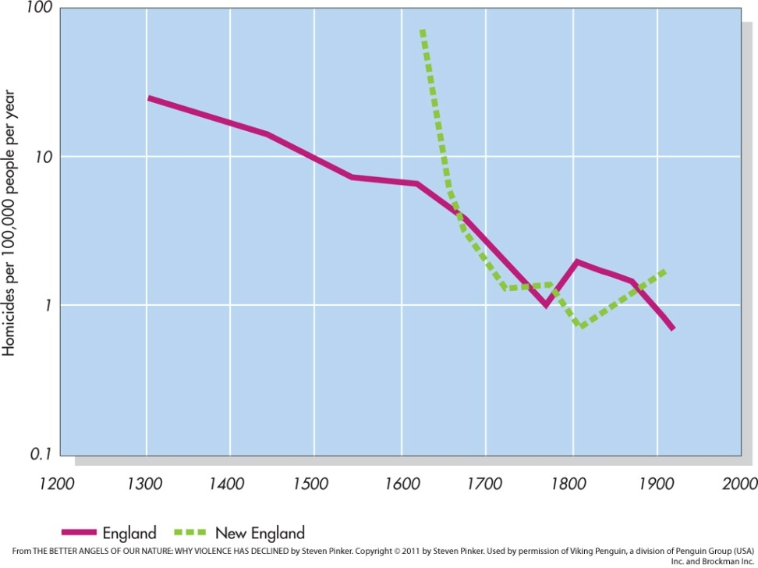
The Decline of Violence
Notes:
The homicide rates per 100,000 people per year in five regions of Western Europe from the year 1300 to 2000 are depicted in the graph on the top. These rates for England (from 1300 to 1925) and New England (from 1630–1914) are presented in the graph on the bottom.
From Pinker, S., The better angels of our nature: Why violence has declined. Copyright © 2011 by Steven Pinker.
Used by permission of Viking Penguin, a division of Penguin Group (USA) Inc. and Brockman Inc.

Slide 39
Situational and Sociocultural Factors
An improved economy, healthier living conditions, and social support are extremely important in reducing the frustration, negative affect and thinking, and provocations that fuel much aggression.

Slide 40
Multiple-Level Approaches: Programs to Prevent Violence and Bullying
One of the most successful treatment programs for violent juvenile delinquents is called multisystemic therapy (MST).
Comprehensive programs that operate on multiple levels have also proven to be effective in reducing the incidence of bullying.

Slide 41
The Olweus Bullying Prevention Program

Slide 42
Some Steps to Reduce Aggression and Violence

