Slide 1
Psychology 313
Interventions with Children and Families
Week 6
Silver Text- Parts 2 & 3
Wiki ”KID” ia

Slide 2
Learning Disabilities
What is it?
How is this different from mental retardation (ID)
Types of Learning Disabilities
Input
Integration
Memory
Output

Slide 3
Input
Visual Perception Disabilities
Depth perception, association cortex (e.g. hitting a baseball)
Auditory Perception Disabilities
Auditory lag
Vestibular Perception Disabilities
Autism

Slide 4
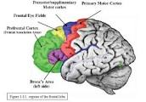
Integration
Three steps
Sequencing
12 – 4 =
21 – 4 =
Abstracting (Keep you eyes on your paper)
Organizing (executive function)
Frontal lobe and prefrontal cortex

Slide 5
Memory
Encoding, storage & Retrieval
Encoding
Storage
Retrieval
Immediate Recall, STM (working memory), LTM

Slide 6
Output Disabilities
Language
Spontaneous
Demand
Motor
Handwriting
How and when do these issues become problematic?

Slide 7
The evaluation process
Who?
How should I request it?
Where do I go?
Who can do it (diagnostic testing)?
3 Parts to the Process
Planning
Assessment (testing/observing/interviewing)
Interpretation of the findings

Slide 8
How should you prepare your child for evaluation?

Slide 9
Attention Deficit/Hyperactivity Disorder
What is it?
What does it look like?
Why does it happen?
Why are the rates going up?
Tests?

Slide 10
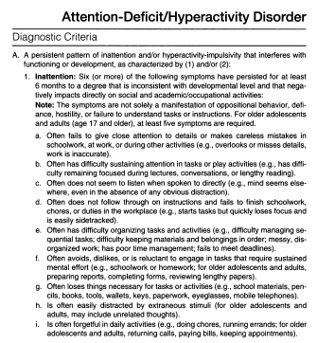

Slide 11
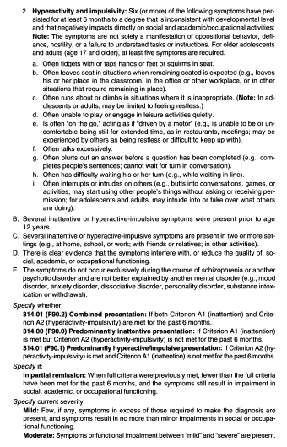

Slide 12
Other causes of these behaviors
Anxiety
Depression
???

