Slide 1
A Topical Approach to Life-Span Development, 7th edition John W. Santrock
Chapter 17 –
Death, Dying, and Grieving
Copyright McGraw-Hill Education, 2014

Slide 2
The Death System and Cultural Contexts
Death occurs most often among older adults
In past, most people in U.S. died at home, cared for by family
A larger number of older adults die apart from their families
More than 80% of deaths occur in institutions or hospitals
Minimized exposure to death and painful surroundings
Copyright McGraw-Hill Education, 2014

Slide 3
Defining Death and Life/Death Issues
In past, the end of certain biological functions were considered clear signs of death
Breathing, blood pressure, rigidity of body (rigor mortis)
Brain death
Neurological definition of death
A person is brain dead when all electrical activity of brain ceases for a specific period of time
Higher brain regions may die but lower portions may continue breathing and heartbeat
Copyright McGraw-Hill Education, 2014

Slide 4
Defining Death and Life/Death Issues
Living will
Designed to be completed while individual can still think clearly
Expresses desires regarding extraordinary medical procedures that may sustain life when medical situation becomes hopeless
Hospice
Program committed to making end of life as free from pain, anxiety, and depression as possible
Emphasizes palliative care – reducing pain and suffering and helping individuals die with dignity
Copyright McGraw-Hill Education, 2014

Slide 5
Developmental Perspective on Death
In United States, deaths of older adults account for approximately ⅔ of the 2 million deaths that occur each year
What is known about death and grieving is based on information about older adults
Youthful death is much less common
Copyright McGraw-Hill Education, 2014

Slide 6
Developmental Perspective on Death
Death can occur at any point in life span
In childhood, death occurs most often due to accidents or illness
Major illnesses that cause death in children – heart disease, cancer, birth defects
Death in adolescence likely to occur because of motor vehicle accidents, homicide, suicide
Older adults are more likely to die from chronic diseases
Often incapacitated before death; produces a long course of dying
Copyright McGraw-Hill Education, 2014

Slide 7
Developmental Perspective on Death
Age influences the way death is thought about and experienced
Mature, adult-like conception of death includes:
An understanding that death is final and irreversible
Death represents end of life
All living things must die
Copyright McGraw-Hill Education, 2014

Slide 8
Developmental Perspective On Death
Infants experience brief separations as total losses
Loss of a parent can negatively affect infant’s health
In early childhood, children have little or no idea what death means
Confuse death with sleep or ask “why doesn’t it move?”
Rarely get upset at death
Believe that dead can be brought back to life
Believe only people who want to die, who are bad or careless, actually die
Copyright McGraw-Hill Education, 2014

Slide 9
Developmental Perspective On Death
Children develop more realistic perceptions of death in middle and late childhood
Do not view death as universal and irreversible until about 9 years of age
Death of a parent is especially difficult for children
School performance and peer relationships often worsen
Death can devastate and result in hypersensitivity about death
Loss of sibling may cause similar outcomes
Copyright McGraw-Hill Education, 2014

Slide 10
Developmental Perspective On Death
Adolescents develop more abstract conceptions of death
Describe in terms of darkness, light, transition, or nothingness
Develop religious and philosophical views about nature of death or whether life exists after death
Not unusual for adolescents to believe they are immune to death or that it happens to other people, but not them
Copyright McGraw-Hill Education, 2014

Slide 11
Developmental Perspective On Death
Suicidal behavior escalates in adolescence and further increases in emerging adulthood
Far more adolescents think about or attempt suicide than complete attempts
Females are more likely to attempt suicide than males, but males more likely to succeed
Males use more lethal means in suicide attempts
Copyright McGraw-Hill Education, 2014

Slide 12
Developmental Perspective On Death
Suicidal behavior of adolescents also varies by ethnicity
Native American/Alaska Native adolescent females are most likely
African American males among the least likely
Depression is most frequently cited factor associated with adolescent suicide
Sense of hopelessness, low self-esteem, high self-blame
Suicides often occur in clusters
“Copycat” suicides raise issue of whether suicides should be reported in the media
Copyright McGraw-Hill Education, 2014

Slide 13
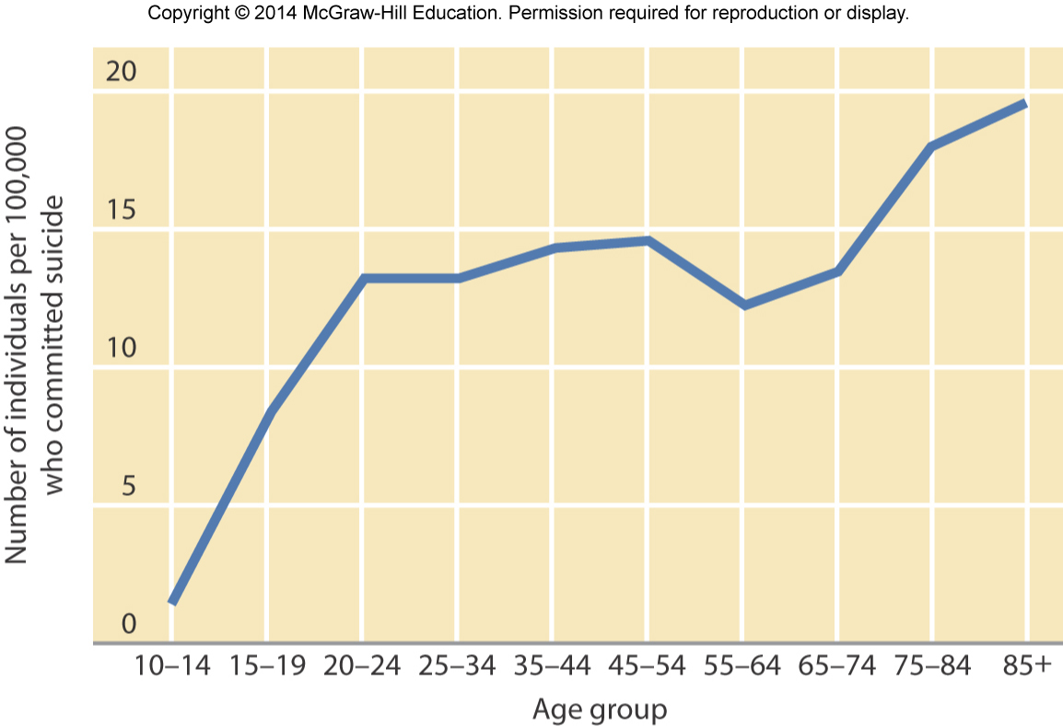
Developmental Perspective On Death
Copyright McGraw-Hill Education, 2014

Slide 14
Facing One’s Own Death
Kubler-Ross’ Stages of Dying:
Denial and isolation – denies death is taking place
Anger – anger, resentment, rage, and envy
Bargaining – develops hope that death can be delayed
Depression – perceives certainty of death
Acceptance – develops sense of peace, acceptance of one’s own fate, and often desire to be left alone
Some psychologists prefer to describe “stages” as potential reactions to dying because of criticisms
Copyright McGraw-Hill Education, 2014

Slide 15
Coping With Others’ Death
Grief
Emotional numbness, disbelief, separation anxiety, despair, sadness, and loneliness that accompany loss of loved one
Pining for lost person is important dimension of grief
Intermittent, recurrent wish or need to recover lost person
Feelings of grief occur repeatedly after a loss
As time passes, pining and protest over loss tend to diminish
Becomes more manageable over time, with fewer abrupt highs and lows but TOO MANY VARIABLES.
Bereavement
Copyright McGraw-Hill Education, 2014

