Slide 1
A Topical Approach to Life-Span Development, 7th edition John W. Santrock
Chapter 11 –
The Self, Identity, and Personality
Copyright McGraw-Hill Education, 2014

Slide 2
The Self
Self
All characteristics of a person
Identity
Who a person is, representing a synthesis and integration of self-understanding
Personality
Enduring personal characteristics of individuals
Copyright McGraw-Hill Education, 2014

Slide 3
The Self
Self-understanding
Cognitive representation of the self, the substance of self-conceptions
Based, in part, on roles and membership categories
Underpinnings for identity development
Copyright McGraw-Hill Education, 2014

Slide 4
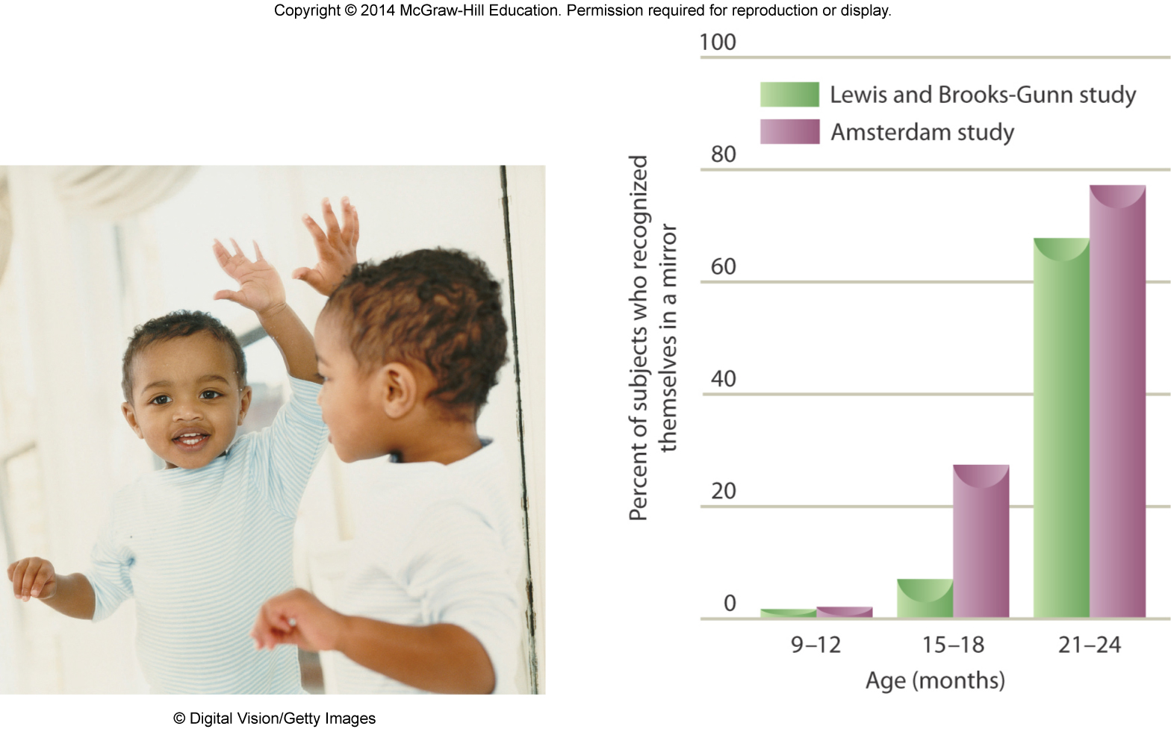
The Self
Early form of self-recognition – being attentive and positive toward one’s image – appears as early as 3 months
Mirror technique
Increased touching means that infant recognizes itself in the mirror
Signs of self-recognition appear between 15-18 months old
Infants develop a conscious awareness of their bodies by second year of life
Copyright McGraw-Hill Education, 2014

Slide 5
The Self
Children begin to describe themselves and perceive others in terms of psychological traits
Gradually understand that people do not always give accurate reports of their beliefs
Individual differences in children’s self-understanding
Some children are better than others in understanding others’ feelings and desires
Children’s self-understanding becomes more complex during middle and late childhood
Copyright McGraw-Hill Education, 2014

Slide 6
The Self
Perspective taking
Ability to assume another person’s perspective and understanding his/her thoughts and feelings (intent)
Improves children’s likelihood of understanding and sympathizing with others when distressed or in need
Copyright McGraw-Hill Education, 2014

Slide 7
The Self
Adolescent developments in self-understanding:
Abstract and idealistic thinking
Self-consciousness
Contradictions within the self
Fluctuating self
Real and ideal selves
Possible selves include what adolescents hope to be and what they dread becoming
Copyright McGraw-Hill Education, 2014

Slide 8
The Self
Among the aspects of understanding others important to adolescent development include perceiving others’ traits, perspective taking, and social cognitive monitoring
Adolescents understand that others are complex and have private and public faces
Adolescents monitor their social world more extensively
May be important part of social maturity
Copyright McGraw-Hill Education, 2014

Slide 9
The Self
Self-awareness becomes more important in early adulthood
How much a young adult is aware of his/her psychological makeup, including strengths and weaknesses
Many do not have good awareness of psychological makeup and skills, as well as causes of weaknesses
Early adulthood is a time when individuals can benefit considerably from addressing weaknesses
Copyright McGraw-Hill Education, 2014

Slide 10
The Self
As individuals age, they describe fewer possible selves and portray them in more concrete and realistic ways
By middle age, individuals frequently describe possible selves in areas of their lives in which they have already performed
Older adults are more concerned with maintaining what they have
Preventing or avoiding health problems and dependency
Copyright McGraw-Hill Education, 2014

Slide 11
The Self
Self-esteem
Global evaluations of the self
Self-concept
Domain-specific evaluations of the self
Academic, athletic, appearance, etc.
Foundations of self-esteem and self-concept emerge from quality of parent-child interactions in infancy and early childhood
Copyright McGraw-Hill Education, 2014

Slide 12
The Self
Self-esteem and life satisfaction
Low self-esteem in adolescence predicts lower levels of life satisfaction at age 30
Low self-esteem implicated in being overweight or obese, high levels of anxiety, delinquency, and attempting suicide
Self-esteem and job performance
Modest correlations between school performance and self-esteem
Occupational success may lead to higher self-esteem
Opposite may not occur – Why?
Copyright McGraw-Hill Education, 2014

Slide 13
The Self
Self-esteem and happiness
Self-esteem is strongly related to happiness
High self-esteem increases happiness
Self-esteem and physical appearance
Self-esteem is related to perceived physical appearance
Self-esteem and depression
Individuals with low self-esteem report feeling more depressed
Low self-esteem implicated in suicide attempts and anorexia nervosa
Copyright McGraw-Hill Education, 2014

Slide 14
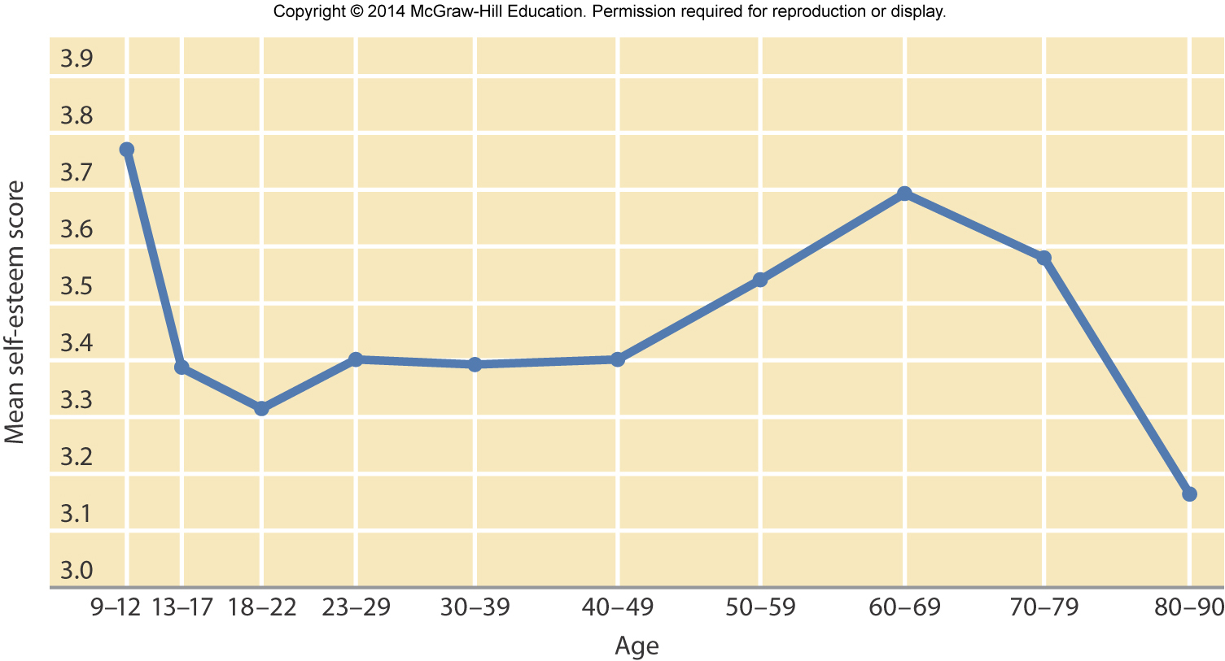
The Self
Self-esteem fluctuates across the life span
Self-esteem decreases in adolescence, increases in the twenties, levels off in the thirties, rises in the fifties and sixties, drops off in seventies and eighties
Self-esteem of males tends to be higher than females (emerges by adolescence)
Pick one of these and create your own theory.
Copyright McGraw-Hill Education, 2014

Slide 15
The Self
Current concern among college students is inflated self-esteem
Growing up receiving empty praise for mediocre or poor performance
Experience difficulty handling competition and criticism
95% will rate themselves in the top 50%
Copyright McGraw-Hill Education, 2014

Slide 16
The Self
Among adults, higher levels of self-control are linked to better health and adjustment
Self-control increases in early adulthood and into middle adult years
Decline in perceived self-control of health and cognitive functioning
Copyright McGraw-Hill Education, 2014

Slide 17
The Self
Attainment of meaningful goals is important to life satisfaction
Younger adults more likely to assess well-being in career and accomplishments
Older adults more likely to link well-being with good health and ability to accept change
Copyright McGraw-Hill Education, 2014

Slide 18
Identity
What is identity?
Career and work path
Political beliefs
Spiritual beliefs
Relationship status
Achievement/intellectual identity
Cultural/ethnic identity
Interests
Personality
Physical identity/body image
Copyright McGraw-Hill Education, 2014

Slide 19
Identity
Erikson’s stage - identity vs. identity confusion
Adolescents faced with deciding who they are, what they are all about, and where they are going in life
Questions occur throughout life, but become especially important during adolescence
Search for identity aided by psychosocial moratorium
Society leaves adolescents relatively free of responsibility
Allows them to try on different identities
Adolescents who do not successfully resolve identity crisis suffer from identity confusion
Copyright McGraw-Hill Education, 2014

Slide 20
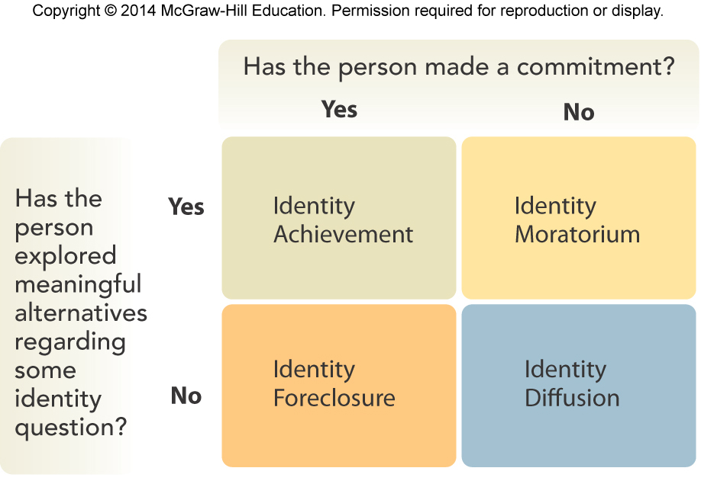
Identity
Identity statuses (Marcia)
Crisis – a period of identity development during which individual explores alternatives
Commitment – personal investment in identity
4 statuses:
Identity diffusion
Identity foreclosure
Identity moratorium
Identity achievement
MAMA cycles
Copyright McGraw-Hill Education, 2014

Slide 21
Identity
Parents are important in adolescent identity development
Poor communication and persistent conflict with friends linked to less positive identity development
Family atmosphere promotes individuality and connectedness:
Individuality – self-assertion and separateness
Connectedness – mutuality and permeability
Identify can occur in a variety of contexts.
Copyright McGraw-Hill Education, 2014

Slide 22
Personality
Trait theories
Personality consists of broad dispositions that produce characteristic responses
Type theories
Big Five factors of personality
Openness to experience
Conscientiousness
Extraversion
Agreeableness
Neuroticism
Related to health, intelligence, cognitive functioning, achievement, work, and relationships
Copyright McGraw-Hill Education, 2014

Slide 23
Personality
Levinson’s Seasons of a Man’s Life
Stages and transitions in midlife change
Developmental tasks mastered at each stage
Twenties as a novice phase of adult development
Thirties as a focus on family and career development
By age 40, stable career reached and looks forward to life as a middle-aged adult
Copyright McGraw-Hill Education, 2014

Slide 24
Personality
Change to middle adulthood lasts about 5 years (ages 40-45)
Adult male must come to grips with existing conflicts:
Being young vs. being old
Being destructive vs. being constructive
Being masculine vs. being feminine
Being attached to others vs. being separated
70-80% of men studied found midlife transition tumultuous and psychologically painful
Levinson maintains that females also undergo midlife crisis
Copyright McGraw-Hill Education, 2014

Slide 25
Personality
Generativity versus stagnation
Generativity – adults’ desire to leave a legacy of themselves to the next generation
Stagnation – an individual senses he/she has done nothing for the next generation
Middle-aged adults are especially concerned about generativity
Linked to positive social engagement in family life and community activities
In what ways might one find generativity?
Copyright McGraw-Hill Education, 2014

Slide 26
Personality
Personality traits continue to change during adult years, even into late adulthood
Most change occurs during early adulthood
More stability shown in personality traits after midlife
Personality changes across adulthood move in a positive direction
Social maturity comes with confidence, warmth, being responsible, and calm
Copyright McGraw-Hill Education, 2014

