Slide 1
A Topical Approach to Life-Span Development, 7th edition John W. Santrock
Chapter 8 –
Intelligence
Copyright McGraw-Hill Education, 2014

Slide 2
The Concept of Intelligence
Intelligence
Ability to solve problems
Capacity to adapt and learn from experience
Can only be evaluated indirectly
Individual differences measured by intelligence tests
Designed to tell whether a person can reason better than others
Copyright McGraw-Hill Education, 2014

Slide 3
The Concept of Intelligence
Intelligence quotient
Mental age divided by chronological age multiplied by 100
IQ scores approximate a normal distribution
Symmetrical, bell-shaped curve with a majority of cases falling in the middle of the range of possible scores
Few scores appearing toward the ends of the range
Stanford-Binet Tests among one of the most widely used intelligence tests
Copyright McGraw-Hill Education, 2014

Slide 4
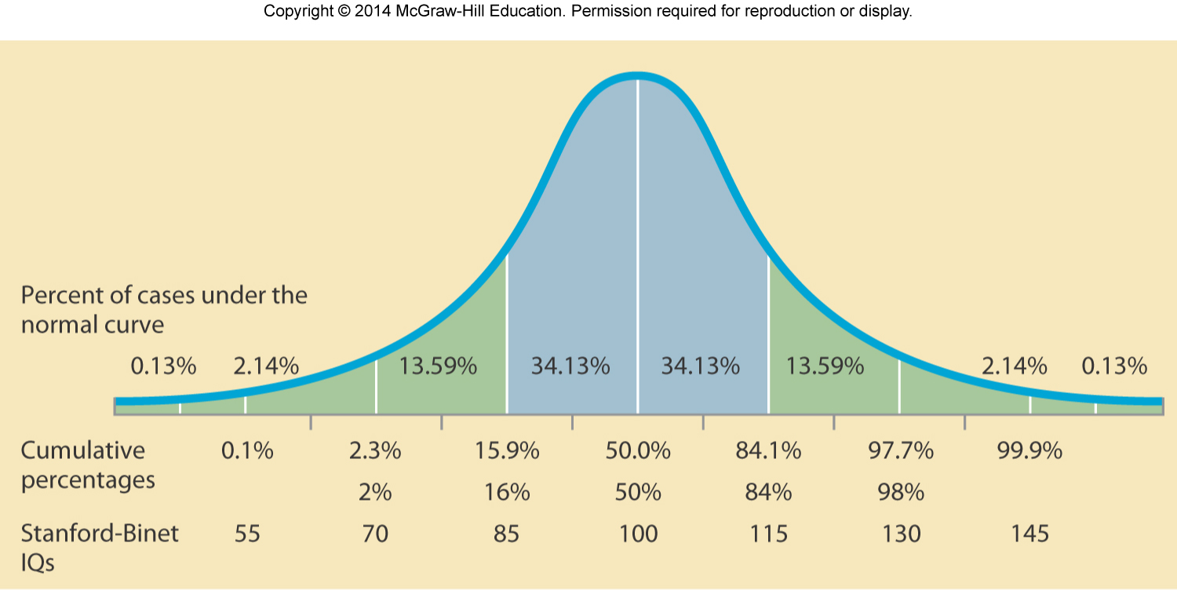
The Concept of Intelligence
Copyright McGraw-Hill Education, 2014

Slide 5
The Concept of Intelligence
Wechsler Adult Intelligence Scale (WAIS-IV)
Designed for adults
Wechsler Intelligence Scale for Children (WISC-IV)
Designed for children and adolescents between 6-16 years old
Wechsler Preschool and Primary Scale of Intelligence (WPPSI-III)
Designed for children age 2 years 6 months-7 years 3 months
Overall IQ score but also yield composite scores
Verbal comprehension, memory, processing speed
Copyright McGraw-Hill Education, 2014

Slide 6
The Concept of Intelligence
Intelligence tests predict school and job success
Moderately correlated with work performance
Many other factors contribute to success in school and work
Motivation to succeed, physical and mental health, and social skills
Intelligence tests used in conjunction with other information
Developmental history, medical background, school performance, social competency, family experiences, etc.
Copyright McGraw-Hill Education, 2014

Slide 7
The Concept of Intelligence
Gardner’s Theory of Multiple Intelligences
Verbal
Mathematical
Spatial
Bodily-kinesthetic
Musical
Interpersonal
Intrapersonal
Naturalist
Individuals have each type of intelligence to varying degrees
Problems with tests?
AKA – emotional intelligence
Copyright McGraw-Hill Education, 2014

Slide 8
What Causes Intelligence?
Moderate correlation between brain size and intelligence
Frontal lobes are likely the location of intelligence
Highest levels of thinking in prefrontal cortex
Brain-imaging studies reveal a distributed neural network involving frontal and parietal lobes is related to higher intelligence
Temporal lobe, occipital lobe, and cerebellum also linked to higher intelligence to a lesser degree
Neurological speed may also play a role in intelligence
Heredity and environment contribute to brain size and intelligence
Copyright McGraw-Hill Education, 2014

Slide 9
Development of Intelligence
Considerable stability in intelligence from late infancy through preschool years
Intelligence scores can fluctuate dramatically across childhood years
Copyright McGraw-Hill Education, 2014

Slide 10
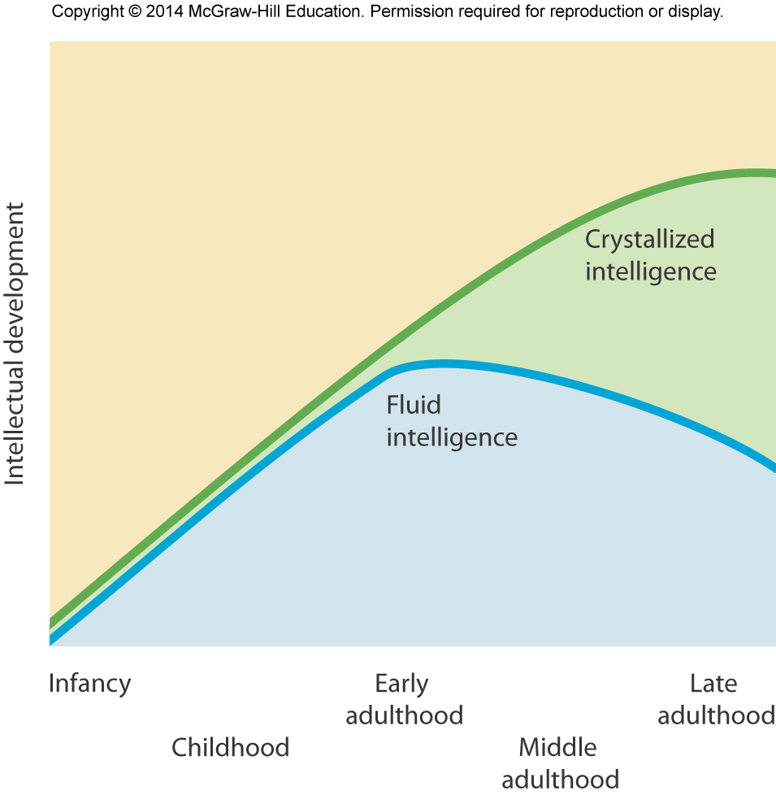
Development of Intelligence
Crystallized intelligence
Individual’s accumulated information and verbal skills
Continues to increase across life span
Fluid intelligence
Ability to reason abstractly
Begins to decline during middle adulthood
Copyright McGraw-Hill Education, 2014

Slide 11
Development of Intelligence
Cognitive mechanics
“Hardware” of the mind
Speed and accuracy in sensory input, attention, visual and motor memory, discrimination, comparison, and categorization
Age-related declines likely due to biology, heredity, and health
Cognitive pragmatics
Culture-based “software” of the mind
Reading and writing skills, language comprehension, educational qualifications, professional skills, self and life skills
Improvement into old age is possible
Copyright McGraw-Hill Education, 2014

Slide 12
Development of Intelligence
Wisdom
Expert knowledge about practical aspects of life that permits excellent judgment about important matters
Insight about human development and life matters, good judgment, understanding of how to cope with difficult life problems
High levels of wisdom are rare
Factors other than age critical for wisdom to develop to a high level
Personality factors, such as openness to experience, generativity, and creativity are better predictors of wisdom than intelligence
Copyright McGraw-Hill Education, 2014

Slide 13
The Extremes of Intelligence and Creativity
Intellectual disability
Limited mental ability in which individual has:
Has low IQ, usually below 70 on a traditional intelligence test
Has difficulty adapting to demands of everyday life
First exhibits these characteristics by age 18
About 5 million Americans fit definition of intellectual disability
Varying degrees of intellectual disability
Copyright McGraw-Hill Education, 2014

Slide 14
The Extremes of Intelligence and Creativity
Organic intellectual disability
Genetic disorder or lower level of intelligence due to brain damage
Down syndrome
Cultural-familial intellectual disability
Results from growing up in a below-average intellectual environment
Copyright McGraw-Hill Education, 2014

Slide 15
The Extremes of Intelligence and Creativity
Creativity often peaks in adulthood
80% of most important creative contributions completed by age 50
Researchers found creativity often peaks in forties before declining
Domain-related declines where lyrical poetry, abstract mathematics, and theoretical physics experience peak of creativity in twenties or thirties
Other areas experience declines much later in life
Copyright McGraw-Hill Education, 2014

