Slide 1
A Topical Approach to Life-Span Development, 7th edition
John W. Santrock
Chapter 6 –
Cognitive Development Approaches
Copyright McGraw-Hill Education, 2014

Slide 2
Piaget’s Theory of Cognitive Development
Piaget’s theory stresses that children actively construct their own knowledge of the world
  Create mental structures to help us adapt to our world
  Discusses systematic changes in children’s thinking
Processes of development:
  Schemes
    Actions or mental representations that organize knowledge
  Assimilation
    Children use existing schemes to incorporate new information
  Accommodation
    Adjusting schemes to fit new information and experiences
Copyright McGraw-Hill Education, 2014

Slide 3
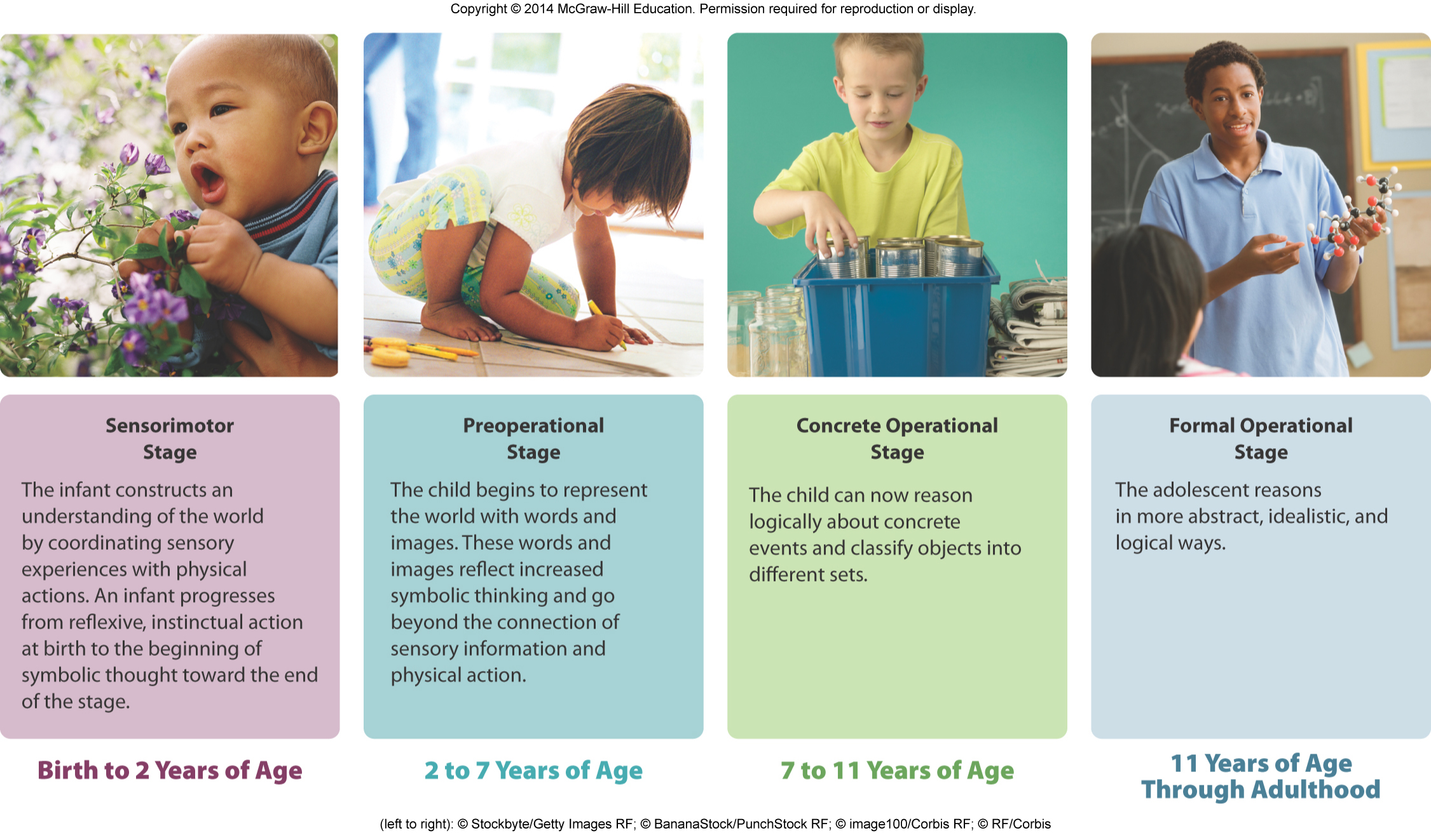
Piaget’s Theory of Cognitive Development
Copyright McGraw-Hill Education, 2014

Slide 4
Piaget’s Theory of Cognitive Development
Sensorimotor Stage:
  Lasts from birth to 2 years
  Infants construct an understanding of world by coordinating sensory experiences (such as seeing and hearing) with physical, motor actions
6 Substages:
  Simple reflexes
    First month after birth
    Sensation and action are coordinated through reflexive behaviors
    Infant begins to produce behaviors that resemble reflexes in absence of the usual stimulus
Copyright McGraw-Hill Education, 2014

Slide 5
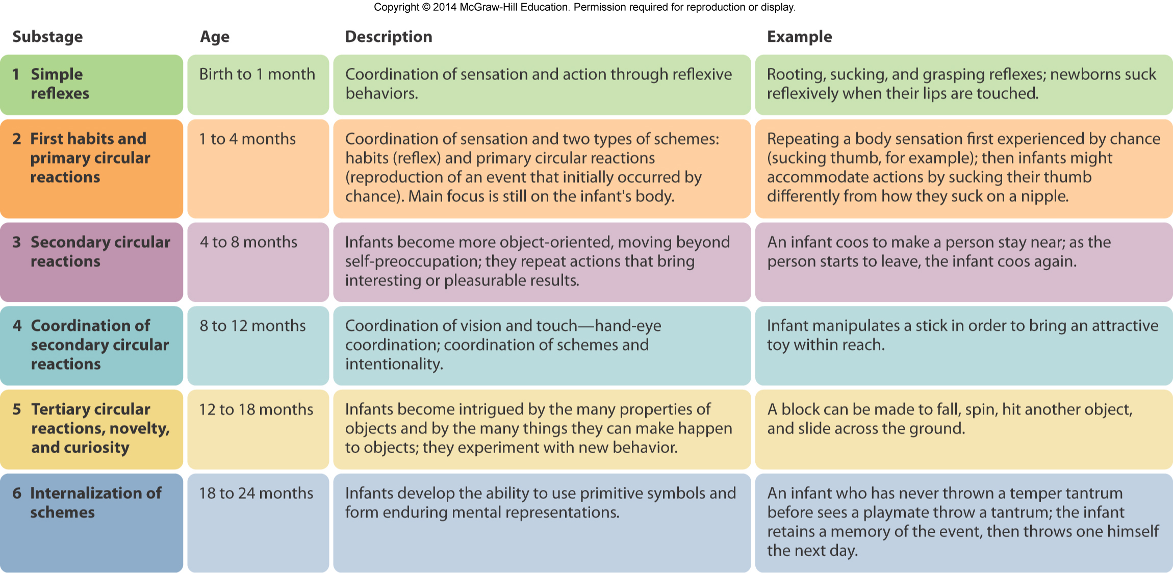
Piaget’s Theory of Cognitive Development
Copyright McGraw-Hill Education, 2014

Slide 6
Piaget’s Theory of Cognitive Development
Object permanence
  Understanding that objects continue to exist even when they cannot be seen, heard, or touched
  Important accomplishment made during first year of infancy
Copyright McGraw-Hill Education, 2014

Slide 7
Piaget’s Cognitive Development Theory
Preoperational Stage
  Lasts from approximately 2 to 7 years of age
  Children begin to represent the world with words, images, drawings
  Form stable concepts and begin to reason
  Do not yet have understanding of operations
    Reversible mental actions that allow children to do mentally what before they could only do physically
Copyright McGraw-Hill Education, 2014

Slide 8
Piaget’s Cognitive Development Theory
Symbolic function substage
  Occurs between ages 2 to 4
  Child gains the ability to mentally represent an object that is not present
    Scribble designs to represent people, houses, cars, etc.
    Use language and engage in pretend play
Copyright McGraw-Hill Education, 2014

Slide 9
Piaget’s Cognitive Development Theory
Egocentrism
  Inability to distinguish between one’s own perspective and someone else’s perspective
  Preschool children often show the ability to take another’s perspective on some tasks but not others
Animism
  Belief that inanimate objects have lifelike qualities and are capable of action
  Failure to distinguish between appropriate occasions for human and nonhuman perspectives
Copyright McGraw-Hill Education, 2014

Slide 10
Piaget’s Cognitive Development Theory
Intuitive thought substage
  Second substage of preoperational thought
  Between ages 4 to 7 years old
  Children use primitive reasoning and want to know the answers to all sorts of questions
  “Why?” questions signal emergence of interest in figuring out why things are the way they are
Copyright McGraw-Hill Education, 2014

Slide 11
Piaget’s Cognitive Development Theory
Centration
  Focusing of attention on one characteristic to the exclusion of all others
Conservation
  Awareness that altering the appearance of an object or substance does not change its basic properties
  Conservation may appear earlier than Piaget thought
    Attention is especially important in explaining conservation
Copyright McGraw-Hill Education, 2014

Slide 12
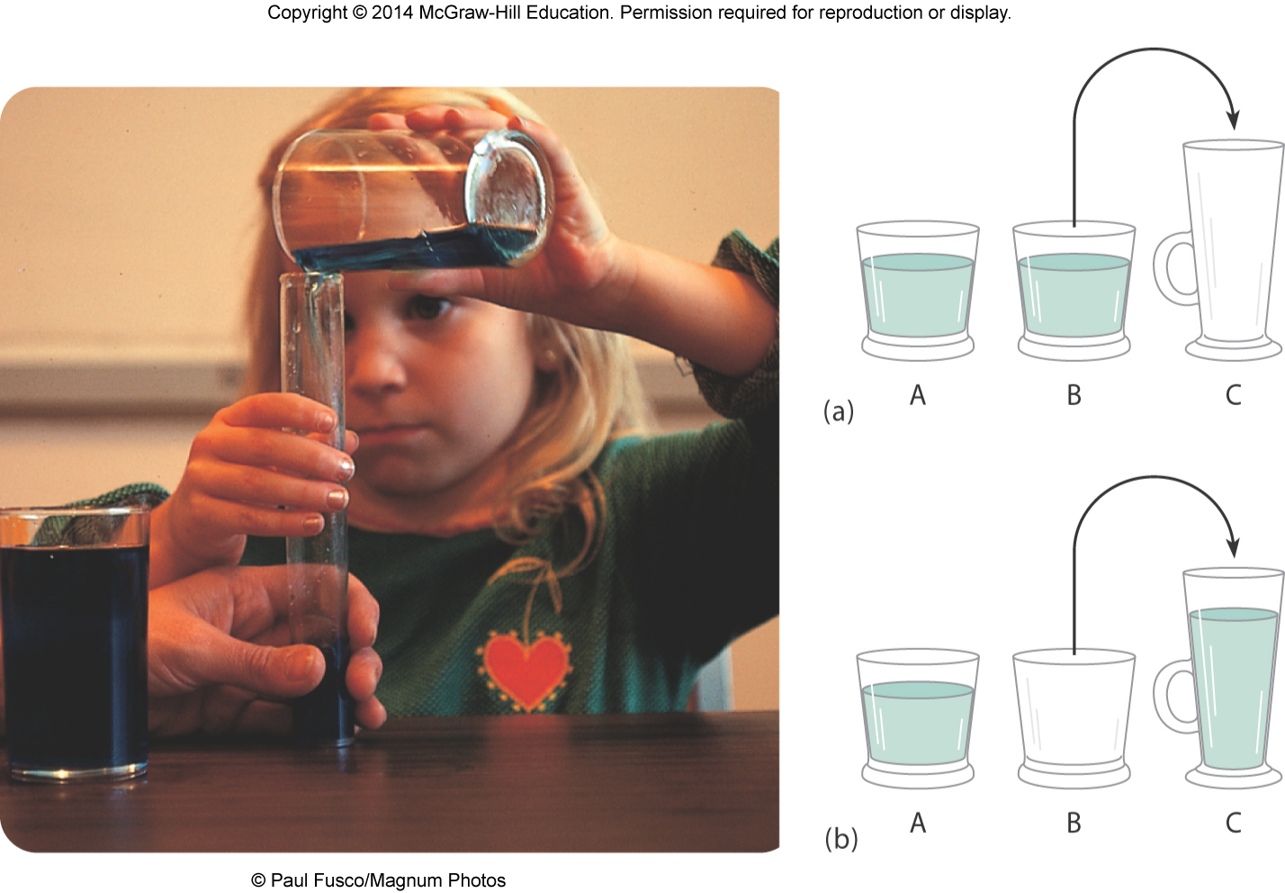
Piaget’s Cognitive Development Theory
Copyright McGraw-Hill Education, 2014

Slide 13
Piaget’s Cognitive Development Theory
Concrete operational stage
  Lasts from approximately 7 to 11 years of age
  Children can perform concrete operations and logical reasoning as long as it can be applied to specific or concrete examples
  Concrete operations allow a child to consider several characteristics rather than to focus on a single property of an object
Copyright McGraw-Hill Education, 2014

Slide 14
Piaget’s Cognitive Development Theory
New skills at concrete operational stage:
  Classify and divide into different sets or subsets
    Consider interrelationships among objects
  Capable of seriation
    Ability to order stimuli along a quantitative dimension (such as length)
  Transitivity
    Ability to logically combine relations to understand certain conclusions
Copyright McGraw-Hill Education, 2014

Slide 15
Piaget’s Cognitive Development Theory
Formal operational stage
  Appears between 11 to 15 years of age
  Begin to think in abstract, more logical ways
  Develop images of ideal circumstances
Deductive reasoning
  Develop hypotheses, or best guesses, and systematically deduce which is the best path to follow in solving the problem
Copyright McGraw-Hill Education, 2014

Slide 16
Piaget’s Cognitive Development Theory
Adolescent egocentrism
  Heightened self-consciousness of adolescents
  Reflected in beliefs that others are as interested in them as they themselves are
Imaginary audience
  Feeling one is the center of attention and sensing one is on stage
Personal fable
  Sense of personal uniqueness and invincibility
Copyright McGraw-Hill Education, 2014

Slide 17
Applying and Evaluating Piaget’s Theory
Piaget’s theory applied to teaching children:
Take a constructivist approach
  Children learn best when active and seeking solutions for themselves
Facilitate rather than direct learning
  Design situations where students learn by doing
Consider child’s knowledge, level of thinking
  Teachers need to interpret what students are saying and respond in a way not too far from student’s level
  Important to examine children’s mistakes to help guide to a higher level of understanding
Copyright McGraw-Hill Education, 2014

Slide 18
Applying Piaget’s Theory
What should a Piagetian Classroom look like?
Copyright McGraw-Hill Education, 2014

Slide 19
Evaluating Piaget’s Theory
Some cognitive abilities emerge earlier than Piaget estimated
  Other cognitive abilities emerge later than Piaget’s ideas
    Many adolescents still think in concrete operational ways or are just beginning to master formal operations
    Many adults are not formal operational thinkers
Children can be trained to reason at a higher cognitive stage
Culture and education exerts stronger influence than Piaget maintained
Neo-Piagetians argue for more emphasis on how children use attention, memory, and strategies to process information
Copyright McGraw-Hill Education, 2014

Slide 20
Vygotsky’s Theory of Cognitive Development
Vygotsky also emphasized that children actively construct their knowledge and understanding
  Emphasized the role of the social environment in stimulating cognitive development
    Society provides tools to support cognitive development
    Cognitive development is shaped by cultures in which we live
Copyright McGraw-Hill Education, 2014

Slide 21
Vygotsky’s Theory of Cognitive Development
Zone of proximal development (ZPD)
  Range of tasks that are too difficult for children to master alone but can be mastered with guidance and assistance from adults or more-skilled children
  Lower limit of ZPD is level of skill reached by child working independently
  Upper limit of ZPD includes additional responsibility child can accept with assistance of an able instructor
Copyright McGraw-Hill Education, 2014

Slide 22
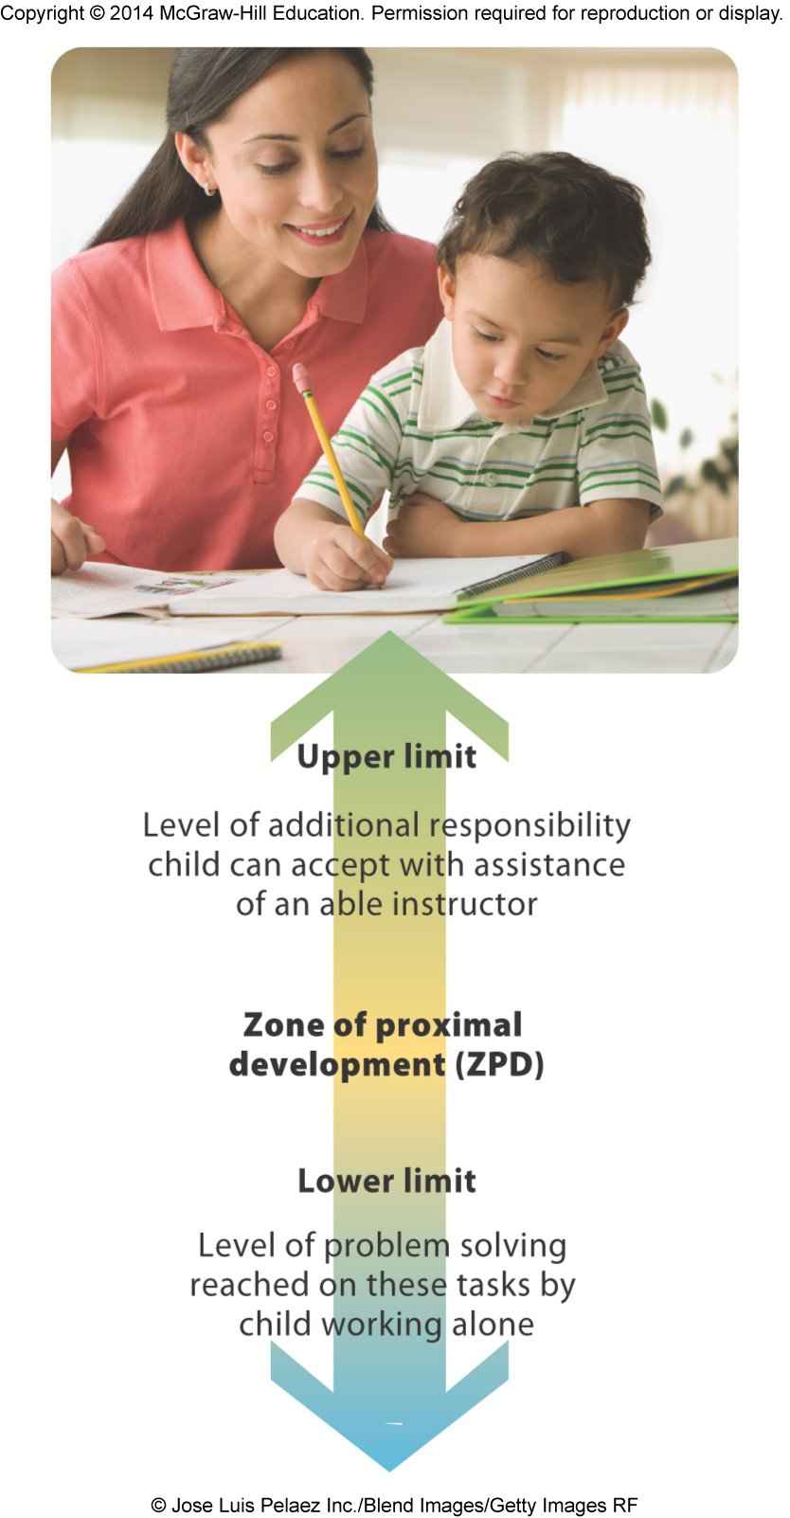
Vygotsky’s Theory of Cognitive Development
Copyright McGraw-Hill Education, 2014

Slide 23
Vygotsky’s Zone of Proximal Development
Scaffolding
  Changing level of support over the course of a teaching session
  More skilled person adjusting guidance to fit child’s current level of performance
    When student is learning a new task, skilled person can use direct instruction
    As student’s competence increases, skilled person gives less guidance
  Dialogue is an important tool of scaffolding
    Through dialogue, child’s concepts become more systematic, logical, and rational when met with skilled person’s concepts
Copyright McGraw-Hill Education, 2014

Slide 24
Vygotsky’s Cognitive Development Theory
Children use speech not only for social communication but to help them solve tasks
  Private speech – language of self-regulation
    Involves talking to oneself to guide through a task
  As children age, they can act without verbalizing and self-talk becomes internalized into inner speech
    Inner speech becomes their thoughts
  Children use private speech more often when tasks are difficult, when they have made errors, and when they are not sure how to proceed
  Children using private speech are more attentive and improve their performance more than children who do not
Copyright McGraw-Hill Education, 2014

Slide 25
Vygotsky’s Cognitive Development Theory - Applied
Vygotsky’s theory applied to education:
Use child’s ZPD in teaching
  Teachers should begin teaching toward zone’s upper limit so child can reach goal with help and move to a higher level of skill or knowledge
  Simply observe child and provide support when needed
Use more-skilled peers as teachers
  Children also benefit from support and guidance of more-skilled children
Monitor and encourage use of private speech
  Be aware of change from externally talking to oneself in preschool years to privately talking to oneself in elementary school
  Encourage elementary school children to internalize and self-regulate their talk
Place instruction in meaningful context
  Provide students with opportunities to learn in real-world settings
Copyright McGraw-Hill Education, 2014

Slide 26
Vygotksy’s Cognitive Development Theory
Social constructivist approach
  An emphasis on social contexts of learning and construction of knowledge through social interaction
Criticisms:
  Vygotsky’s theory not specific enough about age-related changes
  Does not adequately describe how changes in socioemotional capabilities contribute to cognitive development
  May have overemphasized the role of language in thinking
  Collaboration and guidance may be “too helpful” in some cases
    Children may become lazy and expect help when they could have done something on their own
Copyright McGraw-Hill Education, 2014

Slide 27
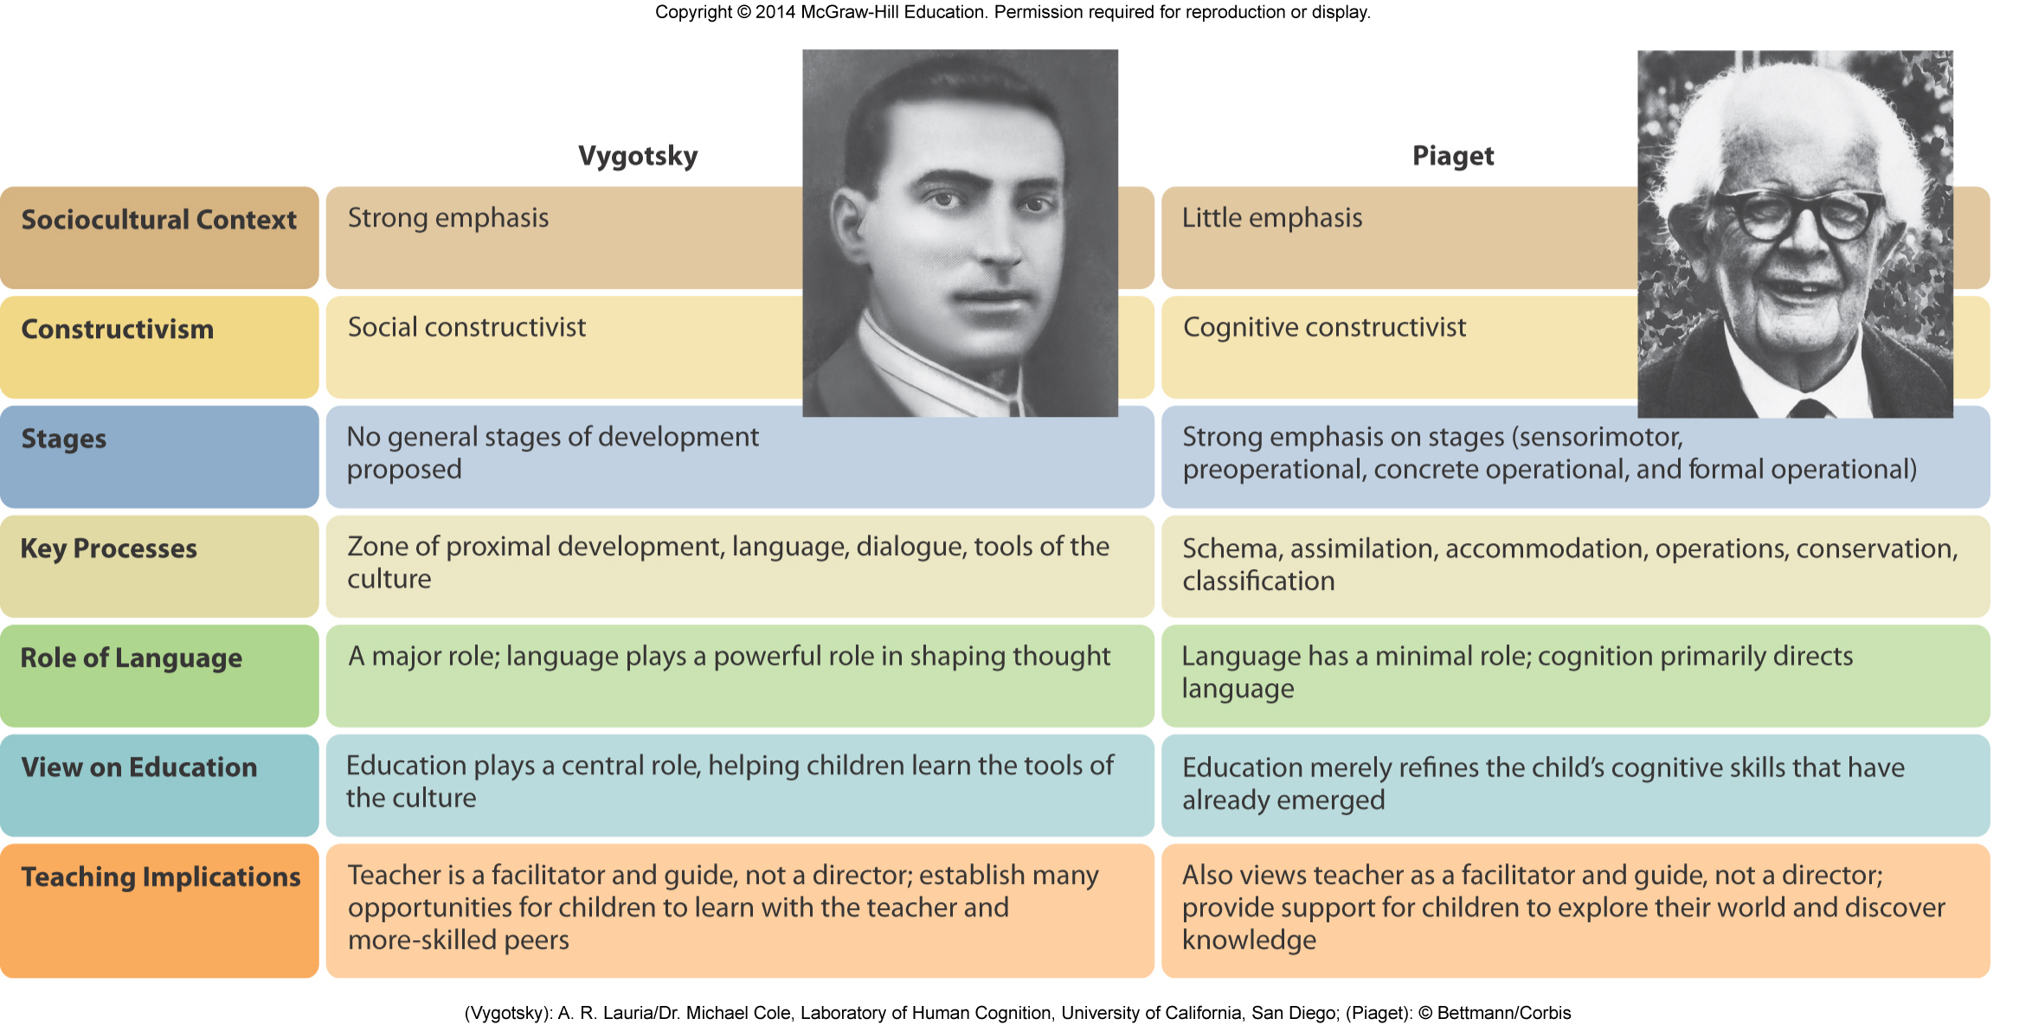
Vygotsky’s Cognitive Development Theory
Copyright McGraw-Hill Education, 2014

Slide 28
Cognitive Change in Adulthood
Postformal or Dialectic thought
  Thinking that is reflective, relativistic, and contextual
    Recognition that the correct answer to a problem requires reflective thinking and may vary from one situation to another
    Become more skeptical about the truth and seem unwilling to accept an answer as final
    Understand that thinking can’t always be abstract; in some instances, it must be realistic and pragmatic
    Understand that thinking is influenced by emotions
    Understand that opposites can both be true.
Copyright McGraw-Hill Education, 2014

