Slide 1
A Topical Approach to Life-Span Development, 7th edition John W. Santrock
Chapter 3 –
Physical Development and
Biological Aging
Copyright McGraw-Hill Education, 2014

Slide 2
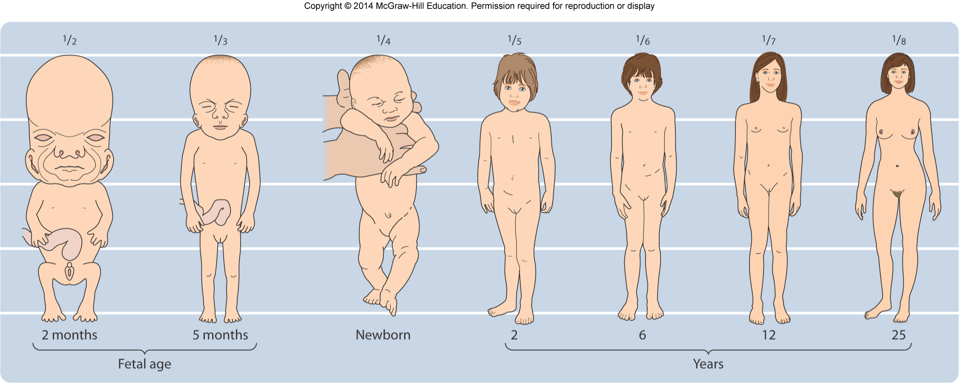
Body Growth and Change
Patterns of growth
Cephalocaudal pattern
Growth sequence that gradually works from top to bottom of the body
Proximodistal pattern
Growth sequence in which growth starts at the center of the body and moves towards the extremities
Copyright McGraw-Hill Education, 2014

Slide 3
Body Growth and Change
Puberty
Period of rapid physical maturation involving hormonal and bodily changes that take place in early adolescence
Signs of sexual maturation
Menarche
A girl’s first menstrual period
Growth spurt
Girls’ onset of puberty between 9 to 15 years of age
Boys’ onset of puberty between 10 to 17 years of age
Copyright McGraw-Hill Education, 2014

Slide 4
Body Growth and Change
Hormones
Powerful chemical substances secreted by endocrine glands and carried through bloodstream
Hypothalamus
Brain structure involved in eating and sexual behavior
Testosterone
Hormone associated in boys with genital development, increased height, deepening voice
Estradiol
Hormone associated in girls with breast, uterine, and skeletal development
Copyright McGraw-Hill Education, 2014

Slide 5
Body Growth and Change
Body image
Adolescents are preoccupied with their bodies
Body dissatisfaction is more acute during puberty than late adolescence
Gender differences
Girls tend to be less happy with their bodies and have more negative body image than boys
Boys become more satisfied with their bodies as they move through puberty
Copyright McGraw-Hill Education, 2014

Slide 6
Body Growth and Change
Early and late maturation
Early-maturing boys perceived themselves more positively and had more successful peer relationships than late-maturing boys
Similar findings with girls, but not as strong
Early maturation may increase girls’ vulnerability to problems
Smoking, drinking, depression, eating disorders, struggle for independence, early dating and sexual experiences
Copyright McGraw-Hill Education, 2014

Slide 7
Body Growth and Change
Subtle physical changes happen through early adulthood
Peak functioning of joints occurs in the twenties
Peak of muscle tone and strength in late teens and twenties
Begins to decline in thirties
Copyright McGraw-Hill Education, 2014

Slide 8
Body Growth and Change
Middle Adulthood
Physical changes are gradual
Genetic and lifestyle factors play a role in chronic disease
Physical appearance
Lose height and gain weight
Noticeable signs of aging by forties or fifties
Strength, joints, and bones
Sarcopenia, age-related loss of lean muscle and strength
Copyright McGraw-Hill Education, 2014

Slide 9
Body Growth and Change
Cardiovascular disease
Cholesterol levels increase through adult years
Increased risk of cardiovascular disease
Blood pressure rises
Metabolic syndrome
Condition characterized by hypertension, obesity, and insulin resistance
Leads to development of diabetes and cardiovascular disease
Lungs
Gradual change in elasticity of lung tissue after age 55
Copyright McGraw-Hill Education, 2014

Slide 10
Body Growth and Change
Sexuality
Climacteric
Midlife transition in which fertility declines
Menopause
Usually in late forties and fifties
Menstrual period ceases
Dramatic decline in production of estrogen
Copyright McGraw-Hill Education, 2014

Slide 11
Body Growth and Change
Late Adulthood
Physical appearance
Midlife changes become more pronounced in late adulthood
Face wrinkles and age spots
Weight drops because of lost muscle mass
Circulatory system
Increased blood pressure, linked to heart attack, stroke, kidney disease
Drug treatment, healthy diet, exercise can reduce risk of cardiovascular disease
Copyright McGraw-Hill Education, 2014

Slide 12
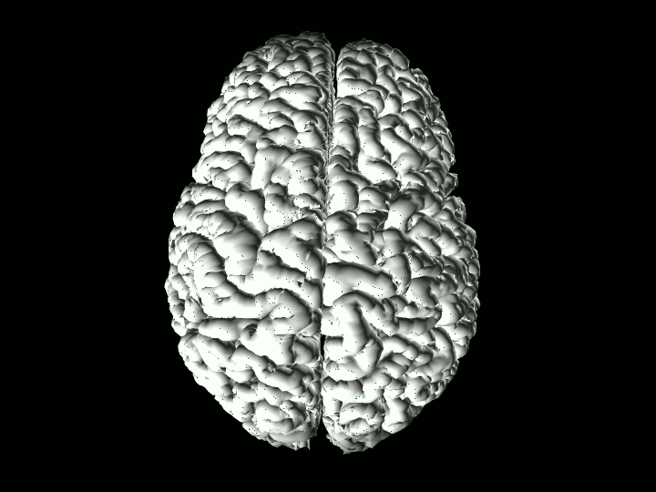
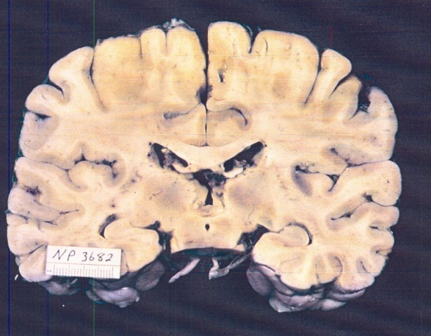
The Brain
Brain physiology
Two brain hemispheres
Cerebral cortex responsible for 80% of brain’s volume
Critical in perception, thinking, language, etc.
Copyright McGraw-Hill Education, 2014

Slide 13
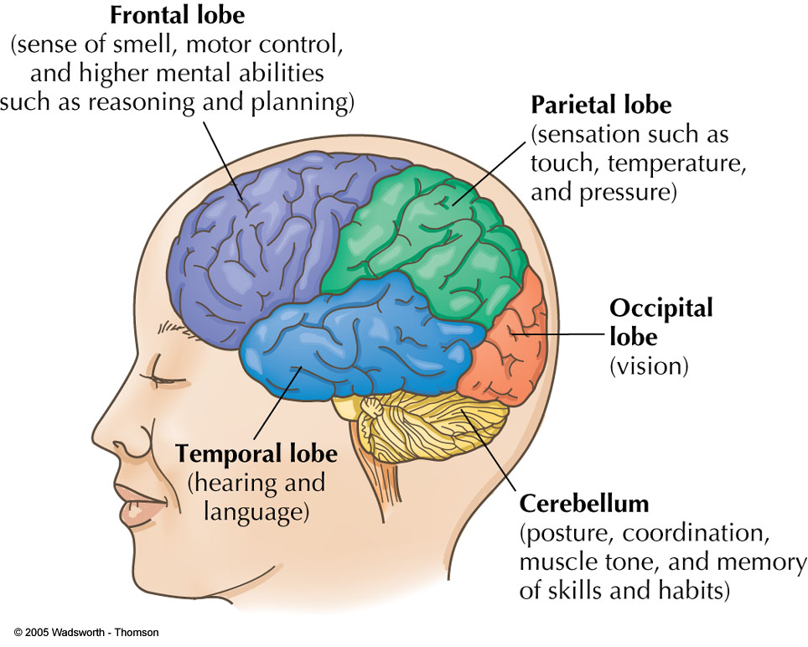
The Brain
Frontal lobes
Voluntary movement, thinking, personality, emotion, memory, attention, intentionality, or purpose
Occipital lobes
Vision
Temporal lobes
Hearing, language processing, and
memory
Parietal lobes
Spatial location, attention, and motor control
Copyright McGraw-Hill Education, 2014

Slide 14
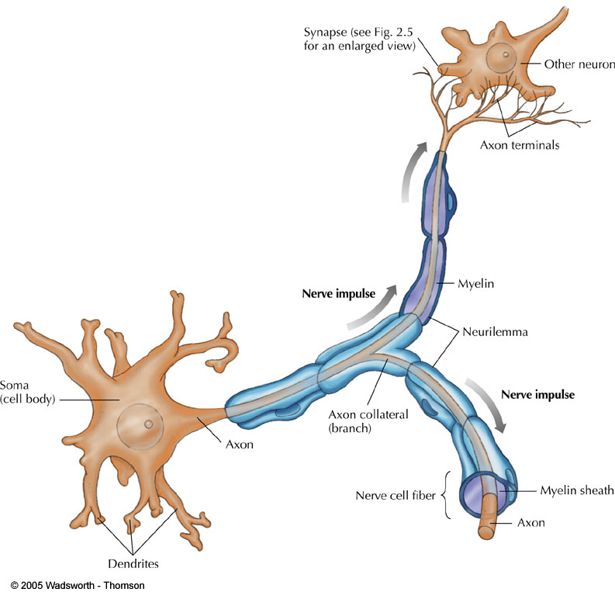
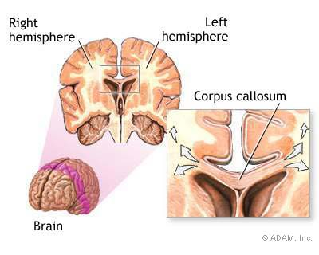
The Brain
Myelination
Encasing of axons with a myelin sheath
Helps increase the speed and efficiency of information processing
Lateralization
Specialization of function in one hemisphere of the brain
Copy

Slide 15
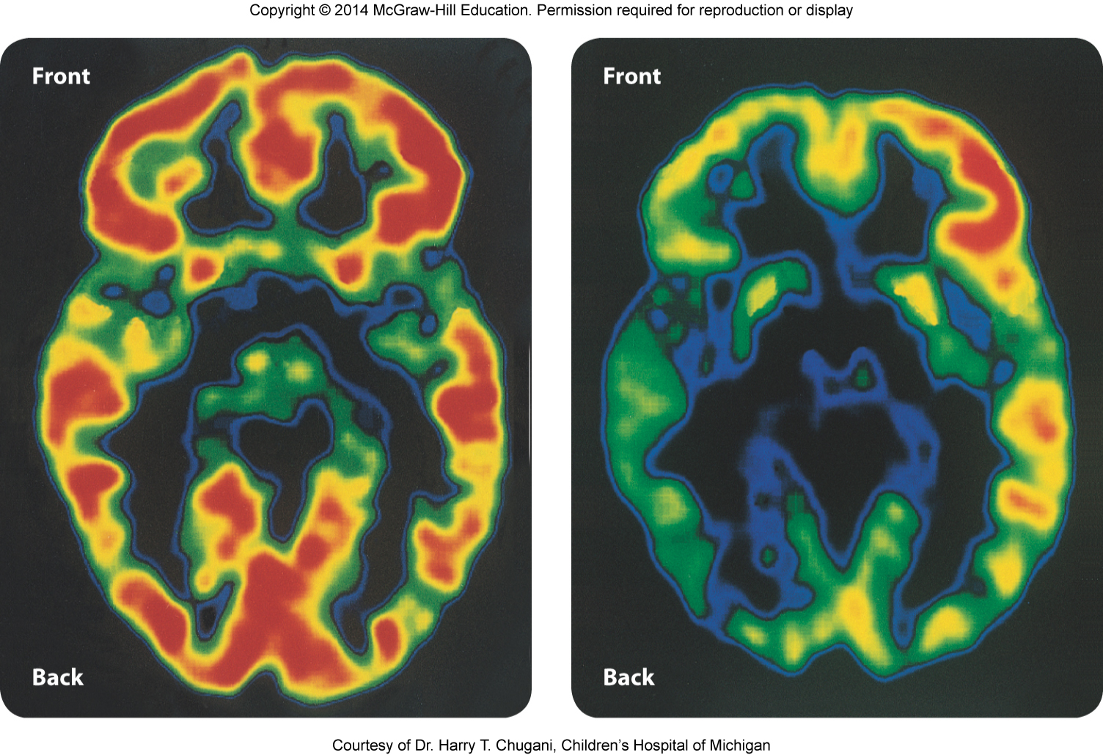
The Brain
Infancy
Brain development occurs extensively during prenatal period
Infant’s head should be protected from fall or other injuries
Shaken baby syndrome can produce brain swelling and hemorrhaging
Infant’s brain is waiting for experiences to determine how neural connections are made
Children who grow up in deprived environments exhibit depressed brain activity
Copyright McGraw-Hill Education, 2014

Slide 16
The Brain
Infant’s brain is 25% of its adult weight
During first two years of development:
Extensive myelination
Connections between neurons
Nearly twice as many connections are made than will ever be used
Blooming and pruning process begins
Copyright McGraw-Hill Education, 2014

Slide 17
The Brain
Childhood
Brain and head grows more rapidly than any other part of body
Brain development not as rapid as in infancy
Myelination continues
Connections in the brain continue to develop
Greatest anatomical brain increases from ages 3 to 15 years; distinct bursts of growth
Copyright McGraw-Hill Education, 2014

Slide 18
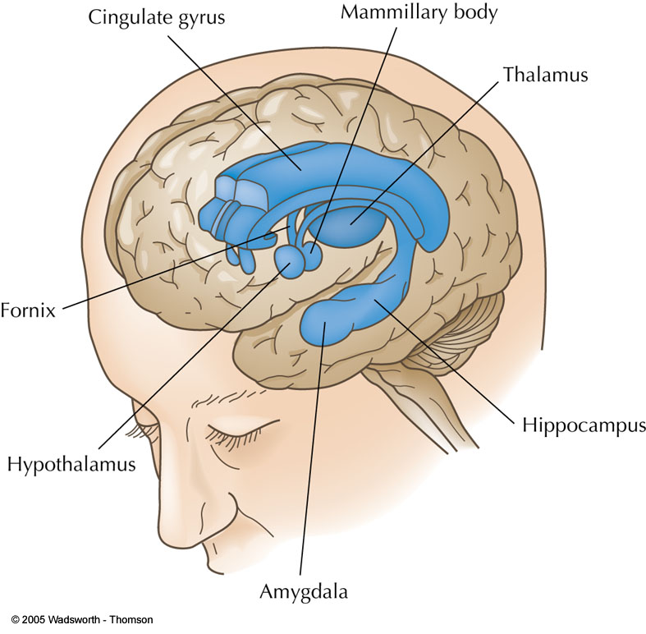
The Brain
Adolescence
Brain is still growing in adolescence
Adolescents have fewer, more selective, more effective neural connections than children
Corpus callosum
Band of fibers that connects brain’s left and right hemispheres
Thickens during adolescence, improving ability to process information
Amygdala
Brain’s center for emotions, such as anger
Matures earlier than prefrontal cortex
Capable of strong emotion but may lack self-control
Copyright McGraw-Hill Education, 2014

Slide 19
The Brain
Adulthood and aging
Brain loses 5-10% of its weight between ages of 20 and 90
Brain volume also decreases
General slowing of brain and spinal cord function
Begins in middle age, accelerates with age
Reduction in neurotransmitters
May play a role in memory decline
Problems in planning and carrying out motor activities
Copyright McGraw-Hill Education, 2014

Slide 20
Sleep
Infancy
Newborns sleep 16-17 hours per day
By 6 months of age, infants have moved closer to adult-like sleep patterns
About half of infant’s sleep is REM sleep, whereas adults spend only ⅕ of the night in REM sleep
Sudden infant death syndrome (SIDS)
Childhood
Experts recommend young children get 11-13 hours of sleep each night
Copyright McGraw-Hill Education, 2014

Slide 21
Sleep
Many adolescents exhibit inadequate sleep patterns
Less than 8 hours a day
Linked to fatigue, moodiness, depression, more caffeine beverage use, falling asleep in school
Average American adult gets just under 6 hours of sleep per night
Work and school pressures, family and social obligations lead to long hours of wakefulness and irregular sleep/wake schedules
Beginning in forties, wakeful periods during the night become more frequent
Shorter periods of deep sleep
Older adults go to bed earlier and wake earlier in morning
Approximately 50% of older adults complain of difficulty sleeping
Lack of sleep linked to health problems
Copyright McGraw-Hill Education, 2014

Slide 22
Longevity
Average life expectancy in United States is 77.9 years
Varies for men and women and ethnic groups
Women live longer than men, but men live better.
Copyright McGraw-Hill Education, 2014

