Slide 1
A Topical Approach to Life-Span Development, 7th edition John W. Santrock
Chapter 2 –
Biological Beginnings
Copyright McGraw-Hill Education, 2014

Slide 2
The Evolutionary Perspective
Natural Selection
Individuals best adapted to their environment are most likely to survive and reproduce
Their characteristics are passed on to the next generation
Over generations, organisms with characteristics best suited for survival make up an increased percentage of the population
Copyright McGraw-Hill Education, 2014

Slide 3
The Evolutionary Perspective
Evolutionary psychology
Emphasizes adaptation, reproduction, and survival of the fittest in shaping behavior
Evolution explains human physical features and behaviors
Evolutionary developmental psychology
Extended childhood evolved for human beings
Evolved characteristics are not always adaptive in contemporary society
Copyright McGraw-Hill Education, 2014

Slide 4
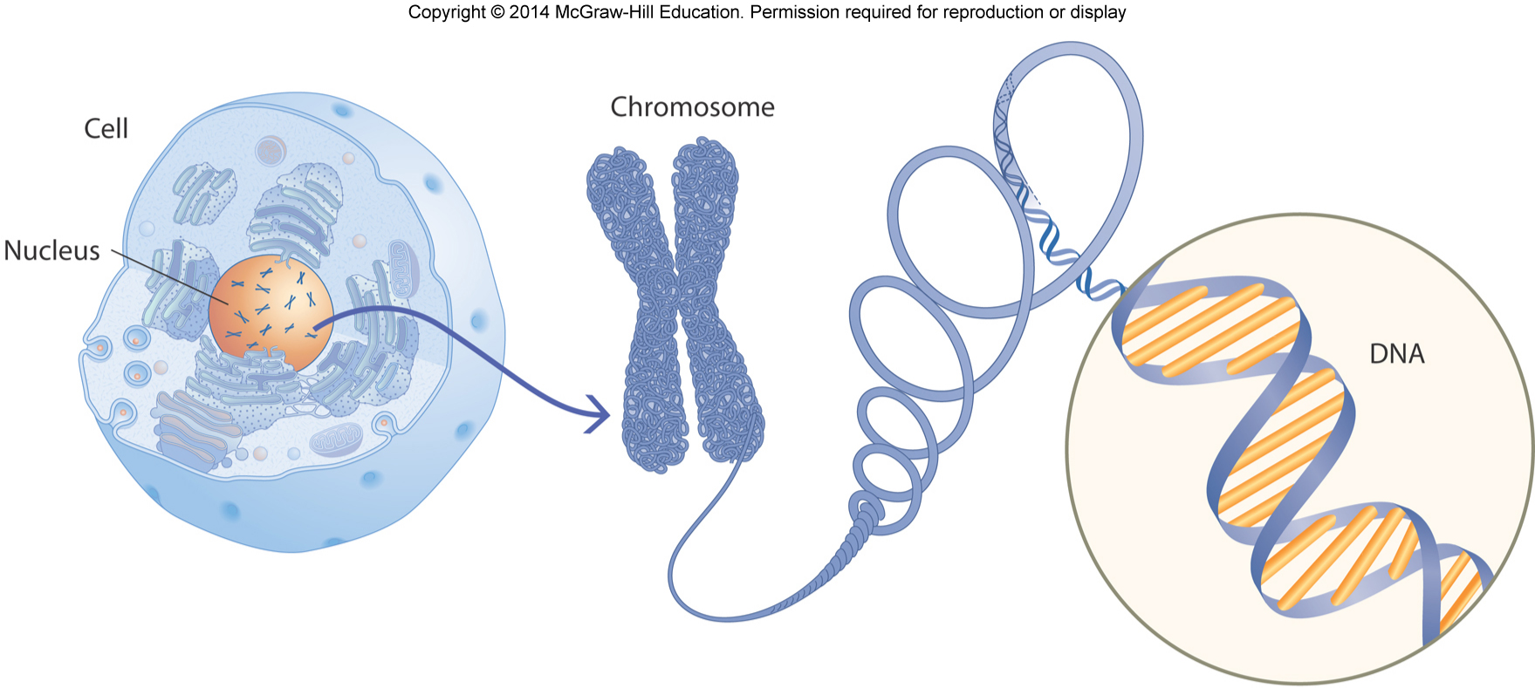
Genetic Foundations of Development
Chromosomes
Threadlike structures located in the nucleus of each human cell
Made up of deoxyribonucleic acid (DNA)
DNA
Complex molecule with a double helix shape
Contains genetic information
Humans have about 30,000 genes
Copyright McGraw-Hill Education, 2014

Slide 5
Genetic Foundations of Development
All cells in the human body have 23 pairs—or a total of 46—chromosomes
All cells—except ____________
Copyright McGraw-Hill Education, 2014

Slide 6
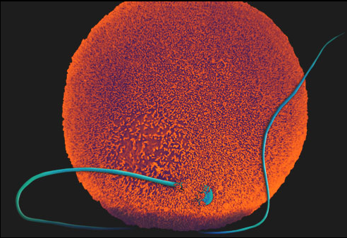
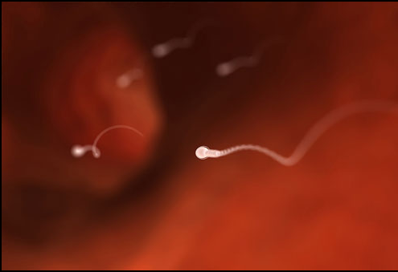
Genetic Foundations of Development
Fertilization
Egg and sperm cells fuse to create a single cell
Newly fertilized cell is called a zygote
Each zygote has 23 unpaired chromosomes from egg and another 23 unpaired chromosomes from sperm
Twins
Monozygotic
Dizygotic
Copyright McGraw-Hill Education, 2014

Slide 7
Genetic Foundations of Development
Genotype
A person’s actual genetic material
Phenotype
Observable and measurable characteristics of an individual
Height
Hair color
Intelligence
Range of phenotypes can be expressed for each genotype
Copyright McGraw-Hill Education, 2014

Slide 8
Genetic Foundations of Development
Dominant-recessive genes
Dominant gene overrides the expression of the recessive gene
Recessive gene exerts its influence only if both genes in the pair are recessive
Sex-linked genes
X-linked inheritance results when a mutated gene is carried on the X chromosome
Females are carriers, while males may exhibit an X-linked disease
Copyright McGraw-Hill Education, 2014

Slide 9
Genetic Foundations of Development
Genetic imprinting
Occurs when genes have differing effects depending on whether inherited from mother or father
Chemical process “silences” one member of the gene pair
Polygenetic inheritance
Most human characteristics are determined by interaction of several genes
Copyright McGraw-Hill Education, 2014

Slide 10
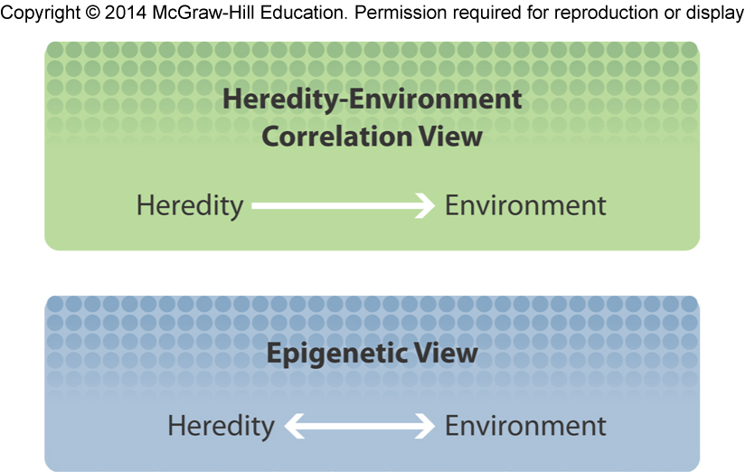
Heredity and Environment Interaction
Epigenetic view
Development is the result of an ongoing, bidirectional interchange between heredity and environment
Copyright McGraw-Hill Education, 2014

Slide 11
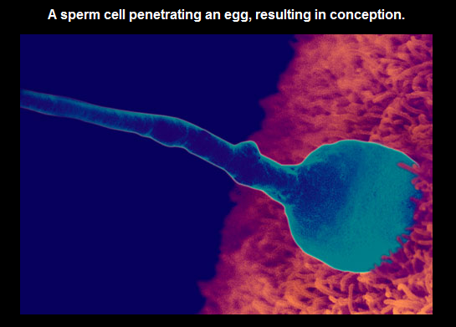
Prenatal Development
Conception
When a single sperm cell unites with an ovum in a process called fertilization
Prenatal development
Lasts for approximately 266 days
Beginning with fertilization and ending with birth
Further divided into three periods
Copyright McGraw-Hill Education, 2014

Slide 12
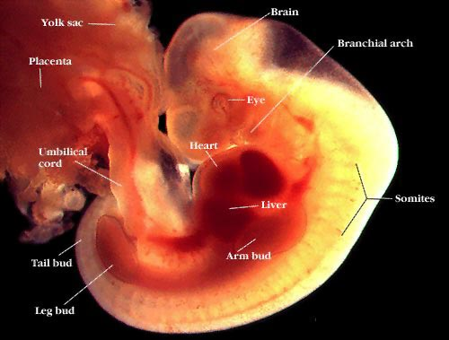
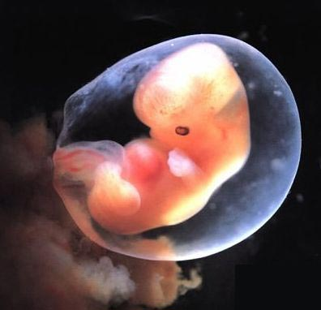
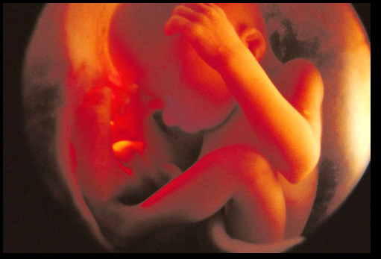
Prenatal Development
Germinal period
Takes place during the first two weeks after conception
Creation of fertilized egg
Cell division
Attachment of zygote to uterine wall
Embryonic period
Occurs from two to eight weeks after conception
Rate of cell differentiation intensifies
Support systems for cells form
Organs appear
Fetal period
Lasts about seven months until birth
Fetus is viable at about 6 months after conception
Can survive outside of the womb if born
At birth, the average American baby weighs 7½ pounds and is about 20 inches long
Copyright McGraw-Hill Education, 2014

Slide 13
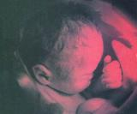
Fetal Assessment
Chromosomal
Amniocentesis
Growth Development
Ultrasound
MRI
Blood/ Urine
Alpha-fetoprotein (AFP)
Fetoscopy

Slide 14
Prenatal Development
Teratogen
Any agent that can potentially cause a birth defect or negatively alter cognitive or behavioral outcomes
Severity of damage from teratogens depends on:
Dosage
Genetic susceptibility
Time of exposure
Copyright McGraw-Hill Education, 2014

Slide 15
Prenatal Development
Common teratogens:
Drugs
Incompatible blood types
Environmental pollutants
Infectious diseases
Nutritional deficiencies
Maternal stress
Advanced maternal and paternal age
Environmental pollutants
Copyright McGraw-Hill Education, 2014

Slide 16
Prenatal Development
Prenatal Care
Defined schedule of visits for medical care
Screening for manageable conditions and treatable diseases that can affect baby or mother
Often includes comprehensive education, social, and nutritional services
Especially valuable for first-time mothers and women in poverty
Copyright McGraw-Hill Education, 2014

Slide 17
Birth Choices
Attendants
Drugs
Location

Slide 18
Physical Process of Birth
Stage 1
Dilation
Effacement
Stage 2
Labor/ Delivery
Stage 3
Delivery of the Placenta

Slide 19
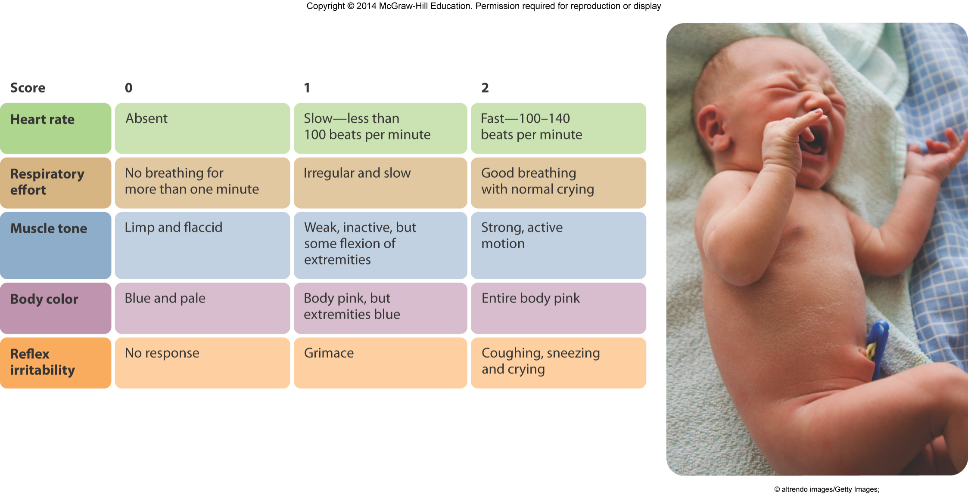
Birth and Postpartum Period
Apgar Scale
Used to assess the health of newborns at one and five minutes after birth
Heart rate, respiratory effort, muscle tone, body color, and reflex irritability evaluated
Copyright McGraw-Hill Education, 2014

Slide 20
Birth and Postpartum Period
Low birth weight infants
Infants that weigh less than 5½ pounds at birth
Preterm infants
Infants born three weeks or more before pregnancy has reached full term
Small for date infants
Infants whose birth weights are below normal when the length of pregnancy is considered
May be preterm or full term
Copyright McGraw-Hill Education, 2014

