Slide 1
A Topical Approach to Life-Span Development, 7th edition John W. Santrock
Chapter 1 –
Introduction
Copyright McGraw-Hill Education, 2014

Slide 2
The Life-Span Perspective
Development
Pattern of change that begins at conception and continues through life span
Includes growth, but also decline and dying
Traditional view of development
Extensive change from birth to adolescence
Little to no change during adulthood
Decline in old age
Copyright McGraw-Hill Education, 2014

Slide 3
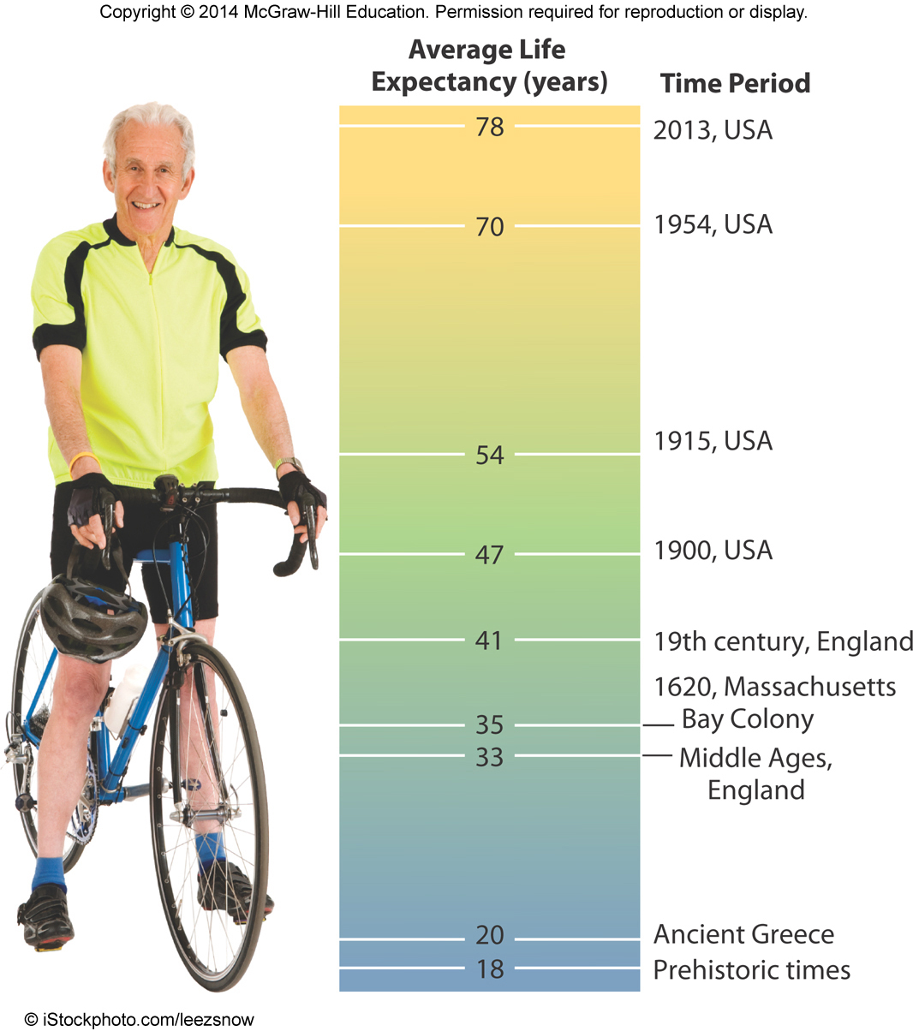
The Life-Span Perspective
Life-span perspective
Developmental change occurs throughout
childhood and adulthood
Human life expectancy
Maximum life span – upper boundary
of human life span
Currently regarded as 122 years
Life expectancy – average number
of years that a person born in a particular
year can expect to live
Currently 78 years in the United States
Copyright McGraw-Hill Education, 2014

Slide 4
The Life-Span Perspective – 3 types of development
Normative age-graded influences - Universal
Similar for individuals sharing the same age group
Normative history-graded influences – Group specific
Common to people of a particular generation due to historical circumstances
Nonnormative life events - Individual
Unusual occurrences that have a major impact on an individual’s life
Copyright McGraw-Hill Education, 2014

Slide 5
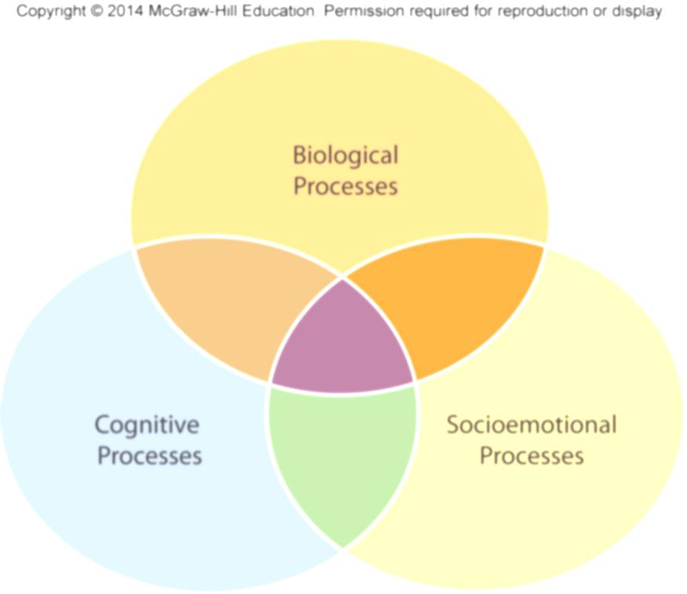
The Nature of Development
Biological processes
Produce changes in an individual’s physical nature
Cognitive processes
Involve changes in an individual’s thought, intelligence, and language
Socioemotional processes
Involve changes in an individual’s relationships with other people, emotions, and personality
Copyright McGraw-Hill Education, 2014

Slide 6
The Nature of Development
Copyright McGraw-Hill Education, 2014

Slide 7
The Nature of Development
Chronological age
Number of years since birth
Biological age
Age in terms of biological health
Psychological age
Adaptive capacities compared with others of the same chronological age
Social age
Connectedness with others and social roles individuals adopt
Copyright McGraw-Hill Education, 2014

Slide 8
Developmental Psychology
Scientific study of age-related changes in physical, cognitive, and social.
A science of exclusion.
Variety of views
Innately good
Innately bad
Tabula Rasa (blank slate)
Result?

Slide 9
JOHN – A Case Study Exercise
John was the illegitimate only child of Sara. Sara was 16 when he was born and sexually promiscuous both prior to and after the birth. She would frequently leave him with neighbors and disappear for weeks at a time. Occasionally he would live with his grandmother or aunt. When he was five, his mother was imprisoned for armed robbery. He was placed with an aunt and uncle who had numerous fights, until a religious conversion, at which time they became extremely strict and rigid. At the age of eight, his mother was released from jail, reclaimed him, drank heavily, and moved from place to place with a variety of men.
At the age of twelve, his mother requested voluntary foster family care for him. His caseworker could not locate a foster home for him and consequently placed him in Residential Program A, basically a custodial program. His adjustment was noted as “fair”. He was considered moody. After ten months he ran away to his mother who did not want him so he ran away again. This time he became involved with several B & E’s, was caught, and placed in detention where he ran again. When he was finally picked up, the worker placed him in a religious Institution (Program B) where he ran again after only four days. He and another boy became involved with several armed robberies and burglary. This time the worker placed him in Training School A where he remained for three years – running away and being returned, 18 times.
At the age of 16, John ran away again, this time out of state. He again became involved in armed robbery, was caught and sent to Training School B. His worker’s diagnosis was “aggressive, anti-social personality disorder”, requiring “psychiatric assistance”. He was then referred to Dr. A, who gave John regular psychotherapy. Eventually, Dr. A recommended that John needed to be trusted and therefore placed him in a less structured program. At this time his aunt came forward, offering to take him upon his release. Less than a month before his hearing for said release, John held a knife to another boy’s throat and sexually assaulted him. He was then sent to a high security program as his worker considered him “highly dangerous”. He became involved in several homosexual episodes, and many disciplinary measures. At age 18, his behavior suddenly changed and John became cooperative and involved with school, although still having a problem with authority. He was discharged at the age of 19.
Less than one month later, John was arrested again for auto theft, which began his life in adult crime. Over the next 10 years, he was involved in burglary, auto theft, pimping, forgery, and eventually, homicide. He is currently serving a life in prison sentence.
Please rank in order of who/what you believe is most responsible for what happened to John. (#1 being most responsible)
____Genetics
____John ____Worker
____Sara (mother) ____Doctor A
____Aunt and Uncle ____Grandparents
____Residential Program A ____Training School A
____Residential Program B ____Training School B

Slide 10
Theories of Development
Scientific Method
Conceptualize process or problem to be studied
Collect research information (data)
Analyze data
Draw conclusions
Theory
Set of ideas to explain a phenomenon and make predictions
Hypotheses
Specific predictions that can be tested
Copyright McGraw-Hill Education, 2014

Slide 11
Why do we study these changes?
Research or Scientific Methods (aka “Goals”)
Describe
Explain
Predict
Influence

Slide 12
Theories of Development
Psychoanalytic theories
Describe development as primarily unconscious and heavily influenced by emotions
Stress that early experiences with parents deeply shape development
Freud’s Stages of Psychosexual Development
Adult personality is shaped by how we resolve conflicts between sources of pleasure at each stage and demands of reality
Copyright McGraw-Hill Education, 2014

Slide 13
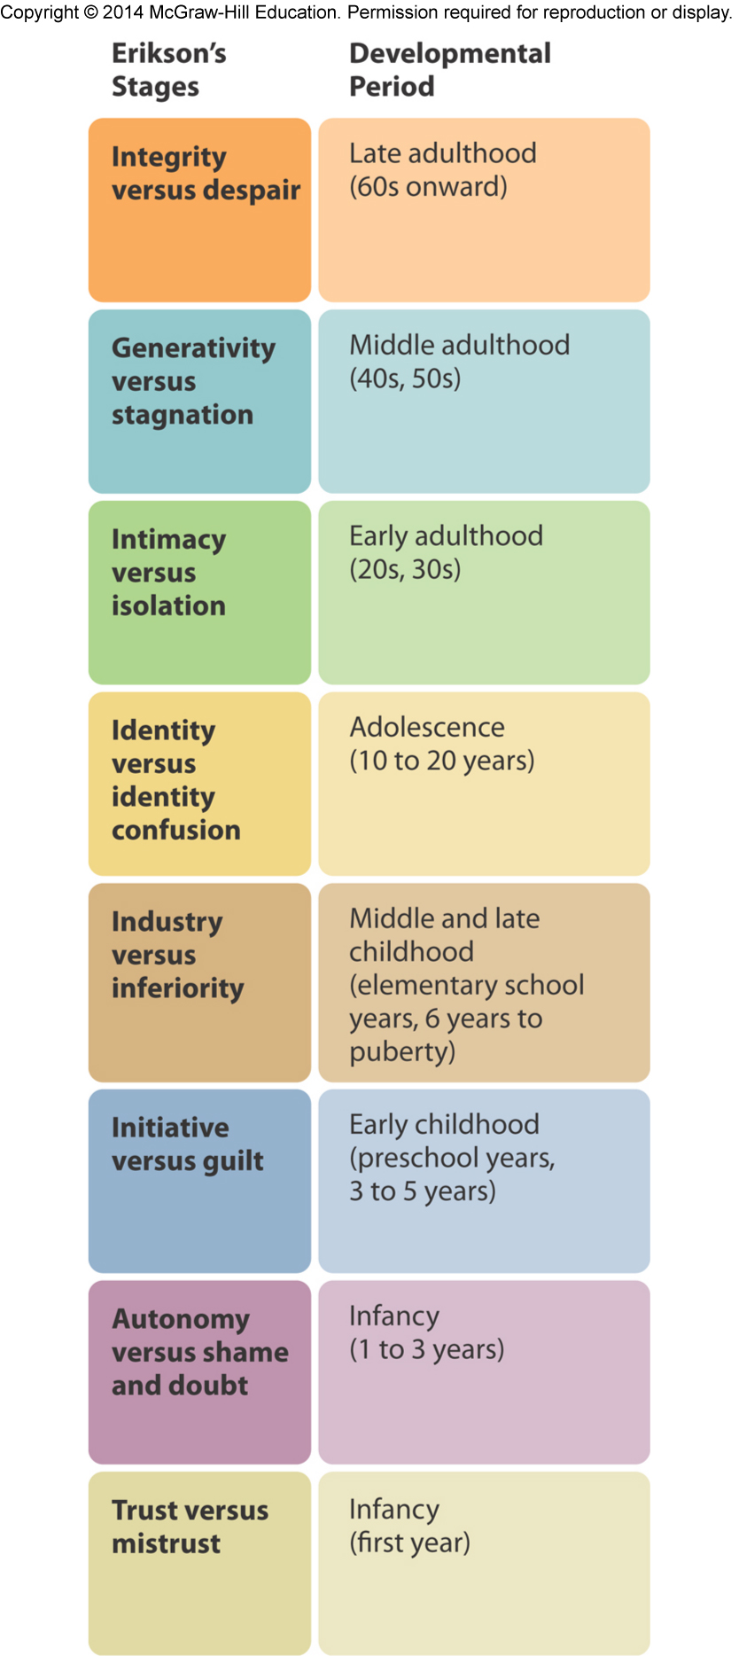
Theories of Development
Erikson’s Psychosocial Theory
Social motivations and desire to affiliate with
others is central influence in development
Emphasized importance of early and later
experiences in life
Copyright McGraw-Hill Education, 2014

Slide 14
Theories of Development
Cognitive theories
Emphasize conscious thought
Three important theories:
Piaget’s cognitive developmental theory
Vygotsky’s sociocultural cognitive theory
Information-processing theory
Copyright McGraw-Hill Education, 2014

Slide 15
Theories of Development
Piaget’s Cognitive Development Theory
Children actively construct understanding of the world
Organizing observations, connecting ideas, adapting to environmental demands
Copyright McGraw-Hill Education, 2014

Slide 16
Theories of Development
Vygotsky’s Sociocultural Cognitive Theory
Children actively construct knowledge about the world
Social interaction and culture play greater role in theory
Learning from more highly-skilled peers and adults
Information-Processing Theory
Individuals manipulate, monitor, and strategize information
Gradually develop increasing capacity for processing information
Allows acquisition of increasingly complex knowledge and skills
Copyright McGraw-Hill Education, 2014

Slide 17
Theories of Development
Behavioral and Social Cognitive Theory
Development is observable behavior that we learn through experience with the environment
Emphasizes continuity in development
Copyright McGraw-Hill Education, 2014

Slide 18
Theories of Development
Skinner’s Operant Conditioning
Consequences of behavior produce changes in probability of behavior
Rewards and punishments shape behavior
Bandura’s Social Cognitive Theory
Development shaped through observational learning
Form cognitive representations of others’ behaviors
May adopt behaviors, thoughts, and feelings accordingly
Copyright McGraw-Hill Education, 2014

Slide 19
Theories of Development
Ethological Theory
Behavior is strongly influenced by biology, tied to evolution, and characterized by critical or sensitive periods
Specific time frames during which the presence or absence of certain experiences has long-lasting influences
Konrad Lorenz
European zoologist who studied behavior of greylag geese
Imprinting – rapid, innate learning involving attachment to first moving object
Copyright McGraw-Hill Education, 2014

Slide 20
Theories of Development
John Bowlby & Mary Ainsworth
Applied ethological theory to human development
Studied attachment to caregivers
Attachment is an important development over the first year of life
Secure attachment predicts optimal development in childhood and adulthood
Copyright McGraw-Hill Education, 2014

Slide 21
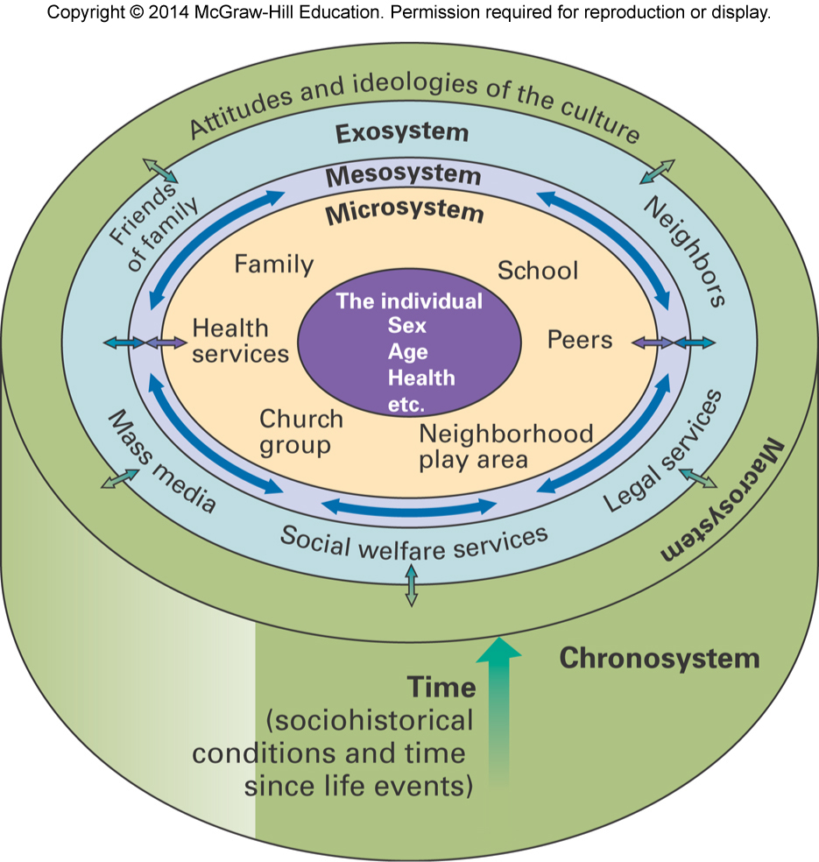
Theories of Development
Ecological theory
Emphasizes environmental factors on development
Bronfenbrenner’s ecological theory
Development reflects the influence of several environmental systems
Microsystem
Mesosystem
Exosystem
Macrosystem
Chronosystem
Copyright McGraw-Hill Education, 2014

Slide 22
Theories of Development
Eclectic Theoretical Orientation
No single theory explains the complexity of life-span development
Each theory has furthered understanding of the factors that shape development
Rather than a strict following of a single approach, theoretical perspectives are compared to and contrasted in their views of development
Copyright McGraw-Hill Education, 2014

Slide 23
How do we study these changes?
Types
Cross-sectional
Longitudinal
Sequential
“How” of data collection
Case study
Naturalistic Observation
Survey
Experiment
Hope for causal relationships although settle for correlations
Ethnography – Cultural Consideration

Slide 24
Research in Life-Span Development
Descriptive Research
Aims to observe and record behavior
Correlational Research
Strives to describe the strength of the relationship between two or more events/characteristics
Prediction based on strength of relationship
Correlation coefficient (+1.00 to -1.00)
Copyright McGraw-Hill Education, 2014

Slide 25
Research in Life-Span Development
Experimental Research
Used to determine if one factor causes another
Experiment uses carefully related procedures in which one or more factors are manipulated while all other factors are held constant
Independent variable
Factor changed by experimenter
Dependent variable
Measured by experimenter
Copyright McGraw-Hill Education, 2014

Slide 26
Research in Life-Span Development
Experimental group
Group whose experience is manipulated by researcher
Control group
Used for comparison purposes to experimental group
Random assignment
Used to determine if participants placed in experimental or control group
Copyright McGraw-Hill Education, 2014

Slide 27
Research in Life-Span Development
American Psychological Association established ethical guidelines for research
Offers protection against mental or physical harm for research participants
Informed consent
All participants must know what research will involve, including potential risks
Participants have right to withdraw from study at any point or for any reason
Copyright McGraw-Hill Education, 2014

Slide 28
Research in Life-Span Development
Do no harm
Confidentiality
All research participants’ data must be kept confidential
When possible, data is kept completely anonymous
Debriefing
Once study is completed, participants should be informed of study’s purpose and methods
Deception
If deception is used, it must not pose harm to participants
Participants must be debriefed as soon as study is completed
Copyright McGraw-Hill Education, 2014

