Slide 1
A Topical Approach to Life-Span Development, 7th edition John W. Santrock
Chapter 12 –
Gender and Sexuality
Copyright McGraw-Hill Education, 2014

Slide 2
Biological, Social, and Cognitive Influences on Gender
Gender
Characteristics of people as males and females
Gender identity
A sense of one’s own gender, including knowledge, understanding, and acceptance of being male or female
Gender roles
Sets of expectations that prescribe how females and males should think, act, and feel
Gender-typing
Acquisition of traditional masculine or feminine role
Copyright McGraw-Hill Education, 2014

Slide 3
Biological, Social, and Cognitive Influences on Gender
Gender identity emerges before 2 years old
Sex-typed behavior increases during preschool years
Children who engaged in the most sex-typed behavior during preschool were still doing so at 8 years old
Copyright McGraw-Hill Education, 2014

Slide 4
Biological, Social, and Cognitive Influences on Gender
Social role theory
Psychological gender differences result from contrasting roles of women and men
In most world cultures, women have less power and status than men, and they control fewer resources
Social hierarchy and division of labor are important causes of gender differences in power, assertiveness, and nurture
Copyright McGraw-Hill Education, 2014

Slide 5
Biological, Social, and Cognitive Influences on Gender
Psychoanalytic theory of gender
Stems from Freud’s view that preschool children develop a sexual attraction to opposite-sex parent – Phallic Stage
At 5-6 years old, children renounce attraction because of anxious feelings
Identifies with same-sex parent and unconsciously adopts same-sex parent’s characteristics
Copyright McGraw-Hill Education, 2014

Slide 6
Biological, Social, and Cognitive Influences on Gender
Social cognitive theory of gender
Children’s gender development occurs through observation and imitation
Rewards and punishments shape gender-appropriate behavior
Social-Cognitive
Gender Constancy
Gender Identity – 2
Gender Stability – 4
Gender Constancy/Conservation of Gender – 6
Gender Schema
Copyright McGraw-Hill Education, 2014

Slide 7
Biological, Social, and Cognitive Influences on Gender
Schools and teachers – bias against boys
Compliance, following rules, and being neat and orderly valued and reinforced in many classrooms
Large majority of teachers are female, especially at elementary level
Boys are more likely to have learning disability, ADHD, and to drop out
Boys are more likely to be criticized by teachers
Boys’ behavior is more likely to be stereotyped as problematic
Copyright McGraw-Hill Education, 2014

Slide 8
Biological, Social, and Cognitive Influences on Gender
Schools and teachers – bias against girls
Girls’ compliance and quiet in the classroom may come at the cost of diminished assertiveness
Teachers spend more time watching and interacting with boys
Boys get more instruction and more help when having trouble than girls
Girls and boys enter first grade with same level of self-esteem
Girls’ self-esteem becomes lower than boys’ by middle school
Copyright McGraw-Hill Education, 2014

Slide 9
Biological, Social, and Cognitive Influences on Gender
Argument that single-sex education eliminates distractions from opposite sex and reduces sexual harassment
Unsupported by valid scientific evidence
Reduces opportunity for boys and girls to work together in supervised, purposeful environment
Single-sex public schools have increased in recent years
No Child Left Behind legislation used to improve academic achievement of low-income students of color
Copyright McGraw-Hill Education, 2014

Slide 10
Gender Stereotypes, Similarities, and Differences
Gender differences in brain structure and activity
Part of the hypothalamus involved in sexual behavior is larger in men
Area of the parietal lobe that functions in visuospatial skills is larger in males
Areas of brain involved in emotional expression tend to show more activity in females
Female brains are 10% smaller than males’
Female brains have more folds, and larger folds allow more surface brain tissue
Copyright McGraw-Hill Education, 2014

Slide 11
Gender Stereotypes, Similarities, and Differences
No gender differences found in overall intellectual ability
In some cognitive areas, gender differences do exist
Boys have better visuospatial skills than girls
No differences in math scores
Girls have more negative math attitudes and parents’ and teachers’ expectations for math competence are biased in favor of boys
Girls score higher than boys in reading and writing
Girls earn better grades overall and complete high school at a higher rate
Copyright McGraw-Hill Education, 2014

Slide 12
Gender Stereotypes, Similarities, and Differences
Boys are more physically aggressive than girls
Occurs in all cultures and appears early in child development
Difference in physical aggression pronounced when provoked to anger
Physical aggression seems to begin to decline around 4. Why?
Girls use relational aggression – Equals things out.
Harming someone by manipulating social relationships, more than boys
Increases in middle and late childhood
Copyright McGraw-Hill Education, 2014

Slide 13
Exploring Sexuality
Sexually transmitted infections (STIs)
Diseases contracted primarily through sex
Penile-vaginal intercourse
Oral-genital sex
Anal-genital sex
Gonorrhea, syphilis, and chlamydia, AIDS, genital herpes, genital warts
19 Million - STIs are one of the most critical health challenges facing the nation today. CDC estimates that there are 19 million new infections every year in the United States. Often diagnosed in early adulthood. Why?
$17 Billion - STIs cost the U.S. health care system $17 billion every year—and cost individuals even more in immediate and life-long health consequences
Copyright McGraw-Hill Education, 2014

Slide 14
Sexuality Through The Life Span
Many sexually active adolescents do not use contraceptives or use them inconsistently
Every year, more than 3 million American adolescents acquire an STI
United States continues to have one of the highest rates of adolescent pregnancy and childbearing in industrialized countries
Rates have been on downward decline
Fear of STIs, school/community health classes, and higher hopes for future among reasons for decline
Copyright McGraw-Hill Education, 2014

Slide 15
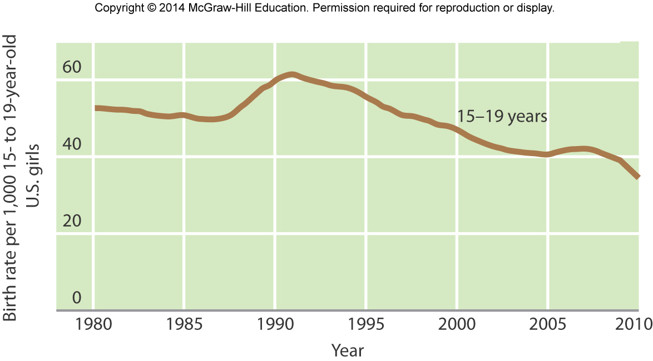
Sexuality Through The Life Span
Copyright McGraw-Hill Education, 2014

Slide 16
Exploring Sexuality
Sexual Violence – Contributors?
Violence is Violence.
Rape
Forcible sexual intercourse with a person who does not give consent
Legal definitions vary from state to state
Actual number of cases is not easily determined due to reluctance to report incidents
Occurs most often in large cities
8 of every 10,000 women ages 12 or older are raped each year
Copyright McGraw-Hill Education, 2014

Slide 17
Sexuality Through The Life Span
Climacteric
Midlife transition in which fertility declines
Menopause
When a women’s menstrual periods cease
Usually during late forties or early fifties
Perimenopause
Transitional period from normal menstrual periods to no menstrual periods
Often takes up to 10 years
Copyright McGraw-Hill Education, 2014

