Slide 1
Cognition
This section covers:
  What it means to “think”
  How we solve problems
Notes:
IMAGE: [© Kevin Dietsch/UPI/Landov] (Coon, p. 305): Stephen Hawking.
Cognition 1 of 12
This section covers:
What it means to “think”
How we solve problems
Unlike other species, humans owe their success more to thinking abilities than to physical strength or speed. That’s why we are called Homo sapiens (from the Latin for man and wise). Our mental abilities make us highly adaptable.
Consider Steven Hawking. Lou Gehrig’s disease has ravaged his spinal cord, short-circuiting messages between his brain and muscles. Today, confined to a wheelchair, he “speaks” by controlling a speech synthesizer through cheek movements. Yet despite his severe disabilities, his brain is unaffected by the disease and remains fiercely active. He can still think.

Slide 2
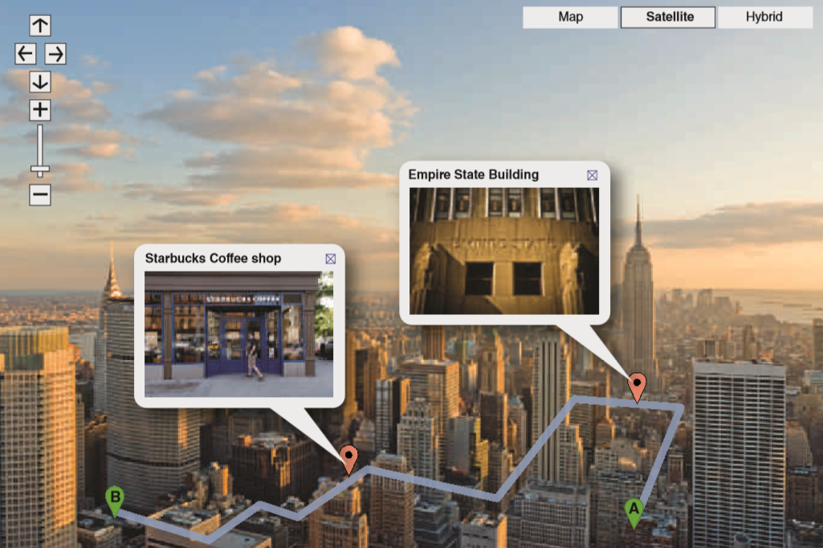
Images
Representations of sensory experiences that are stored in memory and can be retrieved for use
Notes:
IMAGE: [© Illustration: © Cengage Learning 2013; photos: (aerial view of Manhattan) © Patrick Batchelder/Alamy; (Empire State Building) © Justin Green/Alamy; (Starbucks) © Martin Shields/Alamy] (Cacioppo, Figure 10.1, p. 359): Forming Mental Maps. A person familiar with New York City could follow a mental route between these buildings, zoom in or out, and identify important features like landmarks and a favorite place to have coffee.
Cognition 2 of 12
The word cognition, as in the term cognitive psychology, is derived from the Latin cogito, which literally means “to think.”
Thinking allows us to manipulate information internally to construct models of the world, plan our interactions with that world, and regulate ourselves to meet our goals.
Albert Einstein is widely quoted as relying on mental visualization in the early stages of his thinking and only later putting his ideas into words.
To what extent do the rest of us have an ability to think in mental images?
By mental image, we are referring to a representation of any sensory experience that is stored in memory and can be retrieved for use later.
For example, you can call up a visual image of your first car, picture the letters of your name, or silently hum the first bars of “Happy Birthday to You” to your- self quite easily.
People appear to treat mental images much like they would a real object.
We can turn visual mental images around in our minds, zoom in or out, and identify their features.
In one interesting study, Stephen Kosslyn and colleagues had participants imagine two differently-sized animals, such as an elephant and rabbit, sitting side-by-side.
Participants were significantly faster to describe visual details of the larger animals than the smaller ones.
Kosslyn has suggested that this occurs because participants need to “zoom in” to the smaller animals before they’re able to “see” the details, and the zooming process takes time.
Children are particularly likely to use visual images in their thinking.
Adults, on the other hand, tend to rely more on verbal representations than images.
It is possible that language becomes an increasingly important way to organize thinking during childhood and might actually begin to overwrite or interfere with the ability to directly access visual images.

Slide 3
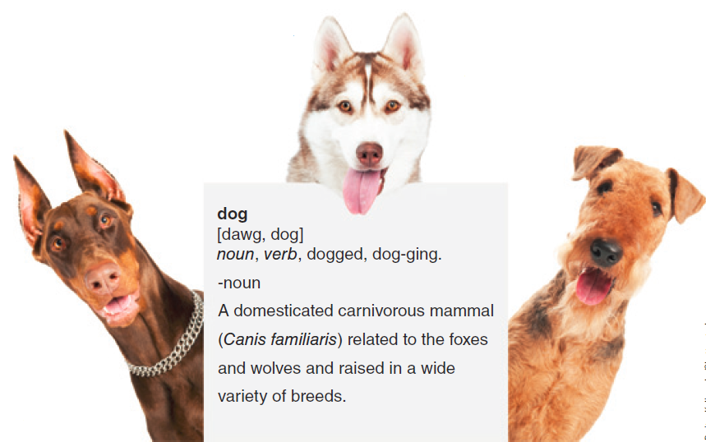
How Are Concepts Defined?
What features are necessary?
How flexible should the definition be?
Notes:
IMAGE: [Dmitry Kalinovsky/Shutterstock] (Cacioppo, p. 361): Although correct, this dictionary definition of a dog might not help you figure out if an animal standing in front of you is a dog or not.
Cognition 3 of 12
Regardless of the exact form taken by mental representations, our knowledge would be useless to us unless we imposed some type of organization on all the bits we know.
To supply this organization, we extract special, organizing ideas known as concepts from the specific instances and occurrences we experience.
Concepts can be formal or natural
We acquire formal concepts as we learn the rigid rules that define certain categories of things.
Concepts that develop naturally as we live our lives and experience the world are referred to as natural concepts.
We do not learn formal rules for these concepts; rather, we intuit and create the rules as we learn about our world.
As a result, the boundaries defining natural concept categories are often blurry, or “fuzzy.”
Consider what happens when we try to define the concept of “dog.”
If you were asked to feed your neighbor’s dog while your neighbor goes on vacation, it is likely that you could locate the correct animal, provide dog food instead of cat food, and exercise appropriate caution if your neighbor’s dog happens to be unfriendly.
This activity sounds very simple, but what if you found yourself trying to recruit an alien from another planet to help you with your task?
What information about dogs would the alien need to know in order to succeed?
Essentially, what you must convey to your alien friend is the concept of “dog”
You might start the discussion with a dictionary definition of “dog.”
In the dictionary, however, you find that a dog is “a domesticated carnivorous mammal (Canis familiaris) related to the foxes and wolves and raised in a wide variety of breeds.”
This definition seems rather remote from what we “know” to be a dog. You really don’t need to know what dogs eat and who their nearest relatives are to identify one correctly.
Perhaps we can find some common features of dogs that would allow us to distinguish between dog and non-dog.
We could tell our alien friend that dogs are furry animals with four legs that bark and wag their tails.
Unfortunately, there is a major logical flaw in this system.
No matter how careful your definitions, even for the simplest of concepts, somebody will be able to think of an exception.
Although we can agree that all dogs are animals, this feature alone is insufficient for distinguishing dogs from cats and raccoons.
Having fur does not describe hairless dogs, and Basenjis don’t bark.
A dog that has lost a leg in an accident no longer has four legs.
To resolve this dilemma, we can make our definition more flexible.
Instead of being rigidly defined by a checklist of features, a concept could describe a group of instances that share overlapping features.
This approach is similar to a feature detection model.
Using this approach, the alien could compare the features of an animal suspected of being a dog with a checklist of dog features.
There are several problems with this approach, too.
Some categories are quite clear, like triangles, but others do not have precise enough boundaries for the checklist approach to work.
People in some cultures would list “taste good” as a feature of dogs, but Americans probably would not.
In addition, the feature checklist approach just doesn’t seem to match our personal experience with thinking.

Slide 4
Comparing Types of Concepts
TYPE | CHARACTERISTIC
Conjunctive | Two or more features
Disjunctive | At least one of several possible features
Relational | How features relate to one another
Faulty | Oversimplified or inaccurate
Prototype | Ideal model
Exemplar | Specific member of a category
Notes:
Cognition 4 of 12
What are some different kinds of concepts?
Conjunctive concepts, or “and concepts,” are defined by the presence of two or more features (Reed, 2013). In other words, an item must have “this feature and this feature and this feature.” For example, a motorcycle must have two wheels and an engine and handlebars.
Disjunctive concepts have at least one of several possible features. These are “either/or” concepts. To belong to the category, an item must have “this feature or that feature or another feature.” For example, in baseball, a strike is either a swing and a miss or a pitch over the plate or a foul ball. The either/or quality of disjunctive concepts makes them harder to learn.
Relational concepts are based on how an object relates to something else, or how its features relate to one another. All of the following are relational concepts: larger, above, left, north, and upside down. Another example is brother, which is defined as “a male considered in his relation to another person having the same parents.”
Faulty concepts Using inaccurate concepts often leads to thinking errors. For example, social stereotypes are oversimplified concepts of groups of people (Le Pelley, et al., 2010). Stereotypes about men, African Americans, women, conservatives, liberals, police officers, or other groups often muddle thinking about members of the group.
An alternate approach to thinking about concepts is to consider some type of “standard” or “ideal model” of a dog, or a prototype that represents your entire category.
The prototype results from an averaging of all the members of your category, and it may not even resemble any real instance
When thinking about a category, we might also retrieve a specific instance of a concept, or an exemplar.
This could be the dog you raised during your childhood or a dog featured in your favorite movie.
In spite of the similarities between the prototype and exemplar approaches, exemplars do have some advantages.
Compared to prototypes, exemplars provide a better way of thinking about the variability of a category.
Averages, which characterize prototypes, do not provide much information about the range of features that can be found in a category.

Slide 5
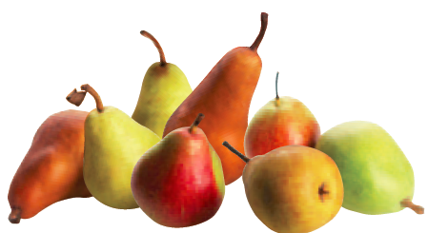


Organizing Concepts
Superordinate
Basic
Subordinate
Notes:
IMAGE: [fruit bowl: © RTimages/Alamy; different kinds of pears: © Envision/Corbis; Bosc pears: Charles Mistral/Alamy] (Pastorino, p. 312): The basic level category pear falls under the superordinate category fruit. The label Bosc pear is a subordinate category of the basic level category pear.
Cognition 5 of 12
Another benefit of mental concepts is that we can organize them into hierarchical categories.
Psychologists have found that we tend to organize our knowledge into three levels of categorization.
The highest, most general level is called the superordinate category.
The superordinate level contains concepts that are broad and general in their description.
For example, fruit would be considered to be a superordinate category.
The intermediate level of categorization is the basic level category.
The basic level seems to be the level that we use most often to think about our world.
For example, when we write out a shopping list, we probably list basic level concepts, such as oranges rather than fruit.
Accordingly, people tend to be faster in naming and categorizing objects at the basic level, a phenomenon called the basic level effect.
For example, determining that an animal is a dog should take less time than determining that an animal is a schnauzer.
Interestingly, the basic level is also the first level of knowledge young children acquire.
The third level in the hierarchy is the subordinate category.
Concepts at the subordinate level are less general and more specific than those at the basic level.
When speaking of oranges, the subordinate category would contain items like Valencia oranges, navel oranges, and blood oranges.
Although the subordinate level is the most specific, it is not the first level that springs to mind when we think about our world.
You would be much more likely to place the basic level concept—oranges—on your shopping list than you would be to place Valencia oranges.

Slide 6
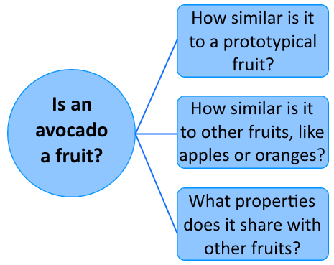
Concepts as Theories
Guide thinking
Tested for accuracy
Notes:
Cognition 6 of 12
It might be useful to view concept formation as a type of theory building.
Theories are “sets of facts and relationships between facts that can be used to explain and predict phenomena.”
This definition can also apply to a concept.
Like theories, concepts can guide our thinking and be continually tested for accuracy against new, incoming information.
For instance, if a friend is describing a trip to the beach, your interpretation of the story depends on your concept of “beach.”
If you’re familiar with the specific beach, you may picture it. Otherwise, you might picture a generic scene with sand, water, and waves.
Also like theories, our concepts do not exist in isolation.
Concepts can be viewed as part of a vast, interconnected network of memories.
Thinking about concepts as theories provides insight into the problem of judging category membership, such as deciding whether an avocado is a fruit.
Prototypes and exemplars provide a useful starting place for judging category membership.
We test our theory that the new item (avocado) fits the category by comparing it to the prototypes (average fruit) and exemplars (apple) of a concept (fruit).
We might make the occasional mistake, such as including bats or excluding ostriches in a concept of “bird,” but most of the time, we will be successful and fast.
This is how children tend to acquire new concepts.
Category membership, however, can also be determined by looking at features and properties.
This approach can be useful when items are atypical or unfamiliar.

Slide 7
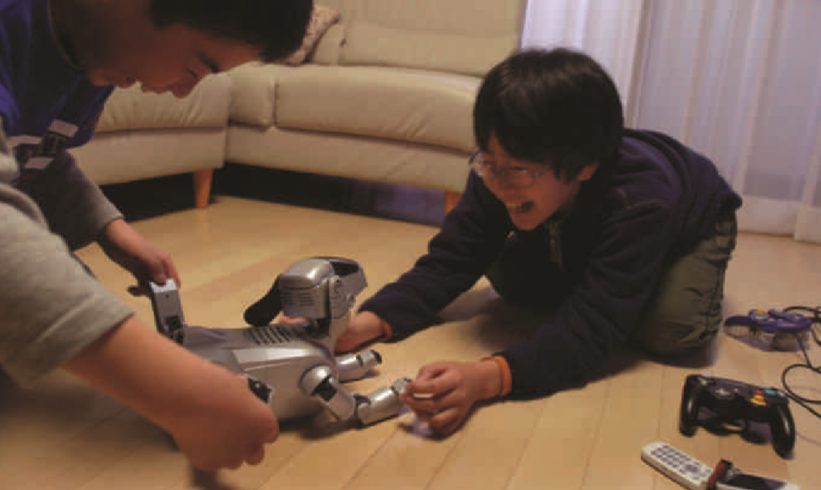
Schemas
Representations of a concept stored in memory.
  Used to guide behavior and interpret new situations.
Notes:
IMAGE: [© jeremy sutton-hibbert/Alamy] (Cacioppo 1e, p. 459): Prototypes and exemplars depend on similarity, which can result in similar items, like this robotic dog, being included in our dog category.
Cognition 7 of 12
Our dog concept is embedded in a rich, complex set of beliefs and expectations about dogs, animals, nature, and personal experience known as a schema.
This type of schema not only shapes memory storage and retrieval of information relevant to dogs but it also allows us to predict new facts about them.
If our schema includes “likes to play ball,” we know that playing ball with a friend’s new dog is likely to be successful.
Under what circumstances do people apply a schema to new information?
Once again, comparisons to “typical” members of a category appear to play a role.
People who are told a new fact about a very typical instance of a category are more willing to extend the new fact to all members of a category, whereas a new fact about an atypical category member is less likely to be widely applied.
For example, if you learn about a new fruit disease found in apples (an exemplar fruit for many people), you are more likely to think other fruits are vulnerable than if you learn that the disease targets a less typical member of the fruit category, such as olives or avocados.
One specific type of schema is known as a script. As you might guess, it’s a schema that describes how a series of actions should unfold.
For instance, think of what happens when you go to a restaurant.
When you walk in, there will probably be a host or hostess asking, “how many in your party?”
When you are seated, you’ll probably expect to be handed a menu.
After a reasonable period of time, your waiter will appear to take your order, and so on until the bill arrives and you pay for your meal.
These expectations provide guidelines for appropriate behavior. In fact, we tend to get annoyed or even angry when these expectations are violated.
When a waiter takes your order, you expect to receive the proper food.
When a new situation deviates from our script, we may be confused about how to behave.
A restaurant in a foreign country may operate very differently than what we’re expecting. When that happens, we usually wind up following the example of the locals.

Slide 8
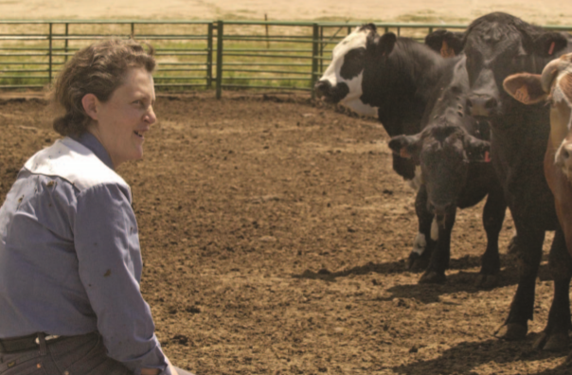
Unique Ways of Thinking: Temple Grandin
Notes:
IMAGE: [© AP Images JOHN EPPERSON] (Barlow, p. 498): Temple Grandin has a PhD in animal science and a successful career in designing humane equipment for handling livestock. She also has autism.
Cognition 8 of 12
Grandin has described her cognitive experience as “thinking in pictures.”
She has written that her mind works like an internet search engine that searches for pictures and that her thoughts are photorealistic pictures.
When Grandin underwent diffusion tensor imaging (a brain imaging method that allows characterization of microstructures), a large white fiber tract (myelinated axons) was found running from deep in her visual cortex up to her frontal cortex, something not seen in neurotypical individuals

Slide 9
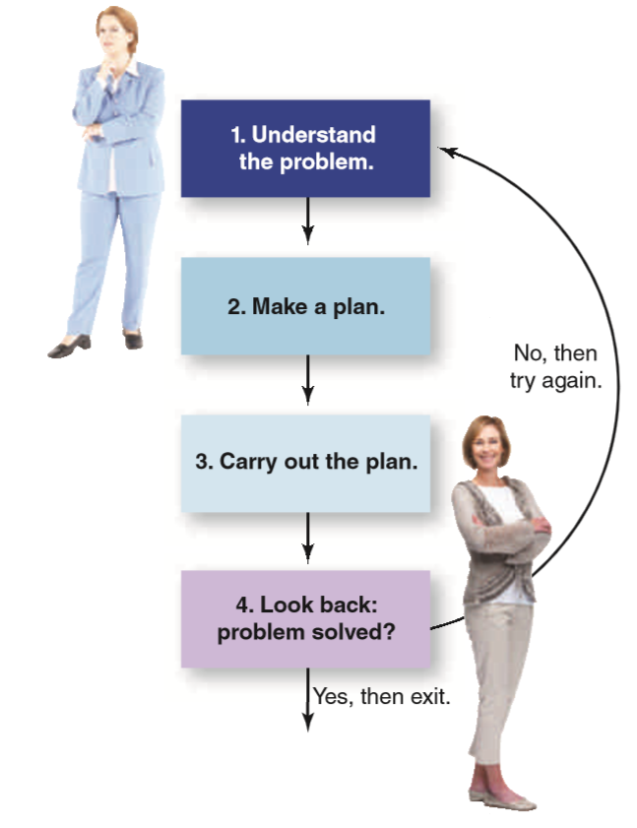
Problem-Solving: Algorithms
Step-by-step approach that leads to a solution
  Utility theory
Well-structured vs. ill-structured problems
Notes:
IMAGE: [© Illustration: © Cengage Learning®; photos: Hemera Technologies/Photos.com; Jacob Wackerhausen/Photos.com] (Cacioppo, p. 365): Problem-Solving Flow Chart. Effective problem solving can be achieved by following a system proposed by Polya (1957). If you reach step 4 and the problem is solved, you can exit the system. If the problem is not solved, you return to step 1 and try again.
Cognition 9 of 12
Some types of problems lend themselves to precise, step- by-step rules for reaching a particular solution, known as algorithms.
Algorithms have the advantage of producing an accurate solution reliably.
One such algorithm, the utility theory, is widely used in economics.
According to this theory, we compute the expected outcomes of our choices and select the best likely one.
The expected outcome is computed by multiplying measures of the usefulness of the outcome by its expected probability.
You might find that applying utility theory is a useful exercise when faced with an important decision, like whether to accept a job offer with modest pay in your hometown or one with higher pay in another state.
It is clear, however, that we rarely make decisions by solving equations.
Even when utility is held constant, people show a preference for one solution or the other based on how the solutions are framed.
Ill-structured problems are problems for which there is no known algorithm, such as trying to end global warming or effect world peace.
Intuition, simply believing that something is true independent of any reasoning process, is a common strategy for solving ill-structured problems.
The danger is that we may not even think of certain possible solutions to our problems.
This is often the case with ill-structured problems.
Often we get stuck in particular ways of trying to solve problems, and we lack the insight required to find a true solution. insight occurs when we find a new way of looking at the problem that leads to a sudden understanding of how to solve it.
Because of its perceived suddenness, insight is often referred to as the “Aha!” experience.
Insight often feels as if a light bulb has turned on, illuminating the answer for us.
But current research indicates that insight isn’t such a sudden process. Insight often occurs only after we have thought about the problem for a while.
Your belief that you can implement a particular solution will determine whether you decide to pursue that solution or look for another solution.
Once you have decided on a solution, it is time to try it out.
At this point, one of the most critical elements in successfully implementing your solution is planning.
Solutions that might otherwise succeed can fail when people do not anticipate the time and resources needed for implementation.
As you implement your solution, you will need to know if it is bringing you closer to your goal, which usually means that you need some type of measurement of success.
In the example of our holiday weight gain, the logical way to assess progress is to get back on the scale at regular intervals.
At the same time, solutions usually require time to work, and a failure to make immediate progress should not be the basis for discarding a promising solution.
Evaluation is an ongoing process, but it is especially important once a solution has been fully implemented.

Slide 10
Problem-Solving: Heuristics
Availability
Representative
Recognition
Affect
Notes:
IMAGE: [© Pavel L Photo and Video/Shutterstock.com] (Pastorino, p. 320): According to the availability heuristic, the ease with which we can retrieve memories of events from long-term memory biases our judgments of how frequently the event occurs in real life. Seeing news coverage of air disasters leaves us with vivid memories of plane crashes that cause us to overestimate the probability of a plane crash occurring in the future. As a result, air traffic often falls off immediately following a crash, although in general flying is still safer than driving to your destination.
Cognition 10 of 12
Because of the time needed to use algorithms, we often substitute “rules of thumb,” or shortcuts to problem solving, known as heuristics.
Because heuristics do not go through the exhaustive evaluation of solutions required by algorithms, they are faster.
Another advantage of heuristics is that they typically require far less information than algorithms do.
However, unlike algorithms, heuristics do not guarantee a solution.
Not only can heuristics fail to find a solution, they can lead us in the wrong direction.
The availability heuristic is used when people predict that events that are easy to think about will be more frequent.
For example, dramatic and memorable media reports make people think shark attacks are much more common than they really are.
If we asked which is more common, being killed by a shark or by falling airplane parts, which would you choose?
You actually have 30 times the risk of being killed by falling airplane parts than by sharks.
In the aftermath of 9/11, with its vivid media imagery of airplanes crashing, more Americans chose to drive rather than fly.
The extra traffic that resulted from fear of flying led to an estimated 9% increase in automobile fatalities, compared to typical rates, in the three months following the attacks.
The representativeness heuristic leads people to estimate that stimuli which are similar to a prototype are more likely to fit the category than are stimuli which are different from the prototype.
For example, is Thomas, who is short, slim, and loves poetry, more likely to be an Ivy League classics professor or a truck driver?
Although some of these examples make it sound like heuristics lead to bad decisions, it is likely that the ability to use heuristics to make quick, effective, and efficient decisions was a significant adaptive advantage for our ancestors.
An example of a very effective heuristic is the recognition heuristic, which predicts that people will place a higher value on the more easily recognized alternative.
The affect heuristic is particularly relevant to the way people make important choices.
According to this approach, we use our emotional responses to each choice to guide our decisions.
Based on our past experience with similar choices, we literally develop a “gut” reaction to our options, pushing us toward alternatives we expect to produce desirable outcomes and away from alternatives we expect to produce undesirable outcomes.
Our decision making is also affected by the need to avoid the complex emotion of regret.
By considering ways to explain and justify the reasons for their decisions in advance, people are able to live more comfortably with the decisions they have made.

Slide 11
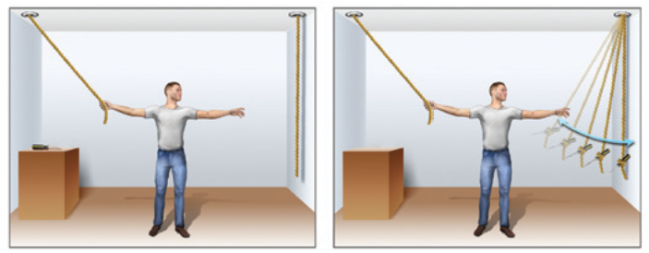
Barriers to Problem Solving
Framing
Functional fixedness
Mental sets
Notes:
IMAGE: [© Argosy Publishing, Inc.] (Cacioppo, Figure 10.4, p. 366): Functional fixedness, or our tendency to think about a concept in only one way, can interfere with problem solving. In this classic problem, the person’s task is to grab both ropes simultaneously. The only tool available is a screwdriver, which can be tied to one rope and used to make the rope swing within reach. If you only think about the screwdriver one way, as a tool used to turn screws, you cannot solve this problem.
Cognition 11 of 12
Although carefully formulating, or framing, a problem takes time, this is generally time well spent.
All relevant data should be collected, analyzed, and organized. What do we know? What information do we need that is missing? How does all this information fit together?
An important part of this step is to represent or frame the problem in a useful way. What does it mean to represent a problem?
In the case of problem solving, the mental representations we form relate to how we see the problem.
For example, you might represent your weight problem as the result of your holiday splurge or as the result of a broken bathroom scale.
Your representation of the problem in these two different ways clearly leads to separate solutions, and in many cases, your representation will determine how successful you will be at solving the problem.
Psychologists have identified a number of helpful suggestions for making the most useful representations of problems and for avoiding some common mistakes that frequently lead to failure.
For example, big, long-term problems are easier to solve if they are broken down into components, or intermediate goals.
The representation of a problem can be improved by recognizing any personal bias you might have toward particular solutions.
Careful formulation of a problem also helps us avoid distractions from irrelevant information.
A pitfall that often interferes with a useful representation of a problem is known as functional fixedness, or a person’s tendency to think about a concept in its most typical form and no others.
Generating possible solutions obviously involves some creativity, but most importantly, it requires time.
People who spend the most time on a problem typically generate the most diverse solutions.
Generating the most solutions raises your chances of finding one that will work.
A common obstacle to problem solving is a mental set.
A mental set is a tendency to habitually use the methods of problem solving that have worked for you in the past.
Mental sets become an obstacle when we persist in trying solutions that may have worked in the past but are not working in the current situation.
If you find yourself having little success in solving a problem, stop working on the problem for a while and let it incubate.
Incubation, or a period of not thinking about the problem, sometimes helps us solve a problem.
When we incubate, unproductive strategies recede from memory, and we are better able to attack the problem from a fresh, more productive perspective when we return to it.

Slide 12
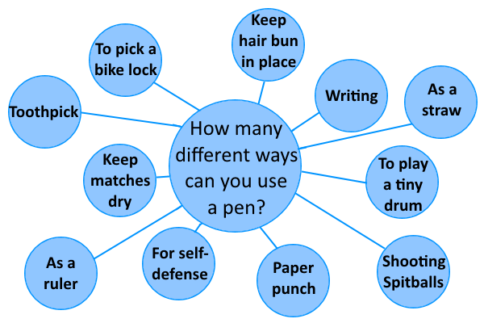
Creativity
Combining elements in new and useful ways
Divergent thinking
Notes:
IMAGE:
Cognition 12 of 12
For more than 50 years, psychologists have been trying to define exactly what creativity is and what abilities or traits creative people possess.
To date, the major agreement among researchers has been that creativity involves the ability to combine mental elements in new and useful ways.
Creativity may mean finding a novel solution to a problem or coming up with a unique approach to creating some new product—a piece of music, a painting, or a scientific theory that is widely recognized as being creative
The good news is that recently researchers have found evidence that supports the idea that we may be able to develop specific competencies that are related to being creative.
Robert Epstein and Victoria Phan conducted a large-scale study of people, measuring their levels of trainable competencies and their self-reported degree of creativity.
They found that capturing new ideas so they are not forgotten, challenging oneself with difficult tasks, broadening one’s skills and knowledge through continued learning, and surrounding oneself with a stimulating environment were all predictors of how creative the person reported themselves to be.
These data suggest that learning to stimulate and challenge oneself are characteristics that coincide with creativity.
However, is thirsting for knowledge and stimulating experience enough to guarantee creativity? Probably not.
Obviously, not everyone who visits an art museum is a creative artist.
What individual cognitive skills might explain why some of us turn knowledge and inspiration into feats of creativity and some of us do not?
One cognitive trait that has received a great deal of research attention is a skill called divergent thinking.
Divergent thinking is the ability to generate many ideas quickly in response to a single prompt.
For example, a divergent thinker can quickly come up with many different ways to tie a scarf or many different uses for an ink pen.
Divergent thinking aids creativity because it allows you to come up with many different ideas about how to solve a problem.
When you can think quickly to generate many different ideas, you are less likely to be blocked by some of the common obstacles to problem solving, including functional fixedness and mental sets.

Slide 13
Language
This section covers:
  Language and behavior
  The evolution of language
  The building blocks of language
  The biology of language
  The learning and development of language
  Differences in language
Notes:
IMAGE: [© Anna Clopet/CORBIS] (Nevid, p. 259)
Language 1 of 9
This section covers:
Language and behavior
The evolution of language
The building blocks of language
The biology of language
The development of language
Differences in language

Slide 14
What is Language?
A system for communicating thoughts and feelings
A set of arbitrary signals that vary geographically
A way to connect with others, even across space and time
Notes:
IMAGE:
Language 2 of 9
Language has been defined as a system for communicating thoughts and feelings using arbitrary signals, such as voice sounds, gestures, or written symbols.
Language provides us with powerful tools for organizing and manipulating our thinking, problem solving, and decision making.
Although thoughts can be represented visually as well as verbally, language extends our thinking abilities to abstract concepts like truth and beauty that would be difficult to visualize.
Above all, language connects us with others.
Not only can we communicate with people in our immediate vicinity, but language spans time and distance, allowing us to share the thoughts of people living long ago and in very distant places.
Because of language, the thoughts we record today might reach into the future to influence the thinking of people not yet born.

Slide 15
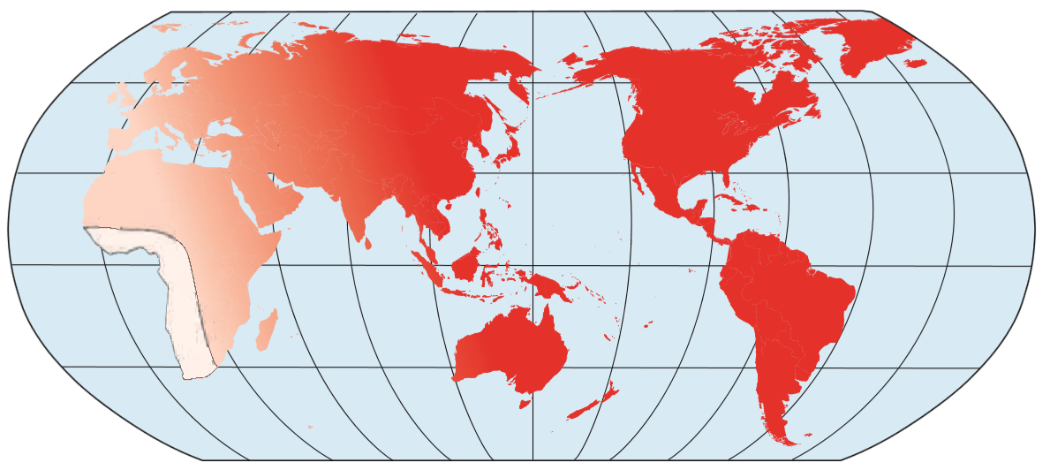
The Evolution of Language
FOXP2 gene
Tracing the roots of language
Endangered languages
Notes:
IMAGE: [© Cengage Learning 2013] (Cacioppo, Figure 10.10, p. 377): Phoneme Diversity Shows the Path of Language. The number of phonemes, or speech sounds, per language decreases with the distance of the culture using the language (indicated by shades of red) along migration routes from the western coast of Africa. Many African languages feature over 100 speech sounds, compared to 45 in English and 13 in Hawaiian. Source: Adapted from Atkinson, Q. D. (2011). Phonemic Diversity Supports a Serial Founder Effect Model of Language Expansion from Africa. Science 332(6027), 346–349. Copyright © 2011 The American Association for the Advancement of Science.
Language 3 of 9
To fix the emergence of human languages in time, we can assume that certain complex social behaviors would be difficult to conduct without the ability to speak.
Elaborate tool use and cooperation would be much easier to accomplish using language.
Because our version of the human species, Homo sapiens, appeared between 100,000 and 200,000 years ago, most anthropologists are convinced that human language existed at that time, if not earlier.
A critical gene mutation in the FOXP-2 gene occurring around 100,000 years ago possibly marked the start of modern language as we know it.
Regardless of timing, the enormous advantages of language to human culture and cooperation would ensure its continuity.
Much evidence points to Africa as the source of the first human languages.
Some anthropologists suggest that it would be difficult for early humans to migrate successfully to other continents without the cooperation provided by language.
Taking a very different approach, an analysis of over 500 contemporary languages has demonstrated that the number of speech sounds in a language decreases systematically with the culture’s distance from Africa along migration routes.
Many African languages feature over 100 speech sounds, compared to 45 in English and 13 in Hawaiian.
Languages are living entities, under constant pressure to change.
A report on endangered languages states that nearly half the world’s spoken languages may soon be lost.
Following assimilation into larger cultures, speakers might stop using their native languages or fail to transmit them to their children.
With each language lost goes an opportunity for scientists to understand the unique local knowledge of a culture, along with the historical and cognitive implications of the language.

Slide 16
The Building Blocks of Language
Phonemes
Morphemes
Syntax
Semantics
Surface and deep structures
Notes:
IMAGE: [© eddie linssen/Alamy] (Bernstein, p. 247): Making sure that the surface structures we create accurately convey the deep structures we intend is one of the greatest challenges people face when communicating through language.
Language 4 of 9
Organization of language occurs first at the level of sounds.
A phoneme is the smallest unit of sound that affects the meaning of speech.
Changing a phoneme changes the meaning of a spoken word, much as changing a letter in a printed word changes its meaning.
Tea has a meaning different from sea, and sight is different from sigh.
Although changing a phoneme affects the meaning of speech, phonemes themselves are not meaningful.
We combine them to form a higher level of organization: morphemes.
A morpheme is the smallest unit of language that has meaning.
For example, because they have meaning, dog and run are morphemes; but so are prefixes such as un- and suffixes such as -ed because they, too, have meaning, even though they cannot stand alone.
Words are made up of one or more morphemes.
Words, in turn, are combined to form phrases and sentences according to a set of grammatical rules called syntax.
According to English syntax, a subject and a verb must be combined to form a sentence, adjectives typically appear before the nouns that they modify, and so on.
Even if you use English phonemes combined in proper ways to form morphemes strung together according to the laws of English syntax, you may still not end up with an acceptable sentence.
Consider the sentence “Rapid bouquets deter sudden neighbors.”
It somehow sounds right, but it is nonsense.
Why? It has syntax, but it ignores the set of rules, called semantics. This is the study of meaning in words and language. It is here that the link between language and thought becomes most evident.
In 1965, Noam Chomsky started a revolution in how we study language.
He argued that if linguists looked only at the sentences people produce, they would never uncover all the principles underlying language.
Without looking deeper into language, he said, they could not explain, for example, why the sentence “This is my old friend” can have more than one meaning.
Nor could they account for the similar meaning conveyed by such seemingly different sentences as “Don’t give up just because things look bad” and “It ain’t over till it’s over.”
To take these aspects of language into account, Chomsky chose a more abstract level of analysis.
He suggested that behind the strings of words people produce, which he called surface structures, there is a deep structure, an abstract representation of the relationships expressed in a sentence.
For example, the surface structure “The shooting of the psychologist was terrible” can represent either of two deep structures: (1) that the psychologist had terrible aim or (2) that it was terrible that someone shot the psychologist.
Chomsky’s analysis of deep and surface structures was important because it encouraged psychologists to analyze not just verbal behavior and grammatical rules but also mental representations.

Slide 17
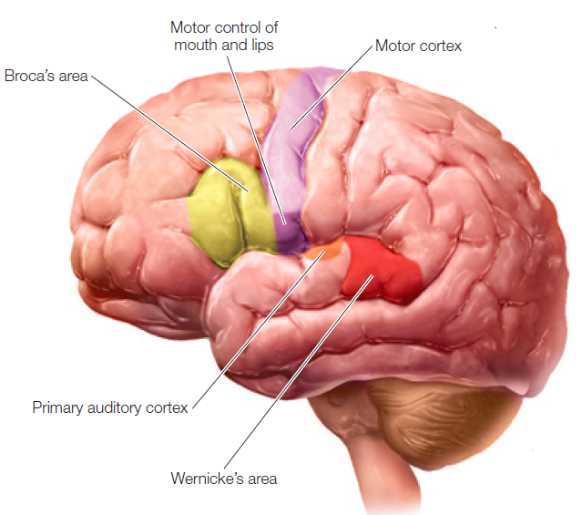
The Biology of Language
Broca’s aphasia
Wernicke’s aphasia
Notes:
IMAGE: [© Argosy Publishing, Inc.] (Cacioppo, Figure 10.11, p. 378): The Major Brain Structures Participating in Language.
Language 5 of 9
We can learn about the biology of language by surveying some of the problems that arise due to brain damage resulting from head injury or stroke.
Aphasia is the loss of the ability to speak or understand language.
The closely related processes of reading and writing may also be affected by aphasia, but this is not always the case.
One of the earliest case studies of aphasia was conducted by Paul Broca in 1861.
Broca’s subject was a 51-year-old man named Leborgne, who had been institutionalized for over 20 years.
Leborgne came to be referred to as “Tan,” because when questioned, “tan” was one of a very few syllables Leborgne could produce.
Leborgne entered the hospital after several months of being unable to speak.
He apparently understood much of what was said to him and retained his ability to answer numerical questions by raising an appropriate number of fingers on his left hand.
Leborgne died shortly after Broca’s examination of him, and Broca performed an autopsy on his patient’s brain.
Broca found significant damage to the patient’s left frontal lobe, possibly due to a stroke.
The damaged area is now referred to as Broca’s area, in honor of Paul Broca’s discovery.
Today, Leborgne would be diagnosed with Broca’s aphasia.
This condition is characterized by difficulty producing speech.
The speech that the patient manages to produce is slow and very effortful, but it generally makes sense.
About 13 years after Paul Broca presented his revolutionary work on patient Tan, Carl Wernicke published his observations on another type of language deficit.
In honor of his contributions, this syndrome is now referred to as Wernicke’s aphasia, and the affected area of the brain is known as Wernicke’s area.
Wernicke’s area is located near the primary auditory cortex, located in the temporal lobe.
The symptoms of Wernicke’s aphasia could hardly be more different than those of Broca’s aphasia.
Where Broca’s aphasia affects the production of speech, Wernicke’s aphasia affects its comprehension.
In Broca’s aphasia, speech is slow and laborious, but generally meaningful.
In Wernicke’s aphasia, the opposite is true.
Speech is rapid and fluent, but virtually meaningless.
If you don’t pay attention to the meaning, the speech of patients with Wernicke’s aphasia sounds rather normal, if slightly fast.
Grammar is generally correct.
On further examination, we find that meaningfulness is completely lacking.
These patients are completely locked into a world without social connection, yet they do not seem overly aware of their circumstances nor are they in any apparent distress.
It is overly simplistic to assume that the brain has only two main language “centers,” Broca’s and Wernicke’s areas.
Instead, contemporary research has identified complex pathways for processing language that connect Broca’s and Wernicke’s areas to other cortical areas involved in cognition

Slide 18

Animal communication
Communication vs. language
Can animals learn human language through intensive instruction?
Notes:
IMAGE: [© Rick Friedman/Corbis] (Pastorino, p. 327): Although controversial, studies of animals like Alex, the African grey parrot, challenge the presumption that language is a solely human attribute.
Language 6 of 7
Related to the issue of the biology of human language is communication by animals
Many animals communicate with each other, often in complex ways.
All forms of communication, however, do not involve the flexibility and creativity we see in language.
We can identify three major patterns of animal communication.
Some animals have a fairly inflexible group of calls used for functions such as signaling danger and identifying territories.
A second set contains signals that communicate magnitude, as in the case of bee dances that indicate the location of food.
Finally, other animals communicate through sequences of behavior, as in the case of birdsong.
The extent to which these animal forms of communication may have acted as precursors for human language in an evolutionary sense is speculative at this point.
To search for animal precursors to human language capability, the most logical place to start is with the great apes.
Chimpanzees, bonobos, and gorillas have a part of the brain analogous to the human Broca’s area.
In both humans and apes, this area shows a difference in size between the right and left hemispheres that might be correlated with language ability.
Many researchers have attempted to teach human languages to apes.
In one of the earliest experiments in ape language, Winthrop N. Kellogg and his wife “adopted” a baby chimpanzee named Gua in 1931.
Gua was raised alongside the Kelloggs’ son, Donald.
However, due to the limitations of the chimpanzee vocal apparatus, efforts to teach Gua to talk were doomed to failure.
In 1969, Allen and Beatrice Gardner taught sign language to a chimp named Washoe.
After 4 years of work, Washoe had mastered 132 signs.
The Gardners’ efforts were followed by Francine Patterson, who trained a gorilla named Koko to use signs.
Sue Savage-Rumbaugh and her colleagues have successfully taught a pygmy chimpanzee named Kanzi to associate geometric symbols with words.
Even before his own training began, Kanzi appeared to have learned 10 symbols simply by observing his mother’s training sessions. Kanzi also seems to be able to understand some human speech.
When given 660 verbal requests, such as “Put the collar in the water,” Kanzi behaved correctly 72% of the time.
In addition to investigations of language behavior in apes and monkeys, Irene Pepperberg makes a strong case for her African grey parrots.
While we often use the term “to parrot” to indicate mindless mimicry, Pepperberg argues that her parrots actually demonstrate complex cognitions related to language.
Additional debate has also occurred regarding the language abilities of dolphins and whales, dogs, and prairie dogs.
Whether efforts to communicate with animals demonstrate real language abilities is the subject of ongoing debate.
Although children build vocabularies spontaneously, critics point out that ape language must be taught laboriously.
Word order does not seem to matter too much to apes, although it has an essential role in human language.
Trainers of the apes might be making biased observations.
When Washoe signed “water-bird” while observing a swan, the Gardners concluded that she was making a new, creative observation, but Washoe may simply have noticed a “bird” sitting on the “water.”
Whether we believe that animals have true language or not, we are left with an enormous respect for both the complexity and intelligence of animal behavior and the remarkable sophistication of human language.

Slide 19
Learning Language
Behaviorist approach
Nativist approach
Notes:
IMAGE: [© Marilyn Conway/Getty Images] (Bernstein, p. 248): Long before they say their first words, babies are getting ready to talk. Laboratory studies show that even six-month-olds tend to look longer at faces whose lip movements match the sounds of spoken words. This tendency reflects babies’ abilities to focus on, recognize, and discriminate the sounds of speech, especially in their native language. These abilities are crucial to the development of language (Lewkowicz & Hansen-Tift, 2012; Mayberry, Lock, & Kazmi, 2002).
Language 7 of 9
Learning language proceeds differently than do many types of learning.
No specific instruction is needed, as it is for the related skills of reading and writing.
A typical child exposed to language will learn language.
The type and extent of exposure, however, is very important in determining how well an individual child will learn.
Social interaction is an essential component of this process, and two-way interaction in the form of conversation produces maximum results.
Conversing with children produces greater language competence than simply reading to them.
Even when exposure is one-way, as when a child is listening to a speaker, more language learning will occur when a real person is speaking with the child face-to-face than when a child is listening to the same speaker on television.
This finding implies that parents using passive television or computer videos to enhance their child’s language learning are likely to be very disappointed in the outcomes.
Behaviorists, including B. F. Skinner, argued that children learn language through operant conditioning.
Using a word correctly is reinforced when it produces a desired outcome.
This approach might explain your success in learning key terms for your psychology exams, but there is much more to learning language than memorizing vocabulary words and their definitions.
The types of mechanisms proposed by the behaviorists simply do not seem to match up well with observations of children in the process of learning language.
Parents responding to children’s sentences are much more likely to attend to the meaning of a sentence than to its grammatical structure.
When the child says, “We goed to the store today,” the parent is likely to respond, “Oh no, that’s not right. We went to the store yesterday.”
The parent is modeling the correct use of the past tense (went instead of goed), but shows much more interest in shaping truthfulness.
Several observations, including the speed and ease with which very young infants can learn complicated language tasks, have led to the assumption by many, including linguists Noam Chomsky and Steven Pinker, that human beings have an inborn capacity for learning language – the nativist approach to language acquisition.
No human culture on Earth exists without language.
Language acquisition follows a common course, regardless of the native language being learned.
Whether a child is exposed to English or Cantonese, similar language structures appear at just about the same point in development.
For example, children all over the world go through a stage in which they overapply language rules. Instead of saying, “She went to the store,” the child will say “She goed to the store.”
Eventually, the older child will switch to the correct forms, long before any formal instruction.
In addition, human brain structure is correlated with language.
Most people process language in the left hemisphere of the brain.
Damage to these left hemisphere language areas due to stroke or other brain injury produces specific types of language deficits.
Assuming an inborn capacity for learning language further implies that language has a basis in our genes.
Several genetic conditions appear to selectively impact individuals’ language learning abilities.
For several generations, members of a family known as the KE family have been studied extensively by researchers interested in the genetics of language.
Many, but not all, KE family members have very severe difficulties with the production of language accompanied by a mutation in a single gene.
The KE family mutation occurred in the FOXP-2 gene, the same gene suspected of mutating about 100,000 years ago, making human language possible in the first place.
Another condition affecting language, Williams syndrome, results from a rare genetic mutation and produces a moderate level of intellectual disability.
In most cases, individuals with intellectual disability experience difficulties with language, but individuals with Williams syndrome are fluent speakers with very large vocabularies.
Williams syndrome and another genetic disorder, Down syndrome, produce a similar level of intellectual disability, but language use in these two groups is quite different, with children with Williams syndrome having a much greater ability to use language.
On the other end of the intelligence scale, it is not unusual for a person of normal to high intelligence to have significant difficulties learning language.
Very accomplished people who have been diagnosed with verbal learning disabilities or suspected of having learning disabilities include such notables as Albert Einstein, Sir Winston Churchill, Leonardo da Vinci, Thomas Edison, and even psychology’s own William James.

Slide 20

The Development of Language
Cooing and babbling
Communicating
Single words
Telegraphic speech
Pragmatics
Notes:
IMAGE: [© Masterfile] (Pastorino, p. 323): The speed and uniformity with which infants learn language across the world suggests to some that humans have a language acquisition device or innate knowledge of the syntax of language.
Language 8 of 9
Most of us acquire our first language beginning in the first couple of years of life.
Research indicates that newborns from birth to 1 month are capable of perceiving vowel sounds in an adult-like manner, and by about 2 months, infants begin cooing.
Cooing involves making vowel sounds, such as “ooo” and “ah.”
By 4 months, infants begin to engage in babbling, which adds consonant sounds to the vowel sounds they emitted during cooing.
For example, an infant might repeat the sound “ka, ka, ka” over and over. Infants’ first babbles are very similar across cultures, but this soon changes.
By 7 months, infants begin to emit babbles that contain sounds that are part of the language they have been exposed to in their environment.
In this fashion, the infant’s language system apparently tunes itself to the language or languages that the infant hears on a regular basis.
By 1 year, children’s babbling contains the sounds and intonations of their native language.
Once a child achieves the stage of babbling the basic sounds, or phonemes, of her native tongue, the next step in language development is learning to communicate.
At around 12 months, children begin trying to communicate in earnest with others.
This communication is often based on gestures before it is based on words.
For example, a child may point at a toy that he wants. When parents learn to interpret these preverbal gestures, communication is achieved.
As they catch on to their child’s preverbal gestures, parents often verbalize the meaning of the gesture for the child.
Parents say things like, “Oh, do you want this toy?”
This verbalization of the child’s intention allows the child to begin to learn morphemes, or the smallest sounds in a language that have meaning.
As a result, by the end of the first year or so, children begin to speak their first words.
A child’s first words are usually the names of familiar objects, people, actions, or situations, ones with which they have had a great deal of contact.
Typically, these words are Dada, Mama, hi, hot, and the like.
Between 12 and 18 months of age, children usually utter one word holophrases, and often they convey tremendous meaning with these one-word sentences.
For example, the utterance “Milk!” may stand for “I want some milk, please!”
As young children begin to speak, they may exhibit overextension in their language, using one word to symbolize all manner of similar instances.
For instance, the word dog may be used to symbolize any animal.
During this period, the opposite problem may also occur when children exhibit underextension of language.
In this situation, children inappropriately restrict their use of a word to a particular case, such as when a child uses the word dog to refer only to the family pet.
By the time children reach 20–26 months, they begin to combine words into two-word sentences in what is called telegraphic speech.
Telegraphic speech is often ungrammatical, but it does convey meaning, such as “Doggie bad,” meaning “The dog was bad.”
From here, children rapidly acquire both vocabulary and grammar, or the rules that govern sentence structure in their language, such as word order and verb tenses.
From the simple subject–verb combinations of telegraphic speech, English-speaking children progress to more complex subject–verb–object sentences between ages 2 and 3.
Children who speak other languages adopt the relevant grammatical patterns of their native language.
As children develop throughout the preschool years, their knowledge and use of grammar becomes increasingly complex.
By age 6, the average child has an impressive vocabulary of around 10,000 words and a fairly competent mastery of grammar.
As children develop better vocabularies and acquire the grammatical rules of language, they exercise these abilities during social interactions with others.
It’s during these social interactions with peers and adults that children begin to learn pragmatics, or the rules of conversation operating in their culture.
Pragmatics may include rules about turn taking, eye contact, tone of voice, and other aspects of conversation.
These hard-earned linguistic abilities will be very valuable to the child, as they are to us all.

Slide 21

Linguistic relativity
The vocabulary a person uses affects how he or she thinks about a topic.
Notes:
IMAGE: [© Left: © National Snow and Ice Data Center/Photo Researchers, Inc.; right: © iofoto/Shutterstock] (Cacioppo, p. 376): According to Benjamin Lee Whorf, a skier who knows what “early sintering” means is able to think differently about snow than a person who is unfamiliar with the term. Sintering occurs when snow crystals break down and fuse into larger crystals.
Language 2 of 9
Language both reflects and shapes thought.
Benjamin Lee Whorf’s hypothesis of linguistic relativity examines the effect of having a rich vocabulary on a person’s ability to think about a topic.
According to Whorf, a skier who can name and identify powder, slush, and other variations of snow thinks differently about the snow than does a person born and raised in a tropical climate.
In Whorf’s original theory, he claimed that language placed limits on the types of thoughts that people were capable of having.
Most contemporary psychologists argue for a modified version of linguistic relativity: language makes certain types of thinking easier or more difficult.

Slide 22
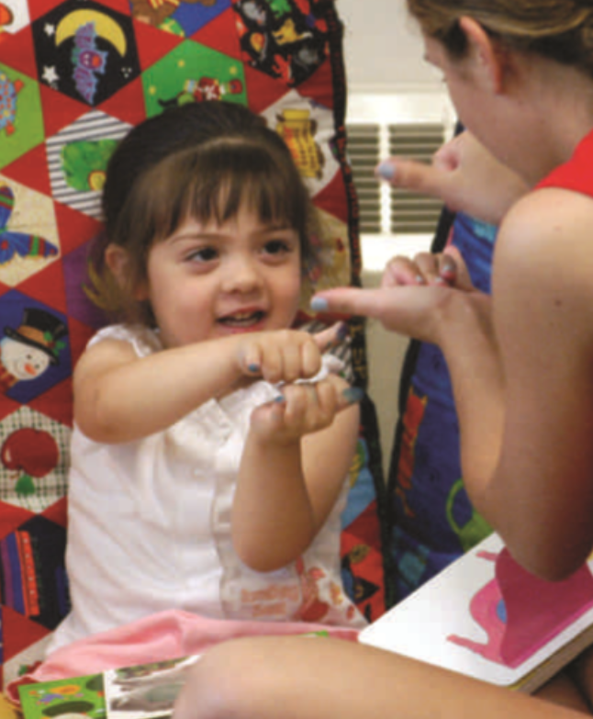
Differences in Language
Dyslexia
Bilingualism
American Sign Language
Notes:
IMAGE: [© AP Photo/Terry Gilliam] (Cacioppo, p. 383): American Sign Language (ASL) is a distinct language based on sight and movement rather than sound.
Language 9 of 9
Individuals with dyslexia experience difficulties in learning to read in spite of typical intelligence and exposure to adequate teaching methods.
The first description of a dyslexic patient, Percy F., was published by W. Pringle Morgan.
Percy F. was described by Morgan as “quick at games, and in no way inferior to others of his age. His great difficulty has been—and is now—his inability to learn to read.”
Dyslexia is strongly influenced by genetic factors, which in turn result in differences in the symmetry of the cerebral hemispheres.
People with dyslexia are more likely to be left-handed or ambidextrous than people without dyslexia.
In addition to these differences in brain structure, people with dyslexia have difficulty distinguishing between similar-sounding phonemes, or basic speech sounds, such as m or n.
Compared to typical readers, their brains show different patterns of activation during rhyming tasks, which are based on the sound of words.
Because reading most languages depends on matching phonemes to the letters that represent them, people with dyslexia show evidence of using a “workaround” when they read.
Brain activity has been recorded while university students with and without dyslexia were reading.
Compared to typical readers, readers with dyslexia showed less activity in a pathway connecting visual cortex in the occipital lobe to Wernicke’s area in the temporal lobe.
Instead, the readers with dyslexia showed greater activation of Broca’s area, which participates in speech production.
More than half the world’s population is bilingual, or proficient in at least two languages.
In comparison to the learning of a single language, learning two or more languages takes time.
Children learning two languages simultaneously can master approximately the same number of vocabulary items as children learning a single language, but this total must be divided between the two languages.
A typical 10-year-old knows about 40,000 words.
For the single-language learner, these 40,000 words are obviously all in the same language.
For the bilingual learner, the 40,000 words will be divided between the two languages.
This characteristic may produce the appearance of vocabulary delay in the bilingual learner in childhood.
By adulthood, any remaining discrepancies in vocabulary size are likely to be small and insignificant.
Any disadvantages in total vocabulary might be offset by other advantages.
Older adults who were bilingual seemed to experience a delayed onset of symptoms of Alzheimer’s disease compared to monolingual older adults.
Being bilingual did not change the brains of these individuals, but possibly provided alternate routes for processing information.
Are different languages represented in different parts of the brain?
Evidence from bilingual people who experience brain damage suggests that the answer to this question is no.
Brain areas involved with multiple languages appear to overlap.
The amount of overlap depends on the timing of learning and proficiency in each language.
When a person learns two languages early in childhood, the extent of overlap in the brain is greater than when the second language is learned in adulthood.
When a person is nearly equally skilled in two languages, more overlap will occur as well.
American Sign Language (ASL), used by people with hearing impairments and people who wish to communicate with them, provides further insight into the processing of language.
There is no question that ASL constitutes a distinct language, although it uses spatial cues of sight and movement instead of sound.
ASL provides an interesting contrast between language functions, generally found in the left hemisphere of the brain, and spatial functions, generally managed by the right hemisphere.
Both clinical observation and imaging studies support the notion that the brain manages ASL in the same way it manages other languages, in spite of its obvious spatial characteristics.
Prior to brain surgery, surgeons first identify which functions are processed by each hemisphere in an individual patient’s brain by anesthetizing one hemisphere at a time.
When the left hemisphere of an English-speaking patient proficient in ASL was anesthetized, she made errors in both spoken English and ASL signing.
Neither anesthetizing the right hemisphere nor the subsequent surgery on her right hemisphere produced deficits in either language.
In spite of the spatial nature of ASL, this case suggests that a language is still a language, and the left hemisphere is the likely place for that language to be processed.
These clinical observations have been confirmed by imaging studies.
The same areas of the brain are activated during language tasks regardless of whether the subject uses spoken English or ASL.

