Slide 1
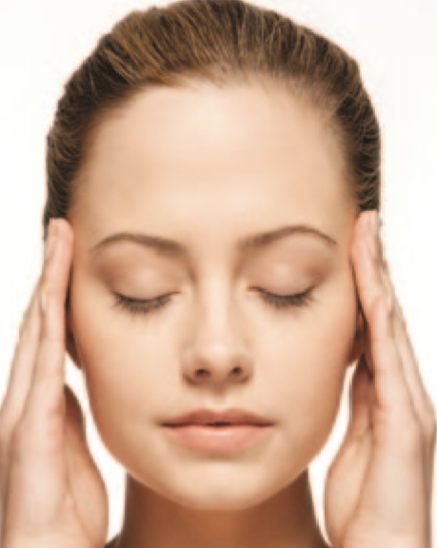
States of Consciousness
This section covers:
  What it means to be conscious
  Altered states of consciousness
Notes:
IMAGE: [©caia image/Alamy] (Pastorino, p.129)
States of Consciousness 1 of 9
This section covers:
What it means to be conscious
Altered states of consciousness
Consciousness has been a favorite topic among psychologists for many years.
William James (1890) coined the term “stream of consciousness” to capture the moving, seemingly unbroken flow of conscious awareness.
Sigmund Freud used the term consciousness to refer to aspects of the mind that could be retrieved voluntarily, in contrast to the unconscious parts of the mind that remain hidden to voluntary searches for information.
Contemporary cognitive psychologists debate the reasons why some information becomes conscious while other information does not.

Slide 2
The Continuum of Consciousness
Consciousness refers to our awareness of external stimuli and our own mental and other internal processes
Notes:
IMAGE [© David Welling/Animals Animals] (Bernstein, p. 293)
States of Consciousness 2 of 9
What does it mean to you to be conscious? Is consciousness uniquely human? What is the relationship between brain function and consciousness?
Most of us would agree that bacteria do not possess consciousness, but that people do.
This implies that consciousness emerged at some point in the course of evolution.
The exact location of that point remains highly debatable.
The question of the emergence of consciousness in animals is complicated by the multiple meanings of consciousness.
Most, if not all, animals show variations in states of awareness.
While ducks sleep, one hemisphere of their brains can process visual information from an eye that remains open. Birds positioned where they are most vulnerable to predators, such as at the end of a row, may spend twice as much time in this “alert” sleep than do birds in more protected positions (Rattenborg, Lima, & Amlaner, 1999).
Consciousness defined as an awareness of ongoing sensations (both internal and external) is probably less common in the animal kingdom.
Many animals would survive quite well by simply responding automatically to the world around them (“food” or “predator”) without necessarily thinking “I smell food” or “I see a predator.”
The self-awareness aspect of consciousness—as exemplified in “I” statements—might be the rarest of all among living things.

Slide 3

States of Consciousness
Conscious states can be viewed as points along a continuum
Notes:
IMAGE [© iStockphoto.com/Manu1174] (Pastorino, p. 130): It is estimated that more than 24,000 deaths occur annually in accidents caused directly or in part by drowsy drivers.
States of Consciousness 3 of 9
The continuum of consciousness refers to a wide range of experiences, from being acutely aware and alert to being totally unaware and unresponsive.
Controlled processes are activities that require full awareness, alertness, and con- centration to reach some goal. The focused attention required in carrying out controlled processes usually interferes with the execution of other ongoing activities.
Automatic processes are activities that require little awareness, take minimal attention, and do not interfere with other ongoing activities.
Daydreaming is an activity that requires a low level of awareness, often occurs during automatic processes, and involves fantasizing or dreaming while awake.
Altered states of consciousness result from using any number of procedures (such as meditation, psychoactive drugs, hypnosis, or sleep deprivation) to produce an awareness that differs from normal consciousness.
Unconsciousness, which can result from disease, trauma, a blow to the head, or general medical anesthesia, results in total lack of sensory awareness and complete loss of responsiveness to one’s environment.

Slide 4
Hypnosis
Neodissociation theory vs. Response set theory
Can hypnosis help with any of the following?
  Relieve pain…yes
  Cure addictions…no
  Decrease anxiety…yes
  Improve memory…probably not
Notes:
IMAGE: [© iStockphoto.com/AtnoYdur] (p. 309, Bernstein)
States of Consciousness 4 of 9
Hypnosis, another method of deliberately influencing consciousness, has its roots in various healing techniques that date back through human history.
Psychologists today are divided in their opinions about whether hypnosis represents a truly altered state of consciousness.
When PET scans of hypnotized participants were correlated with self-reports of their hypnotized experience, several structures that play important roles in consciousness, including the anterior cingulate cortex and the thalamus, showed characteristic changes in activity when a person was hypnotized
On the other hand, hypnosis does not cause people to completely abandon their sense of morality or do things they wouldn’t otherwise do.
Hypnotic susceptibility is the ability to become hypnotized. Some people have a low degree of susceptibility—they cannot easily be hypnotized.
Others have a high susceptibility, meaning that they can be easily hypnotized.
People who are easily hypnotized tend to be better able to focus their attention, have vivid imaginations, and have positive expectations about hypnosis.
Currently, two theories seek to explain hypnosis: neodissociation theory and the response set theory.
Ernest Hilgard’s neodissociation theory suggests that hypnosis is truly an altered state of consciousness: a person feels, perceives, and behaves differently than in a conscious state. To dissociate means to split or break apart. Hilgard maintains that under hypnosis, your consciousness divides into two states. One level of your consciousness voluntarily agrees to behave ac- cording to the suggestions of the hypnotist. However, at the same time, a hidden observer state exists. This hidden observer is aware of all that is happening.
The response set theory of hypnosis asserts that hypnosis is not an altered state of consciousness. Rather, hypnosis is merely a willingness to respond appropriately to suggestions. Several studies do support that people’s response expectancies influence their responsiveness to hypnosis.
American Psychological Association Consensus Statement:
When using hypnosis, one person (the subject) is guided by another (the hypnotist) to respond to suggestions for changes in subjective experience, alterations in perception, sensation, emotion, thought or behavior.
What can and cannot hypnosis do?
Relieving pain. One of the best documented uses for hypnosis is pain relief.
Curing addictions. Posthypnotic suggestions have proven less successful for treating addictions or self-control behaviors, even in people with a high susceptibility to hypnosis. Although hypnosis has been used as a treatment to stop smoking, nail biting, overeating, gambling, alcoholism, and other addictions, it has proven no more successful than other treatments at controlling these behaviors.
Decreasing anxiety and enhancing psychotherapy. Hypnosis has proven useful in decreasing fears and anxieties for people with a high susceptibility to hypnosis
Enhancing or recovering memory. One of the most controversial applications of hypnosis has been in the area of memory enhancement. Research in this area has focused on two key issues: age regression and recovered memories.
Age regression refers to a person’s reliving earlier childhood experiences. Numerous studies on age regression demonstrate that under hypnosis, adults act the way they expect children to behave.
A recovered memory is one in which a person recalls forgotten traumatic events or information, such as events from a crime scene or from one’s childhood. Being in a relaxed state may facilitate recall under certain circumstances. However, research reveals that hypnotized people may also recall untrue events.

Slide 5

Meditation
A state of heightened awareness achieved by using attention to control one’s mental processes
Notes:
IMAGE: [© Marco Secchi/Getty Images] (Cacioppo, p. 226)
States of Consciousness 5 of 9
The photo shows an individual who is a Sufi. Sufis belong to a mystic Muslim sect that uses spinning as a means of inducing a state of meditation. Spinning can last an hour or more, after which the Sufi typically falls to the ground and experiences a sense of oneness with the earth.
Meditation techniques vary widely and may occur in either religious or nonreligious contexts.
When experienced practitioners are asked to describe the subjective experience produced by meditation, they describe a conscious state without thought, accompanied by a blissful emotional state.
EEG recordings during meditation feature increased proportions of alpha waves, which we described earlier as being characteristic of an awake but relaxed state.
However, these findings are not believed to represent any unique state of consciousness.
In participants who had meditated more than three years, increased theta activity, normally found in lighter stages of sleep, was observed over the frontal lobes of the brain.
Theta activity in the prefrontal areas of the brain has been correlated with positive emotions.
Imaging studies using functional MRI suggest that meditation represents a voluntary regulation of attention and autonomic functions.
In addition, meditation appears to result in physical changes in the brain. Meditation has been correlated with increased cortical thickness and increased gray matter in the brainstem.
Some studies suggest that there are long-term health benefits associated with regular meditation. The following items are all associated with regular mediation:
Lower levels of stress hormones in the body
Enhanced immune system functioning
Improved cardiovascular health
Reductions in chronic pain

Slide 6
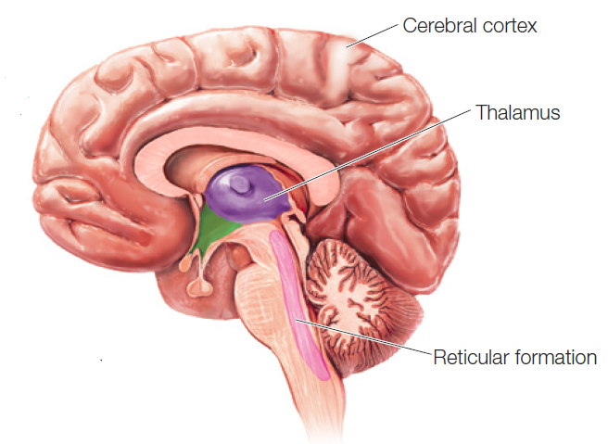
Consciousness and the Brain
Certain brain structures are necessary, but not sufficient, for consciousness
Notes:
IMAGE [© Argosy Publishing, Inc.] (Cacioppo, Figure 6.1 p. 197): Brain Structures Associated with Consciousness
States of Consciousness 6 of 9
Consciousness, the mind, and the brain are like a set of nested Russian dolls.
The brain, the outside doll, houses the mind but has other functions as well, such as maintaining breathing and body temperature.
The mind, the middle doll, houses consciousness, the innermost doll, but also manages unconscious functions such as long-term memory.
Consciousness requires complex interactions between areas of the cerebral cortex and the thalamus
Lesions of the thalamus result in the type of profound unconsciousness typically associated with brain death
Additional brain structures, such as the reticular formation of the brainstem, play an active role in raising or lowering the thresholds of conscious awareness
Structures such as the thalamus and reticular formation have been described as “enabling” consciousness, but they do not produce its content
One of the challenges facing psychologists interested in consciousness is how to explain how the brain forms a unified whole out of large quantities of information.
This question is known as the “binding problem.”
One suggested solution to the binding problem is that sensory information combines with an individual’s past experience to produce expectations for managing a current situation.
This integration of sensory input and prior experience becomes part of the “stream of consciousness.”
The frontal lobes provide working space for this integration, along with opportunities for making decisions.
The involvement of learned expectations in the “stream” also provides an attractive explanation for the gradual emergence of consciousness in the developing child.

Slide 7
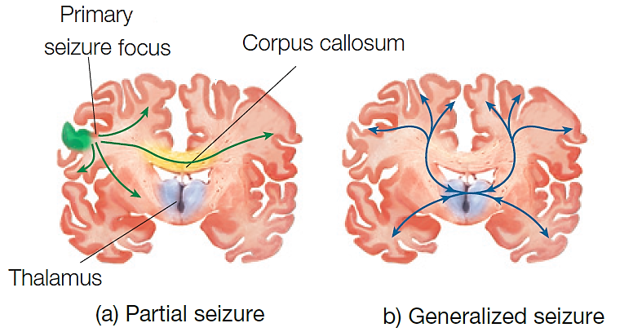
Seizures
Uncontrolled electrical disturbances in the brain that are often correlated with changes in consciousness
Notes:
IMAGE: [© Argosy Publishing, Inc.] (Figure 6.14, p. 216 Cacioppo): Pathways for the Spread of Partial and Generalized Seizures.
States of Consciousness 7 of 9
Seizures are uncontrolled electrical disturbances in the brain that are often correlated with changes in consciousness, providing further evidence that cortical activity is correlated with consciousness.
People with recurring seizures are diagnosed with epilepsy.
Seizures frequently occur as a result of brain injury or infection, but can also appear without an obvious cause.
Disturbances in the activity of the inhibitory neurotransmitter GABA might account for many seizures.
Drugs that inhibit GABA reliably produce seizures, while drugs that enhance GABA activity, like barbiturates, serve to prevent or control seizures.
Withdrawal from drugs that boost the activity of GABA, such as alcohol, often stimulates life-threatening seizure activity.
Most seizures may be classified as either partial seizures or generalized seizures.
Partial seizures originate in a particular part of the brain, known as the focal area, and are often accompanied by an aura, or a premonition that a seizure is about to occur.
Generalized seizures do not arise from a focal area. Instead, these seizures are characterized by the abnormal activation of circuits connecting the cortex and thalamus.
Generalized seizures are typically not accompanied by an aura.
Partial seizures originating in the temporal lobe often produce distortions of consciousness, leading to the experience of déjà vu (French for “already seen”), a feeling that one is reliving the past, or jamais vu (French for “never seen”), a sense that one’s familiar circumstances are suddenly foreign or strange.
Consciousness is lost completely in generalized seizures.
The two major categories of generalized seizure are the tonic-clonic and absence seizures.
Tonic-clonic seizures begin with a loss of consciousness, cessation of breathing, and intense muscular contraction. This phase usually gives way to violent, rhythmic contractions that may result in broken bones or other physical injuries. These phases are followed by a period of coma, lasting about five minutes.
In an absence seizure, the person briefly loses consciousness and awareness of his or her surroundings, and motor movements are limited to blinking, head turns, and eye movements.

Slide 8
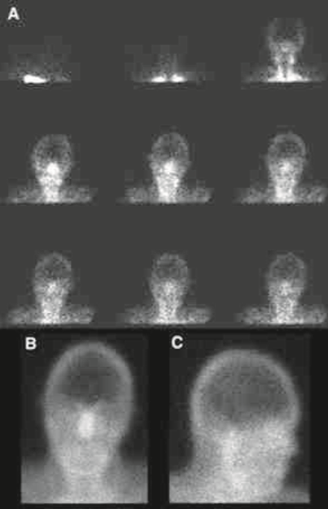
Brain Damage
Coma
Persistent vegetative state
Brain death
Near-death experience
Notes:
IMAGE: [© Society of Nuclear Medicine, 2009] (Figure 6.13, p. 215 Cacioppo): Determining Brain Death
States of Consciousness 8 of 9
Our word coma comes from the Greek koma, which means “deep sleep.”
Coma produces a profound state of unconsciousness. In a state of coma, a person does not have sleep-waking cycles, cannot be awakened, does not respond to pain or light, and is incapable of any voluntary behavior.
Coma results from a wide variety of medical conditions that impact the nervous system, including traumatic brain injury (TBI) and loss of oxygen.
Comas last anywhere from a few days to several weeks. After a period of 2 to 4 weeks, most patients will have recovered, moved on into a vegetative state (described later in this section), or died. Among those who recover, improvement is usually very slow and gradual.
Persistent vegetative state often follows a period of coma.
PVS is characterized by wakefulness without consciousness. In contrast to the patient with coma, patients with PVS look rather normal. Their eyes open periodically, and they grind their teeth, scream, smile, or cry. Some are responsive to pain.
However, most behavior appears to be spontaneous and internally driven as opposed to being elicited by any external stimulus.
Medical authorities are divided regarding the possibility of recovering from PVS.
Two PVS patients appeared to recover after 5 years of apparent unconsciousness. Others dispute these findings and suggest instead that “miraculous recoveries” occur only in patients who were initially misdiagnosed with PVS
With the advent of technologies that can artificially maintain certain bodily functions, including respiration and blood circulation, we have been placed in the odd position of requiring a new definition of death. Brain death is now defined as a complete and irreversible lack of measurable brain activity, as evidenced by two flat-line EEG recordings taken 24 hours apart or lack of blood circulation to the brain.
In the images showing blood flow, blood can be seen flowing into the neck, scalp, and face (particularly the nose, which leads to the phrase “hot nose sign”). However, no blood flow is seen in the brain itself, which remains dark. A careful determination of brain death is required due to the common practice of organ donation following death.
In brain death, the patient shows no responses to external stimuli, including pain, and no reflexes related to the cranial nerves.
Once again due to improvements in technology that literally bring people “back to life,” over 8 million Americans report having had a near-death experience.
Patients who recover following a cardiac arrest or some other life-threatening condition often report similar experiences.
These experiences typically feature an out-of-body experience, in which the person feels that she is viewing her own body from a floating position above. In addition, many people report a “light at the end of the tunnel” visual experience, which may include images of deceased friends and relatives or deities. These visual sensations are accompanied by a peaceful, calm emotional state, followed by a reluctant return to the body.
The similarities among documented cases of near-death experiences lead us to assume that the dying-revival experience produces consistent responses in the human brain.
Strong out-of-body sensations occur in volunteers using the anesthetic ketamine.
Ketamine is known to block glutamate receptors.
When the brain is damaged, cells typically release large quantities of glutamate. Glutamate, in turn, has further toxic effects on the brain.
Consequently, the brain may release its own glutamate blockers in response to damage in an effort to minimize the cell loss produced by excess glutamate release. These glutamate blockers, similar to the artificial ketamine, may be responsible for the reported phenomena of near-death experiences.

Slide 9
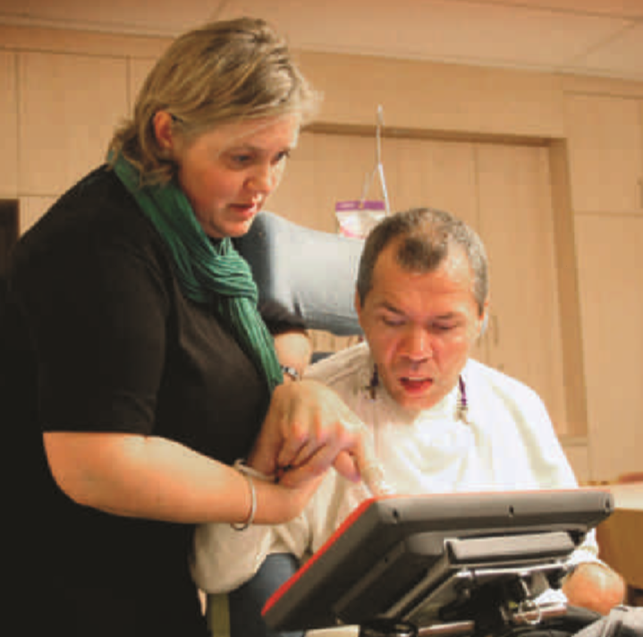
Case Study: Communication during a Persistent Vegetative State
Notes:
IMAGE: [© REUTERS/Romain Eyckens] (p. 215, Cacioppo)
States of Consciousness 9 of 9
It is hard to imagine a more traumatic experience than to be conscious but trapped in an unresponsive body.
This is the nightmare that many scientists working with patients with PVS fear might be happening.
This fear has led to a search for ways to communicate with the patient.
Following a traffic accident more than 20 years ago, Rom Houben has been in a persistent vegetative state.
Doctors attempted to communicate with Houben by asking him to type with his right index finger, which was not paralyzed.
Messages from Houben immediately gained worldwide attention.
Unfortunately, follow-up research showed that Houben’s speech therapist, who was supposed to be providing support for his hand, was actually responsible for the messages.
This “facilitated communication” has often produced similar false results.
However, the doctors continue to look for a way to reach Houben, whose brain appears to be acting only slightly differently than normal in imaging studies.
Using functional MRI, other scientists have identified PVS patients whose brains showed reliable and distinct patterns of activity when asked to imagine playing tennis or walking around their own homes.
Using “tennis” for “yes” and “home” for “no,” the patients were able to correctly answer a series of questions, such as “Do you have brothers?” or “Is your father’s name Thomas?”
In spite of the accuracy of these responses, the patients show no outward signs of consciousness, nor do they show any normal behavioral reactions to stimuli.

Slide 10
Sleeping and Dreaming
This section covers:
  Circadian rhythms
  Sleep cycles and dreaming
  Sleep disturbances and disorders
Notes:
IMAGE: [© BURGER/PHANIE/Photo Researchers, Inc.] (Weiten, p. 145)
Sleeping and Dreaming 1 of 9
This section covers:
Circadian rhythms
Sleep cycle and dreaming
Sleep disturbances and disorders
Photo: Researchers in a sleep laboratory can observe subjects while using elaborate equipment to record physiological changes
during sleep. This kind of research has disclosed that sleep is a complex series of physical and mental states.
Topic for discussion:
Are you a morning person or an evening person?
If you were entirely free to plan your evening and had no commitments the next day, at what time would you choose to go to bed?
You have to do 2 hours of physically hard work. If you were entirely free to plan your day, in which time period would you choose to do the work?
For some reason you have gone to bed several hours later than normal, but there is no need to get up at a particular time the next morning.
Will you wake up at the usual time and not fall asleep again; wake up at the usual time and doze thereafter; wake up at the usual time but fall asleep again; or not wake up until later than usual?
You have a 2-hour test to take that you know will be mentally exhausting. If you were entirely free to choose, in which time period would you choose to take the test?
If you had no commitments the next day and were entirely free to plan your own day, what time would you get up?
A friend has asked you to join him twice a week for a workout in the gym. The best time for him is between 10 p.m. and 11 p.m. Bearing nothing else in mind other than how you normally feel in the evening, how do you think you would perform?
One hears about “morning” and “evening” types of people. Which of these types do you consider yourself to be?
Sleep consists of ﬁve different stages that involve different levels of awareness, consciousness, and responsiveness, as well as different levels of physiological arousal. Dreaming is a unique state of consciousness in which we are asleep but experience a variety of astonishing visual, auditory, and tactile images, often connected in strange ways and often in color.

Slide 11
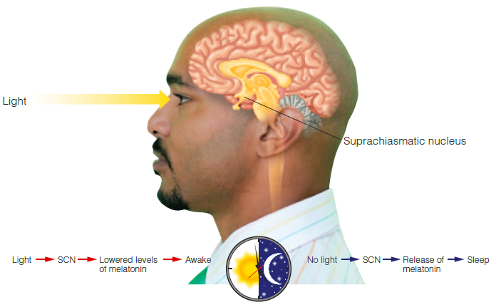
Circadian Rhythms
Notes:
IMAGE: [© Steve Wisbauer/Photodisc/Getty Images] (Pastorino, Figure 4.2, p. 134)
Sleeping and Dreaming 2 of 9
A circadian rhythm is a built-in cycle of physical processes in living beings.
In humans, circadian rhythms include core body temperature, alertness, hormone productions and other biological processes.
Our cycle of sleep is also greatly influenced by our biology.
For example, if you were put in a cave and had no cues as to time—no watches, light, or clocks—your body would exhibit a natural rhythm of sleeping and waking that closely resembles a 24- to 25-hour cycle.
This sleep circadian rhythm is programmed by a group of brain cells in the hypothalamus called the suprachiasmatic nucleus (SCN).
The SCN works very much like an internal clock, signaling other brain areas when to be aroused (awake) to start the day and when to shut down (sleep) for the day.
The SCN is very responsive to light changes and takes its cues from your eyes. When your eyes transmit light information to the SCN, they are in essence telling it whether it is light or dark outside.
The light information helps the SCN direct the release of melatonin, the hormone that facilitates sleep. Hence, light information and melatonin regulate your sleep circadian rhythm and help you get to sleep or awaken.
When circadian rhythms are out of sync, the effect can be quite disruptive.
Flying across time zones can leave you groggy and fatigued (jet lag). It may take a day or more for your body’s clock to align with the new time zone.
Workers scheduled to rotating or unpredictable shifts tend to have lower productivity and more accidents than workers that have a consistent schedule.

Slide 12
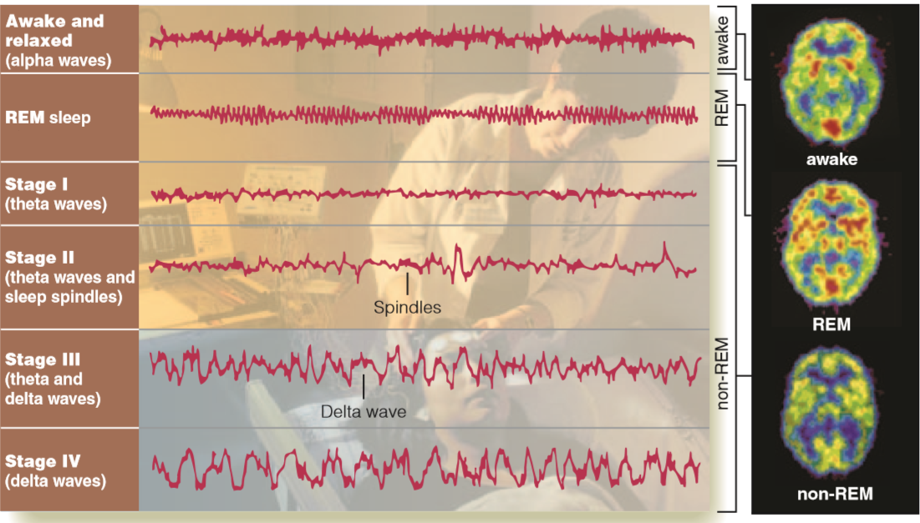
Stages of Sleep
Notes:
IMAGE: Figure 4.3 [© Hank Morgan/Science Source] (Pastorino, p. 136): Brain Activity During Wakefulness and the Various Stages of Sleep
Sleeping and Dreaming 3 of 9
Using electroencephalogram (EEG) technology, sleep researchers have identified five stages of sleep.
When we are awake and alert, our brain (as measured by an EEG) emits beta waves.
Beta brain waves are rapid, with a high number of cycles per second. This indicates frequent impulses of electrical activity in the brain.
When we are awake yet relaxed, our brain emits alpha waves.
Alpha waves are somewhat slower and less frequent than beta waves.
As we sleep, our brain-wave patterns change in a predictable sequence.
Stage I sleep is a light sleep and is characterized by theta waves.
Theta waves are slower and less frequent than beta or alpha waves.
During this stage, your breathing and heart rate slow down. You may experience sensations such as falling or floating. You can easily awaken from stage I sleep, which typically lasts from 1 to 7 minutes.
Stage II sleep is characterized by sleep spindles and lasts approximately 20 minutes.
Sleep spindles are a pattern of slower theta waves sporadically disrupted by bursts of electrical activity.
During stage II sleep, breathing, muscle tension, heart rate, and body temperature continue to decrease. You are clearly asleep and not easily awakened.
Research suggests that stage II sleep spindles help us process both simple and complex motor skills that we have learned.
Stages III and IV sleep are referred to as slow-wave sleep.
In stage III sleep, you begin showing delta brain-wave patterns.
Delta waves are large, slow brain waves.
When a consistent pattern of delta waves emerges, you have entered stage IV sleep.
Stage IV sleep is referred to as deep sleep. The body is extremely relaxed. Heart rate, respiration, body temperature, and blood flow to the brain are reduced. Growth hormone is secreted.
It is difficult to awaken people from deep sleep. When they are awakened, they may be disoriented or confused. It is believed that during this deep sleep, body maintenance and restoration occur.
REM sleep is a very active stage of sleep (next slide).

Slide 13
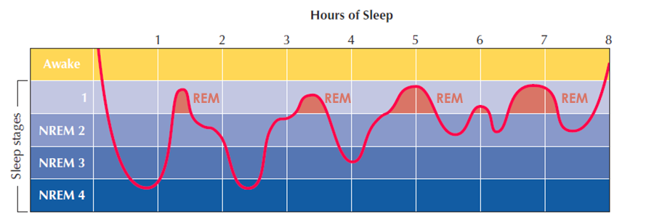
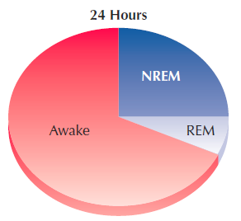
REM (Rapid-Eye-Movement) Sleep
Notes:
IMAGE: Figure 4.3 [© Cengage Learning 2013] (Coon, p. 198)
Sleeping and Dreaming 4 of 9
After approximately 30–40 minutes of slow-wave sleep, your brain and body start to speed up again.
You cycle back through stage II of non-REM sleep and then enter REM (rapid-eye-movement) sleep.
Your breathing rate increases, and your heart beats irregularly.
Blood flow increases to the genital area and may cause erections (in males) or vaginal lubrication (in females).
These effects are not related to the content of a person’s dream, however. They are byproducts of changes in blood flow.
However, your muscle tone significantly decreases, leaving the muscles extremely relaxed and essentially paralyzed.
REM sleep is intimately connected to dreaming. Although you can dream in some form in all sleep stages, dreams during REM sleep are more easily recalled. More than 80% of people awakened from REM sleep report dreaming.
The body paralysis that occurs during REM prevents you from acting out your dreams. However, in rare instances, people do not experience the paralysis that normally accompanies REM sleep. This condition, which mainly affects older men, is referred to as REM behavior disorder. People with REM behavior disorder may thrash about while in REM sleep, causing harm to themselves or others.
Researchers are continuously questioning the purpose of REM sleep. Some studies indicate a connection between REM sleep and memory processing. People who are deprived of REM sleep and dreaming are less likely to recall complex information learned earlier in the day than are people who were not deprived of REM sleep. REM-deprived people also report having difficulty concentrating when they awaken. These findings have led researchers to speculate that REM sleep—and perhaps dreaming—facilitates the storage of memories as well as mental strategies. At the same time, REM appears to help us process recent emotional experiences and to “discard” information that is trivial or less important to us.
The figure above shows:
(a) Average proportion of time adults spend daily in REM sleep and NREM sleep. REM periods add up to about 20 percent of total sleep time.
(b) Typical changes in stages of sleep during the night. Note that dreams mostly coincide with REM periods.

Slide 14
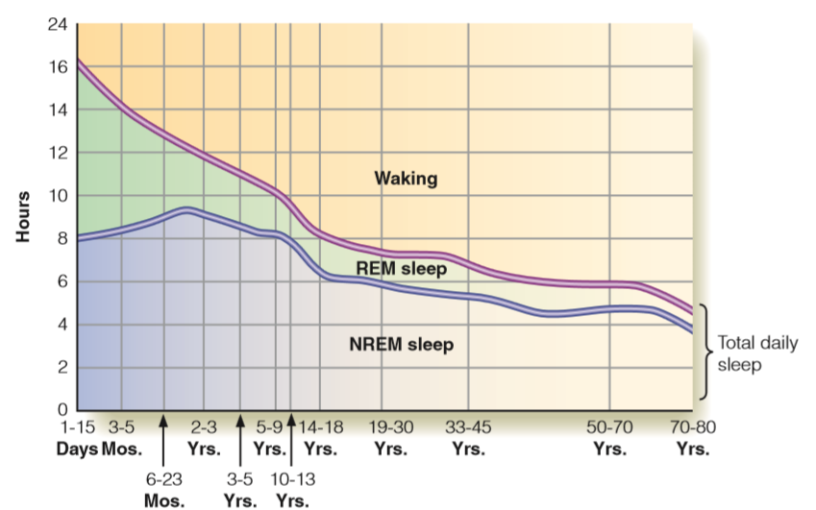
Experiencing Psychology: How Much Sleep Do We Need?
Notes:
IMAGE: [© Based on AAAS 1966] (Pastorino, Figure 4.1, p. 132): Age Differences in Sleep Needs
Sleeping and Dreaming 5 of 9
Some people brag about how little sleep they need. Yet research shows that although the amount of sleep we need varies from person to person and depends on several factors, many of us are not getting enough. Here are some sleep factors and facts:
Age. The older we get, the less sleep we need.
Babies require a lot of sleep, between 16 and 18 hours a day.
Preschoolers require less sleep, about 10–12 hours a day, typically including a midday nap.
Teenagers and young adults need less sleep than children, but they still require 8–10 hours of sleep a night.
Lifestyle (environment). Our cultural beliefs, lifestyle habits, and bedroom environment also influence the amount of sleep that we need or get
If you were raised in a home in which everyone was up early on the weekends to do chores, you adapted to a different sleep schedule than someone who slept until 10 a.m. or noon on weekends.
Genetics. Genes may play a role in the amount of sleep that each of us requires.
For example, studies that measured the sleep patterns of identical twins compared to fraternal twins found more similar sleep needs and sleep behaviors among identical twins.
Additional research also suggests that genes may influence our propensity to be either “night owls” or “early birds.”

Slide 15
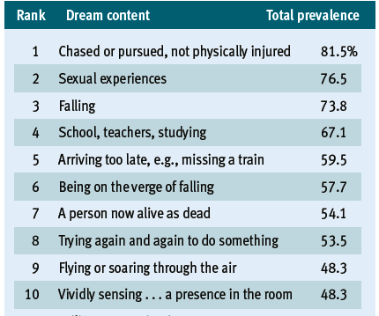
The Nature of Dreams
Notes:
IMAGE: [© Nielsen, T. A., Zadra, A. L., Simard, V., Saucier, S., Stenstrom, P., Smith, C., & Kuiken, D. (2003). The typical dreams of Canadian university students. Dreaming,
13, 211–235 [from Table 1, p. 217]. Copyright © 2003 Association for the Study of Dreams, American Psychological Association.] (Weiten, Figure 5.7 (partial), p. 156)
Sleeping and Dreaming 6 of 9
What do you dream about?
Studies of dream content find that certain themes are particularly common. The data shown here are from a study of 1181 college students in Canada (Nielsen et al., 2003). This list shows the 10 dreams most frequently reported by the students. Total prevalence refers to the percentage of students reporting each dream.

Slide 16

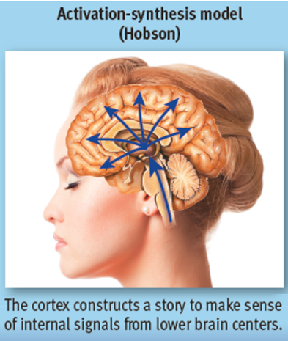
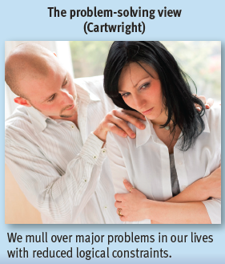
Three Theories of Dreaming
Notes:
IMAGE: [© George Allen Penton/Shutterstock, © Chris Rout /Alamy, © Anton Zabielskyi/Shutterstock] (Weiten, Figure 5.8, p. 158)
Sleeping and Dreaming 7 of 9
Dreams can be explained in a variety of ways. Three theories are shown above. Below are explanations of these and others. All of these theories are speculative
and have their critics.
Freudian theory (Sigmund Freud) is one of the most controversial and best-known theories of dreaming.
In his Interpretation of Dreams (1900/1980), Freud called dreams “the royal road to the unconscious.”
According to Freud, dreams allow us to express fears and sexual and aggressive desires without the censorship of our conscious thought processes.
Having straightforward dreams about these “unacceptable” desires would cause us anxiety. Instead, we dream in symbols that represent our unconscious desires.
For Freud, dreams contained both manifest content, which is what you recall when you awaken.
Dreams also have latent content, which is the hidden or symbolic meaning of the dream. These are often driven by unconscious conflicts.
The problem-solving view, or the continuity hypothesis (Cartwright) suggests that dreaming is a way of coping with daily problems and issues.
We dream about everyday experiences and current concerns in an effort to resolve these issues.
Memory theory suggests that dreams are a way to consolidate information and to get rid of trivial details in our memories.
From this viewpoint, dreams represent a function of memory.
The threat simulation theory (TST) suggests an evolutionary function of dreams.
TST proposes that dreaming is essentially an ancient biological defense mechanism that allows us to experience potentially threatening situations so that we can rehearse our responses to these events.
Although studies do show that childhood trauma or recurrent dreams are associated with a greater number of threatening dream events, not all of our dreams involve themes of survival.
Activation-synthesis theory (Hobson) suggests that dreaming is just a consequence of the highly aroused brain during REM sleep, when the brain shows activation of millions of random neural impulses.
The cortex of the brain attempts to create meaning out of these neural impulses by synthesizing them into familiar images or stories based on our stored memories.
These images and stories may reflect our past, our emotions, our personal perspectives, and information accessed during waking, but they have no hidden “Freudian” meaning.
However, because we are the ones who integrate these images into a plot, the storyline may provide us with insights about ourselves.

Slide 17
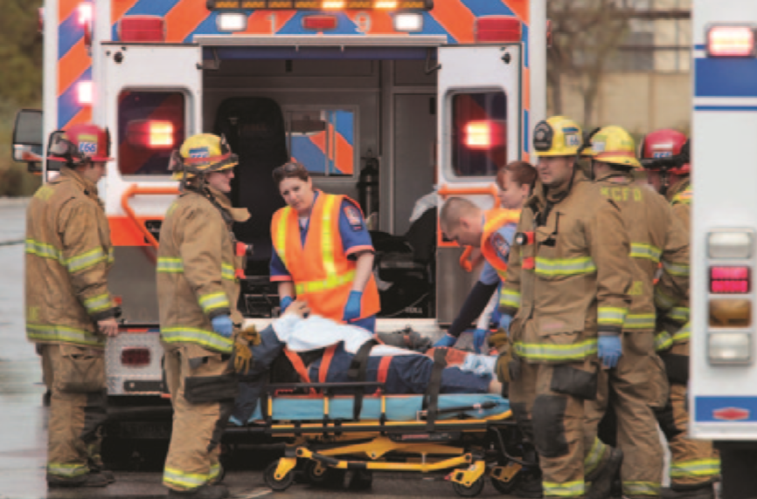
Circadian Rhythm Disturbances
Working the night shift
Jet lag and weekend lag
Notes:
IMAGE: [© ZUMA Press, Inc/Alamy] (Pastorino, p. 135): Shift work may interfere with normal sleep patterns, affecting job performance.
Sleeping and Dreaming 8 of 9
​Our body’s sleep circadian rhythm also has implications for the roughly 15% of full-time workers in the United States who do shift work.
Shift workers in general report more sleep disturbances; more hormonal irregularities (for women); more accidents, injuries, and illnesses; and decreased cognitive performance
If late-night or early-morning shifts are regular, then your body can adapt to the new rhythm.
However, if the shift hours are constantly changing, your sleep circadian rhythm is disrupted, and your sleep benefits diminish. Hence, you may be less alert, more easily distracted, and more prone to mental errors.
Many of us disrupt our sleep circadian rhythm on a weekly basis.
We attempt to maintain a routine sleep schedule on weekdays, going to bed around the same time every night so that we can get up in the morning for work or school.
Then the weekend comes, and many of us stay up later at night and “sleep in” the next morning, forcing our SCN to reset its cycle.
When Sunday night arrives we may have the best intentions—getting to bed at a decent hour so that we’ll get enough sleep to meet the demands of our Monday schedules.
But instead, we toss and turn, look at the clock, and wonder when we are going to fall asleep.
When Monday morning comes, we feel tired – we experience weekend lag.
Our sleep circadian rhythm must also be reset to adapt to the 1-hour time change that takes place in the fall and spring in most parts of the United States and in many other countries.
It must also be reset when we travel to different time zones, and we may experience jet lag as we adjust.
On average, for each hour of time change, it takes 1 day to reset our sleep circadian rhythm.

Slide 18
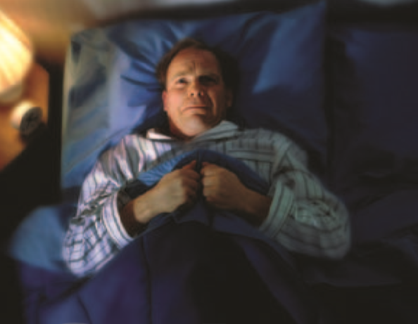
Sleep Disorders
Insomnia
Narcolepsy
Sleep apnea
Restless legs syndrome
Sleepwalking
Night terrors
Notes:
IMAGE: [© Rob Bartee/Superstock] (Plotnik, p. 176)
Sleeping and Dreaming 9 of 9
​Not everyone sleeps soundly.
An estimated 50–70 million adults in the United States experience a sleep disorder, or a disturbance in the normal pattern of sleep.
Sleep disorders also affect approximately 25% to 40% of children and adolescents.
Insomnia, the most commonly reported sleep disorder, is the inability to get to sleep and/or stay asleep.
Occasional insomnia is quite common, with more than a third of American adults reporting insomnia in the last year.
Insomnia is associated with a multitude of factors, including stress, coping with the loss of a loved one, a change in sleep schedule, obesity, chronic pain, drug abuse, anxiety, or depression.
Insomnia can be treated medically using antianxiety or sedative medications such as Xanax or Ambien, or by taking over-the-counter medications such as Sominex and Nytol that contain antihistamines and pain relievers to induce sleepiness.
However, long-term use of these drugs may lead to dependence and serious side effects, including memory loss, fatigue, and increased sleepiness.
Chronic insomnia is best treated with a combination of taking medication for a limited time, cognitive-behavioral therapy (which focuses on changing thoughts and behaviors that interfere with restful sleep), and following several sleep guidelines that have evolved from our study of how we sleep
Establish a regular sleep–wake cycle to work with your body’s natural sleep rhythm.
Avoid long naps during waking hours. Naps can disrupt your sleep circadian rhythm.
Don’t use your bed for anything other than sleeping.
If you can’t get to sleep after 15 minutes, get up and do something that you think will make you tired enough to get to sleep, such as reading (but not in your bed). Then try again to fall asleep.
Avoid sleeping pills, alcohol, cigarettes, and caffeine. These are all drugs that can interfere with your natural sleep cycle and disrupt REM sleep.
Exercise during the day can promote good sleep. However, avoid physical workouts within an hour of bedtime. Your body should be relaxed prior to sleeping.
Turn off your cell phone and computer prior to sleeping. Anticipating incoming text messages or calls, as well as the vibration or sound that occurs when a message or call is received, interrupts the natural sleep cycle and makes deep sleep less likely.
Turn off the lights. Unnecessary light exposure, from the television, cell phone, LCD clock display, or a night light affects sleep quality. It increases stage 1 sleep and decreases slow-wave or deeper sleep.
Narcolepsy, a rare sleep disorder that affects approximately 56 out of every 100,000 Americans, occurs when a person falls asleep during alert times of the day.
Narcolepsy is thought to stem from a loss of neurons in the hypothalamus of the brain.
These neurons are responsible for producing a chemical, called hypocretin, that helps to control the sleep–wake cycle.
The person with narcolepsy experiences brief periods of REM sleep that may be accompanied by muscle paralysis, a condition called cataplexy.
Narcolepsy with cataplexy occurs in roughly 25–50 of every 100,000 persons.
Sleep apnea is a disorder in which a person stops breathing while sleeping.
Estimates of sleep apnea in the general population range from 4% to 20%
In an attempt to get air, people with sleep apnea often emit loud snores or snorts that may awaken them or their partners.
This pattern may occur hundreds of times during the night. People afflicted may feel sluggish, tired, irritable, or unable to concentrate the next day because of the nighttime sleep disruption.
Obesity, being overweight, and the use of alcohol or sedatives increase one’s chances of developing sleep apnea.
Sleep apnea is a risk factor for heart failure and stroke and is highly associated with heart disease, especially for middle-aged men
Once diagnosed, sleep apnea may be treated in various ways.
If obesity is a factor, a weight-loss program is the first treatment.
In addition, a nasal mask (called a continuous positive airway pressure, or CPAP, device) that blows air into the nose to facilitate continuous breathing can be worn at night.
Wearing mouth retainers can help in some cases.
In severe cases, removing the tonsils or surgery to alter the position of the jaw can be performed.
Considerable evidence suggests a genetic basis for sleep apnea
Sleep apnea has been suggested as one cause of sudden infant death syndrome (SIDS), or “crib death,” when apparently healthy babies die while they are sleeping.
They stop breathing for reasons that are not yet understood.
SIDS affects babies at an average age of 4 months. African American and American Indian babies are at greater risk than White or Hispanic babies, and the risk is higher for males than for females.
Restless legs syndrome (RLS) is a common sleep movement disorder in which a person has unpleasant sensations in the legs and an irresistible urge to move them to relieve the pain.
Symptoms occur primarily at night.
Estimates of RLS in the general population range from 5% to 25%, although the incidence is higher in women.
The cause of RLS is unknown.
Current hypotheses focus on a genetic component, low levels of iron in the brain, and the role of the neurotransmitter dopamine, as dopamine is needed to produce smooth, muscle activity and movement.
Medications that influence dopamine functioning can lessen the discomfort and facilitate restful sleep.
Sleepwalking, or somnambulism, occurs during non-REM slow-wave sleep.
People with this disorder get up and walk around during deep sleep, sometimes performing actions that make them appear to be awake. They may cook, eat, open doors, or engage in minimal conversation. Because sleepwalkers are asleep, they may injure themselves or others.
During night terrors, people awaken in an apparent state of fear. Their heart rates and breathing are rapid, and they may scream loudly and sit up in bed, wide-eyed with terror. People rarely recall the incident in the morning .
Night terrors occur during non-REM slow-wave sleep, and an attack may last 5–20 minutes.
Although they can occur any time in one’s life, night terrors are more commonly reported in children between the ages of 4 and 12, and in older adults with various neurological and cognitive disorders such as Parkinson’s disease and elderly dementia.
In the United States, an estimated 1% to 6% of children experience night terror episodes. For adults, estimates are less than 1%.
Night terrors are different from nightmares. Nightmares are brief scary dreams that typically occur during REM sleep and are often recalled in vivid detail in the morning.

Slide 19
Psychoactive Drugs
This section covers:
  Drug dependence
  Effects and mechanisms of drugs
  Categories of drugs
Notes:
IMAGE: [© Corbis Photography/Veer] (Nevid, p. 170): Many problem drinkers use alcohol as self-medication in the attempt to wash away their problems or troubling emotions.
Psychoactive Drugs 1 of 10
This section covers altered states of consciousness, including
Drug dependence
Effects and mechanisms of drugs
Categories of drugs
Historically, human beings have gone to great lengths to obtain psychoactive drugs, or substances that alter consciousness.
Human beings may be unique among animals in their willingness to voluntarily seek alterations in consciousness through the deliberate use of psychoactive substances.
Most psychoactive substances are quite poisonous (livestock eating tobacco leaves in the field will die) and usually have the bitter taste associated with most poisons.
On the rare occasions when nonhuman animals do consume psychoactive substances (cats and catnip or elephants and alcohol), we have no way of knowing whether this consumption is motivated by a desire to alter consciousness.

Slide 20
Drug Dependence
Key principles
  Tolerance
  Withdrawal
  Addiction
  Physical dependence
  Psychological dependence
Notes:
IMAGE: [© Ingrid W./Shutterstock] (Weiten, p. 166)
Psychoactive Drugs 2 of 10
Several general principles are related to the use of drugs, including tolerance, withdrawal, and addiction.
Tolerance occurs when one of two things happen. In many cases, these outcomes go hand-in-hand.
1. The effects of a drug lessens over time, when a constant amount is taken.
2. A person must take larger quantities of a drug in order to produce the desired effects.
When some habitually used drugs are no longer available, the user might experience withdrawal, a negative feeling that occurs when a drug is discontinued.
Withdrawal often leads people to seek out the drug, in an effort to find relief from a negative state.
In many cases, the negative state is the opposite of the drug’s effect:
For instance, alcohol is a depressant that slows the nervous system. If a chronic alcohol user stops drinking, he or she may experience a rebound effect consisting of excess brain activity. In some cases, these are severe enough to produce life-threatening seizures.
Withdrawal from stimulants like caffeine can make the user sluggish and lethargic.
Although many abused drugs produce significant withdrawal, others do not.
Heroin and nicotine produce powerful withdrawal effects, but cocaine usually does not
Addiction is traditionally viewed as a physical or psychological dependence on a substance or activity.
When a person compulsively uses a drug to maintain bodily comfort, a physical dependence (addiction) exists.
Although tolerance and withdrawal are two hallmark symptoms of physical dependence on a drug, not all addictive drugs display these features.
The defining features of an addiction are the compulsive repetition of drug use or an activity and the inability to abstain from the addictive behavior in spite of serious negative consequences.
Addiction overwhelms normal control of behavior, distorts typical systems of reward, and interferes with the recognition of problems.
Psychological dependence exists when a person must continue to take a drug to satisfy intense mental and emotional cravings.

Slide 21
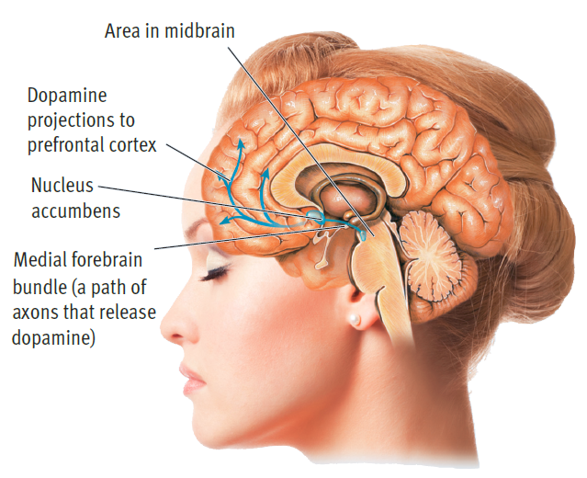
The “Reward” Pathway
Notes:
IMAGE: [© Graphic: Cengage Learning 2013; © Anton Zabielskyi/Shutterstock] Weiten, Figure 5.10, p. 166)
Psychoactive Drugs 3 of 10
The “reward pathway” in the brain consists of neural circuits.
The neural circuits shown here in blue make up the mesolimbic dopamine pathway.
Axons in this pathway run from an area in the midbrain through the medial forebrain bundle to the nucleus accumbens and on to the prefrontal cortex.
Recreational drugs affect a variety of neurotransmitter systems, but theorists believe that heightened dopamine activity in this pathway—especially the portion running from the midbrain to the nucleus accumbens—is responsible for the reinforcing effects of most abused drugs.

Slide 22
Hallucinogens
Capable of producing false perceptions
  Mushrooms
  Mescaline
  Phencyclidine (PCP)
  Marijuana
  LSD
Notes:
IMAGE: [© Ann Marie Rousseau/The Image Works] (Nevid, p. 167)
Psychoactive Drugs 4 of 10
Hallucinogens are psychoactive substances capable of producing hallucinations, or false perceptions, interfering with the normal consciousness of sensory input.
Mushrooms: Among the most ancient hallucinogens is the fly agaric mushroom, or Amanita muscaria.
Mescaline: The green peyote cactus (Lophophora williamsii) grows across much of Mexico and the southwestern United States.
This plant is a source for mescaline, which was popularized by Aldous Huxley in his book The Doors of Perception (Huxley, 1954).
Phencyclidine (PCP): Phencyclidine (PCP) was originally used as an anesthetic, primarily in veterinary medicine.
It is hard to imagine why somebody would purposely take PCP, as the effects are typically unpleasant.
In addition to experiencing vivid hallucinations, users become aggressive to the point of being physically violent, and muscular tone becomes either rigid or too flexible.
Marijuana: Cannabis, from the Cannabis sativa plant, is another drug with a long human history. It was included in the pharmacy written by Chinese Emperor Shen Neng nearly 5,000 years ago.
Marijuana, the smoked form of cannabis, remains the most commonly used illegal substance in the United States today.
The behavioral effects of cannabis are often so subtle that people may report no changes at all in response to its use.
Most individuals experience some excitation, vivid imagery, and mild euphoria. Others respond with depression and social withdrawal.
At somewhat higher doses, cannabis produces hallucinations, leading to its formal classification as a hallucinogen.
Marijuana uniquely distorts a person’s sense of time, distance, and speed, which is why people operating machinery, including automobiles, should not take it.
LSD: In 1938, a group of Swiss pharmaceutical researchers began investigating potential headache remedies. During the course of the research, one of the scientists, Albert Hoffman, reported some unusual sensations after working with one of the compounds, lysergic acid diethylamide (LSD).
Hoffman deliberately ingested some of the chemical and reported vivid, colorful visual hallucinations.

Slide 23
Stimulants
Increase alertness and mobility while decreasing reaction time
  Caffeine
  Nicotine
  Cocaine
  Amphetamines
  Methylphenidate
  MDMA (Ecstasy)
Notes:
IMAGE: [© National Library of Medicine] (Coon, p. 212)
Psychoactive Drugs 5 of 10
Stimulants impact consciousness by increasing alertness and mobility, while decreasing reaction time.
In contrast to negative attitudes toward hallucinogens, stimulant drugs have been embraced by cultures like our own where the ability to work long and hard is typically valued and rewarded.
Caffeine: Caffeine is found in a wide range of sources, including coffee, tea, cola drinks, and many over-the-counter pain relievers.
Caffeine interferes with the inhibition normally produced by adenosine in the brain.
If you keep an inhibitory substance like adenosine from doing its job, the result is increased excitation and alertness.
Nicotine: After caffeine, the most commonly used stimulant in the United States is nicotine, usually in the form of smoked or chewed tobacco.
Nicotine mimics the action of the neurotransmitter acetylcholine, increasing heart rate and blood pressure, reducing fatigue, and improving cognitive performance, while at the same time producing muscular relaxation.
Normally, when we are mentally alert, our bodies feel somewhat tense, so nicotine’s combination of relaxation with alertness is unique.
Cocaine and Amphetamine: The behavioral effects of cocaine and amphetamine are quite similar to one another, as both substances boost dopamine activity in the brain.
One primary difference between cocaine and amphetamines is their method of production:
Cocaine is extracted from the leaves of the coca plant, while amphetamines are entirely synthetic compounds.
Because of their direct effects on the dopamine reward systems of the brain, these drugs are among the most rapidly addictive substances commonly used.
At moderate doses, cocaine and amphetamine produce alertness, elevated mood, confidence, and a sense of well-being.
At higher doses, these drugs can produce symptoms that are quite similar to schizophrenia.
Users experience hallucinations, such as a feeling of bugs running on the skin, and delusional fears that others are trying to harm them.
Some users experience repetitive motor behaviors, such as chewing movements or grinding the teeth.
Cocaine was the main ingredient in many nonprescription elixirs before the turn of the twentieth century (see photo). Today, cocaine is recognized as a powerful and dangerous drug. Its high potential for abuse has damaged the lives of countless users.
Methylphenidate (Ritalin): The use of stimulant medications like methylphenidate (Ritalin) for attention problems resulted from an accidental discovery in 1937, when Charles Bradley gave stimulant drugs to a group of children with learning and behavior problems.
Children today who are diagnosed with attention deficit hyperactivity disorder (ADHD) are still very likely to take stimulant drugs.
The two most common choices are methylphenidate (Ritalin) or a combination of amphetamine salts (Adderall).
Both of these drugs boost the activity of dopamine and norepinephrine, which in turn increases users’ ability to stay alert and concentrate.
At clinical doses, these drugs do not seem to produce dependence, although they affect sleep and appetite.
MDMA (Ecstasy): MDMA (Ecstasy) is a relative of amphetamine and mescaline that increases heart rate, blood pressure, and body temperature.
MDMA increases sociability by stimulating the activity of serotonin and oxytocin, a hormone believed to participate in romantic and parental bonding.

Slide 24

Depressants
Slow down the activity of the nervous system
  Alcohol
  Barbiturates
  Benzodiazepines
Notes:
IMAGE: [© Alex Segre/Alamy] (Nevid, p. 160)
Psychoactive Drugs 6 of 10
The noisy animation at drinking parties is due to alcohol’s effect as a depressant. Small amounts of alcohol reduce inhibitions and produce feelings
of relaxation and euphoria. Larger amounts cause greater impairment of the brain until the drinker loses consciousness.
Alcohol also is not an aphrodisiac. Rather than enhancing sexual arousal, it usually impairs performance, especially
in males. As William Shakespeare observed long ago, drink “provokes the desire, but it takes away the performance.”
Depressants share the ability to slow down the activity of the nervous system, leading to reductions in alertness and anxiety.
Major substances in this category act to boost the activity of the inhibitory neurotransmitter GABA.
Because these drugs all converge on the GABA receptor, combining them often results in a fatal level of nervous system inhibition.
Alcohol is one of the earliest psychoactive drugs used by humans, dating back into our prehistory.
In addition to seeking the relaxation produced by alcohol, early humans might have turned to fermented beverages as a safety precaution against contaminated water supplies, as alcohol has natural antiseptic qualities.
Alcohol’s status as a depressant drug might seem confusing in light of its frequent use at parties. Why would anyone take a depressant to have a good time?
The answer lies in alcohol’s ability to slow down activity in the judgment areas of the cortex, reducing behavioral inhibitions.
At low doses, alcohol dilates blood vessels, giving people a warm, flushed feeling. It reduces anxiety, which makes relatively shy people more outgoing at a party.
At higher doses, alcohol’s inhibition of the higher levels of the brain leads to aggression, risky behaviors, and poor motor coordination.
At very high doses, alcohol can produce coma and death, either from suppression of breathing or aspiration of vomit.
Barbiturates are depressants that are often used as sedatives. These drugs can have powerful interactions with alcohol, potentially leading to overdose.
These days, barbiturates are mostly prescribed for anti-seizure purposes (anticonvulsants).
Barbiturates were once used very widely as anti-anxiety medications. Their popularity, however, decreased with the introduction of benzodiazepines, which have lower risk of toxicity and dependence.
Benzodiazepines are a newer class of depressants used to treat a wide range of psychological disorders, but also have the potential to create dependence and can be abused recreationally.
Some benzodiazepines (e.g. Xanax, Valium) act as muscle relaxants and can have anti-anxiety effects.
Others are used as anticonvulsants.
Still others are used to treat insomnia by inducing sleep.

Slide 25
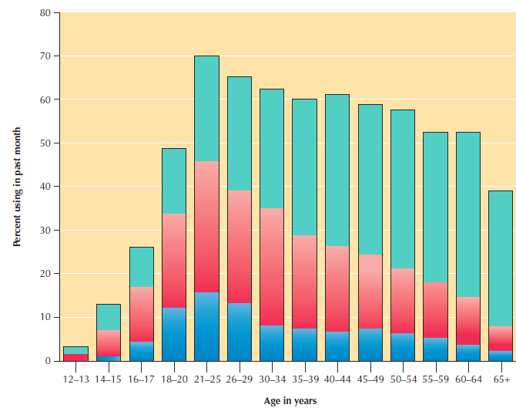

Alcohol Use and Abuse
Notes:
IMAGE: [© Cengage Learning 2013] (Coon, Figure 25.3, p. 217)
Psychoactive Drugs 7 of 10
Many Americans of all ages abuse alcohol. According to this 2010 survey, about 40 percent of young adults aged 18–29 admitted to binge drinking at least once in the month before the survey was administered (Substance Abuse and Mental Health Services Administration, 2012)
Roughly 11% of young adults had more than 5 binge episodes in the past month, which qualifies as “heavy alcohol use.”
Binge drinking and heavy alcohol use are highest among adults age 21–25, and rates gradually decline across older populations.

Slide 26

Opiates
Used to treat pain by mimicking pain-inhibiting neurotransmitters in the body such as endorphins
Notes:
IMAGE: [© Michael S. Yamashita/CORBIS]
Psychoactive Drugs 8 of 10
The photo shows an opium poppy being harvested. One of the remarkable aspects of human drug use is how much trouble people are willing to go to in order to obtain a drug. Opium poppies are not wild, but must be domesticated. The seed cases of the poppies must be scraped and the resulting sap collected. How this process was discovered remains a mystery.
The opium poppy is the source of several natural psychoactive opiates, including morphine and codeine.
Heroin can be synthesized through further processing of morphine.
These substances are effective because they imitate the action of our natural opiates, or endorphins (which is short for endogenous morphine).
Opiates have legitimate medical purposes, including pain control, cough suppression, and the control of diarrhea.
At low doses, opiates produce a sense of euphoria, pain relief, reduced anxiety, muscle relaxation, and sleep.
The higher doses characteristic of opiate abuse impact consciousness by producing a tremendous euphoria, or rush.
With even higher doses, opiates exert a strong depression on breathing, occasionally leading to death.

Slide 27
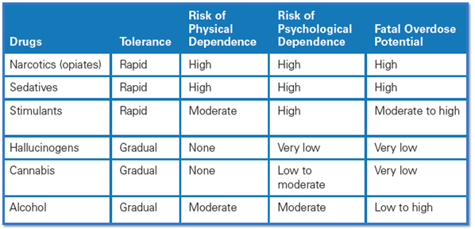
Effects and Risks of Psychoactive Drugs
Notes:
IMAGE: [© Cengage Learning 2013] (Weiten, Table 5.3 (partial), p. 165): Psychoactive Drugs: Tolerance, Dependence, Potential for Fatal Overdose, and Health Risks
Psychoactive Drugs 9 of 10
Recreational drug use can affect physical health in a variety of ways. The three principal risks are overdose, tissue damage (direct effects), and health-impairing behavior that results from drug abuse (indirect effects).
Any drug can be fatal if a person takes enough of it, but some drugs are much more dangerous than others. The table above shows estimates
of the risk of accidentally consuming a lethal overdose of each listed drug.
Drugs that are CNS depressants—sedatives, narcotics, and alcohol—carry the greatest risk of overdose. It’s important to remember that these drugs are synergistic with each other, so many overdoses involve lethal combinations of CNS depressants.
What happens when a person overdoses on these drugs? The respiratory system usually grinds to a halt, producing coma, brain damage, and death within a brief period. Fatal overdoses with CNS stimulants usually involve a heart attack, stroke, or cortical seizure. Years ago, deaths attributable to overdoses of stimulant drugs were relatively infrequent. However, cocaine overdoses have increased sharply as more people have experimented with smoking crack and using other more dangerous modes of ingestion (Repetto & Gold, 2005).

Slide 28
The Changing View of Drugs
The legal and social status of a drug can vary across cultures and over time
Notes:
IMAGE: [© Thinkstock/Gettyimages] (Bernstein, Figure 9.9, p. 314)
Psychoactive Drugs 10 of 10
The legal and social status of a drug can vary across cultures and over time (Weiss & Moore, 1990). For example, in the United States cocaine was once a respectable, commercially available drug; today it is illegal. Marijuana, once illegal throughout the United States, is now legal in some states. Meanwhile, alcohol, which is legal in the United States and many other nations, is banned in countries such as Kuwait, Iran, and Saudi Arabia.

