Slide 1
Genetics
This section covers:
  Fundamental genetic structures
  The interaction of genes and the environment
Notes:
IMAGE: [©Biophoto Associates/Photo Researchers, Inc.] (Cacioppo, p. 78):
X chromosome (left) and Y chromosome (right)
Genetics 1 of 5
This section covers:
Fundamental genetic structures
The interaction of genes and the environment

Slide 2
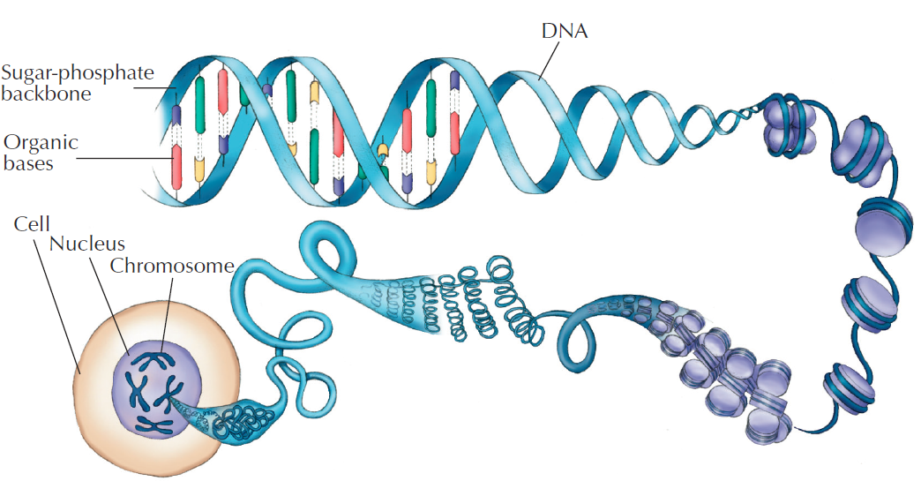
Genes, Chromosomes, and DNA
Notes:
IMAGE: Figure 12.1 DNA (Coon)
[©Cengage Learning] (Coon, Figure 12.1, p. 95)
Genetics 2 of 5
The nucleus of every human cell contains DNA (deoxyribonucleic acid).
The order of these molecules, or organic bases, acts as a code for genetic information
Human DNA is organized into 46 chromosomes
Genes are small segments of DNA that affect a particular process or personal characteristic
Genes may be dominant or recessive
A feature a dominant gene controls will appear every time the gene is present
A recessive gene must be paired with a second recessive gene before its effect will be expressed
Alleles are one of several different versions of a gene, as in having an A, B, or O blood type allele
Your personal set of instructions is known as a genotype, which interacts with the environment to produce observable characteristics known as a phenotype
Learn about the basics of genetics at https://www.youtube.com/watch?v=CBezq1fFUEA (10:17)

Slide 3
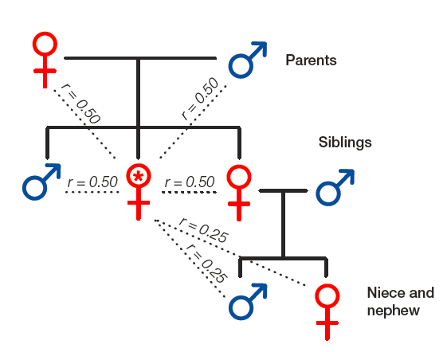
Relatedness
Notes:
IMAGE: [©Cengage Learning] (Cacioppo, Figure 3.5, p. 78)
Genetics 3 of 5
Relatedness is defined as the probability that two people share copies of the same allele from a common ancestor
Identical twins who share identical genes demonstrate the powerful influence of heredity
Even when they are reared apart, identical twins are strikingly alike in motor skills, physical development, and appearance. at the same time, twins are less alike as adults than they were as children, which shows environmental influences are at work
Fraternal twins have the same proportion of shared genes as other biological siblings
Learn about twin studies at https://www.youtube.com/watch?v=dkdPkNn1VQM (0:52)
Learn about how psychologists approach the study of genetics at https://www.youtube.com/watch?v=z-wNZmypjAM (4:13)
Find out more about twin studies at https://www.youtube.com/watch?v=bRKbZtpBcgI (4:12)

Slide 4
Gene Expression
Three-year-old twin chromosomes
50-year-old twin chromosomes
Areas of red indicate that differences between the two are related to differences in gene expression
Notes:
IMAGE: [©Mario Fraga] (Cacioppo, p. 79)
Genetics 4 of 5
Having identical genotypes, as is the case with identical twins, does not guarantee identical phenotypes, or observed characteristics
When factors other than the genotype itself produce changes in a phenotype, we say that an epigenetic change has occurred
Epigenetic change often works by influencing gene expression, the process by which the DNA forms proteins that contribute to features of living cells
Mario Fraga and his colleagues studied 160 identical twin pairs between the ages of 3 and 74. The two chromosomes on the left belong to 3-year-old twins and those on the right to a pair of 50-year-old twins. Areas of red indicate differences between the two chromosomes related to differences in gene expression. As the twins aged, their gene expression became more different, as indicated by the greater amount of red in the chromosomes from the older twins. Twins who had spent the most time apart showed the greatest epigenetic differences.
Epigenetic differences arise during the lifetime of monozygotic twins,” by Mario Fraga et al., in Proceedings of the National Academy of Sciences 2005 Jul 102 (30) 10407-8, Fig. 5. © 2005 National Academy of Sciences, U.S.A.
Listen to a TED talk about epigenetics and its role in human adaptability at https://www.youtube.com/watch?v=7hWUhEA6hxk (13:43)

Slide 5
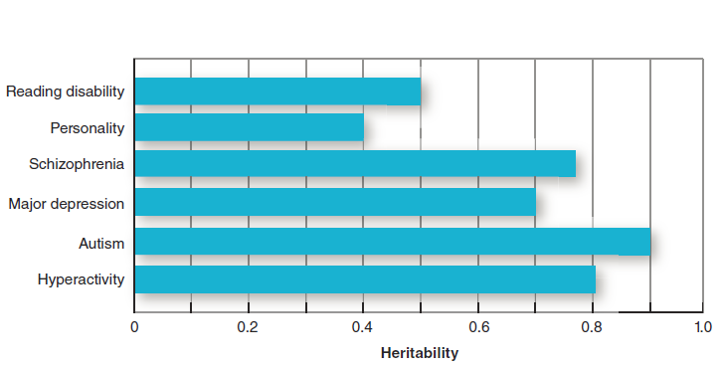
Heritability
Notes:
IMAGE: [©Cengage Learning] (Cacioppo, Figure 3.11, p. 84): Heritability of some human conditions.
Genetics 5 of 5
Behavioral geneticists often speak in terms of the heritability of a particular trait, or the statistical likelihood that variations observed across individuals in a population are due to genetics
Heritability is usually presented as a ratio of the amount of variation observed in a population due to genetics relative to the total amount of variation due to both genetic and environmental influences
Heritability always refers to populations, not to individuals
Saying that a trait such as shyness is 40% heritable does not say that 40% of one individual’s shyness is produced by genes and the other 60% by the environment.
Instead, a 0.40 heritability ratio suggests that the variations in shyness we see across the population (from very high to very low) are influenced moderately by both genetic and environmental factors
Heritability rates tell us how much of the variability seen in a population can be due to genetics. For example, according to data, we can say that genes have a greater influence on autism than on reading disabilities. Source: Adapted from McGuffin, Riley, and Plomin (2001).
Learn about the genetics of autism at https://www.youtube.com/watch?v=ywI6JdLapgA (53:07)

Slide 6

Prenatal Development
This section covers:
  Important issues in development
  Prenatal development
  Risks during prenatal development
Notes:
IMAGE: [© Eye of Science/Photo Researchers, Inc.; © K. H. Kjeldsen/ Photo Researchers, Inc.; © Dr. G. Moscoso/Photo Researchers, Inc.] (Cacioppo, Figure 11.3a, p. 404): Prenatal Development: For the first 2 weeks after conception, the developing organism is known as a zygote. Cell division continues at a very rapid pace as the zygote travels down the mother’s fallopian tube, reaching the uterus during its second week. The embryo stage lasts from week 3 through week 8 following conception.
Prenatal Development 1 of 9
This section covers:
Important issues in development
Prenatal development
Risks during prenatal development

Slide 7
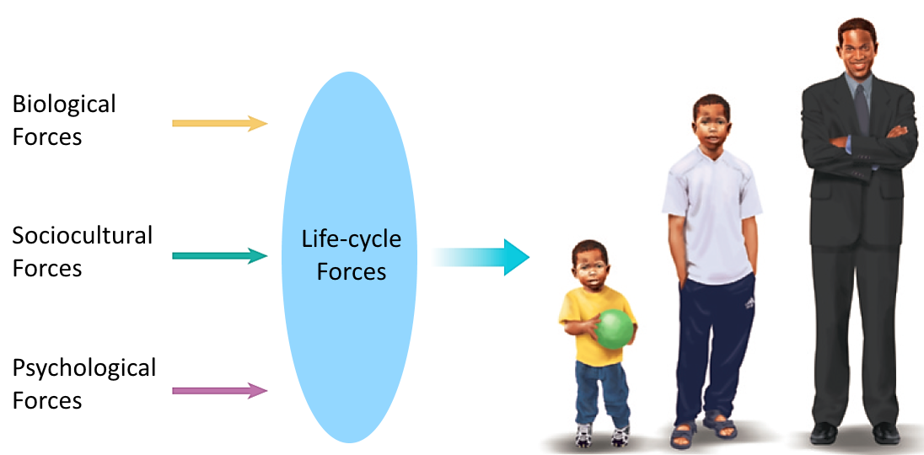
The Biopsychosocial Framework
Human development is a result of interacting forces
Notes:
IMAGE: [© Cengage Learning] (Kail/Cavanaugh 7e, Figure 1.1, p. 8): The biopsychosocial framework.
Prenatal Development 2 of 9
When trying to explain why people develop as they do, scientists usually consider four interactive forces:
• Biological forces that include all genetic and health-related factors that affect development.
• Psychological forces that include all internal perceptual, cognitive, emotional, and personality factors that affect development.
• Sociocultural forces that include interpersonal, societal, cultural, and ethnic factors that affect development.
• Life-cycle forces that reflect differences in how the same event affects people of different ages.
One useful way to organize the biological, psychological, and sociocultural forces on human development is with the biopsychosocial framework, which emphasizes that each of the forces interacts with the others to make up development.

Slide 8
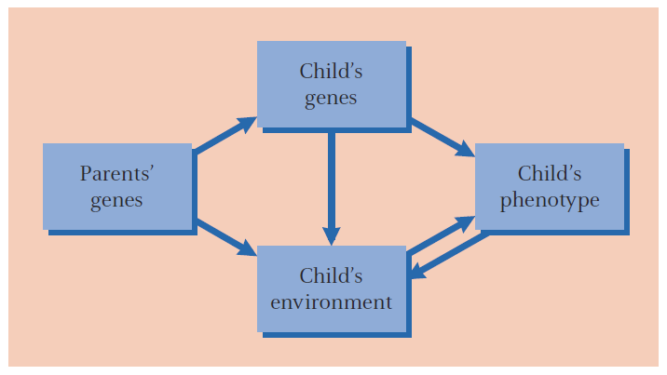
Nature and nurture
Genes can be turned on or shut off by events and items in the environment.
Notes:
IMAGE: [© Cengage Learning] (Kail/Cavanaugh, Figure 2.4, p. 50): Parents influence their children by providing genes and experiences; children’s genes and their environments work together to shape development.
Prenatal Development 3 of 9
Developmental psychology explores the normal changes in behavior that occur across the lifespan.
Three overarching issues in developmental psychology are the interaction of nature and nurture; continuity and discontinuity in development; and universal and ecological development.
Significant progress has been made in the understanding of how genes and the environment interact.
We now understand that the underlying DNA that makes up our genes is turned on or off by the surrounding chemical tags (the epigenome) that accumulate through life.
The study of this process is known as epigenetics.
Among the external environmental factors that can chemically “tag” our DNA are diet, nurture, and stress.
This epigenetic process is not constant across the life span, just as an individual’s physical, cognitive, and social and emotional behaviors change.
In prenatal development, most of the chemical tags that influence gene expression come from within the developing organism, with some external influence from the mother’s diet and her stress hormones.
After birth, internal signals continue to be important in driving physical growth, but the child is now exposed to a wider array of environmental influences, including diet, social interactions, and physical activity.
Throughout the remaining life span, epigenetic tags continue to accumulate in response to ongoing experience.
This process leads to the divergence in appearance and health seen in older identical twins that we noted in our chapter on nature and nurture.
These outcomes mean that epigenetics plays an increasingly dominant role over the life span.
Because younger children have had less time for epigenetic interactions between their genes and experience to take place, they have more in common with each other at any particular age than do older adults, whose decades of experience have caused their epigenetic paths to lead them in many different directions.
The contrast between children and adults might have led earlier psychologists to the mistaken belief that development “stopped” at some point in childhood or adolescence, when all they were seeing was a transition point where internal influences were becoming overshadowed by external ones.

Slide 9
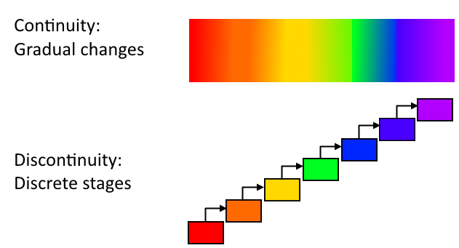
Important Issues in Development
Continuity and discontinuity
Universal and ecological
Notes:
Prenatal Development 4 of 9
Another major question asks whether development proceeds gradually and smoothly over time (continuity) or changes more abruptly from one stage to the next (discontinuity).
The gradual approach might be visualized as a rainbow, with one color (stage) gradually merging into the next, with no bold line separating the two.
In contrast, the discontinuity approach views development as a staircase to be climbed.
The behavior on one step is qualitatively different from the step that preceded it, and the change from one step to the other is abrupt.
As in the case of nature and nurture, the continuity-discontinuity debate does not have a “right answer.”
Some features appear to be more continuous in their developmental course, such as the gradual development of infant temperament into later personality.
Other features do seem to appear seemingly out of nowhere.
Psychologists taking the universal approach to development look for age-related behaviors that are found across the entire human species, whereas psychologists taking an ecological view ask questions about the impact of culture and environment on development. Which approach is correct?
Both universal and ecological approaches improve our understanding.
Although there are universals in development, such as the age at which most children begin walking unassisted, we also know that children growing up in cultures where early walking is encouraged walk at slightly younger ages than children growing up in cultures where restricting infant movement is the norm.
Although a consideration of human universals is useful, most contemporary psychologists would be unwilling to consider many behaviors outside their context of social relationships and culture.

Slide 10

Prenatal Development
Zygote, embryo, and fetus
Ectoderm, mesoderm, and endoderm
Notes:
IMAGE: [© Cengage Learning, Inc.] (Kail, Figure 2.7, p. 55): Fetal Development. During the fetal stage, from 8 to approximately 40 weeks following conception, considerable growth and maturation of organs and tissues prepare the fetus for birth. The baby-to-be becomes much larger during the period of the fetus, and its
bodily systems start to work.
Prenatal Development 5 of 9
The 9 months between conception and birth are full of growth and activity.
For the first 2 weeks following conception, the developing organism is known as a zygote.
During the second week, the zygote typically completes its journey through the mother’s fallopian tube to the uterus, where it implants in the lining.
During weeks 3 through 8 following conception, we use the term embryo, and for the remainder of the pregnancy, we use the term fetus.
The nervous system has a very high priority in human prenatal development.
During the first week following conception, the zygote differentiates into three germ layers—the ectoderm, mesoderm, and endoderm.
The ectoderm develops into nerve tissue and skin, while the mesoderm will give rise to muscle and bone.
The endoderm is the source of much of the body’s soft tissue, such as the organs of the digestive tract.
By the fourth week following conception, the nervous system has differentiated into forebrain, midbrain, hindbrain, and spinal cord.
During the seventh week, cells that will form the cerebral cortex begin a carefully orchestrated journey from the lining of the neural tube to their ultimate destinations.
By the seventh month of pregnancy, the majority of the brain’s cells have been formed
Other systems, while perhaps not as dramatic as the nervous system, also begin to differentiate and develop during the embryonic stage.
The heart, stomach, liver, and other organs are formed during this period, and the initial differentiation between male and female internal sex organs occurs.
As we transition from embryo to fetus 2 months after conception, the fetus is about 1 inch long, weighs about 1 gram (0.04 ounces), and looks decidedly human.
The remainder of the pregnancy involves continued growth and maturation of the systems that are now in place.
New neurons are born in large numbers and begin the process of forming connections with each other.
Myelination of the nervous system begins about six months following conception.
During the seventh month of the pregnancy, rapid eye movement sleep can be recorded for the first time.
Fetal REM sleep might provide the spontaneous activity necessary for the refinement of connections in the nervous system.
The fetus’s ability to hear noises outside the mother’s body is quite good during the last few months of pregnancy.
When pregnant mothers read the Dr. Seuss classic The Cat in the Hat out loud twice a day, their infants later preferred to listen to tapes of their mothers, but not others, reading this story.
This preference has obvious advantages in the attachment and bonding that occurs between mother and newborn.
We also begin learning food preferences before birth.
When pregnant women consumed carrot juice, their infants subsequently chose to eat more cereal prepared with carrot juice than did infants whose mothers did not consume any carrot juice during pregnancy.
The infants exposed prenatally to carrot juice also appeared to enjoy the carrot juice cereal more than infants who were not exposed prenatally.
Children may be born with a familiarity and preference for the safe and available foods in their environment.
Most pregnancies last about 40 weeks, and babies born between 37 and 42 weeks are considered typical, or “term,” births.
Just over 12% of babies born in the United States are born prematurely, or before 37 weeks of pregnancy and 2% are born before 32 weeks of pregnancy.
Term infants average about 7 pounds at birth, with an average length of 20 inches.
Premature infants are much smaller. At the time of her birth, one of the smallest surviving premature infants was about the size of a cell phone and weighed only about half a pound, less than a can of soda.

Slide 11
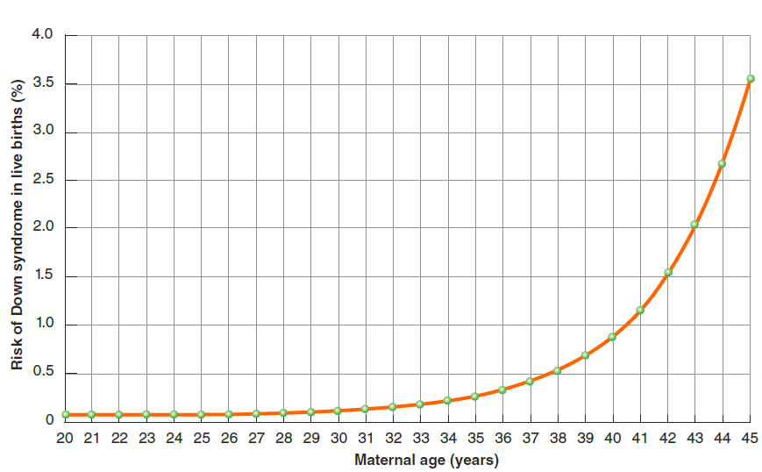
Atypical Development – Genetic Influences
Notes:
IMAGE: [© Cengage Learning 2013] (Cacioppo, Figure 11.5, p. 405): Risk of Down Syndrome and Maternal Age. Many genetic disorders, such as Down syndrome, are more common as the age of the mother increases. Errors in the final cell division forming the mother’s egg immediately prior to ovulation become more likely over time as a woman is exposed to more potentially harmful environmental influences, such as radiation.
Prenatal Development 6 of 9
In the vast majority of cases, prenatal development proceeds according to plan.
Genetic abnormalities that have adverse effects are rarely passed along in large numbers.
The more common genetic abnormalities seen in children are those that become more likely when their parents are older.
Older parents, and particularly mothers, have an increased probability of errors in the development of eggs and sperm.
A woman’s eggs are first formed when she is in her own prenatal period.
Each of these immature eggs contains a complete set of 46 chromosomes, only half of which (23) will be passed along to her child.
The child’s other 23 chromosomes will be contributed by the father through fertilization.
The final division of a woman’s immature egg into a mature ovum, leaving only 23 chromosomes, does not occur until just before ovulation.
Before they make this last crucial division, a 40-year-old woman’s eggs have been exposed to 40 years of environmental influences, possibly including harmful factors such as X-rays, which raise the probability that something will go wrong as they divide.
In contrast, it takes a little over two months for a man to produce a sperm cell, which reduces the chances of the cell’s exposure to harmful influences.
Down syndrome, or trisomy 21, results from the child’s receiving three copies of the 21st chromosome instead of the usual two, usually due to faulty cell division during the production of the mature ovum.
Down syndrome results in intellectual disability, a pattern of mild physical abnormalities, and a probable life span of only 40 to 50 years.
A woman’s chances of giving birth to a child with Down syndrome are only about 1 out of 2,000 at age 18, but rise to 1 out of 30 at age 45.
The vast majority of genetic abnormalities in an embryo will result in spontaneous abortion, or miscarriage, often before the woman has any idea she was pregnant at all.
In addition, advances in the ability to screen for genetic disorders have led to a sharp reduction in births of individuals with many genetic conditions.
Parents who are known carriers of genetic disorders might choose to use assisted reproductive technologies to screen embryos prior to implantation.
Other technologies alert parents that a fetus has a genetic disorder, providing them with the choice to terminate the pregnancy.
Approximately 30% of fetuses with Down syndrome in the United States are aborted, which is low compared to the 85% of fetuses with Down syndrome aborted in France.
These practices raise significant ethical questions about how “perfect” a fetus needs to be and emphasize the need for expert genetic counseling for parents facing such decisions.

Slide 12
Atypical Development – Teratogens
DRUG | POTENTIAL CONSEQUENCES
Alcohol | Fetal alcohol syndrome, cognitive deficits, heart damage, developmental delays
Aspirin | Deficits in intelligence, attention, and motor skills
Caffeine | Low birth weight, decreased muscle tone
Cocaine and heroin | Developmental delays, irritability in newborns
Marijuana | Low birth weight, reduced motor control
Nicotine | Developmental delays, possible cognitive impairments
Notes:
Prenatal Development 7 of 9
Any agent that can produce harmful effects in the zygote, embryo, or fetus is known as a teratogen .
Most teratogens fall into one of three categories: drugs, diseases, or environmental hazards.
A dramatic example of a teratogen was the medication thalidomide.
During the 1960s, thalidomide was prescribed to many women in Europe to prevent morning sickness.
However, the drug was associated with frequent fetal abnormalities of the arms and legs, so it was not approved for use in the United States.
Because even the most safe and routine substances are capable of acting as teratogens, pregnant women are well advised to consult with health care providers before taking any type of medication.
Here are some key points about teratogens.
1. The impact of a teratogen depends on the genotype of the organism.
2. The impact of teratogens changes over the course of prenatal development. The
3. The impact of teratogens depends on the dose.
4. Damage from teratogens is not always evident at birth but may appear later in life.
Recreational drugs consumed by the mother are the most common and preventable sources of adverse effects in the developing fetus.
In spite of widely publicized medical advice about the necessity of abstaining from recreational drugs during pregnancy, significant numbers of women are unable or unwilling to do so.
Infants born to women who use tobacco are at risk for premature birth and being underweight, circumstances that are major risk factors for numerous physical and psychological problems later on in the child’s life.
A pregnant woman can be exposed to viruses that can trigger conditions that occur immediately or later in the child’s life.

Slide 13
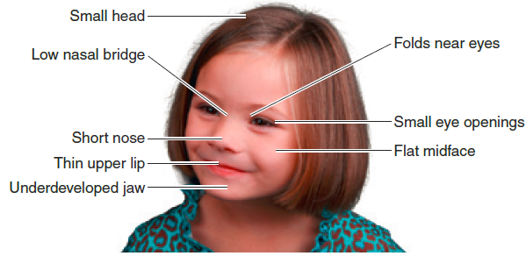
Teratogens: Fetal Alcohol Syndrome (FAS)
Notes:
IMAGE: [Child: ©Rick’s Photography/Shutterstock; Brains©Rick’s Photography/Shutterstock, and Courtesy of Dr. Sterling K. Clarren] (Cacioppo, Figure 11.7, p. 407): Fetal Alcohol Syndrome (FAS). No known amount of alcohol consumption is considered safe during pregnancy, yet about 8% of pregnant women in the United States drinks some alcohol and about 1.4% binge drinks (has five or more drinks at one time; CDC, 2012). Drinking during pregnancy can result in FAS, which produces (a) characteristic facial features, (b) reduced brain volume, and attentional and other behavioral problems in children.
Prenatal Development 8 of 9
There are no known safe levels of alcohol consumption for pregnant women. Most physicians readily agree that the only safe amount of alcohol during pregnancy is ZERO.
You might be thinking, “My mother drank when she was pregnant with me, and I’m okay,” but until we have more information, it is just not worth the risk.
The intricate programming of nervous system development in the fetus appears to be especially vulnerable to interruption by alcohol consumed by the mother during pregnancy.
Alcohol consumption by a pregnant woman can result in a condition known as fetal alcohol syndrome (FAS).
FAS produces a number of physical abnormalities, including growth retardation, skin folds at the corners of the eyes, nose and mouth abnormalities, and small head circumference, as well as cognitive and behavioral problems, including reduced IQ, attention problems, and poor impulse control.
Mothers who drink alcohol during pregnancy are often malnourished and have other health problems that indirectly affect their developing fetus.
They are more likely to smoke or use other psychoactive drugs, which produce their own sets of problems for the fetus.
A mother’s use of alcohol, tobacco, marijuana, or cocaine during pregnancy significantly reduces the volume of gray matter of her child’s brain, but combinations of two or more of these drugs produce even more dramatic reductions.
Gray matter refers to areas populated by neural cell bodies, and the thickness of cortical gray matter is correlated with measures of intelligence.
These are not short-term effects, as children exposed prenatally to multiple drugs show reduced gray matter thickness and head circumference at 10 to 13 years of age.

Slide 14
Infant Mortality
Notes:
Prenatal Development 9 of 9
Infant mortality refers to the number of infants out of 1,000 births who die before their first birthday
The graph depicts infant mortality rates for 12 developed nations as well as for 8 of the least developed countries. Not surprisingly, risks to infants are far greater—about 20 times, on average—in the least developed nations compared with developed nations (Central Intelligence Agency, 2013). In fact, the differences are so great that the graphs for the two groups of nations are usually drawn on different scales. When collapsed into a single graph, it can be difficult to see differences among the developed countries.
If you’re an American, you may be surprised to see that the United States ranks near the bottom of the list of developed nations. The difference is small, but if the United States were to reduce its infant mortality rate to the 4% that’s common in European countries, this would mean that 8,000 American babies who now die annually before their first birthday would live.
Key factors include low birth weight (particularly in the U.S.), inadequate or no prenatal care, inadequate prenatal care, inadequate nutrition for mother and infant, and disease. However, with improved prenatal care and improved health care and nutrition for infants, the global infant mortality has been cut in half since 1990 (UNICEF, 2007). With continued improvements in such care, the main challenges for infants worldwide will be walking, talking, and bonding with parents—not sheer survival.

Slide 15

Infancy and Childhood
This section covers infancy and early childhood in terms of:
  Behavior
  Physical development
  Cognitive development
  Social and emotional development
Notes:
IMAGE: [© Robin Moore/National Geographic Stock] (Cacioppo, p. 414): Kenyan parents often encourage early walking in their children. Compared to American children, whose average age of walking unassisted is about one year, Kenyan children observed by Super (1976) walked between the ages of 7 and 11 months. In contrast, practices such as swaddling young infants are associated with slightly later attainment of motor milestones.
Infancy and Childhood 1 of 17
This section covers:
Infant behavior
Physical development
Cognitive development
Social and emotional development

Slide 16

Infant Behavior
Activity
Sensory function
Notes:
IMAGE: [© Tony Wear/Shutterstock] (Cacioppo, p. 408): Newborn babies will grasp anything placed in their hand, including a parent’s finger.
Infancy and Childhood 2 of 17
According to medical definitions, the “newborn” stage of life begins officially at birth and lasts for 28 days.
Newborns spend up to 16 to 18 hours per day sleeping.
A large proportion of this time is spent in REM sleep, which might participate in the wiring of the newborn’s brain.
During times of wakefulness, the baby alternates between periods of alert looking about and periods of physical movement of the arms and legs.
Unfortunately for parents, most newborns also spend about two to three hours per day either crying or being close to tears.
As upsetting as this crying may be, it represents the infant’s first efforts at communicating with the parents.
Babies generally cry for a reason, such as hunger or pain, and most parents are stimulated by the crying to find ways to make their infant more comfortable.
Newborns have significant, although immature, sensory capacities.
Because babies obviously can’t talk, researchers have had to be fairly creative in assessing their sensory capacities.
Measures of heart rate, facial expression, and head movements may correlate with distinctions between stimuli.
Researchers also take advantage of habituation, the type of learning in which we reduce responding to repeated stimuli.
Because of habituation, babies will gaze longer at a new stimulus than at one they have seen previously.
When the baby spends equal time looking at two stimuli, we can assume he or she cannot tell the difference between them.
Newborns show considerable sensitivity to smells and respond differently to pleasant smells (chocolate, honey) than to unpleasant smells (rotten eggs).
They are also capable of recognizing their mother by smell, which has obvious survival advantages.
Babies even recognize their mother’s favorite brand of perfume.
Infants are quite sensitive to taste and can respond differentially to the major taste qualities of sweet, sour, bitter, and salty.
They apparently have a sweet tooth and will nurse longer when their breast-feeding mother has consumed sweet-tasting foods.
The fetus can hear quite well beginning in the seventh month of pregnancy, but improvement in hearing continues after birth.
We might tiptoe around a sleeping newborn, but older children and adults have superior hearing for very quiet sounds.
The infant’s ability to hear is best for sounds found in the range of frequencies that normally occur in human speech.
This ability allows infants to begin the process of learning language.
Infant vision can be tested by measuring the amount of time the child spends viewing a pattern rather than a uniform screen.
Using this technique, we can demonstrate that young infants do not see detail at a distance as well as adults do.
In addition, infants need more contrast than adults in order to see well.
These features of infant vision probably explain babies’ preference for large, high-contrast, colorful objects.
Newborns demonstrate an innate preference for looking at faces.
This capacity has obvious advantages in social behavior and language learning.
We know that infants who refuse to make eye contact often develop social and language impairments later on.
An early preference for viewing faces is not unique to humans, suggesting that this behavior provides an adaptive advantage.
Other primates show similar preferences for faces, which may be related to the importance of social relationships in primate species, including our own.

Slide 17
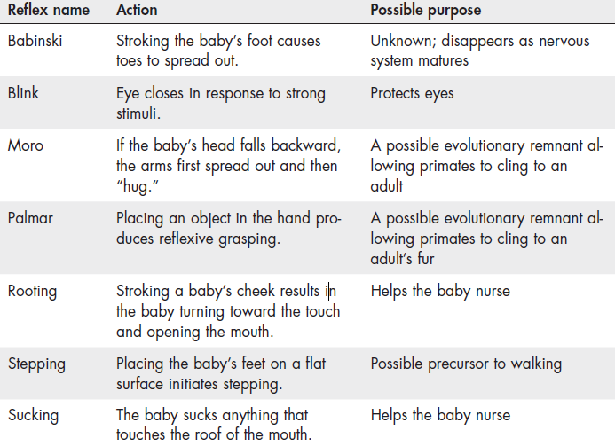
Infant Reflexes
Notes:
IMAGE: [© Cengage Learning 2013] (Cacioppo, Table 11.2, p. 409)
Infancy and Childhood 3 of 17
Newborns have a number of reflexive behaviors that begin to operate immediately.
A baby immediately turns its head to the source of a touch, opens its mouth, and searches for the mother’s nipple.
This rooting reflex obviously assists the newborn with the essential process of feeding.
If an object is placed in the baby’s mouth, it begins to suck reflexively, which also leads to effective feeding.
Other reflexes form the basis for the later development of more sophisticated behaviors.
Very young babies will reflexively grasp any object placed in the hand, which leads to the later voluntary grasping of objects.
If you hold a newborn upright with his or her feet touching a surface, the baby will show a stepping reflex, which possibly serves as a basis for much later walking.

Slide 18
Physical Development in Infancy and Childhood
Notes:
IMAGE: [© Cengage Learning] (Kail/Cavanaugh, Figure 3.3, p. 89): Physical Growth Is Very Rapid in Childhood. Infants grow very rapidly, tripling their birth weight during the first year alone. As they grow, their proportions also change significantly. The newborn’s head takes up approximately one quarter of his or her height, whereas the adult’s head is about one seventh to one eighth of his or her height. In contrast, the ratio of the trunk to overall height remains the same over the life span at about three eighths.
Infancy and Childhood 4 of 17
In the latter months of pregnancy and for the first 18 months of life, the human brain shows rapid growth in gray matter, or collections of neural cell bodies.
Following this burst of brain growth, cells and connections that are not useful are systematically deleted.
In other words, we produce more neurons and synapses than we will eventually need, then keep only those that are working well for us.
What does it mean to have neurons and synapses that are working well?
The nervous system develops according to a “use it or lose it” principle, which emphasizes the important role of experience in wiring the brain.
Children who are raised in a stimulating and enriched environment, with many things to explore, are likely to have the best outcomes.
Children living in intellectually impoverished circumstances may retain too few connections, which may lead to mild forms of intellectual disability.
Myelination, the growth in white matter that begins about six months after conception, continues to develop at a fairly regular rate throughout childhood and adolescence.
An interesting spurt in myelination occurs between the ages of 6 and 13 years in parts of the brain associated with language and spatial relations.
The rather sudden end of this white matter growth coincides with the ending of a sensitive period for language development.
Bilingual individuals who learn language after the age of 10 or so process their second languages differently than native language speakers.
Unfortunately, most students in the United States begin foreign language study after this age.

Slide 19
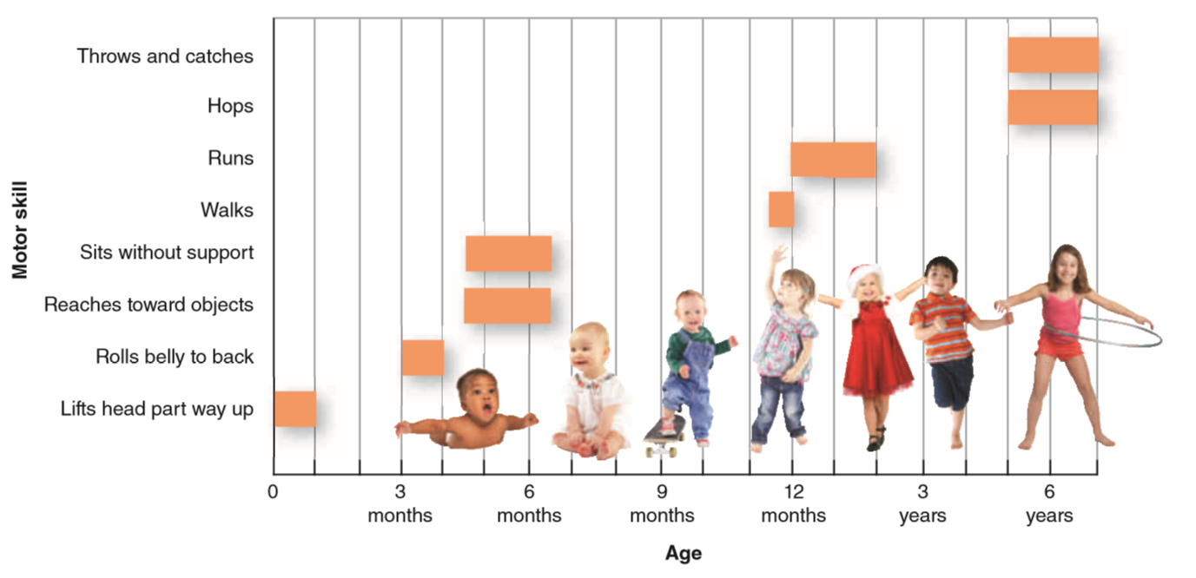
Motor Milestones in Infancy and Childhood
Notes:
IMAGE: [© Illustration: © Cengage Learning 2013; photos, left to right: © Flashon Studio/Shutterstock; © NADKI/Shutterstock; © Max Topchii/Shutterstock; © Tom Viggars/Shutterstock; © Nadia Virronen/Shutterstock; © Jaimie Duplass/Shutterstock; © Andre Blais/Shutterstock] (Cacioppo, Figure 11.13, p. 414): Motor Milestones. These motor milestones emerge at predictable times over the course of childhood, but can range significantly from child to child. The ages in this chart represent the average time at which children reach a milestone.
Infancy and Childhood 5 of 17
Newborn human infants are relatively helpless compared to their chimpanzee and gorilla counterparts.
The newborn human’s mobility is handicapped by her proportions.
One quarter of her length is made up by her head.
In contrast, adults’ heads make up approximately one seventh to one eighth of their height.
Motor development, or change in the individual’s ability to move and perform physical skills, is largely driven by our human genetic blueprint.
Identical twins typically reach motor milestones such as walking with more similar timing than fraternal twins or non-twin siblings.
Because identical twins share more genes in common than fraternal twins, reaching milestones at the same time indicates an important role for genetics in early motor development.
Motor development in childhood proceeds simultaneously in two directions. First, we see development in the head-to-toe direction.
Controlling the muscles of the neck and shoulders allows the 2-month-old infant to raise his or her head to look around.
This achievement is followed by development of the muscles of the torso at about 3 months of age, which are necessary for rolling and sitting.
Between 6 and 9 months, the baby begins to crawl, although some happily skip this stage.
Finally, around the first birthday, the muscles of the legs are developed sufficiently to support the weight of the child when standing or walking.
Well into middle childhood, children continue to improve their movement and coordination, demonstrated by the abilities to skip rope, hop on one foot, and combine movements, such as throwing a ball while running
The second direction of motor development begins at the midline, an imaginary line dividing our bodies in equal halves, and proceeds outward.
Infants can bat at toys suspended above their cribs (3 months) before they are able to grasp any objects (5 months).
In other words, accurately directing the arms precedes the ability to direct the hands and fingers.
Incidentally, infants learn to grasp objects before they learn to release them, a fact parents may wish to consider before wearing long hair or dangling earrings.
Well into elementary school, children are continuing to master control over the fine muscle movements of the hands and fingers required for writing.
Perhaps you recall the rather large-lined paper you used in first grade and the challenges of coloring “within the lines.”
Females enjoy a slight advantage in developing fine motor skills.
In contrast, boys enter kindergarten with significantly more muscle mass than girls of the same age and often prefer large-scale movements such as running, climbing, and jumping
We can predict with some certainty the average age at which each motor milestone will be reached.
However, we must be cautious when measuring the progress of any one child against the average age. Around these average ages is a wide range of normal development.
Although the majority of children might walk unassisted around their first birthday, some children walk as early as 9 or 10 months of age, while still others do not take their first steps alone until about 18 months of age.
Although early motor milestones are driven largely by biology, they do respond to experience.
It is possible to slow down motor milestones by restricting movement.
Some cultures, out of safety concerns, restrict the movement opportunities of young children, which slightly delays motor milestones such as walking alone.
In other cases, motor milestones may be reached slightly earlier by providing specific practice in sitting, standing, and walking.
These changes in the developmental timeline are usually slight, because myelination of motor nerves usually just precedes the achievement of a new skill.
Once the relevant parts of the nervous system are sufficiently mature, new skills develop rapidly with little practice.

Slide 20
Cognitive Development: Piaget and the Discontinuity Approach
Schemas
Assimilation and accommodation
Notes:
IMAGE: [© KimPinPhotography/Shutterstock.com ] (Kail/Cavanaugh, p. 120): This baby will learn that many objects can be grasped easily with one hand—illustrating
heavier objects can be grasped only with two hands—illustrating accommodation.
Infancy and Childhood 6 of 17
Interacting with brain development and the child’s ability to move and explore the environment are changes in the way children process information and solve problems.
Even when children are exposed to the same information as adults, their thinking often leads them to very different conclusions.
One of the classic theories about the development of cognition was proposed by Swiss psychologist Jean Piaget.
While working with Théodore Simon, who along with Alfred Binet developed some of the first intelligence tests, Piaget became more interested in the errors made by the children rather than their correct responses.
He believed that these errors were representative of growth in the child’s ability to reason.
According to Piaget’s theory, cognitive abilities develop through regular stages, making Piaget’s work a classic example of the discontinuity approach.
Cognition matures as the child increasingly uses concepts and organizing schemas to think.
Two types of adjustments can be made to a schema, depending on the nature of any discrepancies between new information and the existing category.
Assume that a child has a rather well-developed schema for birds, which includes features such as “has wings,” “has feathers,” and “can fly.”
If the child then learns about a new species of bird, such as a hawk, the child can assimilate the new information into the existing bird schema.
Hawks definitely have wings and feathers and the ability to fly.
In assimilation, no changes to the existing schema are required in order to add the new instance.
However, let’s now assume that the child meets a kiwi, a small, flightless bird from New Zealand.
The kiwi doesn’t fit neatly at all into the existing schema, which assumes that all birds can fly.
The schema must be adapted to fit the new information, a process Piaget referred to as accommodation.
Through accommodation, the child now understands that although most birds can fly, some exceptions occur.

Slide 21
Cognitive Development: Piaget’s Stages
Sensorimotor stage (Birth–2)
  Object permanence
Preoperational stage (ages 2–6)
  Egocentrism
  Conservation
  Animism
Notes:
IMAGE: [© Lew Merrim/Science Source] (Cacioppo, p. 417): Preoperational children are unlikely to recognize that pouring liquid from one glass to another of a different size and shape does not change the amount of liquid. They usually believe that the glass that is “higher” holds more. The abruptness with which children master conservation tasks led Jean Piaget to suggest that cognitive development proceeds in stages, but other psychologists believe changes occur more gradually.
Infancy and Childhood 7 of 17
Piaget’s first stage, the sensorimotor stage, begins at birth and lasts until the child’s second birthday.
The name of this stage reflects the infant’s existence in the here and now.
The child at the sensorimotor stage does not think extensively in terms of past and future.
Sensations immediately evoke motor responses.
As soon as they can crawl, infants work their way (usually quite rapidly) through the environment, exploring new objects by interacting with them physically, particularly by putting them in their mouths.
Infants do not seem particularly deterred by features such as taste and are very likely to sample the drain cleaner under the sink unless parents take appropriate precautions to “baby- proof” their homes.
One of the major milestones that occur during the sensorimotor stage is the achievement of object permanence.
Infants under the age of 8 months or so do not seem to be able to form clear memories, or mental representations, for objects once they are removed from the immediate present.
Piaget carried a rather beautiful gold pocket watch, which of course was quite attractive to young children.
If Piaget covered the watch with his beret while an infant watched, the infant would not show any signs of searching for the now missing watch.
Around the age of 8 months or so, infants become more persistent. If you hide the pocket watch now, they will look for it.
Object permanence coincides with achieving sufficient growth in the prefrontal cortex.
During the sensorimotor period, the child’s language abilities are developing rapidly.
By the age of 17 months, children usually have a working vocabulary of 10 to 50 words, and by the age of 2 years, they are beginning to combine words into short but meaningful sentences, such as “Want cookie” or “Go bye-bye”.
These new ways of thinking symbolically lead the child into the subsequent preoperational stage.
Piaget’s preoperational stage lasts from approximately age 2 to age 6, or the child’s preschool years.
While significant advances in cognitive and language abilities occur during this stage, thinking is still relatively immature.
The stage gets its name from the notion that children are still incapable of engaging in internal mental operations or manipulations, such as following the transformation of objects from one form to another.
Preoperational children have limited abilities to understand points of view other than their own, a characteristic described by Piaget as egocentrism.
In one experiment, children were seated in front of a 3-D model of mountains. A doll was placed at different locations and children were asked to choose a photograph that matched the doll’s perspective.
Children who showed egocentrism often chose the scene depicting their own perspective, regardless of where the doll was positioned.
This can help explain why young children often behave in ways that are selfish. For instance, if a 4-year-old wants to play a certain game, she may have trouble understanding that other children want to play something else. The child doesn’t realize that other people have different perspectives.
Conservation tasks require the child to recognize that changing the form or appearance of an object does not change its quantity.
Children often don’t realize that the tall, skinny beaker holds the same amount of liquid as the short, wide one. Children often display centration, where they focus on only one aspect of a problem and fail to consider additional information.
In the beaker example, children focus exclusively on height.
One observation that led Piaget to adopt a stage model of cognitive development is the abrupt way in which conservation tasks are often solved.
Children who could not solve the problem a few weeks earlier suddenly look at the adult experimenter with pity, as if to say, “This may be the world’s stupidest grown-up.”
Animism is a tendency to believe that all things are living. This is can be seen when children ask about the actions, feelings, or motivations of inanimate objects.
For instance, consider the following exchange:
Child: “How come the wind is mad at me?”
Parent: ”Why do you think the wind is mad?”
Child: “Because it keeps knocking over my blocks. I’m trying to build a tower and the wind keeps knocking it down, so it must be mad at me.”
Preoperational thinking is also limited by beliefs that appearances are real.
While older children understand that movies feature real people dressed up and acting like superheroes, the younger child might believe that not only is the superhero real, but he can really fly.

Slide 22
Cognitive Development: Piaget’s Stages (cont’d.)
Concrete operations (ages 6–12)
Formal operations (after age 12)
Notes:
IMAGE: [© Lawrence Migdale/Science Source] (Cacioppo, p. 418): One of Piaget’s legacies to early childhood education is his emphasis on hands-on learning. Colorful objects, or “manipulatives,” have replaced endless worksheets used to teach math concepts such as sorting to older generations of students.
Infancy and Childhood 8 of 17
Piaget referred to the stage between the ages of 6 and 12 as the concrete operational stage.
Rather suddenly, problems of conservation are easily solved, and thinking becomes more logical.
The only remaining limitation is an inability to handle abstract concepts, which will not be resolved until the next and final stage.
Piaget used the term concrete operations for this stage because he observed that children reasoned best when allowed to engage in “hands-on” learning.
This observation of Piaget’s has had an enormous impact on the way early childhood education is conducted in many nations.
Endless paper-and-pencil worksheets requiring students to regurgitate math facts have given way to colorful boxes of manipulatives, which allow children to count and sort real things.
Children’s museums, petting zoos, interactive websites, and other opportunities for experiential learning have become commonplace.
For Piaget, cognitive development matures in the formal operational stage, which begins around the age of 12.
The final piece to be added to the child’s cognitive skill set is the ability to handle abstract concepts.
Abstract concepts usually involve “what if” types of questions and form the heart of scientific inquiry.
If you were to ask a group of sixth graders what would happen if everyone on earth became blind tomorrow, they would likely struggle to come up with a reasonable answer.
A group of high school students, however, would readily reply that people who were already blind would become instant leaders, as they would have existing skills for coping with blindness.
Accompanying the ability to think abstractly is a big improvement in problem solving.
Younger children tend to approach problems by trying things out and seeing what happens, a rather inefficient trial-and-error approach.
Teens are more likely to think through several alternatives in a more systematic manner.

Slide 23
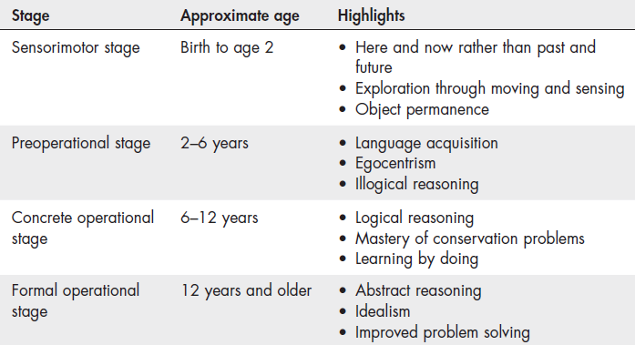
Cognitive Development: Piaget’s Stages – Summary
Notes:
IMAGE: [© Cengage Learning 2013] (Cacioppo, Table 11.3, p. 416)
Infancy and Childhood 9 of 17
Piaget’s classic theories set the standard for his time, but more contemporary developmental psychologists argue that some aspects of his view of cognitive development need updating and revising.
Psychologists point out that individual cognitive development can be quite variable.
Some adults fail to achieve the ability to reason abstractly, or do so only on some problems and not others. This variability makes cognitive development look much more gradual and continuous than stage-like as suggested by Piaget.
Piaget did not specify any mechanisms responsible for moving from one stage to the next.
Today, using brain imaging methods, we can explain some of these changes, such as the achievement of object permanence and frontal lobe development.
Other transitions, such as the relatively sudden mastery of conservation problems, are not so easily explained.
Many psychologists believe that Piaget underestimated the capabilities of young children.
At the same time, he might have overestimated the cognitive abilities of adolescents.
The human brain is not fully mature until a person’s early 20s, so we would not expect fully adult cognition in an adolescent.
For example, adolescents perceive risk as well as adults do, but unlike adults, adolescents are likely to be enticed by a large reward into selecting a very risky alternative.
Finally, Piaget has been criticized for viewing the developing child in relative isolation from his or her family, community, and culture.
These criticisms, while valid, shouldn’t take away from what Piaget got right. On the whole, his theory serves as a useful description of how thinking advances through the childhood and adolescence.

Slide 24
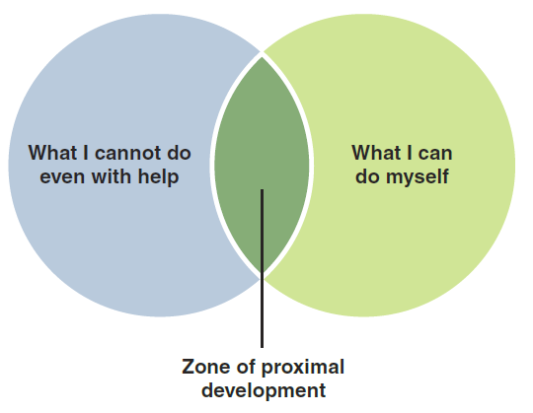
Cognitive Development: Vygotsky’s Theory
Notes:
IMAGE: [© Cengage Learning (Cacioppo, Figure 11.14 Chart, p. 419); © John Birdsall /The Image Works, (Kail/Cavanaugh, p. 139)]: Vygotsky’s Zone of Proximal Development. Young children can often accomplish far more with some adult guidance than they can accomplish alone; Vygotsky referred to this difference as the zone of proximal development.
Infancy and Childhood 10 of 17
An alternative to Piaget’s approach was proposed by Soviet psychologist Lev Vygotsky (1896–1934).
Piaget and Vygotsky illustrate the theme of universal versus ecological development.
Unlike Piaget, whose interest viewed human development as universal across cultures, Vygotsky stressed the role of culture and cultural differences in the development of the child.
For Vygotsky, cultures teach children not only what to think but how to think.
Piaget’s developing individual learns to understand the world by actively exploring it, like a miniature scientist, whereas Vygotsky’s individual gains knowledge of the world by interacting socially and collaboratively with parents, teachers, and other members of the community .
Language was a particularly important aspect of cognitive development for Vygotsky.
Children first use language to initiate social contact and opportunities to learn.
Later, self-directed talk, such as “I need to finish my game before dinner,” aids in problem-solving and, in the older child, forms inner speech.
According to Vygotsky, because cognition is so intimately tied to our social interactions, culture has a profound influence on our mental processing.
The language, measurement systems, rituals, beliefs, and technology of a culture both limit and support certain ways of thinking.
For instance, if your language does not have a word to capture an idea or expression, it is difficult to imagine or understand that concept.
Similarly, children who have the opportunity to read books, use the Internet, travel, and attend cultural events will be more capable of conceptualizing ideas than will children without such tools.
According to Vygotsky, cognitive development does not occur in fixed stages as Piaget theorized.
Rather, cognitive development may proceed in any number of directions, depending on our culture, social interactions with others, and the environment we live in.
Representing concepts is not achieved simply by having these tools.
Conceptual thinking is taught to children by parents, teachers, siblings, coaches, and other important people in their lives.
This instruction is most helpful when it is within a child’s zone of proximal development (ZPD)—the gap between what a child can already do and what he or she is not yet capable of doing without help.
Through collaborative interaction, the adult initially guides and supports the child’s efforts to master a task.
The less able a child is to do a task, the more direction and guidance an adult must give.
The adult then gradually minimizes the guidance and support until the child can do the task alone, in a process called scaffolding.

Slide 25
Other Approaches to Cognitive Development
Information processing
Naïve theories
Theory of mind
Notes:
IMAGE: [© iStockphoto.com/BanksPhoto] (Kail/Cavanaugh,, p. 128). Toddlers distinguish animate objects, such as goats, from inanimate objects, such as furniture and tools.
Infancy and Childhood 11 of 17
Naïve theories :
Contemporary developmental psychologists believe that Piaget’s assertion was wrong.
Instead, very young children seem to understand a great deal about objects and how they work, even before they have had much experience interacting with them.
By the preschool years, children’s naïve theories of biology have come to include many of the specific properties associated with living things, such as movement and growth. A fundamental part of young children’s theory of living things is a commitment to teleological explanations: Children believe that livings things and parts of living things exist for a purpose. Young children’s theories of living things are also rooted in essentialism: Children believe that all living things have an essence that can’t be seen but gives a living thing its identity.
An information processing model of cognitive development provides important extensions to Piaget’s theory.
The overall rate of processing information, analogous to your computer’s CPU speed, increases during childhood.
In tasks that require judgment, such as deciding which of two numbers is larger, adults are three times faster than 4- and 5-year-olds and twice as fast as 8- and 9-year-olds.
Surprisingly, by the time children enter elementary school, their performance on tasks requiring focused attention and disregard of distracters reaches adult levels.
In contrast, the ability to sustain attention over time remains very limited until the age of 11 years.
Around this age, attention span begins to lengthen significantly each year until adulthood.
Children’s memory abilities change dramatically following their second year of life.
These changes are likely due to maturation of brain structures related to memory.
The amygdala and most of the hippocampus are relatively mature at a very early age, around 6 months, but changes in the frontal lobe and hippocampus during the third year of life allow children to form more long-term memories, particularly for sequences of events.
Improved memory and a growing sense of self combine to produce some of the first autobiographical memories between the ages of 3 and 5 years
Piaget used the concept of egocentrism to describe the young child’s relative lack of awareness of the viewpoints of others.
An elaboration of this concept, theory of mind (TOM), has emerged as an important tool in tracking typical and abnormal development.
Theory of mind occurs when a person understands that others have beliefs, desires, and intentions that are different from his or her own
The classic procedure for demonstrating TOM is the false belief task, often referred to as the “Sally–Anne” task.
Imagine that one doll, Sally, places her ball in a basket and then leaves the room.
Another doll, Anne, enters the room, moves the ball from the basket to a box, and then leaves.
If Sally comes back, where will she look for her ball?
Children who have developed a theory of mind understand that their personal knowledge of where the ball is located is different than the knowledge of Sally, who was absent when the ball was moved.
They will correctly decide that Sally will look in the basket.
Some researchers have suggested that the social difficulties associated with autism spectrum disorder can be explained by an absence of theory of mind.
Specifically, individuals with this condition may have trouble understanding the emotions and motivations of others. They may also fail to appreciate the social rules that underlie many interactions.

Slide 26

Gender
Gender roles
Gender permanence
Gender schema
Notes:
IMAGE: [© Fuse/Getty Images] (Pastorino, p. 382): Parents’ interactions with their children influence their developing schemas of gender roles
Infancy and Childhood 12 of 17
As children get older, they start to notice that males and females can be different from one another. When psychologists discuss issues related to males and females, they often make a distinction between sex, which is a biological construct, and gender, which refers to psychological and social characteristics.
Sex is defined primarily by genetic makeup, hormones, and reproductive organs.
Gender is based more on a person’s sense of identity and the social and cultural expectations associated with being male or female.
By 2 or 3 years old, children know whether they are a boy or a girl and can label the gender of others.
These labels then provide a framework for understanding what clothes, toys, colors, jobs, and behaviors are “appropriate” for each sex.
Thus, children at a very early age are processing and developing schemas about gender roles, or society’s expectations for how a female and a male should behave.
Gender permanence or gender constancy is the knowledge that our assigned gender will not change.
Typically, children under the age of 6 years do not yet understand that their gender is permanent.
The process by which a child develops gender roles and comes to label specific behaviors and activities as either masculine or feminine is not completely understood.
Many psychologists currently endorse Sandra Bem’s gender-schema theory, a perspective that combines elements of social learning theory and cognitive development.
Gender-schema theory suggests that the learning processes of modeling and reinforcement work together with a child’s developing mental abilities to facilitate the child’s understanding of gender.
From a very early age, children are keen observers of their environment.
They see which behaviors men and women engage in, and which of those behaviors are reinforced or punished.
With these observations, children actively construct schemas on gender behaviors.
These schemas then guide children’s decisions about how they and others should behave.

Slide 27
Temperament
Surgency or extroversion
Negative affect or mood
Effortful control
Environmental
interactions
Notes:
IMAGE: [© istockphoto.com/Robert Churchill/Vetta Collection] (Kail/Cavanaugh, p. 85): Twin studies show the impact of heredity on temperament: If one identical twin is active, the other one usually is, too.
Infancy and Childhood 13 of 17
A child’s temperament reflects his or her prevailing patterns of mood, activity, and emotional responsiveness.
Much of the early research in this area focused on three types of temperament:
Easy children, who are relaxed and agreeable.
Difficult children, who are moody and easily irritated
Slow-to-warm-up children, who are shy and somewhat unexpressive
The nine temperament traits proposed by Thomas and Chess were distilled more recently by Mary Rothbart and her colleagues into three categories: surgency or extroversion (happy, active, vocal, social), negative affect or mood (angry, fearful, shy, frustrated), and effortful control (the ability to pay attention and inhibit behavior).
Differences along these initial dimensions predict adult personality.
Because these individual differences emerge so early in life, it is likely that they represent genetic differences.
In addition, temperaments are predictive of later psychological disorders.
Children who are fearful and shy are at greater risk for anxiety disorders and depression, while children who are frequently angry are at greater risk for externalizing disorders, or problems with aggression and self-control.
Temperament may predispose a child to interact with the environment in certain ways and will have an impact on the behavior elicited from caregivers and others.
A child that is high in surgency or extroversion may elicit different responses than one high in negative affect.
Parents may need to adjust their own behaviors in response to the child’s temperament.
Fearful children raised by gentle parents tend to develop a stronger sense of morality than fearful children raised by punitive parents.

Slide 28
Attachment
Separation and stranger anxiety
Secure and insecure attachment styles
  Avoidant, anxious-ambivalent, and disorganized
Notes:
IMAGE: [© Mary Kate Denny/PhotoEdit] (Kail/Cavanaugh, p. 164): When infants have an attachment relationship with the mother, they use her as a secure base from which to explore the environment.
Infancy and Childhood 14 of 17
Because of the physical dependency of the human infant on the adult caregiver, maintaining closeness is a high priority.
Infants engage in a number of behaviors, such as smiling, cooing, and crying, that are very effective in ensuring adult attention.
Attachment between parent and offspring is not unique to humans.
Harry Harlow studied infant attachment by removing baby rhesus monkeys from their mothers at birth and providing them with a wire mother, such as the one shown here, and a similar mother covered with carpet. Regardless of which “mother” provided food, the infant monkeys spent more time cuddling with the cloth mother than the wire one. Harlow concluded that “contact comfort” provided by the mother was more important to attachment than the food she provided.
A key factor in predicting the timing of attachment appears to be mobility.
Young birds that are mobile upon hatching need to form immediate attachments to a protective adult.
Human infants, who are not particularly mobile until the second half of their first year of life, have more time to bond with a caregiver.
About the same time infants begin to crawl, usually between 6 and 8 months, they also begin to show evidence of having bonded with particular people in the form of separation anxiety.
Prior to this stage, infants tolerate being handed around to admiring relatives and babysitters without much protest.
Once children demonstrate stranger anxiety, however, they will respond to unfamiliar people with crying and distress.
Although stranger anxiety may be a nuisance for parents hiring a new sitter or an insult to visiting relatives, it is an important step forward in the infant’s social development.
The child now recognizes who does and, more importantly, who does not belong in his or her social world.
Mary Ainsworth and her colleagues examined differences in attachment styles using The Strange Situation experiment.
Young children in a laboratory playroom were observed through a two-way mirror as their mothers or a friendly stranger left or entered the room.
Based on the children’s reactions to these separations and reunions, their attachment to their mothers was classified as either secure or insecure.
Children who demonstrated secure attachment played happily and interacted positively with the stranger as long as their mothers were present.
However, when the mother left, the child responded by searching for her, crying, and showing other signs of distress.
Efforts by a stranger to comfort the child were rejected.
When the mother returned, she was greeted warmly, and the child returned to his or her play.
The remaining children demonstrated different patterns of insecure attachment.
Two of these, avoidant and anxious-ambivalent attachment, were identified by Ainsworth, and a fourth, disorganized attachment, was identified in later work.
Children with avoidant attachment did not react to their mother’s leaving with distress and allowed themselves to be comforted by the stranger.
When the mother returned, the child with an avoidant attachment did not immediately approach her.
Children who showed anxious-ambivalent attachment never seemed very comfortable, even when their mother was present. Her leaving was greeted with great distress, and the child was alternately clingy and rejecting when she returned.
Avoidant or anxious-ambivalent attachment is more common in children with high negative affect.
Because of the challenging aspects of their strong negative emotions, these children may elicit less warm and nurturing behavior from their caregivers. In response to little attention from the caregiver, the infant forms a weaker attachment, and the cycle continues.
Children with disorganized attachment seemed confused and not well attached at all.
Such children showed contradictory behavior, such as approaching the mother walking backward.
Some researchers suggest that disorganized attachment is the result of abuse or neglect.

Slide 29
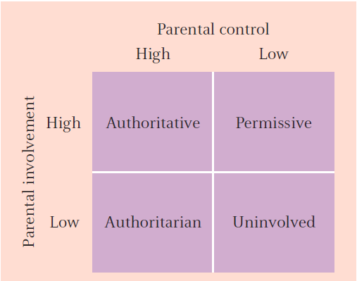
Parenting Styles
Authoritative
Authoritarian
Permissive
Uninvolved
Notes:
IMAGE: [© Cengage Learning] (Kail/Cavanaugh, Figure 7.2, p. 238)
Infancy and Childhood 15 of 17
Parenting styles can be divided into four categories.
These four parenting styles vary along two dimensions: support and behavioral regulation.
The authoritative parenting style is a cross between high support and high regulation.
This is the ideal style for parents, as evidenced by the superior outcomes among children raised by parents using this style.
The authoritative parent is a teacher who disciplines the child with an eye toward making that child a productive, prosocial member of the community.
Limits are appropriate for the age and stage of the child’s development, and consequences are educational, not punitive.
For example, a teen who abuses the privilege of using the family car might lose that privilege for a reasonable time.
Because of the emphasis on teaching, these parents tend to use little or no physical punishment.
They are consistent and firm but also warm and reasonable.
They communicate their standards and invite feedback, but there is no question as to who is running the show.
The authoritarian parenting style combines low support with high regulation.
The high regulation provided by these parents prepares children for the limits they inevitably meet in the community from other authority figures such as teachers and law enforcement personnel, but this is considered a less-than-ideal approach in most contemporary environments due to lower levels of warmth and support.
Authoritarian parents have a greater tendency than authoritative parents to use harsh punishments, including physical punishment.
This behavior can prompt some rebelliousness in the child that is not seen as frequently in response to authoritative parents.
Cross-cultural research has found that the impact of authoritarian parenting does not differ between collectivist cultures and individualistic cultures.
Authoritarian parenting in China, Egypt, Australia, and the United States is viewed quite similarly by the children exposed to it, and the outcomes for children of authoritarian parents vary little across these cultures.
These children tend to have few problems with externalizing (“acting out”) behaviors, such as drug use.
However, compared to children raised in authoritative homes, the children of authoritarian parents have more internalizing symptoms, such as depression.
The indulgent or permissive parenting style is produced by crossing high support with low regulation.
These are very warm, loving parents, but they simply do not want to be the ones who tell their children the dreadful word “no.”
They are much more comfortable letting others, such as teachers, neighbors, and law enforcement, be the ones to establish any rules.
Children of indulgent parents are monitored much less than children of authoritative and authoritarian parents and show a much higher level of cigarette and alcohol use and antisocial behavior.
The cross between low support and low regulation is the uninvolved parenting style.
This style generally does not occur unless there is something seriously wrong with the family situation.
Illness, marital discord, psychopathology, or substance abuse can prevent the parent from carrying out his or her duties in regard to children.
As a result of the incapacity of the parent, the children are basically ignored.
In extreme cases, neglect may require the intervention of social services in order to maintain the health and safety of the child.
By the 12th grade, children of uninvolved parents drink and smoke nearly twice as much as children of authoritarian or authoritative parents, and sons of uninvolved parents are at a very high risk of antisocial behavior.

Slide 30
Parenting Styles and Child Outcomes
Notes:
IMAGE: [© Cengage Learning] (Cacioppo, Figure 11.18, p. 427) Parenting Style and Child Outcomes. Authoritative and authoritarian parenting styles are associated with lower rates of antisocial behavior in children than the indulgent or uninvolved parenting styles. However, children with authoritarian parents experience more depression and withdrawal than do children of authoritative parents. Source: Adapted from “Parenting and Trajectories of Children’s Maladaptive Behaviors: A 12-Year Prospective Community Study,” by K. Luyckx, E. A. Tildesley, B. Soenens, J. A. Andrews, S. E. Hampson, M. Peterson, et al., 2011, Journal of Clinical Child and Adolescent Psychology, 40(3), pp. 468–478.
Infancy and Childhood 16 of 17
Authoritative and authoritarian parenting styles are associated with lower rates of antisocial behavior in children than the indulgent or uninvolved parenting styles.
However, children with authoritarian parents begin to show progressively higher rates of internalizing problems (feeling depressed and withdrawn) over the course of adolescence compared to children with authoritative parents.

Slide 31
Sociocultural Influences on Development
Divorce and remarriage
Birth order and siblings
Abuse and maltreatment
Peers, popularity, and bullying
Electronic media
Perspective taking
Notes:
IMAGE: [© CHRISTOPHER WALKER/MCT/Landov ] (Kail/Cavanaugh, p. 249). Following divorce, most men and women remarry, creating a blended family.
Infancy and Childhood 17 of 17
Divorce can harm children in a number of areas, ranging from school achievement to adjustment. The impact of divorce stems from less supervision of children following divorce, economic hardship, and conflict between parents.
Parents have higher expectations for first-born children, which explains why such children are more intelligent and more likely to go to college. Later-born children may be more popular and more innovative. Contradicting the folklore, only children are rarely worse off than children with siblings; in some respects (such as intelligence, achievement, and autonomy), they are often better off.
Factors that contribute to child abuse include poverty, social isolation, and a culture’s views on violence. Parents who abuse their children were often neglected or abused themselves and tend to be unhappy, socially unskilled individuals. Younger or unhealthy children are more likely to be targets of abuse. Children who are abused often lag behind in cognitive and social development.
Children with friends are more skilled socially and are better adjusted. Some crowds have higher status than others, and members of higher-status crowds often have higher self-esteem than members of lower-status crowds. Common to most groups is a dominance hierarchy, a well-defined structure with a leader at the top. Peer pressure is neither totally powerful nor totally evil. In fact, groups influence individuals primarily in areas where standards of behavior are unclear, as in tastes in music or clothing or with regard to drinking, drug use, and sex. Repeated peer rejection often leads to school failure and behavioral problems. Children who are chronic victims of aggression typically overreact or refuse to defend themselves.
TV programs can cause children to become more aggressive, to adopt gender stereotypes, and to act prosocially. Programs designed to foster children’s cognitive skills, such as Sesame Street, are effective. Many criticisms about TV as a medium (e.g., it shortens children’s attention span) are not supported by research.
Children’s perspectives of others change in much the same way children’s descriptions of themselves change. During the early elementary school years, descriptions emphasize concrete characteristics. In the late elementary school years, they emphasize personality traits. In adolescence, they emphasize providing an integrated picture of others.

Slide 32
Adolescence
This section covers:
  Physical development
  Cognitive and moral development
  Social and emotional development
Notes:
IMAGE: [© Tetra Images/Alamy] (Nevid, p. 353): Though conflicts between adolescents and parents are common, most adolescents say they have good
relationships with their parents.
Adolescence 1 of 8
This section covers adolescents in terms of their:
Physical development
Cognitive and moral development
Social and emotional development

Slide 33
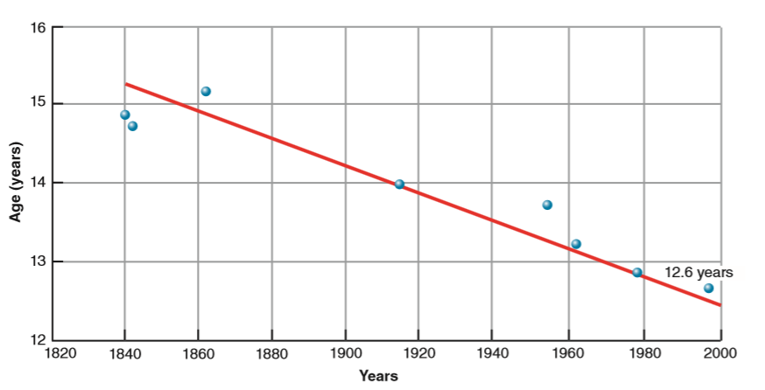
Defining Adolescence
The transition from childhood to adulthood
  Has become longer over time
    Earlier onset of puberty
    Extended education and training
Notes:
IMAGE: [© Cengage Learning 2013] (Cacioppo, Figure 11.20, p. 429): The Age of Puberty Has Decreased Over the last 100 Years. Since 1840, the average age of first menstruation has dropped from nearly 16 years to its current average of 12.6 years.
Adolescence 2 of 8
Adolescence is an artificial, arbitrary period of development that is a relatively recent phenomenon in human experience.
In hunter-gatherer societies, sexual maturity at puberty signaled the young person’s entry into adult roles, privileges, and expectations.
Our word puberty comes from the Latin word for “adult.”
Although adolescence is assumed to begin with puberty, we do not have much consensus regarding its endpoint.
Legally, an 18-year-old is an adult in the United States.
However, we restrict legal alcohol consumption to those over 21, and rental car companies rarely rent cars to young adults under the age of 25.
Lifestyle factors associated with adulthood, such as financial independence from parents, separate living arrangements, marriage, and parenthood, are far more descriptive of the end of adolescence than age.
Two factors have resulted in an extended period of adolescence in modern, industrial societies, such that it starts earlier and ends later than in the past.
One is the earlier onset of puberty, as depicted in the graph.
Since the mid-1800s, the average age of puberty in the United States has steadily dropped from about age 16 to around age 12.
For people living 100 years ago, taking on adult roles around the age of puberty was much more realistic than it would be today.
Recent evidence shows that this trend is ongoing, though we are exactly sure why puberty is occurring earlier.
Some researchers suggest that nutritional improvements have led to this change, while others point to changing agricultural practices, like the use of animal hormones in meat and dairy production.
A second factor contributing to the length of modern adolescence is the extended period of education and training needed in technological societies.
Adolescents are expected to remain in school until at least age 18, and many college students don’t finish until 22 or 23.
In previous generations, it was common for people to enter the workforce or become trade apprentices at younger ages.

Slide 34
Physical Development: Puberty
AGE | MALES | FEMALES
10 |  | Breasts buds appear
11 | Testes enlarge | Pubic hair appears
12 | Pubic hair appears Penis enlarges | Underarm hair appears First menstruation
13 | First ejaculation
14 | Underarm & facial hair appears Voice deepens | Pubic hair matures
15 | Penis reaches adult size Pubic hair matures | Breasts mature
Notes:
Adolescence 3 of 8
The onset of puberty is marked by a cascade of hormone release, culminating in the maturation of reproductive organs and the development of secondary sex characteristics.
Males experience muscular development, maturity of the external genitalia, growth of facial hair, and enlargement of the larynx, which leads to a deeper voice.
Females experience breast growth, maturity of the external genitalia, maturity of the uterus, and changes in fat distribution and quantity.
Menarche, or the first menstrual cycle, occurs relatively late in the puberty process for girls.
In response to the same hormones, skeletal growth for both boys and girls begins to slow down.
Individuals experiencing early puberty will stop growing at an earlier age.
The obvious evolutionary purpose of puberty is to prepare an individual for sex, so not too surprisingly, teens respond to the physical changes of puberty with a dramatic increase in sex drive.
For the hunter-gatherer, no conflicts occurred, as the assumption of adult roles, including adult sexual relationships, coincided with these feelings.
With modern children experiencing puberty as young as 7 or 8 years old, however, we face challenges that are relatively new in our evolutionary history.
Sexual maturation during the teen years parallels further development in gender identity, the assumption of sex-role behaviors, and sexual orientation.
Sexual orientation refers to a stable pattern of attraction to people of a certain sex, independent of gender identity, sex-role behavior, and sexual experiences.
Gender identity refers to a person’s sense of being male or female, and sex-role behavior refers to a pattern of traditionally male or female behavior.
Many variations in combinations of these variables occur.
People with a homosexual orientation typically demonstrate a gender identity consistent with their biological sex, while showing the same range of variation in sex-role behaviors, from traditionally masculine to traditionally feminine, as people with a heterosexual orientation.
The timing of puberty also has a psychological impact on the self-image of an adolescent, one that differs for boys and girls.
For boys who mature early, the growth in stature and muscle brings with it a better self-image and body image than for boys who mature later.
However, early-maturing boys report somewhat more stress than late-maturing boys.
Early-maturing females experience more adjustment difficulties and are more likely to smoke and drink alcohol during adolescence and to do less well in school than are those who mature later.
Girls whose breasts develop early may find the attention they receive hard to cope with and fraught with pressures to become sexually active when they may not be ready cognitively and emotionally to do so.
Girls who develop later are better adjusted to these changes because the pressure to become sexually active occurs at an older age, when their cognitive abilities are better able to handle such pressures.
Long-term studies suggest that the effects of early versus late maturation in puberty may be short-lived, except for early-maturing girls.
At age 24, early-maturing girls report poorer family and peer relation ships, lower life satisfaction, and higher rates of depression compared to other females.

Slide 35
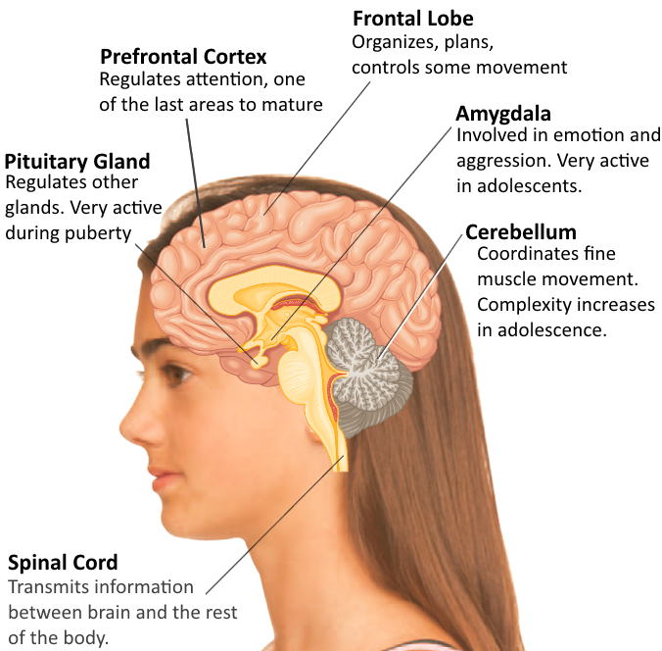
Physical Development: The Brain
Notes:
IMAGE: [© Bill Reitzel/Photodisc/Getty Images] (Pastorino, p. 386): Changes in the adolescent brain generally start at the back of the brain and move toward the front. Hence the areas of the brain that are most involved in problem solving, planning, and critical thinking are the last areas to mature.
Adolescence 4 of 8
Early developmental psychologists, including Piaget, argued that cognition is rather mature at puberty, which in turn implies that the brain is mature.
In some aspects this conclusion is correct.
By the teens, areas of the brain that process language, spatial relations, hearing, and other sensory processes appear complete.
However, much additional work remains to be done before we can consider the brain to be fully adult.
Far from considering the brain complete at puberty, today’s psychologists are viewing the early teen years as being a second critical period of growth (the first being prenatally up to age 18 months).
The onset of puberty is accompanied by substantial gray matter growth, which peaks between the ages of 11 and 12 years.
Following this burst of growth, the gray matter normally thins somewhat over the remainder of the teen years.
Abnormalities in this process may be associated with the onset of schizophrenia.
Youth with early-onset forms of this disorder show four times more loss of gray matter in the frontal lobes than is usually seen in teens of the same age.
On the other hand, white matter, or myelin, continues to mature through the teen years and into young adulthood.
Myelination of the frontal lobes is much greater in adults aged 23 to 30 than in youth between the ages of 12 and 16.
Unfortunately, the adolescent’s white matter is more susceptible than an adult’s to damage from binge drinking
Structural differences between the brains of teens and adults affect their interpretations of the emotions of other people.
Functional magnetic resonance imaging (fMRI) has been used to observe brain activity in adolescents and young adults while they react to photographs of facial expressions of emotion.
Adults identified the expressed emotions accurately, but teens frequently misunderstood the emotions being displayed.
The amygdala, which provides a quick, subconscious assessment of emotion, showed the same pattern of activity in adults and teens.
However, the adults showed more activity in the frontal lobes than the teens did, which might account for the adults’ superior judgment of emotional expression.
The earlier maturation of the emotional parts of the brain, such as the amygdala, relative to the logical frontal lobes might account for some of the “risky” behaviors that characterize the teen years, such as reckless and drunk driving, driving without seatbelts, experimenting with drugs, and having unprotected sex.
Risky behavior does not result from the teen’s inability to judge what is risky or not.
If anything, teens actually view life as more risky than it really is and vastly overestimate their personal risks for becoming crime victims or dying in the near future.
At the same time, teens typically believe that they are somehow immune from the consequences of risky behavior—for example, that drunk driving accidents happen to other people.
The teen brain also responds more vigorously to pleasure than the adult brain, which means that the immediate pleasurable consequences of a risky behavior can overwhelm the teen’s “better judgment”

Slide 36
Cognition
Abstract thought
Idealism of youth
Return to egocentrism
Imaginary audience
Personal fable
Notes:
IMAGE: [© Janine Wiedel Photolibrary/Alamy] (Kail/Cavanaugh, p. 290): The ability to reason abstractly allows teenagers to successfully tackle complex academic topics.
Adolescence 5 of 8
Recall that Piaget proposed that teenagers begin to think abstractly during the formal operations stage.
This ability to reason abstractly allows them to imagine what could be and to hypothesize about future events and future outcomes.
As a result, adolescents experience what they believe are—and sometimes are—tremendous insights into how things could be rather than how they are.
This phenomenon is often labeled the idealism of youth.
Adolescents believe that they have the answers to problems such as world hunger or conflicts.
This mental ability also helps adolescents in discovering who they are as individuals.
Formal operational thinking also allows teenagers to tackle more challenging academic subjects (science, geometry, calculus) that rely on abstract visualization and reasoning powers.
It also enables adolescents to argue more effectively, a power that may not be seen positively by their parents!
They are more capable of suggesting hypothetical scenarios (“What if . . .”) to justify their position, making them more effective debaters.
However, along with this ability to think abstractly comes the return of egocentrism.
Egocentrism in adolescence involves teenagers’ imagining what others must be thinking.
However, teens believe that other people are concerned with the same things they are.
Because adolescents’ ideas focus mainly on themselves, they believe that others are equally concerned about them.
For example, a teen with a pimple on his face may imagine that his peers and teachers are thinking only about the pimple on his face.
Teenagers may not ask or answer questions in class because they are so sure that everyone is talking about them and thinking about them.
They are newly and acutely aware of their own being, and self-consciousness peaks.
Because teens believe that others are focused on them, they behave as if they are on stage— playing to an audience—a phenomenon referred to as the imaginary audience.
They may laugh especially loudly or behave dramatically because of their belief that they are being constantly watched.
Neuroimaging research and adolescent self-reports support this heightened sensitivity to others’ evaluation in adolescence.
Although the imaginary audience and egocentrism are most associated with the teenage years, they may still be somewhat present later in life as young adults choose clothing, jobs, or interests to impress an audience that is largely imaginary.
Another feature of adolescents’ thought that relates to egocentrism is the personal fable.
Teenagers develop the “personal fable” that they are special and unique, that their thoughts and feelings cannot be adequately understood by others.
Reflect back on your first love. When that relationship ended, you may have felt as if no one in the world could identify with what you were feeling. The story you tell yourself is that this person, who is the only person in the world for you, has now gone away, and your life will never be happy again. This is one personal fable of adolescence.
Personal fables may contribute to adolescent risk taking. Because teenagers feel that they are special and unique, they often feel that their own risks are less than those of their peers.

Slide 37
Moral Reasoning
Kohlberg
  Preconventional
  Conventional
  Postconventional
Gilligan
  Gender perspective
Notes:
IMAGE: [© AP Images/Bill Wolf] (Kail/Cavanaugh, p. 294): Teenagers who engage in moral behavior such as participating in protest marches, often reason at high levels in Kohlberg’s theory.
Adolescence 6 of 8
Lawrence Kohlberg, a student of Piaget’s, attempted to extend Piaget’s theory of cognition to explain the development of moral reasoning.
To assess changes in moral reasoning, Kohlberg presented children, adolescents, and adults with a number of ethical dilemmas.
He was not so interested in the choice the participant would make in response to the dilemma as he was in the reasoning the participant provided for his or her choice.
Children and young adolescents are typically in the preconventional stage of moral development.
In this stage, children will make moral choices based on their expectations of reward and punishment.
Needless to say, some individuals never progress beyond this stage. Stealing or cheating is okay as long as you don’t get caught.
Kohlberg believed that during adolescence, the majority of the population moves to the next stage, conventional morality, and stays there.
In this stage, rules are seen as governing moral behavior and are therefore to be followed.
Conventionally moral people are also sensitive to public opinion.
They want to do the right thing so that others will approve of their behavior.
Although conventional morality adds to the stability of a society, it runs the risk of being arbitrary and rigid.
In addition, history is full of situations in which local public opinion was supportive of morally abhorrent activities, such as genocide or slavery.
The final step of moral development for Kohlberg was postconventional morality.
Relatively few people, according to Kohlberg, attain this stage.
In conjunction with the abstract reasoning of formal operations, the individual now recognizes that rules are made by human beings and can therefore be flawed.
Consequently, personal standards are used as reference points.
The postconventional thinker is likely to evaluate laws and rules critically before complying with them.
Kohlberg is not without his critics.
Postconventional reasoning has been criticized as characteristic of males in Europe and the United States, rather than representing a universal stage of moral development.
Children and adults living in the United States give responses to Kohlberg’s dilemmas consistent with the culture’s emphasis on personal justice and individual rights.
Other cultures place a higher priority on interpersonal factors, such as duty and responsibility to others, and these values can lead to different responses to ethical dilemmas
Carol Gilligan hypothesized that males and females do not judge right and wrong in the same manner.
She believed that Kohlberg’s model emphasized the male perspective on moral reasoning more than the female view.
In her book A Different Voice (1982), Gilligan speculated that males and females focus on different principles for deciding what is right and wrong.
Males tend to be more focused on concepts of fairness and justice.
Females are more likely to emphasize concern, care, and relations with others in making judgments about right and wrong.
Gilligan asserts that women’s focus on caring is a different, but not a less valid, basis for moral reasoning.
Research evaluating gender differences in moral reasoning has not strongly supported Gilligan’s claims.
On hypothetical dilemmas, both males and females emphasize themes of justice and caring in their responses.
Thus, moral reasoning may be based on justice or caring independent of gender.

Slide 38
Erikson’s Psychosocial Stages – Childhood and Adolescence
Age | Stage | Description
Birth – 18 mo. | Trust vs. mistrust | The child views the world as a safe, dependable place.
18 mo. – 3 years | Autonomy vs. shame & doubt | The child begins to explore.
3 – 6 years | Initiative vs. guilt | The child begins to act on the world.
6 – 12 years | Industry vs. inferiority | The child develops self-confidence.
Adolescence | Identity vs. role confusion | Teens ask “Who am I?” Failure to achieve an identity leads to role confusion and subsequent problems.
Notes:
Adolescence 8 of 8
Erik Erikson, a student of Freud, made significant contributions to our understanding of identity, or a unified, consistent sense of self.
For Erikson, social development proceeds in stages, with each stage characterized by a fork in the road between a positive outcome and a less than desirable outcome.
How do you relate to the challenges of adolescence and young adulthood as described by Erikson’s psychosocial stages?
How do older adults in your life relate to the challenges or midlife and late adulthood?

Slide 39
Social and Emotional Development
Identity formation
  Group identity
Family relationships
Notes:
IMAGE: [© ZUMA Press, Inc./Alamy] (Kail/Cavanaugh, p. 285): Many teens explore questions of identity by trying on different roles and affiliating with different groups. From participating in sports, youth can improve their self-esteem and learn skills about how to work effectively as part of a group.
Adolescence 7 of 8
Adolescence challenges teens to develop a sense of identity (the positive outcome).
If they fail, the result is role confusion (obviously, the less desirable outcome).
Teens begin the process of identity formation by asking such questions as “Who am I?” and “What kind of person do I want to be?”
These are profound questions indeed, made possible by the newly developed abstract reasoning skills of the teen.
The answers are not immediately apparent.
Considerable exploration may be necessary before the teen discovers a direction.
Many teens may try on a number of different identities, from jock to nerd to goth, before finding one that works.
Because this process may be somewhat unpleasant, teens may be tempted to short- circuit the process.
One technique for prematurely adopting an identity is to assume the identity of a group. By affiliating with a particular club, clique, or gang, teens take on a preformed identity and avoid the challenges of finding their own individual identities.
A second approach is the adoption of ready-made identities provided by parents or other mentors. Although parents may have valuable advice regarding choice of college major and career, these are highly individual choices with significant implications.
For many adolescents, ethnic identity, or how an individual feels about being a member of a particular ethnic or racial group, is a major part of their overall identity.
Having an ethnic identity boosts the overall self-esteem of adolescents and young adults.
An ethnic identity is usually the outcome of an adolescent’s exploration of what it means to be a part of the group and a sense of belonging to that group.
Many environmental factors contribute to this experience, including family attitudes and the extent of exposure to same-ethnic peers.
Ethnic identities differ in centrality, or the degree to which an individual feels pride in and connection with a group.
Running parallel to the search for identity is a tendency on the part of teens to spend more time with peers and less with family.
Although this preference can be upsetting for the parents, especially if the peers are not to their liking, it may be viewed as a natural step in teen development.
After all, most significant social relationships in adulthood will be with age peers, rather than individuals who are years older or younger.
This affiliation with peers can be taken too far, however, as there is evidence that teens who continue to interact regularly with their parents, such as having regular dinners together, are more likely than teens who don’t interact much with parents to avoid pitfalls of substance abuse and promiscuity.
A healthy balance between family and peer influences appears to produce the best outcomes.
In contrast to popular press accounts of the “stormy” teen years, most teens (and their parents) navigate their passage to adulthood with no more than a few bumps and bruises.
Generation gaps” may occur, but teens typically do not deviate too far from their parents’ values.
Research indicates that most teens love their parents, feel loved by their parents in return, share many of their parents’ values, and turn to them regularly for advice.
Even the “rebellious” teen rarely goes in the opposite direction from his or her parents.
Very few of the student radicals of the 1960s were the offspring of conservative parents.
Instead, these young people were slightly more to the left of their already left-leaning parents.

Slide 40

Adulthood
This section covers:
  Emerging adulthood
  Midlife
  Late adulthood
Notes:
IMAGE: [© Ed Kashi/Corbis] (Cacioppo, p. 440): With increasing life expectancies on one side and later parenthood on the other, many contemporary midlife adults find themselves “sandwiched,” or caring for their aging parents and growing children at the same time.
Adulthood 1 of 7
This section covers:
Young adulthood
Midlife
Late adulthood

Slide 41
Erikson’s Psychosocial Stages – Adulthood
Age | Stage | Description
Young adulthood | Intimacy vs. isolation | People with clear identities form stable, intimate relationships, while others experience feelings of loneliness and isolation.
Middle adulthood | Generativity vs. stagnation | Midlife adults who find value in their lives, even if they haven’t met their goals, experience generativity. They are likely to “put back” energy into family, work, and community.
Late adulthood | Integrity vs. despair | Toward the end of life, adults who feel that they have lived fully have a sense of integrity and calm.
Notes:
Adulthood 2 of 7
Just as children and adolescents must navigate through a series of conflicts, so too must adults, according to Erikson.
The issues faced by adults, however, are much different than those occurring earlier in life, and the stages associated with adulthood last much longer.
The primary conflict in young adulthood is trying to form a meaningful connection with someone else.
It’s important to remember that Erikson’s theory is considered a general description of social development. As such, it won’t apply to everyone.
Some people aren’t very concerned with developing intimacy. Some even actively try to avoid it.
It does, however, describe much of the social behavior that occurs at this age. Many people are going on dates and looking to start relationships and families.
Middle adulthood is associated with becoming accomplished in some way.
For some people, generativity is all about having a successful career.
For others, generativity is achieved through the raising of children.
Every individual will define generativity somewhat differently. The bottom line for Erikson is whether you feel satisfied with the progress you’ve made toward your goals.
Late adulthood is associated with reflecting back upon the life you’ve lived.
Again, the primary issue is whether you feel satisfied with the life you’ve lived. If so, you’ll have a sense of integrity.
If you have regrets over things you did (or perhaps things you didn’t do), you may lapse into despair.
Some people have great difficulty coming to terms with the fact that there’s no “do over” in life.
How do you relate to the challenges of adolescence and young adulthood as described by Erikson’s psychosocial stages?
How do older adults in your life relate to the challenges or midlife and late adulthood?

Slide 42
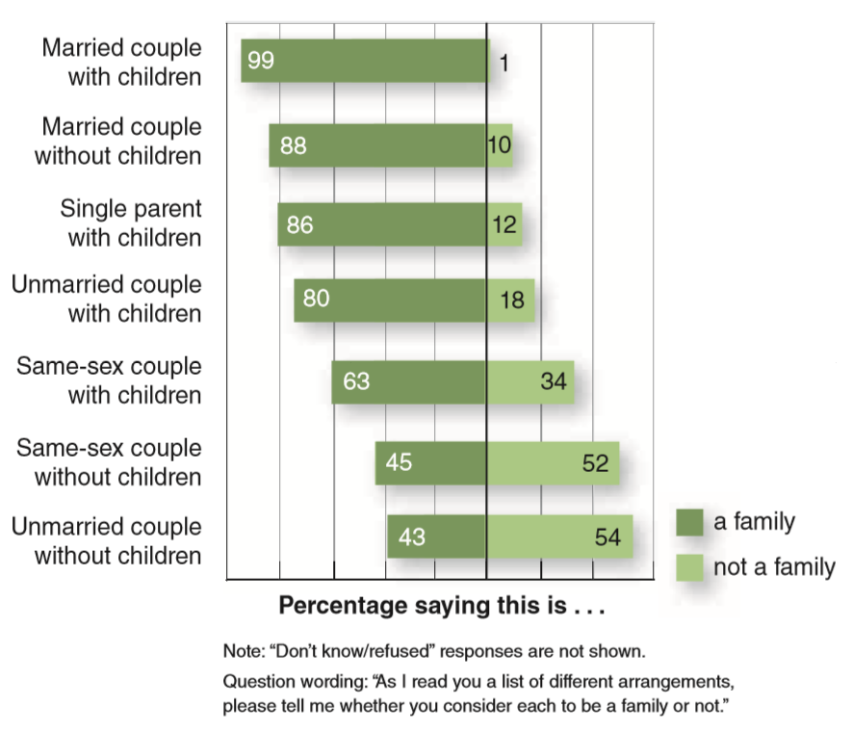
Emerging and Early Adulthood
Physical status
Postformal thought
Relationships
Notes:
IMAGE: [© Pew, Social & Demographic Trends] (Cacioppo, Figure 11.24, p. 437): What Is a Family? American attitudes about what constitutes a “family,” a term once restricted to two parents living with their biological children, continue to change and expand to recognize diverse approaches to intimacy. Source: Adapted from “The Decline of Marriage and Rise of New Families” from http://www.pewsocialtrends .org/2010/11/18/the-decline-of-marriage- and-rise-of-new-families/. Used by permission of Pew, Social & Demographic Trends.
Adulthood 2 of 6
Some human developmentalists view the period from the late teens to the mid-to-late twenties as distinctive. They refer to it as emerging adulthood, a period when individuals are not adolescents but are not yet fully adults (Arnett, 2013; Arnett & Fishel, 2013). Emerging adulthood is a time to explore careers, self-identity, and commitments. It is also a time when certain biological and physiological developmental trends peak and brain development continues in different ways.
Although many questions we face in college have right answers, such as an element’s atomic weight or whether or not a hypothesis was shown to be incorrect, many more are open to debate.
Postformal thought recognizes that the “right answer” is often “it depends” and that many important questions are complex and ambiguous.
Adolescents are much more likely to think in absolutes and defer to authorities, such as professors.
Efforts to move adolescents toward independent, postformal thought are often described as “critical thinking” exercises.
Using formal operations, a student can evaluate a hypothesis and conclude whether or not it needs to be rejected.
However, postformal thinking is an integral part of creativity, in science or in any other field.
Scientists who are unable to look beyond the “right answers” already existing in their fields are unlikely to make creative contributions that stretch that knowledge.
As teens enter young adulthood, Erickson suggests that they confront a new challenge: intimacy versus isolation.
Frequently, the search for intimacy concludes with marriage and the establishment of a family.
Those who fail to find the level of intimacy they seek might experience feelings of loneliness, which in turn can elicit behaviors that are more likely to alienate others instead of promoting intimacy.
One key to successful intimacy, according to Erikson, is to have established a solid identity in adolescence.
If you still don’t know who you are, it is unlikely that you will make good judgments about the type of person who will make you happy.
Current trends in the United States include diverse approaches to intimacy and family.
In addition to forming traditional families that include two biological parents and their children, large numbers of people are choosing to remain single, live together without being married, be single parents, have children without being married, divorce, and remarry.
For those who do choose to have children, the experience of being parents often dominates much of their adult lives.
Although most parents are quite happy with their choice to take on this role, many young couples experience a drop in marital satisfaction as they adjust to new responsibilities.
After all, it’s rather difficult to feel attractive for your partner with peanut butter and jelly in your hair.
Marital satisfaction decreases when children are quite young, and rebounds when children become more independent.
Couples who describe their relationships as successful experience milder impacts from having children.

Slide 43
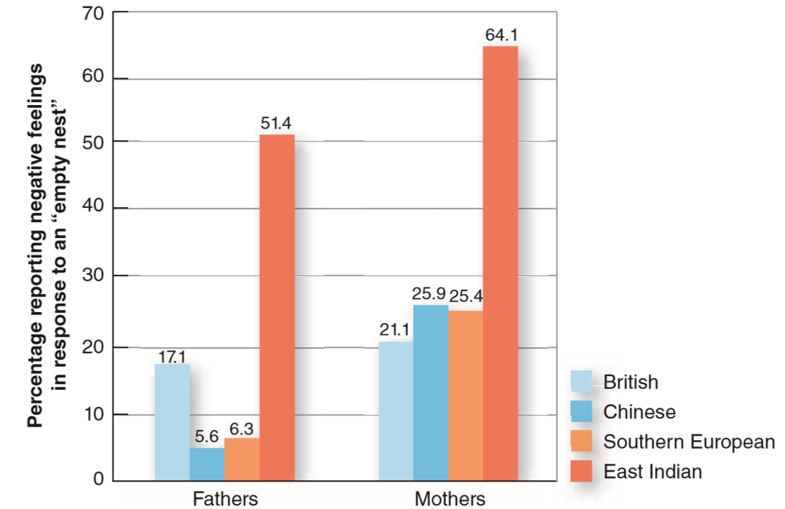
Middle Adulthood
Physical and cognitive changes
Social changes
Notes:
IMAGE: [© Cengage Learning, 2013] (Cacioppo, Figure 11.26, p. 440): Responses to the “Empty Nest” Vary Across Cultures. Although most Americans report positive reactions to their last child leaving home, reactions do vary across cultures. Among Canadians of different ethnic groups, being an “empty nest” parent has different meanings. Parents from Chinese and Southern European cultures are less likely to report negative responses to their last child leaving home than are parents with a British background. Parents from India experienced the most negative response of all the groups studied. Source: Adapted from Mitchell and Lovegreen (2009).
Adulthood 3 of 6
The major theme of physical and cognitive development in midlife is stability.
Assuming that people maintain good health, any changes in the physical and cognitive domains tend to be mild and gradual.
The most significant physical change in midlife for women is the end of their ability to reproduce.
Menopause is the point where menstruation stops.
For most women, menopause is complete in their early 50s, but loss of fertility is a very gradual process beginning many years earlier.
Menstrual cycles may become irregular in a woman’s 40s as her sex hormone levels that regulate the cycles begin to drop.
During the period of transition between the start of irregular periods and the final disappearance of menstruation, women can experience a number of physical and psychological symptoms.
Hot flashes, night sweats, headaches, joint pain, mood swings, and sleep disturbances are common complaints, and the severity of these issues can range from barely noticeable to nearly disabling.
Hormone treatments to offset these symptoms are used quite cautiously, as they can also increase a woman’s risk of stroke, heart attack, breast cancer, and later dementia
Men experience much more gradual changes in their reproductive status through the remainder of their lives.
Sperm quantity may be reduced, but men in their 80s remain half as fertile as men who are 25.
Most men experience little if any decreases in testosterone over the course of the midlife years, although other conditions, such as diabetes, can interfere with the maintenance of an active sex life.
For both men and women in midlife, the availability of a partner is much more predictive of sexual activity than any health issues
In contrast to the relative stability in the physical and cognitive domains during midlife, this period of life is characterized by significant changes in social and work roles.
Children grow up and move out. If you are the youngest child in your family, you may have noticed that your parents are beginning to feel somewhat more relaxed.
For many parents, the “empty nest” period following their last child leaving home is actually accompanied by an improvement in marital satisfaction.
Your parents no doubt love you, but they’re also relieved to have many of the responsibilities of parenting behind them.
However, the likelihood that negative emotions will accompany an empty nest varies from culture to culture
Adults in midlife continue to pursue their careers, becoming more expert, or they might initiate a new career that was not previously compatible with the financial and social responsibilities of raising a family.
Recent economic and social changes have made midlife work much less stable than it has been for previous generations.
At a time when midlife workers want to stay employed longer than previous groups (at least until age 65), some are experiencing downward mobility by taking jobs below their levels of skill and experience or early withdrawal from employment altogether
During midlife, Erikson suggests that adults experience either generativity or stagnation.
Many people, particularly during adolescence, set a number of goals for themselves. You may want to win a Nobel Prize or the Olympics, or simply help others have a better life.
Whatever your goals, by the time you reach midlife, you will have a rather good idea about whether or not these goals will be met.
In many cases, we find that progress has been made toward our goals, although we perhaps didn’t meet them completely.
Wherever an adult finds himself or herself at midlife, the question posed by Erikson is whether or not value exists.
If people feel that their lives have had value, even if they are short of their goals, they experience generativity.
Adults experiencing stagnation, in contrast, have not found much satisfaction in their lives.

Slide 44

Late Adulthood
Physical changes
Cognition
Notes:
IMAGE: [© REUTERS/David Bebber/BEB/ASA/ACM] (Cacioppo, p. 441): Fauja Singh, born in 1911, competes in marathons worldwide as part of the Sikhs in the City team, a group of four runners whose combined age is over 330 years. Running marathons isn’t necessary to prevent cognitive decline, but people who participate in 20 minutes or more per day of physical activity have the lowest rates of dementia.
Adulthood 4 of 6
Assuming good health, the effects of aging on an adult’s physical status are gradual and rather mild.
Nonetheless, some physical change is inevitable, and understanding the nature of these changes provides guidance for coping with them.
The brain reaches maturity at about age 25, and few further changes occur until about the age of 45.
At that time, the weight of the brain begins to decrease, leading to about a 5% decrease by the age of 80.
However, this decrease is not accompanied by dramatic cognitive and behavioral changes.
Results from the Baltimore Longitudinal Study of Aging show that healthy aging is accompanied by very mild changes in the speed of learning and problem solving and that most of these observable changes occur very late in life.
As with other physical changes, age-related changes in sensory abilities are gradual, and their effects can be offset by the use of technologies, such as eyeglasses and hearing aids.
Intelligence remains relatively stable during adulthood, as long as general health remains good.
Although many people erroneously believe that aging is inevitably accompanied by loss of intellect, only about 6.4% of the population over the age of 60 experiences dementia, such as Alzheimer’s disease .
Cardiovascular disease, including strokes, may have a negative effect on intellect by reducing blood flow to the brain.
Certain types of intelligence change more due to aging than others.
Crystallized intelligence, or the use of accumulated knowledge, changes less than fluid intelligence, or a person’s basic information processing skills.
Fluid intelligence correlates with speed of processing, whereas crystallized intelligence might be viewed as wisdom, or the ability to draw on past knowledge and experience to solve problems.
Many people maintain high levels of intellectual functioning well into their senior years.
Early studies of scientific, scholarly, and artistic accomplishments as a function of age demonstrated a peak in a person’s 40s.
However, more recent studies show a relatively constant level of professional output.
Among professors, research output was far more related to pressure to publish than to a professor’s rank or age.

Slide 45
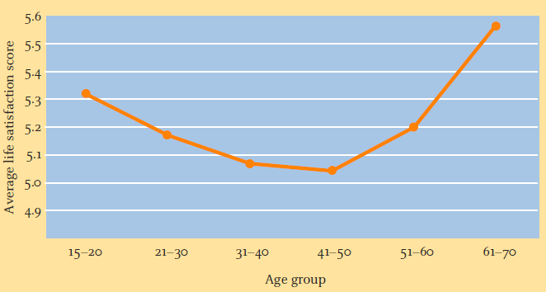
Late Adulthood (cont’d.)
Social and emotional matters
Notes:
IMAGE: [© Cengage Learning, 2013] (Kail/Cavanaugh, Figure 15.2, p. 520): The pattern of a typical person’s happiness through life. From A. Oswald “Happiness, Health, and Economics,” Warwick University, http://imechanica.org/files/andrew_oswald_presentation_071129.pdf.
Adulthood 5 of 6
One common difficulty for older adults is fighting against ageism.
Many individuals have stereotypic beliefs about the feelings and abilities of older adults. These can sometimes translate into discriminatory behaviors.
For instance, you might hold a common stereotype about older adults being sad and lonely.
If so, you will probably be surprised to learn that psychological research has found that depression is higher in young people than in healthy, older adults, and that older adults report higher subjective well-being overall than young adults.
Given the frequent challenges of aging, including physical and cognitive changes, what could possibly account for this increase in emotional well-being?
Part of the explanation lies in the way people look at the time they have remaining in life.
When people see a long stretch of time remaining in their lives, they pursue achievement, possibly at the expense of meeting their social and emotional needs.
In contrast, when older adults are looking at a much shorter period of remaining life, their goals are refocused toward seeking positive emotional experiences.
In later adulthood, Erikson suggests that people experience either integrity or despair.
Older people who are happy with their life’s experiences generally experience integrity.
They met their goals for the most part and are able to reflect on their lives and feel positive about their journey.
In contrast, people who reach their senior years feeling that life passed them by are likely to experience a sense of despair.
One thing that doesn’t change throughout the life span is the need for social connection.
Older adults show significant benefits from their friendships, but they have fewer of them than younger adults and are less likely than younger adults to form new ones.
Relationships with siblings can be especially meaningful for older adults.
Relationships with grown children and grandchildren also form a significant part of the social life of older adults.
Traditionally, many parents entered the role of grandparent during midlife, but with more young adults postponing parenting, the grandparent role is occurring later as well.
Human beings are somewhat unusual among primates in their length of life span beyond their productive years, a phenomenon known as the “grandmother effect.”
A healthy woman might live 40 or 50 years past her age at menopause.
It is possible that her contributions to the care of her grandchildren, freeing her children for other tasks, might have provided an adaptive advantage over the course of evolution.
Marriage in late adulthood is typically seen as making an important contribution to continued good health.
In married older adults, interacting with the spouse contributes to happiness by buffering the individual from stress.
Seniors who have remained married to the same person for decades have seen many changes in their relationships over the years.
We observed earlier that parents of young children experience a drop in marital satisfaction, which improves as children leave the home as young adults.
Long-term marriage partners show more similarities with each other due to a lifetime spent in each other’s company, along with a characteristic lack of attention to past negative events and personality traits.
In other words, they believe their relationship has been more positive than it actually was.
These couples also show an interesting pattern of conflict avoidance, which contributes to higher levels of marital satisfaction.

Slide 46
Death and Dying
Grief
Bereavement
Reactions to confronting death
Notes:
IMAGE: [© Max Milligan/AWL Images/Getty Image] (Kail/Cavanaugh, p. 552): The symbols we use when people die, such as these caskets from Ghana, provide insights into how cultures think about death.
Adulthood 6 of 6
When a loved one dies, bereavement and grief follow. Bereavement is the experience of losing a loved one; grief is our emotional reaction to that loss. Just as death is a highly personal experience, so too is grief. Research on bereaved people has identified common themes and emotional reactions within three phases: impact/shock, confrontation, and accommodation/acceptance (Bowlby, 1980; Parkes, 1986, 1991; Rando, 1995).
Most people’s first reaction to the loss of a loved one is shock. This impact phase may include disbelief on hearing that a loved one has died. It may feel as if a numbness has settled within one’s body or mind. This numbness is adaptive, dulling the painful emotions of loss.
Deep despair and agony may soon follow the numbness and shock in the confrontation phase. The survivor must confront the reality of the loss, and this can be especially painful. By confronting each wave of despair, the person moves closer to realizing that the loved one is gone.
As the pain of the confrontation phase subsides, the survivors begin to accept the death of the loved one in the accommodation phase. The survivors reengage with life, and the memories of the deceased are internalized. People are now able to refocus their emotional energies on normal daily events and relationships with the living.
If you were told today that you only had 6 months to live, how would you react? Elisabeth Kübler-Ross (1926–2004) (1969, 1974), a pioneer researcher on death and dying, identified five reactions that may characterize dying people: denial, anger, bargaining, depression, and acceptance.
When people first learn that they have a terminal illness, a typical reaction is denial. They behave as if they have not just been told that they are going to die. For example, they may insist on a second or third medical opinion.
As denial dwindles, it is replaced by the emotional reaction of anger. People lash out at loved ones and medical personnel over the unfairness of death. “Why me?” may be a common response during this stage. Looking for others to blame may also be an expression of this anger.
Following denial and anger, some dying people may also express emotions indicative of bargaining. They attempt to strike a deal for more time with the doctors, a supreme being, or the universe.
People who are dying may become depressed or extremely sad when denial, anger, and bargaining fail to delay the progress of their illness. They may lose interest in their usual activities or refuse to participate. This depression may be one way for those who are near the end of life to mourn their own death.
The final emotional state described by Kübler-Ross is acceptance. A peace and calm characterize the dying as they face the end of life. They may separate themselves from all but a few of their loved ones as they prepare for life’s ending.
Today, many psychologists view Kubler-Ross’s theory as a general description of the types of responses people can have.
They are also quick to point out that there is no evidence suggesting that people progress through a particular set of stages or move through stages in a particular order.
Some people immediately achieve acceptance, some people fall into depression, some start off depressed before engaging in denial or anger.
Death, like many other developmental processes, is influenced by a variety of factors, including one’s personality and coping style, the type of support received from family members and health professionals, and the nature of the terminal illness. People may also experience similar reactions when they face a divorce, unemployment, or the impending death of a loved one.

