Slide 1
The Nervous System
This section covers:
  The organization of the nervous system
  The functions of the peripheral nervous system
Notes:
IMAGE: [©Argosy Publishing, Inc.] (Cacioppo, Figure 4.1, p. 111)
The Nervous System 1 of 6
This section covers:
The organization of the nervous system
The functions of the peripheral nervous system

Slide 2
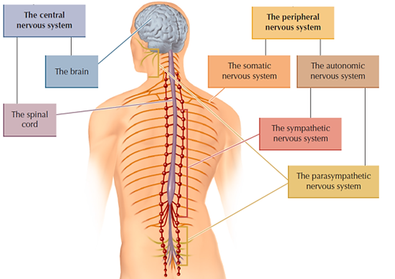
The Organization of the Nervous System
Notes:
IMAGE: [from Freberg, L. A. Discovering Biological Psychology, 2e. © 2010 Wadsworth, a part of Cengage Learning, Inc.] (Coon, Figure 7.1, p. 56)
The Nervous System 2 of 6
There are two major components in the nervous system:
Central nervous system: consists of the brain and spinal cord
Peripheral nervous system: consists of the somatic nervous system and the autonomic nervous system

Slide 3
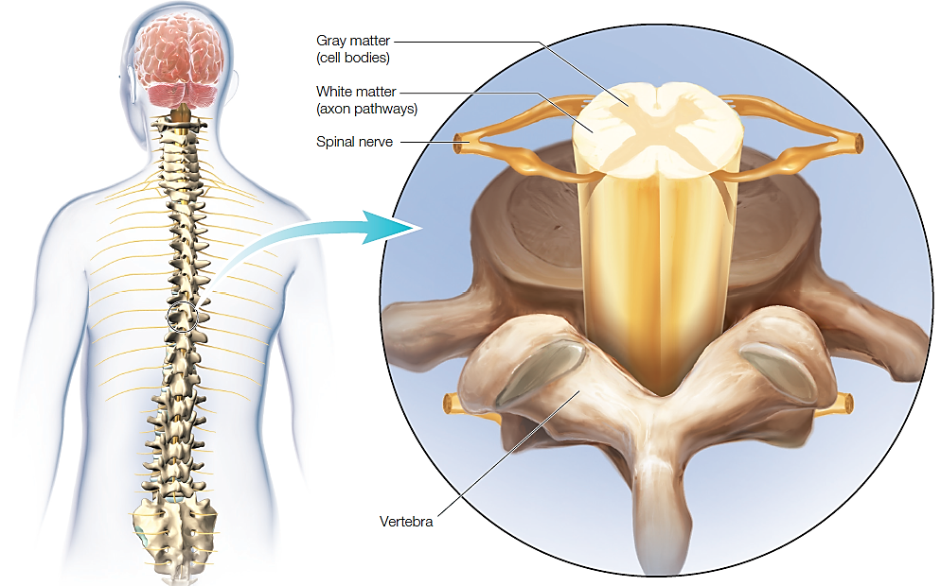
The Spinal Cord
Notes:
IMAGE: [©Argosy Publishing, Inc.] (Cacioppo, Figure 4.3, p. 113)
The Nervous System 3 of 6
Spinal cord: Thirty-one pairs of spinal nerves exit between the bones of the vertebrae to bring sensory information back to the central nervous system and to carry motor commands to muscles
Learn more about the spinal cord and its importance at https://www.youtube.com/watch?v=zxpb1-okVig (3:28)

Slide 4
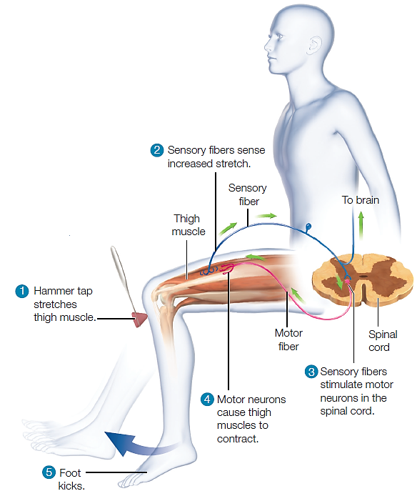
The Spinal Nerves and Reflexes
Notes:
IMAGE: [©Argosy Publishing, Inc.] (Cacioppo, Figure 4.4, p. 115)
The Nervous System 4 of 6
A number of important reflexes are initiated by the spinal cord without the assistance of the brain
Spinal reflexes give us an opportunity to look at the functions of three different types of neurons
Sensory neurons carry information from the external environment or from the body back to the CNS
Motor neurons carry commands from the CNS back to the muscles and glands of the body
Interneurons, which have neither sensory nor motor functions, play important roles in more complex reflexes and throughout the nervous system
Watch an examination of reflexes at https://www.youtube.com/watch?v=cYOnWQHxJts (3:14)

Slide 5
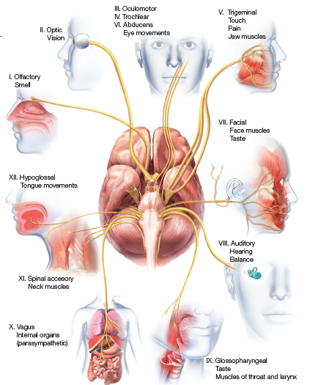
The Somatic Nervous System and the Cranial Nerves
Notes:
IMAGE: [©Argosy Publishing, Inc.] (Cacioppo, Figure 4.16, p. 129)
The Nervous System 5 of 6
The somatic nervous system is the part of the peripheral nervous system that transmits commands for voluntary movement from the central nervous system to the muscles and brings sensory input back to the CNS for further processing. These functions are carried out by the 31 pairs of spinal nerves serving the torso and limbs, and the 12 pairs of cranial nerves serving the head, neck, and some internal organs.
Learn more about the cranial nerves at https://www.youtube.com/watch?v=vFp_qNifHzw (12:39)

Slide 6
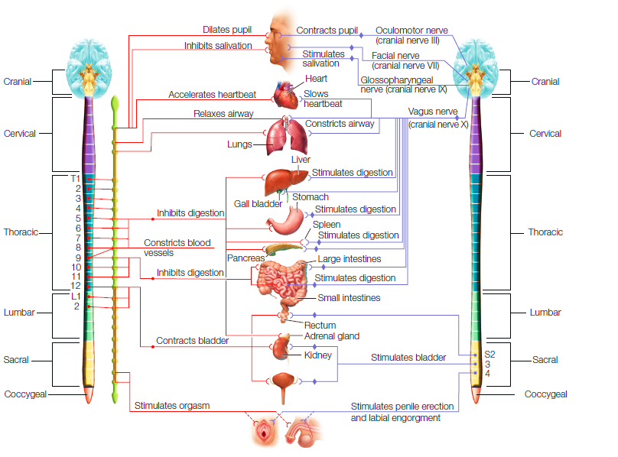


The Autonomic Nervous System and Homeostasis
Notes:
IMAGE: [©Argosy Publishing, Inc.] (Cacioppo, Figure 4.17, p. 131)
The Nervous System 6 of 6
The autonomic nervous system is responsible for homeostasis – the regulation of important body functions such as temperature and thirst, and our fight-or-flight response to emergencies
The ANS contains two subdivisions, the sympathetic division and the parasympathetic division.
Nerve cells participating in the sympathetic division are found in the middle regions of the spinal cord in the torso and lower back
Nerve cells participating in the parasympathetic division are located either in the brain or in the lowest segments of the spinal cord
The sympathetic division prepares the body for situations requiring the expenditure of energy
The parasympathetic division directs the storage of energy
The operation of the internal organs in response to environmental stimuli reflects a sophisticated combination of inputs from both the sympathetic and parasympathetic divisions
The nature of the autonomic nervous system is important to our understanding of stress
The sympathetic division was designed to deal with emergencies that could be resolved relatively quickly
Worrying about far distant dangers, like next month’s rent or upcoming exams is a luxury that human beings did not have until quite recently
Whenever you identify something as a significant threat, the sympathetic division goes into action
Learn more about the sympathetic and parasympathetic nervous system at https://www.youtube.com/watch?v=H8ItFuDgYKw (4:34)

Slide 7
Neurons and Neurotransmission
This section covers:
  The structures and functions of neurons
  How neurons communicate
Notes:
IMAGE: [© MPI Biochemistry/Volker Steger/Science Source] (Cacioppo, p. 134)
Neurons 1 of 11
The neuron in the photo has been grown on a silicon chip, a line of research that might lead to better treatment for people with amputated limbs. Prosthetic devices, such as an artificial leg or hand, could possibly communicate directly with the person’s nervous system.
This section covers:
The structure and functions of neurons
How neurons communicate

Slide 8

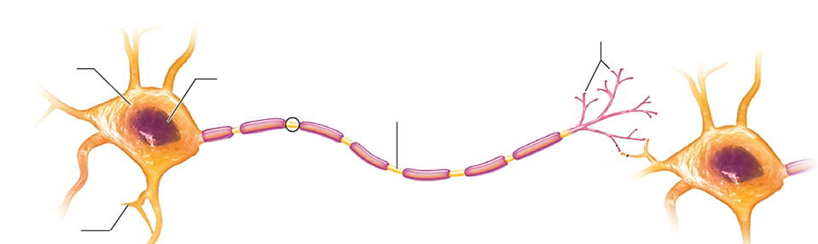




The Structure and Function of Neurons
Neurons process and transmit information
  Two types of branches extend from the cell body: axons and dendrites
Notes:
IMAGE: [©Argosy Publishing, Inc.] (Cacioppo, Figure 4.20, p. 135)
Neurons and Neurotransmission 2 of 11
A neuron is a specialized nerve cell that processes and transmits information
Neurons are like other types of animal cells
The cell body contains the nucleus
The fatty membrane separates intracellular and extracellular fluids
Neurons perform the usual tasks of all cells
Basic housekeeping
Metabolic functions
Protein manufacturing
Neurons are unlike other cells in a few ways
Include specialized branches (axons and dendrites), which pass information to and receive information from other cells
Axon: branch of a neuron that is usually responsible for transmitting information to other neurons
Dendrite: branch from the neural cell body that usually receives input from other neurons
Learn about the structure, function, and types of neurons at
https://www.youtube.com/watch?v=cUGuWh2UeMk (4:08)

Slide 9
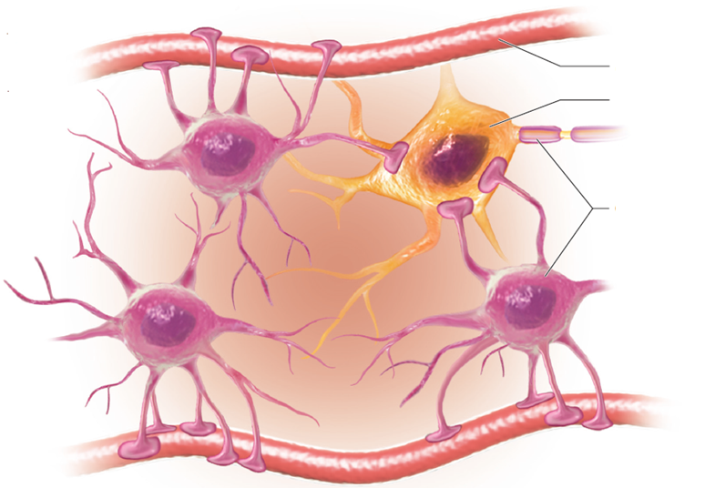


Glial Cells and the Blood-Brain Barrier
Notes:
IMAGE: [©Argosy Publishing, Inc.] (Cacioppo, Figure 4.21, p. 136)
Neurons and Neurotransmission 3 of 11
Glial cells
Form the framework that holds neurons in place
Create tight connections with blood vessels serving the brain, the blood-brain barrier
Clean up debris where neurons have been damaged
Learn more about the functions of glial cells at https://www.youtube.com/watch?v=64MgiEDWyRg (8:00)

Slide 10
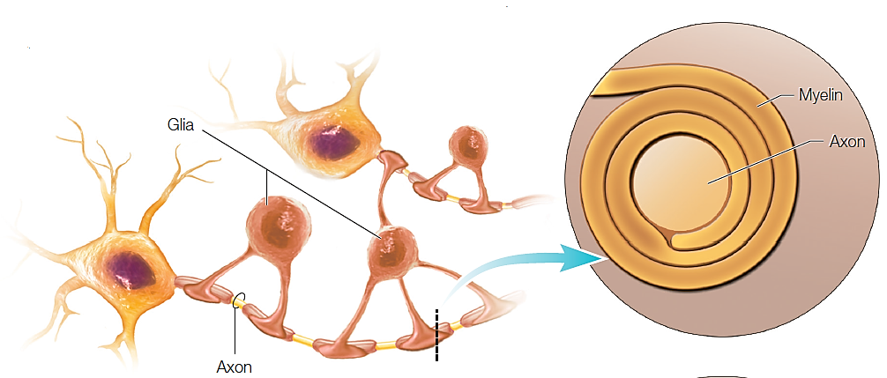
Glia Form Myelin
The myelin sheath insulates axons and speeds electrical transmission along axons
Notes:
IMAGE: [©Argosy Publishing, Inc.] (Cacioppo, Figure 4.22a, p. 137)
Neurons and Neurotransmission 4 of 11
Neurons are the “grey matter” of the brain and myelin is the white matter
The myelin sheath insulates and protects the axon, and speeds up transmission of electrical signals along the axon and is generated by glial cells
Myelin in the brain and spinal cord forms scar tissue when damaged, interfering with transmission; myelin in the rest of the nervous system does not
Learn about the advantages of myelin at:
http://www1.pbrc.hawaii.edu/~danh/InvertebrateMyelin/advantages.html

Slide 11
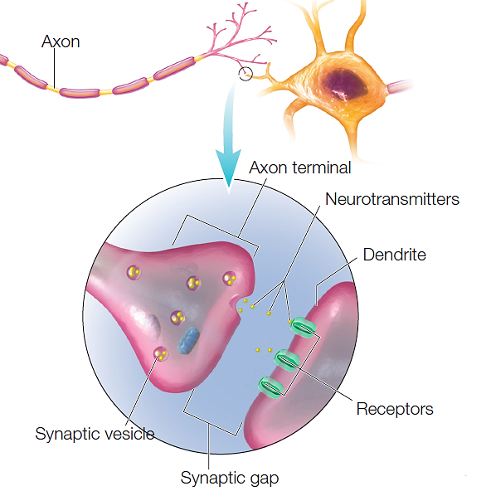
Axons Transmit Information
Notes:
IMAGE: [©Argosy Publishing, Inc.] (Cacioppo, Figure 4.20, p. 135)
Neurons and Neurotransmission 5 of 11
An axon is the branch of a neuron that is usually responsible for transmitting information to other neurons
Some axons are myelinated and some are not – myelin speeds up electrical transmission
The axon terminal contains synaptic vesicles, which contain chemical messengers called neurotransmitters that transmit signals between neurons
These neurotransmitters communicate with receptors on the dendrites of other neurons

Slide 12
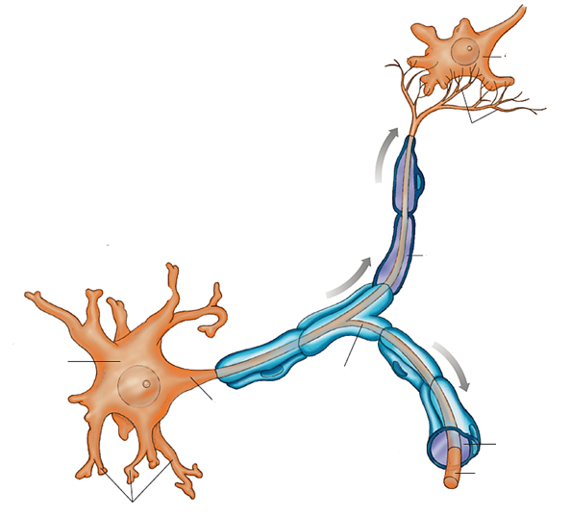






Dendrites Receive Information
Notes:
IMAGE: [©Cengage Learning] (Coon, Figure 7.3, p. 58)
Neurons and Neurotransmission 6 of 11
A dendrite is a branch from the neural cell body that usually receives input from other neurons
Neurotransmitters from the sending neuron communicate with receptors on the dendrites of other neurons
Nerve impulses usually travel from the dendrites and soma (cell body) to the branching ends of the axon

Slide 13
Neural Communication: A Two-Step Process
Electrical signaling: action potential
Chemical signaling: neurotransmitters
Notes:
IMAGE:[©Cengage Learning] (Coon, Figure 7.3, p. 58)
Neurons and Neurotransmission 7 of 11
There are two steps in the transmission of information between neuron
First step:
Takes place in the signaling neuron’s axon
Neuron generates an electrical signal known as an action potential
Signal travels the length of the axon from its junction with the cell body to its terminal
Second step
Takes place between two neurons
Arrival of an action potential at the axon terminal of the first neuron signals the release of neurotransmitters
Neurotransmitters float across the extracellular fluid separating the two neurons
On the influence of neurotransmitters, the second neuron may respond with its own action potential and send the message along
Read an overview of neurotransmission at
http://science.education.nih.gov/supplements/nih2/addiction/activities/lesson2_neurotransmission.htm

Slide 14
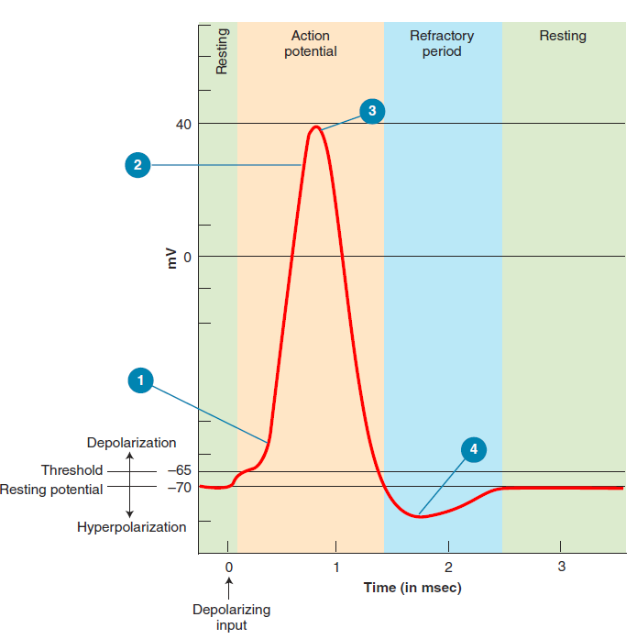
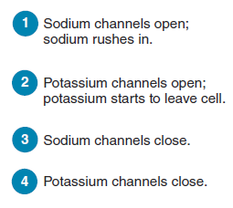
Generating an Action Potential
Notes:
IMAGE: [©Cengage Learning] (Cacioppo, Figure 4.23, p. 139)
Neurons and Neurotransmission 8 of 11
Now let’s look at the action potential in more detail:
When a neuron is not processing information, we say that it is at rest
When a cell is at rest, the difference between the readings from the interior of the axon and the external fluid is known as the resting potential
The interior of the neuron is negatively charged relative to its exterior
Neurons can respond to incoming chemical signals by becoming either depolarized or hyperpolarized
When a neuron is depolarized by sufficient input, it will reach a threshold
Reaching the threshold initiates a sequence of events that reliably produces an action potential
The size and shape of action potentials are always the same
Either an action potential occurs, or the cell remains at rest—there is no middle ground. Because of this consistency, we say that action potentials work in an all-or-none fashion
Watch this video to understand neurotransmission from a more physiological standpoint:
http://www.dnatube.com/video/1310/Physiology-of-an-Action-Potential

Slide 15
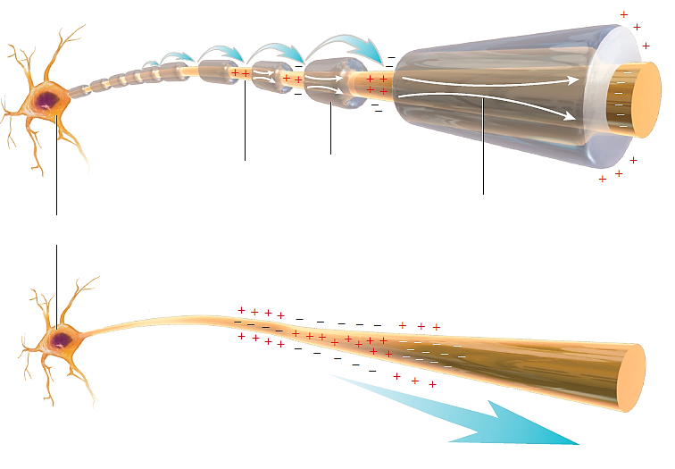







Electrical Signaling: Propagating an Action Potential
Notes:
IMAGE: [©Argosy Publishing, Inc.] (Cacioppo, Figure 4.24, p. 140)
Neurons and Neurotransmission 9 of 11
Action potentials do not affect the entire axon all at once
The next step is propagation, or the duplication of the electrical signal down the length of the axon to the axon terminal
Propagation takes place differently in myelinated and unmyelinated axons
In an unmyelinated axon, action potentials occur in a step-by-step manner, from one small section of the axon to the next
Action potentials in myelinated axons are formed only at the sections of the axon membrane between adjacent segments of myelin, known as nodes of Ranvier; propagation in myelinated axons can “skip” the sections covered in myelin, and is fast and efficient.
Once the action potential reaches the axon terminal, the neural communication system switches from an electrical signaling system to a chemical signaling one

Slide 16
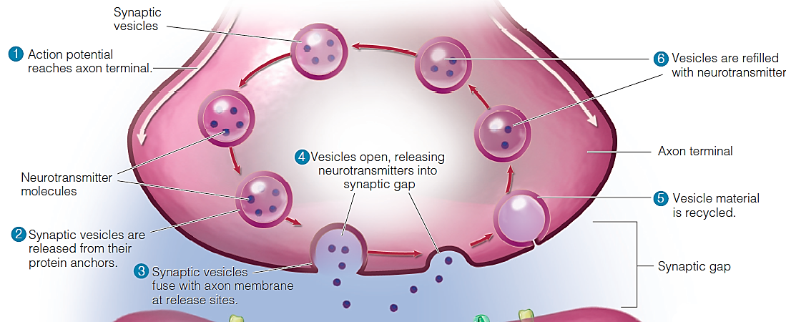
Chemical Signaling: Releasing Neurotransmitters
Notes:
IMAGE: [©Argosy Publishing, Inc.] (Cacioppo, Figure 4.25, p. 141)
Neurons and Neurotransmission 10 of 11
When an action potential arrives at a terminal, neurotransmitters are released
Neurotransmitters are stored in tiny sacs called synaptic vesicles
When a nerve impulse reaches the end of an axon, the vesicles move to the surface and release these chemical messengers across the synapse (or synaptic gap)
There are more than 50 different neurotransmitters
Acetylcholine is a neurotransmitter found in a number of systems important to behavior, e.g., at the neuromuscular junction, the synapse at which the nervous system commands muscles; they are also intimately involved in the brain circuits related to learning and memory
Norepinephrine is released in the brain and leads to arousal and vigilance
Dopamine is a neurotransmitter involved with systems that govern movement, planning, and reward
Serotonin is involved with systems regulating sleep, appetite, and mood
Endorphins (short for “endogenous morphine,” or morphine produced by the body) modify our natural response to pain (see also hormones, as endorphins act as both)
The video shows how the release of a specific neurotransmitter, dopamine, results in feelings of pleasure:
https://www.youtube.com/watch?v=M55co-GYTxQ
Look at a list of the most common neurotransmitters, their functions, and associated disorders, see:
http://thebrain.mcgill.ca/flash/i/i_01/i_01_m/i_01_m_ana/i_01_m_ana.html
(bottom half of page)

Slide 17
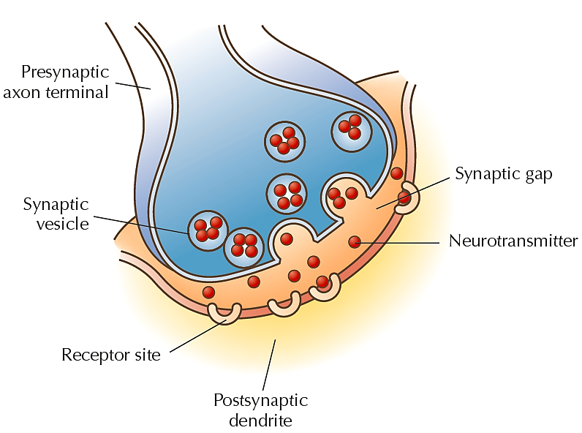
Communicating Through the Synapse
Notes:
IMAGE: [©Cengage Learning] (Coon, Figure 7.7, p. 61)
Neurons and Neurotransmission 11 of 11
The neurotransmitters released across the synaptic gap come into contact with special channels on the receiving neuron, known as receptors
Receptors work with the neurotransmitters like locks and keys
Neurotransmitters do not stay bound to receptors very long
Once they pop out of the receptor binding site, neurotransmitter molecules either drift away from the gap, are broken down by enzymes, or return to the axon terminal from which they were released in a process called reuptake
For a stylized animation of a synapse, see:
https://www.youtube.com/watch?v=90cj4NX87Yk

Slide 18
SECTION:
The Brain
This section covers:
  The structures and functions of the brain
  Methods for studying the brain
Notes:
IMAGE : Chapter 4, page 156 (Cacioppo)
[©Zephyr/Photo Researchers, Inc.]
Methods that allow scientists to observe the activity of the living brain are beginning to answer questions that were once impossible to study. Here, diffusion tensor imaging (DTI) highlights the rich connections formed by the white matter in the brain.
This section covers:
The structures and functions of the brain
Methods for studying the brain

Slide 19


The Organization of the Central Nervous System
Notes:
IMAGE: Figure 4.8 The Organization of the Central Nervous System (Cacioppo)
[©Argosy Publishing, Inc.]
The Structures and Functions of the Brain (1 of 11)
There are two major components of the nervous system:
The central nervous system consists of the brain and spinal cord
The peripheral nervous system consists of the somatic nervous system and the autonomic nervous system (discussed in the next section)

Slide 20
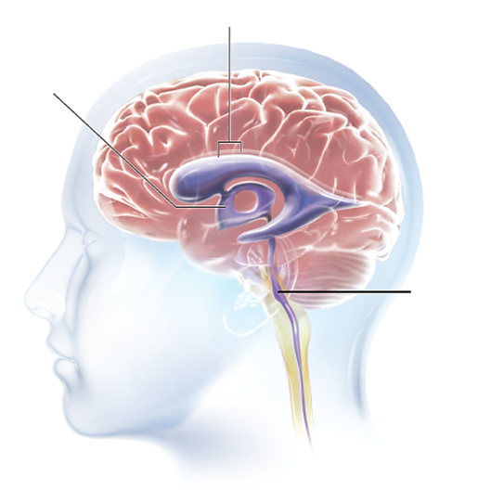


The Ventricles of the Brain
Notes:
IMAGE: Figure 4.9 The Ventricles of the Brain (Cacioppo)
[©Argosy Publishing, Inc.]
The Structures and Functions of the Brain (2 of 11)
The spinal cord and brain are cushioned by cerebrospinal fluid, which is generated by the ventricles
Learn more about the ventricles of the brain at https://www.youtube.com/watch?v=9hI1j4xQ-n8 (5:13)
Find out about hydrocephalus, which occurs when the normal flow of cerebrospinal fluid is impeded, at https://www.youtube.com/watch?v=bHD8zYImKqA (6:08)

Slide 21
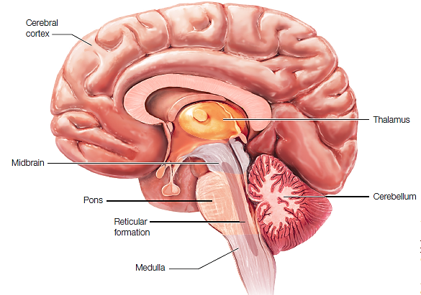
The Structures of the Brainstem
Notes:
IMAGE: Figure 4.12 Structures of the Brainstem. (Cacioppo)
[©Argosy Publishing, Inc.]
The Structures and Functions of the Brain (3 of 11)
The hindbrain is composed of the medulla, pons, and cerebellum
The medulla merges with the spinal cord
Contains large bundles of axons traveling to and from higher levels of the brain
Manages many essential functions, such as heart rate and blood pressure, and thus, damage to the medulla usually results in quick death
The pons sits above the medulla
Involved with the management of sleep, arousal, and facial expressions
Connects the cerebellum to the rest of the brain
The cerebellum
Essential for maintaining balance and motor coordination and one of the first brain structures to be affected by alcohol
Recent research suggests the cerebellum is involved in a wide range of functions including language, cognition, and perception
The hindbrain is composed of the medulla, pons, and cerebellum
The midbrain sits above the pons
Contains a number of structures involved in sensory reflexes, movement, and pain
The reticular formation
Runs the length of the brainstem’s core from the upper medulla into the midbrain
Participates in the control of mood, arousal, and sleep
Learn more about the brainstem and the cerebellum at https://www.youtube.com/watch?v=yS3wJF1wnRA (9:02)

Slide 22


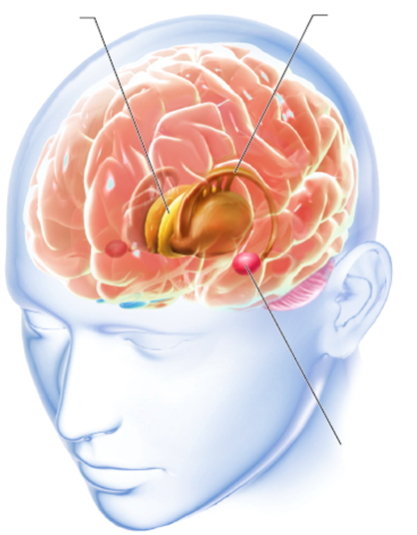
Subcortical Structures and Their Functions:
Thalamus – Basal Ganglia – Amygdala
Notes:
IMAGE: Figure 4.13 The Thalamus and Basal Ganglia (Cacioppo)
[©Argosy Publishing, Inc.]
The Structures and Functions of the Brain (4 of 11)
Early anatomists collected some of the subcortical structures into the limbic system
Sometimes referred to as the “emotional” brain
This term is losing popularity as the full range of functions in which subcortical structures play roles becomes better understood
Thalamus
Often referred to as the “gateway to the cortex,” as input from most of our sensory systems (vision, hearing, touch, and taste) travels first to the thalamus
Involved with memory and states of consciousness
Basal ganglia
Collection of large structures involved with voluntary movement
Degeneration of the basal ganglia occurs in Parkinson’s disease, a condition that makes the initiation of voluntary movement extremely difficult
Involvement of the basal ganglia is also suspected in a number of other conditions, including obsessive- compulsive disorder (OCD) and attention deficit hyperactivity disorder (ADHD)
Amygdala
Appears to have a role in identifying, remembering, and responding to fear and aggression
Learn about the role of the amygdala in the development of PTSD: https://www.youtube.com/watch?v=fx5_vldZ1_I (2:22)

Slide 23

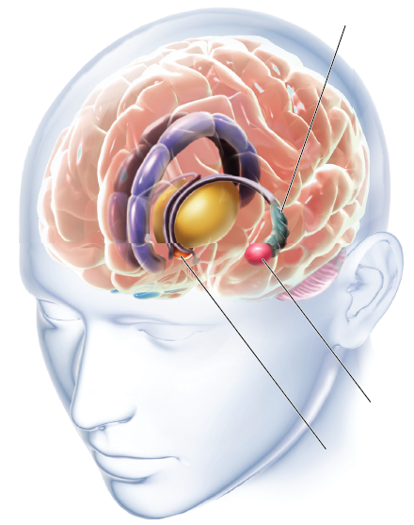

Subcortical Structures and Their Functions:
Hypothalamus – Hippocampus
Notes:
IMAGE: Figure 4.14 Other Important Subcortical Structures. (Cacioppo)
[©Argosy Publishing, Inc.]
The Structures and Functions of the Brain (5 of 11)
Hypothalamus
Collection of structures involved with motivation and homeostasis, or the regulation of body functions such as temperature, thirst, hunger, biological rhythms, and sexual activities
Carries out its motivational and homeostatic tasks by directing the autonomic nervous system and the endocrine system and its hormones
Hippocampus
Essential to the formation of long-term memories
Involved in the storage and retrieval of memories located elsewhere in the brain
Cingulate cortex
Forward two-thirds of this structure, known as the anterior cingulate cortex (ACC), participates along with the hypothalamus in the control of the autonomic nervous system
ACC also important in decision making, emotion, anticipation of reward, and empathy
The rear third, or posterior cingulate cortex (PCC), participates in memory and visual processing
Nucleus accumbens
Important part of the brain’s reward and pleasure circuitry
Listen to a TED talk about the hippocampus and memory at
https://www.ted.com/talks/neil_burgess_how_your_brain_tells_you_where_you_are
(8:59) (Neil Burgess)

Slide 24
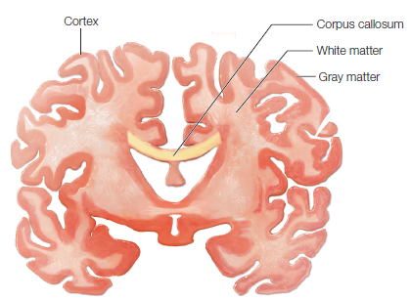
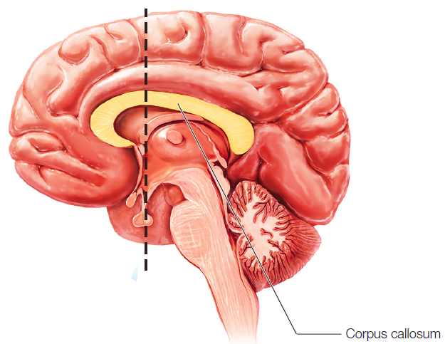
The Cerebral Hemispheres and the Corpus Callosum
Notes:
IMAGE: Figure 4.16 The Cerebral Cortex (Cacioppo)
[©Argosy Publishing, Inc.]
The Structures and Functions of the Brain (6 of 11)
Above the brainstem, we find the two large cerebral hemispheres
The corpus callosum is a large bundles of axons that connects these hemispheres
The cerebral cortex is the thin layer of cells covering the outer surface of the cerebral hemispheres
The cerebrum, hypothalamus, and thalamus are collectively referred to as the forebrain
Listen to a description of the cerebral cortex at
https://www.youtube.com/watch?v=dMdrnYGek7I (5:01). From the Charlie Rose Brain Series.

Slide 25
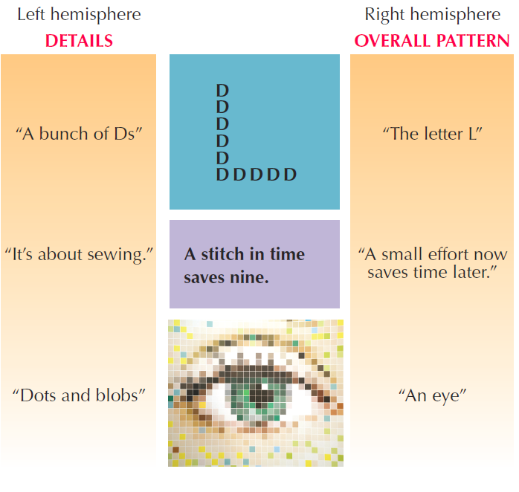
Hemispheric Specialization
Notes:
IMAGE: Figure 9.6 One Brain, Two Styles (Coon)
[©imagebroker.net/SuperStock]
The Structures and Functions of the Brain (7 of 11)
Hemispheric specialization:
Motor planning and sensation on the right half of the body are processed mainly by the left hemisphere, whereas these functions on the left half of the body are processed mainly by the right hemisphere.
Many myths about “right brain” versus “left brain” abilities and personalities have not stood up to the tests of science. However, in most people, language is processed primarily by the left hemisphere, and positive emotions may be lateralized to the left as well.
Evidence suggests that spatial orientation and most negative emotions may be lateralized to the right hemisphere of the cortex.
The left and right brain have different information processing styles. The right brain gets the big pattern; the left focuses on small details.

Slide 26
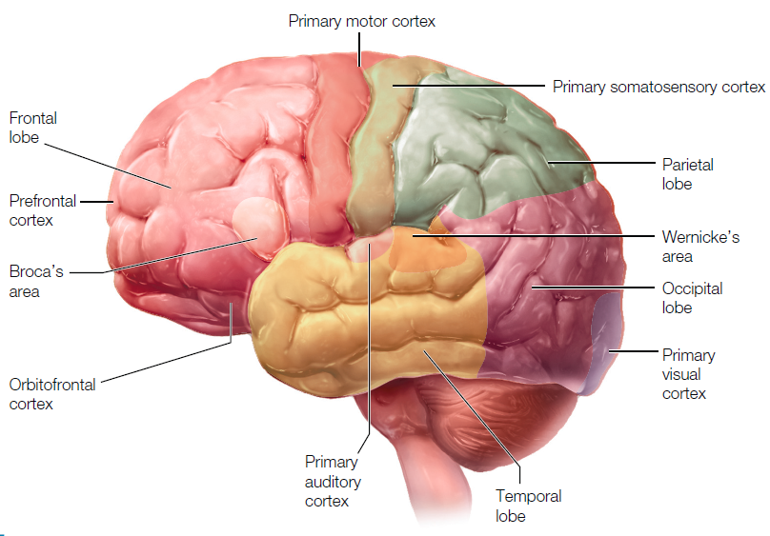
The Four Lobes of the Cerebral Cortex
Notes:
IMAGE: Figure 4.12 Lobes of the Cerebral Cortex. Some functions are localized and lateralized in the cortex. (Cacioppo) [©Argosy Publishing, Inc.]
The Structures and Functions of the Brain (8 of 11)
Frontal lobe
Home of the primary motor cortex
Has a number of important, sophisticated cognitive functions
The most forward portion of each frontal lobe, known as the prefrontal cortex, is involved with the planning of behavior, attention, and judgment
The orbitofrontal cortex, a part of the prefrontal cortex located just behind the bony orbits protecting the eyes, plays an important role in our emotional lives
Occipital lobe
Located at the back of the brain
Home to the primary visual cortex
Two important pathways link the occipital lobe with the rest of the brain
A pathway connecting the occipital lobe with the temporal lobe allows us to recognize objects we see
The second pathway connects the occipital lobe with the parietal lobe and allows us to process the movement of objects
Temporal lobe
Has a number of areas that are specialized for particular functions
Home to our primary auditory cortex, which allows us to process incoming sounds
Processes some higher visual system tasks including the recognition of objects and the faces of familiar people
Parietal lobe
Home to our primary somatosensory cortex, which helps us localize touch, pain, skin temperature, and body position
Processes input about taste and, like the temporal lobe, engages in some complex processing of vision

Slide 27
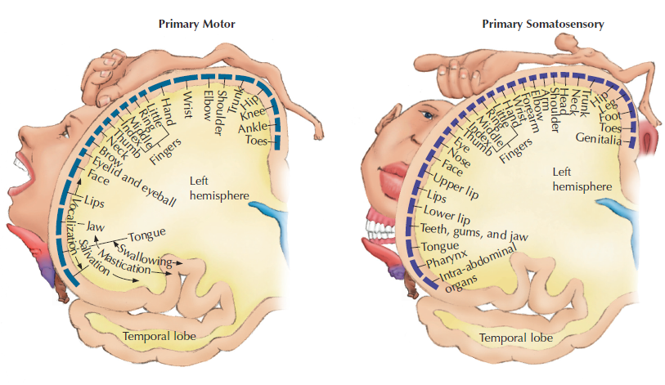
Sensory and Motor Functions in the Cerebral Cortex
Notes:
IMAGE: Figure 9.8 Functions of some cortical areas. (Coon)
[©Cengage Learning]
The lobes of the cerebral cortex and the primary sensory, motor, visual, and auditory areas on each. The top diagrams show (in cross section) the relative amounts of cortex “assigned” to the sensory and motor control of various parts of the body. (Each cross section, or “slice,” of the cortex has been turned 90 degrees so that you see it as it would appear from the back of the brain.)
The Structures and Functions of the Brain (9 of 11)
An area of the cortex can have sensory, motor, and/or association functions
Practice highlighting different areas of the brain at
http://www.pbs.org/wgbh/nova/body/mapping-the-brain.html

Slide 28
Studying the Brain
Technology | Procedure | What Questions Can We Answer?
electroencephalogram (EEG) | electrodes (to track electrical activity) | What is a person’s state of arousal?
positron emission tomography (PET) | radioactively tagged glucose or oxygen (to track chemical activity) | What parts of the brain are active during a particular task?
functional magnetic resonance imaging (fMRI) | magnets (to track the flow of oxygen) | What parts of the brain are active during a particular task?
Notes:
The Structures and Functions of the Brain (10 of 11)
Modern technologies allow us to collect information about the brain.
An electroencephalogram (EEG) measures the brain’s electrical activity using electrodes placed on the scalp
A positron emission tomography (PET) scan uses the accumulation of radioactively tagged glucose or oxygen to identify activity levels in parts of the brain
Magnetic resonance imaging (MRI) uses magnetism to form images of the brain
Functional magnetic resonance imaging (fMRI) identifies active parts of the brain using magnetism to track the flow of oxygen
Our understanding of the correlations between brain and behavior leaped forward with continuing improvements in research methods. In particular, methods that allow scientists to observe the activity of the living brain, including positron emission tomography (PET) and functional magnetic resonance imaging (fMRI), began to answer questions that were impossible to study previously.
Because of these improved methods, today we can talk about how the brain responds differently to images of faces and places (Downing, Chan, Peelen, Dodds, & Kanwisher, 2006), “feels” the pain of social exclusion (Eisenberger, Lieberman, & Williams, 2003; Eisenberger, 2011), and develops abnormally in teens diagnosed with schizophrenia (Thompson et al., 2001). Moving into the 21st century, the ranks of neuroscientists continue to grow, from 500 members of the Society for Neuroscience in 1969 to more than 40,000 members today (Society for Neuroscience, 2011).
Learn more about fMRI at https://www.youtube.com/watch?v=lLORKtkf2n8 (4:00)
Compare the methods of studying the brain at https://www.youtube.com/watch?v=nFmYvp-NT1w (3:12)

Slide 29
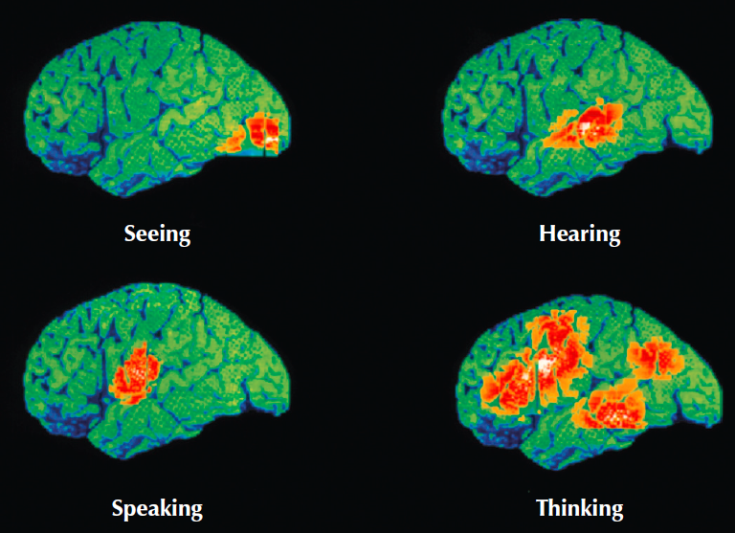
Brain Imaging
MRI
PET
Can you identify any of these brain regions?
Notes:
IMAGES:
Figure 8.1 MRI (Coon) [©Pete Saloutos/Keepsake RM/Corbis]
A colored MRI scan of the brain reveals many details.
Figure 8.4 PET scans (Coon) [©WDCN/Univ. College London/Science Source]
PET scans reveal different patterns of brain activation when we engage in different tasks
The Structures and Functions of the Brain (11 of 11)
Modern imaging technology can provide incredible detail and insight into brain structures and functions
Look at Einstein’s brain at http://video.pbs.org/video/2304521197/ (3:39)
(PBS Nova, 2012)
Learn about what scans can tell us about behavior at https://www.youtube.com/watch?v=esPRsT-lmw8 (14:36)

Slide 30
The Endocrine System
This section covers:
  The endocrine glands
  The functions of hormones
Notes:
IMAGE: [©Argosy Publishing, Inc.] (Cacioppo, Figure 4.19, p. 132): The glands of the female endocrine system.
The Endocrine System 1 of 4
This section covers:
The endocrine glands
The functions of hormones

Slide 31
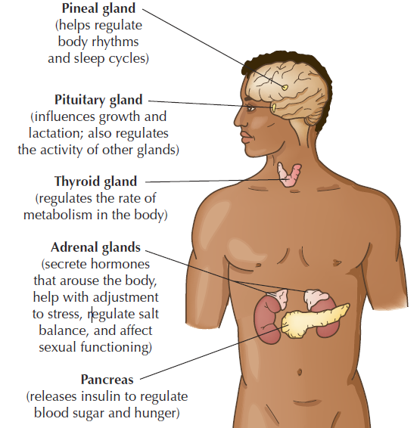
The Endocrine Glands
Notes:
IMAGE: [©Cengage Learning] (Coon, Figure 10.3, p. 86)
The Endocrine System 2 of 4
The endocrine system is comprised of a number of glands that release chemical messengers known as hormones into the bloodstream to communicate with other body parts
Responds to input from the nervous system and from the hypothalamus in particular
Especially involved with arousal, metabolism, growth, and sex
Important glands of the endocrine system include the pineal gland, the pituitary gland (known as the “master gland” due to its role in regulating the functioning of other glands), the thyroid gland, and the adrenal glands.
In males, the major reproductive glands are the testes.
They are responsible for secreting testosterone, which influences sexual function and plays a critical role in puberty.
In females, the major reproductive glands are the ovaries.
They are responsible for secreting estrogen, which influences sexual function, plays a critical role in puberty, and is one of the major hormones involved in the menstrual cycle.

Slide 32
The Pituitary Gland
Notes:
IMAGE: [©Cengage Learning] (Coon, Figure 10.1, p. 83)
The Endocrine System 3 of 4
The pituitary gland
Often referred to as the body’s master gland, because many of the hormones it releases activate the body’s other glands
Regulated by the hypothalamus, which lies directly above it
Two types of pituitary hormones
One group, including oxytocin and vasopressin, is released directly from the pituitary
Oxytocin participates in a number of important functions, including breastfeeding, and also plays a major role in human bonding
The second group consists of several hormones that influence the release of hormones by other glands
Pituitary hormones direct the release of growth hormone, which stimulates growth and regeneration, making it a popular performance-enhancing substance used illegally by some elite athletes
The pituitary also releases endorphins that relieve pain
Learn more about the hypothalamus and the pituitary at https://www.youtube.com/watch?v=nNLsXKkLSTs (4:57)

Slide 33
Endorphins and Other Important Hormones
Hormone | Function
Endorphins | Endogenous morphines that modify our natural response to pain; act as neuromodulators
Melatonin | Released by the pineal gland in response to daily cycles of light and dark
Epinephrine | Adrenal hormone that tends to arouse the body; associated with fear
Norepinephrine | Neurotransmitter and adrenal hormone that tends to arouse the body; associated with anger
Thyroid hormones | Help regulate metabolism rate
Notes:
The Endocrine System 4 of 4
Endorphins (short for “endogenous morphine,” or morphine produced by the body) modify our natural response to pain
Other important hormones include melatonin, epinephrine, norepinephrine, and the thyroid hormones, and the sex hormones

