Slide 1
Chapter 18: Applied Psychology

Slide 2
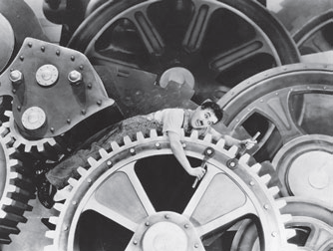
Industrial / Organizational (I/O) Psychology
This section covers:
Leadership theories
Leadership strategies
Job satisfaction
Characteristics of organizations
Personnel psychology and Selection procedures

Slide 3
Applied Psychology and I/O Psychology
Applied psychology
Uses psychological principles and research methods to solve practical problems
Industrial/Organizational (I/O) psychology
Studies people at work and in organizations
Notes:
Largest applied areas: clinical and counseling psychology
I/O psychology
Identifies job skills and selects and trains people for those jobs (the industrial part)
Creates structures and company cultures that will improve worker performance (the organizational part)

Slide 4
Leadership Theories
Type of Leadership | Theory X | Theory Y | Transformational
Emphasis | Work efficiency | Psychological efficiency | More complete organization
Orientation | task oriented | People oriented | Organization oriented
Perspective | Maximum output at lowest cost | People like challenging work and will work hard given the right conditions | People exceed expectations when they are inspired and intellectually stimulated
Notes:
Page 572-3
TYPES OF LEADERSHIP
Theory X leadership (scientific management): emphasizes work efficiency (maximum output at lowest cost), e.g., assembly lines, job specialization
Theory Y leadership: emphasizes psychological efficiency and views people as industrious, responsible, and interested in challenging work
Transformational leadership: aimed at transforming employees to exceed expectations and look beyond self-interest to help organization better compete
Leadership stereotypes: men viewed as agentic (dominant, confident) and as better leaders, while women viewed as communal (dependent, caring)
Stereotypes: Leadership by Gender (feature box on Critical Thinking: From Glass Ceiling to Labyrinth) p 573
WHY TITLED GLASS CEILING TO LABYRINTH? WHAT IS THE “LABYRINTH”?
MEN: agentic (dominant, confident)
WOMEN: communal (dependent, caring
Maybe as gender stereotypes fade and theory Y gains wider acceptance, women will escape the “labyrinth”
The clash in leadership stereotypes and stereotypes of women.

Slide 5
Leadership Strategies
Shared leadership
Management by objectives
Self-managed teams
Quality circles
Notes:
TWO STRATEGIES OF Theory Y and transformation leadership (p 574)
Shared leadership (participative management): employees at all levels involved in decision making
Management by objectives: workers given specific goals to meet so they can know if they are doing a good job
SOME GIVE GROUPS OF WORKERS EVEN GREATER FREEDOM/RESPONSIBILITY
Self-managed team: work group with freedom in how they achieve the shared goals of the group
HOW CAN NON MANAGEMENT WORKERS GET INVOLVED IN MANAGEMENT DECISIONS? (p 574)
Quality circles: voluntary employee discussion groups that make suggestions to improve quality and solve problems

Slide 6
Job Satisfaction
Job satisfaction: good fit between work and a person’s
Interests abilities
needs
expectations
Theory Y leadership tends to improve
job satisfaction over Theory X leadership.
Notes:
Job satisfaction: degree of comfort and satisfaction with one’s work (good fit between work and one’s needs)
Flexible Work Arrangements
Flextime: starting and quitting times flexible, as long as employees are present during a core work period
Compressed workweek: fewer days but more hours a day
Flexplace (telework, telecommuting): using a computer to remain connected to the office throughout the work day
Job enrichment: making a job more personally rewarding, interesting, or intrinsically motivating by increasing the worker’s knowledge and skills

Slide 7
Characteristics of Organizations
Organizational Culture
blend of customs, beliefs, values, attittudes and rituals within an organization
Creates organization’s unique “flavor”
Includes things like dress code and how workers are hired and trained
Workers who display good fit, conscientiousness, helpfulness, and participation are good organizational citizens
Notes:
Organizational culture: the blend of customs, beliefs, values, attitudes, and rituals within an organization, e.g., how workers are hired and trained; dress code
Organizational citizenship: making positive contributions to the success of an organization in ways that go beyond one’s job description
Desk rage: workplace anger
Common triggers: job-related stresses, such as feelings of being treated unfairly; conflict with others
Companies now offer mental health services to troubled employees.

Slide 8
Personnel Psychology and Selection Procedures
Personnel Psychology
Concerned with enhancing success in hiring with good fit between employees and organizations
Work with testing, selection, placement and promotion of employees
Selection Procedures
Job analysis-understand the role being filled
Collecting biodata from applicants
Interviews
Psychological testing
Notes:
Personnel psychology: concerned with testing, selection, placement, and promotion of employees
Job analysis: a detailed description of the skills, knowledge, and activities required by a particular job
Job analysis is the first step in personnel selection and is done by interviewing expert workers and supervisors.
Critical incidents: situations that arise in a job with which a competent worker must be able to cope
Biodata: detailed biographical information from applicants
Aptitude tests: evaluations that rate a person’s potential to learn skills or tasks used in various occupations
Personal interview: formal or informal questioning of job applicants to learn their qualifications and to gain an impression of their personalities
Halo effect: tendency of interviewer to extend favorable or unfavorable impressions to unrelated aspects of a person’s personality
Impression management: seeking to portray a positive image to interviewers
Vocational interest tests: paper-and-pencil tests that assess a person’s interests and match them to interests found among successful workers in various occupations, e.g., Strong-Campbell Interest Inventory and Kuder Occupational Interest Survey
Assessment center: program within organizations to conduct in-depth evaluations of potential employees
Situational judgment tests: present realistic work situations to observe applicant’s skills and reactions
In-basket test: simulates individual decision-making challenges that executives face; basket full of memos is given to applicant to read and take appropriate action
Leaderless group discussion: test of leadership that simulates group decision making and problem solving
Testing:
vocational interest tests. These tests assess people’s interests and match them to interests found among successful workers in various occupations
aptitude tests tests that rate a person’s potential to learn tasks or skills used in various occupations.
situational judgment tests are used to present difficult but realistic work situations to applicants
in-basket test simulates the decision-making challenges executives face
leaderless group discussion test of leadership that simulates group decision making and problem solving.

Slide 9
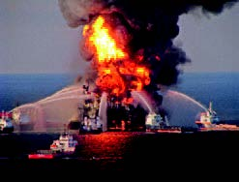
Human Influences on the Environment
This section covers:
Environmental psychology
Stressful Environments
crowding
Attentional overload
noise pollution
Overpopulation
Environmental damage and Resource consumption
Social dilemmas
Environmental problem solving
Oil Rig Explosion

Slide 10
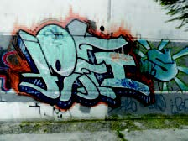
Environmental Psychology
What do environmental psychologists do?
Look at social environments, physical environments, and behavioral settings to consider environmental impacts
Look at how environmental settings influence behavior
Structure of public settings can influence rates of crime
Shopping areas can be structure to encourage lingering
Look at territorial behaviors
What types of spaces cane be “owned” or “saved”?
When-and how- do we mark territory?
Notes:
Environmental psychology: specialty concerned with the relationship between environments and human behavior
Types of environments:
physical (natural or constructed);
social (defined by groups and their activities, e.g., party);
behavioral setting (smaller well-defined area, e.g., office)
Territorial behavior: any behavior that defines a space as one’s own or protects it from intruders
Territorial markers: objects that indicate control of a particular area, e.g., photos in an office, graffiti, or a “gated community”

Slide 11
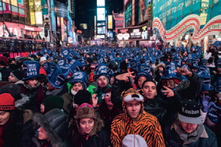
Stressful Environments: Crowding
Pathological effects of crowding (John Calhoun’s research)
Does crowding cause pathological behaviors?
Crowding v. Density
Crowding: subjective feeling of being overstimulated by social inputs or loss of privacy
Density: number of people in a
given space
Notes:
John Calhoun studied the effects of overcrowding among animals (rats)
Found high rate of pathological behavior in both males (aggression) and females (lack of maternal behavior) (page 581)
Pregnancies decreased, and infant mortality ran extremely high. Many of the animals became indiscriminately aggressive and went on rampaging attacks against others. Abnormal sexual behavior was rampant, with some animals displaying hypersexuality and others total sexual passivity. Many of the animals died, apparently from stress-caused diseases. The link between these problems and
overcrowding is unmistakable. (page 581)
Effects of overcrowding on humans
It is tempting to assume that violence, social disorganization, and declining birthrates as seen in these areas are directly related to crowding. However, the connection has not been so clearly demonstrated with humans (Evans et al., 2010). People living in the inner city suffer disadvantages in nutrition, education, income, and health care. These conditions, more than crowding, may deserve the blame for pathological behaviors. (page 581)
Density: number of people in a given space
Crowding: subjective feelings of being overstimulated by social inputs or a loss of privacy Times Square
Whether high density is experienced as crowding depends on the relationships among those involved. (page 581) when crowding causes loss of control over one’s immediate environment, it results in stress and possibly health problems.

Slide 12
Stressful Environments: Attentional Overload and Noise Pollution
Attentional Overload
Stimulation from senses, information, social contact make excessive demand on attention
Experienced as a stressful condition
Concept from Stanley Milgram, who said city dwellers prevent it by ignoring nonessential events, seeming “callous”
Noise Pollution
Stressful and intrusive noise
Causes stress symptoms such as high blood pressure, reduced attention
Notes:
Attentional overload: stressful condition that occurs when sensory stimulation, information, and social contacts make excessive demands on attention (p. 581)
City dwellers prevent attentional overload by engaging only in brief, superficial contacts, ignoring nonessential events, and being cold and unfriendly
Noise pollution: stressful and intrusive noise, including noises made by animals, humans, or artificially generated by machinery
Children have shown stress, higher blood pressure, and poor reading skills due to noise pollution.

Slide 13
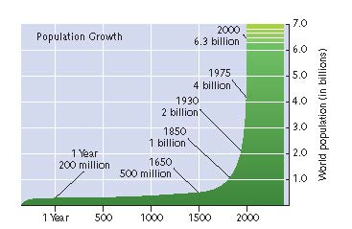
Overpopulation
One of the top problems facing the world today
World Population: >7.2 billion
Estimated world population by 2050: 9.6 billion
Maximum sustainable population of earth: between 5-20 billion
Notes:
World population is now more than 7.2 billion people and may exceed 9.6 billion by 2050. (The maximum sustainable population of Earth is estimated at between 5 and 20 billion.) (p. 583)
Pessimistic experts think we’ve already exceeded the number of people that the earth can sustain indefinitely (p. 583)

Slide 14
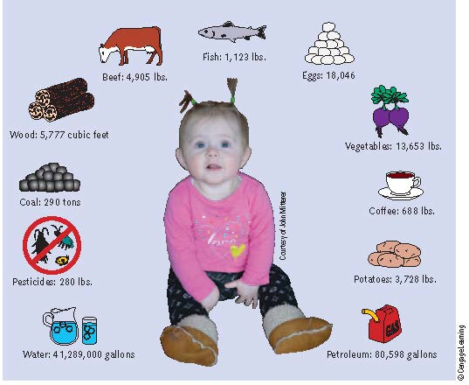
Environmental Damage and Resource Consumption
Overpopulation is closely connected to environmental damage
Most environmental problems trace to human overuse of natural resources.
How can we improve resource use?
Reduce ecological footprint
Conservation
Reduce carbon footprint
Reduce, reuse, recycle
Individuals, industries, and
governments
Notes:
Most environmental problems can be traced back to the human tendency to overuse natural resources. We alter natural cycles, animal populations, and the face of the earth. We burn fuels, destroy forests, use chemicals and strip, clear, and farm land.
Through these alterations: climate change, plant and animal extinction, ozone hole, pollution to air, water (oceans), land.
Resource consumption can be measured as a(n):
Ecological footprint: amount of land and water area required to replenish the resources that a human population consumes
Carbon footprint: volume of greenhouse gases individual consumption adds to the atmosphere
Major barriers to conservation include a lack of control and a lack of feedback.
Programmable thermostats, smart meters, and energy-saving appliance settings can help.
Recycling can be encouraged by:
Learning about environmental problems
Providing monetary rewards for recycling
Removing barriers to make recycling more convenient
Using persuasion and revising attitudes about recycling
Obtaining public commitments and goal setting
Giving feedback about how much is being recycled

Slide 15
Environmental Problems and Social Dilemmas
Social dilemmas contribute to many environmental problems.
A social dilemma is a social situation that rewards actions that have undesired effects in the long run.
No individual acts intentionally against group interest
When everyone acts alike, the cumulative effect is harm
Tragedy of the Commons
A specific type of social dilemma in which each person acts in his or her self-interest resulting in collectively using too much of a scarce resource.
Notes:
Social dilemma: any social situation that rewards actions that have undesired effects in the long run
Because everyone wants to drive a car to work, traffic jams and a lack of parking spaces in cities occur.
Tragedy of the commons: social dilemmas in which individuals, each acting in his or her self-interest, overuse a scarce resource
Individuals each watering their own lawns during a drought overuse water so no one has enough water.
Ways to escape dilemmas: persuasion, education, and rearranging rewards and costs
CAN YOU THINK OF EXAMPLES?
Social dilemma example page 584: Overcrowded highways with underused public transportation.
Individuals think driving is more convenient, but when everyone does it, it becomes inconvenient.
Tragedy of Commons example page 585: already discussed previously the lack of individual incentives to conserve gas, water, electricity. If everyone overuses, it taxes the system.
Other examples: polluting waterways/rivers. Throwing trash on the roadside, using plastic bags then throwing away. Farmers using pesticides on crops to save from insect damage, but if every farmer does, the water becomes polluted.

Slide 16
Escaping Dilemmas
How do we escape social dilemmas?
Persuasion
Education
Rearranging the rewards and costs associated with behaviors
Some problems are harder and require a multi-pronged approach
Notes:
Persuasion and education have been used with some success to
get individuals and businesses to voluntarily reduce destructive
activities. Effective appeals may be based on self-interest (cost
savings), the collective good (protecting one’s own children and
future generations), or simply a personal desire to take better care
of the planet (page 585)
rearranging rewards and costs. For example, many companies are
tempted to pollute because it saves them money and increases
profits. To reverse the situation, a pollution tax could be levied so
that it would cost more, not less, for a business to pollute. (p. 585)
Likewise, incentives could be offered for responsible behavior. An
example is the rebates offered for installing insulation or buying
energy-efficient appliances (p. 585)

Slide 17
Environmental Problem Solving
How do environmental psychologists find solutions to environmental problems?
Environmental assessment: analysis of effects that an environment has on behavior and perceptions
Architectural psychology: study of the effects of buildings on behavior and the design of buildings using behavioral principles
Solution to Crowding in Dorms
Notes:
environmental assessments see how environments influence the behavior and perceptions of the people using them.
For example, anyone who has ever lived in a college dorm knows that at times, it can be quite a “crazy house.” In one wellknown
environmental assessment, Baum and Valins (1977) found that students housed in long, narrow, corridor-design dormitories
often feel crowded and stressed. The crowded students tended to withdraw from others and even made more trips to the campus
health center than students living in less-crowded buildings. (example shown on slide) (page 585)
Architectural psychology: study of the effects of buildings on behavior and the design of buildings using behavioral principles
What sort of solution does this suggest? A later study showed that small architectural changes can greatly reduce stress in highdensity
living conditions. Baum and Davis (1980) compared students living in a long-corridor dorm housing 40 students with those
living in an altered dorm where the hallway was divided in half, with unlocked doors, and three center bedrooms were turned into a
lounge area (● Figure 18.3). At the end of the term, students living in the divided dorm reported less stress from crowding. They also
formed more friendships and were more open to social contacts. Incomparison, students in the long-corridor dorm felt more crowded,
stressed, and unfriendly, and they kept their doors shut much more frequently—presumably because they “wanted to be alone.”

Slide 18
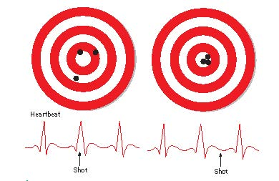
Psychology of Law, Education, and Sports
This section covers the
Psychology of Law
Jury behavior
Scientific jury selection and death-qualified juries
Psychology of Education
Teaching strategy
Learning and Teaching styles
Psychology of Sports
Psychological approach to sports
Peak performance
Sports psychologists found that top shooters squeeze the trigger between heartbeats.

Slide 19
Psychology of Law
Psychology of Law: study of the behavioral dimensions of the legal system
Topics of Special Interest in the Psychology of Law
Arbitration | Expert testimony | Memory
Attitudes toward law | Eyewitness testimony | Parole board decisions
Bail setting | Forensic hypnosis | Police selection
Capital punishment | Insanity plea | Police stress
Conflict resolution | Juror attitudes | Police training
Criminal personality | Jury decisions | Polygraph accuracy
Diversion programs | Jury selection | Sentencing decisions
Effects of parole | Mediation | White-collar crime
Notes:
Psychology of Law: study of the behavioral dimensions of the legal system (p. 587)
Conduct jury research, evaluate people for sanity hearings, do counseling in prisons, profile criminals, and select and train police cadets

Slide 20
Jury Behavior
Psychologists use mock or simulated juries to research how real jurors vote.
They have found that jurors:
Cannot set aside biases, attitudes and values when deciding verdict
Often fail to separate evidence from other information
Are influenced by inadmissible evidence
Have difficulty suspending
judgment until all information is in
Notes:
Mock jury: group that realistically simulates a courtroom jury to help understand what determines how real jurors vote. Volunteers read written evidence and arguments or watch videotapes of trials staged by actors
JURY BEHAVIOR
1. Jury research is unsettling and shows that jurors are rarely able to put aside biases, attitudes and values while making a decision.
Examples
Jurors are less likely to find attractive defendants guilty (on the basis of the same evidence) than unattractive defendants.
In one mock jury study, defendants were less likely to be convicted if they were wearing eyeglasses than if they were not.
2. Jurors not good at separating evidence from other information
Examples
if complex scientific evidence is presented, jurors tend to be swayed more by the expertise of the witness than by the evidence itself
their perceptions of the defendant, attorneys, witnesses and what they think the judge wants influence their decision
place too much confidence in DNA evidence
3 Verdict often influenced by inadmissible evidence
Examples
(mention of defendant’s prior conviction)
A related problem occurs when jurors take into account the severity of the punishment that a defendant faces (Sales & Hafemeister, 1985). Jurors are not supposed to let this affect their verdict, but many do.
4 Jurors have difficulty suspending judgment until all information is in (tend to make decision early in trial)

Slide 21
Scientific Jury Selection and Death-Qualified Juries
Scientific Jury Selection
Apply social science to jury selection
Collect demographic info on potential jurors
Survey community on attitudes toward case
Look for authoritarian personality traits
Look at nonverbal behavior
Death-qualified Jury
Must favor or have no opinion on death penalty
Tend to be male, high income, conservative, authoritarian
Notes:
Scientific jury selection: social science principles are applied to jury selection process
Collect demographic information of potential jurors
Community survey regarding attitudes toward case
Look for authoritarian personality traits in potential jurors (traits of those who tend to vote for conviction)
Look at nonverbal behavior
Death-qualified jury: must favor the death penalty or at least be indifferent to it
Tend to be male, white, high income, conservative, and authoritarian
How do you think the selection criteria cause bias? How would this bias affect juries willingness to convict?

Slide 22
Educational Psychology
Educational psychology: field that seeks to understand how students learn and teachers instruct
Teaching strategy: planned method of instruction
Step 1: Learner preparation
Step 2: Stimulus presentation
Step 3: Learner response
Step 4: Reinforcement
Step 5: Evaluation
Step 6: Spaced review
Notes:
Step 1: Learner preparation. Begin by gaining the learner’s
attention, focusing interest on the topic at hand.
Step 2: Stimulus presentation. Present instructional stimuli
(information, examples, and illustrations) deliberately and
clearly.
Step 3: Learner response. Allow time for the learner to
respond to the information presented (by repeating correct
responses or asking questions, for example).
Step 4: Reinforcement. Give positive reinforcement (praise,
encouragement) and feedback (“Yes, that’s right,” “No, this
way,” and so on) to strengthen correct responses.
Step 5: Evaluation. Test or assess the learner’s progress so that
both you and the learner can make adjustments when
needed.
Step 6: Spaced review. Periodic review is an important step in
teaching because it helps strengthen responses to key stimuli.(p. 589)

Slide 23
Learning and Teaching Styles
Learning Styles: how students learn best
Based on Howard Gardner’s multiple intelligences
Visual, hearing, or interpersonal learning are examples
Teaching Styles: ways teachers teach
Direct instruction
Discovery learning
Universal Design for Instruction: lessons designed to benefit students with diverse needs and learning styles
Use a variety of instructional methods
Make learning materials simple and intuitive
Notes:
There are many different approaches to the topic of learning
styles. One stems from Howard Gardner’s theory of multiple intelligences
(see Chapter 9). Someone high in language ability may
learn best by hearing or reading, someone high in visual intelligence
may learn best through pictures, someone high in interpersonal
intelligence may learn best working in groups, and so on (p. 589)
Direct instruction: factual information presented by lecture, demonstration, and rote practice. Students peform better on objective/standardized tests
Discovery learning: encourages students to construct knowledge for themselves. Students perform better on tests of abstract reasoning.
Universal design: box page 590
Use variety of instructional methods such as lecture, podcast of lecture, group activity, online discussion
Make learning materials simple and intuitive: remove unnecessary complexity, clear grading standards, complete course outlines.

Slide 24
Sports Psychology: Task Analysis and Motor Skills
Sports psychology: study of the psychological and behavioral dimensions of sports performance
Psychological Approaches to Sports
Task analysis
Motor skills research
Developing motor programs
How to optimize skill learning
How to reach Peak Performance
Notes:
Sports psychology: study of the psychological and behavioral dimensions of sports performance
Task analysis: breaking complex skills into subparts so key elements can be identified and taught. Such methods are an extension of techniques first used for job analyses, as described previously. (p 591)
Motor skills: Typically, athletic performances involve learning motor programs.
A motor program is a mental plan or model of what a skilled movement should be like. Motor programs allow an athlete—or a person simply walking across a room—to perform complex movements that fit changing conditions. If, for example, you have learned a “bike-riding” motor program, you can easily ride bicycles of different sizes and types on a large variety of surfaces.
Optimal skill learning involves
imitating a skilled model,
learning verbal rules,
practicing in lifelike natural units,
getting feedback,
using mental practice.

Slide 25
Reaching Peak Performance
Peak performance (flow):
physical, emotional, and mental states are harmonious and optimal
feelings of intense concentration, a lack fatigue, and a subjective slowing of time; “personal bests” occur
Athletes can mentally improve performance by
Ensuring arousal level is appropriate for the task
using imaging techniques to mentally rehearse task
using cognitive-behavioral and self-regulation strategies to guide efforts and evaluate performance
Notes:
Mental practice: imagining a skilled performance to help refine motor programs
Peak performance (flow): physical, emotional, and mental states are harmonious and optimal
feelings of intense concentration, a lack fatigue, and a subjective slowing of time; “personal bests” occur
Athletes can mentally improve performance by
making sure arousal level is appropriate for the task
For a sprinter at a track meet, that may mean elevating arousal to a very high level. For example,
the sprinter could try to become angry by picturing a rival cheating. For a golfer or a gymnast, lowering arousal may be crucial, in order to avoid “choking” during a big event.
using imaging techniques to mentally rehearse task
Play as a movie in ones mind, mental rehearsal of the task
using cognitive-behavioral and self-regulation strategies to guide efforts and evaluate performance
for instance, don’t get down on self if make an error, and avoid negative self critical thoughts, which tend to disrupt or distract performance. Learn tricks to focus on the positive and maintain confidence.

Slide 26
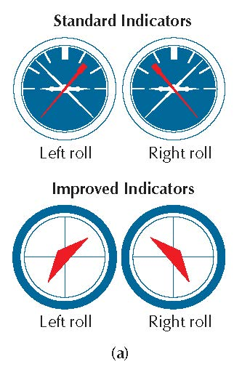
Human Factors Psychology
This section covers:
Natural Design
Feedback
Usability Testing
Human-Computer Interaction (HCI)
Using tools effectively
Space Habitats
In planes, improved roll displays are easier to read because of human factors psychology.

Slide 27
Designing for Human Use
Human factors psychology (ergonomics):
specialty concerned with making machines and work environments compatible with our sensory and motor capacities
Natural design: making use of perceptual signals the people understand naturally
Feedback: information the user receives in response to their action
Usability testing: research to see how easily users can learn to use a machine.
Notes:
Human factors psychology (ergonomics): specialty concerned with making machines and work environments compatible with our sensory and motor capacities
Natural design: making use of naturally understood perceptual signals,
e.g., vertical placement of elevator buttons to match the organization of the floors themselves.
metaphors like “desktop” used to design the computer’s main screen, and the “trash can” for files to delet
CAN YOU THINK OF OTHERS
Feedback: information about the effect of making a response, e.g., artificial sounds engineered into electric cars so pedestrians can detect their presence
Usability testing: empirical investigation of the ease with which people can learn to use a machine, e.g., thinking aloud protocol

Slide 28
Human-Computer Interaction (HCI) and Using Tools Effectively
HCI: the application of human factors to the design of computers and computer software
Using Tools Effectively
Understand your task
Understand your tools
Notes:
HCI: the application of human factors to the design of computers and computer software
Interface: a set of input and output devices that allow humans to communicate with computers
Telepresence: computer interfaces that create a sense of being in a remote location (telesurgery)
Using tools effectively Understand your task & understand your tools
Will Satisficing Work? = engaging in behavior that achieves an acceptable result, rather than an optimal result (will knowing just a little about how to use my camera give me “good enough” photos? That may only use a fraction of the camera’s capabilities. If you want the “best” instead the “good enough” you may have to maximize your understanding of your tools to maximize your knowledge of the task and how to complete it! (p. 595)

Slide 29
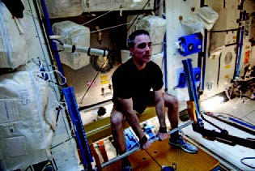
Human Factors Psychology in Space!
In helping formulate the International Space Station, human factors psychology provided the following insights:
Rooms should clearly define “up” and “down”
flexibility is needed for use of living and work areas
Offer solutions or constant noise on the space station, which disrupts sleep cycles
Address sensory monotony, stress, and
boredom by creating diversions, such as
movies and music
Provide areas of privacy for solitary activities
such as reading
Notes:
Human factors psychology can help us understand how to make many habitats human friendly.
An example is the International Space Station
In helping formulate the International Space Station, human factors psychology provided the following insights:
Rooms should clearly define “up” and “down”
flexibility is needed for use of living and work areas
Offer solutions or constant noise on the space station, which disrupts sleep cycles
Address sensory monotony, stress, and
boredom by creating diversions, such as
movies and music
Provide areas of privacy for solitary activities
such as reading

