Slide 1
Prosocial and Antisocial Behavior
This section covers:
  How we interact with others
  How our behavior is influenced by others
Notes:
IMAGE: [© Marmaduke St. Duke/Alamy] (Cacioppo, p. 497)
Social Influence 1 of 11
This section covers:
How the presence of others influences our behavior
How we interact with others
Think about how you behave for a second. Do you behave differently when you’re alone versus when others are around?
Are there things you do when alone that you wouldn’t do in front of others?
A lot of people like to sing in the shower, but would be mortified to do it in public.
The presence of other people can have a big impact on how we act.
Other people provide a social context in which certain behaviors are more acceptable than others.
The presence of others can even change the way we think about a situation.

Slide 2
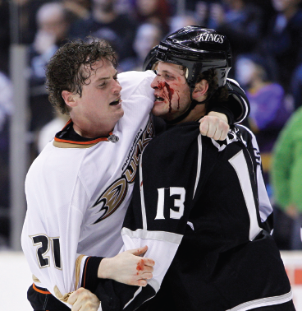
Aggression
An action done with the intent to harm others
Several contributing factors:
  Biology
  Frustration
  Learning
Notes:
IMAGE: [© Ric Tapia/Newscom] (Coon, p. 630)
Social Influence 9 of 11
Aggression is the conscious intent to harm others
Instrumental aggression occurs when harm is done because it helps in obtaining a particular goal.
A child that wants to play with someone else’s toy may hit that person to get them to drop the toy.
Hostile aggression occurs when causing pain or harm is the intended goal.
A child bullies a classmate by pushing him or her into a locker.
Relational aggression harms another person’s social standing through behaviors such as ignoring, exclusion, and gossip.
Defensive aggression involves harm done to others as a form of self-defense.
Although it is probably safe to say that our human heritage contains a capacity for aggression, the actual expression of aggression is elicited by environmental factors and modified by experience
The biological underpinnings of aggression reflect genetic, hormonal, and neurotransmitter influences.
Higher levels of testosterone are associated with increased capacity for aggression.
Some drugs, especially alcohol, lower inhibitions, which can lead to increased aggressive behavior.
The frustration-aggression hypothesis states that frustrating situations produce an internal motivation to act aggressively.
The aggression may be directed at the source of the frustration, such as a person hitting a dog that won’t stop barking.
Sometimes, aggression can’t be directed at the source, so it’s directed at an available target.
After getting reprimanded at work, a person may drive home in an aggressive manner, causing problems for others on the road.
Social-cognitive theorists view aggression as learned behaviors that are acquired through observational learning and reinforcement.
Children may see their parents or siblings modeling aggressive behavior.
Children often see aggressive actions being reinforced on television and in movies.
According to some estimates, the average child is exposed to several thousand acts of violence by the time they finish elementary school.
When the hero of a movie is rewarded for using violence against the “bad guy,” it sends a powerful message about the appropriateness of using violence.
The amount of violent programming a person watches is positively correlated with engaging in aggressive behaviors.
How can genes and the environment interact to produce criminal behavior? http://www.pbs.org/wgbh/nova/tech/criminal-minds.html (15:40)
Learn about the biology of aggression: https://www.youtube.com/watch?v=xj1l3OtTkVA (18:13) and the role of social factors in aggression: https://www.youtube.com/watch?v=EvSvw4sL4yo (24:07)

Slide 3
Altruism
Engaging in helping behaviors without the expectation of any personal gain
Notes:
IMAGE: [© AP Photo/Marl Lennihan] (Coon, p. 626)
Social Influence 10 of 11
Does the person lying on the ground need help?
What factors determine whether a person in trouble will receive help in an emergency?
Surprisingly, the presence of more potential helpers tends to lower the chances that help will be given.
Altruism is being willing to engage in helping behavior without any expectation of reward. In some cases, being altruistic actually comes with a cost.
Someone that is donating a kidney or bone marrow is putting themselves at a slight risk of having medical complications during the surgery.
If behavior usually leads to improved survival and reproduction, how can we account for altruism?
Several different evolutionary mechanisms have been proposed that account for the continuation of cooperative, altruistic behavior.
“Altruistic” genes will survive as long as the cost to the altruist is associated with a large enough benefit to relatives.
Selfishness might be limited by punishment administered by other group members.
Learn more about altruism: https://www.youtube.com/watch?v=db7li_TMJ0M (22:30)

Slide 4
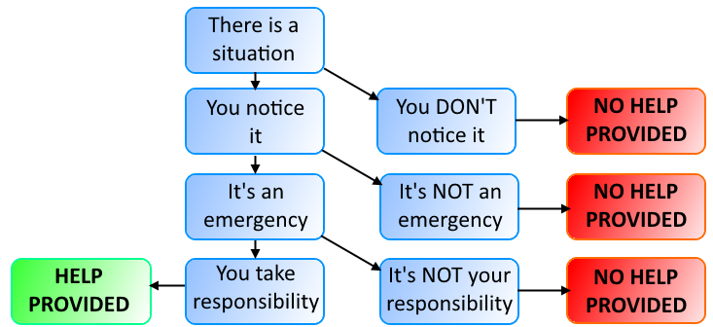
Bystander Apathy
People’s willingness to lend help decreases when others are around.
Notes:
Social Influence 11 of 11
One surprising finding about altruism is that people’s willingness to get involved in a situation or provide help is influenced by the presence of others. People often show bystander apathy, when other people are around.
The more people that are around to help, the less likely it is for any particular individual to get involved.
It’s as if people feel less responsibility since there are so many others who could provide help instead.
“It’s OK if I don’t help, because somebody will.”
Psychologists call this diffusion of responsibility.
Latané and Darley constructed a model of the thought process involved in deciding whether to provide help.
First, someone must actually notice the situation. If they’re distracted or preoccupied, they may not even know help is needed.
Next, they must determine whether it’s an emergency.
If a man is lying unconscious on the sidewalk, he might need medical assistance.
If that same man is lying in a car with the seat reclined, he’s probably just sleeping.
If there are a bunch of people milling about, the situation may not seem like an emergency. You might misinterpret what’s really happening.
Finally, they need to take responsibility for getting involved.
In a crowd, people are often reluctant to be the first to help, because they may not feel personally responsible.
When people see someone else helping, they’re more willing to jump in.

Slide 5
Stereotyping
A simplified set of traits that are associated with group membership
Notes:
IMAGE: [© Juan Camilo Bernal/Shutterstock.com] (Weiten, p. 427)
Social Cognition 10 of 13
Stereotypes are a simplified set of traits that are associated with group membership.
They provide a shortcut that can guide how you think about a person by allowing you to make certain assumptions.
Most stereotypes are based on sex, age, and race, but they can be applied to any group.
For instance, there are certain assumptions people make about teachers, athletes, fraternity/sorority members, blue-collar workers, people with certain religious beliefs, and a whole host of other groups.
They can even be based on split-second perceptions about someone’s appearance.
Often, they contain a mixture of positive and negative qualities.
They’re still an oversimplification that defines a person by superficial characteristics.
Listen to another explanation of prejudice with this TED Talk:
https://www.youtube.com/watch?v=KDBcoRLkut8 (16:23)

Slide 6
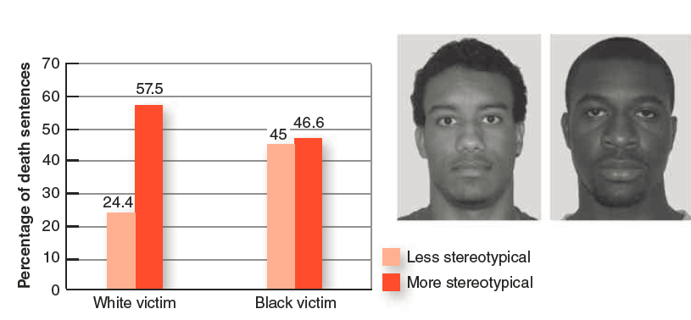
Prejudice
A preconceived opinion or attitude about an issue, person, or group
Notes:
IMAGE: [© Cengage Learning] (Cacioppo, Figure 13.8, p. 509)
Social Cognition 11 of 13
A person who makes a negative assessment of another person on the basis of his or her membership in a group is demonstrating prejudice
Members of many types of groups are victims of prejudice: racial minorities, gays and lesbians, women, the homeless, and the overweight
People’s prejudice toward a group often conflicts with their behaviors toward individual members of that group
Prejudice can result from direct experience or indirectly absorbed from the social world
Human prejudice based on group membership might have deep roots in our evolutionary past as an important skill for early hunter-gatherers
Participants’ ratings of stereotypical “Black features” predicted the men’s likelihood of being sentenced for murder with the death penalty, but only when the victim was described as White.
The men in these photographs have no criminal records but are examples of individuals who were viewed as less stereotypical (left) and more stereotypical (right).
Source: From Eberhardt, J. L., et al. (2006). Looking deathworthy: Perceived stereotypicality of black defendants predicts capital-sentencing outcomes, Psychological Science 17(5), 383–386.
Copyright © 2006 Association for Psychological Science.
Learn more about prejudice:
People who are overweight and obese: https://www.youtube.com/watch?v=nFwgEevvncs (8:06)
Homophobia: https://www.youtube.com/watch?v=4h_NMJf37D8 (9:59)

Slide 7
Discrimination
The biased treatment of people based on their membership in a particular group or category
Notes:
IMAGE: [© Bob Daemmrich/Alamy] (Coon, p. 639)
Social Cognition 12 of 13
Discrimination involves treating members of various social groups differently in circumstances where their rights or treatment should be identical
Discrimination involves an action or behavior. Prejudice, whether subtle or overt, is often a factor in discriminatory behavior.
Sometimes, the actions are taken to exclude a certain group of people.
Refusing to rent an apartment to members of a certain ethnic or racial group.
Choosing to only interview males for job opening.
Sometimes, the actions target a specific group of people.
Under the NYPD stop-and-frisk program, officers stopped many more African-Americans (56% of stops) and Latinos (29%) than Caucasians (11%)
Many school districts in the United States require students to wear uniforms.
Appearance (including gang colors) is one of the major reasons kids treat each other differently.
Uniforms help minimize status inequalities and in-group/out-group distinctions.
In Long Beach, California, a switch to uniforms was followed by a 91 percent drop in student assaults, thefts, vandalism, and weapons and drug violations (Ritter, 1998).
Learn more about discrimination:
Individuals with mental illness and employment issues:
https://www.youtube.com/watch?v=PbnF-kgonpQ (11:42)
Racism and the death penalty: https://www.youtube.com/watch?v=pqkxYX59okw (1:52:27)

Slide 8
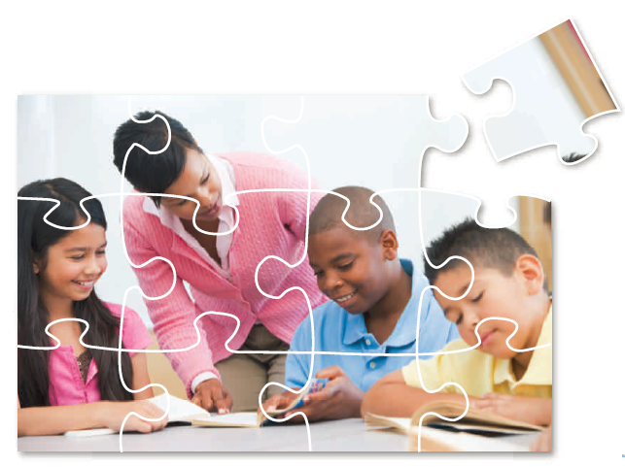
Reducing Prejudice
Increase contact in cooperative activities
Notes:
IMAGE: [© Illustration: Cengage Learning; Photo: Monkey Business Images/Shutterstock] (Cacioppo, p. 510)
Social Cognition 13 of 13
Increased contact can reduce prejudice, but specific kinds of contact are necessary:
Contact between people of equal standing is more effective in reducing prejudice.
When inequality exists, people tend to self-segregate and differences persist.
Contact is particularly beneficial in reducing prejudice when groups participate in cooperative activities
Aronson’s jigsaw classroom is an example of this.
Students from diverse groups are asked to complete a project.
Each child is responsible for a different portion of the project.
Children have to depend upon one another and are accountable to one another.
As children focus on the task, they attend less to their differences.
They begin to see each other as belonging to the same group, which reduces prejudice and hostility.
Cooperative learning programs similar to Aronson’s jigsaw classroom above are used in the vast majority of public schools in the United States today.
http://www.jigsaw.org/

