Slide 1
Defining and Measuring Stress
This section covers:
  The definition of stress
  Measuring stress
Notes:
IMAGE: [© AP Images (Cacioppo, p. 623)
Defining and Measuring Stress 1 of 9
What stresses you? How much stress do you have in your life?
This section covers:
The definition of stress
Measuring stress

Slide 2

Sources of stress
Major life events
Catastrophes
Daily hassles
  Frustration
Conflict
Notes:
IMAGE: [© Image Source/Digital Vision/Getty Images] (Pastorino, p. 504): Life events, both good and bad, can be perceived as stressful and require us to adjust to them.
Defining and Measuring Stress 2 of 9
Stress can be defined as any event or environmental stimulus (stressor) that we respond to because we perceive it as challenging or threatening.
This definition implies three aspects to stress.
First, we all encounter stressors—stimuli in our lives that we perceive as challenges or threats, such as traffic, an approaching midterm exam, or a hurricane.
Second, our reactions to these stressors include bodily reactions.
Third, by perceiving and then reacting, we cope with the challenges or threats (successfully or not)
Health psychologists, who study how people’s behavior influence their health for better or worse, have classified stressors into several types:
Major life events
Catastrophes
Daily hassles
Frustration
Pressure
Conflict

Slide 3
Holmes and Rahe Social Readjustment Rating Scale
RANK | LIFE EVENT | LIFE CHANGE UNITS
1 | Death of a spouse | 100
2 | Divorce | 73
3 | Marital separation | 65
4 | Jail term | 63
7 | Marriage | 50
12 | Pregnancy | 40
16 | Change in financial state | 38
20 | Take out mortgage or loan for major purchase | 31
25 | Outstanding personal achievement | 28
32 | Change in residence | 20
38 | Change in sleeping habits | 16
41 | Vacation | 13
Notes:
IMAGE: [© Source: Reprinted with permission from T. H. Holmes & R. H. Rahe (1967), “The Social Readjustment Rating Scale,” in the Journal of Psychosomatic Research, Vol. 11, No. 2, pp. 213–218. Copyright © 1967 Elsevier Science] (Pastorino, Table 12.1, p. 505): Holmes and Rahe’s Social Readjustment Rating Scale. Scores of 0–150 = no significant problems; 150–199 = mild life crisis; 200–299 = moderate life crisis; 300 = or more major life crisis.
Defining and Measuring Stress 3 of 9
Pioneering research by Thomas Holmes and Richard Rahe (pronounced RAY) in 1967 set out to measure the impact of particular stressors on people’s health.
They asked a large sample group to rate life events, or changes in one’s living, both good and bad, that require us to adjust to them.
From these ratings, Holmes and Rahe developed the Social Readjustment Rating Scale (SRRS).
Holmes and Rahe assigned each major life event a numerical value, referred to as a life change unit.
The higher the number, the more stressful this life event was rated by Holmes and Rahe’s sample.
Notice that the life events on the scale include positive as well as negative changes—for example, marriage, a new family member, and outstanding personal achievement.
However, it is not just experiencing one of these events that is at issue. Rather, it is reacting to several of these events within a year that Holmes and Rahe found may influence one’s health.
Subsequent research evaluating Holmes and Rahe’s scale indicates that the impact of these life changes is not simply a matter of how many of them one experiences.
We need to take several other variables into account, including these:
The voluntary or involuntary nature of the life change
How desirable or undesirable the life change is perceived to be
Whether the life change is scheduled or unscheduled

Slide 4
Undergraduate Stress Questionnaire
Sample items:
  Death (family member or friend)
  It’s finals week
  Found out boy/girlfriend cheated on you
  Problems with your computer
  Working while in school
  Can’t finish everything you need to do
  Parents controlling with money
  Had a visit from a relative and entertained him/her
Notes:
IMAGE: [© Source: C. S. Crandal et al., “Measuring Life Event Stress in the Lives of College Students: The Undergraduate Stress Questionnaire (USQ),” in Journal of Behavioral Medicine, 15(6), pp. 627–662, © 1992. Reprinted with kind permission of Springer Science and Business Media.] (Pastorino, Table 12.2, p. 507): Undergraduate Stress Questionnaire
Defining and Measuring Stress 4 of 9
The Undergraduate Stress Questionnaire includes more of the stressors that you typically face than does Holmes and Rahe’s SRRS.
It was specifically designed to measure life event stress in college students.
Undergraduates who have experienced more of these life events are more likely to report more physical symptoms and are less likely to report a positive mood.
It may therefore provide a more accurate assessment of your stress level and hence your susceptibility to illness.

Slide 5

Catastrophes
Uncontrollable disasters that can be traumatic
  Affect both physical and mental health
Notes:
IMAGE: [© Tony Arruza/Encyclopedia/Corbis] (Pastorino, p. 508): Unexpected catastrophes or traumatic events also cause stress and can affect one’s physical and mental health.
Defining and Measuring Stress 5 of 9
Unexpected traumatic events or catastrophes that almost all people perceive as threats also qualify as stressors.
In general, theses types of events are uncontrollable, highly negative, and occur with little to no warning. In some cases, they can be life-threatening.
Often, survivors of a catastrophe experience negative physical and psychological effects.
In particular, catastrophic events such as floods, earthquakes, hurricanes, tornadoes, or fires can produce feelings of depression or extreme anxiety.
We have for a long time recognized the stress of war on soldiers, as evidenced by the various names we have given to the pattern of symptoms that some soldiers experience when they return.
It was called shell shock in World War I, battle fatigue in World War II, and posttraumatic stress disorder (PTSD) following the Vietnam War and Operation Desert Storm.
Rape victims report similar physical and psychological symptoms that may meet the criteria for what is referred to as rape trauma syndrome— more evidence that unexpected events may take their toll on one’s health.
Traumatic events and catastrophes are often involuntary, undesirable, and unscheduled, in that we typically don’t have a lot of time to prepare for them; it is relatively easy to see how they might influence our health and well-being.
Do catastrophes or traumatic events always affect health negatively?
Not necessarily. Some people exposed to disaster may show chronic dysfunction, yet many others show remarkable resilience, experiencing only temporary distress.
Moreover, research has documented a potential positive effect of stressful life experiences for some people, referred to as posttraumatic growth or benefit-finding.
People report that these events have changed their lives in positive ways, such as building stronger relationships with others, emphasizing enjoyment in life, and initiating positive changes in health behaviors

Slide 6
Extremities of Stress: Trauma and PTSD
Notes:
IMAGE: [Source: Adapted from Pietrzak, Goldstein, Southwick, and Grant (2011)]
Defining and Measuring Stress 6 of 9
In a recent study, researchers asked approximately 30,000 people with and without PTSD to identify the “worst trauma they had ever experienced.”
Some big differences were noted between those with PTSD and those without.
Individuals with PTSD chose military combat, sexual assault, and intimate partner violence significantly more often than those without PTSD.
In general, people with PTSD were more likely than those without to choose an event they personally experienced.
This doesn’t mean that a trauma has to be personal for PTSD to develop. Keep in mind that roughly 40% of those with PTSD chose a misfortune (death, illness, injury) happening to someone close as their most traumatic experience.
Individuals without PTSD chose “indirect exposure to 9/11” much more frequently than those with PTSD.
This suggests that 9/11 was widely viewed as a catastrophe, but one that did not produce a lasting PTSD in most people that witnessed it.

Slide 7
Daily Hassles
May add to stress of major life events
May just be part of daily life
Notes:
IMAGE: [© Rubberball/Mike Kemp/Getty Images] (Pastorino, p. 509): Everyday irritations and frustrations increase our stress level and can influence our health.
Defining and Measuring Stress 7 of 9
When psychologists evaluate the relationship between stress and health, they not only measure life changes and analyze the influence of catastrophes; they also evaluate the impact of everyday irritations and frustrations.
These daily hassles also appear to play a major role in our health.
Even though each individual hassle causes a low-level of stress, the overall impact can quickly add up. In fact, research suggests that hassles account for the majority of stress that people feel.
Major life events and catastrophes can be hugely stressful, but they occur more infrequently.
At times these irritants add to the stress of major life changes and catastrophic events, such as the daily planning for a wedding or getting stuck in traffic during an evacuation due to a natural disaster.
As the number of daily hassles increases, our physical and mental health tends to decrease.
However, whether we perceive these frustrations as stressful is of prime importance in determining our susceptibility to illness.
Some people easily shrug off these annoyances, whereas others find them particularly perturbing.
The attitude you have towards hassles impacts how you respond in these situations and the level of stress you feel in dealing with them.

Slide 8
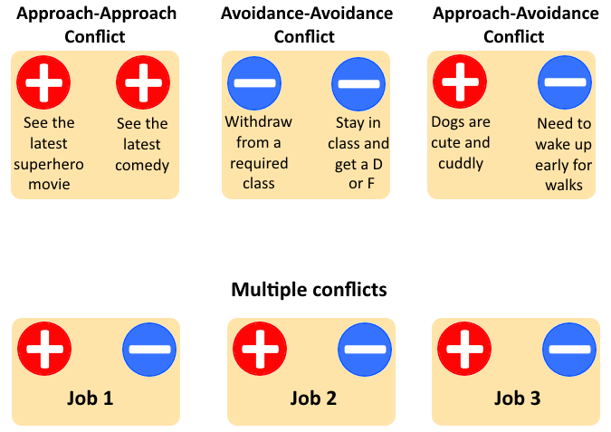
Conflicts
Notes:
Defining and Measuring Stress 8 of 9
Conflict, or having to choose between two or more needs, desires, or demands, can also place stress on us.
The easiest conflict to resolve, and therefore the conflict that is accompanied by the least amount of perceived stress, is the approach–approach conflict, in which a person must choose between two likable, or positive, events.
In this type of conflict, you really can’t lose because both options are favorable.
The opposite of the approach–approach conflict is the avoidance–avoidance conflict, in which a person has to choose between two undesirable, or negative, events.
Because both options in an avoidance–avoidance conflict are unappealing, many people remain undecided and inactive, or “frozen.” They don’t do anything.
Consequently, avoidance–avoidance conflicts are accompanied by a greater degree of perceived stress than are approach–approach conflicts.
Another stressful conflict to resolve is the approach–avoidance conflict, in which a person is faced with a single choice that has both positive and negative aspects.
He or she is drawn to the situation because of its positive features (approach), but is also repelled by and would rather not experience the negative aspects of the situation (avoidance).
As with avoidance–avoidance conflicts, these situations may immobilize people so that they cannot make a decision or resolve the conflict, which leads to the experience of stress. This is sometimes referred to as vacillation.
In real life, many conflicts involve several alternatives, each with both positive and negative features.
These multiple approach–avoidance conflicts can contribute to the amount of stress we feel.

Slide 9
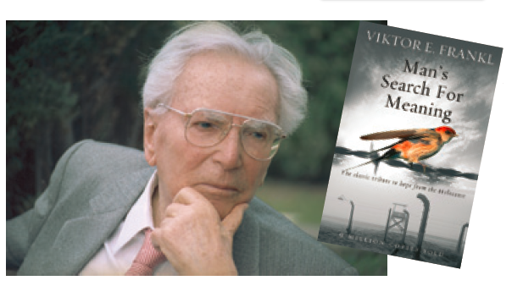
The Experience of Stress
Acculturative and minority stress
Poverty and stress
Resilience in the face of stress
Notes:
IMAGE: [© Marmaduke St. John/Alamy Katharina Vesely/Imagno/Hulton Archive/Getty Images Cover designed by Two-Associates/Courtesy Rider Books/Ebury Publishing] (Cacioppo, p. 638)
Defining and Measuring Stress 9 of 9
Austrian psychiatrist Viktor Frankl (1905–1997) was sent to the dreaded Nazi concentration camp Auschwitz, where he lost his pregnant wife, parents, and brother. Frankl used his experiences in developing his theories of logotherapy, after the Greek word for “meaning.” The ability to find meaning even in the depths of despair by recalling pleasant memories or helping a suicidal inmate helped Frankl survive the stress and horror surrounding him.
Gender, race, age, socioeconomic status, sexual orientation, and education all seem to influence our perception of stress.
Women are more likely than men to perceive stress from concerns about money, having a lot of things to do, health concerns, and trouble relaxing.
In general, younger people report more daily hassles in their lives than older people.
Those with more money and more education also report lower levels of perceived stress from daily hassles than do those with lower income and less education.
Although people who make more money and have more education may lead full and hectic lives, they generally perceive that they have more control over their lives and report having more fun.
African Americans are more likely than Hispanic or European Americans to report economic hassles, exposure to noise, feeling lonely, and invasion of personal privacy as frequent day-to-day hassles.
Hispanic Americans are more likely than European or African Americans to report problems with aging parents as a hassle of daily living.
Some minorities and immigrants may experience acculturative stress, or the difficulties associated with adapting to a new culture.
Prejudice and discrimination are unique sources of stress for members of racial and sexual minority groups termed minority stress and members of lower-income groups (called social-class discrimination).
Anticipating being discriminated against or interpreting others’ behaviors as discriminatory can increase stress in some people.
They worry that their behavior will be interpreted in a way that confirms negative stereotypes.
Such situations are potentially stressful and can influence people’s physical and mental health.
Under the right conditions, facing adversity can build resilience or the ability to adapt well to significant stressors.
Resilience essentially conveys the ability to respond well to adversity.
Key factors in resilience may be related to biopsychosocial factors.
For example, a child’s temperament or internal locus of control may play a role.
Family factors such as social support and maternal warmth and nurturance may buffer children from the harmful effects of poverty.
Some research suggests that successfully recovering from significant stress especially early in life may strengthen health neural networks in our bodies such that we are less vulnerable or tougher to subsequent stressors later in life.
In contrast, chronic, uncontrollable stress in childhood may weaken neural networks and alter immune system functioning such that one is more vulnerable to physical and mental health disorders in adulthood.
Canadian psychologist Edith Chen proposes that some individuals from low socioeconomic conditions may develop “shift-and-persist” strategies that reduce their physical responses to the chronic stress they face, which then lessens their susceptibility to chronic disease.
Shifting involves accepting stressors as uncontrollable and less threatening to reduce their emotional impact.
Persisting involves enduring by finding meaning when times get tough and remaining optimistic about one’s future.
Several investigations also indicate that experiencing moderate cumulative adversity is related to resilience.

Slide 10
The Stress Response
This section covers:
  The biology of stress
  Stress and health
Notes:
IMAGE: [Old zoo: © maratr/Shutterstock; New zoo: © Photocase Addicts GmbH/Alamy] (Cacioppo, p. 622): Older zoos featured cages that often contributed to stress and illness among the animals. Modern zoos go to great lengths to provide more natural, less stressful habitats for their animals in recognition of the stress that often accompanies captivity.
The Stress Response 1 of 5
This section covers:
The biology of stress
Stress and health

Slide 11
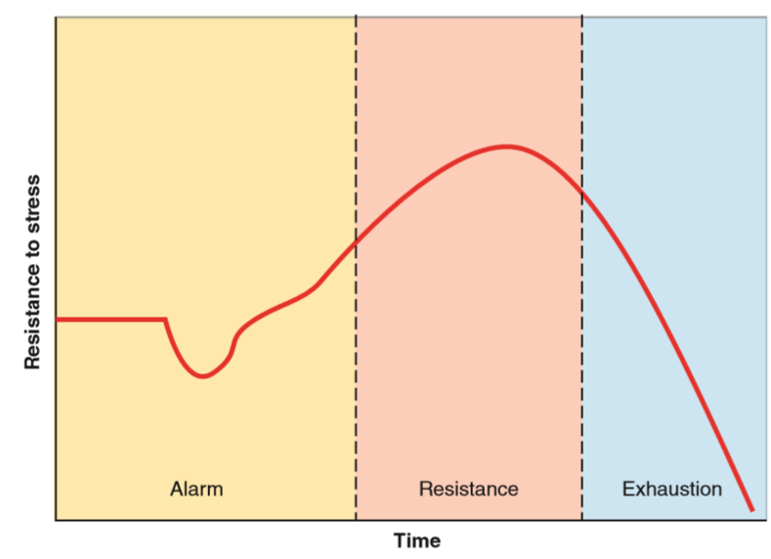
General Adaptation Syndrome
Notes:
IMAGE: [Illustration: © Cengage Learning 2013] (Cacioppo, Figure 16.1, p. 621)
The Stress Response 2 of 5
Hans Selye, worked primarily with rats, exposing them to a variety of stressors and measuring the amount of time they could subsequently swim before giving up. (They were then rescued, of course.)
Cold water, restraint, electric shock, surgery, and having their whiskers cut off were some of Selye’s stressors that greatly reduced the amount of time the rats would swim before giving up.
Regardless of the nature of the stressor, Selye found that the rats responded with a consistent pattern of behavior, which he labeled the General Adaptation Syndrome.
The GAS occurs in three stages.
An alarm reaction is initiated when a stressor is first perceived and identified.
Selye’s alarm reaction is essentially the same process as Cannon’s fight-or-flight response.
All possible resources are deployed to survive the danger, and all nonessential systems are inhibited.
When stressors are prolonged, Selye suggests we enter a stage of resistance.
During this stage, we continue to experience ongoing stress, which requires us to adapt and cope as well as possible.
Although resistance is not as dramatic as the briefer and more intense alarm reaction, it still takes its toll.
Under normal circumstances, we alternate between periods of calm and periods of relative arousal.
During the calm periods, we have an opportunity to store nutrients and rest and repair the body.
During periods of arousal, such as during the quiz, we expend energy instead of storing it.
In the resistance phase of the GAS, we attempt to take care of both arousal and resting functions simultaneously. Neither function operates as smoothly under these circumstances as when it is operating alone.
The length of this stage depends upon several factors, including (a) the severity of the stressor, and (b) the individual’s stress response style.
If stressors are severe and last long enough, a person might reach Selye’s exhaustion stage.
Strength and energy drop to very low levels.
The exhaustion stage has much in common with the criteria for major depressive disorder.
When a person is in exhaustion, they are susceptible to stress-related illnesses.
In extreme cases, exhaustion can even lead to death.

Slide 12
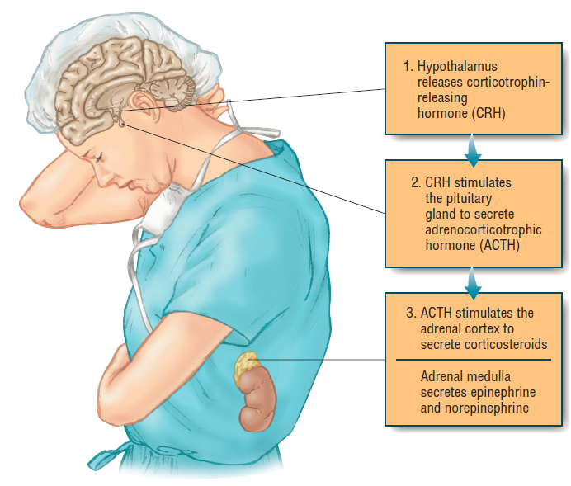
The Biology of Stress
The HPA Pathway
Notes:
IMAGE: [© Cengage Learning] (Nevid 10.5, p. 385)
The Stress Response 3 of 5
Perceiving a potential source of danger mobilizes the body’s resources using two systems—the sympathetic adrenal-medullary (SAM) system and the hypothalamic-pituitary-adrenal (HPA) axis.
The SAM system initiates the release of adrenaline (also known as epinephrine) and norepinephrine into the bloodstream from the adrenal glands located above the kidneys in your lower back.
These chemical messengers circulate to many organs and to the brain, producing many of the immediate, short-lived, fight–flight responses to stress, such as a pounding heart and rapid breathing.
Simultaneously, activation of the HPA axis sets an entirely different system in motion. Here’s how the circuit works.
The hypothalamus (H) communicates with the pituitary gland (P), located just above the roof of your mouth, which in turn tells the adrenal glands (A) to release a hormone known as cortisol into the bloodstream.
Circulating cortisol boosts the energy available for dealing with a stressor.
The HPA axis response to stress can continue much longer than the SAM response, which explains many of the outcomes of chronic stress.
One of the possible outcomes of chronic stress is prolonged high levels of circulating cortisol.
Long-term exposure to cortisol can produce a number of harmful effects, including the death of neurons.
Studies in humans who have a medical condition (Cushing’s disease) that results in unusually high cortisol levels suggest that cortisol abnormalities might contribute to reduced hippocampus volume, memory problems, abnormal sleep patterns, and depression.
Not only can high levels of cortisol damage neurons, but these same levels appear to inhibit the neurogenesis, or birth of new neurons, that might help to offset the damage.
Normally, activity of the HPA axis is regulated by a feedback loop involving the hippocampus.
The hippocampus contains large numbers of receptors for cortisol and other stress hormones.
When the hippocampus detects high levels of these hormones, it signals the hypothalamus, which in turn tells the adrenal glands to reduce the release of cortisol, and arousal dissipates.
The role of the hippocampus as the limiter of the HPA axis might be the bridge between extreme stress and depression.
Many cases of depression are preceded by unusually stressful events.
Consistently elevated levels of cortisol due to stress can overwhelm the hippocampus’s feedback loop, leading instead to the continuous release of cortisol and constant arousal.
Without the regulation of cortisol usually provided by the hippocampus acting as a rev limiter, a person can begin to experience depression.
Patients who are treated with cortisol and similar stress hormones for medical conditions such as rheumatoid arthritis are often troubled by deep depression, reinforcing the role of excess cortisol in depressed mood.
Not only can the hippocampus fail to regulate cortisol release under conditions of extreme stress, but continued stress can actually damage the hippocampus further.
People with post-traumatic stress disorder also show evidence of having a smaller than average hippocampus.
Having a smaller than average hippocampus might make a person exposed to trauma more vulnerable to the development of PTSD, or elevated levels of cortisol could reduce the size of the hippocampus, or both.

Slide 13
Stress and Health
Immune system
Heart disease
Notes:
IMAGE: [© Jetta Productions/Blend Images/Alamy] (Cacioppo, p. 630)
The Stress Response 4 of 5
Very short-term bursts of stress can have a beneficial effect on many biological systems, including the immune system, your body’s frontline defense against infection and cancer.
However, the immune system does not perform as well in the face of long-term, chronic sources of stress.
When responding to an emergency, our stress response system prioritizes body functions.
Those that are not necessary for handling the immediate emergency are taken offline.
Numerous studies indicate that people experiencing chronic stress are more vulnerable to infectious diseases, like colds and the flu.
The progression of HIV infection to AIDS is influenced by a patient’s level of stress.
Stressed students show greater vulnerability to the virus responsible for mononucleosis, which normally is kept in check by a robust immune system.
Stress related to our social relationships seems to be especially harmful to our ability to stay healthy.
A meta-analysis of almost 300 studies and about 20,000 participants demonstrated that chronic stressors affecting people’s social roles (e.g., death of a loved one, divorce) produce the greatest suppression of the immune system.
In the 1970s, Meyer Friedman and Ray Rosenman stimulated a large quantity of research by suggesting that highly competitive workaholics, whom they called Type A personalities, were more susceptible to heart disease than the more mellow, laid-back people they called Type Bs.
Further study, however, showed that simply being competitive had little to do with increased risk of heart disease.
Instead, the Type As who did develop heart problems exhibited a pattern of interpersonal hostility.
Stress puts the cardiovascular system at risk by affecting the ability of blood vessels to expand when necessary.
People whose arteries are already stiff or clogged due to age, poor fitness, or disease often suffer from high blood pressure and might be especially susceptible to heart attacks following stress.

Slide 14
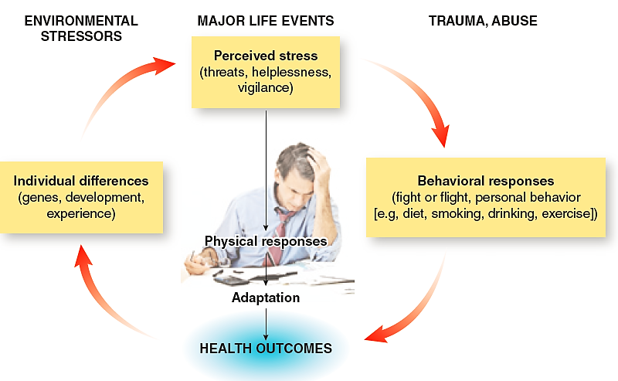
A Biopsychosocial Model of Health
Notes:
IMAGE: [© Cengage Learning; photo: forestpath/Shutterstock.com] (Cacioppo, Figure 16.11, p. 640)
The Stress Response 5 of 5
Health today is viewed as the product of interactions among individual characteristics, life experiences, cognitions, and behavior.
Source: Adapted from “Allostatic Load Biomarkers of Chronic Stress and Impact on Health and Cognition,” by R.-P. Juster, B. S. McEwen, and S. J.
Lupien, 2010,” Neuroscience and Biobehavioral Reviews, 35(1), pp. 2–16, doi:10.1016/j.neubiorev.2009.10.002
The biopsychosocial model views health as the product of interactions between a range of different factors.
Biological factors include genetics, physiological functioning, fitness levels, illness, and internal body chemistry, including hormones and neurotransmitters.
Psychological factors include lifestyle, stress, cognitive functioning, beliefs, mental illness, and modes of thinking.
Social factors include culture, family, interpersonal relationships, social support, and your general environment.
These factors interact with and can influence one another. In other words, making a change to one factor can produce changes to the other factors.
Consider someone who is feeling depressed and tries to self-medicate by consuming alcohol.
His friends may notice changes in his behavior, leading them to show concern and encourage him to seek help. (Social factor)
This could prompt him to see a physician or psychiatrist and receive a prescription for antidepressants (Biological factor)
The antidepressants may alleviate some of his negativity (Psychological factor), making him more pleasant to be around.
The change in mood then leads to increased positive interactions with friends and family (Social factor), which helps maintain the change in mood (Psychological factor).

Slide 15

Managing Stress
This section covers:
  Stress appraisal
  Coping approaches
  Stress management
Notes:
IMAGE: [© Jochen Schlenker/Masterfile] (Pastorino, p. 524): The stress management technique of guided imagery involves using your mind to achieve a state of relaxation. Whenever you feel stressed, you focus on a pleasant, calming environment like the image shown here to relieve bodily tensions and promote relaxation.
Managing Stress 1 of 5
This section covers:
Cognitive appraisal
Coping approaches
Stress management

Slide 16
Cognitive Appraisal
Primary
  Is this a threat, harm, or challenge?
Secondary
  How can I cope or manage this stressor?
Notes:
IMAGE: [© Image Source/Alamy] (Pastorino, p. 513)
Managing Stress 2 of 5
We all experience stressors, especially daily hassles.
We all wait in lines, sit in traffic, and pay bills.
Yet not all of us interpret these events as equally stressful.
Some people view giving blood as less stressful than others.
You may feel excited about giving a speech, whereas others cringe at the same prospect.
Therefore, the first step in experiencing stress is how you think about or interpret an event or situation.
Our initial interpretation of an event is called our primary appraisal.
This primary appraisal can be irrelevant, positive, or stressful.
If your primary appraisal of an event is irrelevant, you interpret the situation as unrelated to your happiness or safety.
Primary appraisals also can be positive and we typically don’t feel much stress in situations such as these.
However, when we appraise a situation as stressful, we believe it will require a great deal of our emotional and psychological resources.
Our primary appraisal of an event as stressful can lead to positive or negative emotions that either increase or decrease our perceived stress levels.
How much stress we experience will depend on whether we see the situation as a threat, a harm, or a challenge.
If we appraise a stressful event as threatening, we believe that the situation will cause us some harm in the future.
When we interpret an event in this manner, we typically feel fear, anxiety, or anger—negative emotions that increase our stress levels and decrease our performance.
If we appraise an event as harmful, we believe it will do us some damage or injury.
Such appraisals typically lead to feelings of fear and anxiety that increase our feelings of stress.
Situations can also be appraised as challenging, as a means toward personal growth or personal gain.
Challenge appraisals typically elicit positive emotions such as excitement and happiness, and are therefore perceived as less stressful.
Not all primary appraisals break down easily into the categories of threat, harm, or challenge.
A situation or event may involve a combination of appraisals.
For example, starting a relationship, finding a job, and having a baby are complex situations that may involve appraisals of both threat and challenge.
Also, the appraisal process is a personal one.
Not everyone appraises the same situation in the same manner.
Once you appraise a situation or event as a threat or a challenge, you must evaluate what can be done to cope with or manage the stressor, referred to as secondary appraisal.
In secondary appraisal, people take into account the resources available to cope with the stressor.
It includes an assessment of how they might cope, if that strategy or behavior will be successful in managing the stressor, and the likelihood that they can actually produce the necessary coping behaviors and strategies

Slide 17

Coping with Stress – Approaches
Problem-focused coping
Emotion-focused coping
Notes:
IMAGE: [© Jetta Productions/Getty Images] (Pastorino, p. 519)
Managing Stress 3 of 5
Whatever you do to manage an event or stimulus that you perceive as threatening is part of coping.
How we cope with stress influences the way stress affects us.
There are two broad types of strategies for coping: problem-focused coping and emotion-focused coping.
Some research suggests that females are somewhat more likely to use emotion-focused strategies and males are somewhat more likely to use problem-focused coping, but these gender differences are dependent on the nature of the stressor.
Anyone may use one or both types of coping when faced with a stressor. Each has its benefits and costs.
Problem-focused coping is aimed at controlling or altering the environment that is causing the stress.
One benefit of either of these problem-focused coping strategies would be elimination of the perceived stressor.
At the same time, you benefit by experiencing more control over your environment, which may also enhance your self-esteem.
However, it is also possible that you have misdiagnosed the problem, which is a cost of problem-focused coping.
Generally, problem-focused coping tends to be most useful when we feel that we can actually do something about a situation.
Under these circumstances, problem-focused coping is more likely to lead to a more positive health outcome.
However, when we do not feel that a situation is controllable, we often rely more on emotion-focused coping strategies.
Emotion-focused coping is aimed at controlling your internal, subjective, emotional reactions to stress.
You either express your emotions or alter the way you feel or think in order to reduce stress.
Stressors activate a variety of emotions, including anxiety, worry, guilt, shame, jealousy, envy, and anger.
Because these emotions are usually experienced as unpleasant, we are motivated to release, reduce, or avoid them.
We attempt to lessen the effects of these negative emotions in two ways: by engaging in cognitive reappraisal and by using psychological defense mechanisms.
Cognitive reappraisal is an active and conscious process in which we alter our interpretation of the stressful event.
Cognitive reappraisal can be an emotionally constructive way of coping with a stressful event.

Slide 18
Coping with Stress – Defense Mechanisms
MECHANISM | DEFINITION
Denial | Refusing to accept or acknowledge the reality of a situation or idea
Rationalization | Devising a plausible reason or motive to explain one’s behavior
Reaction formation | Engaging in a behavior or attitude that is at the opposite extreme of one’s true motive or impulse
Regression | Returning to an earlier stage of development in one’s behavior, thinking, or attitudes
Sublimation | Directing emotions into an activity that is more constructive and socially acceptable
Repression | Excluding wishes, impulses, ideas, or memories from consciousness
Projection | Attributing one’s own ideas, feelings, or attitudes to other people
Displacement | Directing emotions toward a less threatening source
Notes:
Managing Stress 4 of 5
A more automatic and unconscious way in which we lessen the effects of our emotions is by using defense mechanisms.
Sigmund Freud was one of the first theorists to identify psychological defense mechanisms.
Freud suggested that we use coping strategies unconsciously to reduce our anxiety and maintain a positive self-image and self-esteem.
Because of these features, we now consider these defense mechanisms emotion-focused coping strategies.
We use them to avoid or reduce the emotions associated with a stressor, but they do not necessarily eliminate the source of stress.
The use of defense mechanisms involves costs and benefits.
The main reason we use them is to restore our self-image.
We also benefit because defense mechanisms reduce anxiety.
They may also give us the confidence to handle additional stressors.
However, the benefits of defense mechanisms are typically outweighed by the costs.
Defense mechanisms often inhibit our ability to resolve a problem.
Using our emotions to cope with stressors may impede our functioning in other daily activities
Most important, using defense mechanisms keeps us in a state of unawareness as to the true source of any stress-related symptoms.
Given these disadvantages, why do we continue to use defense mechanisms? Basically, they are easier and produce quicker results in reducing our feelings of anxiety.
Unfortunately, these advantages are often at the expense of our well-being as we may experience more distress and negative mood over the long run.

Slide 19
Stress Management Techniques
Physical | Psychological | Social
Exercise | Imagine a calm environment | Develop social support
Progressive relaxation | Try to be optimistic | Talk with friends
Meditation | Be spiritual | Find community
 | Laugh
 | Manage time wisely
Notes:
Managing Stress 5 of 5
Some form of regular aerobic exercise, such as swimming, walking, or dancing, can be an effective strategy for reducing physical stress reactions.
Exercise reduces negative emotions such as depression and anxiety that we often feel in response to stress.
Exercise raises energy levels, strengthens the heart, and lowers muscle tension.
We sleep more soundly after exercise and also feel better as the body increases its production of natural mood elevators like serotonin and endorphins.
One of the most successful nonchemical ways to manage stress is through the application of relaxation techniques.
Such methods may include progressive relaxation training, in which you learn to alternately tense and then relax each muscle group of the body in a systematic fashion.
This activity gives you an awareness of when and where you feel tension when you’re under stress.
You then learn to manage and control the tension that you feel by relaxing on command.
Other relaxation techniques may include regular massages, meditation, yoga, deep breathing exercises, engaging in a hobby, or listening to music.
Daily use of relaxation procedures are effective in lessening symptoms of asthma, insomnia, headaches, rheumatoid arthritis, high blood pressure, chronic pain conditions, intestinal problems, and chronic anxiety.
Relaxation techniques also have been helpful in reducing anxiety and stress levels of cancer patients
Imagine a calm environment.
Guided imagery is a technique in which you learn to use your mind to achieve a state of relaxation.
You imagine that you are in a safe, pleasant, calming environment, perhaps walking along a beach or in a forest.
You maintain your focus on this image as you feel the tensions associated with stress leave your body.
Develop social support.
As social animals, humans are motivated to maintain social connections with others.
Having friends, a shoulder to cry on, or someone to discuss an issue or trying event with are all examples of social support—having close and positive relationships with others.
Social support buffers the effects of stress.
Family stability, a partner’s support, or simply having friends to confide in is related to a longer life span, as well as a longer survival rate for those with cancer or heart disease.
Even giving social support to others appears to buffer the effects of stress.
Social support also may act to decrease the release of stress hormones and reduce stress-induced immune responses.
Yet cultural norms influence the appropriateness of seeking and using social support networks.
Be optimistic.
Simply expecting good things to happen may influence your health.
Meditation in the form of yoga, Zen, mindfulness, or transcendental meditation also may reduce tension and anxiety caused by stress.
These practices are mental exercises in which people consciously focus their attention on thoughts, emotions, or body sensations to heighten awareness.
The person sits in a comfortable position with her eyes closed and silently focuses her attention on a specially assigned word that creates a resonant sound or on a bodily state such as her breathing.
Meditation appears to decrease heart rate, respiration, and oxygen consumption.
Some studies have also found that meditation can improve mood, lessen tiredness, and enhance immune system response.
Be spiritual.
Spiritual faith, prayer, membership in a faith community, and strong value systems may promote physical health and well-being for some people.
Spirituality often means having a purpose in life, self-awareness, and connectedness with self, others, and a larger community.
Religiousness is typically defined as participation in an institutionalized doctrine.
Religion, spirituality, and health are correlated.
We cannot conclude, however, that religiousness or spirituality causes better health.
Laughter promotes relaxation, which may explain why good- humored people perceive less stress when faced with life’s challenges.
Laughter may buffer stress by reducing blood pressure, increasing deep breathing, boosting the immune system, increasing feelings of well-being, and raising energy.
Manage your time wisely.
Many of us experience stress because we feel that there is not enough time to accomplish all the tasks, errands, and work that we have established for ourselves.
Feelings of time pressure can negatively affect our health and well-being.

