Slide 1
Defining Personality
This section covers:
  Key concepts in the study of personality
Notes:
IMAGE: [©Jose Luis Pelaez Inc/Blend Images/Getty Images] (Nevid, p.417)
Defining Personality 1 of 3
This section covers:
Key concepts in the study of personality
How might your personality traits contribute to living a longer, healthier, and more satisfying life?

Slide 2
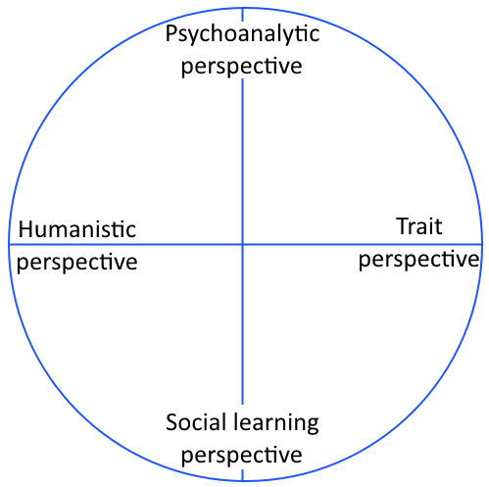
What Is Personality?
Characteristic patterns of thinking, feeling, and behaving
Multiple ways of viewing personality
Notes:
Defining Personality 2 of 3
Beyond the general definition of personality as the characteristic patterns of thinking, feeling, and behaving, psychologists do not agree on a single, specific answer to this question—personality is difficult to define, difficult to measure, and influenced by many factors.
As such, four dominant scientific perspectives have emerged to explain our personalities: the psychoanalytic approach, the trait approach, the social cognitive approach, and the humanistic approach.
No single approach can explain all facets of personality in all people, and each perspective has advantages and disadvantages.

Slide 3
Important Questions in Studying Personality
To what extent is a person’s personality truly unique?
How much do our personalities overlap with those of others?
How consistent or inconsistent is our behavior across time and across situations?
How much of a role does biology or experience play in developing our personalities?
Is the basic nature of humans good or bad?
Notes:
Defining Personality 3 of 3
Suppose you were given the following feedback about your personality:
You have a need for other people to like and admire you and yet you tend to be critical of yourself. Although you have some weaknesses, you are generally able to compensate for them. You have considerable unused capacity that you have not turned to your advantage, however. Disciplined and self-controlled on the outside, you tend to be worrisome and insecure on the inside. At times you have serious doubts as to whether you have made the right decision or done the right thing. You prefer a certain amount of change and variety and become dissatisfied when hemmed in by restrictions and limitations. You also pride yourself as an independent thinker and do not accept other’s statements without satisfactory proof. But you have found it unwise to be too frank in revealing yourself to others. (Forer, 1949, p. 120)
How well does this description fit your beliefs about your personality? You might be impressed by how this paragraph presents such specific and personalized information about you. Ironically, you probably can relate to this description because it applies to nearly everyone. So the question is: If our personalities are so unique, how can we all be so easily described in a few brief sentences?
Psychologists studying personality might have different perspectives about how it should be defined, but they’re often interested in similar questions.

Slide 4

Psychodynamic Theories
This section covers:
  Freudian theory
  Neo-Freudian approaches
Notes:
IMAGE: [© Adrian Sherratt / Alamy] (Pastorino, p. 468) : According to Freud, the genital stage of psychosexual development unconsciously motivates teens to interact with potential sexual partners.
Psychodynamic Theories 1 of 9
This section covers:
Freudian theory
Neo-Freudian approaches

Slide 5
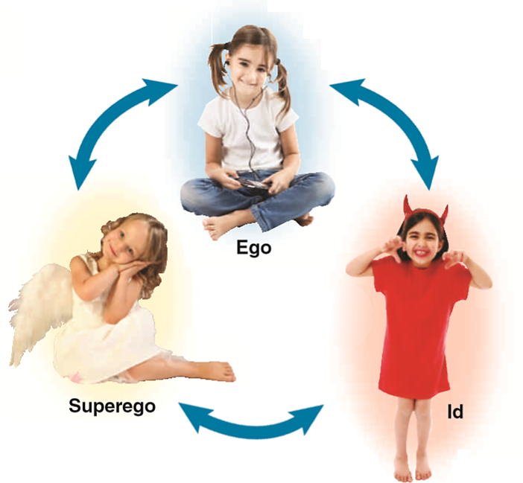
Freudian Personality Structure
Id
Ego
Superego
Notes:
IMAGE [Illustration: © Cengage Learning 2013; photos, clockwise from top: © IKO/Shutterstock; © hartphotography/Shutterstock; © lukaszfuz/Shutterstock] (Cacioppo, Figure 12.3, p. 451): The Id, Ego, and Superego. Freud viewed the mind as a closed system in which energy flows from one compartment to the next. It is the job of the ego, or self, to balance the pleasure-seeking impulses of the id with the morality imposed by the superego.
Psychodynamic Theories 2 of 9
Personality was viewed by Freud as a closed energy system, in which “psychic” or instinctive energy moves among three compartments: the id, ego, and superego.
Freud proposed that the id, which literally means “it” in Latin, is present at birth and contains the primitive drives that serve as a source of energy for the personality, such as hunger, thirst, and sex.
According to Freud, the id operates according to the pleasure principle, in which it seeks immediate gratification and relief.
As a child begins to interact with parents and other social influences, the ego and superego begin to control the id.
The ego is the component of the personality that is readily seen by others, so it acts as the person’s “self.”
Its task is to coordinate the needs of the id with reality and operates according to the reality principle. In some sense, it serves as the decision maker and strives to achieve a sense of balance.
The superego develops when a child begins to internalize his or her society’s rules for right and wrong, forming what we normally refer to as a “conscience.”
It operates according to the moral principle.
In healthy personality development, energy in these three compartments remains balanced.
Imbalances among the components can be the source of unhealthy behavior.
An overly dominant id can lead to antisocial behavior, or an overactive superego produces too much guilt.

Slide 6
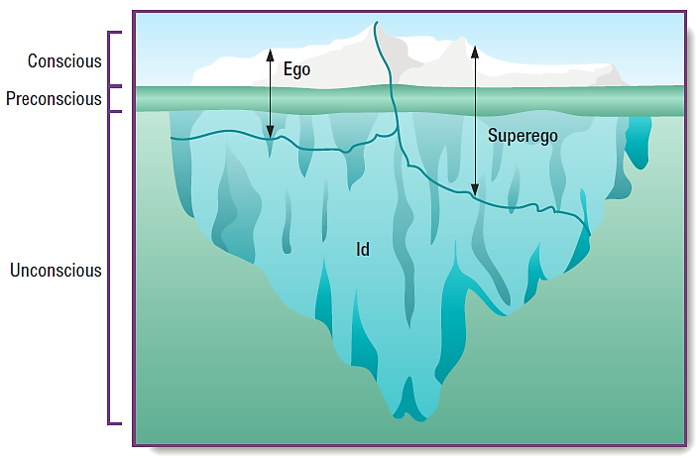
Levels of Awareness
Notes:
IMAGE [© Cengage Learning] (Nevid, Figure 11.1, p. 409): Freud’s Levels of Conscious Awareness. The human mind in Freudian theory can be likened to an iceberg in which only the tip rises above the level of conscious awareness. Though information held in the preconscious can be brought into the conscious mind at any time, much of the
contents of the mind—including many of our deepest wishes, ideas, and urges—remain mired in the dark recesses of the unconscious.
Psychodynamic Theories 3 of 9
Freud likened the mind to an iceberg, with about one tenth of the mind being conscious and the remaining nine tenths unconscious.
Freud believed that we can retrieve information voluntarily from the conscious but not the unconscious mind—a notion that predated contemporary research on implicit and explicit memories.
Material that could move at any time into the conscious state, but is not there presently, is preconscious, sometimes also known as the subconscious.
Your conscious mind might be concentrating on understanding Freud right now, but your preconscious mind might contain a thought about how nice it would be to stop for a break and get a slice of pizza.
According to Freud, unacceptable and threatening ideas maintained in the unconscious mind are actively repressed, or blocked from entering consciousness.
Repressed ideas can leak into consciousness in the form of anxiety symptoms, dreams, and verbal errors we now refer to as “Freudian slips.”

Slide 7
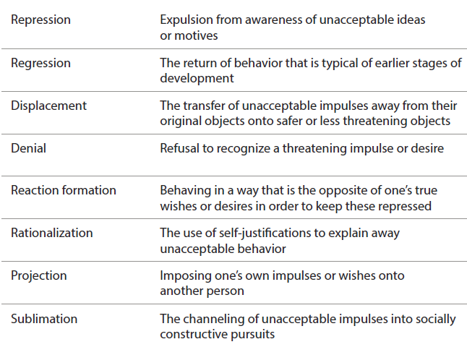
Freudian Defense Mechanisms
Notes:
IMAGE [© Cengage Learning] (Nevid, p. 410)
Psychodynamic Theories 4 of 9
Threats to the balance between the id, ego, and superego can result in anxiety, or the sense that danger is just around the corner.
When the ego is faced with anxiety, it engages in a variety of protective behaviors referred to as defense mechanisms.
Freud defines 9 primary defense mechanisms: repression, sublimation, rationalization, displacement, reaction formation, projection, denial, regression, and identification.
According to Freud, each of these mechanisms helps us channel potentially self-destructive or painful psychic energy into more constructive or manageable behaviors.
Freud noted, though, that each mechanism has its limits; if a person continually uses a particular defense mechanism or even defense mechanisms in general, she risks doing damage to the self as well.
Can your students guess which defense mechanism is illustrated by these examples?
A person remains unaware of harboring hateful or destructive impulses toward others. (repression)
Under stress, a college student starts biting his nails or becomes totally dependent on others. (regression)
A worker slams a door after his boss chews him out. (displacement)
A person who nearly chokes someone to death acts afterward like it was “no big deal.” (denial)
A sexually frustrated person goes on a personal crusade to stamp out pornography. (reaction formation)
When asked why she continues to smoke, a woman says, “Cancer doesn’t run in my family.” (rationalization)
A sexually inhibited person misinterprets other people’s friendly approaches as sexual advances. (projection)
A person channels aggressive impulses into competitive sports. (sublimation)

Slide 8
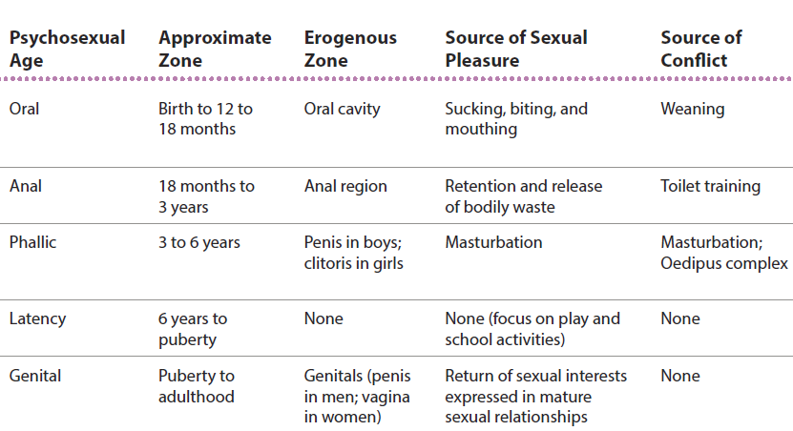
Freudian Psychosexual Development
Notes:
IMAGE [© Cengage Learning] (Nevid, p. 413)
Psychodynamic Theories 5 of 9
Freud proposed five psychosexual stages of personality development: oral, anal, phallic, latency, and genital.
It’s important to note that Freud used the term “sexual” to refer to various forms of physical and tactile pleasure, and not intercourse or sex as most adults think of it.
During each stage, a different part of the body, known as an erogenous zone, serves as the focus of a person’s sexual urges.
Freud believed that the person developed in a stage-like fashion and that successful passage through each stage contributed to the psychic health of the person.
The oral stage lasts from birth to 1 year and pleasure obtained by sucking.
The anal stage lasts from 1 to 3 years and is marked by conflict between child’s ability to eliminate wastes at will versus societal expectations of toilet training
The phallic stage lasts from 3 to 6 years. During this stage, the Oedipus and Electra complexes lead to identification with same-sex parent.
It’s also during this time that children begin to take notice of their genitalia and realize that males and females differ in this regard.
Freud applied the Oedipus complex term to both boys and girls, but his followers restricted the term to boys’ development and added the concept of an Electra complex for girls.
Freud’s Oedipus complex begins with the idea that the child’s first love object is the parent of the opposite sex. As a result, the child feels compelled to compete with the same-sex parent for attention from the opposite-sex parent.
Freud argues that the Oedipus complex is resolved when the child reduces feelings of competition and conflict by identifying with the same-sex parent. As part of this identification process, the values of the parents are internalized by the child.
The latency stage lasts from 6 to 12 years and is characterized by a focus on internalization of society’s rules
The genital stage, from 12 years and above has a focus on adult sexual interests and behaviors
For Freud, personality is the product of conflict occurring during the psychosexual stages.
Personality characteristics emerge as the id, ego, and superego resolve their conflicts and struggle for balance.
Freud believed that a failure to resolve a particular conflict, such as weaning, toilet training, or finding a sexual identity, resulted in fixation.
If fixation occurs, the person maintains childlike behaviors that are related to the conflict and stage in which problems occurred.
For example, a child who does not receive adequate stimulation in the oral stage may experience an oral fixation.
According to Freud, this person may continue to pursue oral gratification, in the form of overeating, smoking, or drinking, throughout adulthood.
Fixations could lead to the development of a neurosis, Freud’s term for what is now referred to as an anxiety disorder.
A neurosis for Freud represents a continuing conflict between the ego and the id, superego, or both.
Should the conflict become so great as to produce a conflict between the ego and reality, psychosis (including abnormal behaviors characteristic of schizophrenia and other serious disorders) might occur.

Slide 9
Neo-Freudians: Alfred Adler
Inferiority complex
Overcompensation
Birth order
Notes:
IMAGE [© Indeed/Getty Images] (Pastorino, p. 470): Children’s small stature and dependence on parents create inferiority feelings that motivate them toward achievement, according to Adler.
Psychodynamic Theories 6 of 9
Alfred Adler (1870–1937) contributed the notion of an inferiority complex to psychodynamic thought.
According to Adler, an inferiority complex, or overwhelming feelings of inferiority, can lead to overcompensation, usually in the form of seeking the appearance of superiority rather than the substance.
For example, a person might overcompensate for feelings of inferiority with peers by purchasing a fancy, expensive automobile.
Adler was also one of the first psychologists to suggest that siblings, along with parents, could have an influence on development, leading to investigations of the effects of birth order.

Slide 10

Neo-Freudians: Carl Jung
Personal and collective unconscious
Individual differences
Archetypes
Notes:
IMAGE [© The Star-Ledger/Aristide Economopoulos/The Image Works] (Cacioppo, p. 454): This Tibetan mandala represents unity formed out of the four elements of earth, wind, water, and fire, a theme that Carl Jung believed was universal in the human collective unconscious.
Psychodynamic Theories 7 of 9
Carl Jung (1875–1961), a Swiss psychiatrist, divided the unconscious mind into two components.
The personal unconscious remained the same as Freud’s unconscious mind.
Jung added a deeper level, the collective unconscious, comprised of our common psychological predispositions as human beings passed from generation to generation.
After observing common themes in cultures around the world during his extensive travels,
Jung argued that generations of experience with concepts such as darkness, power, death, and parents would lead to characteristic ways of unconsciously thinking about such topics, which he called archetypes.
Jung’s ideas are echoed in today’s evolutionary approach to psychology, which views the mind as having adapted over the course of evolution.
In addition to his expansion of the concept of the unconscious, Jung deviated from Freud by providing more specific information about differences in individual personality.
In particular, Jung’s concepts of the personality characteristics of extroversion (outgoing) and introversion (relatively less outgoing) are still very much alive in current discussions of personality.

Slide 11
Neo-Freudians: Karen Horney
Emphasized the impact of a male-dominated society on women
Male envy of pregnancy and motherhood
Basic anxiety
Notes:
IMAGE [© Bettmann/Corbis] (Nevid, p. 414): Karen Horney was one of the first female psychiatrists, and although considered a neo-Freudian, she rejected many of Freud’s ideas to concentrate on the sources of women’s feelings of inferiority.
Psychodynamic Theories 8 of 9
Karen Horney (1885–1952, pronounced “HORN-eye”) was one of the first female psychiatrists.
Horney rejected many of Freud’s ideas to concentrate on aspects of the culture that contributed to women’s feelings of inferiority.
Simultaneously, while treating male patients, Horney became convinced that men envied women’s ability to become pregnant and be mothers.
Her emphasis on the impact of a male-dominated society on women helped set the stage for many subsequent feminist scholars.
Horney also suggested that family environments and disturbances in early relationships lead to basic anxiety, or a feeling of helplessness in children.
Children cope with this basic anxiety by pursuing love, power, prestige, or detachment.

Slide 12

Evaluating Freudian Theory
Influence on culture
Empirical support
Operationalizing constructs
Effectiveness of psychoanalysis
Notes:
IMAGE [© All: © The Unemployed Philosophers Guild/www.philosophersguild.com; (shelf) © kovaleff/Shutterstock] (Cacioppo, p. 453): Sigmund Freud has become a mainstay in popular culture.
Psychodynamic Theories 9 of 9
Although there is no question regarding the tremendous influence Sigmund Freud has had on modern thinking, his legacy today is considered mixed.
Freud’s approach to development contrasts sharply with the scientific theories of development, and most psychologists today do not adhere to Freud’s theory.
But his work remains important in that it had such a profound influence in psychology and popular culture.
Instead of viewing children as miniature adults, Freud saw them as having different needs at different ages, which revolutionized many aspects of parenting and child care.
We continue to be vastly entertained and intellectually challenged by plays, novels, and other art featuring characters who are driven by unconscious conflicts to behave in ways they don’t understand.
A few Freudian constructs appear to be supported by scientific investigation, even though the theoretical mechanisms he proposed have been refuted.
The notion of defense mechanisms, the distinction between conscious and unconscious processes, and descriptions of some types of adult personalities remain topics of research in psychological science.
On the other hand, contemporary scientists point out that Freud’s ideas rarely lend themselves to scientific investigation.
For example, how would you design an experiment to study the Oedipus complex?
Some of his other ideas, such as women’s penis envy, are viewed as remarkably sexist.
Additional criticisms center around the effectiveness of psychoanalysis.

Slide 13
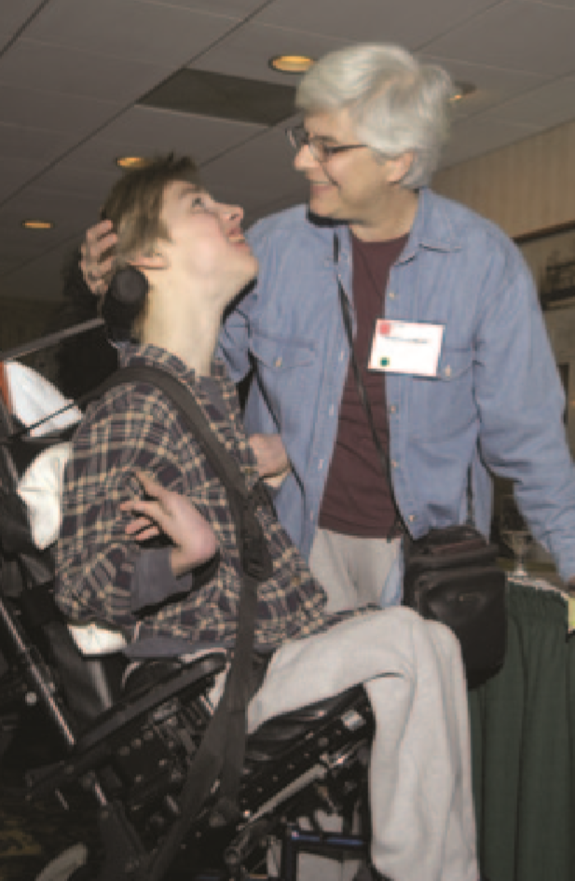
Humanistic Theories
This section covers:
  Abraham Maslow
  Carl Rogers
  The role of culture
Notes:
IMAGE: [© Realistic Reflections/Getty Images] (Pastorino, p. 487): The approval (or disapproval) we receive from others influences our self-concept, according to humanist Carl Rogers.
Humanistic Theories 1 of 4
This section covers:
Abraham Maslow
Carl Rogers
The role of culture
The humanists stressed the belief that every person is a unique individual. Much of their view of personality is based on the notion that people are, on the whole, good and are driven to achieve some level of personal fulfillment.
Instead of trying to classify personality, however, they were more interested in how personality develops.

Slide 14
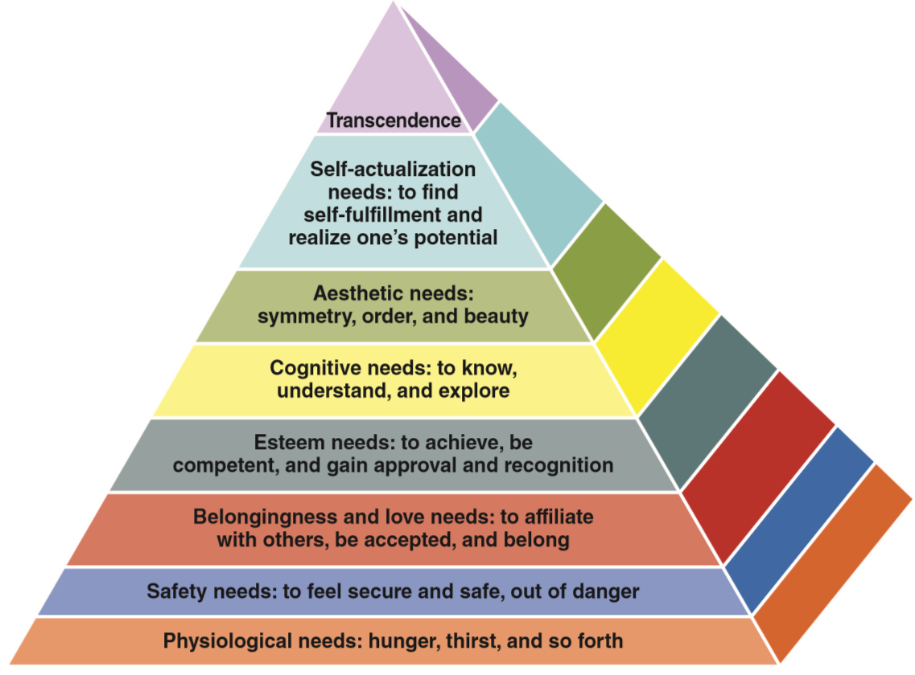
Humanistic Theories – Abraham Maslow
Personality results from motivation
Notes:
IMAGE: [© Cengage Learning 2013] (Pastorino, Fig 5.3, p. 178): Maslow’s Hierarchy of Needs
Humanistic Theories 2 of 4
One of the leading humanists, Abraham Maslow, was primarily interested in human motivation.
He did not attempt a full-fledged theory of personality, although he made some interesting conclusions about the characteristics of exceptional people.
After reviewing biographies of people like Albert Einstein, Jane Addams, William James, and Abraham Lincoln, Maslow observed that exceptional people had a number of common traits.
In addition to the expected characteristics, such as creativity, realistic thinking, and concern for others, Maslow’s exceptional people had some surprising qualities.
They had few friends, well-developed senses of humor, and periodic mystic or peak experiences.
One interpretation of Maslow’s theories states that a person’s personality and behavior result from the type of need he or she is trying to fulfill.
Somebody that is unable to meet lower-level physiological or safety needs will behave differently than someone seeking to fulfill cognitive or aesthetic needs.

Slide 15
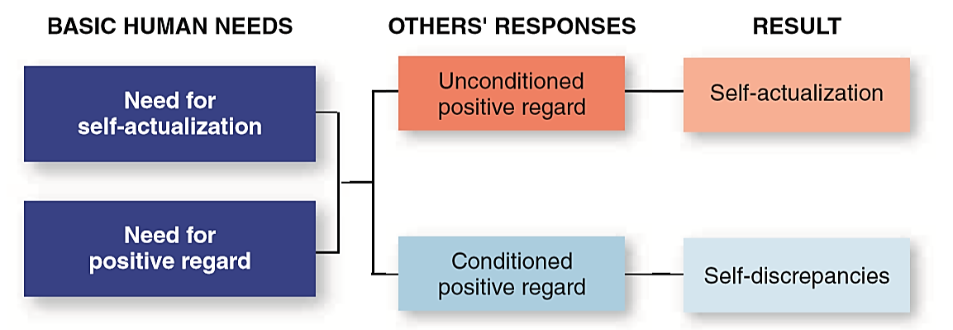
Humanistic Theories – Carl Rogers
Humans strive toward self-actualization
Congruence vs. incongruence
Notes:
IMAGE: [© Cengage Learning 2013] (Cacioppo, Figure 12.5, p. 455): Carl Rogers’s Humanistic Theory of Personality.
Humanistic Theories 3 of 4
Carl Rogers, a notable humanist, put forward a theory of personality based on his experience as a therapist.
Rogers, like Maslow, believed that humans strive toward self-actualization, or maximizing their individual potential.
For Rogers, people who follow the path laid out by their feelings will lead productive, healthy lives.
They will experience congruence, or similarity, between their real selves and their ideal selves.
Congruence is most likely to occur in response to unconditional positive regard, or a nonjudgmental appreciation for a person’s true nature.
Being treated judgmentally makes people act in ways that are incongruent, or inconsistent, with their ideal selves, which might lead to disordered behaviors.
Rogers’s proposed actualizing tendency is set at birth and moves the infant to recognize that she is separate from the mother and an independent being.
The infant begins to experience the self as “I” or “me.”
This self gradually evolves into the person’s self-concept.
Self-concept is our perception or image of our abilities and our uniqueness.
At first one’s self-concept is very general and changeable, as in the 4-year-old who describes herself as a girl with brown hair or the 3-year-old who states in one moment that he is happy but 5 minutes later that he is sad.
As we grow older, these self-perceptions become much more organized, detailed, and specific.
It is somewhat difficult to move from the humanists’ description of personality to our original definition of personality as consisting of stable and consistent patterns of behavior.
The humanists are more interested in the process by which personality develops than in the actual characteristics that emerge.
Like the psychodynamic theories they rejected, the humanists are subject to criticisms of being unscientific in their methods

Slide 16
Culture and Personality
Collectivistic versus individualistic cultures
Notes:
IMAGE: [© RyFlip/ShutterStock.com] (Nevid, p. 430). Culture and conceptions of self.
Humanistic Theories 4 of 4
How you define your personality may depend on the culture in which you were raised.
Collectivistic cultures foster the development of communal or interdependent concepts of the self, whereas individualistic cultures encourage definitions of the self that embody individuality and uniqueness.
If you were raised in a collectivistic culture, you might define yourself in terms of the social roles you assume or the groups to which you belong (Markus & Kitayama, 1991; Triandis & Suh, 2002). You might say, “I am a Korean American” or “I am Jonathan’s father.”
By contrast, if you were raised in an individualistic culture, you are likely to define yourself in terms of your unique individuality (the characteristics that distinguish you from others) and your personal accomplishments. You might say, “I am a systems analyst” or “I am a caring person.”
Despite differences between individualistic and collectivistic cultures, the mind possesses the ability to think both individualistically and collectivistically depending on the circumstances (Oyserman, Coon, & Kemmelmeier, 2002).
Extremes of either individualism or collectivism can have undesirable outcomes. Excessive collectivism may stifle creativity, innovation, and personal initiative, whereas excessive individualism may lead to unmitigated greed and exploitation.

Slide 17
Trait Theories
This section covers:
  Early trait theories
  The Big Five
Notes:
IMAGE: [© Chuck Karcher/Getty Images] (Pastorino, p. 474): According to psychologist Marvin Zuckerman, some people are high in the trait of sensation seeking. They engage in highly energizing and stimulating activities such as skydiving and extreme sports.
Trait Theories 1 of 7
This section covers:
Early trait theories
The Big Five

Slide 18
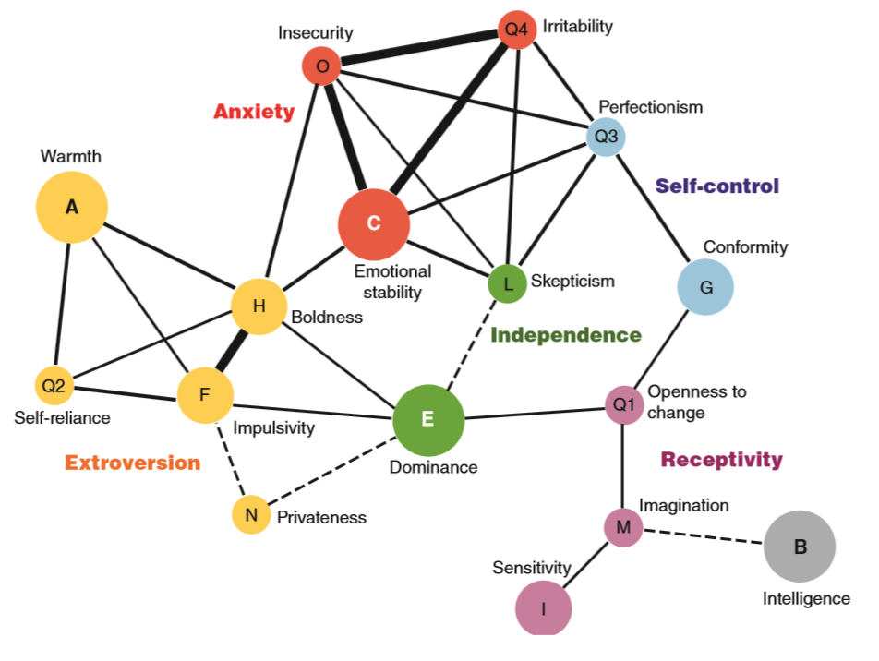
Personality Traits
Notes:
IMAGE: [© Cengage Learning 2013] (Cacioppo, Figure 12.6, p. 455): Factor Analysis Identifies Clusters of Personality Traits. The statistical technique of factor analysis allows psychologists to identify factors that positively correlate or cluster together as well as the strengths of those relationships. Raymond Cattell identified 16 personality factors that formed five clusters (extroversion, anxiety, self-control, independence, and receptivity) that are similar to the factors in the Big Five theory proposed later by McCrae and Costa. The darker lines represent stronger statistical relationships.
Trait Theories 2 of 7
A trait is a stable personality characteristic.
Psychologists were hard at work testing personality traits long before they derived coherent theories to explain their findings.
They realized intuitively that traits often clustered together.
An outgoing person might also be expected to be brave and cheerful.
However, these approaches lacked the precision required by a true theory of personality.
Statistical methods of correlation and factor analysis came to the rescue.
Correlations allow us to see if two variables have some systematic relationship with each other, such as height and weight or speed and strength.
Factor analysis allows a researcher to compare large numbers of correlations simultaneously, which makes the technique perfectly suited to the study of clustered personality traits.

Slide 19
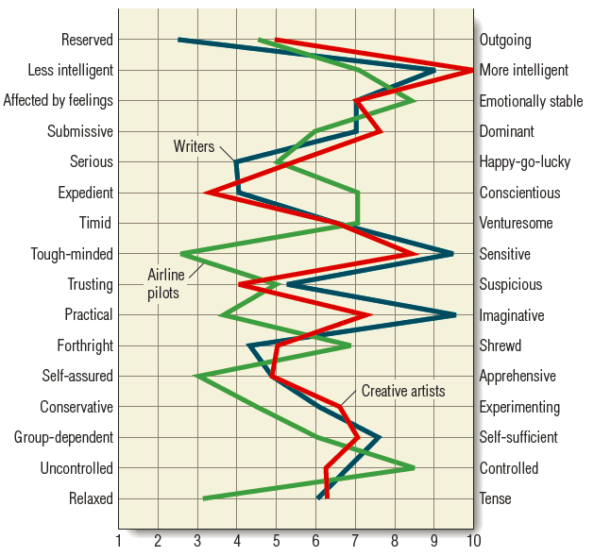
Early Trait Theories – Allport and Cattell
Notes:
IMAGE: [© Cengage Learning 2014] (Nevid, Figure 11.2, p. 418): Cattell’s 16 Personality Factors
The 16PF is a personality test that compares individuals on 16 source traits or key dimensions of personality, each of which is represented on a continuum ranging from one polar extreme to the other. Here we see the average scores of samples composed of three occupational groups: creative artists, airline pilots, and writers. Notice the differences in the personalities in these groups. For example, compared to the other groups, airline pilots tend to be more controlled, self-assured, and relaxed—traits that should help put airline passengers at ease. Source: Adapted from Cattell, Eber, & Tatsuoka, 1970.
Trait Theories 3 of 7
One of the earliest efforts to identify personality traits began with the selection of 4,500 words that described observable traits out of a dictionary by Allport.
Cardinal traits describe how we behave across all situations.
Allport considered these a very basic and permanent element of our personalities—but he had difficulty finding cardinal traits in all people that he studied.
Consequently, the validity of cardinal traits became suspect.
Central traits are characteristics that most clearly define and differentiate a person.
These are the types of terms you might use when trying to describe someone you know: smart, hard-working, and outgoing.
Secondary traits describe how we behave in certain situations; they are tendencies that are less consistent and more situation-specific.
Many of us behave aggressively in certain situations, such as when we are frustrated or when we see others behave aggressively.
We all have secondary traits, but whether a specific quality is considered a secondary trait may differ from person to person.
Emerging computer technologies in the 1940s allowed psychologists to refine lists of traits further.
Using factor analysis, the original list of 4,500 words was reduced to 16 major personality traits.
Each trait took the form of a continuum between opposites.
For example, the trait of suspiciousness would range from “trusting” at one extreme to “suspicious” at the other.
Raymond Cattell attempted to document relationships among traits using a sophisticated statistical technique called factor analysis.
In contemporary factor analysis, the possible traits that could be used to describe people are entered into a computer program; then the program groups related traits into factors.
In this way, Cattell reduced the number of personality traits that could be used to describe all people.
Cattell’s research originally yielded 36 surface traits that could describe personality.
He then hypothesized that there must be common underlying factors that account for the 36 surface traits.
Cattell referred to these qualities or dimensions as source traits.
Source traits are basic, broad, and relatively universal tendencies at the core of our personalities.
We may differ in the amount or quality of these traits, but they are present in everyone’s personality to some degree.
Through subsequent analysis and research, Cattell identified 16 source traits.
However, Cattell’s 16 source traits did not easily lend themselves to research.
Research led by British psychologist Hans Eysenck would further reduce the number.

Slide 20
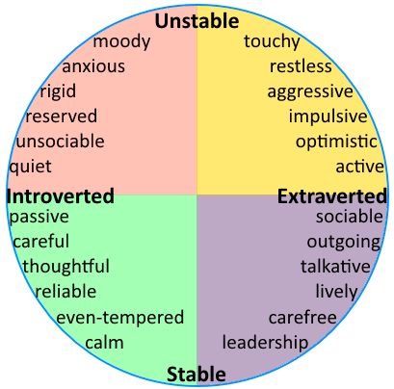
Early Trait Theories – Eysenck
Notes:
IMAGE: [© Cengage Learning 2014] (Based on Coon, Figure 51.1, p. 443): Eysenck’s Trait Theory: British psychologist Hans Eysenck arrived at two universal traits using factor analysis. The stable– unstable axis defines one’s emotionality; the introverted–extraverted axis defines the degree to which a person’s energy is directed inward or outward. The traits in each quadrant indicate where they are placed with respect to these two factors. These characteristics, in turn, are related to four basic types of temperament first recognized by the early Greeks. The types are: melancholic (sad, gloomy), choleric (hot-tempered, irritable), phlegmatic (sluggish, calm), and sanguine (cheerful, hopeful). (Adapted from
Eysenck, 1981.)
Trait Theories 4 of 7
Building on Cattell’s factor analytic studies, Eysenck and Rachman found two factors that they believed measured people’s key characteristics: introversion/ extraversion and emotional stability/neuroticism.
Introversion and extraversion define where a person’s energy is directed.
Introversion means that the person’s energy is directed inward.
This tendency could include being rigid, reliable, sober, or controlled.
Extraversion means that the person’s energy is directed outward.
This tendency could include being easygoing, lively, or excitable.
Emotional stability and neuroticism refer to control over one’s emotions.
Being even-tempered and calm are traits that include more control over emotions and represent emotional stability, whereas moody and touchy describe traits that represent neuroticism.
We all are somewhere on the introversion/ extraversion scale and somewhere on the emotional stability/neuroticism continuum; however, we all differ in the degree to which we express the two factors.
In the 1970s, Hans Eysenck, in collaboration with his wife, Sybil Eysenck, added a third dimension called psychoticism to the model.
Psychoticism includes tendencies toward recklessness, disregard for common sense and cultural norms, inconsideration, hostility, anger, and impulsivity.
Eysenck originally characterized impulsivity as a dimension of extraversion.
However, once the dimension of psychoticism was added, he moved this trait from extraversion to psychoticism.
Eysenck’s three-factor model of personality is referred to as the PEN (psychoticism, extraversion, neuroticism) model.
Research has generally supported Eysenck’s arousal theory; several studies confirm that introverts tend to show higher levels of physical arousal than extraverts Another prominent explanation of introversion and extraversion is the reward-processing theory. It suggests that extraverts’ brains are more sensitive to both rewards and dopamine functioning, which leads them to gravitate to more stimulating social activities.

Slide 21
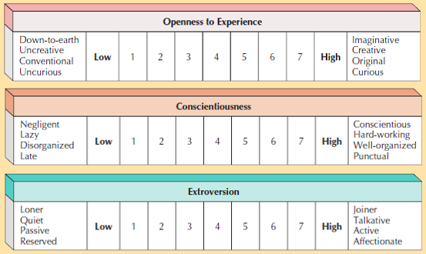
The Big Five
Notes:
IMAGE: [© Cengage Learning 2013] (Coon, Figure 51.3, p. 444)
The Big Five. According to the five-factor model, basic differences in personality can be “boiled down” to the dimensions shown here. Rate yourself on each factor. The five-factor model answers these essential questions about a person: Is she/he extroverted or introverted? Agreeable or difficult? Conscientious or irresponsible? Emotionally stable or unstable? Smart or unintelligent? These questions cover a large measure of what we might want to know about someone’s personality. (Trait descriptions adapted from McCrae & Costa, 2001.)
Trait Theories 5 of 7
Currently, the most widely accepted trait theory derived from factor analysis is Paul Costa and Robert McCrae’s five factor theory.
This theory proposes five core dimensions that can be measured along a continuum in all people (three described on this slide; two on the next slide). A useful mnemonic for remembering the core dimensions is OCEAN.
Openness: the degree to which one is thoughtful and rational in considering new ideas.
People who score high in openness tend to be imaginative, creative, and curious and to prefer variety; those who score low in openness prefer routine and are more narrow-minded in their ideas and experiences.
Conscientiousness: the degree to which one is aware of and attentive to other people, to the details of a task, or to both.
People who are high in conscientiousness tend to be hardworking, ambitious, reliable, and self-controlled, whereas individuals low on this dimension are more often described as unreliable, lazy, and spontaneous.
Extraversion: the degree to which one’s energy is directed inward or outward.
People high in extraversion are talkative and sociable and prefer to be around others. At the other end of the continuum are people low in extraversion (introverts), who are quiet, reserved, and more comfortable on their own.

Slide 22
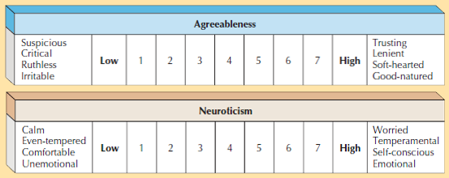
The Big Five (cont’d.)
Notes:
IMAGE: [© Cengage Learning 2013] (Coon, Figure 51.3, p. 444)
Trait Theories 6 of 7
Paul Costa and Robert McCrae’s five factor theory (cont’d.)
Agreeableness: the degree to which one gets along well with others.
Being easygoing and trusting are traits characteristic of one high in agreeableness.
At the other end of the spectrum are people who are unfriendly, antagonistic, and suspicious (low agreeableness).
Neuroticism: the degree to which one is emotionally stable or unstable.
People high in neuroticism are temperamental, worrisome, and pessimistic. People who score low on this factor tend to be more even-tempered and calm.

Slide 23

Implications of Trait Theories
Genetic contributions: temperament; neurotransmitter functioning
Situational factors: person-situation interactions
Notes:
IMAGE: [© Ashley Cooper/Alamy] (Pastorino, p. 479): Studies have found more similarities between identical twins’ personalities than between nonidentical twins’ personalities, indicating a significant genetic role in the personalities that we exhibit.
Trait Theories 7 of 7
The trait perspective assumes that people have internal dispositions to behave consistently across situations.
Thus, some researchers have speculated that we inherit some aspects of our personalities.
Recall that newborn infants do show differences in behavior that we refer to as temperament.
Research indicates that these temperamental differences appear strongly related to genes and that they are quite stable over time
Researchers in the field of behavioral genetics study the degree to which personality traits are influenced by genetics and hereditary factors.
Again, evidence indicates a significant genetic role in the personalities we exhibit.
Personality neuroscience has focused on genes that direct neurotransmitter functioning, specifically serotonin and dopamine.
For example, several studies have found an association between the serotonin transporter gene and anxiety-related personality traits.
Other studies have investigated the relationship between a dopamine receptor gene and the personality trait of novelty seeking
What about age-associated stability in personality?
After the age of 30, changes in personality traits are smaller than in childhood and young adulthood.
As a part of the developmental process, children, adolescents, and young adults experiment with new identities and ways of behaving.
They may adopt new values and attitudes or revise existing ones.
Changes in personality, therefore, are more frequent during these periods.
Some studies suggest that at least for some traits, there is a consistency from childhood to adulthood
However, research on U.S. and cross-cultural samples also suggests substantial changes in personality even during the course of adulthood.
People generally become more conscientious, agreeable, and emotionally stable, slightly less open to experience, and less extraverted across adulthood.
Situational factors also influence the stability and consistency of traits.
Many of us display the same trait (behave the same way) when faced with similar circumstances—that is, when the environmental cues are the same.
However, when the situation is different, our behavior may change.
This relationship among traits, situations, and behavior is referred to as the person–situation interaction.
How do psychologists reconcile these seemingly contradictory findings?
Psychologists recognize that personality is both stable and changeable.
Some traits are probably more consistent across the life span and from culture to culture, whereas others are more easily influenced by one’s society, gender, environment, and daily situations.
Such flexibility enables individuals to face developmental changes and challenges throughout their lives.

Slide 24

Social Cognitive Theories
This section covers:
  Social cognitive approaches to personality
Notes:
IMAGE: [© IE134/Image Source Plus/Alamy] (Pastorino, p. 483): People who exercise may be more likely to believe that they can control their health—an example of an internal locus of control.
Social Cognitive Theories 1 of 3
This section covers:
Social cognitive approaches to personality

Slide 25
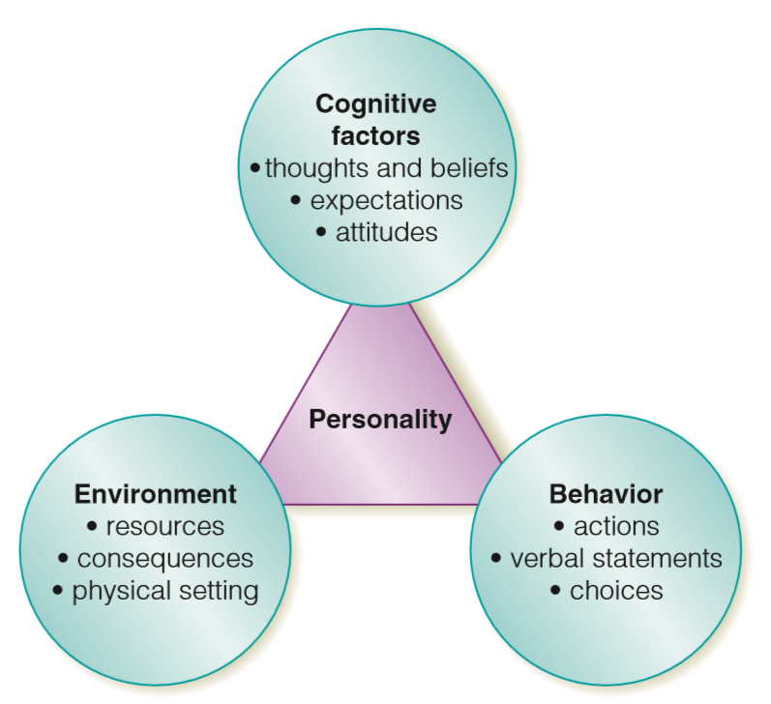
Social Cognitive Theories – Albert Bandura
Reciprocal determinism
Self-efficacy
Notes:
IMAGE: [©Cengage Learning, 2014] (Pastorino, Figure 11.4, p. 483): Bandura’s Reciprocal Determinism: Albert Bandura speculates that the constant interaction among our behavior, thoughts (cognitive factors), and environment determines our personalities.
Social Cognitive Theories 2 of 3
The social cognitive approach sees personality as influenced by both the environment and one’s thoughts.
Whereas Freud focused on how unconscious forces influence behavior, and the trait perspective investigates internal dispositions, the social cognitive approach looks at the characteristic ways a person perceives and interprets events in the environment.
For example, the person who assumes that others are unlikely to treat her fairly is more likely to have a quarrelsome personality than a person who tends to assume that things generally happen for the best.
These patterns of thoughts are established through our interactions with and observations of other people.
Two examples of this approach are Albert Bandura’s reciprocal determinism and Julian Rotter’s locus of control theory.
Albert Bandura speculates that personality is the product of three interacting forces: environment, behavior, and thoughts.
Bandura called the constant interaction among these three factors reciprocal determinism.
We choose to place ourselves in certain environments, and these environments then influence our behavior and the way we think.
However, the way we think—our attributions, goals, values, and perceptions—may guide which environments we choose to be in as well as the behavior we exhibit.
Our behavior, in turn, may change the environment as well as the way we think.
All three variables influence each other in a reciprocal manner.
A critical cognitive element in this interplay is what Bandura termed self-efficacy, or one’s expectation of success in a given situation.
Self-efficacy can differ among different domains in one’s life.
People with high self-efficacy in a certain domain believe that they will be successful in that domain.
Approaching a situation with this belief is more likely to result in actual success.
In contrast, people with low self-efficacy in a particular domain are more likely to approach a task believing that they won’t succeed at it.
This mindset then decreases their chance of succeeding by causing them to give up too easily or to not even really try in the first place.
Self-efficacy, however, must be tempered by realistic evaluations of one’s skills.
If you’re beliefs don’t line up with your actual abilities, having a high level of self-efficacy won’t necessarily lead to success.

Slide 26

Social Cognitive Theories – Rotter
Locus of control
  External
  Internal
Notes:
IMAGE: [© P.A. Lawrence, LLC./ Alamy] (Cacioppo, p. 461)
People with an with an internal locus of control believe that most of our outcomes are due to our own efforts, while people with an external locus of control believe that our outcomes are more often due to factors beyond our control. Although people with an internal locus of control experience less stress, they tend to be less sympathetic with the plight of others. The person with an internal locus of control might believe this woman needs to try harder to escape homelessness, while the person with an external locus of control might believe this woman just needs help and better opportunities.
Social Cognitive Theories 3 of 3
Julian Rotter provides another example of a social cognitive approach to personality.
His theory is referred to as locus of control, or location of control.
Rotter believes that we all have expectations regarding how much control we have over the outcome of an event.
These expectations fall on a continuum from internal to external.
Rotter suggests that these varying expectations of control lead to differences in personality.
Think about your health. Who would be more likely to exercise regularly and maintain a healthy lifestyle?
Externals are more likely to attribute their weight, health, or medical condition to fate. “What will be, will be” could be their motto. They feel that when their time is up, their time is up.
Internals, however, believe that they can control their health and are therefore more likely to exercise, follow doctors’ directions, get regular checkups, and eat wisely, behaviors that actually contribute to better health

Slide 27
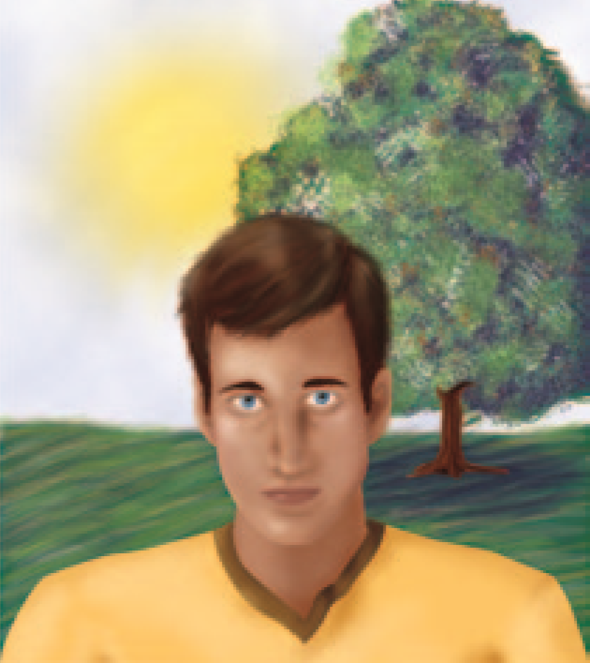
Assessing Personality
This section covers:
  Personality inventories
  Projective tests
Notes:
IMAGE: [© Cengage Learning, 2014] (Pastorino, Figure 11.6, p. 490): Sample Thematic Apperception (TAT) Card: In taking the TAT, a person is asked to tell a story about a scene such as this one.
Assessing Personality 1 of 3
This section covers:
Personality inventories
Projective tests

Slide 28
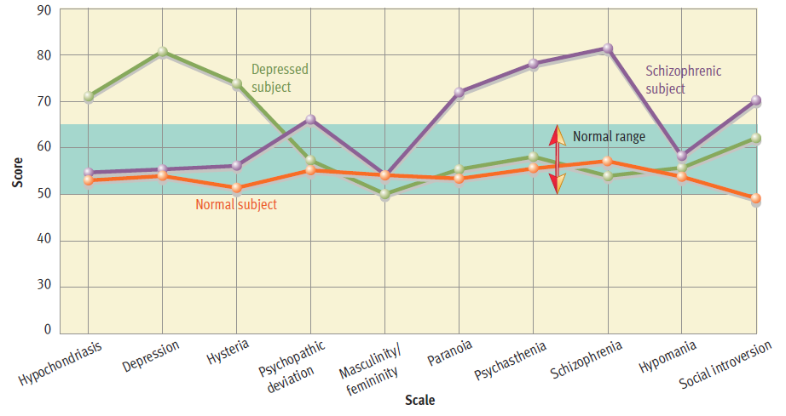
Personality Inventories
Minnesota Multiphasic Personality Inventory
Notes:
IMAGE: [© Cengage Learning] (Weiten, Figure 11.13, p. 390): The Minnesota Multiphasic Personality Inventory (MMPI) Profiles. Scores on the ten clinical scales of the MMPI are often plotted as shown here to create a profile for a client. The normal range for scores on each subscale is 50 to 65. People with disorders frequently exhibit elevated scores on several clinical scales rather than just one.
Assessing Personality 2 of 3
Personality inventories are objective tests, often using numbered scales or multiple choice.
These tests have some obvious advantages over more subjective measures, such as interviews or observation.
Large numbers of people can be assessed quickly and inexpensively.
Many of the tests appear to perform quite well in terms of reliability and validity.
On the other hand, the results of personality inventories are based on self-report and might be influenced by a person’s need to appear socially appropriate.
One of the most frequently used personality inventories is the Minnesota Multiphasic Personality Inventory, or MMPI, published in the early 1940s and most recently revised in 2001.
This test compares the responses of typical people and those hospitalized for a psychological disorder to a number of true-false items
Although the MMPI was designed to assist with clinical diagnosis, this is only one of its present-day uses.
The publisher’s website suggests that the test may also be used for college and career counseling recommendations, screening of potential public safety employees, marriage and family counseling, and many other purposes.
Some personality inventories are based on the Big Five traits, while others focus on characteristics related to positivity and negativity.
Many of these inventories collect responses using Likert scales, instead of true-false measures.
In a Likert scale, people often choose a number along a continuum that represents their answer.
Probably the most familiar type of Likert scale is a statement followed by a question asking participants to rate how much they agree with the statement.
Strongly disagree – Agree – Slightly disagree – Neutral – Slightly agree – Agree – Strongly agree.

Slide 29
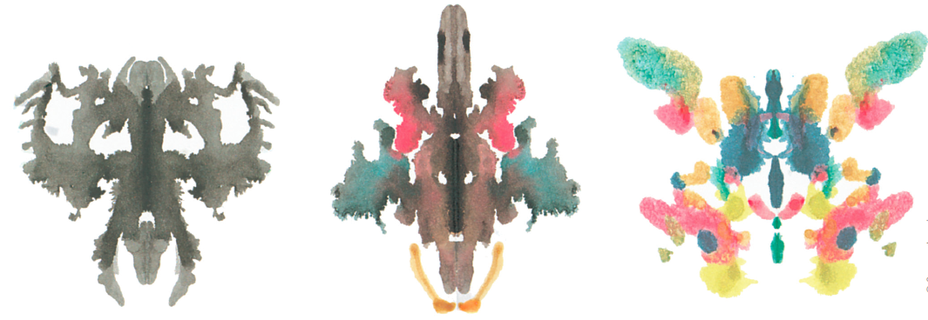
Projective Tests
Rorschach
Thematic Apperception Test
Notes:
IMAGE: [© Cengage Learning] (Coon, Figure 50.4, p. 437): Swiss psychologist Hermann Rorschach (1884–1922), the son of an artist, was nicknamed “Klecks,” or “inkblot,” by his high school classmates because of his hobby of making inkblot pictures. After becoming a psychiatrist, he became curious about why people saw the inkblots very differently, and he began analyzing their responses. In spite of very poor validity and reliability, the Rorschach Inkblot Test continues to be used widely. Inkblots similar to these are used on the Rorschach. What do you see?
Assessing Personality 3 of 3
Projective tests are derived directly from the Freudian defense mechanism of projection
According to the psychodynamic approach, we supposedly can access the unconscious mind by providing an ambiguous stimulus, onto which the participants “project” their personalities as they describe the object.
One of the most famous projective tests is the Rorschach Inkblot Test, which contains 10 different inkblots, some in color and others in black and white.
The job of the participants is to describe what each inkblot looks like to them.
These responses are written down by the examiner and scored according to a manual.
For instance, the examiner might note that a participant talked about a part of the inkblot instead of the entire image.
This response would be scored as an indication of the participant’s concrete, rather than abstract, way of thinking.
In spite of serious questions about its reliability and validity, the Rorschach Inkblot Test remains more widely used than the MMPI.
Out of a randomly selected group of 1,000 therapist members of the American Psychological Association (APA), 82% reported using the Rorschach at least “occasionally,” and 43% use it “frequently” or “always.”
Another widely used projective test is the Thematic Apperception Test (TAT).
In the TAT, you are shown images that are not as ambiguous as inkblots yet still allow for a variety of interpretations.
You are asked to tell a story about the image, and your responses are then coded for any consistent themes, emotions, or issues.

