Slide 1
Sex, Gender, and Sexuality

Slide 2
Sexual Development and Sexual Orientation
This section covers:
Sex and gender
Dimensions of sex
Prenatal sexual development
Intersexuality
Sexual orientation
Genes, hormones,
and sexual orientation
Homosexuality

Slide 3
Definitions and Dimensions of Sex
Sex
physical, biological classification as male or female
Gender
psychological and social characteristics associated with being male or female
Dimensions of sex
Genetic sex: XX or XY chromosomes
Gonadal sex: ovaries or testes
Hormonal sex: predominance of androgens or estrogens
Genital sex: clitoris and vagina in females; penis and scrotum in males
Notes:
Sex: one’s physical, biological classification as male or female
Gender: psychological and social characteristics associated with being male or female
Dimensions of sex (p. 350)
Genetic sex: XX or XY chromosomes’
Determined at the instant of conception
XX: two X chromosomes produce a female
XY: an X chromosome from the mother and a Y chromosome from the father produce a male
Kleinfelter’s syndrome: boy is born XXY; may appear feminine, have undersized sex organs, and be infertile
Turner’s syndrome: girl is born with only one X chromosome; will be infertile and may appear boyish as an adolescent
Gonadal sex: ovaries or testes
gonads (or sex glands) affect sexual development and behavior by secreting estrogens (female hormones) and androgens (male hormones)
Hormonal sex: predominance of androgens or estrogens
In general, sexual characteristics also are related to the effects of sex hormones before birth. (Hormones are chemical substances secreted by endocrine glands.)
Genital sex: clitoris and vagina in females; penis and scrotum in males
Primary sexual characteristics refers to the sexual and reproductive organs
vagina, ovaries, uterus in females and the testes, penis, scrotum in males
Secondary sexual characteristics refers to the more superficial features that appear at puberty
breasts and broadening of hips in females and facial hair and voice changes in males
Other changes: menstruation and ovulation
Menarche (onset of menstruation)
Ovulation (release of eggs)
Menopause (end of monthly fertility cycles)

Slide 4
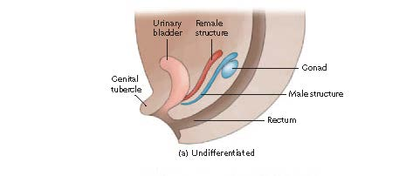
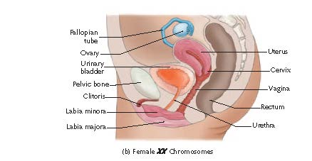
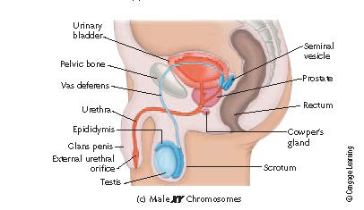
Prenatal Sexual Development
Sex organs are the same in males
and females at first. When
androgens are absent, female
structures develop, while male
structures develop in the presence
of androgens.

Slide 5
Intersexuality
Prenatal growth does not always match genetic sex.
Hormonal variations before birth can result in ambiguous sexual development.
An Intersexual person is someone with ambiguous sexual anatomy
Notes:
Prenatal growth does not always match genetic sex.
Intersexual person: ambiguous sexual anatomy (having genitals that suggest both sexes)
EXAMPLES:
A genetic male (XY chromosomes) may not develop male genitals if not enough testosterone is present, or if the fetus has inherited Androgen insensitivity syndrome: an inherited disorder causing an unresponsiveness to testosterone and failure of the male genitals to develop
Androgens must be low for a genetic female (XX chromosomes) to develop. A female can be masculinized by anti-miscarriage drug progestin or a problem called congenital adrenal hyperplasia: genetic abnormality causing adrenal glands to release excess androgen, which results in a female with ambiguous genitals

Slide 6
Sexual Orientation
Sexual Orientation:
The degree of stable emotional and erotic attraction one has to
the same sex (homosexual)
the opposite sex (heterosexual)
both sexes (bisexual)
or neither sex (asexual)
Sexual orientation is usually quite stable
Sexual orientation is estimated 30-70% genetic across various research.
Notes:
Degree of stable emotional and erotic attraction to the same sex, the opposite sex, both sexes, or neither sex
Heterosexual: romantically and erotically attracted to the opposite sex
Homosexual: romantically and erotically attracted to the same sex
Bisexual: romantically and erotically attracted to both men and women
Asexual: not romantically or erotically attracted to either men or women
“Sexual orientation is a deep part of personal identity and is usually quite stable. Starting with their earliest erotic feelings, most people remember being attracted to either the opposite sex or the same sex. The chances are practically nil of an exclusively heterosexual or homosexual person being “converted” from one orientation to the other (Glassgold et al., 2009; Mock & Eibach, 2012). If you are heterosexual, you are probably certain that
nothing could ever make you have homoerotic feelings. If so, then you know how homosexual persons feel about the prospects for changing their sexual orientation.” (page 352)

Slide 7
Genes, Hormones, and Sexual Orientation
Is sexual orientation biologically determined?
Two theories that influence sexual orientation
Sexually antagonistic selection suggests that genes that are the same across both sexes but expressed differently in males and females
Epigenetics: the expression of genes during development. Variations in prenatal hormone levels may influence development of sexual orientation.
Notes:
Feature Box page 352
Some researchers estimate that sexual orientation is 30 to 70 percent genetic.
Sexually antagonistic selection: the same genes are expressed differently in males and females
Prenatal hormonal theory of homosexuality: male fetuses exposed to too little testosterone; female fetuses exposed to too much
Support for this theory includes the differences in neurotransmitter levels and structural size of the hypothalamus of homosexuals and heterosexuals

Slide 8
Homosexuality
Parenting does not make children homosexual.
Homosexuals face potential rejection by family and discrimination in hiring and housing.
Homophobia: prejudice, fear, and dislike directed at homosexuals
Heterosexism: the belief that heterosexuality is better or more natural than homosexuality
Much of this rejection is based on false stereotypes about gay and lesbian people.
Notes:
Parenting does not make children homosexual.
Problems faced by homosexuals tend to be related to rejection by family and discrimination in hiring and housing.
Homophobia: prejudice, fear, and dislike directed at homosexuals
Heterosexism: the belief that heterosexuality is better or more natural than homosexuality
Much of this rejection is based on false stereotypes about gay and lesbian people.

Slide 9
Gender Development and Variations
This section covers:
Biological biasing effect
Gender identity
Gender role socialization
Gender roles, gender role stereotypes, and gender role strain
Psychological androgyny
Gender variance

Slide 10
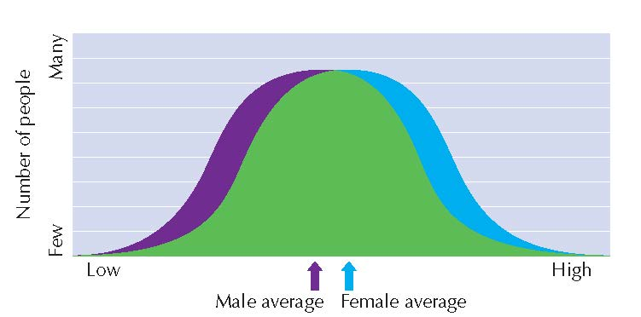
Biological Biasing Effect
Hypothesis that sex hormones “sex-type” the brain before birth.
Most human behaviors are more influenced by learning
Male and female scores on college entrance exams are becoming more alike, suggesting it is not inborn difference
There are some differences based on averages. Females have a slightly higher average on language ability. For other abilities, men have higher averages.
Notes:
Biological biasing effect: hypothesis that sex hormones “sex-type” brain before birth, altering the development of feminine or masculine traits, including thinking abilities
Belief that females more left-brained (language) males more right-brained (spatial reasoning)
Differences in abilities that do exist between women and men are based on averages.
“Note also that the differences that do exist between women and
men are based on averages (● Figure 11.2). Many women are better
at math than most men. Likewise, many men are better at
verbal skills than most women. Scores for women and men overlap
so much that it is impossible to predict whether any one person
will be good or bad at math or language skills simply from
knowing his or her sex.” (page 354)

Slide 11
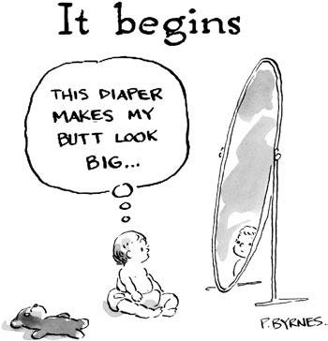
Gender Identity
one’s subjective sense of being male or female as expressed in appearance, behavior, and attitudes
At age 30 months, children are aware of gender role differences
by age 3 or 4, gender identity is well formed
Notes:
Gender identity: one’s subjective sense of being male or female as expressed in appearance, behavior, and attitudes
At 30 months of age, children are aware of gender role differences; gender identity well formed by age 3 or 4

Slide 12
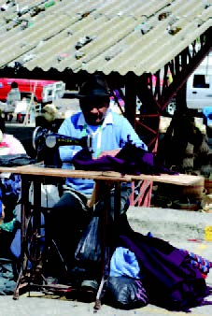
Gender Roles
A gender role is the favored pattern of behavior expected of each sex.
Looking at various cultures shows men and women are expected to act differently, but there is no “natural” or “universal for gender roles
Notes:
Page 355
A gender role is the favored pattern of behavior expected of each sex.
Traditionally, in our culture, boys are encouraged to be strong, fast, aggressive, dominant, and achieving, and females are expected to be sensitive, intuitive, passive, emotional, and “naturally” interested in child-rearing. Despite much progress in the last 40 years, gender role stereotypes continue to have a
major impact on women and men.
“ A look at other cultures shows that our gender roles are by no means “natural” or universal. For example, in some cultures, women do the heavy work because men are considered too weak for it (Best, 2002). In Russia, roughly 75 percent of all medical doctors are women, and women make up a large portion of the workforce. Many more examples could be cited, but one of the most interesting is anthropologist Margaret Mead’s (1935) classic observations of the Tchambuli people of New Guinea.” (page 356)

Slide 13
Gender Role Concepts
Gender role socialization: the process of learning gender behaviors regarded as appropriate for one’s sex in a given culture
parents treat girls and boys differently from birth.
toys, sports and play is typed by sex
In Western cultures
Males encouraged to engage in instrumental (goal-directed) behavior
Females encouraged to engage in expressive (emotion-oriented) behavior
Notes:
Gender role: the pattern of behaviors regarded as “male” and “female” by one’s culture
Gender roles are learned with parents treating boys and girls differently from birth.
Toys and sports are strongly sex-typed; sex-segregated play occurs by age 3.
Gender role stereotypes: oversimplified and widely held beliefs about the characteristics of men and women; can be a career obstacle
Males encouraged to engage in instrumental (goal-directed) behavior in Western cultures
Females encouraged to engage in expressive (emotion-oriented) behaviors in Western cultures
Gender role strain: stress associated with any conflict between your personal identity and the expectations associated with a gender role

Slide 14
Gender Role Concepts
Gender role stereotypes: oversimplified and widely held beliefs about the characteristics of men and women; can be a career obstacle
Gender role strain: stress associated with any conflict between your personal identity and the expectations associated with a gender role
Notes:
Gender role: the pattern of behaviors regarded as “male” and “female” by one’s culture
Gender roles are learned with parents treating boys and girls differently from birth.
Toys and sports are strongly sex-typed; sex-segregated play occurs by age 3.
Gender role stereotypes: oversimplified and widely held beliefs about the characteristics of men and women; can be a career obstacle
Males encouraged to engage in instrumental (goal-directed) behavior in Western cultures
Females encouraged to engage in expressive (emotion-oriented) behaviors in Western cultures
Gender role strain: stress associated with any conflict between your personal identity and the expectations associated with a gender role

Slide 15
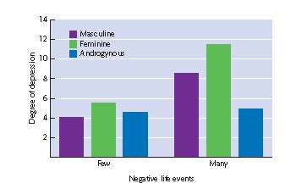
Androgyny
having both masculine and feminine traits in a single person
Term literally means “man-woman”
Androgynous people are more adaptable better at coping with stress, higher in emotional intelligence, and more satisfied with life than highly masculine or feminine people
Sandra Bem’s research
Consists of 60 personality traits: 20 masculine, 20 feminine, 20 neutral
Notes:
Bem Sex Role Inventory (BSRI)
Consists of 60 personal traits, 20 each for “masculine,” “feminine,” and “neutral”
Androgyny: having both masculine and feminine traits in a single person
Androgynous people are more adaptable, better at coping with stress, higher in emotional intelligence, and more satisfied with their lives.

Slide 16
Bem Sex Role Inventory (BSRI)
Sandra Bem’s research
Consists of 60 personality traits: 20 masculine, 20 feminine, 20 neutral
Notes:
Bem Sex Role Inventory (BSRI)
Consists of 60 personal traits, 20 each for “masculine,” “feminine,” and “neutral”
Androgyny: having both masculine and feminine traits in a single person
Androgynous people are more adaptable, better at coping with stress, higher in emotional intelligence, and more satisfied with their lives.

Slide 17
When Sex and Gender Do Not Match
Gender variant (transsexual):
a condition in which a person’s biological sex does not match his or her preferred gender
Unusual but not pathological
Gender dysphoria
a diagnosis used only when a person experiences extreme distress as a consequence of gender variance
Sex reassignment surgery
Surgery that reconfigures the external appearance of genitals
In combination with hormone treatments, it allows a person to transform their sexual identity to the other gender
Being more commonly undertaken with children
Notes:
Gender variant (transsexual): a condition in which a person’s biological sex does not match his or her preferred gender
The emerging consensus is that gender variance may be unusual but is not pathological.
Gender dysphoria: a diagnosis used only when a person experiences extreme distress as a consequence of gender variance
Sex reassignment surgery: reconfigures the external appearance of the genitals
This surgery along with hormone treatments may be undertaken in childhood or in adulthood.
“Sex reassignment surgery also is becoming more common with children. Supporters of early sex assignment argue that the benefits usually outweigh the long-term psychological costs (Zeiler & Wickström, 2009). Critics, however, believe that it is better for individuals to accept who they are and to realize that some bodies do not neatly fit into the categories of male and female (Holmes, 2002). Rather than impose the choice on them as children, they argue that it is better to wait until adulthood, when transsexual and intersexual individuals can choose for themselves
whether or not to have surgery and whether to live as a man or a woman (Thyen et al., 2005).” (page 359)

Slide 18
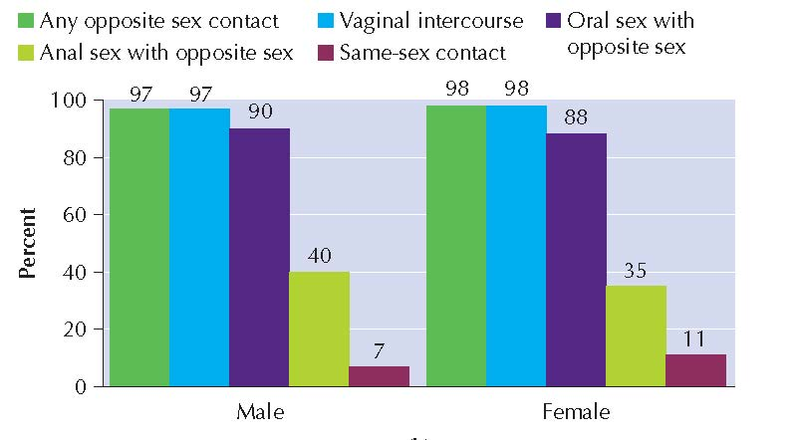
Sexual Behavior, Response, Attitudes, and Consequences
This section covers:
Sexual Behavior and Arousal
Sexual Response
Contemporary Attitudes About Sexual Behavior
The Crime of Rape
Paraphilic Disorders
Sexually Transmitted Diseases
Safer Sex Practices

Slide 19
Sexual Behavior and Arousal
Erogenous zones: areas of the body that produce pleasure and/or provoke erotic desires
Genitals, mouth, breasts, ears, anus, and to lesser degree entire surface of body
Sexual scripts: unspoken mental plans that guide our sexual behavior
Determine when and where we are likely to express sexual feelings and with whom
Provide a plot for order of events in lovemaking
Sex drive: strength of one’s motivation to engage in sexual behavior
Notes:
Erogenous zones: areas of the body that produce pleasure and/or provoke erotic desires
Sexual scripts: unspoken mental plans that guide our sexual behavior
Sex drive: strength of one’s motivation to engage in sexual behavior
Castration: surgical removal of testes or ovaries
Sterilization: surgery (vasectomy or tubal ligation) making the person infertile
Masturbation: self-stimulation of the genitals that causes sexual pleasure or orgasm

Slide 20
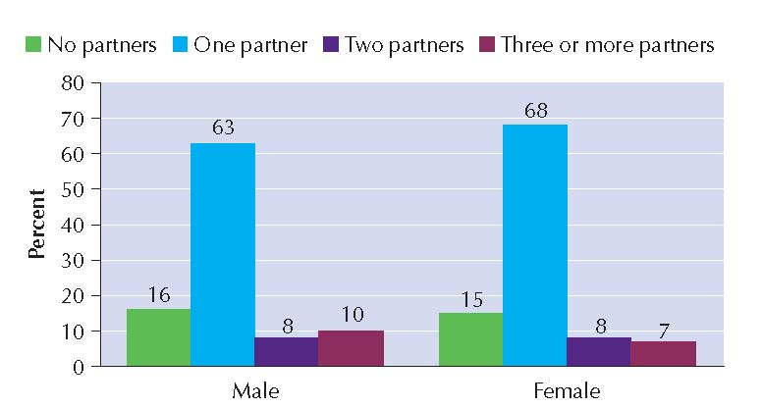
Sexual Behavior and Arousal
Men and women do not differ in average number of sex partners
Notes:
Erogenous zones: areas of the body that produce pleasure and/or provoke erotic desires
Sexual scripts: unspoken mental plans that guide our sexual behavior
Sex drive: strength of one’s motivation to engage in sexual behavior
Castration: surgical removal of testes or ovaries
Sterilization: surgery (vasectomy or tubal ligation) making the person infertile
Masturbation: self-stimulation of the genitals that causes sexual pleasure or orgasm

Slide 21
Sexual Behavior and Arousal
Men and women do not differ in sexual activity patterns
Notes:
Erogenous zones: areas of the body that produce pleasure and/or provoke erotic desires
Sexual scripts: unspoken mental plans that guide our sexual behavior
Sex drive: strength of one’s motivation to engage in sexual behavior
Castration: surgical removal of testes or ovaries
Sterilization: surgery (vasectomy or tubal ligation) making the person infertile
Masturbation: self-stimulation of the genitals that causes sexual pleasure or orgasm

Slide 22
Human Sexual Response (Masters and Johnson’s Research)
Four phases of human sexual response
Excitement
Plateau
Orgasm
Resolution
Notes:
The four phases are the same for all sexual orientations and occur in the following order:
Excitement: initial signs of sexual arousal
Plateau: physical arousal intensifies
Orgasm: climax and release of sexual excitement
Resolution: return to lower levels of sexual tension and arousal
Refractory period: short time period after orgasm when males are unable to reach orgasm again

Slide 23
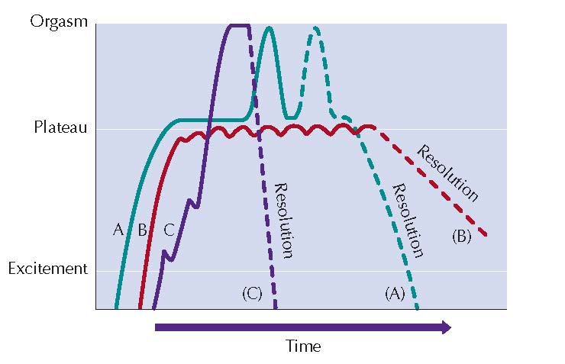
Female sexual response cycle
Notes:
The four phases are the same for all sexual orientations and occur in the following order:
Excitement: initial signs of sexual arousal
Plateau: physical arousal intensifies
Orgasm: climax and release of sexual excitement
Resolution: return to lower levels of sexual tension and arousal
Refractory period: short time period after orgasm when males are unable to reach orgasm again
● Figure 11.7 Female sexual response cycle. The green line shows that
sexual arousal rises through the excitement phase and levels off for a time
during the plateau phase. Arousal peaks during orgasm and then returns to
pre-excitement levels. In pattern A, arousal rises from excitement through the
plateau phase and peaks in orgasm. Resolution may be immediate, or it may
first include a return to the plateau phase and a second orgasm (dotted line). In
pattern B, arousal is sustained at the plateau phase and slowly resolved without
sexual climax. Pattern C shows a fairly rapid rise in arousal to orgasm. Little
time is spent in the plateau phase, and resolution is fairly rapid. (Adapted from
Carroll, 2013.) (p 363)

Slide 24
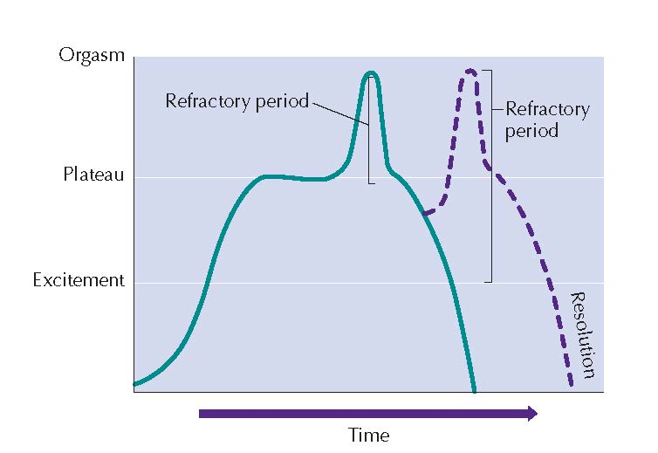
Male sexual response cycle
Notes:
Figure 11.8 Male sexual response cycle. The green line shows that sexual
arousal rises through the excitement phase and levels off for a time during the
plateau phase. Arousal peaks during orgasm and then returns to pre-excitement
levels. During the refractory period, immediately after orgasm, a second sexual
climax is typically impossible. However, after the refractory period has passed, there
may be a return to the plateau phase, followed by a second orgasm (dotted line).
(Adapted from Carroll, 2013.)(p 363)
Although male and female sexual responses are generally quite
similar, the differences that do exist can affect sexual compatibility.
For example, women typically go through the sexual phases
more slowly than do men. During lovemaking, 10–20 minutes is
often required for a woman to go from excitement to orgasm.
Males may experience all four stages in as little as 3 minutes. However,
there is much variation, especially in women. (Note that
these times refer only to intercourse, not to an entire

Slide 25
Contemporary Attitudes About Sexual Behavior
Has there been a “sexual revolution”?
Since the 1960s
More liberalized sexual attitudes
Increased access to effective birth control
More sexual activity among teens, but reversed somewhat since 1980s up to present day
Is the revolution over?
Adults now spend as much of adult lives alone as they do in marriage
Trends in oversexualizing young girls due to spread of porn and other media influences
Notes:
In 1960s, more liberalized sexual attitudes and access to effective birth control significantly changed sexual behavior.
Changes in attitudes still larger than actual changes in sexual behavior.
Double standard: applying different standards of appropriateness to male and female sexual behaviors (has become less relevant now than in the past)
Other recent changes: oversexualizing of young girls due to media influences and the spread of porn via the Internet (with its unrealistic imagery)

Slide 26
The Crime of Rape
20% of all American women are raped in their lifetimes
Types of rape
Forcible rape
Acquaintance (date) rape
Rape myths: false beliefs about rape that tend to blame the victim and increase the likelihood that some men will think that rape is justified
Notes:
Forcible rape: sexual intercourse carried out against the victim’s will, under the threat of violence or bodily injury
act of brutality based on a need to debase others
Acquaintance (date) rape: forced intercourse that occurs in the context of a date or other voluntary encounter
Rape Myths: false beliefs about rape that tend to blame the victim and increase the likelihood that some men will think that rape is justified
(p. 367)

Slide 27
Paraphilic Disorders
DISORDER | SEXUAL AROUSAL FROM:
Fetishistic | Inanimate objects
Transvestic | Wearing clothes of opposite sex
Sexual masochism | Receiving pain or humiliation as part of sex act
Sexual sadism | Inflicting pain or humiliation as part of sex act
Frotteurism | Sexually touching or rubbing a nonconsenting person in publich
Exhibitionistic | Flashing or displaying genitals to unwilling viewers
Pedophilic | Children, child molesting
Notes:
Paraphilic disorders: compulsive or destructive deviations in sexual preferences or behavior
Fetishistic disorder: sexual arousal associated with inanimate objects
Transvestic disorder: achieving sexual arousal by wearing clothes of the opposite sex
Voyeuristic disorder: “peeping,” or viewing the genitals of others without their permission
Sexual masochism disorder: desiring pain, humiliation, or both as part of the sex act
Sexual sadism disorder: deriving sexual pleasure from inflicting pain, humiliation, or both
Frotteurism: sexually touching or rubbing against a nonconsenting person (in public, e.g., a subway)
Exhibitionistic disorder: “flashing,” or displaying the genitals to unwilling viewers
Exhibitionists are usually male, married, and come from strict repressive backgrounds.
Most feel a deep sense of inadequacy producing a compulsive need to prove their “manhood” by frightening women.
Exhibitionists have a high repeat rate with many going on to commit more serious sex crimes.
Pedophilic disorder: sex with children, or child molesting

Slide 28
Pedophilic Disorder (Child Molestation)
Most molestors are
Male
Married
Fathers
Usually rigid, passive and/or puritanical
Molestation rarely exceeds fondling
Most abusers act alone
Most abusers target children by offering gifts and then use threats to gain continued compliance
Notes:
Most molesters are male, married, and fathers, and are usually rigid, passive, and/or puritanical.
Most molestations rarely exceed fondling, although the impact of the molestation depends on the duration of the abuse and whether genital sex acts were involved.
Signs of molestation: unusual avoidance or interest in sexual matters, secretiveness, nightmares, misbehavior (unusual risk taking), emotional disturbance, and loss of self-esteem
Most abusers act alone and target children first with gifts and then use threats to gain continued compliance.
Children should be taught not to keep secrets and to shout “No!” if an adult tries to engage them in sexual activity.

Slide 29
Pedophilic Disorder (Child Molestation)
Signs of molestation
Unusual avoidance or interest in sexual matters
Secretiveness
Nightmares
Misbehavior (unusual risk taking)
Emotional disturbance
Loss of self-esteem
Impact on the molested person depends on duration of abuse and whether genital sex acts were involved
Children should be taught to not keep secrets and shout “No!” if an adult tries to engage them in sexual activity
Notes:
Most molesters are male, married, and fathers, and are usually rigid, passive, and/or puritanical.
Most molestations rarely exceed fondling, although the impact of the molestation depends on the duration of the abuse and whether genital sex acts were involved.
Signs of molestation: unusual avoidance or interest in sexual matters, secretiveness, nightmares, misbehavior (unusual risk taking), emotional disturbance, and loss of self-esteem
Most abusers act alone and target children first with gifts and then use threats to gain continued compliance.
Children should be taught not to keep secrets and to shout “No!” if an adult tries to engage them in sexual activity.

Slide 30
Sexually Transmitted Diseases
a disease passed from one person to another by intimate physical contact; a venereal disease (also called STD).
Chlamydia
Gonorrhea
Hepatitis B
Genital herpes
Syphilis
HPV (human papillomavirus)
PID (pelvic inflammatory disease)
HIV (human immunodeficiency virus)
AIDS (acquired immune deficiency syndrome)
Notes:
Sexually transmitted disease (STD): a disease passed from one person to another by intimate physical contact; a venereal disease
Chlamydia, gonorrhea, hepatitis B, genital herpes, syphilis, human papillomavirus (HPV), and pelvic inflammatory disease
HIV disables the immune system and leads to AIDS and death due to multiple infections.
HIV infections are spread by direct contact with body fluids, blood, semen, and vaginal secretions, not through casual contact.
Asymptomatic: having a disease while lacking obvious symptoms of illness
Person can test negative for HIV up to six months after infection.
Risk factors for STDs: unprotected sex with infected person; having two or more sex partners; sharing needles or syringes, or having sex with someone who injects drugs
Safer sex practices: not having sex or having sex with one mutually faithful, uninfected person; using a condom; not engaging in sex while intoxicated; not sharing needles or syringes
See chart page 371

Slide 31
Sexually Transmitted Diseases
Risk factors for STDs:
unprotected sex with infected person
having two or more sex partners
sharing needles or syringes
having sex with someone who injects drugs
HIV infections are spread by direct contact with body fluids, blood, semen, and vaginal secretions, not through casual contact.
Asymptomatic: having a disease while lacking obvious symptoms of illness
Notes:
Sexually transmitted disease (STD): a disease passed from one person to another by intimate physical contact; a venereal disease
Chlamydia, gonorrhea, hepatitis B, genital herpes, syphilis, human papillomavirus (HPV), and pelvic inflammatory disease
HIV disables the immune system and leads to AIDS and death due to multiple infections.
HIV infections are spread by direct contact with body fluids, blood, semen, and vaginal secretions, not through casual contact.
Asymptomatic: having a disease while lacking obvious symptoms of illness
Person can test negative for HIV up to six months after infection.
Risk factors for STDs: unprotected sex with infected person; having two or more sex partners; sharing needles or syringes, or having sex with someone who injects drugs
Safer sex practices: not having sex or having sex with one mutually faithful, uninfected person; using a condom; not engaging in sex while intoxicated; not sharing needles or syringes
Page 372

Slide 32
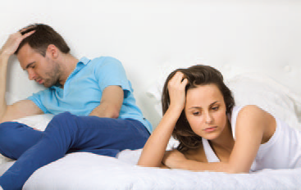
Sexual Satisfaction and Sexual Problems
This section covers:
Elements of Sexual Satisfaction
Ways to Increase Intimacy and Communication
Sexual Dysfunctions
Notes:
This is the Psychology in Action feature starting on page 373

Slide 33
Ways to increase intimacy and communication
Avoid “gunnysacking”
Saving up feelings and complaints, then dumping them on partner during an argument or fight
Be open about feelings
Don’t attack the other person’s character
Don’t try to “win” a fight
Recognize that anger is appropriate
Try to see things through your partner’s eyes
Don’t be a “mind-reader”
Notes:
(p 374)
increase intimacy and communication:
Avoid “gunnysacking”
Be open about feelings
Don’t attack the other person’s character
Don’t try to “win” a fight
Recognize that anger is appropriate
Try to see things through your partner’s eyes
Don’t be a “mind-reader”

Slide 34
Sexual Satisfaction
Elements needed for healthy sexual relationships
sexual anticipation
valuing one’s sexuality
believing you deserve sexual pleasure
valuing intimacy
Notes:
Elements necessary for healthy sexual relationships: sexual anticipation; valuing one’s sexuality; believing you deserve sexual pleasure; and valuing intimacy
Sexual anticipation. Looking forward to
lovemaking can be inhibited by routine
and poor communication between
partners. It is wise for busy couples
to set aside time to spend together.
Unexpected, spontaneous lovemaking
should also be encouraged.
2. Valuing one’s sexuality. This is most
likely to occur when you develop a
respectful, trusting, and intimate relationship
with your partner. Such relationships
allow both partners to deal
with negative sexual experiences when
they occur.
3. Believing that you deserve sexual pleasure.
As previously noted, the essence
of satisfying lovemaking is the giving
and receiving of pleasure.
4. Valuing intimacy. A sense of closeness
and intimacy with one’s partner helps
maintain sexual desire, especially in
long-term relationships (McCarthy,
1995; McCarthy & Fucito, 2005).
(pp 373-374)

Slide 35
Sexual Dysfunctions
Desire disorders: person has either little or no sexual motivation or has too much
Arousal disorders: person desires sexual activity but does not become sexually aroused
Orgasm disorders: person does not have orgasms or experiences orgasms too soon or too late
Sexual pain disorders: person experiences pain which makes lovemaking uncomfortable
Notes:
Desire disorders: person has either little or no sexual motivation or has too much
Hypoactive sexual desire (persistent, upsetting loss of desire); Sexual aversion (fear or disgust about engaging in sex); Hypersexual disorder (persistent, troubling excess of sexual desire) with treatment involving psychotherapy
Arousal disorders: person desires sexual activity but does not become sexually aroused
Erectile disorder and Female sexual interest/arousal disorder with treatments involving medications and the use of Sensate focus (directs couple’s attention to natural sensations of sexual pleasure)
Orgasm disorders: person does not have orgasms or experiences orgasms too soon or too late
Female orgasmic disorder and delayed ejaculation are treated using sensate focus
Premature ejaculation treated using squeeze technique
Sexual pain disorders: person experiences pain which makes lovemaking uncomfortable
Genito-pelvic pain/penetration disorder includes dyspareunia (genital pain) and vaginismus (vaginal muscle spasms)
Treated using desensitization and relaxation methods

