Slide 1

A Brief History of Psychology
This section covers:
  The definition of psychology
  A brief history of psychology
Notes:
IMAGE: [© agsandrew/Shutterstock.com] (Bernstein, p. 2)
A Brief History of Psychology 1 of 13
This section covers:
The definition of psychology
A brief history of psychology
What do you know about psychology and what psychologists do?
The word psychology is a combination of two Greek words: psyche, or “soul,” and logos, “the study of.”
For the ancient Greeks, the use of the word “soul” was closer to our modern view of a spirit or mind.
Logos is the source of all our “ologies,” such as biology, anthropology, and so on. Literally translated, therefore, psychology means “the study of the mind.”
Contemporary definitions of psychology refine this basic meaning.
Most psychologists today define their field as the scientific study of behavior and mental processes—that is, the scientific study of the mind.
Psychologists study what we do and what we think, feel, dream, sense, and perceive.

Slide 2
The Goals of Psychology
To Describe Behavior
To Explain Behavior
To Predict Behavior
To Control or Change Behavior
Notes:
A Brief History of Psychology 2 of 13
The first goal of psychology is to describe the different ways that organisms behave.
Observe events and behaviors, then look at how events might be related.
The second goal of psychology is to explain the causes of behavior.
Predict what events or behaviors may occur, based on their relationship.
The third goal of psychology is to predict how organisms will behave in certain situations.
Suggest and test an explanation (in the form of a hypothesis).
For some psychologists, the fourth goal of psychology is to control an organism’s behavior.
By explaining and understanding the causes of behavior, psychologists can create programs or treatments to control or change the behaviors.
The idea of control can be seen both positively and negatively.
The positive side is that psychologists can help people learn to control undesirable behaviors by teaching better methods of self-control and ways to deal with situations and relationships.
The negative side is the concern that psychologists might control people’s behaviors without their knowledge or consent.

Slide 3
Experiencing Psychology: How Much Do You Know About Behavior?
Indicate whether you believe each statement is true (T) or false (F).
1. People are either left-brain or right-brain thinkers. | T | F
2. Genes only affect people during prenatal development. | T | F
3. For most people, intelligence peaks in their late 30s or early 40s. | T | F
4. During sleep, the brain is mostly resting and inactive. | T | F
5. Feeling good can make you smile, but not the reverse. | T | F
6. Expressing pent-up anger reduces feelings of aggression. | T | F
7. Most relationships follow the idea that “opposites attract” | T | F
Notes:
IMAGE: [© Cengage Learning, 2014] Table 1.1 (Pastorino, p. 5)
A Brief History of Psychology 3 of 13
How many of the items did you mark as true?
All the statements are false, yet many students have such misconceptions or believe such myths about human behavior.
Psychological findings do not always confirm our everyday observations about behavior.
Only by objectively measuring and testing our ideas and observations about behavior can we determine which ideas are more likely to stand up to scientific scrutiny.
Behavior is much more complex than the simple statements suggest.

Slide 4
The Roots of Psychology – Philosophy
Plato (427–347 BCE) to René Descartes (1596–1650)
  Pondered the relationship between the mind and body, and between knowledge and experience
Empiricists such as Locke (1632-1704)
  Viewed the mind as a blank slate
Eventually, philosophical concepts and a physiological understanding of the brain merged into what we now call “psychology”
Notes:
A Brief History of Psychology 4 of 13
The ancient Greek philosopher Plato (427–347 BCE) was one of the earliest thinkers to tackle the question “What is the mind?”
Plato’s version of the mind featured three parts that must be in balance: reason, spirit, and appetite.
Plato’s division of the mind is echoed in the more modern work of Sigmund Freud (1856–1939) (the id, the ego, and the superego).
Another question with ancient roots asks about the relationship between body and mind.
On one side of the question were thinkers who believed in dualism, or the idea that body and mind are quite different and separate.
To the dualist, our bodies are physical, but our minds are some- thing nonphysical and somewhat more mysterious.
Arguing against this point of view were the proponents of monism, the idea that mind and body are not separate.
The ancient Greek philosophers were nearly evenly split between monism and dualism.
The French philosopher René Descartes (1596–1650) was a vocal proponent of dualism. He saw the body as mechanical but the mind as a nonphysical entity not suitable for scientific inquiry.
Just as philosophers disagreed about the relationship of mind and body, they argued about whether the mind’s knowledge was inborn or the product of experience.
Some philosophers, including Descartes, argued that ideas and emotions were innate or inborn.
More commonly, philosophers beginning with Aristotle believed that all knowledge is gained through sensory experience.
Beginning in the 17th century, this idea flourished in the British philosophical school of empiricism.
The empiricists viewed the mind as a “blank slate” at birth that was filled with ideas gained by observing the world.
As one of the major empiricists, John Locke (1632–1704), wrote in An Essay Concerning Human Understanding: “Let us then suppose the mind to be, as we say, white paper void of all characters, without any ideas. How comes it to be furnished? . . . To this I answer, in one word, from EXPERIENCE. (Locke, 1690, II.1.2)”
The philosophical debate about the source of knowledge is echoed in psychology as researchers consider the relative contributions of inborn or innate factors (nature) and experience (nurture) to particular behaviors.
Many early psychologists were trained in physiology and sought to apply their scientific training to the study of the mind.
One important distinction between psychology and philosophy is the emphasis on adhering to the scientific method.
Psychologists conduct research and formulate theories based on empirical evidence.

Slide 5
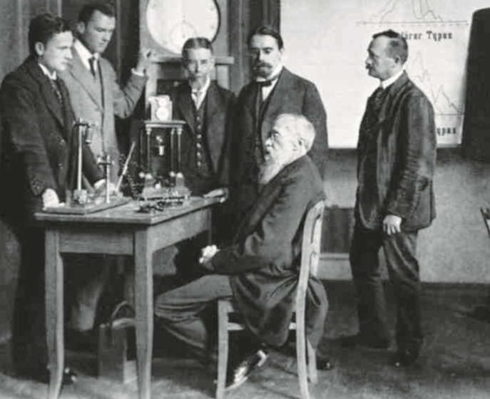
Structuralism – Wilhelm Wundt (1832–1920) and Edward Titchener (1867–1923)
Key idea: our consciousness can be broken down into its essential elements
Notes:
IMAGE: [© INTERFOTO/Personalities/Alamy] (Cacioppo, p. 11): Wilhelm Wundt (1832–1920), seated in this photo, is considered to be the first experimental psychologist.
A Brief History of Psychology 5 of 13
Wilhelm Wundt (1832–1920) established the first formal psychology laboratory at the University of Leipzig in 1879, earning him the nickname of “The father of psychology.”
The first documented psychology experiment was a simple test of reaction time.
How quickly after hearing a ball drop onto a platform could a person respond by striking a telegraph key?
Wundt, trained in medicine and physiology, was one of the physical scientists who became interested in the mind.
Wundt believed that the goal of a new science of psychology was to understand consciousness.
Wundt saw mental experience as a hierarchy.
The mind constructs an overall perception (the food I’m eating tastes good) out of building blocks made up of separate sensations (such as taste or vision) and emotional responses.
One of Wundt’s students, Edward Titchener (1867–1923), expanded on Wundt’s views to establish a theory of structuralism, in which the mind could be broken down into the smallest elements of mental experience.
Titchener’s approach to psychology paralleled the general trends in the physical sciences of his day, such as efforts in chemistry to break molecules into elements and attempts by physicists to describe matter at the level of the atom.

Slide 6

Structuralism – Introspection
The personal observation of our own thoughts, feelings, and behaviors
  Ignore what this object is, and instead, describe your conscious experience of it
Notes:
IMAGE: [© Cengage Learning, 2013] (Bernstein, p. 13)
A Brief History of Psychology 6 of 13
Wilhelm Wundt was interested in studying mental experiences.
He used a method called introspection, or careful self-examination and reporting of one’s conscious experiences.
Because it is difficult for others to confirm an individual’s introspections, this subjective approach does not lend itself well to the scientific method.
In the last 30 years, however, revolutions in the methods used to observe brain activity have allowed psychologists to revisit the question of mental processes with much greater objectivity and success.
For example, he would present subjects with an object, such as piece of fruit, and ask them to describe their impressions or perceptions of the object in terms of its shape, color, or texture
and how the object felt when touched. Or subjects might be asked to sniff a scent and describe the sensations or feelings the scent evoked in them.
In this way, Wundt and Titchener sought to break down mental experiences into their component parts, including sensations, perceptions, and feelings, and then discover the rules that determine how these elements come together to produce the full range of conscious experiences.

Slide 7
Functionalism – William James (1842–1910)
Key idea: our consciousness serves an adaptive purpose by helping us survive
Notes:
IMAGE: [© Bettmann/Corbis] (Pastorino, p. 24)
A Brief History of Psychology 7 of 13
Functionalism emerged as a new type of psychology, partly in response to the publication of Charles Darwin’s The Origin of Species in 1859 and The Descent of Man in 1871.
Functionalism viewed behavior as purposeful, since it led to survival.
Nineteenth-century United States politics and culture, which valued individuality, practicality, and frontier survival, embraced functionalism.
Instead of restricting themselves to exploring the structure of the mind, functionalists were more interested in why behavior and mental processes worked in a particular way.
In short, they were more interested in what consciousness could DO, rather than what it was made of.
To answer these questions, functionalists broadened their research techniques beyond the introspection used by Wundt and Titchener.
Functionalism’s chief proponent was William James (1842–1910), whose textbook, Principles of Psychology (1890), dominated the field of psychology for 50 years.
It is difficult to overestimate the impact of William James on psychology.
Although he really didn’t establish a particular “school” or train large numbers of students as did Wundt or other early psychologists, James’s ideas have become so dominant in psychology that we no longer refer to any separate “functionalist” approach.
Structuralism came and went, but all contemporary psychologists are generally functionalists at heart.

Slide 8
Psychodynamic Theory –
Sigmund Freud (1856–1939)
Key idea: our behavior is deeply influenced by unconscious thoughts, impulses, and desires
  Many unconscious drives are sexual or destructive in nature.
Notes:
IMAGE: [© Imagno/Hulton Archive/Getty Images] (Coon, p. 27): Sigmund Freud’s (1856–1939) focus on the unconscious was unique and led to his formulation of psychoanalytic theory.
A Brief History of Psychology 8 of 13
Between the 17th and 19th centuries, supernatural explanations for psychological disorders began to give way to two scientific approaches: a medical model and a psychological model.
The medical model of psychological disorder emphasized physical causes of abnormal behavior and medical treatments, such as medication.
The psychological model suggested that abnormal behavior can result from life experiences, leading to fear, anxiety, and other counterproductive emotional responses.
Sigmund Freud (1856–1939) built a bridge from his medical training as a physician to his belief in the impact of life experiences on behavior.
His psychodynamic theory and its applications to the treatment of psychological disorders dominated much of psychological thinking for the first half of the 20th century.
Freud managed to combine and communicate ideas about the existence of the unconscious mind, the development of sexuality, dream analysis, and psychological roots of abnormal behavior in such a way that his theories influenced not just psychology but culture.
He nearly single-handedly founded the study of personality in psychology.
He developed the techniques of psychoanalysis for treating mental disorders.
He popularized the use of psychological principles for explaining everyday behavior, and his theories are just as likely to be discussed in your English literature course as they are in a psychology course.
Despite his importance and stature in the field, Freud has been widely criticized on two major grounds:
1. His theories weren’t grounded in empirical research. In fact, some of his theories are impossible to test scientifically.
2. His view of humans was largely negative and overemphasized sex and aggression.

Slide 9
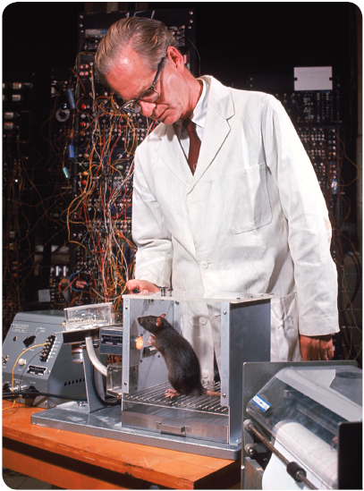
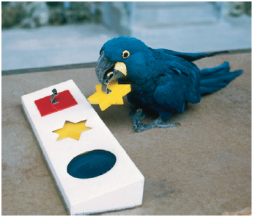
Behaviorism –James B. Watson (1878–1958) and B. F. Skinner (1904–1990)
Key idea: our behavior is learned, observable, and measurable
Notes:
IMAGE: [© Nina Leen/Time Life Pictures/Getty Images, © Tom McHugh/Photo Researchers] (Coon, p. 26; Rathus, p. 10)
A Brief History of Psychology 9 of 13
Beginning at the dawn of the 20th century, the “mental processes” in our definition of psychology took a backseat to observable behavior for the better part of the next 50 years, as psychologists following the perspective of behaviorism concentrated on observable, measurable behaviors.
As part of their effort to measure behavior carefully, many behaviorists restricted their research to studies using animals.
Armed with Darwin’s evidence linking humans to animals, the behaviorists comfortably drew parallels between their observations of animals and their assumptions about human behavior.
In particular, behaviorists were fascinated by learning, which we define as any persistent change in behavior due to experience.
John B. Watson (1878–1958) began experimenting with learning in rats, and independently came to many of the same conclusions as Pavlov.
Watson also echoed the “blank slate” approach of the British empiricist philosophers in his emphasis on the role of experience in forming human behavior.
Other behaviorists were much more interested in the effects of consequences on behavior, an idea that was derived from basic functionalism.
Edward Thorndike (1874–1949) proposed a law of effect, which suggested that behaviors followed by pleasant or helpful outcomes would be more likely to occur in the future, whereas behaviors followed by unpleasant or harmful outcomes would be less likely to occur.
Like Thorndike, B. F. Skinner (1904–1990) was very interested in the effects of consequences on how frequently behaviors were performed.
Skinner shared Watson’s belief that psychology did not benefit from any consideration of consciousness or internal mental states.
Skinner believed that inner, private states such as thinking and feeling existed, but he viewed them as behaviors that followed the same rules as public behaviors, like driving a car.

Slide 10
Humanistic Psychology – Abraham Maslow (1908–1970) and Carl Rogers (1902–1987)
Key idea: we have free will to live more creative, meaningful, and satisfying lives
Notes:
IMAGE: [© Michael Rougier/Time & Life Pictures/Getty Images (Cacioppo, p. 16)
A Brief History of Psychology 10 of 13
By the 1960s, American psychology was primarily characterized by behaviorism on one side and Freud’s theories on the other.
Just as other aspects of American culture began to feature rebelliousness against current ways of thinking, some psychologists began to push against the restrictions of behaviorism and psychoanalysis.
This dissatisfaction with prevailing views led these humanistic psychologists to propose new ways of thinking about the human mind.
Humanistic psychologists rejected the idea that people are innately uncivilized and must be taught to be good.
Humanists extended the views of 18th-century Romantic philosophers into a belief that people are innately good, are motivated to improve themselves, and only behave badly when corrupted by society.
Instead of focusing on what went wrong in people’s lives, humanist Abraham Maslow (1908–1970) asked interesting questions about what made a person “good.”
Maslow introduced a major theory of motivation, the pinnacle of which is the goal of self-actualization.
Humanist therapists rebelled against Freudian approaches to treatment.
Maslow was interested in studying people of exceptional mental health. Self-actualized people, he believed, make full use of their talents and abilities. Maslow offered his positive view of human potential as an alternative to the perspectives of behaviorism and psychoanalysis.
One humanist therapist, Carl Rogers (1902–1987), developed a new approach to therapy, client-centered therapy.
In this type of therapy, the people receiving treatment are referred to as clients rather than patients, reflecting their more equal standing with the therapist and their more active role in the therapy process.
The beliefs of the humanist psychologists provided a foundation for Positive Psychology, a modern perspective which focuses on the factors that influence happiness, well-being, altruism, and other positive characteristics.

Slide 11

The Gestalt Viewpoint –
Max Wertheimer (1880–1941)
Key idea: to understand consciousness, we must study the whole, not just its component parts
Notes:
IMAGE: [© Cengage Learning 2013 (Cacioppo, Figure 1.4, p. 13)
[© Bettmann/Corbis ] (Cacioppo, p. 12)
A Brief History of Psychology 11 of 13
The structuralists’ effort to break behavior down into its essential elements was rejected by a group of early 20th-century German psychologists, including Kurt Koffka, Max Wertheimer, and Wolfgang Köhler, who founded Gestalt psychology.
Gestalt, although lacking a clear translation into English, means “form” or “whole.”
The Gestalt psychologists believed that breaking a “whole” perception into its building blocks, as advocated by the structuralists, would result in the loss of some important psychological information.
This is often captured by the saying “The whole is greater than the sum of its parts.”
Wertheimer first proposed the Gestalt viewpoint to help explain perceptual illusions. He later promoted Gestalt psychology as a way to understand not only perception, problem solving, thinking, and social behavior, but also art, logic, philosophy, and politics.
For example, take a look at the middle image in. It is the same in both the top and bottom rows, yet in the context of the first row, most people would interpret the image as the letter B. In the context of the bottom row, however, the image looks like the number 13.

Slide 12
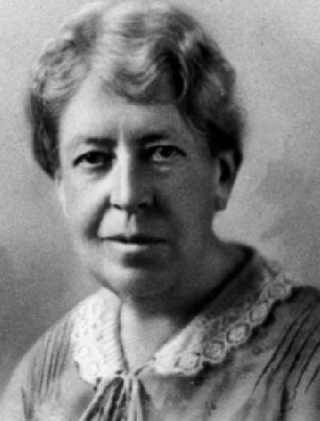
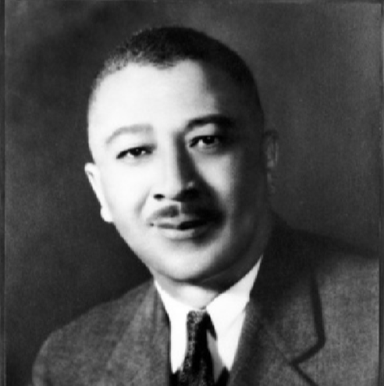
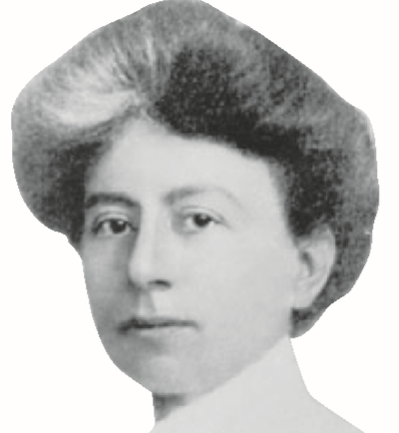
Who Are These Psychologists?
First African-American PhD, examined racism
First female psychologist to earn a PhD in America
Denied a PhD, later elected first woman president of the APA
Notes:
IMAGES: Francis Cecil Sumner [Courtesy of the Moorland-Spingarn Research Center, Howard University Archives] (Cacioppo, p. 24); Mary Whiton Calkins [Courtesy of the Wellesley College Archives] (Cacioppo, p. 17); Margaret Washburn [© History of American Psychology, U. of Akron, Akron, Ohio] (Pastorino, p. 23)
A Brief History of Psychology 12 of 13
What are the important achievements of these psychologists?
In 1920, Francis Cecil Sumner (1895–1954) became the first African American to receive a PhD in psychology from an American university for his work on psychoanalysis. Sumner’s later work focused on religion and racism.
Much of his research was grounded in efforts to refute theories suggesting that Blacks were inferior to Whites.
He argued that much of psychology was dominated by a Eurocentric view that didn’t incorporate the experiences of minorities.
Mary Whiton Calkins (1863–1930) was a student of William James at Harvard, although she could not officially register due to her gender. Despite completing the requirements of a Ph.D., she was never awarded one by Harvard.
She published articles on Psychology and Philosophy, focusing primarily on the workings of memory and established the field of self-psychology.
She was so well-regarded by her peers that she was elected president of the American Psychological Association in 1905.
Margaret Washburn (1871-1939) was the first woman to be awarded a doctorate in psychology.
In 1908, she published The Animal Mind, the first book on animal cognition. This put her at odds with the behaviorists, who argued that internal mental events couldn’t be studied.
Like Calkins, she was elected president of the American Psychological Association. She was also the first woman psychologist to be inducted into the National Academy of Sciences.

Slide 13
Cognitive Psychology –
Ulric Neisser (1928–2012)
Key idea: how our brain processes information influences how we behave
Notes:
IMAGE: [© Courtesy of Cornell University] (Cacioppo, p. 20)
A Brief History of Psychology 13 of 13
By the 1950s, the behaviorists’ disinterest in mental states and activity was challenged by scientists from diverse fields, including linguistics and computer science, leading to a cognitive revolution.
Cognition covers the very private and internal mental processes the behaviorists avoided studying—information processing, thinking, reasoning, and problem solving—in some ways, looking back to the idea of introspection.
Ulric Neisser (1928–2012) gave the new field its name in his 1967 book, Cognitive Psychology.
Breakthroughs in computer technology allowed these new cognitive psychologists to use mathematical and computer models to illuminate the mental processes leading to observable behaviors.
Alan Newell (1927– 1992) and Herbert Simon (1916–2001) wrote groundbreaking artificial intelligence programs using human information processing as their model.
The hardware of the computer was viewed as a metaphor for the brain, and its software mirrored the brain’s activity.

Slide 14
Contemporary Psychology
This section covers:
  Modern psychological perspectives
  Careers in psychology
Notes:
IMAGE: [© Will & Deni McIntyre/Photo Researchers/Getty] (Cacioppo, p. 587)
Contemporary Psychology 1 of 5
This section covers:
Modern psychological perspectives
Careers in psychology
What does psychology look like today? Many people thinking about psychotherapy imagine a bearded man scribbling notes next to a patient reclining on a couch, but this stereotype is usually far from the truth.

Slide 15
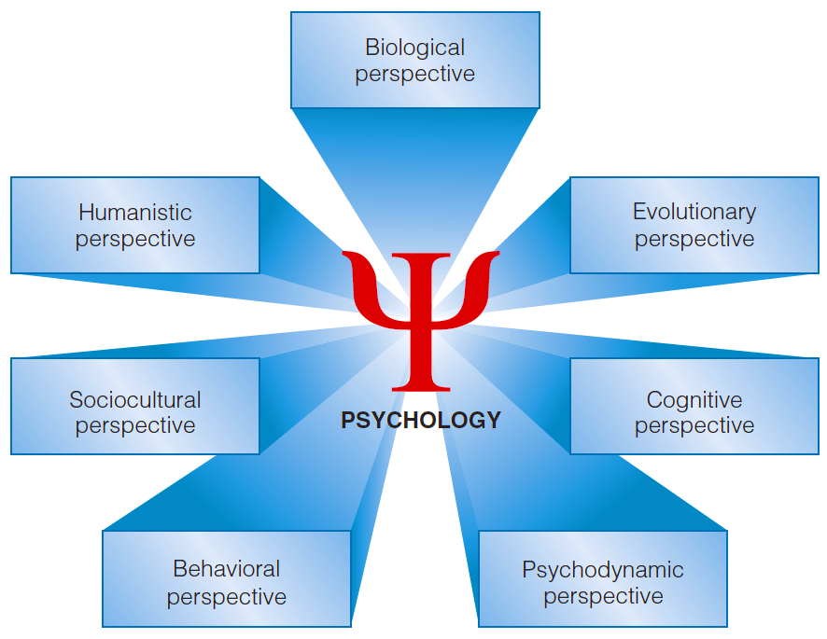
Modern Psychological Perspectives
Notes:
IMAGE: [© Cengage Learning 2013] (Pastorino, Figure 1.7, p. 23)
Contemporary Psychology 2 of 5
Just as a photograph or a piece of art can be examined from many different angles, so, too, can mental processes and behavior. We call these angles perspectives. Each offers a somewhat different picture of why people behave as they do. Taken as a whole, these perspectives underscore the complex nature of behavior.
Biological psychology, also referred to as behavioral neuroscience, focuses on the relationships between mind and behavior and their underlying biological processes, including genetics, biochemistry, anatomy, and physiology.
Technological advances beginning in the 1970s, especially new methods for observing brain activity, initiated an explosion of knowledge about the connections between brain and behavior.
Evolutionary psychology attempts to answer the question of how our physical structure and behavior have been shaped by their contributions to our species’ survival.
The basic principle of evolutionary psychology is that our current behavior exists in its present form because it provided some advantage in survival and reproduction to our ancestors.
An evolutionary psychologist might be interested in the fact that we have a very good memory for faces, and particularly for faces of people who have cheated us in the past
Cognitive psychology focuses on the process of thinking, or the processing of information.
Because our ability to remember plays an integral part in the processing of information, a cognitive psychologist is likely to have a lot to say about the storage and retrieval of memories.
Although not as popular, today, psychologists may adopt a psychodynamic perspective, focusing on internal, often unconscious mental processes, motives, and desires or childhood conflicts to explain behavior.
A modern approach to developmental psychology explores the normal changes in behavior that occur across the lifespan. Using the developmental perspective, a psychologist might look at how memory functions in people of different ages.
The behavioral perspective seeks to explain external causes of behavior, suggests that behavior is learned and is influenced by other people and events define, and treat abnormal behaviors.
Clinical and counseling psychology seeks to define and treat abnormal behavior.
Sociocultural psychology (social psychology) describes the effects of the social environment, including culture, on the behavior of individuals.
One cannot fully explain a person’s behavior without understanding his or her culture, gender identity, ethnic identity and other important cultural factors, and looks at individual differences. Recognizing individual differences is especially important to psychologists interested in variations in personality.
Today’s psychologists who adopt a humanistic perspective explain behavior as stemming from your choices and free will. These choices are influenced by your self-concept (how you think of yourself) and by your self-esteem (how you feel about yourself).
A growing emphasis on human strengths and on how humans attain happiness has led to the subfield of positive psychology, led by psychologists Seligman and Csikszentmihalyi.

Slide 16
Integrating the Perspectives
The eclectic, or integrated, approach
  Combining several perspectives provides a more complete picture of behavior
  For example, anxiety may be described as:
    A change in brain chemistry
    A learned behavior
    An adaptive response
    A product of unresolved feelings
    Rooted in a dissatisfaction with one’s self
Notes:
Contemporary Psychology 3 of 5
Today, most psychologists do not rigidly adhere to just one of these perspectives but are likely to take what is referred to as an eclectic approach when explaining
behavior. An eclectic approach integrates or combines several perspectives to provide a more complete and complex picture of behavior.
Explanations of anxiety:
Biological anxiety is related to chemicals in the body or to genetics (heredity).
Evolutionary anxiety is an adaptive response that prepares one to respond to potential threats in the environment. This response helps humans survive because it warns them of danger and thereby
helps them avoid situations or people that may harm them. However, in modern times, these threats tend to be ongoing: traffic jams, crowding, and the hectic pace of consumerism.
Psychodynamic anxiety is the product of unresolved feelings of hostility, guilt, anger, or sexual attraction experienced in childhood.
Behavioral anxiety is a learned behavior much like Albert’s fear of the white rat. It is a response that is associated with a specific stimulus or a response that has been rewarded.
Sociocultural anxiety is a product of a person’s culture. In the United States, more women than men report being anxious and fearful, and this gender difference results from different socialization experiences. Men in the United States are raised to believe that they must not be afraid, so they are less likely to acknowledge or report anxiety. Women do not experience this pressure to hide
their fears, so they are more likely to tell others that they are anxious and to seek treatment.
Humanistic anxiety is rooted in people’s dissatisfaction with their real self (how they perceive themselves) as compared to their ideal self (how they want to be).
Cognitive anxiety refers to the idea that people think differently than nonanxious people. Anxious people may engage in more pessimistic thinking or worry that everything will go wrong.
Eclectic anxiety stems from various sources depending on the individual. One person may be prone to anxiety because many people in his family are anxious and he has learned to be anxious from several experiences. Another person may be anxious because she is dissatisfied with herself and believes that everything always goes wrong in her life.

Slide 17
Which Subfield Do Psychologists Today Choose?
Notes:
IMAGE: Source: Data from Michalski et al. (2011).
Contemporary Psychology 4 of 5
Students receiving doctoral degrees in 2008–2009 might have identified with one of these major perspectives, but increasingly, doctoral students are choosing to train in multiple or integrated perspectives, such as cognitive neuroscience.
Some students with undergraduate degrees in psychology prefer employment in fields that are directly related to psychology, such as working in research facilities or rehabilitation centers for drug abuse or brain damage.
Others are quite successful in a wide variety of “people-oriented” jobs, such as those found in management, sales, service, public affairs, education, human resources, probation, and journalism.
Graduates with master’s degrees in psychology, usually requiring one to two years of additional study past the bachelor’s degree, can teach at the community college (2-year) level and obtain licensing as therapists in most states. Many master’s level psychologists are employed in health, industry, and education.
Choosing a graduate perspective is similar to choosing an undergraduate major.
Although all psychology graduate students might take core courses in research methods and statistics, they typically pursue coursework and research in their particular area of specialization.
However, training of psychologists in the 21st century is beginning to reflect the connections occurring in the field itself.
Increasingly, students are being trained in combined specialties (e.g., cognitive neuroscience) as psychology becomes a more integrated field of study.
The most rigid distinction occurs between graduate students planning to specialize in clinical or counseling psychology and those who do not.
The clinical or counseling “major” includes extensive internships and supervised training prior to government-regulated licensure that usually add at least one year to students’ graduate studies.

Slide 18
Where Do Psychologists Work?
Notes:
IMAGE: Source: 2009 Doctorate Employment Survey, APA Center for Workforce Studies.
Contemporary Psychology 5 of 5
Do all psychologists do therapy and treat abnormal behavior? Less than 60 percent of psychologists are clinical and counseling psychologists. Regardless, every psychologist is highly trained in the methods, knowledge, and theories of psychology. This chart shows the main activities psychologists do at work. Any one psychologist might participate in several of these activities during a work week. As you can see, most psychologists specialize in applied areas and work in applied settings.
At present, the American Psychological Association (APA) consists of more than 50 divisions, each reflecting special skills or areas of interest. No matter where they are employed or what their area of specialization, many psychologists do research. Some do basic research, in which they seek knowledge for its own sake. For example, a psychologist might study memory simply to understand how it works. Others do applied research to solve immediate practical problems, such as finding ways to improve athletic performance (Davey, 2011). Some do both types of research.
About 36% of new doctoral level psychologists do what your professor and the authors of your textbook do: teach and conduct research at colleges and universities.
About 3% of new doctoral level psychologists work as therapists, either in private practice or in hospitals and clinics.
Smaller numbers of new doctoral level psychologists find employment in business and government settings, elementary and secondary schools, and other related fields.

Slide 19
Research Methods in Psychology
This section covers:
  How to think scientifically
  Methods of conducting research
  Ethical concerns in research
Notes:
IMAGE: [© Richard T. Nowitz/Science] (Coon, p. 15)
Experimental and Nonexperimental Methods 1 of 20
This section covers:
The scientific method
Research methods
The scientific study of dreaming was made possible by use of the EEG, a device that records the tiny electrical signals the brain
generates as a person sleeps. The EEG converts these electrical signals into a written record of brain activity. Certain shifts in brain activity, coupled with the presence of rapid eye movements, are strongly related to dreaming.

Slide 20
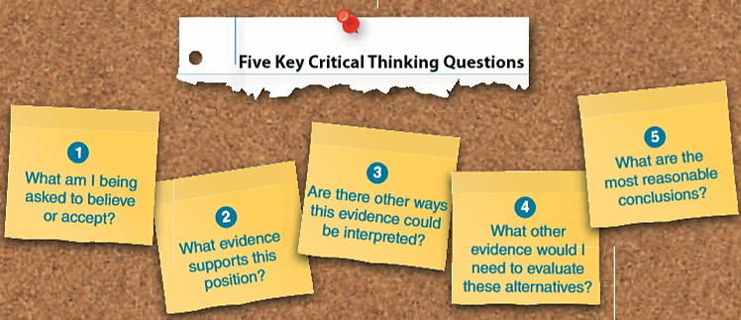
Thinking Like a Scientist
What makes scientific thinking different than everyday observation?
  Objectivity rather than subjectivity
  Systematic observation and repeatable evidence
Notes:
IMAGE: [© Cengage Learning 2013] (Cacioppo, p. 51)
Experimental and Nonexperimental Methods 2 of 20
Not all observations are scientific. How does science differ from everyday observations, like the belief that “opposites attract”?
First, science relies on objectivity rather than subjectivity.
Scientists strive to be objective, but any observation by a human being is, by definition, subjective.
Recognizing when you are being subjective can be difficult, so scientists cannot rely on their own introspections to maintain objectivity.
Scientific methods promote objectivity and help prevent biased, subjective observations from distorting a scientist’s work.
The second important difference between science and everyday observations is the use of systematic observation as opposed to hit-or-miss observation.
By “hit or miss,” we mean making conclusions based only on whatever is happening around us.
Finally, science relies on observable, repeatable evidence, whereas everyday observation often ignores evidence, especially when it runs counter to strongly held beliefs.
Scientific knowledge is both stable and changing.
The fact that we may learn something new tomorrow should not convince you that today’s knowledge is flawed.
Most change occurs very slowly on the “cutting edges” of science, not quickly or at the main core of its knowledge base.
An important feature of scientific literacy is to learn to be comfortable with the idea that scientific knowledge is always open to improvement and will never be considered absolutely certain.
The skilled critical thinker has learned to follow logical arguments, identify mistakes in reasoning, prioritize ideas according to their importance, and apply logic to personal attitudes, beliefs, and values.
Critical thinking is grounded in a skeptical viewpoint.
You can begin by using five critical thinking questions (as illustrated above) to evaluate new information you come across in your everyday life, including in this class.
It is also helpful to recognize the signs that you are not thinking critically:
Instead of figuring out the answer to a problem yourself, you prefer just being given the answer.
You prefer to use “gut feelings” about decisions instead of using reason to choose a solution.
You do not review your mistakes or change your mind if evidence contradicts your original position.
You resent criticism of your ideas.

Slide 21
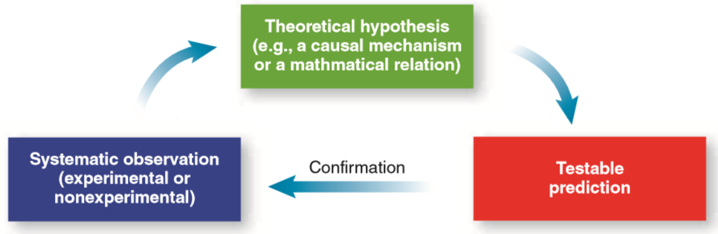
Developing a Research Idea
Hypothesis
  Proposed explanation for a situation: “if A happens then B will be the result”
Theory
  A set of facts and relationships between facts that can explain and predict related phenomena
Notes:
IMAGE: [© Cengage Learning 2013] (Cacioppo, Figure 2.3, p. 40): How to Develop and Test a Theory.
Experimental and Nonexperimental Methods 3 of 20
Theory building begins with generating hypotheses that are then systematically tested. Hypotheses that are not rejected contribute to the theory and help generate new hypotheses.
Science seeks to develop theories, which are sets of facts and relationships between facts that can be used to explain and predict phenomena.
In other words, scientists construct the best possible models of reality based on the facts known to date.
Confusion over the multiple meanings of the word theory have led people mistakenly to view truly scientific theories, like the theory of evolution, as nothing more than casual guesses or hunches rather than the thoroughly investigated and massively supported principles that they are.
The best scientific theories not only explain and organize known facts, but they also generate new predictions.
A scientific prediction is much more than a guess or hunch.
Before attempting to generate your own scientific questions, it pays to become very familiar with relevant theories and previous discoveries.
As Sir Isaac Newton noted, scholars stand on the shoulders of giants—we build on the work of those who came before us.
Scientific progress often takes a giant leap forward when a gifted observer recognizes a deeper meaningfulness in an everyday occurrence.
Based on your understanding of past work and theoretical foundations in your area of interest, coupled with your own observations, you can now generate a hypothesis, which is a type of inference, or, in other words, an educated guess, based on prior evidence and logical possibilities.
Scientific hypotheses must be both falsifiable and testable.
Falsifiable does not mean “false.” Instead, falsifiable means that you can imagine situations that demonstrate your hypothesis to be false.
For example, a hypothesis claiming that all planets outside our solar system are uninhabited is falsifiable, because finding an inhabited planet outside our solar system would show that your hypothesis was wrong.
Hypotheses can be falsifiable but not necessarily testable, which means you can evaluate the hypothesis using known scientific methods.
Scientists can never “prove” that their hypotheses are true, because some future experiment, possibly using new technology not currently available, might show the hypothesis to be false after all.
All we can do is show when a hypothesis is false.
A false hypothesis must always be modified or discarded.

Slide 22
The Scientific Method
Observe behavior or other phenomena
Formulate a research question
Generate a testable prediction (hypothesis) that addresses your question
Collect and analyze data
Draw conclusions and use them to create/refine theories
Notes:
Experimental and Nonexperimental Methods 4 of 20
The purpose of psychological research is to test ideas about behavior.
Researchers use the scientific method when testing ideas about behavior.
The scientific method is a set of rules for gathering and analyzing information that enables you to test an idea or hypothesis.
The decisions that scientists make at each step of the scientific method will ultimately affect the types of conclusions they can draw about behavior.
Step 1: Observe Behavior or Other Phenomena
The scientific method often begins with casual or informal observations. Simply observe the world around you until some behavior or event catches your attention.
Step 2: Formulate a Research Question
This step in the process usually begins by identifying other factors, or variables, that are associated with your observation.
Use those other variables to generate explanations for the behavior that is of interest to you.
Step 3: Generate a Testable Prediction (Hypothesis)
Once you have a research question, you must develop a way to answer it.
Notice that a single hypothesis can lead to several different predictions and that each prediction refers to a specific situation or an event that can be observed and measured.
Also notice that the predictions generated from a hypothesis must be testable—that is, it must be possible to demonstrate that the prediction is either correct or incorrect by direct observation.
Either the observations will provide support for the hypothesis or they will refute the hypothesis.
For a prediction to be truly testable, both outcomes must be possible.
Step 4: Collect and Analyze Data
After a specific, testable prediction has been made, the next step is to evaluate the prediction using direct observation.
The goal is to provide a fair and unbiased test of the research hypothesis by observing whether the prediction is correct.
The researcher must be careful to observe and record exactly what happens, free of any subjective interpretation or personal expectations.
A good research study will have safeguards in place to minimize the likelihood of bias.
Step 5: Draw Conclusions and Create Theories
The final step of the scientific method is to compare the actual observations with the predictions that were made from the hypothesis. To what extent do the observations agree with the predictions?
Some agreement indicates support for the original hypothesis, and suggests that you consider making new predictions and testing them.
Lack of agreement indicates that the original hypothesis was wrong or that the hypothesis was used incorrectly, producing faulty predictions.
In this case, you might want to revise the hypothesis or reconsider how it was used to generate predictions.
In either case, this information is used in creating new theories or refining existing ones.
Researchers attempt to place their findings within a larger context of knowledge.
Once completed, researchers often circle back to step 2; that is, they form a new hypothesis that further explores their theory.

Slide 23
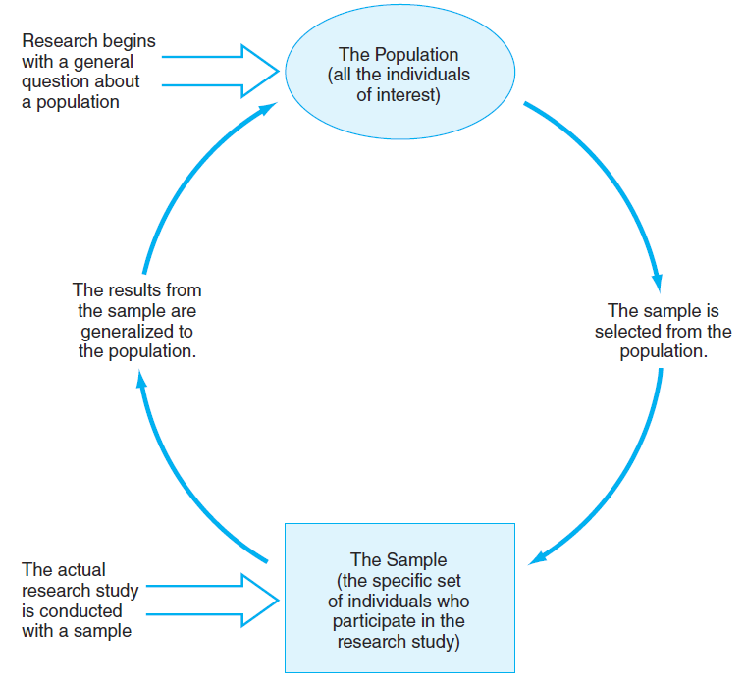
Selecting Participants for a Research Study
Notes:
IMAGE: [© Terry Why/Phototake] (Gravetter, Figure 5.1, p.134)
Experimental and Nonexperimental Methods 5 of 20
An important part of deciding what you are going to research is deciding the group you will be studying.
In a perfect world, researchers would include every person they are interested in studying.
This is termed the population of interest.
For example, for a developmental psychologist who specializes in infant development, all infants would be the population of interest.
It is impossible to test everyone, however, so researchers select a portion, or subset, of the population of interest called a sample.
Because the sample will be used to make inferences or judgments about the entire population, the sample should reflect the whole population as much as possible; that is, it should be a representative sample.
Random sampling of participants ensures a representative sample.
In a random sample, every member of the population has an equal chance of being selected to participate in the study; this avoids introducing sampling bias into the research.
The more representative the sample is, the more the results will generalize (or apply) to the population of interest. But random sampling is not always possible.
Instead, psychological research often uses samples of convenience, or groups of people who are easily accessible to the researcher.
The students in your psychology course are a sample of convenience.

Slide 24
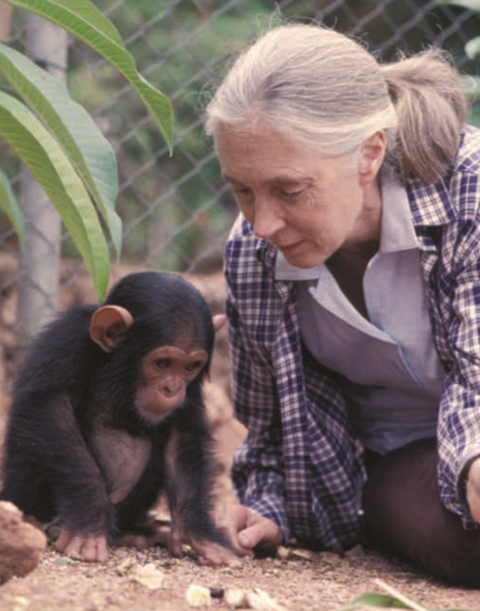
Nonexperimental Methods: Naturalistic Observation
Jane Goodall observing the world of the chimpanzee
Notes:
IMAGE: [© BRUCE COLEMAN INC./Alamy] (Cacioppo, p. 56): Famed naturalist Jane Goodall used naturalistic observation to illuminate the world of the chimpanzee.
Experimental and Nonexperimental Methods 6 of 20
If you are interested in learning about larger groups of people than are possible with the case study method, you might pursue a naturalistic observation, or an in-depth study of a phenomenon in its natural setting.
The researcher looks at a much larger group of people than in a case study (next slide), which strengthens the ability to apply results to the population in general.
We also have the advantage of observing individuals in their natural, everyday circumstances.
With the naturalistic observation method, researchers in the field can examine behavior as it unfolds, but they run the risk of influencing the behavior they are observing.

Slide 25
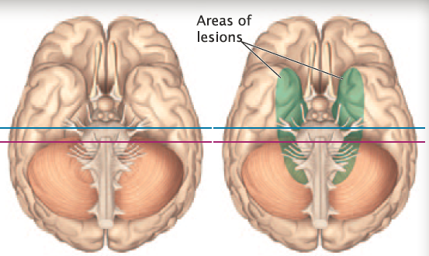
Nonexperimental Methods: Case Studies
Analyzing the case of H.M.
Notes:
IMAGE: [© Courtesy Dr. Suzanne Corkin, Massachusetts Institute of Technology. Copyright © 1997.] (Bernstein, p. 676):
Society for Neuroscience. J. Neurosci., May 15, 1997, 17(10):3964-3979H. M. underwent surgery that removed the hippocampus, the amygdala, and part of the association cortex from both temporal lobes.
Experimental and Nonexperimental Methods 7 of 20
A case study provides an in-depth analysis of the behavior of one person or a small number of people.
Many fields, including medicine, law, and business, use the case study method.
Psychologists often use case studies in situations where large numbers of participants are not available or when a particular participant possesses unique characteristics, like a particular disease or specific injury.
Interviews, background records, observation, personality tests, cognitive tests, and brain imaging provide information necessary to evaluate the case.
Consider the famous case of Henry Molaison, known for much of his life as patient H.M. to protect his identity (Scoville & Milner, 1957). In 1953, as a twenty-seven-year-old man, his epilepsy was so severe that he had brain surgery in an effort to stop his seizures. The surgery removed parts of both his left and right temporal lobes, including parts of the hippocampus on both sides. The surgery removed parts of both his left and right temporal lobes, including parts of the hippocampus on both sides. This radical treatment helped control his seizures, but it left H.M. with a dense amnestic syndrome that persisted until he died at age of eighty-two in 2008. H.M. was carefully studied for years, and the lessons learned from him prompted research on memory loss in other people after medial temporal lobe damage.

Slide 26
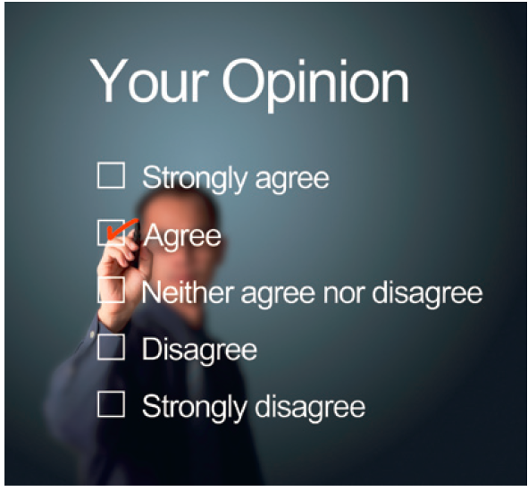
Nonexperimental Methods: Surveys
Polling a large population
Notes:
IMAGE: [© DustIt Shutterstock.com] (Cacioppo, p. 45)
Experimental and Nonexperimental Methods 8 of 20
Surveys or questionnaires allow you to ask large numbers of people questions about attitudes and behavior.
Surveys provide a great deal of useful information very quickly at relatively little expense.
Surveys can be conducted in several different ways (telephone, internet, paper-and-pencil forms)
It’s important to be aware of limitations that arise from the method used. For instance, if you conduct a telephone survey, are you excluding people that don’t have landlines?
One of the primary requirements for a good survey is the use of an appropriate sample, or subset of a population being studied.
Good results require large samples that are typical, or representative, of the population you wish to describe.
Surveys use self-report, so results can be influenced by people’s natural tendency to want to appear socially appropriate.

Slide 27
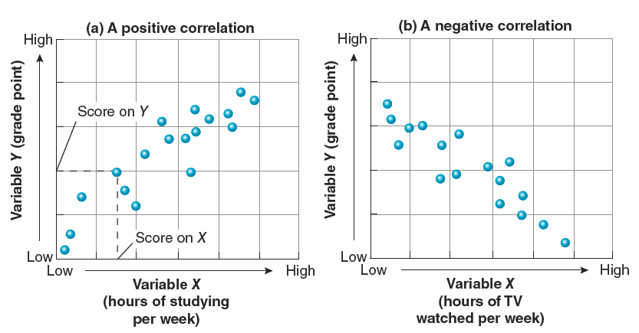
Designing a Correlational Study
Measure the direction and strength of the relationship between two variables, or factors
Notes:
IMAGE: [© Cengage Learning 2013] (Cacioppo, Figure 2.5, p. 47)
Experimental and Nonexperimental Methods 9 of 20
Correlational research measure the direction and strength of the relationship between two variables, or factors that have values that can “vary,” (have a range of values) like a person’s height and weight.
We begin our analysis of correlations by measuring our variables.
A measure answers the simple question of “how much” of a variable you have observed.
After we obtain measures of each variable, we compare the values of one variable to those of the other and conduct a statistical analysis of the results using a correlation coefficient.
Three possible outcomes from the comparison between our two variables can occur: positive, negative, or zero correlations.
In a positive correlation, high levels of one variable are associated with high levels of the other variable.
Height and weight usually show this type of relationship. In most cases, people who are taller weigh more than people who are shorter.
Two variables can also show a negative correlation, in which high values of one variable are associated with low values of another.
For example, high levels of alcohol consumption among college students are usually associated with low grade point averages.
The third possible outcome is a zero correlation, in which the two variables do not have any systematic relationship with each other at all.
When variables have a zero correlation, knowing the value of one variable does not tell you anything about the value of the other variable

Slide 28
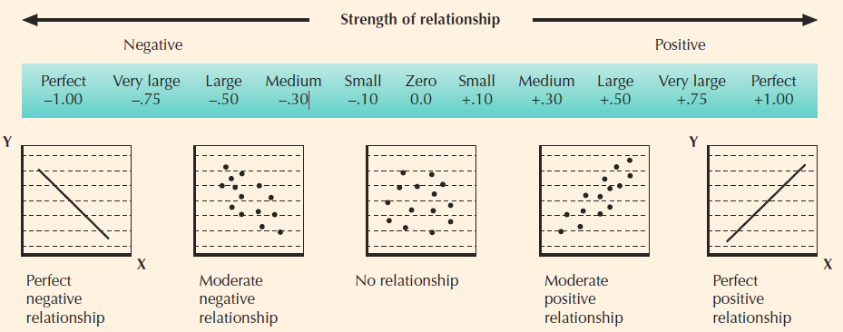
Measuring the Correlation
The correlation coefficient
Notes:
IMAGE: [© Cengage Learning 2013] (Coon, Figure 5.1, p. 46)
Proceedings of the National Academy of Sciences of the United States of America. vol. 104 no. Copyright (2007) National Academy of Sciences, U.S.A.
Experimental and Nonexperimental Methods 10 of 20
How is the degree of correlation expressed?
The strength and direction of a relationship can be expressed as a coefficient of correlation. This can be calculated as a number falling somewhere between +1.00 and −1.00. Drawing graphs of relationships can also help clarify their nature. If the number is zero or close to zero, the association between two measures is weak or nonexistent. If the correlation is +1.00, a perfect positive relationship exists. If it is −1.00, a perfect negative relationship has been discovered.
Note that the strength of the correlation is NOT influenced by its sign. A correlation of −.67 is stronger than a correlation of +.32
These graphs show a range of relationships between two measures, X and Y. If a correlation is negative (a), increases in one measure are associated with decreases in the other. (As Y gets larger, X gets smaller.) In a positive correlation (e), increases in one measure are associated with increases in the other. (As Y gets larger, X gets larger.) The center-left graph (b, moderate negative relationship) might result from comparing time spent playing computer games (Y) with grades (X): More time spent playing computer games is associated with lower grades. The center graph (c, no relationship) would result from plotting a person’s shoe size (Y) and his or her IQ (X). The center-right graph (d, moderate positive relationship) could be a plot of grades in high school (Y) and grades in college (X) for a group of students: Higher grades in high school are associated with higher grades in college.

Slide 29
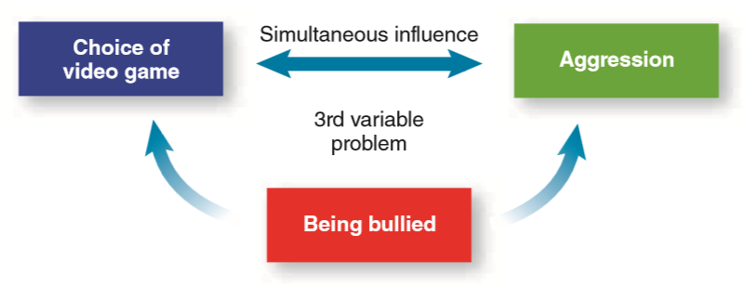
Understanding Causation
The third variable problem
Notes:
IMAGE: [© Cengage Learning 2013] (Cacioppo, Figure 2.7, p. 47) Third Variables and Correlations.
Experimental and Nonexperimental Methods 11 of 20
Third variables can be responsible for the correlation we observe in two other variables. In an example of video game violence and aggression, being bullied could be a third variable that predicts both choice of violent games and a tendency to be aggressive at school. The possibility of third variables is one reason we must be very careful when we reach conclusions based on correlational data.
Correlational research results are frequently misunderstood.
Correlations permit us to discuss the relationships between two variables but tell us nothing about whether one variable causes changes in the other.
Let us say that we discover a positive correlation between violent video games and aggression: Youth who play the most hours of violent video games have the most reports of physical aggression at school.
However, we still cannot say that playing violent video games causes physical aggression at school.
This conclusion may seem very reasonable to you, and it may actually be true, so why must we abandon it?
First, the two variables in a correlation can influence each other simultaneously.
Although it may be true that playing violent video games leads to physical aggression at school, youth who experience physical aggression at school may be more attracted to violent video games as an outlet for their frustration.
Second, we might be observing a situation in which a third variable is responsible for the correlation we see between our two variables of interest.
Consider the observation that many school shootings have been perpetrated by people who had been bullied relentlessly by others.
Perhaps the experience of having been bullied (the third variable in this case) predisposes both a choice of violent recreation and a tendency to engage in aggressive behavior at school

Slide 30
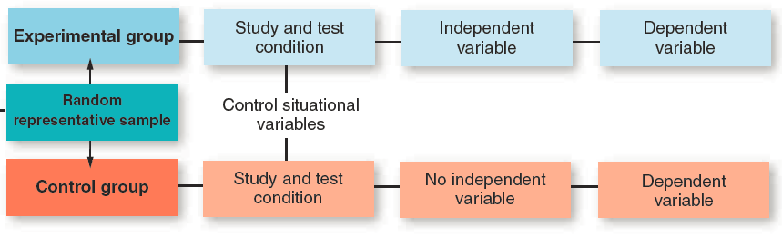
Designing an Experimental Study
Manipulate one variable and observe changes in others
  Independent variable: the cause
  Dependent variable(s): the effect
Notes:
IMAGE: [© Cengage Learning 2013] (Cacioppo, Figure 2.8, p. 49): How to Design an Experiment.
Experimental and Nonexperimental Methods 12 of 20
The scientist’s most powerful tool for drawing conclusions about research questions is the formal experiment.
Unlike cases in which descriptive methods are used, the researcher conducting an experiment has a great deal of control over the situation.
Unlike correlational methods, the use of the formal experiment allows us to talk about “cause”
A researcher begins designing an experiment with a hypothesis, which can be viewed as a highly educated guess based on systematic observations, a review of previous research, or a scientific theory.
To test the hypothesis, the researcher manipulates or modifies one or more variables and observes changes in others.
The variable controlled and manipulated by an experimenter (“If I do this . . . .) is known as the independent variable.
We need some way to evaluate the effects of this manipulation.
We use a dependent variable, defined as the observed result of the manipulation of the independent variable, to tell us “that will happen” as a result of the independent variable.
Like the independent variable, our choice of dependent variable is based on our original hypothesis.

Slide 31
Assigning Participant Groups in a Study
Randomly assign participants to:
  Experimental groups, who experience the independent variable
  Control groups, who do NOT experience the independent variable
Notes:
IMAGE: [© Stephen Kelly/PA Photos/Landov] (Coon, p. 41)
Experimental and Nonexperimental Methods 13 of 20
After determining our independent and dependent variables, we still have quite a bit of work to do.
In most experiments, we want to know how simply going through the procedures of being in an experiment influences our dependent variable.
Perhaps the hassle of going to a laboratory and filling out paperwork changes our behavior.
To evaluate these effects, we assign some of our participants to a control group, or a group that experiences all experimental procedures with the exception of exposure to the independent variable.
The experience of the control group should be as similar as possible to that of the experimental groups, who do experience the independent variable.
A special type of control group is a placebo control group.
A placebo is a treatment that contains nothing known to be helpful but that still produces benefits because the person receiving the treatment believes it will be beneficial (the placebo effect)
We want to ensure that our dependent variables reflect the outcomes of our independent variables, instead of individual differences among the participants’ personalities, abilities, motivations, and other similar factors.
To prevent these individual differences from masking or distorting the effects of our independent variable, we randomly assign participants to experimental or control groups.
Random assignment means that each participant has an equal chance of being assigned to any group in an experiment.
With random assignment, any differences we see between the behavior of one group and that of another is unlikely to be the result of the individual differences among the participants, which tend to cancel each other out.
Individual differences among participants are an example of confounding variables, or variables that are irrelevant to the hypothesis being tested that can alter our conclusions.
Random assignment to groups typically controls for confounds due to these types of individual differences, but other sources of confound exist.
Situational confounds, such as time of day or noise levels in a laboratory, could also affect the interpretation of an experiment.
Scientists attempt to run their experiments under the most constant circumstances possible to rule out situational confounding variables.
Another potential confound is experimenter bias, the unintentional effect that researchers may exert on their results.
To prevent experimenter bias from influencing results, experimenters may use a double-blind design.
In this arrangement, both the research participants and those giving the treatments are unaware of (“blind”) who gets the placebo.
Only researchers who have no direct contact with participants have this information, and they do not reveal it until the experiment is over.
Double-blind testing has shown that at least 50 percent of the effectiveness of antidepressant drugs, such as the wonder drug Prozac, is due to the placebo effect (Kirsch & Sapirstein, 1998; Rihmer et al., 2012). Much of the popularity of herbal health remedies also is based on the placebo effect (Seidman, 2001).

Slide 32
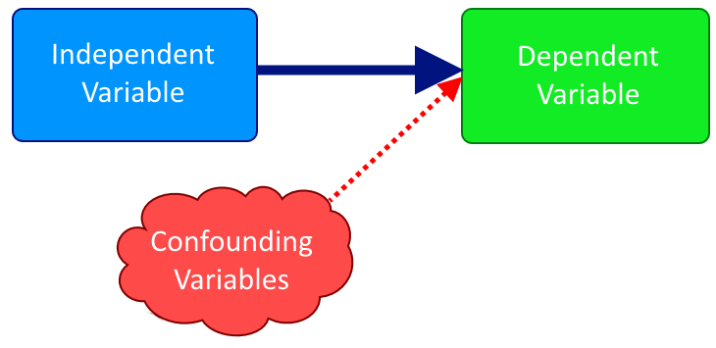
Problems in Experimental Research
Confounding (extraneous) variables
Experimenter bias
Notes:
Experimental and Nonexperimental Methods 14 of 20
When conducting experiments, researchers must be mindful of problems that can produce inaccurate results.
Confounding variables (sometimes called extraneous variables) are uncontrolled factors that influence the results of an experiment.
Individual differences among participants are an example of confounding variables.
Random assignment to groups typically controls for confounds due to these types of individual differences, but other sources of confound exist.
Situational confounds, such as time of day or noise levels in a laboratory, could also affect the interpretation of an experiment.
Scientists attempt to run their experiments under the most constant circumstances possible to rule out situational confounding variables.
Another hazard is experimenter bias, the unintentional effect that researchers may exert on their results.
To prevent experimenter bias from influencing results, experimenters may use a double-blind design.
In this arrangement, both the research participants and those giving the treatments are unaware of (“blind”) who gets the placebo.
Only researchers who have no direct contact with participants have this information, and they do not reveal it until the experiment is over.
Double-blind testing has shown that at least 50 percent of the effectiveness of antidepressant drugs, such as the wonder drug Prozac, is due to the placebo effect (Kirsch & Sapirstein, 1998; Rihmer et al., 2012). Much of the popularity of herbal health remedies also is based on the placebo effect (Seidman, 2001).

Slide 33
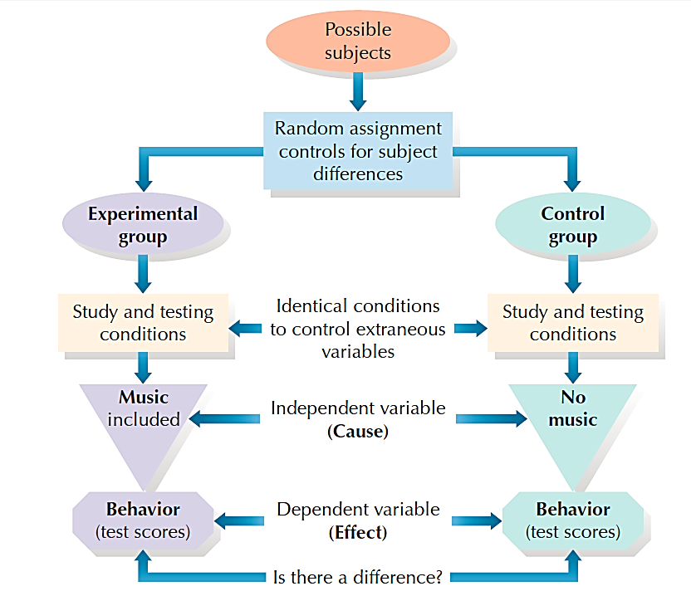
An example experiment: Does Listening to Music While Studying Affect Learning?
Notes:
IMAGE: [© Cengage Learning 2013] (Coon, Fig. 4.1, p. 40): Elements of a simple psychological experiment to assess the effects of music during study on test scores.
Experimental and Nonexperimental Methods 15 of 20
A good experimental design features random assignment of participants to groups, appropriate control groups, control of situational variables, and carefully selected independent and dependent variables.
Let’s examine a simple experiment. Suppose you notice that you seem to study better while listening to your iPod. This suggests the hypothesis that listening to music improves learning.
We could test this idea by forming an experimental group that studies with music. A control group would study without music. Then we could compare their scores on a test.
In this experiment, the amount learned (indicated by scores on the test) is the dependent variable. We are asking, Does the independent variable affect the dependent variable? (Does listening to music affect or influence learning?)

Slide 34
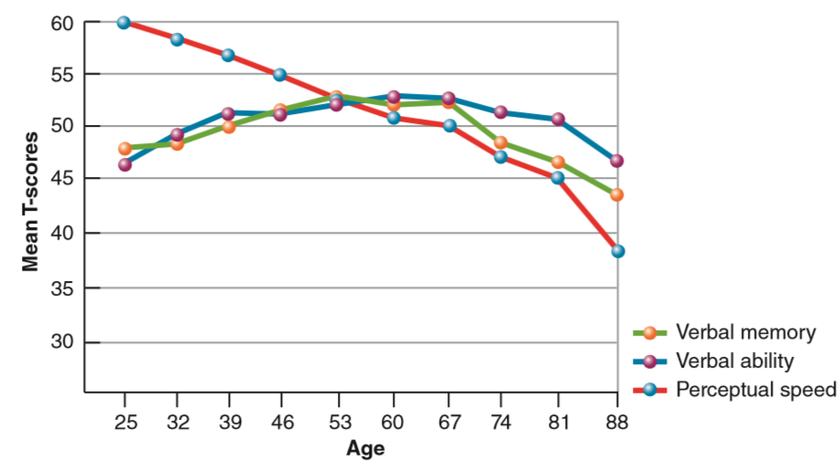
Studying the Effects of Time
Cross-sectional design
Longitudinal design
Mixed longitudinal design
Notes:
IMAGE: [© Cengage Learning 2013] (Cacioppo, Figure 2.12, p. 55): Special Designs Let Us See Behaviors Associated With Age.
Experimental and Nonexperimental Methods 16 of 20
Psychologists have three specific techniques for assessing the normal behaviors associated with age: cross-sectional, longitudinal, and mixed longitudinal designs.
To do a cross-sectional study, we might gather groups of people of varying ages and assess both their exposure to violent video games and their levels of physical aggression.
We might be able to plot a developmental course for age-related differences in both video game exposure and aggressive behavior.
However, the cross-sectional method introduces what we refer to as cohort effects, or the generational effects of having been born at a particular point in history.
Being 20 years old in 1950 was very different from being 20 years old in 1980 or in 2010, due to a variety of cultural influences.
A method that lessens this dilemma is the longitudinal study, in which a group of individuals is observed for a long period.
The longitudinal approach has few logical drawbacks, but it is expensive and time-consuming to do. Participants drop out of the study due to moves or lack of incentive.
Researchers then must worry about whether those who remain in the study still comprise a representative sample.
The third approach, the mixed longitudinal design, combines the cross-sectional and longitudinal methods.
Participants from a range of ages are observed for a limited period of time, usually about five years.
This approach is faster and less expensive than the longitudinal method and avoids some of the cohort effects of the pure cross-sectional method.
Longitudinal designs control for the cohort effects that are often seen in cross-sectional designs. The longitudinal study above shows that verbal ability and verbal memory are fairly stable over the lifetime, but that perceptual speed gradually worsens with age. Source: Adapted from Schaie (1996).

Slide 35
Conducting Ethical Research
American Psychological Association Guidelines
Do no harm.
Accurately describe risks to potential participants.
Ensure that participation is voluntary.
Minimize discomfort to participants.
Maintain confidentiality.
Do not unnecessarily invade privacy.
Use deception only when absolutely necessary.
Provide debriefing to all participants.
Provide results and interpretations to participants.
Treat participants with dignity and respect.
Allow participants to withdraw at any time for any reason.
Notes:
Experimental and Nonexperimental Methods 17 of 20
What ethical standards are researchers expected to uphold?
As a reply to such questions, American Psychological Association guidelines state: “Psychologists must carry out investigations with respect for the people who participate and with concern for their dignity and welfare” (American Psychological Association, 2010a).
Researchers working in universities and other agencies receiving federal funding must receive the approval of institutional review boards (IRBs) for human participant research and institutional animal care and use committees (IACUCs) before conducting research.
The IRBs and IACUCs are guided by federal regulations and research ethics endorsed by professional societies such as the American Psychological Association, the Association for Psychological Science, and the Society for Neuroscience.
At the core of ethical standards for human research is the idea that participation is voluntary.
No participant should be coerced into participating.
Although psychologists are well aware that people who volunteer to participate in research are probably quite different in important ways from those who don’t volunteer, we have chosen to give research ethics a higher priority than our ability to generalize research results.
Scientists have a duty to obtain informed consent from all participants.
In doing so, researchers must briefly describe the goals of the project, the potential risks and/or benefits to the participants, the procedures for maintaining confidentiality, and the incentives or payments offered for participation. Only after these items have been communicated, can participants agree to involvement in the study.
Research should also be conducted in a manner that does no irreversible harm to participants.
Most cases of deception are quite mild, as when participants are told that a study is about memory when it is actually a study of some social behavior.
When researchers must deceive their participants, extra care must be taken to debrief participants and answer all their questions following the experiment.
Research using human participants should be rigorously private and confidential.
Privacy refers to the participants’ control over the sharing of their personal information with others, and methods for ensuring privacy are usually stated in the informed consent.
For example, some studies involve the use of medical records, which participants’ agree to share with the researchers for the purpose of the experiment.
Confidentiality refers to the participants’ rights to not have their data revealed to others without their permission.
Confidentiality is usually maintained by such practices as substituting codes for names and storing data in locked cabinets.

Slide 36
Conducting Animal Research
Can be controversial
APA guidelines for what kind of research is permissible
Notes:
IMAGE: [©Teich/Caro/Alamy] (Cacioppo p. 66)
Experimental and Nonexperimental Methods 18 of 20
The topic of using animals in research is guaranteed to stimulate lively, and possibly heated, discussion.
Some people are adamantly opposed to animal research of any kind, whereas others accept the concept of using animals as long as certain conditions are met.
Currently, about 7 to 8% of published research in psychology journals involves the use of animals as subjects.
Ninety percent of the animals used are rodents and birds, with 5% or fewer studies involving monkeys and other primates.
According to the American Psychological Association (APA), the use of dogs and cats in psychological research is rare.
Research using animals must demonstrate a clear purpose, such as benefiting the health of humans or other animals.
In addition to serving a clear purpose, animal research requires excellent housing, food, and veterinary care.
The most controversial ethical standards relate to minimizing the pain and suffering experienced by animal research subjects.
The American Psychological Association provides guidelines for the use of pain, surgery, stress, and deprivation with animal subjects, as well as the termination of an animal’s life.
The standards approximate the community standards we would expect from local humane societies tasked with euthanizing animals that are not adopted.

Slide 37
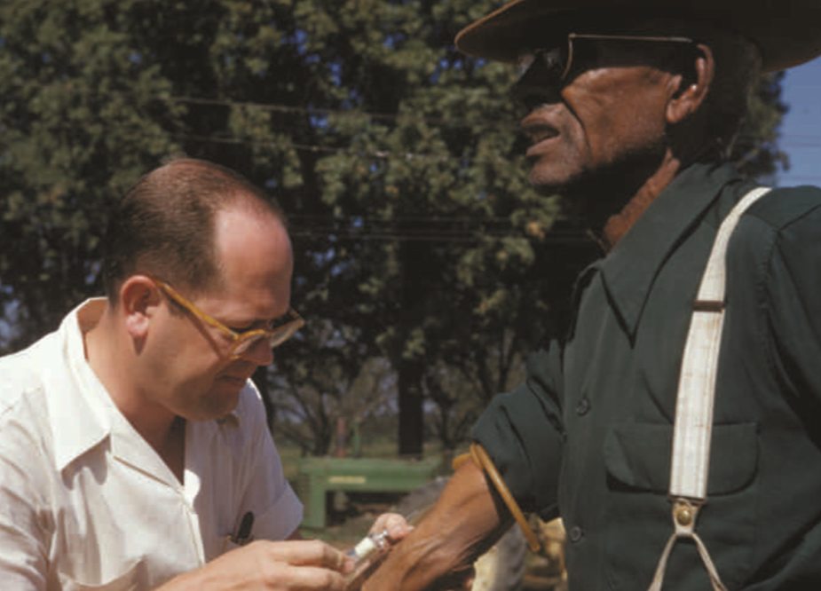
Ethically Questionable Research: The Tuskegee Syphilis Experiments
Prisoners, soldiers, and mental patients were deliberately exposed to syphilis and gonorrhea to test the effectiveness of penicillin
Notes:
IMAGE: [National Archives and Records Administration, ARC Identifier 824608] (Cacioppo, p. 65)
Experimental and Nonexperimental Methods 19 of 20
One of the most egregious examples of unethical research was the Tuskegee syphilis experiment, which lasted from 1932 until 1972.
Researchers from the U.S. Public Health Service recruited about 400 impoverished African American men who had contracted syphilis to study the progression of the disease.
None of the men was told he had syphilis, and none was treated, even though penicillin became the standard treatment for syphilis in 1947.
While examining the papers of Dr. John Cutler, who led the Tuskegee syphilis study, Wellesley historian Susan Reverby discovered that during the 1940s, U.S. and Guatemalan health officials had deliberately exposed prisoners, soldiers, and mental patients to syphilis and gonorrhea to test the effectiveness of penicillin.

Slide 38
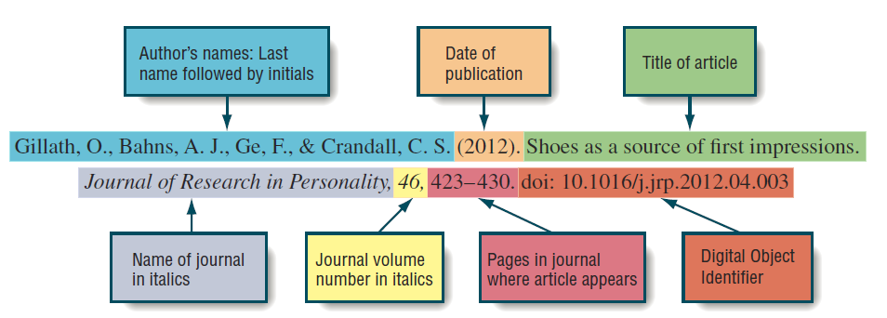
Another Kind of Research Ethics Violation: Plagiarism
Cite your research references!
Notes:
IMAGE: [© Cengage Learning 2013] (Nevid, Figure 1.9, p. 30)
Experimental and Nonexperimental Methods 20 of 20
To present someone else’s ideas or words as your own is to commit plagiarism. Plagiarism, like fraud, is a serious breach of ethics. Reference citations (giving others credit when credit is due) must be included in your paper whenever someone else’s ideas or work has influenced your thinking and writing. Whenever you use direct quotations or even paraphrase someone else’s work, you need to give that person credit.

Slide 39
Behavioral Statistics
This section covers:
  Issues in measurement
  Descriptive statistics
  Inferential statistics
Notes:
Behavioral Statistics 1 of 9
This section covers:
Issues in measurement
Descriptive statistics
Inferential statistics
Some psychologists specialize in administering, scoring, and interpreting psychological tests, such as tests of intelligence, creativity, personality, or aptitude. This specialty, which is called psychometrics, is an example of using psychology to predict future behavior.
How do psychologists draw conclusions from data?

Slide 40
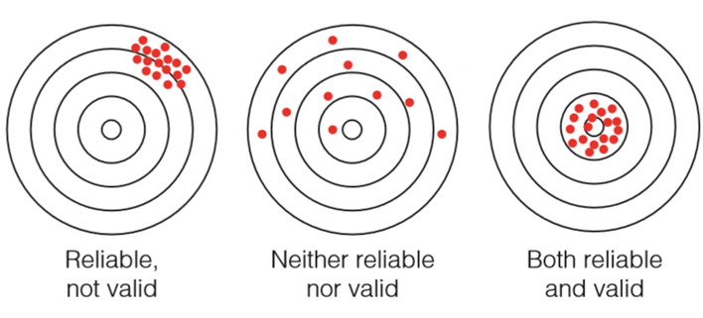
Issues in Measurement
Reliability: consistency
Validity: accuracy
Notes:
IMAGE: [© NA] (Trochim, Figure 5.30, p. 140): The target metaphor for reliability and validity of measurement. (Modified to remove the second target, per our reviewer’s suggestion)
Behavioral Statistics 2 of 9
Reliability is an important aspect of measurement quality.
In its everyday sense, reliability is the consistency or stability of an observation.
While reliability is necessary for ensuring the quality of any measurement, it alone is not sufficient.
Validity is the other important dimension that is crucial for any kind of meaningful measurement, in particular, and research, in general.
Validity deals with accuracy or precision of measurement.
We often think of reliability and validity as separate ideas but, in fact, they’re intimately interconnected.
A favorite metaphor for the relationship between reliability and validity is that of a target.
Think of the center of the target as the concept or construct you are trying to measure.
Imagine that for each person you are measuring, you are taking a shot at the target.
If you measure the concept perfectly for a person, you are hitting the center of the target.
If you don’t, you are missing the center. The more “off” you are for that person, the further you are from the center.
The figure shows three possible situations.
In the first one, you are hitting the target consistently, but you are missing the center of the target.
That is, you are consistently and systematically measuring the wrong value for all respondents.
This measure is reliable, but not valid. (It’s consistent but wrong.)
The second scenario shows a case where your hits are spread across the target and you are consistently missing the center.
Your measure in this case is neither reliable nor valid.
The last figure shows the Robin Hood or William Tell scenario; you consistently hit the center of the target. Your measure is both reliable and valid.

Slide 41
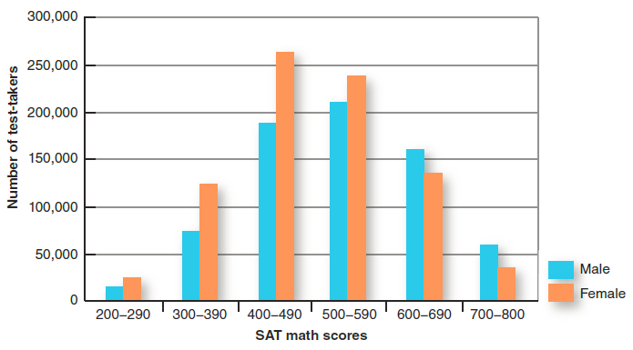
Descriptive Statistics
Find meaningful patterns and summaries in large sets of data
  Measures of Central Tendency
Notes:
IMAGE: [© Cengage Learning 2013] (Cacioppo, Figure 2.13, p. 58): Frequency Distributions
Behavioral Statistics 3 of 9
Descriptive statistics, such as these frequency distributions of SAT mathematics scores, are one way of viewing the numeric results of a research study.
These statistics give researchers a broad snapshot of the data.
Typically, they’re used to summarize the results.
Descriptive statistics can also illustrate trends or patterns within the data.
Researchers must use additional methods, however, to understand and interpret the data.
Among the most frequently used descriptive statistics are measures of central tendency
This gives researchers an idea of how the typical participant performs.
The 3 most popular measures of central tendency are: Mean, Median, and Mode.
Source: Adapted from “2009 College-Bound Seniors: Total Group Profile Report,” by The College Board, 2009, retrieved from http://professionals.collegeboard.com/profdownload/cbs-2009-national-TOTAL-GROUP.pdf.

Slide 42
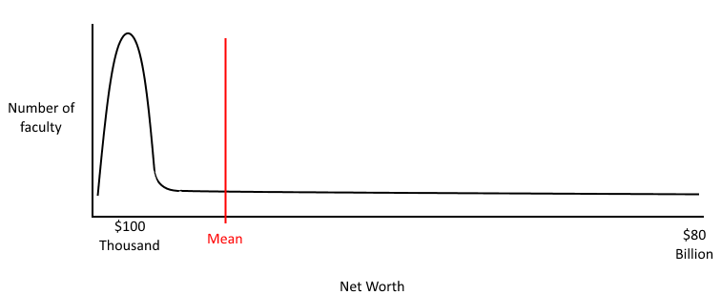
The Mean
A numeric average of a data set.
  Can be skewed by extreme values.
Notes:
Behavioral Statistics 4 of 9
The mean represents the numeric average of a data set.
You take the total scores of everyone and divide by the number of scores you have.
If I want the mean score of the first exam, I would add up every student’s score and divide by the number of students I have.
One problem with the mean is that it can be skewed by extreme values.
If the data contain a particularly high (or low) score, the mean may not represent the typical participant.
Imagine that you’re looking at the net worth of the faculty at this college/university. You’ll probably find some professors doing well (maybe very well), while others are at the start of their careers.
Now, imagine that Bill Gates, who is worth roughly $80 Billion, joins the faculty. The mean net worth will skyrocket, but it probably won’t be very representative of what’s typical.

Slide 43
The Median
The halfway mark in a set of data, with half of the scores above and half below
Notes:
IMAGE: [© Cengage Learning 2013] (Cacioppo, Figure 2.14, p. 59): What New Information Can We Learn From a Median?
Behavioral Statistics 5 of 9
The median represents a halfway mark in the data set, with half of the scores above and half below. The median is far less affected by extreme scores, or outliers, than the mean.
In many cases, like the SAT data, means and medians are very close together.
However, in other cases, like reported lifetime sex partners, these two measures of central tendency provide very different pictures.
The average number of sex partners for males is 20, but half of all men report having had 8 or fewer partners.
This suggests that the upper half of males have a very large number of partners indeed. Source: Adapted from ABC News: Primetime (2001).

Slide 44
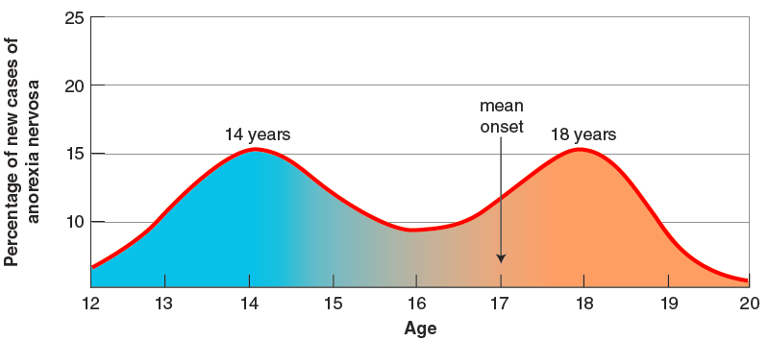
The Mode
The most frequently occurring score in a set of data
Notes:
IMAGE: [© Cengage Learning 2013] (Cacioppo, Figure 2.15, p. 59): What New Information Can We Learn From a Mode?
Behavioral Statistics 6 of 9
The mode in a data set refers to the score that occurs most frequently and is easy to determine from looking at a histogram.
The average age of onset for the eating disorder anorexia nervosa is 17 years, but this measure masks the important fact that age of onset shows two modes— one at 14 years and the second at 18 years.
For public health officials wishing to target vulnerable groups for preventive education, the modes provide better information than the mean. Source: Adapted from Halmi (1979).

Slide 45
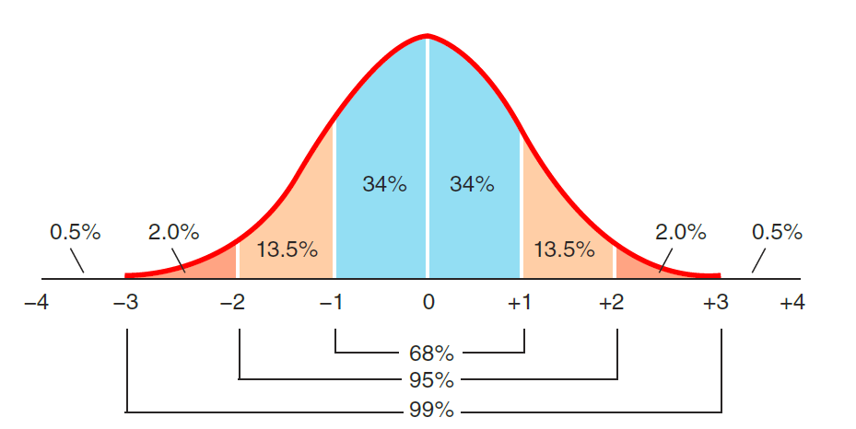
Standard Deviation
Measures how tightly clustered a group of scores is around the mean
Notes:
IMAGE: [© Cengage Learning 2013] (Cacioppo, Figure 2.16, p. 60): The Normal Curve. Many measures of interest to psychologists take the approximate form of a normal distribution.
Behavioral Statistics 7 of 9
We might be interested in identifying the “average” score on our measures, or the central tendency of our data set.
There are three types of measures for central tendency: the mean, median, and mode for each group of scores: the mode, the median, and the mean.
The mean is the numerical average of a set of scores, computed by adding all scores together and dividing by the number of scores.
The traditional way to look at the variability of scores is to use a measure known as the standard deviation. This measure tells you how tightly clustered a group of scores is around the mean.
Many measures of interest to psychologists, such as scores on intelligence tests appear to form a normal distribution.
The ideal normal curve in this illustration has several important features. One, it is symmetrical. Equal numbers of scores should occur above and below the mean. Second, its shape indicates that most of the scores occur near the mean, which is where our measure of variability plays a role. In the standard normal curve, shown in (a), 68% of the population falls within one standard deviation of the mean, 95% falls within two standard deviations, and 99% of the population falls within three standard deviations.

Slide 46
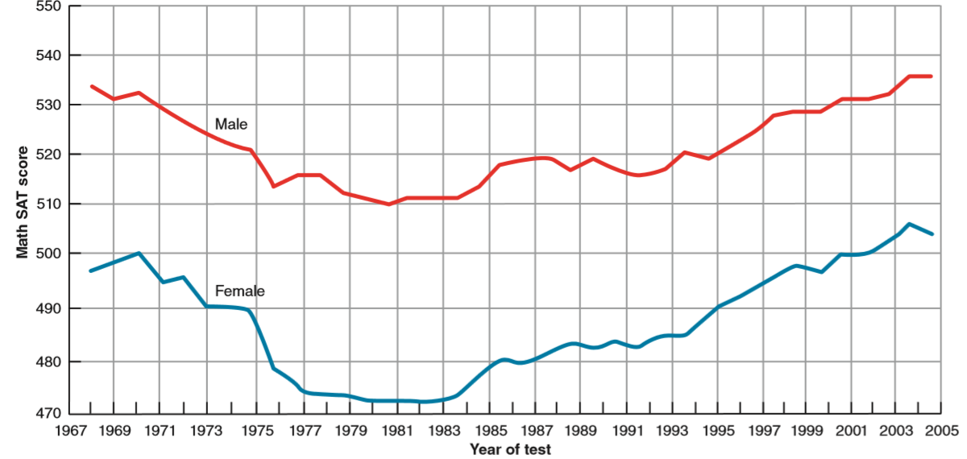
Inferential Statistics
Reach conclusions about data
Notes:
IMAGE: [© Cengage Learning 2013] (Cacioppo, Figure 2.19, p. 64): Are Male and Female Scores on the Math SAT Really Different?
Behavioral Statistics 8 of 9
Inferential statistics allow us to decide whether the observed differences between the performance of males and females on the math SAT represents a real gender difference or is just due to chance.
Although we can learn a great deal from our descriptive statistics, most of research features the use of inferential statistics, so called because they permit us to draw inferences or conclusions from data.
The descriptive statistics described earlier allow us to talk about our sample data, but do not allow us to decide what our sample data might mean more generally.
To reach conclusions about how our observations fit the big picture, we use inferential statistics.
How do we know when a hypothesis should be rejected? Like most sciences, psychology has accepted odds of 5 out of 100 that an observed result is due to chance as an acceptable standard for statistical significance. We can assess the likelihood of observing a result due to chance by repeating a study, like throwing dice multiple times.

Slide 47
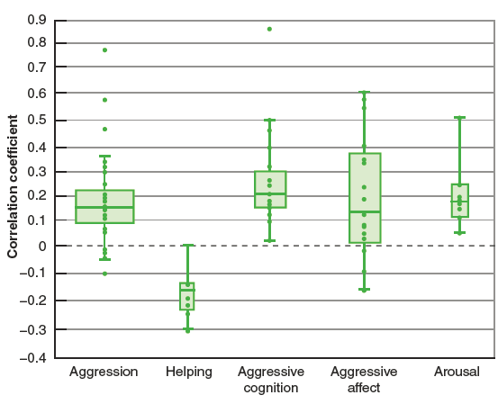
Example: A Meta-Analysis of Video Game Violence and Aggression
A statistical analysis of many prior experiments
Notes:
IMAGE: [© Cengage Learning 2013] (Cacioppo, Figure 2.10, p. 53): Insights From Meta-analyses.
Behavioral Statistics 9 of 9
Conducting a meta-analysis, or a statistical analysis of many previous experiments on the same topic, often provides a clearer picture than single experiments observed in isolation.
In the example shown, combining the findings of over 300 studies representing more than 50,000 participants, Anderson and Bushman (2002) argue that a positive relationship exists between exposure to video game violence and aggression, aggressive cognitions, aggressive affect or mood, and arousal.
Video game violence was negatively correlated with helping behaviors.
This type of graph is known as a boxplot.
The width of each box corresponds to the number of studies of each type.
Twenty-five percent of the results fall below the bottom of the box and another 25% are above the top of each box.
The line in the middle of a box shows the median, the point where half of the data are above and half below. Source: Adapted from Anderson and Bushman (2001).

