Slide 1
Psychology 313
Interventions with Children and Families
Week 7
Ch 9, Silver Text- Parts 2 & 3
Wiki ”KID” ia

Slide 2
Normal Development
Trust (9 months)
Separation (9 months to 3.5 years)
Individuation (3 – 6 years)
Self-concept
Conservation of Gender
Latency (6 years)
Not Freud’s Latency, but kind of…

Slide 3
Issues with Trust
Learning Disabilities or Atypical Development
Sensory Integration Dysfunction
ADHD
Autism/Asperger’s
Emotional Blindness

Slide 4
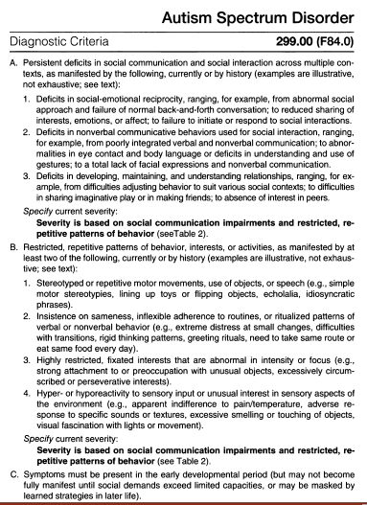

Slide 5
Separation
Two steps
Feel secure enough to venture out.
The world needs to be attractive enough to motivate this exploration.
How could learning disabilities affect either of these?

Slide 6
Individuation
If the child has experienced issues with separation, how might this affect individuation?
What traits might be seen?
Fearfulness
Avoidance
Attempted division of adults or other children
What is the likely outcome of such traits?

Slide 7
Latency
Fail to make the transition into the peer culture
Remain isolative or dependent upon the parents or other adults
How and when do these issues become problematic?
What must a therapist keep in mind when dealing with these issues?
The underlying disability or neurological components.

Slide 8
Common Responses to the Stress Experienced by these Children
Internalize the Stress (Internal locus of control)
Anxiety
Depression
Externalize the Stress (external locus of control)
Oppositional Defiant Disorder
Conduct Disorder
Somatizing the Stress
Using other Approaches
Class Clown
Passive-Aggressive

Slide 9
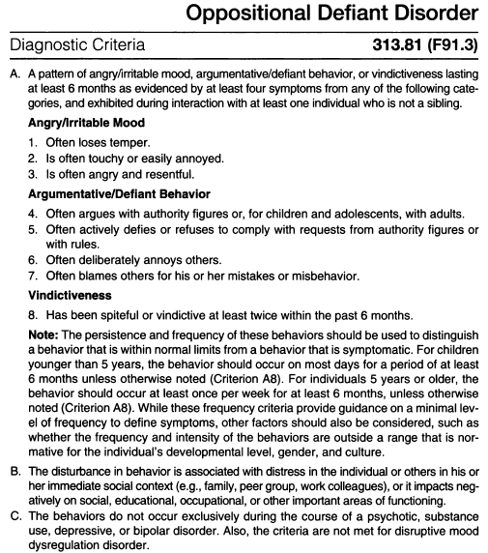

Slide 10
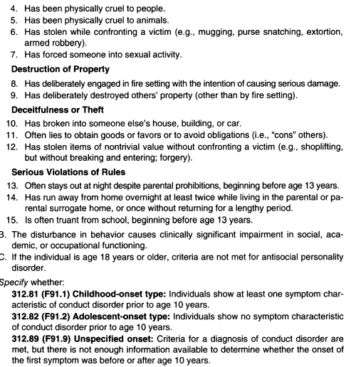
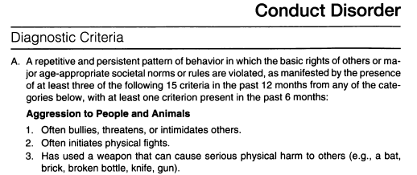

Slide 11
Approaching childhood issues with treatment.
Family counseling v. individual counseling
Benefits and detriments of each?

Slide 12
What is a family?
Usually multigenerational
The history of each individual is help within the family
The family experiences the effects of each individual within the family.

Slide 13
The Value of Family Therapy
Identify the processes and patterns within the family.
Individual and sub-group counseling
Integrating individual and sub-group work with the entire family unit.
Focus on solution building
Identify change and circular processes (resist).
Recognizing the change that occurs between sessions (reinforcing it).
The need for advocacy for the child.
Feedback to referral sources

