Slide 1
Psychology 313
Interventions with Children and Families
Week 3 Chapters 5, 6, 7, 8 & 10
WikiKIDia

Slide 2
Theoretical approaches
Freud
Maslow
Erikson
Piaget/ Kohlberg
Bowlby/Ainsworth
Skinner
Beck/ CBT
Glasser

Slide 3
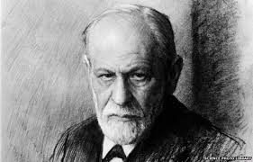
Freud
ID
Ego
Super-ego
Positive and Negative Transference

Slide 4
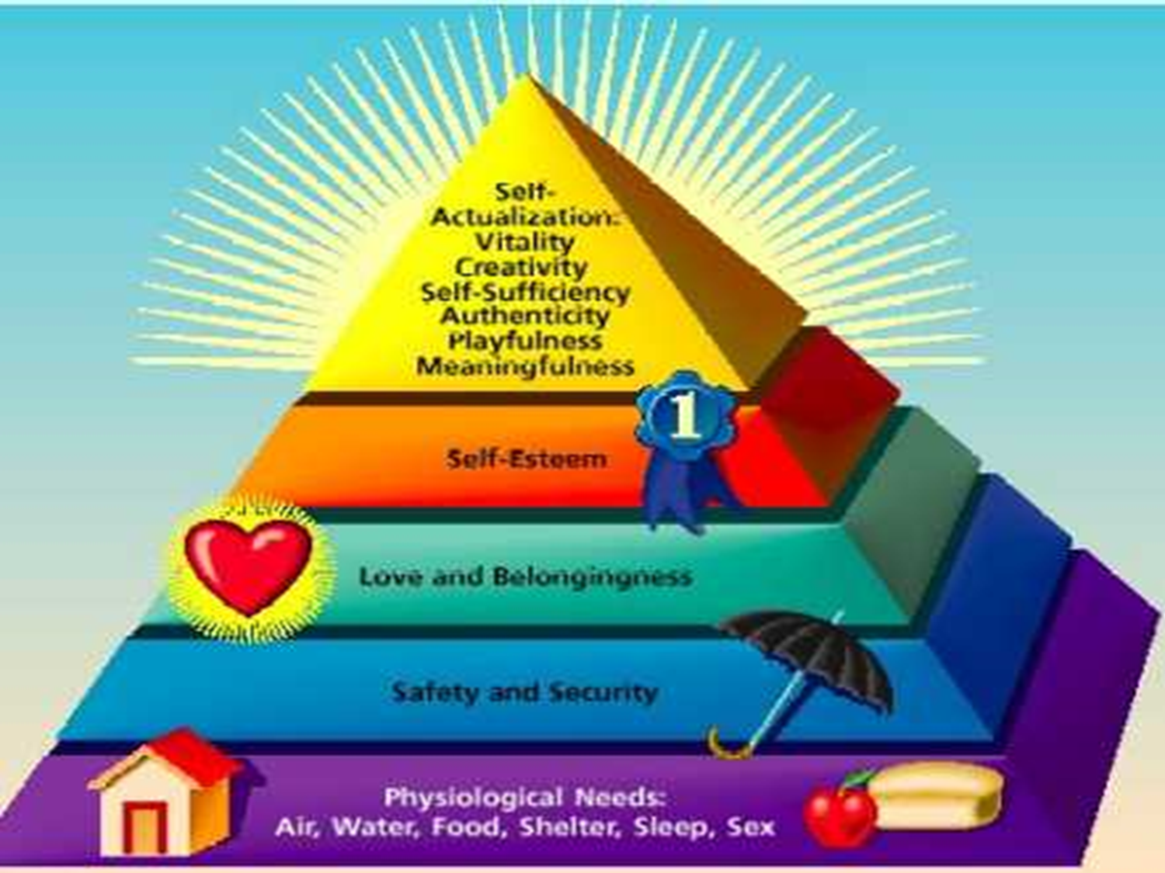
Maslow
Hierarchy of Needs
Erikson
Psychosocial stages

Slide 5
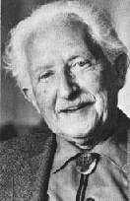
Erik Erikson’s Eight Stages of Psychosocial Dilemmas
Stage Three: Initiative versus Guilt (3-5)
Initiative: Parents reinforce via giving children freedom to play, use imagination, and ask questions
Guilt: May occur if parents criticize, prevent play, or discourage a child’s questions
Stage Four: Industry versus Inferiority (6-12)
Industry: Occurs when child is praised for productive activities
Inferiority: Occurs if child’s efforts are regarded as messy or inadequate

Slide 6
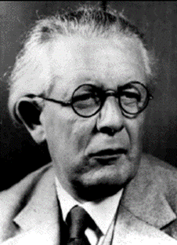
Jean Piaget: Preoperational Stage
Preoperational Stage (2-7 Years): Children begin to use language and think symbolically, BUT their thinking is still intuitive and egocentric.
Intuitive: Makes little use of reasoning and logic.
Egocentric Thought: Thought that is unable to accommodate viewpoints of others.

Slide 7
Jean Piaget: Concrete Operational Stage
Concrete Operational Stage (7-11Years): Children become able to use concepts of time, space, volume, and number BUT in ways that remain simplified and concrete, not abstract.
Conservation: Mass, weight, and volume remain unchanged when the shape or appearance of objects changes.
Reversibility of Thought: Relationships involving equality or identity can be reversed.

Slide 8
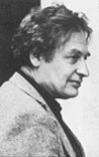
Lawrence Kohlberg and Stages of Moral Development
Moral Development: When we acquire values, beliefs, and thinking abilities that guide responsible behavior
Three Levels
Preconventional: Moral thinking guided by consequences of actions (punishment, reward, exchange of favors)
Conventional: Reasoning based on a desire to please others or to follow accepted rules and values
Postconventional: Follows self-accepted moral principles
Stage theorist, like Freud and Erikson

Slide 9
John Bowlby and Mary Ainsworth
Attachment
What is it and how does it occur?
What is its importance to the child?

Slide 10
Mary Ainsworth and Attachment
Emotional Attachment
Sensitive Period
Separation Anxiety: Crying and signs of fear when a child is left alone or is with a stranger; generally appears around 8-12 months
Quality of Attachment (Ainsworth) & the Strange Situation
Secure: Stable and positive emotional bond; upset by mother’s absence
Insecure-Avoidant: Tendency to avoid reunion with parent or caregiver
Insecure-Ambivalent: Desire to be with parent or caregiver and some resistance to being reunited with Mom
Insecure-Disorganized: Contradictory behaviors
Contact comfort

Slide 11
Narrative Therapy, Skinner, Beck & Glasser
Narrative Therapy
Gestalt
B.F. Skinner - Behavioral
Operant Conditioning
Aaron Beck
CBT
William Glasser
Reality Therapy

Slide 12
The process of Child Therapy
The Assessment - Why is this important?
How would you go about this?
Therapy for the Child
Joining with the child
Inviting and enabling the child to tell their story
Resolution of the issues
Empowerment for the child
Thinking Differently
Acting Differently
Assessment/Review & Closure

Slide 13
The Internal Processes
Child is emotionally disturbed
Child Joins with the Counselor
Child begins to tell their story
Awareness of issues increase
Child deflects or withdraws
Child deals with resistance
Child continues to tell story
View of self changes
Child deals with self-destructive beliefs
Child begins to see options and choices/ or lack thereof
Child rehearses and experiments (no such thing as failure)
Resolution is reached and movement towards adaptive functioning occurs.

Slide 14
SPICC Model
What do you think?
What do you like about it?
What do you not like about it?

Slide 15
The SPICC Model
Phase 1
Child is emotionally disturbed
Child Joins with the Counselor
Child begins to tell their story
Phase 2
Awareness of issues increase
Child deflects or withdraws
Child deals with resistance
Child continues to tell story
Phase 3
View of self changes
Phase 4
Child deals with self-destructive beliefs
Child begins to see options and choices/ or lack thereof
Phase 5
Child rehearses and experiments (no such thing as failure)
Resolution is reached and movement towards adaptive functioning occurs.
Client Centered
Gestalt
Narrative
CBT
Behavior Therapy

Slide 16
Group Counseling for Children
Advantages?
Joining with the child
Inviting and enabling the child to tell their story
Limitations?
Resolution of the issues
Empowerment for the child
Thinking Differently
Acting Differently

Slide 17
Types of groups
Therapy
Psychoeducational
Considerations prior to running a group?
Design a group for children

