Slide 1
A Topical Approach to Life-Span Development, 7th edition John W. Santrock
Chapter 14 –
Families, Lifestyles, and Parenting
Copyright McGraw-Hill Education, 2014

Slide 2
Diversity of Adult Lifestyles
Adults today choose many different lifestyles and forms of families
United States has more marriages and remarriages, divorces, short-term cohabitation relationships than most countries
Dramatic rise in percentage of single adults
Rising rates of cohabitation and trend toward postponing marriage
Single adults are often stereotyped
Copyright McGraw-Hill Education, 2014

Slide 3
Diversity of Adult Lifestyles
Cohabitation
Living together in a sexual relationship without being married
Number of cohabitating couples in U.S. has increased dramatically since 1970s
More than 75% of adults cohabitate prior to getting married
Cohabitation as a precursor to marriage or ongoing lifestyle
In U.S., cohabitating arrangements tend to be short-lived
Fewer than 1 out of 5 last for five years
Copyright McGraw-Hill Education, 2014

Slide 4
Diversity of Adult Lifestyles
Young adults’ reasons to cohabitate:
Spend time together
Share expenses
Evaluate compatibility
In cohabitating relationships, men are more concerned with loss of freedom while women are more concerned about delays in getting married
Copyright McGraw-Hill Education, 2014

Slide 5
Diversity of Adult Lifestyles
Couples who cohabitate face problems:
Disapproval from parents and other family members
Difficulty owning property jointly
Uncertain legal rights concerning dissolution of relationship
Copyright McGraw-Hill Education, 2014

Slide 6
Diversity of Adult Lifestyles
Lower rates of marital satisfaction and higher rates of divorce in couples who live together before getting married
Less traditional lifestyles may attract less conventional individuals who are not great believers in marriage
Cohabitation may change attitudes and habits in ways that increase likelihood of divorce
Copyright McGraw-Hill Education, 2014

Slide 7
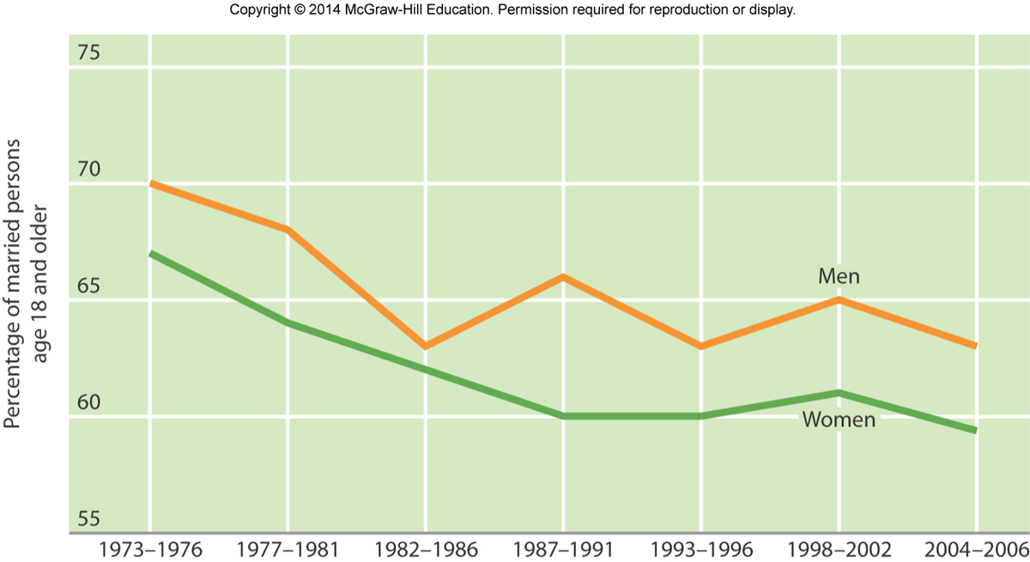
Diversity of Adult Lifestyles
Majority of Americans do still get married
Marriage’s role in signaling a successful social life to family and friends
Many young adults still plan to marry
Changes in percentages of “very happy” marriages over time
Married men consistently report being happier than married women
Copyright McGraw-Hill Education, 2014

Slide 8
Marriages
Successful Types
Validating
Volatile
Avoidant
Unsuccessful Types
Hostile Engaged
Hostile Detached
Divorce
Economic Effects
Social Support

Slide 9
Diversity in Adult Lifestyles
Predictors of success in marriage:
Establishing love maps
Nurturing, fondness, and admiration
Turning toward each other instead of away
Letting your partner influence you
Overcoming gridlock
Creating shared meaning
Copyright McGraw-Hill Education, 2014

Slide 10
Diversity in Adult Lifestyles
Premarital education occurs in groups and focuses on relationship advice
Programs range from several hours to 20 hours
Recommended 6 months to 1 year before wedding
Premarital education linked to higher level of marital satisfaction, commitment to spouse, lower level of destructive marital conflict, lower likelihood of divorce
Beneficial for first and second marriages
Copyright McGraw-Hill Education, 2014

Slide 11
Diversity in Adult Lifestyles
Some marriages that were difficult and rocky during early adulthood improve in middle adulthood
Partners develop a deep and solid foundation to anchor relationship
In middle adulthood, partners experience fewer financial worries, less housework and chores, more time with each other
Engaging in mutual activities linked with viewing marriage more positively
Copyright McGraw-Hill Education, 2014

Slide 12
Diversity in Adult Lifestyles
In midlife, most married individuals voice satisfaction with being married
Higher levels of emotional intimacy skills in early twenties predict well-adjusted marriages in middle age
In late adulthood, married individuals are happier, less distressed, and live longer than singles
Older adults more satisfied with marriages than young or middle-aged adults
Married individuals more likely to care for a sick partner with limited health conditions
Stress of caring for spouse places demands on intimacy
Copyright McGraw-Hill Education, 2014

Slide 13
Diversity of Adult Lifestyles
United States has one of the highest divorce rates in the world
Factors that increase likelihood of divorce:
Youthful marriages, low education level, low income, no religious affiliation, parents who are divorced, having a baby before marriage
Alcoholism, psychological problems, domestic violence, infidelity, inadequate division of household labor
Copyright McGraw-Hill Education, 2014

Slide 14
Parenting
Age of having children has been increasing over time
Birth control is more common practice
Marrying later and having children later or not at all
Advantages of having children early (in twenties):
More physical energy
Fewer medical problems with pregnancy and childbirth
Fewer built-up expectations for children
Problems?
Copyright McGraw-Hill Education, 2014

Slide 15
Parenting
Baumrind’s parenting styles:
Authoritarian parenting
Authoritative parenting
Neglectful parenting
Indulgent parenting
Copyright McGraw-Hill Education, 2014

Slide 16
Parenting
Consequences of child maltreatment:
Poor emotional regulation
Attachment problems
Problems in peer relations
Difficulty adapting to school
Psychological problems, such as depression and delinquency
During adult years, individuals who were maltreated as children are more likely to experience physical, emotional, and sexual problems
Copyright McGraw-Hill Education, 2014

Slide 17
Parenting
Parent-child attachment remains important
Mothers maintain closer emotional ties with adolescents than fathers, especially with daughters
Parent-adolescent conflict escalates during early adolescence
Conflict usually involves everyday issues of family life
Rarely involve major dilemmas, such as drugs and delinquency
Conflicts become less frequent during late adolescence
Copyright McGraw-Hill Education, 2014

Slide 18
Parenting
Children in divorced families more likely to experience:
Academic problems
Internalized and externalized problems
Less socially responsible
Less competent intimate relationships
Drop out of school
Become sexually active earlier
Take drugs, associate with antisocial peers, low self-esteem
Less secure attachment as young adults
Copyright McGraw-Hill Education, 2014

Slide 19
Other Family Relationships
Many adults become grandparents in middle age
Grandmothers have more frequent contact than grandfathers
Meanings attached to being grandparent:
Source of biological reward and continuity
Source of emotional fulfillment
Remote role
Divorce, adolescent pregnancy, drug use by parents among reasons grandparents are thrust back into parenting role
Copyright McGraw-Hill Education, 2014

Slide 20
Other Family Relationships
Empty nest syndrome
When all children leave parental home
Marital couple has more time to pursue careers and other interests and more time for each other
Refilling of empty nest linked to uncertain economic climate
Adult children return to live at home
Middle generation provides support for younger generation, even if nest is bare
Copyright McGraw-Hill Education, 2014

Slide 21
Other Family Relationships
Middle-aged adults have been described as “sandwich,” “squeezed,” or “overload” generation
Responsibilities to adolescent and young adult children and to aging parents
Stress experienced when elderly parents become ill and die
When middle-aged adults have parents with disability, their support increases
Women have important role in maintaining family relationships across generations
Copyright McGraw-Hill Education, 2014

