Slide 1
A Topical Approach to Life-Span Development, 7th edition John W. Santrock
Chapter 9 –
Language Development
Copyright McGraw-Hill Education, 2014

Slide 2
What Is Language?
Language
Form of communication – whether spoken, written, or signed – based on a system of symbols
Words used by a community and rules for varying and combining them
All languages have:
Infinite generativity – ability to produce an endless number of meaningful sentences using a finite set of words and rules
Organizational rules – aka syntax & semantics (meaning of words and sentences)
Copyright McGraw-Hill Education, 2014

Slide 4
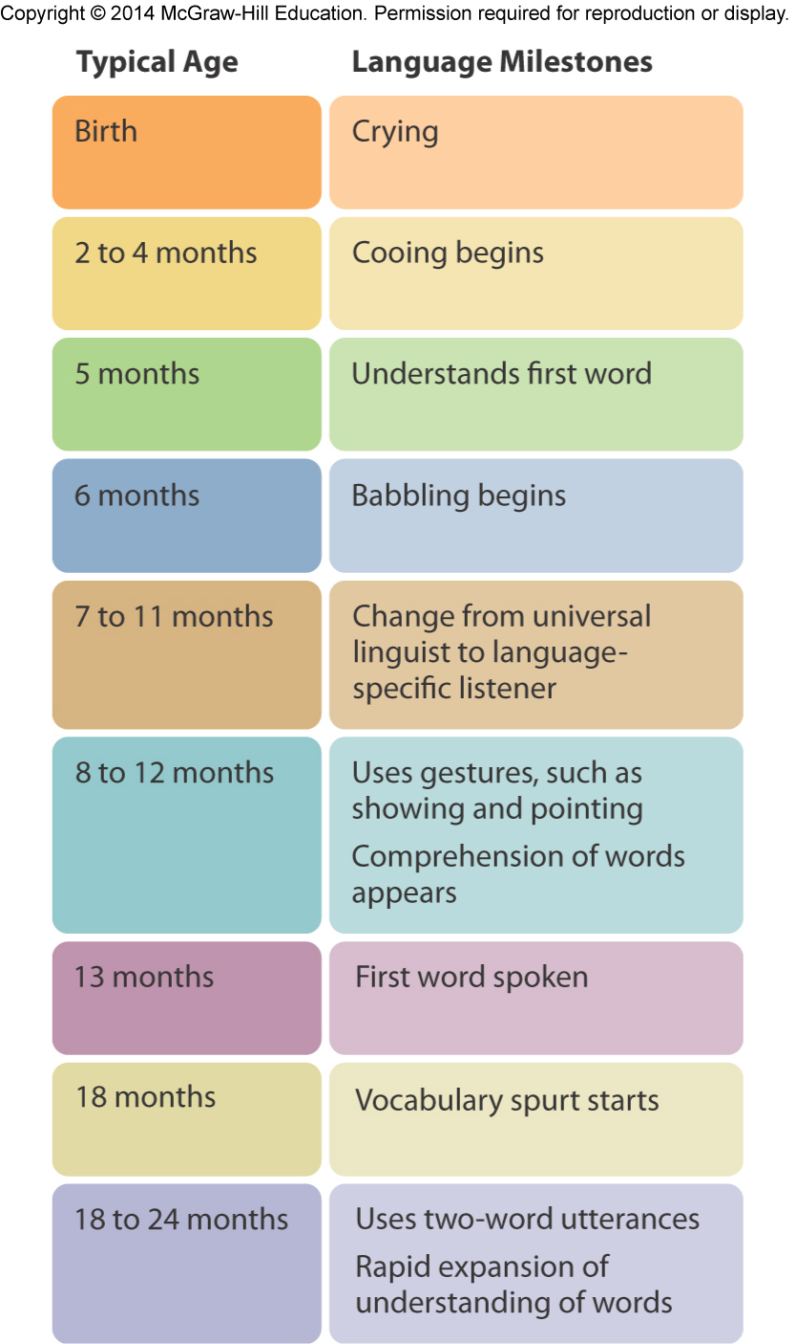
How Language Develops
Infants use early vocalizations to practice making sounds, communication, and attract attention:
Crying (birth)
Cooing (8 weeks to 7 months)
Babbling (6-7 months)
Infants begin using gestures at about 8-12 mo. (telegraphic speech)
Showing and pointing
Some gestures are symbolic
Pointing considered an important social aspect of language
Copyright McGraw-Hill Education, 2014

Slide 5
How Language Develops
Infants understand words (receptive language) before they can speak them (expressive language).
Between 5-12 months of age, infants indicate first understanding of words
First words usually spoken between 10-15 months of age
Common first words:
Names of important people
Familiar animals
Vehicles and toys
Food and body arts
Clothes and household terms
Greetings
Copyright McGraw-Hill Education, 2014

Slide 6
How Language Develops
By 18-24 months, children usually vocalize using two-word utterances
Rely on gesture, tone, and context to convey meaning
Meanings communicated through two-word speech:
Identification: “See doggie”
Location: “Book there”
Repetition: “More milk”
Nonexistence: “All gone”
Possession: “My candy”
Attribution: “Big car”
Agent-action: “Mama walk”
Question: “Where ball?”
Copyright McGraw-Hill Education, 2014

Slide 7
How Language Develops
During preschool years, most children gradually become more sensitive to sounds of spoken words and more capable of producing all sounds of their language
By the time children move beyond two-word utterances, they demonstrate knowledge of morphology rules (3 – 4 years of age “grammar explosion”)
Using plural and possessive of nouns
Appropriate endings on verbs
Use of prepositions, articles, and various forms of verb “to be”
Learn and apply rules of syntax
Show growing mastery of complex rules for word order
Vocabulary development is dramatic
Copyright McGraw-Hill Education, 2014

Slide 8
How Language Develops
Early literacy programs for preschoolers should emphasize:
Oral language
Reading and writing
Phonological and syntactical knowledge
Letter identification
Conceptual knowledge about print and its conventions and functions
Parents and teachers provide supportive atmosphere to develop literacy skills
Copyright McGraw-Hill Education, 2014

Slide 9
How Language Develops
Whole-language approach
Approach to reading instruction that parallels children’s natural language learning
Taught to recognize whole words or sentences and to use context of what they are reading to guess meanings of words
Reading often integrated with other subjects and real-world materials
Phonics approach
Reading instruction that teaches basic rules for translating written symbols into sounds
Children benefit from both approaches, but instruction in phonics needs to be emphasized
Copyright McGraw-Hill Education, 2014

Slide 10
How Language Develops
In early childhood, children’s motor skills progress to the point that they can begin printing letters
As they begin to write, children often invent spellings, basing them on sounds of words they hear
Writing skills develop as language and cognitive skills develop
Metacognitive are skills needed to be a competent writer
Children begin to understand the social uses of language.
Copyright McGraw-Hill Education, 2014

Slide 11
How Language Develops
Adolescents develop greater sophistication in word use
Understanding metaphors, implied comparison between unlike things
Better able to understand satire, or use of irony, derision, or wit
More advanced logical thinking allows adolescents to understand complex literary works
Often speak dialect with peers
Characterized by jargon and slang
Copyright McGraw-Hill Education, 2014

Slide 12
How Language Develops
Older adults’ speech is typically lower in volume, slower, less precisely articulated, and less fluent (more pauses, fillers, repetition, and corrections)
Speech skills adequate for everyday communication
Slower information-processing speed and decline in working memory may contribute to reduced language efficiency
Word finding/generation difficulties among earliest signs of Alzheimer disease
Copyright McGraw-Hill Education, 2014

Slide 13
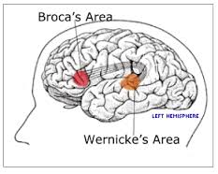
Biological and Environmental Influences
Brain’s role in language
Two regions of the brain involved in language abilities:
Broca’s area – region of the left frontal lobe involved in producing words
Wernicke’s area – region of brain’s left hemisphere involved in language comprehension
Damage to these areas produces aphasia, or loss or impairment of language processing
Copyright McGraw-Hill Education, 2014

Slide 14
Biological and Environmental Influences
Child-directed speech (parentese/motherese)
Language spoken in higher pitch than normal with simple words and sentences
Automatic; parents do not realize they are using it
Helps capture infant’s attention and maintains communication
Copyright McGraw-Hill Education, 2014

