Slide 1
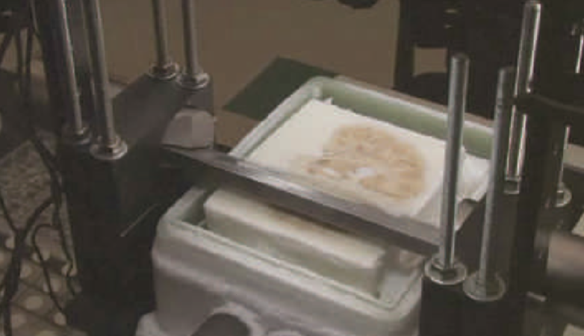
Memory Processes
This section covers:
  The processes involved in memory
Notes:
IMAGE: [© Courtesy of the Brain Observatory, San Diego] (Cacioppo, p. 318): Henry Molaison donated his brain to research. The careful slicing of Molaison’s preserved brain took over 53 straight hours and was broadcast live on the Internet.
Memory Processes 1 of 5
What would it be like if you could not form new memories?
This section covers:
The processes involved in memory

Slide 2
What Is Memory?
The system by which we retain information and bring it to mind
A method of retaining the information and skills we acquire through experience
1. Encoding
Converting information into a form usable in memory
2. Storage
Retaining information in memory
3. Retrieval
Bringing stored information to mind
Notes:
Memory Processes 2 of 5
Human memory can be represented as an information processing system consisting of three basic processes: encoding, storage, and retrieval of information.
Memory does not exist in isolation.
Instead, cognitive psychologists see memory as part of a continuum of information processing that begins with attention, sensation, perception, and learning, and progresses to the use of stored information in thinking, problem solving, language, and intelligent behavior.
The information-processing viewpoint of cognition arose from developments in computing.
Psychologists sought to apply a computer metaphor to the working of the mind.
Information flows in both directions along this continuum, leading to both bottom-up and top-down processing.

Slide 3
Encoding
The transformation of information from one form to another
Notes:
IMAGE: [© racorn/Shutterstock.com] (Cacioppo, p. 320):
Encoding failure is one of the most common memory problems faced by students. If we don’t encode information because we’re daydreaming during a lecture, there will be no memory of the information to retrieve later.
Memory Processes 3 of 5
Memory can be divided into three steps: encoding, storage, and retrieval.
In today’s digital environment, it is common for psychologists to illustrate these processes by comparing the way the brain and computers process information.
In both the brain and the computer, encoding of incoming information must occur before the information can be processed further.
Encoding refers to the process of acquiring information and transferring it into memory.
The computer acquires data entered as strokes on a keyboard, touches on a screen, recorded sounds, or mouse clicks, and translates this information into the zeros and ones that the computer can process and store.
Similarly, sensory systems translate or transduce electromagnetic energy, sound waves, pressure, and chemical stimulation into action potentials that can be processed by the nervous system.
One important aspect of encoding is paying attention to the incoming information.
For instance, I might get a notice that the school’s computer network will be taken offline while updates are made. If I’m not paying attention, I won’t encode that information and won’t be able to remember it later. Then, when I’m posting something for class, I’ll get logged out and not be able to finish.

Slide 4

Storage
The retention of information over time
Notes:
IMAGE: [© Jonathan Nackstrand/AFP/Getty Images] (Cacioppo, p. 320): Both brains and computers feature the ability to store memories, with one critical difference. The computer stores exact copies of data, but the brain does not. Instead, the brain stores bits of data that are reconstructed later for use. This photo shows the high-security computer memory storage at the Swedish Bahnhof, a facility located 100 feet underground in a concrete bunker. The facility manages servers for many secretive organizations, including WikiLeaks.
Memory Processes 4 of 5
Both computer and brain must store incoming data.
In both systems, storage, or the retention of information, can vary in time from very brief traces to essentially permanent storage (if you know where to look).
Storage of memories in the brain can last anywhere from fractions of a second (sensory memory) to several seconds (short-term and working memory) to indefinitely (long-term memory).
However, storage in a computer and storage in the mind differ in one very important respect.
Computers generally store encoded information in reliable and unvarying ways, like putting socks in a drawer or papers in a file.
What you retrieve is essentially identical to what was stored.
When you save your term paper, you can be reasonably sure that it’ll be unchanged the next time you open it.
It’s possible for computer storage to fail or be corrupted by viruses, but in general, what you put in is what you get back.
In contrast, human memory does not generate such exact records.
Instead, bits of information are stored that are later reconstructed into usable memories.
Although this process typically results in a useful memory, errors and distortions can occur.

Slide 5
Retrieval
Recovery of stored information when it is needed
Notes:
IMAGE: [© iStockPhoto/Albany Pictures] (Cacioppo, p. 321): Encoding and storing memories do not guarantee that they can be retrieved when you need them. Stress can make retrieving even the simplest of memories surprisingly difficult.
Memory Processes 5 of 5
The culmination of the memory process for both brain and computer is the retrieval of stored information.
As you have no doubt experienced in using both your computer and brain, storing information is no guarantee that you can find the information again when you need it.
Two of the most common causes of retrieval failure are interference and stress.
For example, we seem to know all the answers when watching Who Wants to Be a Millionaire in the safety of our own homes, but when actually put on the spot, we might be lucky to remember our own names.
Fortunately, understanding the strengths and weaknesses of the brain’s memory functions may be one of the more practical topics for students that we cover in psychology.
Once you understand what can go wrong, you will have an easier time ensuring that your study habits will maximize your performance in school.

Slide 6
Types of Memory
This section covers:
  The stages of memory
  Types of memory
Notes:
IMAGE: [© Kelly Marken/Shutterstock.com] (Nevid, p. 214)
Types of Memory 1 of 16
This section covers:
The stages of memory
Types of memory
Most of us can retain about seven bits of information in short-term memory, plus or minus two. You probably are able to retain in memory a seven-digit telephone number you get from an operator, at least for the few seconds it takes to input it into your phone.

Slide 7
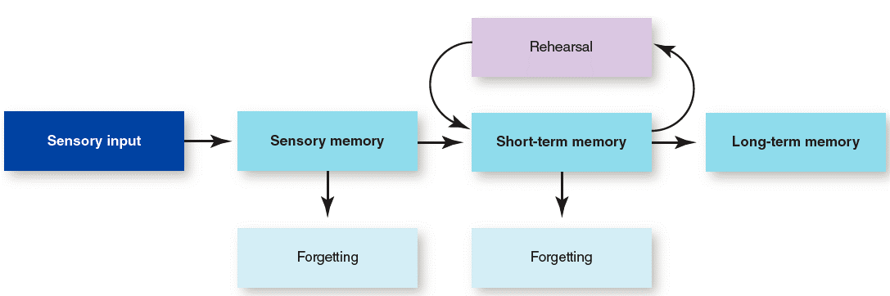
Atkinson-Shiffrin Model
Notes:
IMAGE: [Illustration: © Cengage Learning 2016] (Cacioppo, Figure 9.2, p. 321)
Types of Memory 2 of 16
One of the most influential models of memory was proposed by Atkinson and Shiffrin.
According to this classic model, information flows through a series of separate stages of memory.
The idea of memory stages paralleled the development of computers, where distinctions between an active window on the desktop and the information saved on a hard drive or other media provided models for memory storage areas that differ in capacity and duration.
The model also included control processes, a person’s active interventions that influence memory.
For example, you might use certain strategies, like repeating a bit of information, that help you remember it later.
We will consider these stages and control processes in detail in this section.
Contemporary cognitive psychologists have continued to modify this original model, while retaining the basic ideas that memories can be stored for very different periods of time and that control processes influence the system.

Slide 8
Sensory Memory
Holds large amounts of incoming information for a very short period of time
Notes:
IMAGE: [© moomsabuy/Shutterstock] (Cacioppo, p. 322): Our ability to “see” what we have written with a sparkler results from the remaining traces in our sensory memories. The actual light is long gone.
Types of Memory 3 of 16
Incoming information is processed in a first stage, the sensory memory.
This stage holds enormous amounts of sensory data, possibly all information that impacts the sensory receptors.
However, the data remain for very brief periods of time, usually a second or less, or as long as the neural activity produced by a sensation continues.
The information held in sensory memory has been compared to a rapidly fading “echo” of the real input.
Sensory input is translated, or transduced, into several types of code or representation.
A representation of a memory refers to a mental model of a bit of information that exists even when the information is no longer available.
Visual codes are used for the temporary storage of information about visual images.
Haptic codes are used to process touch and other body senses.
Acoustic codes represent sound and words.
Psychologists believe that input from different sensory systems remains separate in sensory memory, and although these different sensory streams are processed fairly similarly, there are some differences.
Acoustic codes, also known as echoic memories, last somewhat longer than visual codes, also known as iconic memories, possibly to meet our needs to hear entire words and phrases before we can begin to understand spoken language.
Why do we have a sensory memory?
Only a very small subset of this incoming data will be processed by the next stage.
It is likely that we need to collect incoming data until it makes enough sense to process further.
The first number in your classmate’s phone number might be very simple (two), but it still contains two speech sounds (the “t” and “oo”) that must be combined to make sense.

Slide 9
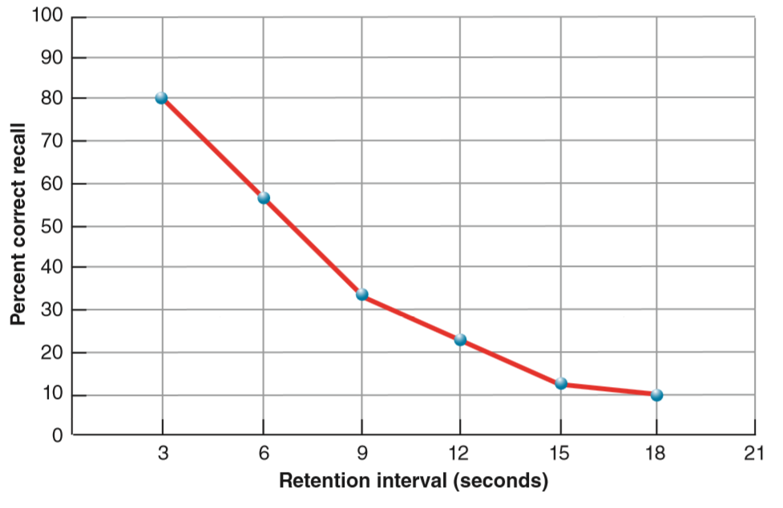
Short-Term Memory
Holds a small amount of information for a limited time
Notes:
IMAGE: [Illustration: © Cengage Learning 2013] (Cacioppo Figure 9.4, p. 323): The Duration of Short-Term Memory. In a classic study by Peterson and Peterson (1959), participants were given triplets of letters, like XPJ or BTP, to recall. Their ability to remember the letters decreased as the time between presentation and recall increased. These results led the Petersons to propose that short-term memory might last up to 18 seconds, but more contemporary scientists using different methods think that it lasts as little as 2 seconds.
Source: Data from “Short-Term Retention of Individual Verbal Items,” by L. R. Peterson and M. J. Peterson, 1959, Journal of Experimental Psychology, 58, pp. 193–198.
Types of Memory 4 of 16
A tiny amount of information in the sensory memory will move to the next stage, short-term memory (STM), for further processing.
When you focus on your new friend’s phone number, the information will move from sensory memory to short-term memory.
Consider all the other information that might be processed by your sensory memory at the same time.
Perhaps you are aware that the professor’s PowerPoint has just appeared on the screen or that the heater in the classroom just cycled on or that your stomach growled because you didn’t have time for breakfast.
None of these bits of information will be processed in short-term memory unless you pay attention to them.
If you are distracted by one of these, it is likely that you will need to ask your friend to repeat her number.
Like sensory memory, short-term memories feature different types of representations.
Acoustic codes, representing sounds, and visual codes, representing images, occur in short-term memory along with semantic codes, which represent the meaning of words.
Short-term memory, like the sensory memory that precedes it, appears to have remarkable limitations in duration.
Without additional processing, information in short-term memory usually lasts 30 seconds at most
You are probably thinking right now that you know exactly what to do to prevent this loss of information.
If you repeat the information over and over, a process known as maintenance rehearsal, information stays in short-term memory indefinitely as long as you are not asked to think about anything else. During rehearsal, data are easily displaced by new, incoming bits of data.
While you are getting ready to program your classmate’s number into your phone, you can rehearse the number in your short-term memory.
However, if your attention is diverted from rehearsing the number when the professor calls on you, the phone number will be gone.
The incoming information of the professor’s question seems to push the previous data out of the system.
If rehearsing the information has been insufficient for moving it into the next stage, long-term memory, the data will be lost.
In addition to limitations of duration, short-term memory is characterized by severe limitations in capacity.
The capacity of short-term memory is the subject of debate.
The most famous estimate of STM capacity came from George Miller, who conducted several memory experiments in the 1950s.
He claimed that the “magic number” of memory was 7 ± 2 (between 5–9 items).
More recent studies by Nelson Cowan have arrived at a different conclusion. Cowan claims that Miller and other researchers failed to account for the strategies that participants were using.
He claims that the true capcity is closer to 4 items, rather than 7.

Slide 10




Experiencing Psychology: Chunking
Notes:
IMAGE: [Courtesy of the United States Federal Bureau of Investigation; Courtesy of the United States Internal Revenue Service; Courtesy of the United States Central Intelligence Agency; Courtesy of the United States Environmental Protection Agency] (Cacioppo, p. 323): It is much easier to remember FBI, IRS, CIA, and EPA in chunks than to remember FBIIRSCIAEPA.
Types of Memory 5 of 16
Trying to remember the following sequence of letters—FBIIRSCIAEPA—appears to be an insurmountable task.
After all, remembering 12 letters lies well outside the capacity of short-term memory.
The task is greatly simplified by chunking the letters into meaningful batches of common abbreviations—FBI IRS CIA EPA.
Now you have only 4 meaningful bits to remember rather than 12, which is safely within the capacities of short-term memory.
Chunking allows people to store more information by increasing the efficiency of short-term memory, as opposed to increasing the overall capacity of short-term memory.
Failure to use chunking as a strategy occurs frequently in people with verbal learning disabilities.
In the absence of chunking, each item to be remembered is processed as a single, unrelated bit of information, which rapidly overwhelms the capacity of short-term memory.

Slide 11
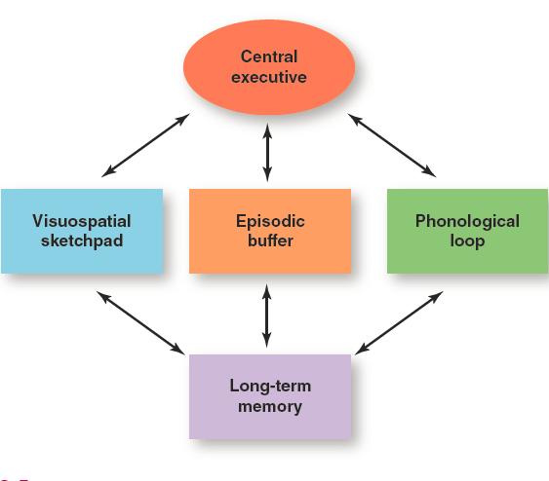
Working Memory
Adaptation of short-term memory
  Actively manipulates information
  Allows for multiple, simultaneous processes
Notes:
IMAGE: [© Cengage Learning 2016] (Cacioppo, Figure 9.5, p. 324): Working Memory. Alan Baddeley’s model of working memory differs from short-term memory in
two important ways: (1) information in working memory can be actively manipulated, whereas short-term memory passively stores memory, and (2) working memory can manage multiple types
of information simultaneously, whereas short-term memory cannot.
Source: Baddeley, A. D., & Hitch, G. J. (1974). Working memory. In G. Bower (Ed.), The psychology of learning and motivation (Vol. 8, pp.
47–89). New York: Academic Press.
Types of Memory 6 of 16
As investigations into memory advanced, researchers proposed an adaptation of this model called working memory.
Short-term memory and working memory differed in two ways. First, short-term memory involves the passive storage of information, while working memory involves an active manipulation of information.
Second, short-term memory was viewed as managing a single process at a time, whereas working memory was more complex, allowing multiple processes to occur simultaneously.
The idea that working memory could manage more than one process at a time resulted from observations that participants could manage two short-term memory tasks at the same time.
After further exploration of the types of information that could be maintained separately in short-term memory, four components were proposed: a phonological loop, a visuospatial sketch pad, a central executive, and an episodic buffer.
The phonological loop is the working memory component responsible for verbal and auditory information. The visuospatial sketch pad holds visual and spatial information. The episodic buffer provides a mechanism for combining information stored in long-term memory. The central executive parcels out the attention.
Parts of the prefrontal cortex, along with the anterior cingulate cortex (ACC), appear to be responsible for the functions of the central executive.
Patients with prefrontal damage can learn to sort playing cards according to a rule, such as “put all the cards having the same color (red or black) together.” However, when they are asked to switch to a new rule, such as “sort the cards by number (aces together, twos together, and so on),” they experience a great deal of difficulty and continue to sort according to the original rule instead of switching their attention to the new one.

Slide 12

Long-Term Memory
Location of permanent memories
Notes:
IMAGE: [© Susie Bennett/Alamy] (Cacioppo, p. 325): The accumulated knowledge of a long life, like this Australian aborigine tribal elder’s familiarity with his harsh surroundings, probably meant the difference between life and death for many of our ancestors. There is no evidence that very old people are unable to add new information to their long-term memories or necessarily lose information they have known a very long time.
Types of Memory 7 of 16
The final stage of memory processing is long-term memory (LTM).
Unlike sensory, short-term, and working memory, long-term memory seems to have few, if any, limitations in either capacity or duration.
In most cases, information moves from short-term or working memory to long-term memory through rehearsal.
Rehearsal can be divided into maintenance rehearsal, which means simple repetition of the material, and elaborative rehearsal, which involves linking the new material to things you already know.
The benefits of elaborative rehearsal can be explained using a levels of processing theory.
When we look at written words we want to remember, we can attend to many “levels” of detail: the visual appearance of the word (font, all caps, number of letters, etc.), the sound of the word, the meaning of the word, or the personal relevance of the word.
These characteristics may be placed along a continuum of depth of processing from shallow to deep, with the encoding of the appearance of a word requiring less processing and effort than the encoding of the sound of a word, which in turn requires less processing and effort than the encoding of the meaning or personal relevance of a word, and so on.
According to the levels of processing theory, words encoded according to meaning would be easier to remember than words encoded according to their visual appearance, because encoding meaningfulness produces a deeper level of attention and processing.
In addition to not sharing limitations of duration and capacity with other types of memory, long- term memory appears to be unique in other ways.
Given the enormous amount of data stored in long-term memory, we cannot retrieve information by using the item-by-item search strategies that we use in working memory.
Instead, we have a system of associations or cues that we use to locate data, like your computer uses folders to organize separate files.
Another difference between working memory and long-term memory relates to the coding of information.
Earlier, we identified three types of codes that occur in short-term and working memory: acoustic, visual, and semantic codes.
Research evidence suggests that these same types of codes are also found in long-term memory.
For example, we can use acoustic codes in long-term memory to recognize the ringtone we’re using, visual codes to recognize our friends, and semantic codes to remember the main points of the page we just read.
Of these three, the semantic codes play a dominant role in long-term memory but a relatively minor role compared to acoustic and visual codes in short-term and working memory.

Slide 13
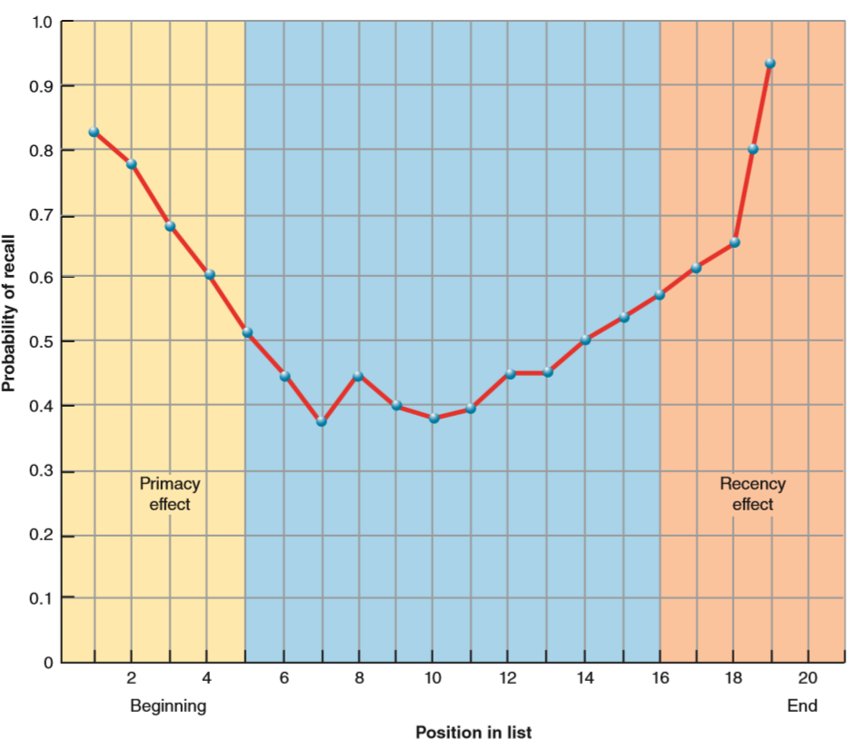
An Experiment: The Serial Position Effect
Notes:
IMAGE: [© Cengage Learning 2013] (Cacioppo, Figure 9.7, p. 327): The Serial Position Effect
Types of Memory 8 of 16
Differences between working and long-term memories can be seen in classic experiments demonstrating the serial position effect.
This phenomenon can be observed when participants are asked to learn a list of words and recall them in any order they choose.
Recall of items takes on a U-shaped appearance when retrieval is plotted as a function of an item’s position in a list during presentation.
The superior recall for the first items on a list is known as the primacy effect, which is believed to result from the storage of these items in long-term memory.
Using a typical list of 20 words, participants would have the most rehearsal time for the first word, a bit less for the second, and so on through the list.
Because rehearsal can move information from working to long-term memory, the earlier words with their greater share of rehearsal would be more likely to be stored in long-term memory than the later words on the list, which probably were not rehearsed much at all.
The superior recall for the last words on the list is known as the recency effect, which probably occurs because these items remain in working memory at the time of recall.
The recency effect, but not the primacy effect, disappears if recall is delayed by 30 seconds.
After 30 seconds, items in long-term memory will still be available for recall, but items in working memory will be long gone.

Slide 14
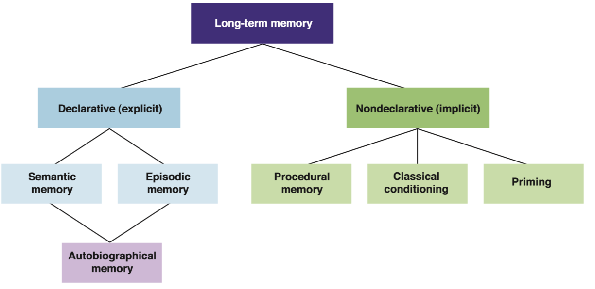
Types of Long-Term Memory
Notes:
IMAGE: [© Cengage Learning 2016] (Cacioppo, Figure 9.8, p. 329): Types of Long-Term Memory. Long-term memory can be divided into several different categories, beginning with a distinction between declarative, or explicit, conscious, memories and nondeclarative, or implicit, unconscious, memories. Declarative memories are further divided into semantic and episodic memories, which are combined when we use autobiographical memories. Examples of nondeclarative memories are procedural memories, classical conditioning, and priming.
Types of Memory 9 of 16
Long-term memory can be divided into declarative or conscious memories and nondeclarative or unconscious memories.
Declarative memories are easy to “declare,” or discuss verbally.
Declarative memories are also referred to as explicit memories because they are typically accessed in a very conscious, direct, and effortful manner.
In contrast to declarative memories, nondeclarative memories are difficult to discuss.
Nondeclarative memories are also known as implicit memories because they affect our behavior in subconscious, indirect, and effortless ways.

Slide 15
Declarative Memory
Semantic
Episodic
Autobiographical
Notes:
IMAGES: [© martin phelps/Alamy (dog): Karina Wallton/Shutterstock (puppy and boy)] (Cacioppo, p. 330): You might have semantic memories that tell you about the characteristics of Labrador retrievers, and episodic memories about the day you chose your first puppy. Your autobiographical memories combine these two elements to give you an account of your own life. A semantic element of your autobiographical memory might be the fact that your dog’s parents were champions. The episodic elements of your autobiographical memory for the event might include memories of your puppy’s warmth and the happy way you felt that day.
Types of Memory 10 of 16
Semantic memory contains your store of general knowledge in the form of word meanings and facts.
Episodic memory is a more personal account of past experiences.
We can distinguish between semantic and episodic memories along four dimensions: the type of information processed, the organization of the information in memory, the source of the information, and the focus of the memory.
Semantic memory contains general knowledge about the world, whereas episodic memories include more specific information about events, objects, and people.
Semantic memory is organized in memory according to categories, while semantic memory is organized as a timeline.
Semantic knowledge originates from others, like your professors, or from repeated experience; episodic memories can result from a single, personal experience.
Semantic memory provides us with an objective understanding of our world, whereas episodic memory provides a reference point for our subjective experience of the self.
Blending of semantic and episodic memories characterizes autobiographical memories.
Autobiographical memories can contain factual, semantic aspects of personal experience without any episodic aspects.
Autobiographical memories appear to be accessed from two points of view.
In some cases, we “relive” an experience very vividly, viewing our memory of an experience from a personal vantage point.
In other cases, we seem to be seeing our life’s history as if we were watching a highlights reel, from the vantage point of an observer rather than a participant.
Newer memories are more likely to be viewed from the personal perspective, whereas older memories are viewed from the observer perspective.
Unlike storage of semantic memories about course- work, we do not seem to store autobiographical memories intentionally.
We work hard to memorize facts about our world, but the process of storing autobiographical information seems effortless.
Like other memories, autobiographical memories help us organize our experience in ways that help us respond to current challenges. If you can recall what you did to solve a problem successfully in the past, you know what to do when you see that problem again.
Having an autobiographical memory also provides a sense of continuity or consistency in the self.
Finally, and perhaps most importantly, an autobiographical memory helps us build social bonds with others throughout our lifespan.

Slide 16
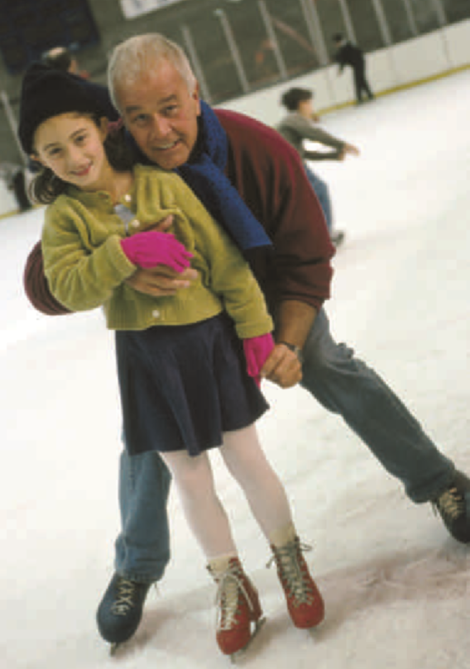
Nondeclarative Memory
Procedural memory
Classical conditioning
Priming
Notes:
IMAGE: [© age fotostock/SuperStock] (Cacioppo, p. 331): It might have been years since this grandfather last put on a pair of ice skates, but to help his granddaughter learn to skate, he’s willing to get back out on the ice. He might be a little wobbly at first, but procedural memories for skilled movement are very persistent. He’ll quickly be skating as if he’d done it every day.
Types of Memory 11 of 16
Cognitive psychologists have studied three types of nondeclarative memories in detail: classical conditioning, procedural memories, and priming.
Procedural memories, which are memories for how to carry out motor skills and procedures, are especially difficult to describe in words.
One great advantage of procedural memories is their ability to automate our performance.
When procedures become automatic, we are free to direct our limited capacities for divided attention to other aspects of the task.
Unfortunately, if a procedure is learned incorrectly, like a bad golf swing, considerable effort must be expended to think about fixing the swing, which will slow down performance.
Classical conditioning results when we learn that a stimulus signals an important upcoming event.
Classical conditioning probably accounts for many of the involuntary and unconscious emotional responses we have to the world around us, such as feeling tense or fearful when we enter a dentist’s waiting room.
We experience these emotions without deliberately remembering our previous visits to the dentist, and it is likely that we would find it difficult to explain why we feel this way.
Priming, or the change in our response to a stimulus due to pre-exposure to related stimuli, explains many everyday effects of familiarity.
We may believe very strongly that our behavior is unaffected by exposure to advertising.
However, people rate advertisements they have seen more positively than those that they have not seen, even if they can’t consciously remember having seen any of the advertisements before.
Priming can influence our responses to stimuli that are perceptually related (two visual stimuli, for example) or conceptually related (two words having a related meaning).

Slide 17
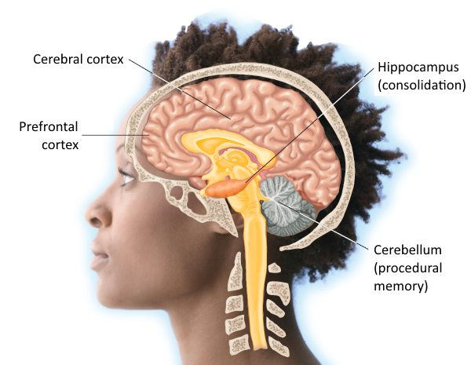
Long-Term Memory and the Brain
Different structures work together for memory
Notes:
IMAGE: [© JLP/Jose Luis Pelaez/zefa/Corbis] (Pastorino, Figure 7.9, p. 298): The Hippocampus and Memory. Damage to the hippocampus or to the pathways connecting it to the cerebral cortex frequently produce the type of declarative memory problems experienced by Henry Molaison.
Types of Memory 12 of 16
The hippocampus itself is unlikely to serve as a storage location for memories, but it clearly participates in the consolidation of information into long-term memory.
Circuits connecting the hippocampus and adjacent temporal lobe memory areas with the cortex are believed to participate in long-term memory consolidation.
Semantic, episodic, and autobiographical memories involve the participation of the cerebral cortex.
Semantic memories appear to be widely distributed across the cerebral cortex
Episodic memories are affected by damage to the prefrontal cortex.
Autobiographical memories are perhaps the most widely distributed of all types of memory in the cerebral cortex.
Because these memories capture perceptual, factual, and emotional details of past experience, we find activation not only in the prefrontal areas associated with episodic memories but also in the relevant areas of cerebral cortex associated with perception and movement.
Procedural memories are correlated with activation of the basal ganglia, forebrain structures that are part of the brain’s motor systems.
Much of what we know about the hippocampus comes from the case of Henry Molaison (1926–2008), known in the scientific literature as “the amnesic patient H.M.”
To reduce Molaison’s severe seizures, possibly resulting from a minor head injury caused by a childhood accident, his neurosurgeons carried out an experimental procedure that would be considered radical today but was even more so in 1953.
They removed the majority of Molaison’s hippocampus in both hemispheres, along with some of the surrounding neural tissue.
As a result, Molaison’s memory functions declined dramatically, although his personality and intellect remained intact.
H.M. had severe deficits in forming new declarative memories, but had an intact non-declarative system.
He was able to learn to perform new tasks, showed intact priming, and could be classically conditioned.

Slide 18
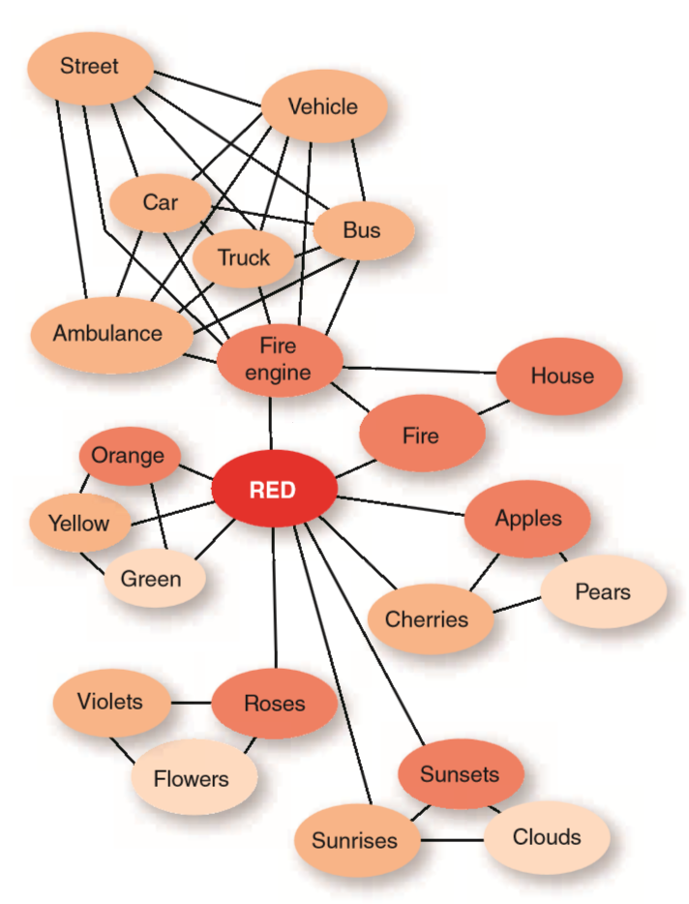
Organization of Long-Term Memory
Connectionist theories
  Spreading activation
Schemas
Notes:
IMAGE: [© Cengage Learning 2013] (Cacioppo, Figure 9.12, p. 335): According to the spreading activation theory, thinking about “red” will activate nearby concepts (“orange,” “green,” and “fire”) faster than more distant concepts (“sunsets,” “roses”). This network suggests that a person would answer the question “Is a bus a vehicle?” faster than the question “Is an ambulance a vehicle?” Source: Adapted from Collins and Loftus (1975).
Types of Memory 13 of 16
Little research exists regarding the organization of nondeclarative memories in long-term memory, but significant efforts have been made to understand the organization of declarative memories.
Within the category of declarative memories, far more is known about semantic than about episodic organization.
However, both types of memory appear to follow some of the same basic principles.
Memories that share characteristics appear to be more closely linked than memories that show very little overlap between their various features.
More formal explanations have evolved to account for this tendency to group memories that share overlapping features.
These explanations fall under the heading of connectionism, or the view of the mind as an interconnected network made up of simpler units.
A doctoral dissertation in computer science by Ross Quillian, later refined with cognitive psychologist Allan Collins, was one of the first efforts to apply a connectionist approach to memory.
Collins, along with Elizabeth Loftus, modified the original Collins and Quillian model to produce a spreading activation model.
The spreading activation model recognized that we do not organize concepts according to strict hierarchies and that people form their own organizations in memory based on their personal experiences.
As early as 1932, psychologist Frederic Bartlett observed that memory does not work like a video recording of events.
When we encounter new information, we attempt to fit the new information into an existing schema, or set of expectations about objects and situations.
Details that are consistent with our schemas are more likely to be retained, whereas inconsistent details are more likely to be left out.
Details may be added in memory if they make a story more consistent and coherent.
Schemas appear to be very important in the process of memory storage,

Slide 19

Retrieval: Cues
Any stimulus that helps you access target information
  Recognition
  Recall
The encoding specificity effect
Notes:
IMAGE: [© Tom Grill/Corbis] (Cacioppo, p. 337): Retrieval systems help us find the information we need, whether we are searching online, looking for a book, or trying to remember something important. Organized information is always easier to find than disorganized information.
Types of Memory 14 of 16
Sternberg’s results in studying short-term memory suggest that we search through short-term memory one item at a time rather than retrieving its contents all at once.
A cue is any stimulus that helps you access target information.
Most students find recognition tasks, such as true-false or matching exam items, relatively easy.
These tasks provide very complete cues (the correct information is right on the page in front of you).
All you need to do is make a judgment about how well the presented information matches what is stored in memory.
Compared to recognition tasks, recall tasks, such as essay exams, require an additional step.
Information must be retrieved from memory and then recognized as correct.
Recall tasks provide many fewer cues than recognition tasks and are typically more difficult as a result.
Why are cues helpful?
Cues might work due to a process known as encoding specificity.
Each time you form a long-term memory, bits of information are encoded along with other important bits that were present at the same time.
As a result, each memory is processed in a unique and specific way, as this exact same combination of bits is unlikely to occur together again.
Any stimulus that was present and noticed during this encoding process could serve as a cue for retrieving the target memory.
Because greater numbers of cues aid retrieval, the more similar your retrieval circumstances are to your encoding circumstances, the more likely you are to successfully retrieve the target memory.
We know from experience that if we have forgotten something, retracing our steps is the fastest way to remember what we forgot.
By returning to the situation where we last processed the target information, we surround ourselves with cues that should lead to successful retrieval.
Among the bits of information that get encoded along with target memories are features of the surrounding environment, leading to context-dependent memory.
You are probably familiar with advice about studying in a well-lit, quiet, professional environment in order to perform your best on exams.
Duplicating your testing situation when you study should pro- vide the greatest number of retrieval cues.
Context-dependent memory not only is relevant to retrieving declarative memories but also explains some of the advantages of simulation in learning new procedures, such as flying a helicopter or driving a tank.
Context-dependent memory can extend beyond a person’s physical environment and body position to include cues from internal physiological states.
The most dramatic of these instances of state-dependent memory occur in response to drugs. Participants were asked to learn word lists after smoking either marijuana or a placebo cigarette. Participants experiencing the same conditions during encoding and retrieval (marijuana–marijuana or placebo–placebo) performed the best.
In addition to drug-related internal states, mood can serve as an encoding cue as can cognitive state.

Slide 20

Retrieval: Flashbulb Memories
Some memories seem permanently etched into our brains
  How accurate are they?
Notes:
IMAGE: [© AP Images/Marty Lederhandler] (Nevid, p. 221): People often report especially vivid episodic memories about where they were and what they were doing when they first heard news that evoked a strong emotional response, although research evidence suggests that these memories are not always as accurate as we think they are.
Types of Memory 15 of 16
Most adults in the United States seem to have formed a flashbulb memory of the terrorist attacks of 9/11, or an especially vivid memory including details of where they were and what they were doing when they first heard the news.
Individuals diagnosed with post-traumatic stress disorder (PTSD) often experience intrusive flashbacks of the events that originally traumatized them.
How do we reconcile these differences in retrieval for emotional events?
To answer this question, we need to consider what happens to the hippocampus and to the amygdala during a negative emotional experience.
The hippocampus plays an essential role in the formation of new declarative memories, whereas the amygdala helps us assess emotional situations, and negative situations in particular.
In most emotional situations, the hippocampus and amygdala will work in tandem to produce a memory that has both declarative and emotional detail.
Flashbulb memories might seem extra vivid because the amygdala is even more active during memory formation than usual.
Although people tend to be overconfident in the accuracy of their flashbulb memories, and even flashbulb memories appear to fade over time, retrieval of these memories continues to be more accurate than other, less emotional, everyday events that occurred at about the same time.
We start to see extremes in retrieval, such as complete failure to recall an emotional event or an intrusive, overly vivid amount of recall, when an event has been encoded during unusually high levels of stress.
Researchers have demonstrated that sudden stress produces a decrease in activity in the prefrontal cortex, which in turn impairs working memory function.
High stress also initiates the release of cortisol into the blood circulation, which produces a general arousal but also specifically increases the activity of the amygdala.
Very high levels of cortisol are correlated with the reporting of more false memories.

Slide 21
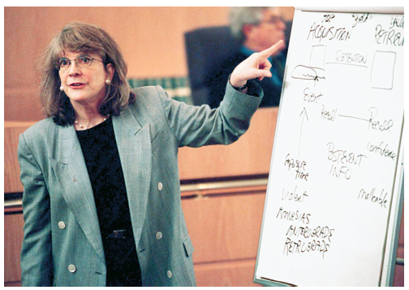
Retrieval: Eyewitness Testimony
Reconstruction during retrieval may be flawed
Notes:
IMAGE: [© Jeff Siner/The Charlotte Observer] (Nevid, p. 221): Memory researcher Elizabeth Loftus.
Types of Memory 16 of 16
Most of us would like to believe that our memories, especially for important life events, are relatively accurate.
Elizabeth Loftus set out to evaluate the reliability of eyewitness testimony in courtroom settings and discovered that memories are rather flexible.
Our memory of events can be altered by later exposure to misleading information about these events (Chan, Thomas, & Bulevich, 2009; Frenda, Nichols, & Loftus, 2011). Loftus described this phenomenon as a misinformation effect. In a landmark study, she and her colleagues had subjects view a film of a car accident that occurred at an intersection with a stop sign (Loftus, Miller, & Burns, 1978). Some subjects were then given misleading information telling them that the traffic sign was a yield sign. When subjects were later asked what traffic sign they saw at the intersection, those given the false information tended to report seeing the yield sign. Subjects who were not given the false information were much more likely to recall the correct traffic sign. This research calls into question the credibility of eyewitness testimony, especially when witnesses are subjected to leading or suggestive questioning that might “plant” ideas in their heads.
Retrieval is not an all-or-none phenomenon. Instead, retrieval proceeds in a step-by-step manner, with each new step bringing you closer to the target.
This incomplete retrieval is best illustrated by the tip-of-the-tongue (TOT) phenomenon.
TOT is probably a very familiar experience for you. You are trying to remember a word or name, and you might retrieve another word that either starts with the same letter or has the same meaning. You know that the retrieved word is not the one you’re looking for, but you’re close.

Slide 22

Forgetting
This section covers:
  Theories of forgetting
  Improving memory
Notes:
IMAGE: [© Andy Reynolds/The Image Bank/Getty Images] (Cacioppo, p. 345): If we were never able to forget where we parked all the previous times we used this lot, finding our car today would be extremely difficult.
Forgetting 1 of 4
This section covers:
Theories of forgetting
Improving memory
Forgetting is a decrease in the ability to remember a previously formed memory.
The key here is that to “forget,” a memory has to have been formed in the first place.
This definition excludes a number of instances that we have discussed previously.
For example, many students maintain that they “forgot” information needed for an exam, when in fact they were daydreaming during the lecture covering the material and never learned it in the first place.
This example is better understood in terms of lack of attention and encoding failure than as an example of forgetting.
Using our definition, you can’t forget something you never learned.

Slide 23
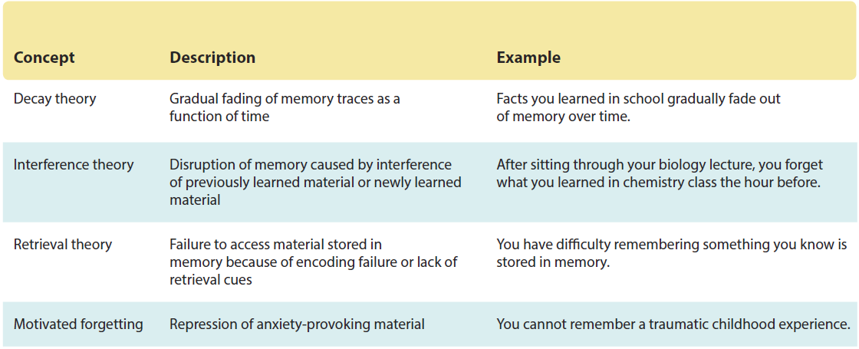
Theories of Forgetting
Notes:
IMAGE: [© Cengage Learning 2013] (Nevid, Concept Chart 6.2, p. 230)
Forgetting 2 of 4
Decay (sometimes called Disuse) occurs when our ability to retrieve information we do not use fades over time.
Imagine taking last term’s final exams today. How would you do?
It might seem to you that the material you learned last term is gone forever, but just because you can’t retrieve something doesn’t mean the memories are lost.
Although the idea of decay fits our everyday experience of “forgetting” quite well, most contemporary psychologists believe that the simple passage of time does not do a very good job of predicting memories that are easy or difficult to retrieve
A significant factor in forgetting is interference, or the competition between new and older information in the memory system.
The brain requires a measurable amount of time to consolidate a memory, or to produce a physical representation.
In the window of time in which memories are being processed but not yet fully consolidated, they may be subject to distortion, loss, or replacement by interference from other bits of information.
Interference can be demonstrated by comparing performance in a list-learning task.
The more lists a participant must learn, the more difficult it becomes for the participant to remember words on the first list.
In other words, learning new lists of words interfered with memory for the first list.
Retrieval theory states that forgetting is caused an inability to access information, due to encoding or retrieval errors.
If information isn’t properly encoded, it cannot enter the storage system and you won’t have access to it in the future.
If information is encoded and stored, you may not have the proper cues to retrieve it.
The information may be there, but it’s inaccessible. Like when you are trying to remember someone’s name. You know it’s somewhere in memory, it may even be on the tip of your tongue, but you just can’t retrieve it when you need to.
The Internal Revenue Service reports that many more people who owe money fail to sign their tax returns than those who are due a refund.
Assuming that the failure to sign the return is not a conscious act of defiance, how can we account for this lapse in memory?
Theories of motivated forgetting, or the failure to remember or retrieve unpleasant or threatening information, suggest that the nonsigners are protecting themselves from further unpleasantness by “forgetting” to sign their tax forms.
Memory is a servant to our overarching goals.
Retrieval, for better or worse, is often influenced by our motivations, and our motivations can distort the memories we retrieve.
While not exactly forgetting in the sense of our earlier definition, motivated distortions of memory can be so extreme that the original information is essentially lost during the process.

Slide 24
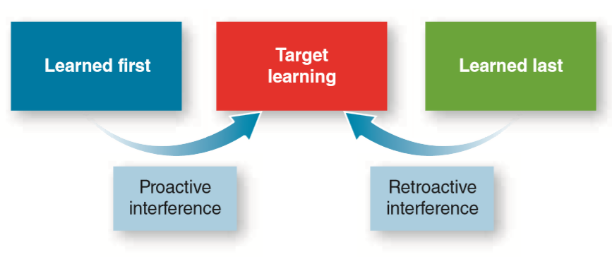
Proactive and Retroactive Interference
Notes:
IMAGE: [© Cengage Learning 2013] (Cacioppo, Figure 9.17, p. 346): Proactive and Retroactive Interference. If we measure recall of a target list of words, we find that it is worse both when preceded by learning another list (proactive interference) and when followed by learning another list (retroactive interference).
Forgetting 3 of 4
Interference can be demonstrated by comparing performance in a list-learning task.
The more lists a participant must learn, the more difficult it becomes for the participant to remember words on the first list.
In other words, learning new lists of words interfered with memory for the first list.
To make matters worse, interference can work in two directions.
Proactive interference refers to reduced memory for target information as a result of earlier learning.
Say you knew someone in grade school named “Kathy.” At some point in high school she started going by her full name, “Katherine,” but whenever you see her you call her “Kathy” and she has to remind you that she doesn’t go by that anymore.
Another example is if you’re forced to change a password for a website. You might keep typing your old password when you try to log in.
In both cases, the item you learned first interferes with your ability to remember something new.
Reduced memory for target information due to subsequent learning is known as retroactive interference.
In some sense, the new information displaces the old.
Imagine that you’ve gotten a new cell phone. After you learn how to use it, you might forget how to access something on the old phone.

Slide 25

Improving Your Memory
Distribute practice
Take tests
Sleep
Recite
Use mnemonics
Notes:
IMAGE: [© samuel wordley/Alamy] (Cacioppo, p. 352)
Forgetting 4 of 4
Psychology professors will never give up trying to convince students that cramming is a terrible memory strategy.
Persistent faith in cramming is surprising, given that we all know that concert pianists and basketball players are better off practicing an hour a day each day for a week than practicing six hours straight the night before a performance.
Nearly all forms of learning show evidence of an advantage of distributed practice (practice spread out over time) as opposed to massed practice.
In other words, spacing the input of information to the brain over time produces better memory than cramming.
We usually think about tests as measuring a student’s ability to retrieve memories, but test-taking is actually a powerful tool for forming memories, too.
In fact, research demonstrates that test-taking produces superior long-term memory when compared with repeated studying of material.
In addition, test-taking improved participants’ ability to think about learned material with greater flexibility and to apply material to new situations.
We are not advocating that you abandon reviewing your textbook and lecture notes, but we do hope you will take advantage of the online testing opportunities that accompany this textbook.
Sleep plays an active role in the consolidation of memories.
Changes related to memory that occur in the brain during sleep might be different than the changes that occur when we learn something while awake.
Wakeful learning might serve to strengthen new connections, but sleep-related processing might reorganize existing memories to accommodate new information
Most students recognize that a certain number of rehearsals of reading and lecture notes are required for success on exams.
One of the traps in a dependence on rehearsal is that we can easily mistake the ease with which we cover familiar material for actually knowing the material.
Just because you can read something doesn’t mean you “know” it.
A somewhat more efficient method is recitation, or the verbalizing of the material to be learned in your own words. Recitation takes advantage of a general superiority for self-referential information.
The early Greeks devised a number of methods, known as mnemonics, for improving memory. Mnemonic devices expand memory capacity by linking the material to be remembered to information that is relatively effortless to retrieve.
The “first letter” approach takes advantage of chunking.
You condense a large amount of information into an acronym.
For example, the four types of processes in working memory start with the letters P, V, C, and E, for phonological, visuospatial, control, and episodic.
Even more effective is the use of first letters to make some type of phrase or sentence.
This approach allows you to recall lists of items that must be in a correct order.
For example, it is easy to remember the 12 pairs of cranial nerves in the proper order if you use this sentence: On old Olympus’ towering top a Fin and German viewed some hops (olfactory, optic, oculomotor, trochlear, trigeminal, abducens, facial, vestibulocochlear, glossopharyngeal, vagus, spinal accessory, and hypoglossal).
One of the classic Greek techniques was the method of loci, or places. This technique is particularly handy when you are trying to memorize a list of items in order, such as the planets in our solar system or the cranial nerves. The method takes advantage of the fact that we form excellent representations of visual images in memory. You begin by imagining a familiar place, perhaps your childhood home. As you imagine yourself walking through your home, you visualize each item in a particular location.

