Slide 1

Sensory Processes
This section covers:
  The key concepts in the study of sensation and perception
Notes:
IMAGE: [©AP Photo/Roberto Pfeil] (Cacioppo, p.181)
Sensory Processes 1 of 13
Think of a time that you have had the experience of watching events with others (sensation) and then being surprised by the different interpretations of we hear of what just happened (perception).
This section covers:
Key concepts in the study of sensation and perception

Slide 2

Sensation and Perception
How do people navigate through the world?
  Sensation: Receive signals from the environment.
  Perception: Organizing and interpreting these signals.
Sometimes, we don’t immediately perceive what we sense
Notes:
IMAGE [© Dlillc/Corbis ] (Coon/Mitterer, p. 137): The Trees Have Eyes
Sensory Processes 2 of 13
In order to function in the world, you need to be able to take information in from your environment.
Information comes in different forms of energy (light waves, sound waves, chemicals, temperature)
Psychophysics is the study of how this energy can be measured and how it’s related to different aspects of the sensory experience (brightness, loudness).
Sensation & perception describes how this energy is converted into something your mind can process and respond to.
Psychologists differentiate between sensation and perception
Sensation is the process by which receptors inside the sensory organs respond to energy within the environment.
The receptors act as biological transducers, converting physical energy into neural activity.
When the brain organizes this activity into meaningful patterns, we speak of perception.
Sometimes, things are sensed but not perceived.
The light waves reflecting off of this snake are being received by your visual receptors, but you might not have noticed the snake at first. You may have initially interpreted it as part of the plant. When you finally realized what was there, your perception of the image changed.

Slide 3
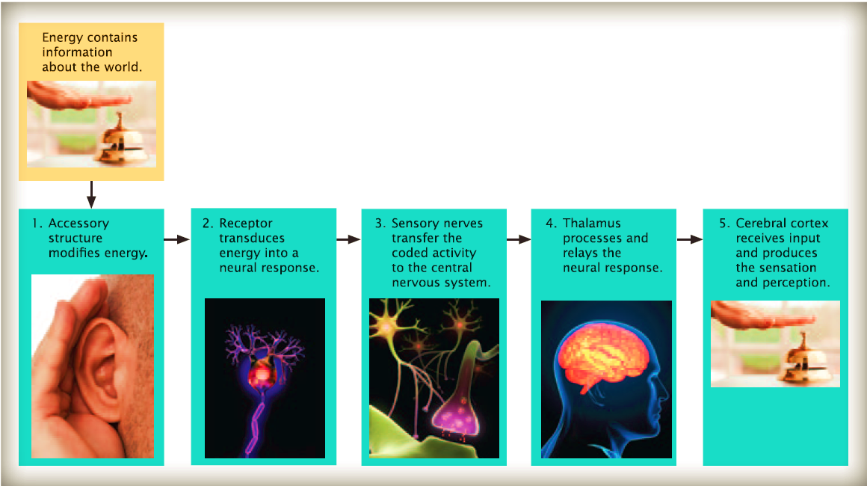
An Overview of Sensation to Perception
Notes:
IMAGE: [© iStockphoto.com/AnthiaCumming; © Ilya Andriyanov/
Shutterstock.com; James Steidl/Photos .com; Xiaofeng Luo/Photos.com; © fusebulb /Shutterstock.com] Figure 4.2 (Bernstein, p. 89)
Sensory Processes 3 of 13
Objects in the world generate energy that is focused by accessory structures and detected by sensory receptors, which convert the energy into neural signals.
The signals are then relayed through parts of the brain, which processes them into perceptual experiences.

Slide 4
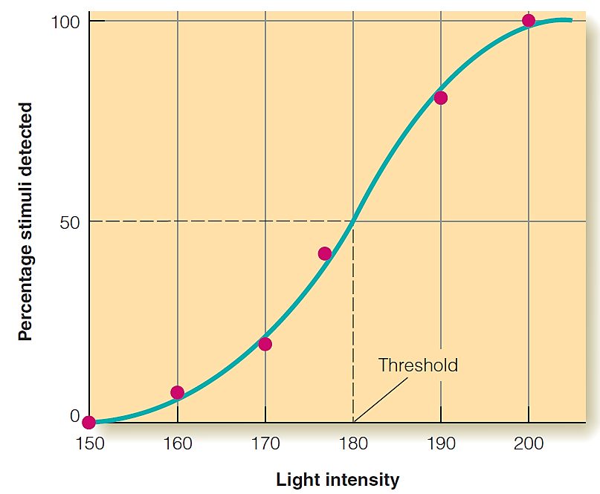
Absolute Thresholds
The lowest level of stimulation that can be detected 50% of the time
Notes:
IMAGE: [© Cengage Learning 2013 (Goldstein, Figure 1.16, p.14)
Sensory Processes 4 of 13
This photo shows the results of a hypothetical experiment in which the threshold for seeing a light is measured by the method of constant
stimuli. The threshold—the intensity at which the light is seen on half of its presentations—is 180 in this experiment.
In the field of psychophysics, physical energy (such as sound waves or electromagnetic radiation) is measured and related to dimensions of the resulting sensations we experience (such as loudness or brightness).
In psychophysics, a threshold is the amount of stimulation needed for an individual to either detect the stimulus itself or to detect that the stimulus has changed under ideal conditions.
An absolute threshold is the smallest amount of sensation that can be perceived 50% of the time under ideal conditions.

Slide 5

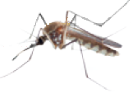



Absolute Thresholds – The Five Senses
Sense | Absolute Threshold
Vision | A candle flame from 30 miles away
Hearing | A mosquito buzzing from 10 feet away
Smell | One drop of perfume in a six-room Apartment
Taste | One tsp of sugar in two gallons of water
Touch | The wing of a fly falling on your cheek from 1cm.
Notes:
IMAGE: [© Cengage Learning 2013; photos, top to bottom: © AlexRoz/Shutterstock; © Karen H. Ilagan/Shutterstock;; © Kuttelvaserova Stuchelova/Shutterstock.com; © Christopher Elwell/Shutterstock; © Gladskikh Tatiana/Shutterstock] Figure 5.4 Absolute Sensory Threshold (Cacioppo, p.152-3)
Sensory Processes 5 of 13
Each of your senses has a different level of sensitivity.
Here are some typical thresholds:
Vision: Seeing a candle flame 30 miles away on a dark, clear night
Hearing: The equivalent of the ticking of an expensive watch 20 feet away
Olfaction: A drop of perfume in the air filling a 6-room apartment
Sweetness: The equivalent of 1 teaspoon of sugar in 2 gallons of water
Touch: The equivalent of feeling the wing of a fly fall on your cheek from a distance of 1 cm
Remember, these are items that will only be detected 50% of the time under ideal circumstances. Still, this shows that your sensory systems can detect things even with a very low intensity.

Slide 6

Subliminal Stimuli – Believe It or Not
Can subliminal advertising persuade you to buy?
Notes:
IMAGE: [© Ocean/Corbis] (Pastorino, p. 94)
Sensory Processes 6 of 13
Subliminal stimuli are stimuli that are below the absolute threshold. (Limen is another word for threshold)
James Vicary attempted to use subliminal messages to entice moviegoers at a public theater to buy more popcorn and soda without them knowing that they were being persuaded
Vicary reported that as a result of his “experiment,” concession sales rose 18%.
As it turns out, Vicary admitted in 1962 that he had not conducted a true experiment. The data that he collected were so few that they could not be used for scientific purposes.
After Vicary’s attempts at subliminal persuasion, researchers began to carefully examine the effects of subliminal perception both in the real world and in the laboratory.
Many studies have failed to yield convincing evidence for the effectiveness of persuasive subliminal messages.
However, newer studies suggest that when certain criteria are met, subliminal persuasion can occur.
For example, when subliminal messages specifically address the dimensions we are evaluating about the product, they may be effective

Slide 7
Case Study – Endangered Manatees
Manatees have poor sensitivity to the low frequency sounds made by slow-moving boats
Notes:
IMAGE
Sensory Processes 7 of 13
Absolute thresholds define the sensory worlds of humans and animals, sometimes with serious consequences.
The endangered Florida manatee (sea cow) is a peaceful, plant-eating creature that can live for more than 60 years.
For the last decade, the number of manatees killed by boats has climbed alarmingly.
Manatees have poor sensitivity to the low-frequency sounds made by slow-moving boats.
Current laws require boats to slow down in manatee habitats, which may actually increase the risk to these gentle giants

Slide 8
Difference Thresholds and Weber’s Law
Why can weightlifters perceive the difference between lighter and heavier weights?
Notes:
IMAGE: [© YURI CORTEZ/AFP/Getty Images/Newscom] (Cacioppo, p.153)
Sensory Processes 8 of 13
A difference threshold or just noticeable difference is the smallest difference between two stimuli that can be detected.
The amount of difference that can be detected depends on the size of the stimuli being compared. As stimuli get larger, differences must also become larger to be detected by an observer. This is referred to as Weber’s Law.
The difference between 5 and 10 pounds would be much more noticeable, even to an experienced weightlifter, than the difference between 400 and 405 pounds.
An everyday example of this can be seen by looking at changes in loudness. If you’re at the library, even a tiny increase in volume will be noticed, because you’re starting off at low levels of intensity.
At a raucous party, however, the change has to be much larger before you notice a difference.

Slide 9
Signal Detection – Beyond Sensory Thresholds
Many perceptions involve some uncertainty
  Use the cognitive process of decision-making
 |  | Does the patient have a tumor?
 |  | Yes | No
Do I think the patient has a tumor? | Yes | HIT | False alarm
 | No | Miss | CORRECT REJECTION
Notes:
IMAGE: [© BSIP/UIG/Getty Images] (Cacioppo, p.154)
Sensory Processes 9 of 13
Does a mammogram indicate a woman has cancer or not? Many decisions we make are based on ambiguous stimuli. Signal detection theory helps us understand how an individual doctor balances risks of missing a cancer and alarming a healthy patient.
This type of decision making can have serious implications, such as in the case of decisions made by radiologists after examining the results of mammograms for signs of cancer. Is there reason for concern or not?
This situation is different from the thresholds described earlier, because it adds the cognitive process of decision making to the process of sensation. In other words, signal detection is a two-step process involving: (1) the actual intensity of the stimulus, which will influence the observer’s belief that the stimulus did occur, and (2) the individual observer’s criteria for deciding whether the stimulus occurred.
As a radiologist gains experience, she develops a better understanding of what a malignancy looks like – her criteria are refined and she is less likely to miss an actual malignancy or incorrectly identify a benign (non cancerous) image as cancer.
Psychologists often use a matrix to examine the judgments people make when trying to detect a stimulus. In every case, there are 4 possible outcomes:
The radiologist may correctly identify the tumor. (hit)
She may misidentify something else she sees as a tumor (false alarm).
She may correctly state that the patient is cancer free (correct rejection).
She may mistakenly say the patient is OK, when there really is a tumor (miss).
Because the consequences of missing a tumor are so severe, the radiologist may be biased toward saying “Yes” even if it leads to many false alarms. You can think of this as “better to be safe than sorry.”

Slide 10
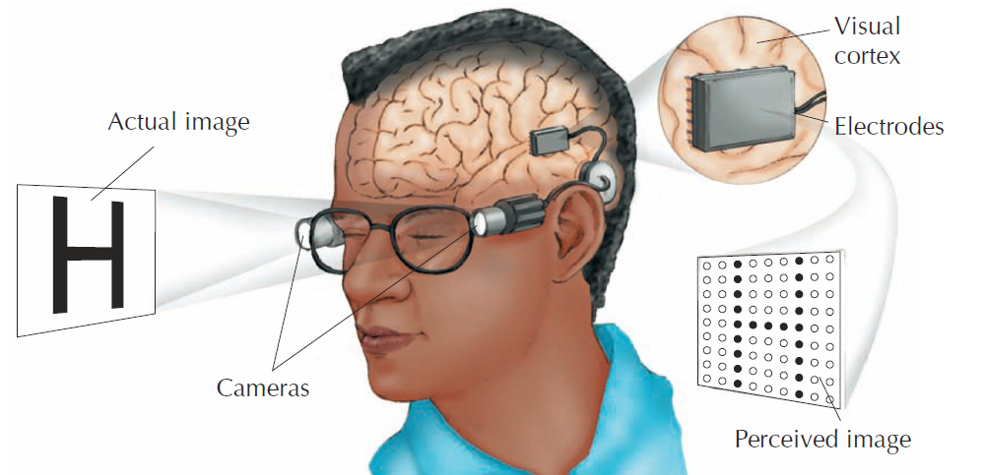
Sensory Prosthetics – Bypassing Transducers
What happens when the sensory organs do not work – when there is no way for the external energy to be transduced?
Notes:
IMAGE: [© Cengage Learning] (Coon, Figure 17.2, p. 140)
Sensory Processes 10 of 13
In this artificial visual system, video cameras translate light into electrical impulses that directly stimulate the visual cortex, resulting in rudimentary visual experiences.
Visual prosthetics have been developed so that people whose eyes cannot transduce electromagnetic energy can “see.”
Cochlear implants are devices used by people whose auditory systems can no longer transduce sound waves into neural impulses.
The stimuli produced by cochlear implants are experienced as being heard.

Slide 11
Attention
The link between sensation, perception, and our experiences
  Directs our sensory systems toward certain stimuli
  Selects specific information for further processing
  Allocates the mental energy needed for that processing
  Regulates the flow of resources needed to perform tasks and coordinate several tasks
Notes:
Sensory Processes 11 of 13
An important gateway to perception is the process of attention, defined as a narrow focus of consciousness.
As energy activates our sensory receptors, we use attention to determine what to focus on and what to disregard.
There are three important characteristics of attention.
Attention improves mental processing.
Attention takes effort.
Attention is limited.
We rarely have the luxury of paying attention to any single stimulus and we simply cannot process all the information converging simultaneously on our sensory systems.
To prioritize input, we use selective attention, or the ability to focus on a subset of available information and exclude the rest.
Selective attention can be described as a filter that blocks certain information from reaching awareness.
At times, we can even suffer from inattentional blindness, a failure to notice a stimulus because attention is focused elsewhere

Slide 12
Selective Attention – Missing the Gorilla
We can sometimes be so focused that we miss important information
Notes:
IMAGE:
Sensory Processes 12 of 13
Selective attention, or our focus on a subset of input, prioritizes incoming information. However, we can sometimes be so focused that we miss important information. In a classic study by Simons and Chabris (1999), people counting the number of times a basketball was passed in a video completely missed the person in the gorilla suit who walked onstage, faced the camera, and pounded its chest. People who do better on multitasking tend to see the gorilla more often than those who do not.
Not seeing something that is plainly before your eyes most likely occurs when your attention is narrowly focused.
Selective attention and inattentional blindness are vividly illustrated by a classic study in which participants were shown a film of two basketball teams, one wearing black shirts and the other wearing white.
Observers were asked to watch the film closely and count how many times a basketball passed between members of one of the teams, while ignoring the other team.
As observers watched and counted, a person wearing a gorilla suit walked into the middle of the basketball game, faced the camera, thumped its chest, and walked out of view.
Half the observers failed to notice this rather striking event. This effect probably explains why fans of opposing sports teams often act as if they had seen two completely different games.

Slide 13
Divided Attention – Multitasking
We are not as good at multitasking as we may like to think
Notes:
IMAGE: [© iStockphoto.com/nycshooter] (Bernstein, p. 133)
Sensory Processes 13 of 13
Talking on any kind of phone—including hands-free models—can create inattentional
blindness and divided attention that impair driving and may contribute to accidents.
(e.g., Briggs, Hole, & Land, 2011; Hyman et al., 2010; Strayer & Drews, 2007).
When faced with multiple stimuli, we often attempt to process multiple sources of sensory information.
We may be so focused on our texting that we miss an oncoming car.
Forty–one states, the District of Columbia, Guam, and the U.S. Virgin Islands ban text messaging for all drivers (for the latest developments on this topic, visit http://distraction.gov).

Slide 14
Vision
This section covers:
  The physical stimulus for vision
  The anatomy of the eye
  Visual pathways and perception
Notes:
IMAGE: [© A. Gragera/Latin Stock/Photo Researchers] (Kalat, p. 102)
Vision 1 of 12
What might a different planet look like? No matter how exotic some other planet might be, it could not have colors we do not have here. The reason is that our eyes can see only certain wavelengths of light, and color is the experience our brains create from those wavelengths.
This section covers:
The physical stimulus for vision
The anatomy of the eye
Visual pathways and perception

Slide 15
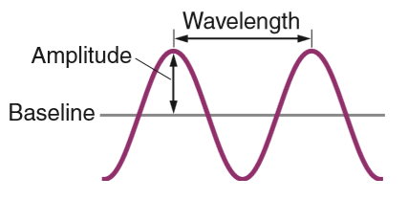
The Visual Stimulus – Light
Light travels in waves with two important properties
  Wavelength, perceived as color
  Amplitude, perceived as brightness
Notes:
IMAGE: [© Cengage Learning 2013] (Cacioppo, Figure 5.5, p. 155)
Vision 2 of 12
Visible light, or the light we can see, is a type of radiation emitted by the sun, other stars, and artificial sources such as the light bulb.
Light energy moves in waves, like the waves in the ocean.
Wavelength, or the distance between successive peaks of waves, is decoded by our visual system as color or shades of gray.
The height, or amplitude, of the waves is translated by the visual system into brightness. Large-amplitude waves appear very bright, and low-amplitude waves appear dim.

Slide 16
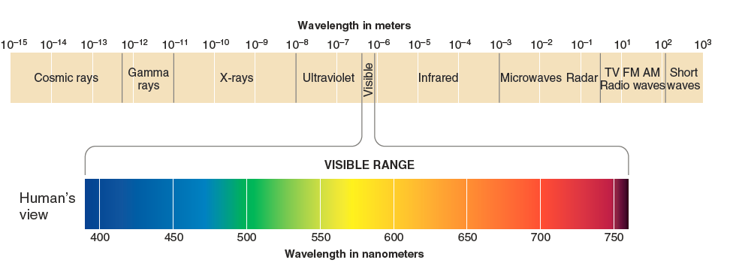
The Electromagnetic Spectrum and Visible Light
The electromagnetic spectrum ranges from cosmic rays, through x-rays and ultraviolet light, to TV and radio waves
Notes:
IMAGE: [© Cengage Learning 2013] (Cacioppo Figure 5.2, p. 150)
Vision 3 of 12
What we call light is part of the electromagnetic spectrum, the continuum of all frequencies of radiated energy from cosmic rays and x-rays with very short wavelengths, through ultraviolet, visible light, and infrared, to radio and TV transmissions.
​Visible ​light ​is ​a ​small ​part ​of ​the​ electromagnetic ​spectrum. ​We ​see ​these​ wavelengths ​because ​our ​receptors ​respond​ to ​them.
Light is visible to us only because our receptors respond to wavelengths from 400 to 700 nanometers (nm).
Other species are sensitive to other portions of the electromagnetic spectrum.

Slide 17
Believe It or Not – What Does a Dog See?
Many people believe dogs cannot see color
  They appear to see in what we would describe as blues and yellows
Notes:
IMAGE: Figure 5.2 [© ChristopherCosner.com] (Cacioppo, p. 182)
Vision 4 of 12
Human beings see only a small part of the electromagnetic energy emitted from the sun.
Some animals see even less.
Dogs apparently do just fine seeing blues, yellows, and grays, whereas humans have evolved to see a much more colorful world.
Colors that look red to us probably look yellow to a dog, and colors we see as green would look gray or white.

Slide 18
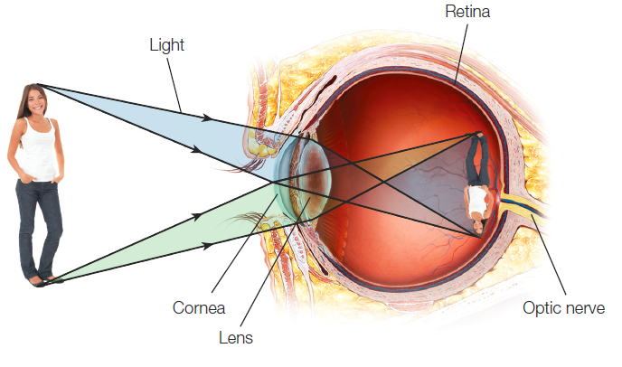
The Anatomy of the Eye
Notes:
IMAGE: [© Argosy Publishing, Inc, James P. Gilman, C. R. A./Phototake] (Cacioppo, Figure 5.8, p. 157)
Vision 5 of 12
Each part of the eye performs a specific function that contributes to transforming light waves into neural signals.
The major parts of the eye include the following:
​The Cornea is the outermost layer of the eye. It is a thin, clear membrane that bends light waves inward.
The Pupil is the opening through which light waves enter the eye. The size of the pupil changes depending on the brightness of the environment.
When it’s dim, the pupil opens wide to let more light in. When it’s bright, the pupil becomes smaller.
The Iris is the pigmented portion of the eye. It’s also the muscle that adjusts the size of the pupil. It expands or contracts as light conditions change.
The Lens focuses the incoming light so that it falls onto the retina. It changes its shape depending on where you’re trying to focus, a process known as accommodation.
If you’re focusing on something close, the lens expands. If you’re focusing on something far away, the lens contracts.
The Retina is a multi-layered collection of neurons that covers the rear of the eye. It contains the visual receptors, which convert light wave energy into neural signals.
The Fovea is the exact center of the retina. It contains receptors that are specialized for fine detail and color vision. It’s the place where your visual acuity (sharpness) is highest.
The Optic nerve is a bundle of fibers that transmit incoming visual signals to the brain. It consists of axons that exit the eye at a spot known as the optic disk.
Because there are no rods and cones within the optic disk, each eye has a blind spot.

Slide 19
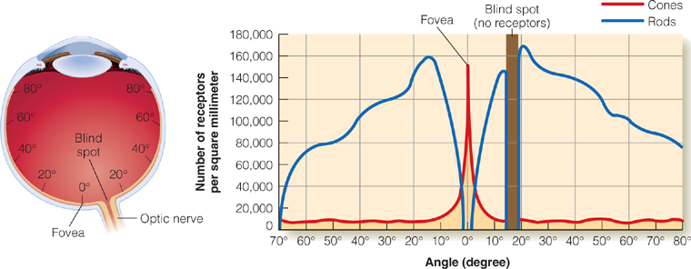
Rods and Cones
Rods – for viewing dim light with no color
Cones – for bright light with color
Notes:
IMAGE: [© ???.] (Goldstein S&P 9e, Figure 2.10)
Vision 6 of 12
The rods and cones are the visual receptors located within the retina. They each contain pigments that are broken down by light energy.
As pigments break down, they start a series of chemical reactions that changes the activity levels of visual system neurons.
Rods and cones are named after their shapes. The human eye contains about 120 million rods and about 6 million cones.
The rods are more sensitive to light than the cones and excel at seeing in dim light.
Rods become more common as we move from the fovea to the periphery of the retina, so your peripheral vision does a better job of viewing dim light than your central vision does.
This extraordinary sensitivity of rods has costs. Rods do not provide information about color, nor do they provide clear, sharp images.
Cones function best under bright light and provide the ability to see both sharp images and color.
​The chart shows the distribution of rods and cones across the human retina.
Cones (the red line) are mostly in the fovea and become less frequent as you move toward the periphery of the retina.
Rods (blue line), on the other hand, greatly outnumber cones within the periphery, and are completely absent from the fovea.

Slide 20
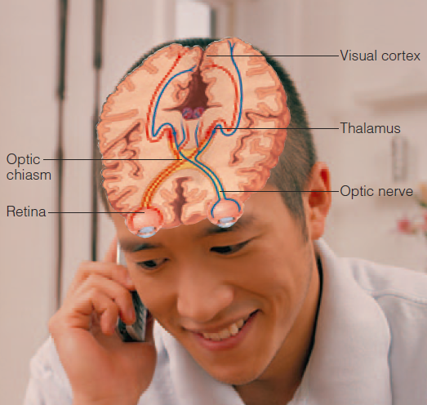
Visual Pathways
Optic Nerve
Optic Chiasm
Optic Tracts
Thalamus
Occipital Lobe
Notes:
IMAGE: [© Shiva Twin/Getty Images] (Pastorino, Figure 3.6, p. 97)
Vision 7 of 12
​Visual information from the retina travels to the thalamus and then to the primary visual cortex in the occipital lobe.
The rods and cones are the only true receptors of the visual system.
When they absorb light, they trigger responses in four additional layers of neurons within the retina.
Axons from the final layer of cells leave the back of the eye to form the optic nerve.
The point at which the optic nerves cross the midline is known as the optic chiasm.
Beyond the optic chiasm, the visual pathways are known as optic tracts.
About 90% of the axons in the optic tracts will synapse in the thalamus.
The remaining fibers connect with the hypothalamus, where their input provides information about light needed to regulate sleep-waking cycles or with the midbrain, which manages a number of visually guided reflexes, such as changing the size of the pupil in response to light conditions.
The thalamus sends information about vision to the amygdala and to the primary visual cortex in the occipital lobe.
The amygdala uses visual information to make quick emotional judgments, especially about potentially harmful stimuli.
Primary visual cortex responds to object shape, location, movement, and color with neurons known as feature detectors.
The primary visual cortex begins, but by no means finishes, the processing of visual input.
The dorsal stream carries signals from the occipital lobe to areas within the parietal lobe. This stream is sometimes referred to as the “where pathway,” since it responds to an object’s location and movement.
The ventral stream carries signals from the occipital lobe to areas within the temporal lobe. This stream is sometimes referred to as the “what pathway,” since it’s responsible for object identification and recognition.

Slide 21
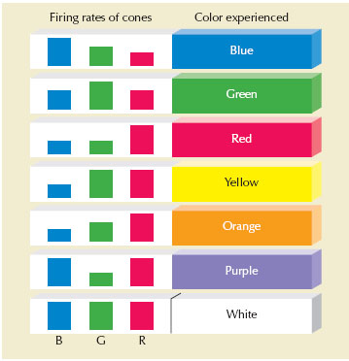
Trichromatic Theory of Color Vision
Perception of color is based on the response rates of three kinds of cones
Notes:
IMAGE: [© ???] (Coon, Figure 18.8, p. 147)
Vision 8 of 12
Trichromatic theory is based on the existence of three types of cones in the retina. Each type of cone responds most to light at particular wavelengths:
Short wavelengths (blue)
Medium wavelengths (green)
Long wavelengths (red)
Our ultimate experience of color comes not from the response of one type of cone, but from comparisons between the responses of many cones.
If blue cones and red cones are highly active while the green cones are resting, the resulting perception will be purple.
If green cones and red cones are active while blue cones rest, the perception will be yellow.
If all three types of cones are active, the perception is white.
Trichromatic theory can account for colorblindness, in which individuals lack certain types of cones.
It accounts less well for other color-related phenomenon such as colored afterimages.

Slide 22

Opponent-Process Theory of Color Vision
Proposes the existence of “opposing” red-green, blue-yellow, and black-white channels
Notes:
IMAGE: [© Cengage Learning 2013] (Cacioppo, Figure 5.13, p. 193)
Vision 9 of 12
​If you stare at the dot in the center of the yellow, green, and black flag for a minute, then shift your gaze to the dot in the white space below, you should “see” the flag in its traditional red, white, and blue colors.
Colored afterimages demonstrate opponent process theory:
This theory proposes the existence of “opposing” color channels: a red-green channel, a blue-yellow channel, and a black-white channel.
We cannot see a color like “reddish-green” or “bluish-yellow” because the two colors share the same channel.
Opponent process theory gets support from our understanding of the anatomy of the visual system.
Groups of cells that process yellow and blue or red and green are located together.
Stimulation of one color group in each pair, for instance red from the red-green pair, will reduce activity in the cells in the other group, or green in this case.
Returning to our green, yellow, and black flag, by staring at the flag, you are producing fatigue in some of your visual neurons.
So fatiguing green, black, and yellow causes a rebound effect in each color channel, and your afterimage looks red, white, and blue.
Both the trichromatic and opponent-process theories are important for color vision. It’s not that one theory is correct and the other isn’t. They are complementary and operate at different points in visual processing. The trichromatic theory describes what happens at the level of rods and cones, while the opponent-process theory describes what happens in other cells of the retina, such as ganglion cells.

Slide 23
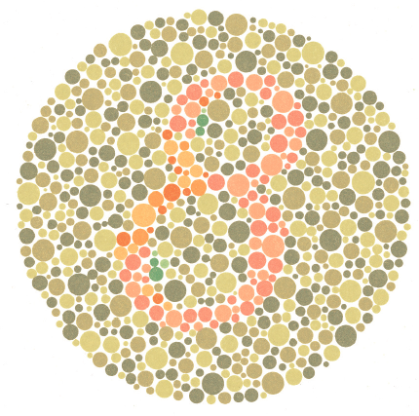
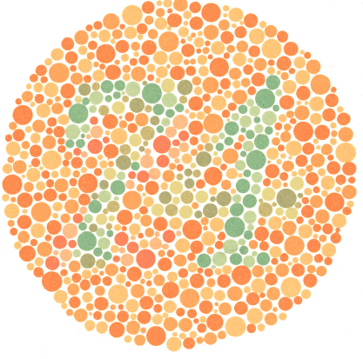
Colorblindness
What numbers do you see?
Notes:
IMAGE: [© Cengage Learning] (Kalat, Figure 4.15, p. 111)
Vision 10 of 12
​These items provide a test for red-green color vision deficiency. A person with normal color vision will see a 74 in the upper figure and an 8 in the lower figure.
Color blindness is the inability to distinguish two or more shades in the color spectrum.
There are different kinds of color blindness.
Monochromats have total color blindness; their worlds look black-and-white. This kind of color blindness is rare and results from individuals having only rods or only one kind of functioning cone (instead of three).
Dichromats usually have trouble distinguishing red from green because they have just two kinds of functioning cones. This is an inherited genetic defect that results in seeing mostly shades of blue and yellow, which differs in severity.
Between 7 and 10% of males and about 0.4% of females have a form of red-green colorblindness. The reason that males are more affected than females is that the genes for the pig-ments used by red and green cones are located on the X chromosome, making red-green colorblindness a sex-linked condition.
Much smaller numbers of people lack blue cones (0.0011%) or cones altogether (0.00001%).

Slide 24

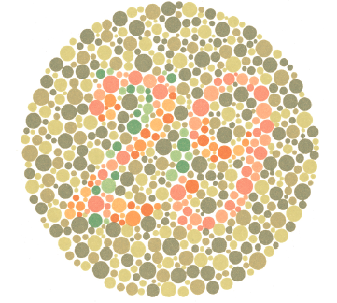

Experiencing Psychology – Colorblindness
Notes:
IMAGE: [© Cengage Learning] (Kalat, Figure 4.16, p. 111)
Vision 11 of 12
​If you have normal color vision, this exercise will show you what it is like to be color deficient. (Instructors may cover the two circles not being viewed for each part.)
First, stare at part a, a red field, under a bright light for about a minute. (The brighter the light and the longer you stare, the greater the effect will be.)
Then look at part b. Staring at the red field fatigued your long-wavelength cones, weakening your red sensation.
Now stare at part c, a green field, for about a minute.
Because you have fatigued your green cones, the figure in b will stand out even more strongly than usual. in fact certain people with red-green color deficiency may be able to see the number in b only after staring at the green circle.

Slide 25
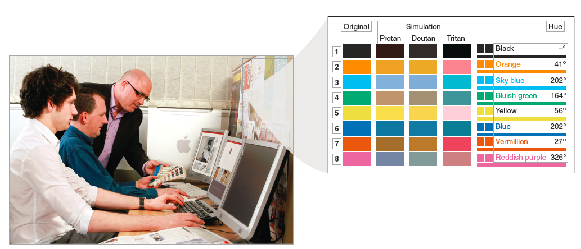
Case Study – Color Vision and Web Design
Notes:
IMAGE: [© Paul Dronsfield,/Alamy] (Cacioppo, Figure 5.16, p. 161)
Vision 12 of 12
​Web designers have found colors that work for people with typical color vision and people who are colorblind. This set of colors shows how different shades would be seen by people with typical vision and by people with three of the most common forms of colorblindness. Even though these colors will be seen differently by the three groups, nobody will mistake one shade for another.
Given the rather common occurrence of colorblindness, making visual materials accessible to people with all types of color vision is a serious concern.
Color can be a very effective tool for designing exciting and engaging websites, but many graphic web designers (who typically have excellent vision themselves) fail to consider how the site might look to a person who is colorblind.
One clue for designing an accessible site can be found in other systems based on color, like traffic lights. Although most of us rely on the color information from the red, yellow, or green lights, the lights also vary in location. In other words, color should never be the only basis for extracting meaning.
A second major concern is contrast. The strong contrast between the black letters on the white pages of this book makes the text easy to read for most people. Colored text against a colored background might add interest, but runs the risk of being harder to read, especially when reds and greens are used.

Slide 26
Hearing
This section covers:
  The physical stimulus for hearing
  The anatomy of the ear
  Types of deafness
Notes:
IMAGE: [© Prof. P.M. Motta/Univ. “La Sapienza,” Rome/Photo Researchers, Inc.] (Cacioppo, p. 176)
Hearing 1 of 9
The photo illustrates the movement of tiny hair cells in the inner ear that produce neural signals that travel to the brain.
This section covers:
The physical stimulus for hearing
The anatomy of the ear
Types of deafness

Slide 27
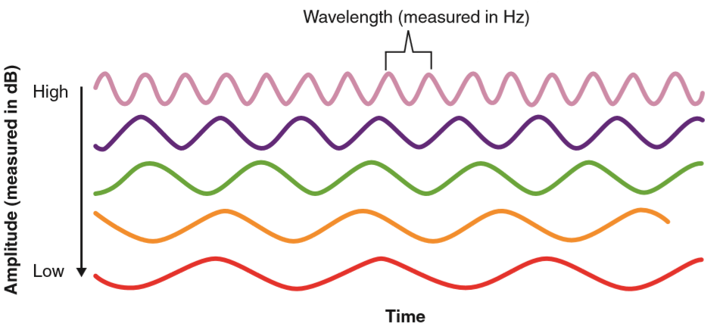
The Sound Stimulus – Sound Waves
Sound waves have different amplitudes and frequencies
  Amplitude is encoded as loudness or intensity
  Frequency is encoded as pitch
Notes:
IMAGE: [© Cengage Learning 2013] (Cacioppo, Figure 5.31, p. 173)
Hearing 2 of 9
Like the light energy we see, sound waves are characterized by frequency and amplitude. We perceive frequency as the pitch of the sound (high or low, measured in Hertz, or Hz) and we perceive amplitude as the loudness of the sound, measured in decibels (dB).
Sound waves have different amplitudes and frequencies.
The amplitude of the wave is encoded as loudness or intensity and the frequency of the wave as pitch.
In sound, amplitude is usually measured in units called decibels (dB), and frequency is measured in cycles per second, or Hertz.
High-amplitude waves are perceived as loud, and low-amplitude waves are perceived as soft.
High-frequency waves (many cycles per unit of time) are perceived as high pitched, whereas low-frequency sounds are low pitched.
Most sounds that we hear are complex combinations of waves.
A wave with only one frequency is known as a pure tone, but these rarely occur in nature. The tuning fork used by a piano tuner produces pure tones.
A complex tone combining multiple waves is perceived as having a characteristic quality, or timbre.
The same note played by a piano, clarinet, and violin will sound very different due to each instrument’s ability to produce different timbres.

Slide 28
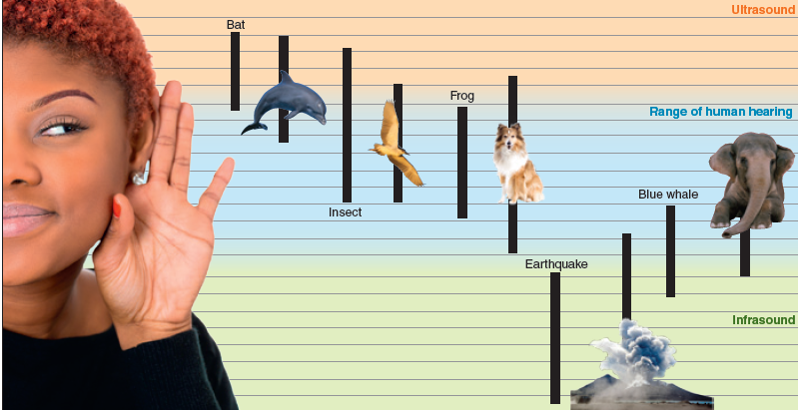
Ranges of Hearing
Notes:
IMAGE: [© Cengage Learning®; photos, left to right: PathDoc /Shutterstock.com; Mike Hill/Alamy; Eric Carr/Alamy, Erik Lam/Shutterstock; Keith J. Smith/Alamy; Matthias Clamer/Stone/Getty Images] (Cacioppo, Figure 5.32, p. 174)
Hearing 3 of 9
Ultrasounds are above the range of human hearing, and infrasounds are below the range of human hearing.
As we observed in the case of the light spectrum, parts of the auditory spectrum are outside the range of human hearing.
Ultrasound stimuli occur at frequencies above the range of human hearing, beginning at about 20,000 Hz.
Ultrasound can be used to clean jewelry or your teeth or to produce noninvasive medical images.
Infrasound refers to frequencies below the range of human hearing, or less than 20 Hz.
Many animals, including elephants and marine mammals, use infrasound for communication.
Infrasound is particularly effective in water, as it allows sound to travel for very long distances.
In humans, however, infrasound stimuli produce dizziness, nausea, uncontrolled bowel movements, and other unpleasant symptoms and are under study as a possible means of nonlethal crowd control.

Slide 29
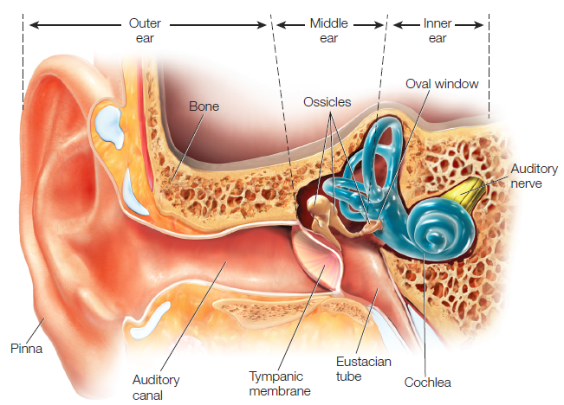
The Anatomy of the Outer, Middle, and Inner Ear
Notes:
IMAGE: [© Argosy Publishing, Inc.] (Cacioppo, Figure 5.33, p. 175)
Hearing 4 of 9
The human ear is divided into the outer, middle, and inner ear.
The outer ear consists of the structures that are visible outside the body.
The pinna, the outer visible structure of the ear, collects and focuses sounds like a funnel.
In addition, the pinna helps us localize sounds as being above or below the head.
Sounds collected by the pinna are channeled through the auditory canal, which ends at the tympanic membrane, or eardrum, at the boundary between the outer and middle ear.
The boundary between the outer and middle ear is formed by the tympanic membrane and the boundary between the middle and inner ear is formed by another membrane, the oval window.
The ossicles, a series of three tiny bones, occupies the gap between the tympanic membrane and the oval window. Generally, these bones are referred to as the malleus (hammer), incus (anvil), and stapes (stirrup).
The purpose of the ossicles is to amplify sound energy as it’s transferred from the air of the outer and middle ear to the fluid found in the inner ear.
Sound waves are weakened as they move from air to water. Without the amplification provided by these small bones, we would lose a large amount of sound energy as the sound waves moved from air to liquid within the ear.
The inner ear contains two sets of fluid-filled cavities embedded in the bone of the skull.
One set is part of the vestibular system.
The other set is the cochlea, from the Greek word for “snail.”
When rolled up like a snail shell, the human cochlea is about the size of a pea.
The cochlea contains specialized receptor cells that respond to vibrations transmitted to the inner ear.

Slide 30
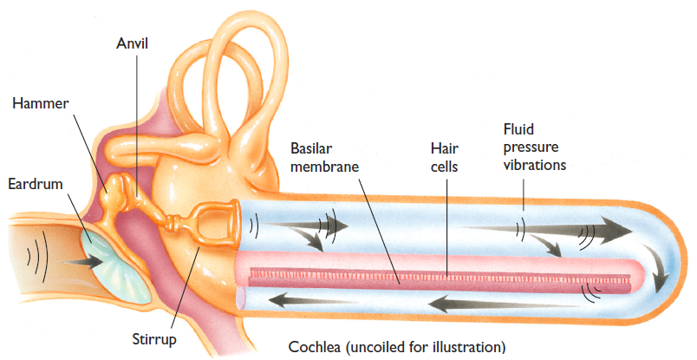
The Cochlea
Vibrations in the ossicles
Waves in the vestibular canal fluid
Movement of hair cells
Notes:
IMAGE: [© Cengage Learning] (Kalat, Figure 4.18, p. 114)
Hearing 5 of 9
​Sound​ waves​ vibrate ​the​ eardrum​.​ Three​ tiny​ bones ​convert​ the ​eardrum’s ​vibrations ​into​ vibrations​ in ​the ​fluid-filled​cochlea​.​
These ​vibrations​ displace​ hair​ cells​ along ​the ​basilar​ membrane ​in​ the ​cochlea.​ Here, ​the ​dimensions ​of ​the ​cochlea ​have ​been ​changed​ to​ make ​the ​principles​ clear.
The cochlea is a very complex structure, which is better understood if we pretend to unroll it.
The cochlea may be divided into three parallel chambers divided from one another by membranes.
Two of these chambers, the vestibular canal and the tympanic canal, are connected at the apex of the cochlea, or the point farthest from the oval window.
Vibrations transmitted by the bones of the middle ear to the oval window produce waves in the fluid of the vestibular canal that travel around the apex and back through the tympanic canal.
Lying between the vestibular and tympanic canals is the cochlear duct. The cochlear duct is separated from the tympanic canal by the basilar membrane.
Resting on top of the basilar membrane is the organ of Corti, which contains many rows of hair cells that transduce sound energy into neural signals.
Each human ear has about 15,500 of these hair cells.

Slide 31
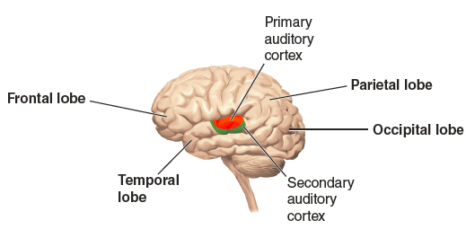
Auditory Pathways
Auditory Nerve
Medulla
Midbrain
Thalamus
Temporal Lobe
Notes:
IMAGE: [© Cengage Learning 2013] (Cacioppo, Figure 5.35, p. 176)
Hearing 6 of 9
The primary auditory cortex is located in the temporal lobe.
Bending the hair cells stimulates the release of neurotransmitters onto the cells of the auditory nerve.
One branch of each auditory nerve cell makes contact with the hair cells while the other branch proceeds to the medulla of the brainstem.
From the medulla, sound information is sent to the midbrain, which manages reflexive responses to sound, as in turning toward the source of a loud noise.
In addition, the midbrain participates in sound localization, or the identification of a source of sound.
The midbrain passes information along to the thalamus, which in turn sends sound information to the primary auditory cortex, located in the temporal lobe.
The primary auditory cortex conducts the first basic analysis of the wavelengths and amplitudes of incoming information.
Surrounding the primary auditory cortex are areas of secondary auditory cortex that respond to complex types of stimuli, like clicks, noise, and sounds having particular patterns.

Slide 32
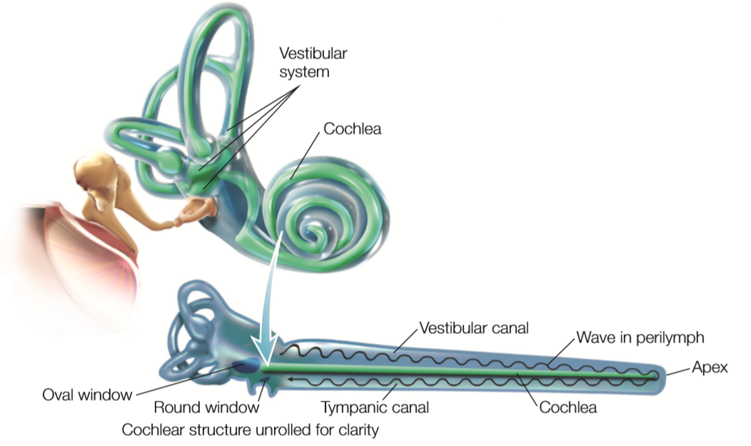
Pitch Perception – The Basilar Membrane
Notes:
IMAGE: [© Argosy Publishing, Inc.] (Cacioppo, Figure 5.34, p. 175)
Hearing 7 of 9
Sound waves produce a peak response on the basilar membrane according to their frequencies. Like the strings on a musical instrument, high tones produce the greatest response at the narrow, stiff base of the basilar membrane, while low tones produce the greatest response at the wide, floppy part of the basilar membrane near the apex. Sound waves travel through the cochlea from the oval window, around the apex, and back to the round window. The waves cause movement of tiny hair cells in the cochlear duct, which we perceive as sound.
The perception of pitch begins with the basilar membrane of the inner ear.
Place theory suggests that the frequency of a sound is correlated with the part of the basilar membrane showing a peak response.
The base of the basilar membrane, closest to the oval window, is narrow and stiff. In contrast, at its farthest point near the apex, the basilar membrane is wide and flexible.
High-frequency tones produce the maximum movement of the basilar membrane near the base, while low-frequency tones produce maximum movement near the apex. The hair cells riding above these areas of peak movement will show a maximum response.
Place theory works well for sounds above 4000 Hz (which is about the frequency produced by striking the highest key on a piano—C8).
Below frequencies of 4000 Hz, the response of the basilar membrane does not allow for precise localization.
In these cases, we appear to use another mechanism known as frequency theory, in which patterns of neural firing “match” the actual frequency of a sound.

Slide 33
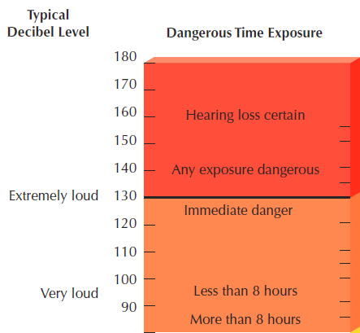
Exposure to Sound
Loudness of sound is measured in decibels
  A whisper: ~ 20 dB
  Normal conversation: ~ 60 dB
  iPod with standard earbuds: 100 dB
  Threshold of pain: 130 dB
Notes:
IMAGE: [© Cengage Learning] (Coon, Figure 19.5, p. 153)
Hearing 8 of 9
Zero decibels is the faintest sound most people can hear. Sounds of 110 decibels are uncomfortably loud. Prolonged exposure to sounds above 85 decibels may damage the inner ear. Some music concerts, which can reach 120 decibels, have caused hearing loss in musicians and may affect audiences as well. Sounds of 130 decibels pose an immediate danger to hearing.
Human beings can perceive sounds that vary in intensity by a factor of over 10 billion, from the softest sound we can detect up to the sound made by a jet engine at takeoff.
Extremely loud sounds can damage structures in the ear.
Conductive hearing loss (conduction deafness) results from injury to or illness affecting the structures in the ear that “conduct” the sound waves, such as the eardrum or the ossicles.
Hearing aids are often helpful for conductive hearing loss.
When the hair cells or the auditory nerve is damaged, neural (sensorineural) deafness results.
Cochlear implants are used for neural deafness.

Slide 34
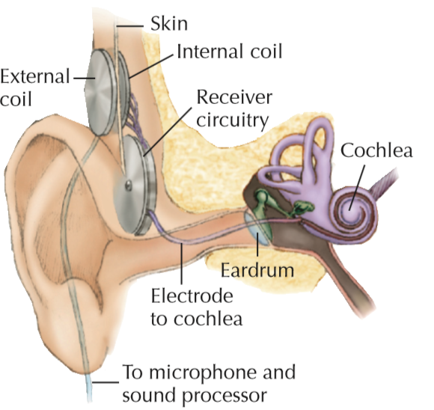
Cochlear Implants
Bypass hair cells and stimulate the auditory nerves directly
Notes:
IMAGE: [© Cengage Learning] (Coon, Figure 19.6, p. 153)
Hearing 9 of 9
The photo illustrates a cochlear implant, or “artificial ear.”
Cochlear implants bypass hair cells and stimulate the auditory nerves directly.
Wires from a microphone carry electrical signals to an external coil.
A matching coil under the skin picks up the signals and carries them to one or more areas of the cochlea.
The latest implants use place theory to separate higher and lower tones into separate channels.
This has allowed some formerly deaf persons to hear human voices, music, and other higher-frequency sounds.
About 60 percent of all multichannel implant patients can understand some spoken words and appreciate music.
Some deaf children with implants learn to speak. Those who receive a cochlear implant before age 2 have the best chance to learn spoken language at a near normal rate.

Slide 35
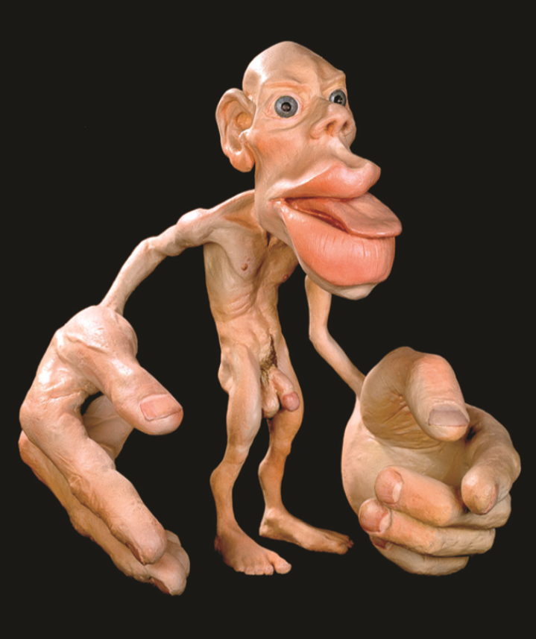
Chemical and Mechanical Senses
This section covers:
  Somatosensation
  Vestibular senses
  Smell
  Taste
Notes:
IMAGE: [© The Natural History Museum/The Image Works] (Cacioppo, p. 181)
Chemical and Mechanical Senses 1 of 9
Homunculus: When parts of the body are drawn next to their corresponding brain areas, the fingers and mouth are very large and the arms and back are small.
This type of picture is called a homunculus, literally, "little man" or person.
This section covers:
Somatosensation
Vestibular senses
Smell
Taste

Slide 36
Somatosensation
Bodily sensations coming from skin, muscles, and joints.
  Processed by your brain’s somatosensory cortex.
Notes:
IMAGE: [© ???] (???)
Chemical and Mechanical Senses 2 of 9
​Somatosensation (soma comes from the Greek word for “body”) provides us with information coming from different parts of your body.
Receptors within the skin provide information about touch, pressure, and temperature.
Receptors within muscles and joints provide information about position and movement.
Both types of receptors can send pain signals to the brain.
Signals are sent up the spinal cord to the thalamus, which relays them to the somatosensory cortex.
Although these senses may not seem as glamorous as vision and hearing, we are severely disabled by their loss.
You might think it would be a blessing to be born without a sense of pain, but people who have impaired pain reception, often die prematurely due to their inability to respond to injury.
Children who are born with a rare inherited insensitivity to pain repeatedly burn themselves, break bones, bite off parts of their tongues, and become ill without knowing it.
As you might imagine, it’s also hard for people with congenital pain insensitivity to have empathy for the pain of others

Slide 37
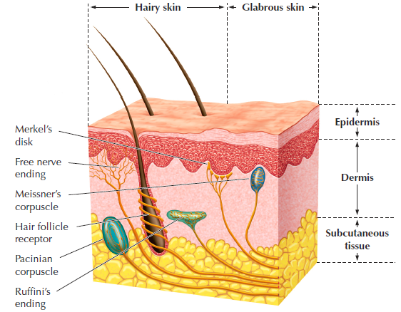
Receptors for Touch, Temperature, and Pain
Notes:
IMAGE: [© Cengage Learning] (Coon, Figure 19.9, p. 156)
​Chemical and Mechanical Senses 3 of 9
The skin has three layers.
The outermost layer is a thin film of dead cells containing no receptors.
In the middle and fatty layers of skin are a variety of receptors with different functions.
Merkel’s disks sense pressure on the skin;
Meissner’s corpuscles sense pressure
Hair follicle receptors sense hair movement;
Pacinian corpuscles sense pressure and vibration;
Ruffini’s endings sense skin stretching
Free nerve endings. One of their major functions is to transmit information about temperature and pain.
All of these receptors send their electrical signals to neurons within the spinal cord, which brings the information to the brain.

Slide 38
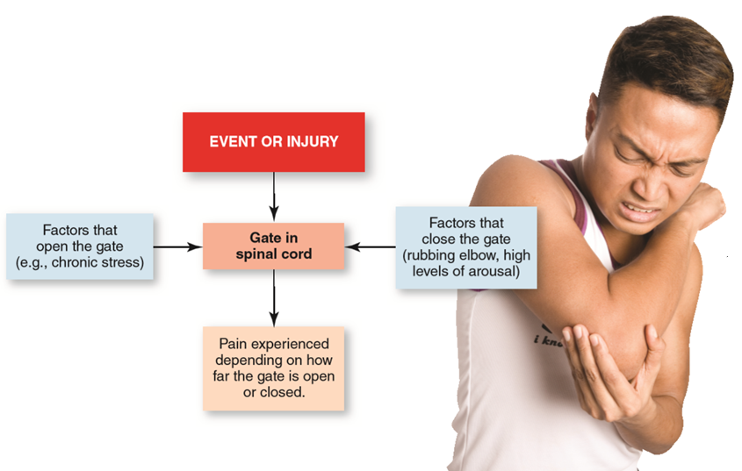
The Gate Control Theory of Pain
Notes:
IMAGE: [© Illustration: © Cengage Learning 2013; photo: © Juriah Mosin/Shutterstock] (Cacioppo, Figure 5.40, p. 183)
Chemical and Mechanical Senses 4 of 9
According to the gate theory of pain, incoming pain messages can be influenced by factors like chronic stress (opening the gate wider and producing a greater sensation of pain) or rubbing an injured body part (closing the gate and reducing the sensation of pain).
​Pain messages traveling to the brain may be modified by competing incoming sensory signals.
Many of us spontaneously rub our elbow after bumping it painfully.
According to the gate theory, input from touch fibers (reacting to rubbing your elbow) competes with input from pain receptors for activation of cells in the spinal cord.
Activation of the touch fibers effectively dilutes the amount of pain information reaching the brain.
In some cases, signals that close the gate can be sent from the brain to the spinal cord.

Slide 39
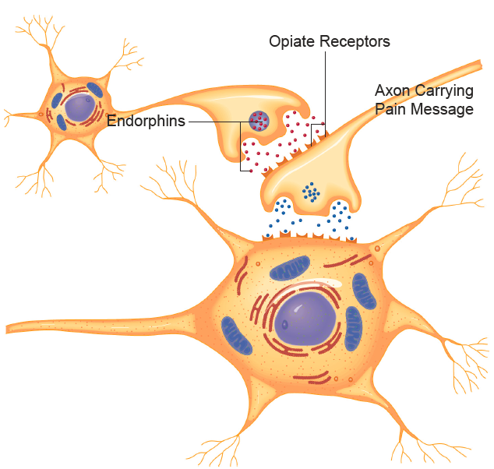
Endorphins
Released in response to pain and pleasure
Notes:
IMAGE: [© Cengage Learning] (Kalat, Figure 4.24, p. 120)
Chemical and Mechanical Senses 5 of 9
​Endorphins​ block ​the ​release ​of ​a​ transmitter ​conveying​ pain​ sensations.​ Opiates ​imitate ​the ​effects ​of ​endorphins.
Your perception of pain from an injury can also be reduced by your brain’s ability to secrete endorphins, which are opioid chemicals similar to morphine.
Endorphins reduce pain by helping to close the gates that allow painful nerve impulses into the brain.
They can be released in a wide variety of circumstances, everything from a traumatic injury, to sustained physical exertion (a runner’s high), to pleasant experiences such as sexual activity or listening to music

Slide 40
Kinesthetic Sense
Being able to perceive how the different parts of your body are positioned.
Notes:
Chemical and Mechanical Senses 6 of 9
The vestibular system is part of the inner ear.
Within the vestibular system, fluid-filled sacs called otolith organs are sensitive to movement, acceleration, and gravity.
The otolith organs contain tiny crystals in a soft, gelatin-like mass. The tug of gravity or rapid head movements can cause the mass to shift.
This, in turn, stimulates hair-like receptor cells, allowing us to sense gravity, acceleration, and movement through space.
Three fluid-filled tubes—called the semicircular canals—are the sensory organs for balance.
Head movements cause the fluid to swirl about.
As the fluid moves, it bends a small “flap,” or “float,” called the crista, that detects movement in the semicircular canals.
The bending of each crista again stimulates hair cells and signals head rotation.

Slide 41
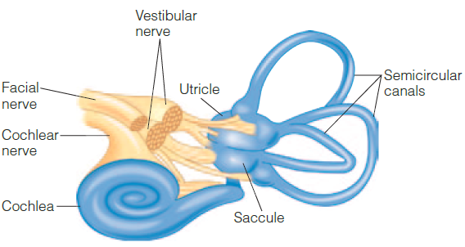
Vestibular Sense – The Inner Ear
Sensitive to position, acceleration, and rotational movements
Notes:
IMAGE: [© Cengage Learning] (Pastorino, Figure 3.14, p. 109)
Chemical and Mechanical Senses 7 of 9
The vestibular system is part of the inner ear.
Within the vestibular system, fluid-filled sacs called otolith organs are sensitive to movement, acceleration, and gravity.
The otolith organs contain tiny crystals in a soft, gelatin-like mass. The tug of gravity or rapid head movements can cause the mass to shift.
This, in turn, stimulates hair-like receptor cells, allowing us to sense gravity, acceleration, and movement through space.
Three fluid-filled tubes—called the semicircular canals—are the sensory organs for balance.
Head movements cause the fluid to swirl about.
As the fluid moves, it bends a small “flap,” or “float,” called the crista, that detects movement in the semicircular canals.
The bending of each crista again stimulates hair cells and signals head rotation.
The vestibular system helps you maintain balance and experience a relatively stable world.
When the vestibular system is compromised, as happens with an inner ear infection, people often experience dizziness and have difficulty with balance.

Slide 42
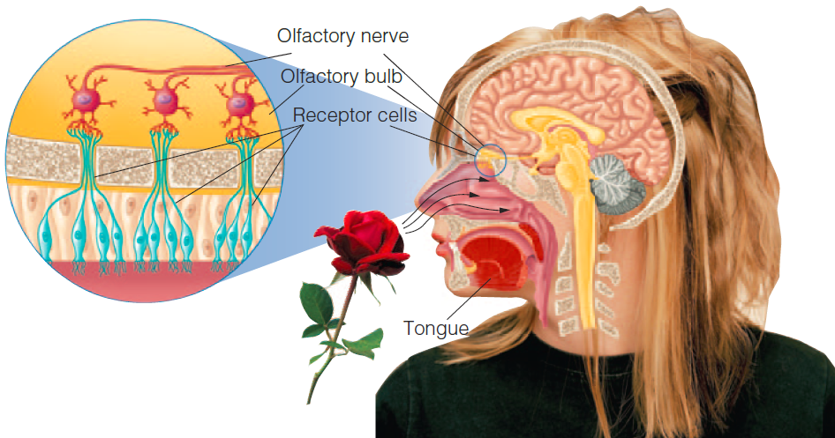
Smell
Olfactory Nerve
Olfactory Bulb
Frontal Lobe
Notes:
IMAGE: [Woman: © Wayne Eardley/Masterfile; Rose: © Margo Harrison/Shutterstock.com] (Pastorino, Figure 3.12, p. 106)
Chemical and Mechanical Senses 8 of 9
​
Olfactory receptors in the nose interact with airborne chemicals to begin the sensing of odor.
Air containing olfactory stimuli is taken in through the nostrils and circulated within the nasal cavities connected to the nostrils.
The receptors are located in a thin layer of cells within the nasal cavity.
Unlike most neurons, the olfactory receptors regularly die and are replaced by new receptor cells in cycles lasting 4 to 6 weeks.
Cells at the base of the receptors are responsible for producing the mucus surrounding the receptors.
One branch of each receptor interacts with molecules dissolved in the mucus.
The other branch carries information back to the central nervous system as part of the olfactory nerve.
The olfactory nerve fibers synapse in one of the two olfactory bulbs, located just below the mass of the frontal lobes.
Unlike most of the other sensory input to the brain, olfactory pathways do not make direct connections with the thalamus before the information reaches the cerebral cortex.
Instead, fibers from the olfactory bulbs proceed to the olfactory cortex, located in the lower portions of the frontal lobe, and to the amygdala.

Slide 43
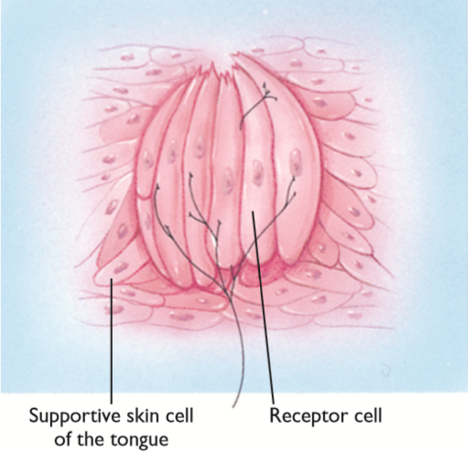
Taste
Mouth and Tongue
Medulla
Thalamus
Parietal Lobe
Notes:
IMAGE: [© Cengage Learning] (Kalat, Figure 4.26, p. 122)
Chemical and Mechanical Senses 9 of 9
​Taste receptors are on taste buds located in the bumps, or papillae, located on the tongue.
The most likely original purpose of our sense of gustation, or taste, was to protect us from eating poisonous or spoiled food and to attract us to foods that boost our chances of survival.
Most of us are familiar with four major categories of taste: sweet, sour, salty, and bitter.
You may not have heard of the fifth type of taste, known by the Japanese term umami, which, roughly translated, means “savory” or “meaty.”
In addition, the tongue contains receptors for capsaicin, an active ingredient in hot peppers. Activating these receptors can cause the perception of a spicy heat.
This experience is more of a tactile sensation than a gustatory one.
You are probably aware of the bumpy texture of your tongue, which results from the presence of papillae, which contain somewhere between 1 and 100 taste buds.
Each taste bud contains between 50 and 150 receptor cells, which extend tiny hair like cilia into the saliva that interact with dissolved taste stimuli and transduce the resulting information into neural signals.
Like olfactory receptors, taste buds have a limited life before they are replaced.
Information about taste travels from the mouth and tongue to the medulla.
The medulla in turn communicates with the thalamus, which sends taste information to the somatosensory cortex of the parietal lobe and to the orbitofrontal cortex where the emotional pleasantness or unpleasantness of particular stimuli is processed.

Slide 44
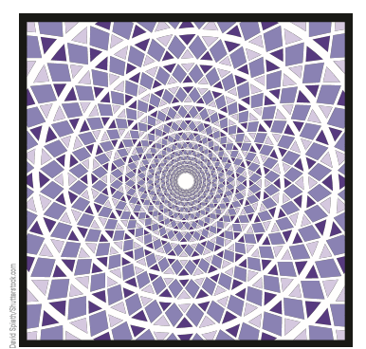
Perceptual Processes and Phenomena
This section covers:
  Top-down and bottom-up processing
  Gestalt principles
  Depth perception
  Perceptual constancies
  Illusions
  Extrasensory perception
Notes:
IMAGE: [© David Spieth/Shutterstock.com] (Coon, Figure 20.3, p. 163)
Perceptual Processes and Phenomena 1 of 20
This photo illustrates the limits of pure perception. Even simple designs are easily misperceived. Fraser’s spiral is actually a series of concentric circles. The illusion is so powerful that people who try to trace one of the circles sometimes follow the illusory spiral and jump from one circle to the next. (After Seckel, 2000.)
This section covers:
Top-down and bottom-up processing
Gestalt principles
Depth perception
Perceptual constancies
Illusions
Extrasensory perception

Slide 45

Types of Information Processing
Do you see a B or a 13?
  Top-down processing
  Bottom-up processing
Notes:
IMAGE: [© Cengage Learning 2013] (Cacioppo, Figure 1.4, p. 15)
Perceptual Processes and Phenomena 2 of 20
Our brains build perceptions.
In top-down processing, context and preexisting knowledge are used to rapidly organize features into a meaningful whole.
You know what numbers and letters are needed to make a complete sequence (B in the top row, 13 in the bottom).
Even though the same stimulus is used in both rows, the way you interpret it depends on the context.
In bottom-up processing, we start constructing at the “bottom” with raw materials—that is, we begin with small sensory units (features) and build upward to a complete perception.
If you saw the B/13 stimulus by itself, you would probably recognize that it’s ambiguous and could be interpreted multiple ways.

Slide 46

Gestalt Principles
We are born with a number of built-in tendencies to organize incoming sensory information in certain ways
  This simplifies the problem of recognizing objects
Notes:
IMAGE: [© Patricia Aranda/Moment/Flickr Vision/Getty Images] (Pastorino, Figure 3.20, p. 116)
Perceptual Processes and Phenomena 3 of 20
What do you see when you look at this picture? Depending on how you use the perceptual rules, you will see different things in this work by Octavio Campo. Do you see horses? Trees? Men’s faces?
One influential approach to understanding form perception is the Gestalt approach.
According to the Gestalt approach, the whole of a perception is greater than the sum of its parts. In fact, the word Gestalt is German for “whole form.”
According to the Gestaltists, when you look at your friend’s face, the resulting perception is not merely a sum of the angles, curves, shapes, and lines that make up the face; rather, you perceive the stimulus as a whole. In this case, you perceive a face because your mind has implicitly grouped all of the stimuli that make up that face into a coherent whole.
One of the major contributions of Gestalt theory is a series of perceptual laws that attempt to explain how our minds automatically organize perceptual stimuli together to produce the perception of a whole form

Slide 47

Gestalt Principles – Figure-Ground
When we perceive a stimulus, we visually pull the figure part of the stimulus forward while visually pushing backward the background
Notes:
IMAGE: [© SSPL/Science Museum/Art Resource, NY] (Cacioppo, p. 165)
Perceptual Processes and Phenomena 4 of 20
This vase was designed to commemorate an anniversary of Queen Elizabeth of England (face on the right) and her husband, Prince Philip (face on the left).
The most basic Gestalt principle is figure-ground: we identify the main object in the scene (the figure), which stands out from the background.
We frequently assume that the figure stands in front of most of the ground, and it seems to have more substance and shape.

Slide 48


Gestalt Principles – Similarity and Proximity
Proximity
Similarity
Notes:
IMAGE: [© Cengage Learning 2013] (Cacioppo, Figure 5.21, p. 165)
Perceptual Processes and Phenomena 5 of 20
The set of dots in (a) do not appear to have any particular relationship with one another, but when we color rows, we suddenly see the dots in columns or rows. Moving two columns or rows very slightly closer to each other in makes us see the array differently as well.
The principle of similarity states that similar stimuli are grouped together.
The principle of proximity states that objects that are close together tend to be grouped together.

Slide 49

Gestalt Principles – Continuity
The tendency towards simplicity and continuity
Notes:
IMAGE: [© Cengage Learning 2013] (Cacioppo, Figure 5.21, p. 199)
Perceptual Processes and Phenomena 6 of 20
The principle of continuity suggests that we assume that points that form smooth lines when connected probably belong together.
The Gestalt principle of continuity says that we perceive points forming a smooth line as belonging to the same object. If you follow this knot, you will see that it is actually formed by two objects, but our initial perception is of a single form.

Slide 50


Gestalt Principles – Closure
The tendency to complete a figure
Notes:
IMAGE: [© Cengage Learning 2012] (Coon, Figure 4.30d) [1986 Panda © WWF Registered Trademark] (Cacioppo, Figure 5.23, p. 166)
Perceptual Processes and Phenomena 7 of 20
Due to the principle of closure, we “fill in the blanks” to see a single object, the World Wildlife logo, although it is really made up of several objects.
Closure occurs when people see a complete, unbroken image even when there are gaps in the lines forming the image.

Slide 51

Gestalt Principles – Common Region
The tendency for items in a region to be seen as a group
Notes:
IMAGE: [© Cengage Learning] (Coon, Figure 20.6, p. 165)
Perceptual Processes and Phenomena 8 of 20
According to the principle of common region, items within a single closed region are grouped together.

Slide 52

Depth Perception
Binocular and monocular cues allow us to perceive depth
Notes:
IMAGE: [© Twentieth Century-Fox Film Corporation/ The Kobal Collection/Art Resource, NY] (Cacioppo, p. 201)
Perceptual Processes and Phenomena 9 of 20
An image projected onto the retina is two-dimensional, as flat as the sheet of paper on which these words appear. Somehow, the brain manages to construct a three-dimensional image from these data.
To construct a three-dimensional image, we use both monocular (one-eye) and binocular (two-eye) cues.

Slide 53
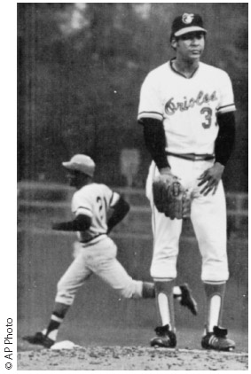
Monocular Cues – Linear Perspective and Relative Size
Linear Perspective
Relative Size
Notes:
IMAGE: [Road: © Mladden Mitrinovic/Stutterstock.com] (Nevid, p. 122); Baseball players: [© AP Photo] (Bernstein, p. 112)
Perceptual Processes and Phenomena 10 of 20
Linear perspective occurs when parallel lines seem to converge in the distance.
Relative size is when we expect two objects to be the same size and they are not. In such cases, the larger of the two objects will be perceived as closer and the smaller will be perceived as farther away.

Slide 54
Monocular Cues – Interposition (overlapping)
Notes:
IMAGE: Horses: © David Stoecklein/Crisp/Corbis (Nevid, p.122)]
Perceptual Processes and Phenomena 11 of 20
Interposition comes into play when objects overlap, or when one object blocks your view of another.
The overlapping object appears closer, and the object that is covered appears farther away.

Slide 55
Monocular Cues – Light and Shadow, and Texture Gradient
Light and Shadow
Texture Gradient
Notes:
IMAGE: [Dots: © AP Images (Bernstein,Figure 4.21, p. 122) Flowers: © Francis ReRichemond/The Image Works (Nevid, p. 122)
Perceptual Processes and Phenomena 12 of 20
Light and shadow:
Brightly lit objects appear closer, while objects in shadow appear farther away.
Shadows create three-dimensional impressions of bumps on the left side of this drawing and of dents on the
right side. But if you turn the book upside down, the bumps will look like dents, and
the dents will look like bumps. This reversal in depth perception occurs partly because
people normally assume that illumination comes from above and interpret the pattern
of light and shadow accordingly (Adams, Graf, & Ernst, 2004; Cook et al., 2008).
Texture gradient:
Areas with sharp, detailed texture are interpreted as being closer, while those with less sharpness and poorer detail are perceived as more distant.

Slide 56
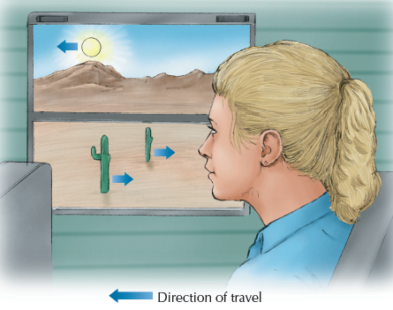
Monocular Cues – Aerial Perspective and Motion Parallax
Aerial Perspective
Motion Parallax
Notes:
IMAGE: [City: © Sylvain Grandadam/The Image Bank/Getty Images (Pastorino, Table 3.2, p. 115); Moving Train: © Cengage Learning (Coon, Figure 20.16, p. 172)]
Perceptual Processes and Phenomena 13 of 20
Aerial perspective, also known as relative clarity: Created by the presence of dust, smog, clouds, or water vapor. We perceive clearer objects as being nearer and hazy or cloudy objects as farther away.
Motion parallax: Based on the speed of moving objects. We perceive objects that are moving at high speeds to be closer than objects moving more slowly or appearing stationary.

Slide 57
Binocular Cues – Convergence
The degree to which the eyes turn in to focus on a close object
Notes:
IMAGE: [© Susan Van Edit/Photoedit (Nevid, Figure 3.24, p. 121)
Perceptual Processes and Phenomena 14 of 20
Convergence is based on signals sent from muscles that turn the eyes.
To focus on objects that are near or approaching, these muscles turn the eyes inward, toward the nose.
The brain uses the signals sent by these muscles to determine the distance of the object.

Slide 58
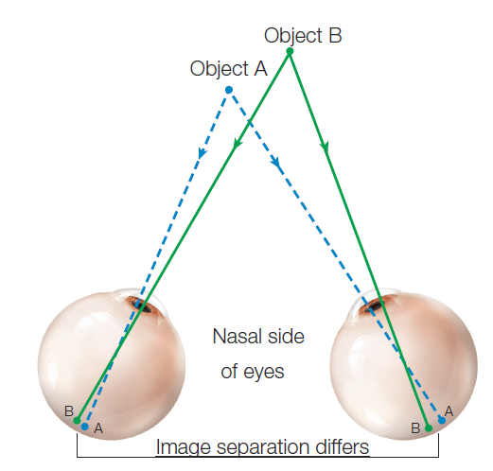
Binocular Cues – Retinal Disparity
The difference in the apparent position of an object as seen by the left and right retinas
Notes:
IMAGE: [© Argosy Publishing, Inc.] (Cacioppo, Figure 5.27, p. 168)
Perceptual Processes and Phenomena 15 of 20
Because of their different positions, each eye receives a slightly different image.
The difference between those images is the retinal disparity.
The brain combines those images to form a single perception, but interprets a large disparity as a close object and a small disparity as a distant object.

Slide 59
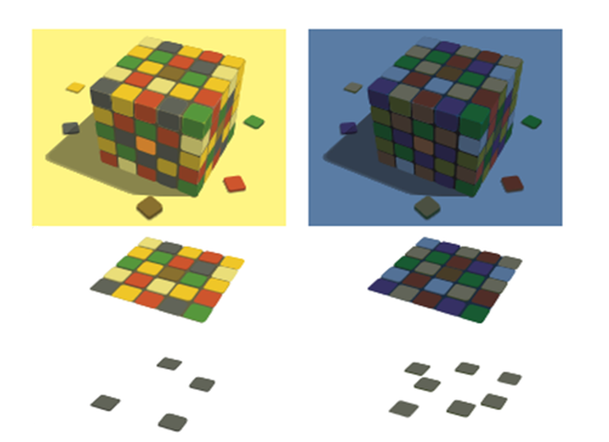
Perceptual Constancies
The tendency to perceive objects as the same even when their physical characteristics change
  Size
  Shape
  Brightness
  Color
Notes:
IMAGE: [© 2003​ Sinauer​ Associates,​Inc.​] (Kalat, Figure 5.13, p. 157)
Perceptual Processes and Phenomena 16 of 20
In this image, when ​the ​block​ is ​under ​yellow ​light ​(left)​ or ​blue ​light ​(right),​ you​ still​ recognize​ the​ colors ​of ​individual​ squares. ​The​“blue”​squares ​in​ the​ left ​half ​and ​the​“yellow”​ squares ​in ​the ​right​ half​ are ​actually ​grayish.​
Perceptual constancy refers to our tendency to perceive sizes, shapes, brightness, and colors as remaining the same even though their physical characteristics are constantly changing.
It is a form of top-down processing that helps maintain order in your world.
Size constancy refers to our tendency to perceive objects as remaining the same size even when their images on the retina continually grow or shrink.
Shape constancy refers to your tendency to perceive an object as retaining its same shape even though when you view it from different angles, its shape is continually changing its image on your retina. When you move a book, the shape projected on your retina may change from rectangular to trapezoidal, yet your perception of the book doesn’t change.
If you look into a dimly lit closet, all the brightly colored clothes will appear dull and grayish. Because of brightness and color constancy, you can still form relatively accurate perception of the clothes and won’t have too much trouble selecting a red shirt. Brightness constancy refers to the tendency to perceive brightness as remaining the same in changing illumination. Color constancy refers to the tendency to perceive colors as remaining stable despite differences in lighting.

Slide 60
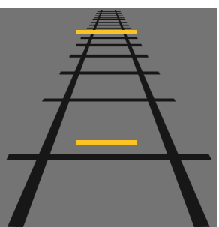
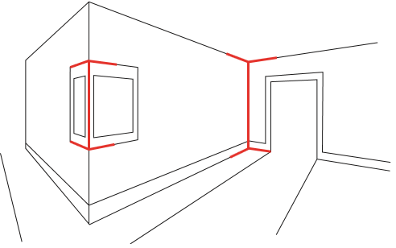
Visual Illusions – Müller-Lyer and Ponzo
Müller-Lyer
Ponzo
Notes:
IMAGE: [© Cengage Learning 2013] (Cacioppo, Figures 5.25 and 5.26, pp. 167 and 168)
Perceptual Processes and Phenomena 17 of 20
An illusion is a perceptual experience in which you perceive an image as being so strangely distorted that, in reality, it cannot and does not exist.
An illusion is created by manipulating the perceptual cues so that your brain can no longer correctly interpret space, size, and depth cues.
In the Müller-Lyer illusion, the arrow on the left appears shorter than the arrow on the right. One explanation for this illusion is that you are relying on size cues learned from your previous experience with corners. If a corner of a room extends outward, it is closer; this experience distorts your perception so that the left arrow appears to be shorter. In contrast, you have learned that if a corner of a room recedes inward, it is farther away, and this experience makes you perceive the right arrow as longer.
In the Ponzo illusion, you perceive the top bar as being farther away, and you have learned from experience that if two objects appear to be the same size but one is farther away, the more distant object.

Slide 61

Visual Illusions – The Ames Room
Ames room
Notes:
IMAGE: [© Field Museum Library/Getty Images] (Cacioppo, Figure 5.24, p. 166)
Perceptual Processes and Phenomena 18 of 20
The Ames room works because it is shaped in an odd way: The left corner is twice as far away from the peephole as the right corner. The grown woman is actually twice as far away from you as the boy. However, the Ames room’s odd shape makes you think that you are seeing the two people from the same distance.

Slide 62
Extrasensory Perception
Telepathy
Precognition
Clairvoyance
Psychokinesis
Notes:
IMAGE: [© PM Images/Getty Images] (Pastorino, p. 88)
Perceptual Processes and Phenomena 19 of 20
Extrasensory perception (ESP) is a group of psychic experiences that involve perceiving or sending information (images) outside normal sensory processes or channels.
Often, it is thought to consist of four general abilities:
Telepathy: the ability to transfer one’s thoughts to another or to read the thoughts of another
Precognition: the ability to foretell events
Clairvoyance: the ability to perceive objects or events that are out of sight
Psychokinesis: the ability to move objects without touching them
According to James Randi and others acquainted with magic, much of what passes for extrasensory perception is actually done through trickery.
Many people who claim to have psychic powers cannot demonstrate such powers under controlled conditions, which eliminate trickery, magic, and educated guessing.
The most popular form of testing telepathic ability is the Ganzfeld procedure.
In this method, one person (the receiver) is placed in a reclining chair in a soundproof room. Translucent ping-pong ball halves are taped over the eyes, and headphones are placed over the ears. The sender, who is isolated in a separate soundproof room, concentrates for some period of time on a target, which is a randomly selected visual stimulus. At the end of this period, the receiver is shown four different stimuli and asked which one most closely matches what the receiver was imagining. Because there are four stimuli, the receiver will guess the target correctly 25% of the time. If the receiver correctly identifies the target more than 25% of the time, it is above chance level and indicates something else may be occurring, perhaps extrasensory perception.

Slide 63

Perception Is Subjective
Notes:
IMAGE: [© Rob Crandall/The Image Works] (Pastorino, p. 120)
Perceptual Processes and Phenomena 20 of 20
Given that culture and environment inﬂuence many of our beliefs and expectations, it stands to reason that culture and environment also affect perception. The Müller-Lyer illusion is a good example of this type of inﬂuence.
People who grow up in noncarpentered environments, where structures tend to be like this round hogan, are less likely to experience the Müller-Lyer illusion.

