Slide 1

Abnormal Behavior
This section covers:
  Definitions of abnormal behavior
  Causes and rates of disorders
  Conceptualizing the causes of disorders
Notes:
IMAGE: [© Maksim Shmeljov/Shutterstock.com] (Sue, p.164)
Abnormal Behavior 1 of 8
How do you know if a behavior is abnormal? How do you know if a behavior indicates a person has some sort of psychological disorder?
This section covers:
The definitions of abnormal behavior
Rates of disorders
Conceptualizing the causes of disorders

Slide 2
What is Abnormal Behavior?
Some definitions
  Not culturally accepted
  Statistically uncommon
  Causes distress
  Causes dysfunction
Notes:
IMAGE [Illustration: © AP Images/James A. Finley] (Sue, p. 10)
Abnormal Behavior 2 of 8
By most people’s standards, the full-body tattoos of the three men in the photo above would be considered unusual. Yet these three men openly and proudly display their body art at the National Tattoo Association Convention. Such individuals may be very “normal” and functional in their work and personal lives. This leads to an important question: What constitutes abnormal behavior, and how do we recognize it?
Some may view abnormal behavior from a statistical perspective. The word abnormal literally means “away from the rule.” But statistics alone do not capture what we mean by abnormal behavior.
When behavior violates social and cultural norms of how people are supposed to behave it may be considered abnormal.
However, it is extremely important to emphasize that social norms vary widely across cultures, within cultures, and across historical times.
For example, changing views on homosexuality in part influenced the American Psychiatric Association to remove homosexuality from its list of mental health disorders in 1973.
Because social norms vary so widely, judging the abnormality of behavior on this aspect alone is especially problematic.
If we judge normal as what most people do, then engaging in a behavior less or more frequently than others would be atypical.
Persons with autism engage in social communication far less than most people.
As such, their behavior may be considered abnormal.
A mental health disorder causes great personal distress to the individual or those around him or her.
Often people seek treatment when a behavior causes such emotional or physical pain.
Alternatively, a person with a mental health disorder may cause distress in others through chronic lying or violence.
In defining abnormality, psychologists consider whether a behavior interferes with a person’s ability to function or causes dysfunction.
Can the person hold a job, go to school, or form close relationships?
The more difficulty a person has in functioning in everyday life, the more likely his or her behavior is considered to be abnormal.
Mental health experts define a psychological disorder as “a clinically significant behavioral or psychological syndrome or pattern that occurs in an individual and that is associated with present distress (e.g., a painful symptom) or disability (i.e., impairment in one or more important areas of functioning) or with a significantly increased risk of suffering death, pain, disability, or an important loss of freedom”

Slide 3
The Diagnostic and Statistical Manual
DSM-5: published in 2013
  Lists 20 categories of disorders
  Covers more then 300 disorders
  Takes an atheoretical approach
  Continues to show improved reliability and validity over time
Note that having standards does not guarantee a correct diagnosis
Notes:
Abnormal Behavior 3 of 8
In 1952, the American Psychiatric Association (APA) published a book listing the symptoms that must be shown in order for a person to be diagnosed with a specific mental health disorder.
More than 60 years later, the Diagnostic and Statistical Manual of Mental Disorders (DSM) is in its fifth edition (2013).
This most recent edition, known as the DSM5, includes 20 major categories of mental health disorders.
Criteria require that the symptoms interfere with the person’s ability to function, adopting the definition of abnormality that we discussed at the start of this chapter and that is accepted by many professionals today.
However, the current version of the DSM does not speculate as to the causes of the individual’s behavior—it is atheoretical.
This atheoretical position underscores the complex biopsychosocial nature of the causes of mental illness.
The numerous revisions of the DSM have attempted to improve its reliability and validity based on sound scientific data.
As a result, the reliability and validity for many of the diagnostic categories have improved
However, the reliability of the personality disorders is considered low, calling into question the validity of diagnosing personality disorders.
The reliability and validity of the changes incorporated into the DSM-5 diagnoses have yet to be determined.
Having a standard system such as the DSM does not guarantee an accurate diagnosis.
Making diagnostic judgments will always involve some subjectivity and personal bias on the part of the clinician, as people’s symptoms often do not fit neatly into one category. Moreover, certain symptoms may be listed as a part of several disorders.
As a result, sometimes people meet the criteria for more than one disorder, and can be diagnosed with both, a situation called comorbidity.
Biases having to do with gender, race, or culture—whether conscious or unconscious—can also skew a diagnosis
Critics of the DSM model also point out the possible negative effects of labeling someone with a mental health disorder.
A diagnostic label may serve as a self-fulfilling prophecy, encouraging a person to behave in a way that is consistent with the disorder.

Slide 4
Overall Rates of Disorders
Notes:
IMAGE: [© Source: National Comorbidity Survey Replication data, Table 1. Updated 2007. http://www.hcp.med.harvard.edu/ncs]
Abnormal Behavior 4 of 8
In 2010, there were an estimated 20% of Americans 18 and older with a mental health disorder in the past year.
Lifetime prevalence estimates are quite a bit higher, with more than half of U.S. adults meeting the criteria for a mental health disorder at some time in their lives
And yet, this may be a conservative estimate as many people who have difficulty functioning may not want or have access to mental health services.
Mental health disorders are the leading cause of disability in the United States and Canada for people between the ages of 15 and 44
Although there is little overall gender difference in the lifetime risk of a mental health disorder, adult females were more likely than adult males to have both any mental health disorder (23% vs. 16.8%) and a serious mental health disorder (6.5% vs. 3.4%) in the last year
Moreover, males and females do show differences in the types of mental health disorders they are more likely to experience
Rates of mental illness also have risen dramatically in the last 10–15 years among high school and college students
College mental health counseling is on the rise, and suicide is the third leading cause of death among those aged 15–24
Self-rated emotional health for first-year college students is at its lowest level since it was first assessed 25 years ago
Data from national surveys indicate that 22% of U.S. teens were likely to experience a mental health disorder with severe impairment or distress at some time in their lives
Does this mean that our society today is more likely to be psychologically distressed? Not necessarily.
Over the past several decades, much has changed in our understanding and assessment of mental health.
Public awareness of mental health disorders has increased, and methods for assessing mental illness have improved dramatically.
Mental health services are more open to people, and the stigma surrounding mental illness is less today than it was in previous decades, so that people may be less reluctant to seek treatment.
Consequently, it is likely that you or someone close to you will at some time experience a mental health disorder.

Slide 5
Rates of Disorders in Men and Women
Notes:
IMAGE: [© Source: National Comorbidity Survey Replication data, Table 1. Updated 2007. http://www.hcp.med.harvard.edu/ncs]
Abnormal Behavior 5 of 8
Although there is little overall gender difference in the lifetime risk of a mental health disorder, adult females were more likely than adult males to have both any mental health disorder (23% vs. 16.8%) and a serious mental health disorder (6.5% vs. 3.4%) in the last year
Moreover, males and females do show differences in the types of mental health disorders they are more likely to experience.
Females often have higher levels of mood and anxiety disorders.
Males, on the other hand, show higher levels of certain personality disorders and substance-use disorders.

Slide 6

Perspectives on the Causes of Disorders
Biological
Psychological
Sociocultural
Biopsychosocial
Notes:
IMAGE: [© Owen Franken/Encyclopedia/Corbis] (Pastorino, p.548): Poverty and adverse environments are important sociocultural factors that must be looked at when evaluating abnormal behavior.
Abnormal Behavior 6 of 8
Biological theories attribute abnormal behavior to some physical process: genetics, an imbalance in hormones or neurotransmitters, or some brain or bodily dysfunction.
The biological perspective is also known as the medical model because mental health disorders are viewed as similar to physical diseases.
As such, they can be diagnosed, treated, or cured in much the same way as other physical illnesses, including by prescribing medications or through surgery.
Psychological theories attribute abnormal behavior to internal or external factors.
The psychoanalytic perspective. This perspective attributes abnormal behavior to unresolved unconscious conflicts.
According to Freud, mental health disorders result from the conflict between the unconscious sexual and aggressive instinctual desires of the id and the outward demands of society.
Newer theories, referred to as psychodynamic theories and developed by Freud’s followers such as Alfred Adler and Karen Horney, downplay the role of sexual and aggressive instincts and instead emphasize the role of the ego and interpersonal relationships in maintaining or restoring mental health.
The social learning perspective. Learning theorists (particularly B. F. Skinner and his successors) explain abnormal behavior as a result of the same learning processes that produce normal behavior—classical conditioning, operant conditioning, and social learning.
A person’s responses to stimuli in the environment and the consequences of these behaviors are what lead to abnormal behavior. A person’s past learning and modeling along with current experiences can explain mental health disorders.
The cognitive perspective. This perspective emphasizes the role of thoughts, expectations, assumptions, and other mental processes in abnormal behavior.
Think about the little voice inside you that comments on your behavior.
Does it encourage you to do well, or does it criticize you for your stupidity?
Is it possible that such internal messages influence your behavior?
The cognitive perspective maintains that they do.
The humanistic perspective. Humanists like Carl Rogers see abnormal behavior as resulting from a distorted perception of the self and reality.
When people lose touch with their personal values and their sense of self, or when they fail to fulfill their basic biological and psychological needs, they cannot attain self- actualization.
Instead, they experience personal distress and are more likely to engage in maladaptive behavior.
Sociocultural theories emphasize social or cultural factors that may play a role in mental health.
Such a perspective argues that internal biological and psychological processes can be understood only in the context of the larger society and culture that shape and influence people’s behavior.
Abnormal behavior, therefore, can be fully understood only when social factors such as age, race, gender, social roles, and socioeconomic status are taken into account.
In addition, social conditions such as poverty, discrimination, and environmental stressors must be looked at when evaluating abnormal behavior
Biopsychosocial perspective. Despite decades of research, no single theory or perspective is correct.
It is only by integrating all the perspectives that our explanations of abnormality become comprehensive.
We often hear in the popular press and in television commercials that a mental health disorder such as depression or anxiety is caused by “a specific gene” or “a chemical imbalance.”
But such reports are too simplistic to explain the complexity of mental illness.
Most mental health disorders result from a combination of biological, psychological, and social factors (hence the name of the biopsychosocial model); they do not have just one cause.
For example, people diagnosed with major depressive disorder often show changes in brain chemistry—a biological factor.
They also are likely to engage in a negative pattern of thinking, a psychological factor.
In addition, major depression is more likely to be diagnosed in women—a sociocultural factor.
Current research in psychology focuses on understanding how these forces operate together, much as the pieces of a jigsaw puzzle fit together.

Slide 7
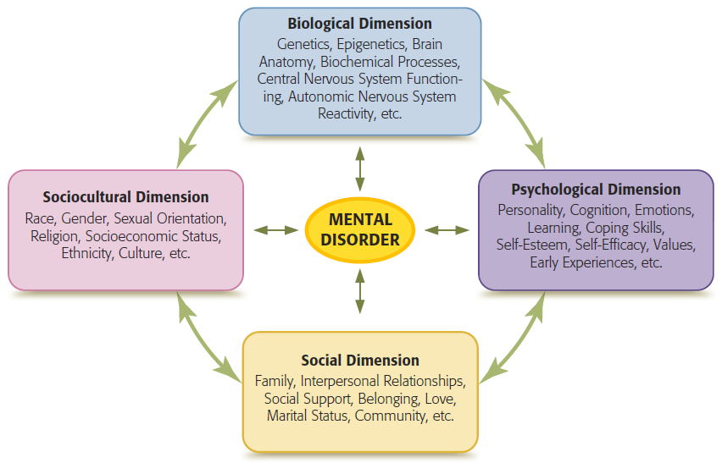
A Multipath Approach
Notes:
IMAGE [© Cengage Learning] (Sue, Figure 2.1, p. 36): The Multipath Model (Sue, Abnormal Psychology)
Abnormal Behavior 7 of 8
The multipath model is not a theory but a way of looking at the variety and complexity of contributors to mental disorders. In some respects it is a metamodel, a model of models that provides an organizational framework for understanding the numerous factors that increase risk for the development of mental disorders, the complexity of potential interactions among factors, and the need to view disorders from a holistic framework.
Each dimension of the multipath model contains factors found to be important in explaining mental disorders. Reciprocal interactions involving factors within and between any of these dimensions can also influence the development of mental disorders.

Slide 8
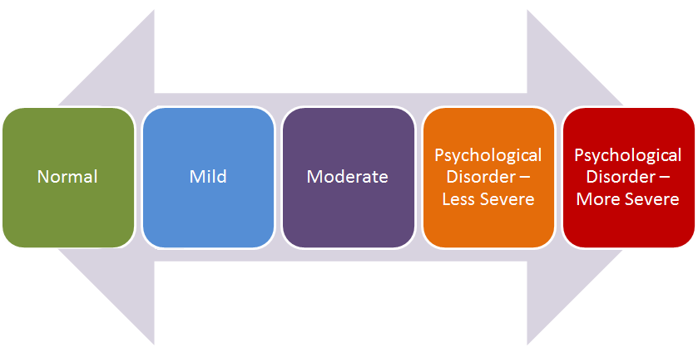
Experiencing Psychology:
Understanding Normal and Abnormal Behavior
Behavior may be viewed on a continuum from normal to psychological disorder
Notes:
IMAGE: Adapted from Kearney and Trull (2012)
Abnormal Behavior 8 of 8
Psychological disorders can be understood both categorically, which means that they each have their own set of distinct characteristics used for diagnosis, and as part of a continuum from normal behavior to severely disordered behavior.
Consider the following:
Normal
Emotions: Good alertness and positive emotional state.
Cognitions: “I’m not getting the grades I want this semester, but I’ll keep trying to do my best.”
Behavior: Going to classes and studying for the next round of tests. Talking to professors.
Mild
Emotions: Feeling sad or down temporarily, but not for long.
Cognitions: “I’m struggling at school this semester. I wish I could study better, or I’ll fail.”
Behavior: Going to classes with some trouble studying. Less contact with others.
Moderate
Emotions: Feeling sad, but a strong positive experience such as a good grade could lift mood.
Cognitions: “These bad grades really hurt. This may set me back for a while. I’m really worried.”
Behavior: Skipping a few classes and feeling somewhat unmotivated to study. Avoiding contact with professors and classmates.
Psychological disorder – less severe
Emotions: Intense sadness most of the day with some trouble concentrating and some loss of appetite
Cognitions: “I’m so worried about these grades that my stomach hurts. I don’t know what to do.”
Behavior: Skipping most classes and unable to maintain eye contact with others. Strong lack of motivation.
Psychological disorder – more severe
Emotions: Extreme sadness all of the time with great trouble concentrating and complete loss of appetite.
Cognitions: “These bad grades just show what a failure I am at everything. There’s no hope; I’m not doing anything today.”
Behavior: Unable to get out of bed, eat, or leave the house. Lack of energy and frequent crying.

Slide 9

Anxiety Disorders, Trauma Disorders, and Obsessive-Compulsive and Related Disorders
This section covers:
  Generalized anxiety disorder
  Panic disorder and agoraphobia
  Specific phobias and social anxiety disorder
  Obsessive-compulsive disorder
  Hoarding disorder
  Post-traumatic stress disorder
Notes:
IMAGE: [© Image Source/Getty Images] (Cacioppo, p. 561)
Anxiety Disorders, Trauma Disorders, and Obsessive-Compulsive and Related Disorders 1 of 8
This section covers:
Generalized anxiety disorder
Panic disorder and agoraphobia
Specific phobias
Obsessive-compulsive disorder
Post traumatic stress disorder
Typically, excessive anxiety can be characterized by four components: physical, cognitive, emotional, and behavioral.
These components interact powerfully, creating an unpleasant experience of fear or dread, although there may not be a specific fear-producing stimulus present.
The physical components of anxiety include dizziness, elevated heart rate and blood pressure, muscle tension, sweating palms, and dry mouth.
These physical symptoms stem from the activation of the sympathetic nervous system.
The hormonal system is also activated as adrenalin is released into the bloodstream.
This process is referred to as the fight-or-flight response.
This fight-or-flight response occurs every time we perceive a threat in our environment.
People with excessive anxiety have concerns that are unrealistic and out of proportion to the amount of harm that could occur.
Cognitive components of anxiety may include worrying, fearing loss of control, exaggerating (in one’s mind) the danger of a situation, exhibiting paranoia, or being extremely wary and watchful of people and events.
These thoughts may lead to emotional reactions such as a sense of dread, terror, panic, irritability, or restlessness.
These thoughts and emotions propel the person to behave in ways meant to cope with the anxiety.
Coping with abnormal anxiety may include behaviors such as escaping or fleeing from the situation; behaving aggressively; “freezing,” which results in being unable to move; or avoiding the situation in the future.
These symptoms are so intense that they disrupt the quality of the person’s life and cause significant distress.

Slide 10
Prevalence of Anxiety Disorders
Notes:
IMAGE: [© Source: National Comorbidity Survey Replication data, Table 2. Updated 2007. http://www.hcp.med.harvard.edu/ncs
Anxiety, Trauma, Obsessive-Compulsive, and Related Disorders 2 of 8
Prevalence of Anxiety, Trauma-, Obsessive-Compulsive and Related Disorders in a Given Year
Approximately 19% of Americans over 18 years of age are diagnosed with an anxiety disorder in a given year
Women have consistently higher rates of anxiety disorders than do men
African Americans have a lower lifetime risk of anxiety disorders than European Americans and Hispanic Americans
Anxiety disorders typically begin in childhood or adolescence and are highly comorbid, meaning that the anxiety disorder occurs along with another mental health disorder
There are three main DSM 5 categories of disorders characterized by excessive anxiety: anxiety disorders, trauma-related disorders, and obsessive-compulsive and related disorders.
The anxiety disorders include generalized anxiety disorder, panic disorder, agoraphobia, specific phobia, and social anxiety disorder.
The obsessive-compulsive and related disorders include obsessive-compulsive disorder and hoarding disorder.
Posttraumatic stress disorder is a trauma-related disorder.

Slide 11

Generalized Anxiety Disorder
Excessive worry about a number of events, often with no identifiable cause
Lasts for at least 6 months
Notes:
IMAGE: [© Photo_Concepts/iStockphoto] (Plotnik, p. 566)
Anxiety, Trauma, Obsessive-Compulsive, and Related Disorders 3 of 8
Some people are anxious all the time in almost all situations.
These individuals may be diagnosed with generalized anxiety disorder (GAD).
Symptoms of GAD include excessive anxiety, worry, and difficulty in controlling such worries.
The person may be easily fatigued, restless, and irritable, and may experience difficulty concentrating or sleeping.
People with GAD chronically worry not only about major issues, such as which car or house to buy, their children’s health, or their job performance, but also about minor issues such as being late, wearing the right outfit, or what to make for dinner.
It is estimated that about 3% of American adults experience GAD in any given year with about 6% meeting the criteria for the disorder some time in their lives.
European Americans are at higher risk of GAD than African Americans and Hispanic Americans
In the U.S., females comprise roughly 2/3 of patients with GAD.
These rates can vary, however, in other countries.

Slide 12

Panic Disorder and Agoraphobia
Characterized by recurrent abrupt experiences of unexpected intense fear accompanied by physical symptoms
Notes:
IMAGE: [© Terry Vine/Blend Images/Alamay] (Barlow, p. 114)
Anxiety, Trauma, Obsessive-Compulsive, and Related Disorders 4 of 8
Imagine that you are attending a party given by a good friend. When you arrive at the party, a feeling of panic suddenly overwhelms you. Your heart begins to pound, you hear ringing in your ears, your skin feels tingly and numb, and it becomes harder and harder to breathe.
These are common symptoms that occur during a panic attack, a short but intense episode of severe anxiety.
As many as 30% of adults in the United States report occasional panic attacks that do not interfere with their daily functioning.
However, when panic attacks are more common, and a person begins to fear having panic attacks to the extent that it interferes with the ability to function, a diagnosis of panic disorder may be given.
It is estimated that between 1.5% and 5% of people will develop panic disorder at some time in their lives.
It typically develops in late adolescence or early adulthood and is twice as common in women as in men.
European Americans and Native Americans tend to have a higher prevalence rate of panic disorder than do African Americans, Asian Americans, and Hispanic Americans
People with panic disorder often feel so overwhelmed by the feelings of panic that they think they are having a heart attack or a seizure.
They may believe that they are “going crazy” or going to die, and many seek medical attention to find out what is wrong with them.
The panic attacks may occur frequently or only sporadically.
Most people with panic disorder cannot identify any specific thing that might have triggered the attack.
However, when a panic attack occurs, the same situation may then trigger a future attack.
Fear of having another panic attack may lead to agoraphobia, or fear of being in places from which escape may be difficult or where help may not be available if one were to experience panic.
People affected with agoraphobia avoid any place—the mall, the grocery store, or the movie theater—in which they believe a panic attack may occur.
Such fears can leave people housebound for years.
At least 75% of those who are diagnosed with agoraphobia are women

Slide 13
Specific Phobias and Social Anxiety Disorder
Persistent fear that is excessive and unreasonable
Lasts for 6 months or more
Notes:
Anxiety, Trauma, Obsessive-Compulsive, and Related Disorders 5 of 8
Prevalence of Different Types of Specific Phobias. In a large random sample of adults, 21.2% of women and 10.9% of men reported having at least one phobia, as defined by the DSM. Gender differences were seen in the prevalence of situational phobias (lightning, enclosed spaces, darkness, flying, and heights) and animal phobias (primarily spiders and snakes). However, no gender differences occurred in injury phobias (injections, dentists, injuries). More than one type of specific phobia was reported by 5.4% of the women and 1.5% of the men. Source: Adapted from Fredrikson, Annas, Fischer, and Wik (1996).
Specific phobias involve a persistent fear and avoidance of a specific object or situation—animals, heights, bridges—or other specific stimuli.
They are one of the most common disorders worldwide, affecting approximately 9% of American adults, 4% of the general population in Mexico, 2.7% in Japan, and 7.7% across several European countries.
Specific phobias typically begin in childhood.
Social anxiety disorder (social phobia) includes an irrational, persistent fear of being negatively evaluated by others in a social situation.
A person with social anxiety disorder may have an extreme fear of rejection, embarrassment, or humiliation.
This disorder may include fear of public speaking, fear of eating or undressing in front of others, or fear of meeting new people.
The person endures intense anxiety or avoids these social situations such that his or her functioning is impaired.
It is estimated that 12% of American adults will experience social anxiety disorder at some time in their lives.
Social anxiety disorder tends to develop in the early preschool years and in adolescence, and it is somewhat more likely to develop in women than in men.
African Americans and Hispanic Americans tend to have a lower lifetime risk of social anxiety disorder than do European Americans.

Slide 14

Post-Traumatic Stress Disorder
Results from exposure to a traumatic event during which one feels helplessness or fear
Notes:
IMAGE: [© Mike Goldwater/Photonica World/Getty Images] (Pastorino, p. 558)
Anxiety, Trauma, Obsessive-Compulsive, and Related Disorders 6 of 8
Excessive anxiety can also develop following a traumatic event as in the case of posttraumatic stress disorder (PTSD).
PTSD develops after exposure to a terrifying event or ordeal in which grave physical harm occurred or was threatened.
Traumatic events may include the following:
Violent personal assaults such as rape, physical abuse, or sexual abuse
Natural or human-caused disasters such as an earthquake, a hurricane, a terrorist attack, or an outbreak of an infectious disease
Military combat
Events that anyone might experience—the sudden, unexpected death of a loved one or witnessing a violent crime or a deadly traffic accident
A diagnosis of PTSD requires that the person repeatedly reexperience the ordeal in the form of distressing memories, nightmares, frightening thoughts, or flashback episodes, especially when exposed to situations that are similar to the original trauma.
At the same time they persistently avoid situations, thoughts, or memories that are associated with the trauma.
In addition, people diagnosed with PTSD may experience emotional numbness or withdrawal from themselves or others such that they lose interest in usual activities or are regarded as distant and emotionally unavailable.
Finally, people with PTSD are always on guard and alert to any real or imagined potential threats in their environments—showing hypervigilance, having difficulty concentrating, or having difficulty sleeping.
Approximately 3.5% of U.S. adults are diagnosed with PTSD in a given year.
In the United States, the rates are higher among African Americans than among Hispanic Americans, Asian Americans, and European Americans.
More than twice as many females as males experience PTSD following exposure to a trauma, typically sexual assault.
Women’s higher PTSD risk has been attributed to a number of variables that reinforce the biopsychosocial perspective on mental health disorders.
For example, sex differences in the responses of the amygdala, the brain structure that mediates fear, have been documented.
Moreover, women are more likely to perceive threat and loss of control than men—psychological factors that may influence the risk of PTSD .
Women are more likely to be victims of sexual abuse and experience these traumas at younger ages than men—social factors that also play a role in PTSD
Soldiers (male or female) are also at high risk for developing PTSD, as military conflict is a source of trauma.
About 19% of Vietnam veterans developed PTSD at some point after the war.
The disorder has also been reported among Persian Gulf War veterans, with estimates running as high as 8%.
After two decades of conflict in Afghanistan, 42% of Afghan participants in a national population-based survey reported PTSD symptoms.
Studies of U.S. military personnel in Iraq and Afghanistan also indicate problems in mental health, most notably PTSD.

Slide 15

Obsessive-Compulsive Disorder
The presence of recurrent, persistent, intrusive thoughts or images (obsessions), and/or repetitive behaviors or mental acts that a person feels driven to perform (compulsions)
Notes:
IMAGE: [© Randal Pfizenmaier/Alamy] (Cacioppo, p. 565)
Anxiety, Trauma, Obsessive-Compulsive, and Related Disorders 7 of 8
Obsessions are recurrent thoughts or images that intrude on a person’s consciousness or awareness.
Compulsions are repetitive behaviors that a person feels a strong urge to perform.
These actions often help reduce feelings of anxiety and distress.
Obsessive-compulsive disorder is a disorder in which a person experiences recurrent obsessions or compulsions or both that he or she feels cannot be controlled.
Obsessions often center on dirt and contamination, doing harm to oneself or others, sexual thoughts, or repeated doubts (such as not having locked the house).
Common compulsions include cleaning, checking, counting things, or arranging and straightening things in a particular fashion.
The compulsions are often performed with the hope of preventing the obsessive thoughts or making them go away.
However, performing these “rituals” provides only temporary relief. Not performing the rituals increases the person’s anxiety.
Recurrent obsessions cause great personal distress, and compulsions can be time-consuming and in some cases harmful—as when a person washes his or her hands so frequently that they bleed.
It is estimated that between 1% and 3% of individuals will develop OCD at some time in their lives; in the United States, the rates are higher among European Americans than among Hispanic Americans and African Americans
Unlike some anxiety-related disorders, OCD is found equally in males and females.

Slide 16

Hoarding Disorder
Characterized by persistent difficulty discarding possessions such that they accumulate and clutter living areas causing significant distress and impairment in functioning
Notes:
IMAGE: [© WR Publishing / Alamy] (Pastorino, p. 557)
Anxiety, Trauma, Obsessive-Compulsive, and Related Disorders 8 of 8
Hoarding disorder is related to OCD but is now considered a separate disorder in the DSM 5.
Hoarding disorder has come to the forefront of awareness in the U.S. as a result of reality television programs that highly the struggles of such individuals.
People who hoard have persistent difficulty throwing away possessions, even when the item is of very little value.
The person’s compulsion to hoard impairs their ability to function, yet having to part with or discard their possessions causes significant distress and anxiety.
As a result, the person’s living environment becomes cluttered, unusable, and in some cases even hazardous.
It is estimated that between 2% and 5% of the population engage in hoarding with nearly equal numbers of males and females.

Slide 17
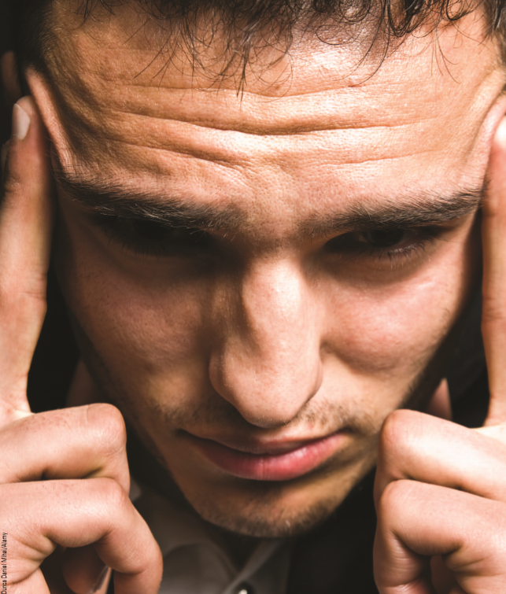
Dissociative Disorders and Somatic Symptom and Related Disorders
This section covers:
  Dissociative disorders
  Somatic symptom and relateddisorders
Notes:
IMAGE: [© Dunca Daniel Mihai/Alamay] (Barlow, p. 170)
Dissociative and Somatic Disorders 1 of 3
This section covers:
Dissociative disorders
Somatic disorders

Slide 18
Dissociative Disorders
Involve a loss of connection with some part of our consciousness, identity, or memory.
Notes:
IMAGE: [© Gordon M. Grant Photography] (Sue, p. 218)
Dissociative and Somatic Disorders 2 of 3
Judy Castelli, reported to have 44 personalities, stands beside her stained-glass artwork. The people in her art have no faces but are connected and touching each other. Castelli considers her artistic endeavors a creative outlet for her continuing struggle with dissociative identity disorder.
To dissociate means to break or pull apart. Thus, the dissociative disorders involve a loss of connection with some part of our consciousness, identity, or memory.
Mild dissociative experiences are common.
For instance, have you ever driven somewhere and on arrival did not remember driving there?
Have you ever missed a part of a conversation but can tell from the speaker’s demeanor that you appeared to have been listening the whole time?
Have you ever appeared attentive in class while you were daydreaming about your plans for the weekend?
All of these are common, everyday dissociative experiences.
Depersonalization-derealization disorder involves frequent episodes in which the person feels detached from own mental state or body that causes significant distress or impairs functioning.
In some instances, people feel as if they’re observing themselves from the outside.
Dissociative amnesia involves memory loss of important personal information, not due to substance use or brain injury that causes significant distress or impairs functioning.
It may occur with or without dissociative fugue in which person unexpectedly travels away from home with memory loss of identity or other personal information.
Dissociative identity disorder (DID), formerly called multiple personality disorder, involves the existence of two or more separate personalities in the same individual.
The separate personalities—referred to as alters (for alternate personalities)—may or may not be known to the “core,” or “host,” personality—the person who asks for treatment.
Each personality has its own perceptions, thoughts, mannerisms, speech characteristics, and gestures.
Each alter appears to have a specific function.
For example, one alter may arise to deal with romantic relationships, whereas another alter deals with academic work.
The alter personalities may be of different ages, gender, or ethnicities.
The majority of people diagnosed with DID are women.
Frequent blackouts or episodes of amnesia are common in people with dissociative identity disorder.
They may notice money missing from their bank accounts that they don’t remember spending, or find objects in their home that they do not recognize.
Self-mutilating behavior is also common in people with this disorder.
They may repeatedly burn or cut themselves and have a history of suicide attempts.
Often they have been previously diagnosed with other disorders such as major depressive disorder, PTSD, a substance-related disorder, or schizophrenia, especially if they have reported hearing voices.
One striking similarity among people with DID is their backgrounds. Almost all have reported experiencing chronic, horrific childhood physical and/or sexual abuse at the hands of family members.
Many clinicians believe that in an attempt to deal with such trauma, these people defensively dissociate, developing alter personalities that can protect them from experiencing such events in life or in memory.
People with DID also are highly susceptible to hypnosis.
Thus, the ability to dissociate may have become an effective coping mechanism early in life.
In contrast, others propose that social learning, expectancies, and sleep dysfunction account for DID.
That is, inadvertent suggestive cueing by therapists, hypnosis as a method of memory recovery, and media portrayals of the disorder lead individuals over time to assume the role of someone with DID.
Moreover, traumatic experiences disrupt the normal sleep– wake cycle and these disruptions increase one’s vulnerability to dissociative symptoms.
Explaining the occurrence of DID is highly debated.
Some psychologists even question the validity of the dissociative identity disorder.
There has been a great increase in the number of reported cases since 1980, and it is more frequently diagnosed in the United States.
Verifying the claims of amnesia and blackouts is difficult, and people with DID have often been diagnosed with other mental health disorders.
Some believe that DID may represent an extreme form of posttraumatic stress disorder.
A subset of people with PTSD do experience dissociative symptoms, especially those who have experienced repeated sexual trauma.
As such, a dissociative-PTSD subtype has been included in the DSM 5.

Slide 19
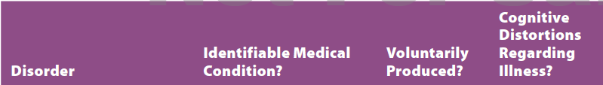
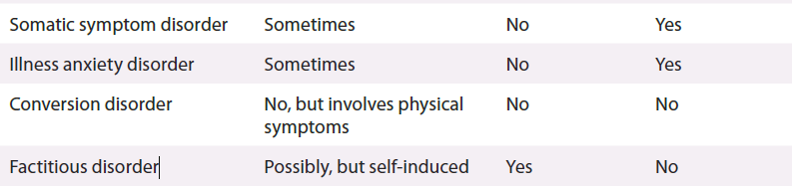
Somatic Symptom and Related Disorders
Involve physical complaints for which there is no apparent physical cause
Notes:
IMAGE: [© SPL/Science Source] (Barlow, p. 175): In illness anxiety disorder, normal experiences and sensations are often transformed into life-threatening illnesses, as depicted in this 18th century satirical artwork.
Dissociative and Somatic Disorders 3 of 3
Somatic symptom and related disorders involve physical complaints for which there is no apparent physical cause.
The physical symptoms are real to the person, but physicians can find no medical reason why the individual is experiencing such symptoms.
Somatic symptom disorder is characterized by six months of persistent physical complaints with excessive thoughts, feelings, or behaviors related to the symptoms that cause distress or disrupt one’s life.
The person has sought medical attention, but no physical cause can be found.
In illness anxiety disorder, a person believes that he or she has a serious medical illness despite evidence to the contrary. This condition was once known as hypochondriasis.
Many of us know someone who frequently complains about physical ailments.
However, people with illness anxiety disorder are convinced that they have a serious illness, not just one or two specific symptoms.
People with illness anxiety disorder may undergo extensive medical testing by several doctors to confirm the existence of their illness.
When a doctor suggests that they may have a mental health problem, people with illness anxiety disorder are likely to seek out another physician rather than seek mental health counseling.
Alternatively, others with the disorder may believe they have a serious illness but refuse to seek medical attention.
People with illness anxiety disorder often have a family history of depression or anxiety, leading some researchers to speculate that this disorder is an intense form of health anxiety related to panic disorder and obsessive-compulsive disorder.
Illness anxiety disorder has an estimated prevalence between 1% and 5% in the general population.
In conversion disorder, there is loss of functioning in some part of the body, but no physical cause can be found; causes significant distress or impaired functioning.
In some cases, distinguishing between someone with conversion disorder and someone who is malingering (faking or prolonging symptoms) can be difficult.
In factitious disorder, a person either fakes having physical symptoms or voluntarily inflicts some type of harm on themselves.
Often, this is done as an attempt to garner attention or play a sick role.
Sometimes, a person will inflict harm upon someone else, such as his or her child. This is known as factitious disorder imposed upon another (formerly known as Munchausen syndrome by proxy).
Again, the primary motivation is to gain attention and sympathy from others.

Slide 20

Mood Disorders
This section covers:
  Depressive disorders
  Bipolar disorders
  Explaining mood disorders
  Suicide
Notes:
IMAGE: [© Kelly Redinger/Design Pics/Corbis] (Plotnik, p. 555)
Mood Disorders 1 of 6
This section covers:
Depressive disorders
Bipolar disorders
Explaining mood disorders
Suicide
Mood disorders involve a significant change in a person’s emotional state.
This change may include feeling depressed or extremely elated for an extended time.
Following anxiety disorders, mood disorders are one of the more common mental health disorders, affecting approximately 9.5% of adult Americans in a given year.

Slide 21

Depressive Disorders
May involve depressed mood or loss of interest or pleasure in one’s usual activities; changes in sleep patterns, appetite, and motor functioning; and loss of energy
Notes:
IMAGE: [© martin-dm/Getty Images] (Pastorino, p. 566): Major depressive disorder is marked by physical, behavioral, and cognitive symptoms, in addition to depressed mood.
Mood Disorders 2 of 6
A diagnosis of major depressive disorder requires that a person experience either depressed mood or loss of interest or pleasure in one’s usual activities plus at least four other symptoms of depression for a period of at least 2 weeks.
These symptoms must be severe enough that they interfere with the person’s ability to function but not be due to a general medical condition or the effects of a substance (drug abuse or medication).
The other symptoms of depression may include these:
Physical and Behavioral Symptoms
Change in sleep patterns—either sleeping too much (hypersomnia) or too little (insomnia)
Change in appetite—either eating too much (resulting in weight gain) or too little (resulting in weight loss)
Change in motor functioning—either moving slowly and sluggishly or appearing agitated in movement
Fatigue, or loss of energy
Cognitive Symptoms
Inability to concentrate or difficulty in making decisions
Exaggerated feelings of worthlessness or guilt
Thoughts of suicide
Major depressive disorder may occur as a single episode or as repeated episodes over the course of years.
Some episodes may be so severe that the person requires hospitalization, especially in the presence of frequent suicide attempts or delusions (believing something that is not true) and hallucinations (perceiving things that are not there).
Persistent depressive disorder or dysthymic disorder is a less severe but more chronic form of major depressive disorder.
The person seems sad and downcast over a longer time.
A diagnosis of persistent depressive disorder requires the symptom of depressed mood plus at least two other symptoms of depression for a period of at least 2 years.
Persistent depressive disorder generally begins in childhood, adolescence, or early adulthood.
Typically, the symptoms of persistent depressive disorder are not severe enough to require hospitalization. However, most people with persistent depressive disorder eventually experience a major depressive episode
Worldwide, depression is projected as the single most burdensome disease in terms of disability by 2030.
In the United States, 17% of adults will experience an acute episode of depression at some time in their lives, and 6% will experience more chronic depression
Depression also appears to be related to age and gender. Although major depressive disorder can develop at any age, the majority of people who experience a major depressive episode do so by early adulthood
People between 15 and 24 years of age are at high risk for experiencing a major depressive episode, whereas 45- to 54-year-olds experience the lowest rates of major depressive episodes
Women are twice as likely as men to experience both mild and more severe depression, a difference found in many different countries, ethnic groups, and across adolescent and adult age groups
Although African Americans and Hispanic Americans have a lower lifetime risk for a major depressive disorder, when they do experience one, it tends to be more chronic and severe.
Hispanics in the United States do show a higher prevalence of depression in the previous year than non-Hispanic people
Unfortunately, many people with depression never receive treatment.
In one study, only 51% of participants who met the criteria for major depressive disorder during the prior year received some type of treatment for it. African Americans and Mexican Americans were least likely to receive any care.

Slide 22
Bipolar Disorders
Involve shifts in mood between two states: depressed and manic
Notes:
IMAGE: [© 13/picturegarden/Ocean/Corbis] (Sue, p. 230): Individuals with bipolar disorder may talk excessively during hypomanic or manic episodes; in contrast, they
may withdraw from social interactions when experiencing depression.
Mood Disorders 3 of 6
Bipolar disorder involves a shift in mood between two states, or poles.
One of these shifts is to a depressed state, with symptoms similar to those of major depressive disorder.
The person feels sad, lacks self-worth, and may show changes in sleeping and eating over a 2-week period.
In Bipolar I disorder, the second mood change is to the opposite extreme—to a “high” or euphoric state, called mania.
During a manic state, people feel elated and have high self-esteem, have a decreased need for sleep, are more talkative than usual, and are highly distractible.
Much energy is directed at achieving goals, although many projects may be started and few finished.
People in this state have an inflated sense of self, feeling confident and able to accomplish anything.
This may result in delusional thinking or hallucinations.
Also, their boundless energy often results in more impulsive and risk-taking behaviors.
When such symptoms of mania, or mania and depression, interfere with a person’s ability to function, a diagnosis of bipolar disorder is appropriate
Bipolar II disorder is similar, but depressive states alternate with hypomanic states.
A person will have an elevated mood, but the symptoms are not as extreme as full mania.
Cyclothymic disorder is a less severe but more chronic form of bipolar disorder.
In cyclothymic disorder, a person alternates between milder periods of mania and more moderate depression for at least 2 years.
The person functions reasonably well during the mild mania but is likely to be more impaired during the depressive phase.
Bipolar disorders are less common than depressive disorders, with 2.6% of adult Americans experiencing an episode of bipolar disorder at some time in their lives.
Men are just as likely as women to be diagnosed with bipolar disorder.
The median age of onset for bipolar disorder is late adolescence and early adulthood.

Slide 23

Explaining Mood Disorders
Genetics
Neurotransmitters
Stress hormones
Brain structures
Psychological factors
Sociocultural factors
Notes:
IMAGE: [© Ada Summer/Crush/Corbis] (Barlow, p. 200)
Mood Disorders 4 of 6
Genetics: The evidence from family history studies and twin studies suggests that mood disorders may be genetically transmitted, especially in the case of bipolar disorder.
For example, first-degree relatives (parent, child, or sibling) of persons with bipolar disorder are much more likely to develop the disorder than are relatives of people without the disorder.
Similarly, if an identical twin is diagnosed as having bipolar disorder, the other identical twin has a higher probability of developing the disorder than if they were fraternal twins.
The evidence for genetic factors in major depressive disorder is less clear.
The trend toward genetic transmission is present, particularly in women and when the depression begins early in life.
One specific gene that may play a role in depression is the serotonin transporter gene.
Specific regions of chromosomes also have been identified that may contribute to one’s risk for depression and bipolar disorder.
Neurotransmitters: The malfunctioning of certain neurotransmitters has also been linked to mood disorders, specifically serotonin and norepinephrine.
Antidepressant drugs that act on serotonin and norepinephrine to relieve the symptoms of depression seem to offer evidence for the role of these neurotransmitters in depression.
Similarly, abnormalities in the neurotransmitters norepinephrine, dopamine, and glutamate have been investigated as possible factors for prone- ness to mania in bipolar disorder.
Stress hormones: When stress hormones are released, they tend to inhibit the activity of brain neurotransmitters that are related to mood.
Hence, repeated activation of the hormonal stress system may lay the groundwork for depression.
Excessive levels of stress hormones have also been linked to the shrinkage of certain brain areas that may be related to depression.
Brain structures: Other studies have focused on brain areas that are involved in depression, specifically abnormal functioning of the prefrontal cortex and limbic system.
Research is also investigating how connections in the brain between the cortex and the limbic system may be associated with depressive symptoms.
Psychological factors: Psychological factors also help in explaining mood disorders, especially depression.
A history of early adverse experiences such as insecure attachments, abuse, separations, and losses can make one vulnerable to depression
Another psychological explanation of depression is learned helplessness, which involves the belief that you cannot control the outcome of events or what is going to happen.
Therefore, you do not respond even when your response could lead to success.
People who are depressed are more likely to engage in what is called a ruminative coping style.
People who are depressed spend a lot of time thinking about their depression and why they are depressed.
People who are depressed are more likely to engage in negative thinking errors, called cognitive distortions, according to classic research by Aaron Beck.
People who are depressed tend to reject positive experiences and focus only on the negative aspects of a situation.
People who are depressed tend to feel undeserving of positive outcomes and attribute negative environmental events to factors within themselves.
Sociocultural factors: Sociocultural factors must also be considered when explaining mood disorders.
Depression is more likely among people of lower social status.
A considerable body of research also documents a consistent relationship between major stressful life events and the onset of depression, especially among people who are genetically predisposed to depression.

Slide 24
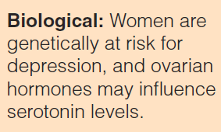
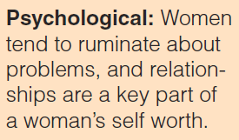
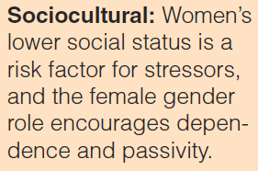
Why Do Women Have Higher Rates of Depression than Men?
Notes:
IMAGE: [© Masterfile] (Pastornio, Figure 13.5, p. 574)
Mood Disorders 5 of 6
Biopsychosocial forces that are unique to women may explain their higher vulnerability to depressive disorders.
Genetic risk of depression appears stronger in women than in men.
Research has also investigated—over many years and many studies—the relationship between the female ovarian hormones, estrogen and progesterone, and mood in an effort to understand pathways to depression.
However, it is not as simple as saying ovarian hormones cause depression.
Symptoms of depression do not appear to correspond to changes in levels of estrogen and progesterone across the menstrual cycle.
Rather, research suggests that women’s estrogen and progesterone levels may influence the functioning of the neurotransmitter serotonin, which plays a central role in mood.
However, researchers don’t yet understand the precise actions by which estrogen and progesterone influence serotonin functioning.
Psychological factors unique to women must also be considered when examining gender differences in depression.
For example, females are more likely than males to engage in a ruminative coping style.
In contrast, men are more likely to engage in some activity to take their minds off their feelings, to withdraw, or to abuse drugs.
Women are also more likely to have an interpersonal orientation that puts them at risk for depression.
Tied to these biological and psychological factors are the social circumstances that women face.
Women are at a disadvantage in society: They earn less and have less power than men. They report less satisfaction with work and family and are more likely to be victims of violence, discrimination, sexual abuse, and poverty.
Negative life events such as these foster feelings of uncontrollability and helplessness, perceptions that are intimately connected to mood disorders.
Traditional gender roles also discourage women from being masterful, independent, and assertive and encourage them to be dependent and passive.
These prescribed roles may increase women’s feelings of uncontrollability and helplessness.

Slide 25
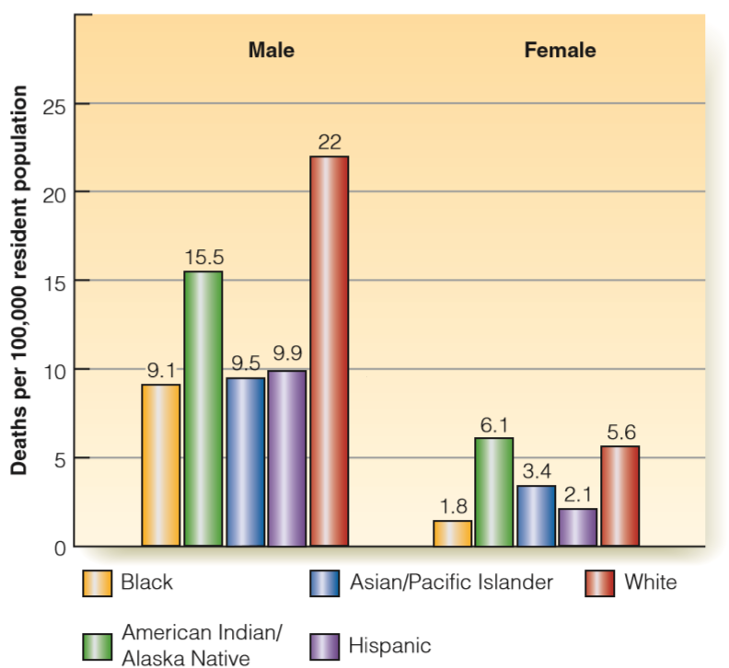
What Do Psychologists Know About Suicide?
Notes:
IMAGE: [© Chuck Karcher/Jupiter Images] (Pastorino, Figure 13.4, p. 568)
Mood Disorders 6 of 6
Research suggests that nearly 90% of all people who commit suicide have some diagnosable mental health disorder, commonly a depressive disorder or a substance-related disorder.
In 2010, suicide was the 11th-leading cause of death in the United States (higher than homicide).
Among 25- to 34-year-olds, it was the second-leading cause of death; among 35- to 44-year- olds, it was the fourth-leading cause of death.
Among 15- to 24-year-olds, suicide was the third-leading cause of death.
However, these rates are probably grossly underestimated given the negative stigma attached to suicide in the United States.
Women are two to three times more likely than men to attempt suicide, but four times as many men actually kill themselves, in part because of the means chosen.
Men tend to shoot, hang, or stab themselves.
Women are more likely to choose less lethal means, such as drug overdoses.
This gender difference appears in many countries across the world except China, where more women commit suicide than men.
In the United States, Whites and American Indian/Alaska Natives have higher rates of suicide than other ethnic groups.
There are many myths about suicide, Here are some facts:
Although most people who talk of suicide do not go on to attempt suicide, people who commit suicide typically have expressed their intentions at some time to family members or friends before their attempt. They may have talked about “going away” or be preoccupied in general with the notion of death. Therefore, any talk of suicide should be taken seriously. A person who is suicidal should not be left alone. You may need to contact a mental health professional, call 911, or call a suicide crisis hotline in your area.
Asking direct questions about a person’s plan for suicide is the only way to assess the person’s risk for committing suicide. Bringing up the subject can also give the person an opportunity to talk about his or her problem. People who have a concrete plan in mind for when or how they will end their life are more likely to attempt suicide than those whose plans are less specific.
In the United States from 2003 to 2007, among women aged 15–44 who committed suicide, 37% had a history of suicide attempts. Similarly, among adolescents, a previous history of suicide attempts is the single best predictor of future suicide attempts and completions. Therefore, a previous suicide attempt puts adolescents and young adult and middle-aged women in particular at a higher risk for future suicide attempts.
Suicide does not typically happen when a person is in the depths of a deep depression. Rather, suicide attempts are more likely to occur when people with depression have energy and can think more clearly and make decisions. This energy and clearer thinking make it appear to loved ones that the person is getting better and is therefore at a lower risk of suicide, when sometimes a better mood can indicate an increased risk of suicide.
Although suicidal thoughts are a symptom of depression and depressed people are 30 times more likely to commit suicide than are healthy individuals, people with other serious mental health disorders, including bipolar disorder, substance-related disorders, dissociative disorders, borderline personality disorder, and schizophrenia, are also at risk for suicide. According to findings from the WHO World Mental Health Surveys, the strongest predictors of suicide attempts in developed countries are mood disorders; whereas in developing countries, they are substance use, PTSD, and impulse control disorders.

Slide 26

Schizophrenia
This section covers:
  The epidemiology of schizophrenia
  Positive symptoms
  Negative symptoms
Notes:
IMAGE: [© Sarah Jane Taylor/Shutterstock.com] (Barlow, p. 446)
Schizophrenia 1 of 6
This section covers:
The epidemiology of schizophrenia
Positive symptoms
Negative symptoms
The causes of schizophrenia

Slide 27
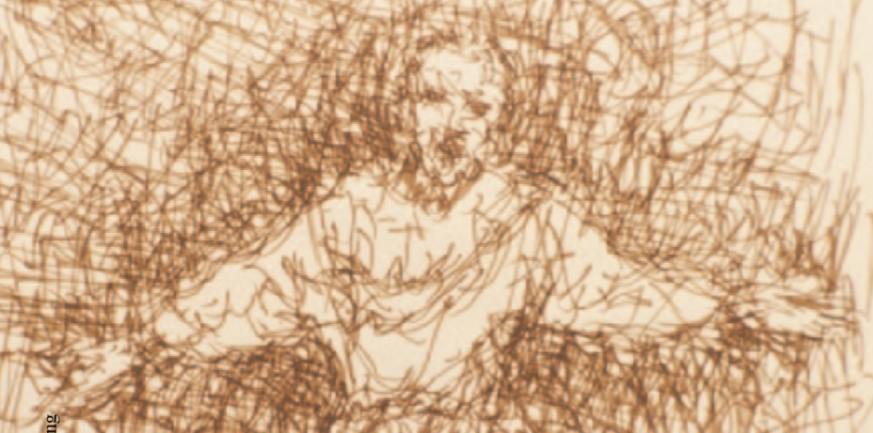
Schizophrenia: Epidemiology
Typically diagnosed in adolescence or early adulthood
  Men generally diagnosed earlier than women
Rates differ by race and ethnicity
Notes:
IMAGE: [© Janine Wiedel/Photolibrary/Alamay] (Pastorino, p. 576): Schizophrenia is a severe mental health disorder marked by disordered thoughts, perceptions, emotions, and/or motor behavior, as depicted in this drawing by someone with schizophrenia.
Schizophrenia 2 of 6
Symptoms of schizophrenia typically appear in adolescence or young adulthood.
In some cases, the symptoms come on gradually; in others, they appear more abruptly.
Schizophrenia affects men and women with equal frequency, although it typically appears earlier in men than in women.
Men tend to develop the disorder in their late teens or early 20s, and women are generally affected in their 20s or early 30s
This gender difference may be related to hormonal and sociocultural factors.
The hormone estrogen may protect women by lessening abnormal brain development associated with schizophrenia.
In addition, women’s higher social competence and more extensive social networks may delay the onset of the disorder.
Perhaps because of the earlier onset, men with schizophrenia tend to be more chronically impaired.
Schizophrenia is diagnosed more often in African Americans and Asian Americans.
However, this difference may be due to racial bias and cultural insensitivity
Lifetime prevalence rates of schizophrenia are lower among Hispanics than among European Americans
Schizophrenia also is more prevalent in lower socioeconomic groups
Most people with schizophrenia suffer throughout their adult lives, losing opportunities for careers and relationships
Several factors contribute to this suffering: the negative stigma that a schizophrenia diagnosis brings, the lack of public understanding, and inaccurate media portrayals of people with schizophrenia as criminally violent. Most people with schizophrenia are not violent toward others but are withdrawn and prefer to be left alone.
Although there currently is no cure, a diagnosis of schizophrenia does not necessarily mean progressive deterioration in functioning, as most people believe.
Rather, for reasons not yet understood, schizophrenic symptoms and episodes tend to decrease as a person ages.
However, recovery is very much related to social factors such as economic and social support. Most people with schizophrenia continue to experience difficulties throughout their lives.

Slide 28
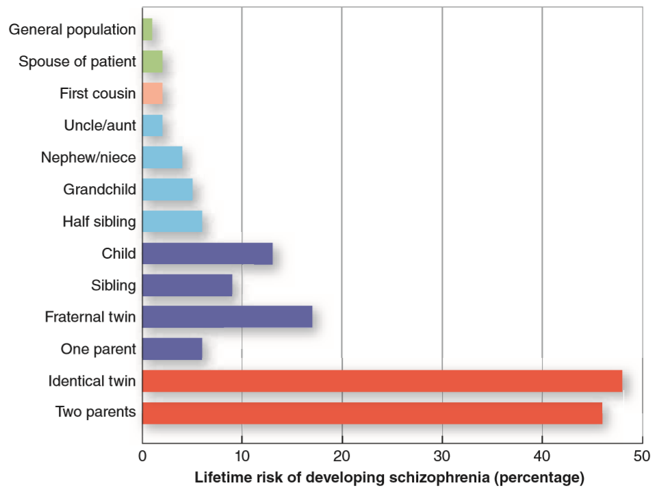
Schizophrenia: Genetics and Environmental Factors
Notes:
IMAGE: [© Cengage Learning 2013] (Cacioppo, Figure 14.8, p. 549): A person’s lifetime risk of developing schizophrenia increases when closely related family members have been diagnosed with the disorder, suggesting that genes play a significant role. The fact that having a spouse with schizophrenia doubles the risk (from 1 to 2%) probably reflects the tendency for people to marry others with whom they share similarities.
Schizophrenia 3 of 6
Genetics: Family, twin, and adoption studies have routinely demonstrated a high heritability of schizophrenia.
Although the incidence of schizophrenia in the general population is 1%–2%, the more genetically similar a person is to someone with schizophrenia, the more likely he or she will also develop the disorder.
Despite these results, it is unlikely that a single gene is responsible for the illness; if it were, the heritability rates would be higher.
Research has therefore moved toward exploring several chromosomal regions that may work together to increase a person’s vulnerability to schizophrenia, as well as altered gene expressions that may give rise to brain abnormalities.
The role of family and environment: Two critical factors that appear to contribute to the onset and course of schizophrenia are family support and exposure to stressful living conditions.
Studies on the families of people with schizophrenia have found that the quality of family communications and interactions may either encourage or discourage the onset of schizophrenia in people who are genetically at high risk.
The quality of family interactions may also influence whether future psychotic episodes are triggered. Families that are critical, harsh, hostile, and poor communicators may make a high-risk person more susceptible to the disorder.
Chronic stress from living a low-income lifestyle or within a family with poor communication also appears to influence future relapses.
Although it appears that family and lifestyle do not cause schizophrenia, they are critical factors in people’s susceptibility to the disorder and must be taken into account when designing prevention or treatment programs for those with schizophrenia.

Slide 29
Schizophrenia: Neural and Developmental Factors
Abnormalities in brain structure and neurotransmitter function are associated with schizophrenia.
These abnormalities may have origins in prenatal and early childhood development.
Notes:
Schizophrenia 4 of 6
Neurotransmitters and structural abnormalities: It was originally believed that schizophrenia was caused by excess activity of the neurotransmitter dopamine in the brain.
The drugs that are prescribed for schizophrenia, called phenothiazines, reduce dopamine activity in the brain and are typically more effective in reducing the positive symptoms of schizophrenia.
However, many people with schizophrenia do not respond to treatment with phenothiazines.
One of the newer drugs used to treat schizophrenia, called clozapine, does not block the same dopamine receptors as the phenothiazines, clearly indicating that dopamine is involved, but in a more complex way.
Other research suggests a potential role for the neurotransmitter glutamate.
Current research is focused on how glutamate and dopamine dysfunction may interact to contribute to the development of schizophrenia
Abnormalities in certain brain structures have also been investigated for their links to schizophrenia.
The most consistent abnormality found in people with schizophrenia is enlarged ventricles.
Brain dysfunction in the frontal and temporal lobes has also been implicated in the development of schizophrenia.
Prenatal and developmental factors: How do people with schizophrenia develop these neurochemical or brain abnormalities?
In addition to possible hereditary factors, these abnormalities have been linked to factors of pregnancy and birth such as birth complications, maternal diabetes, low birth weight, prenatal maternal stress, and the mother’s exposure to prenatal viruses.
A genetic predisposition to schizophrenia interacts with prenatal environmental agents such as a maternal virus or poor nutrition, causing changes in normal brain development.
Then, as the brain reaches maturation (during adolescence), a natural trimming away of brain synapses occurs.
It is hypothesized that in people with schizophrenia, the brain trims away too many synapses, resulting in the expression of the disorder in the teenage years.
Symptoms of schizophrenia are particularly likely to appear if the person has a strong genetic disposition or if environmental circumstances have encouraged the expression of the disorder in those with even a mild genetic link.

Slide 30
Positive Symptoms of Schizophrenia
Delusions
Hallucinations
Disorganized speech
Disordered behavior
Notes:
IMAGE: [© Michael Newman/PhotoEdit] (Barlow, p. 485): Homeless people who suffer from schizophrenia often bear the additional burden of persecutory delusions, which interfere with outside help.
Schizophrenia 5 of 6
Schizophrenia may express itself in many forms, depending on which symptoms are present.
Positive symptoms of schizophrenia represent an excess or distortion of normal functions and are more obvious signs of a break with reality called psychosis. They include delusions, hallucinations, disorganized speech, and grossly disorganized or catatonic behavior.
Delusions are thoughts and beliefs that the person believes to be true but that have no basis in reality.
For example, persecutory delusions involve beliefs about being followed or watched, usually by agents of authorities such as the FBI or the government.
Grandiose delusions involve beliefs about being a famous or special person. For instance, a person with schizophrenia may believe that he is the president of France.
People with schizophrenia may also hold delusions of reference (believing that others are talking about them) or delusions of thought control (believing that their thoughts are controlled by another person or force).
People who are diagnosed with schizophrenia also may experience hallucinations, in which the person sees, hears, tastes, smells, or feels something that others do not perceive.
In schizophrenia, hearing voices or other sounds (called auditory hallucinations) is the most common altered perception, followed by visual hallucinations (seeing things that aren’t there).
The hallucinations may tell the person to perform certain acts or may be frightening in nature.
The speech of individuals with schizophrenia is often disorganized in a variety of ways that impair effective communication.
Disorganized speech (formal thought disorder) involves a lack of associations between ideas and events.
Because the ideas of people with schizophrenia lack connection, we refer to this disconnection as loose associations.
Their ideas seem unrelated to one another, and their speech is often characterized as a word salad (words seem tossed together without any apparent syntax or organization).
They may be saying a lot, but what they say is not communicating anything to the receiver.
Disordered behavior may also characterize some people with schizophrenia.
This may take the form of unusual, odd, or repetitive behaviors and gestures.
Head banging, finger flapping, or tracing a pattern over and over again are examples.
Childlike silliness, inappropriate sexual behavior (such as public masturbation), or difficulty maintaining hygiene may be present.
Some people with schizophrenia may show an absence of all motor behaviors, remaining totally motionless and rigid for hours on end and resisting efforts to be moved.
Such behavior is referred to as a catatonic stupor.
Other people with schizophrenia may show catatonic excitement, in which they are suddenly agitated, fidgety, shouting, swearing, or moving around rapidly.

Slide 31
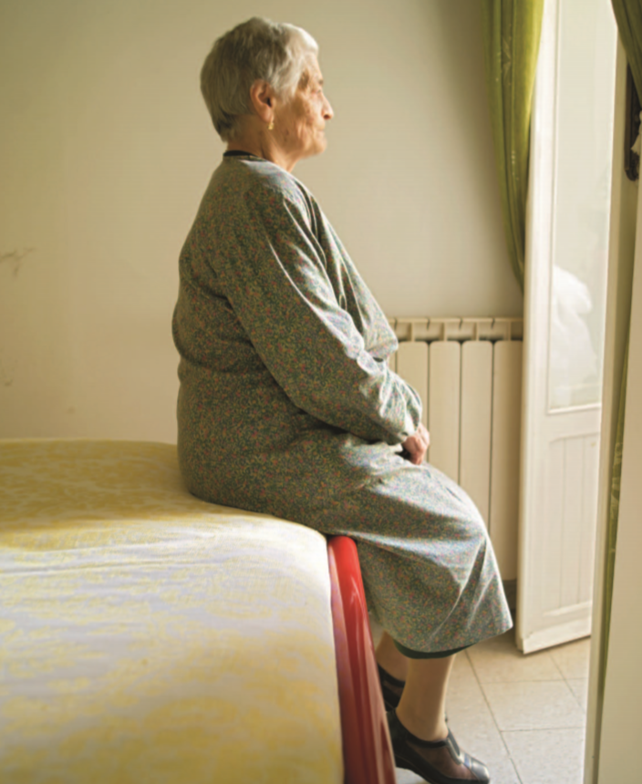
Negative Symptoms of Schizophrenia
Blunted affect
Alogia
Avolition
Notes:
IMAGE: [© John Myers/Workbook Stock/Getty Images] (Barlow, p. 483)
Schizophrenia 6 of 6
Negative symptoms of schizophrenia represent a restriction or absence of normal functions. These include blunted affect, alogia, and avolition.
Approximately 25% of persons with schizophrenia display these symptoms.
Affect, in psychological terms, refers to expressing emotions.
Some people with schizophrenia show blunted affect, or a lack of emotional expression.
They appear passive, with immobile facial expressions.
Their vocal tone does not change even when the conversation is emotional in tone.
They do not respond to events in their environment with any emotion.
Their speech lacks the inflection that usually communicates a speaker’s mood.
Alogia, also called poverty of speech, refers to decreased quality and/or quantity of speech.
The person with schizophrenia gives brief and empty replies.
Avolition is the inability to follow through on one’s plans.
A person with schizophrenia may seem apathetic, sitting for long periods of time, showing little interest in his or her usual activities.

Slide 32

Personality Disorders
This section looks at:
  The three clusters of DSM-5 personality disorders
  Antisocial and borderline personality disorders
  The DSM-5 alternative model
Notes:
IMAGE: [© Clarissa Leahy/cultura/Corbis] (Barlow, p. 465 )
Personality Disorders: 1 of 7
This section covers:
The three clusters of DSM-5 personality disorders
Antisocial and borderline personality disorders
The DSM-5 alternative model
Personality disorders consist of long-standing patterns of malfunctioning.
All of us have personality “quirks.” Some people may be excessively neat.
Others may be somewhat suspicious and mistrustful of others.
However, these traits do not necessarily qualify someone for a personality disorder.
In personality disorders, the person’s emotions, thoughts, and behavior result in persistent distress to self or others and interfere with one’s ability to function.
The 10 specific personality disorders in the DSM-5 are grouped into three behavior clusters:
odd or eccentric behaviors
dramatic, emotional, or erratic behaviors
anxious or fearful behaviors

Slide 33
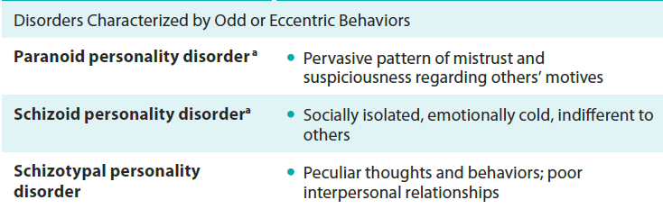
Personality Disorders: Cluster A
Notes:
IMAGE: [© Cengage Learning] (Sue, Table 15.1, p. 472)
Personality Disorders: 2 of 7
Cluster A—Disorders Characterized by Odd or Eccentric Behaviors
Three personality disorders are included in Cluster A: paranoid personality, schizoid personality, and schizotypal personality. These personality disorders share characteristics, including overlapping environmental and genetic risk factors, which are similar to those found in the schizophrenia spectrum disorders (Esterberg, Goulding, & Walker, 2010).
There is some evidence that individuals with disorders in this grouping have a greater likelihood of having biological relatives with schizophrenia or other psychotic disorders (APA, 2013).
Paranoid personality disorder is defined by severe distrust and suspiciousness. People with this disorder are often fearful that others are trying to harm them and tend to interpret the behavior of others as personal attacks.
This leads such individuals to question the motives and loyalty of friends and significant others.
The level of suspicion displayed is unjustified and can seem out of touch with reality.
Schizoid personality disorder is defined by extreme social isolation and detachment from others.
Individuals with this condition may seem aloof or overly cold towards others.
Often, there is no discernable thought pattern that leads to their behavior, which contrasts with the other personality disorders in Cluster A.
It’s not unusual for people with schizoid personality disorder to wind up being homeless.
Their lack of emotion and disinterest in social attachment can make it difficult to maintain family relationship or hold a steady job.
Schizotypal personality disorder is associated with social isolation (though often less extreme than that seen in schizoid personality disorder), along with highly unusual behaviors or thoughts.
In mild cases, such individuals may seem eccentric in their dress and mannerisms.
In more severe cases, people with schizotypal personality disorder may exhibit bizarre beliefs, odd or concerning behavior, high levels of social anxiety, and inappropriate emotional responses.
Some researchers have suggested that schizotypal personality disorder is on the same spectrum as schizophrenia, as it can appear as a slightly less severe form of schizophrenia.

Slide 34
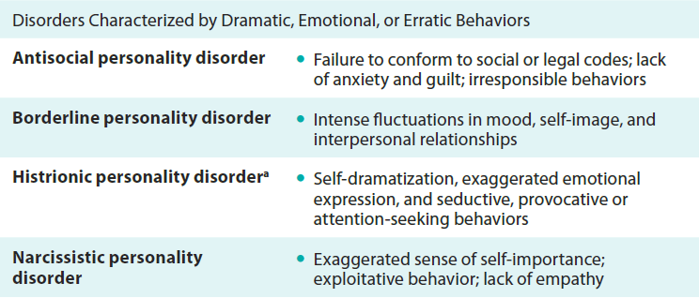
Personality Disorders: Cluster B
Notes:
IMAGE: [© Cengage Learning] (Sue, Table 15.1, p. 472)
Personality Disorders: 3 of 7
The group of disorders in Cluster B, characterized by dramatic, emotional, or erratic behaviors, includes four personality disorders: antisocial, borderline, histrionic, and narcissistic. Antisocial personality disorder and borderline personality disorder are covered in more detail on the next 2 slides.
Histrionic personality disorder is associated with overly dramatic or theatrical behaviors, often as a way to draw attention to themselves.
Individuals with this condition sometimes seem like they’re making a spectacle or being “showy” when they express emotions.
For instance, giving a giant hug to someone you just met and repeatedly expressing intense happiness about being able to know them.
Relationships are often viewed as being closer than they actually are, and behavior towards others can be sexually inappropriate or intentionally provocative.
Narcissistic personality disorder is an extreme form of considering yourself unique and worthy of special treatment.
This can manifest as intense self-centeredness, to the point that the feelings and well-being of others are given zero consideration.
It’s not unusual for people with narcissistic personality disorder to take advantage of others in order to achieve their own goals.
People with this condition often seek to be admired and are highly uncomfortable when sharing the limelight with others.
Their behavior and attitudes can seem arrogant or highly vain.

Slide 35

Antisocial Personality Disorder
Demonstrates a chronic pattern of impulsive and irresponsible behavior
Violates the rights of others and lacks empathy
Does not show remorse or guilt for actions
Notes:
IMAGE: [© Jon Are Berg Jacobsen/Aftenposte/EPA/Newscom] (Cacioppo, p. 571): Anders Behring Breivik killed 8 people with a bomb before shooting another 69 people at a nearby youth camp on July 22, 2011. Police told reporters that during a reenactment of the shootings, Breivik “didn’t show any remorse.” Although we don’t know whether Breivik will be diagnosed with antisocial personality disorder, a callous lack of empathy and remorse is typical of people with this diagnosis.
Personality Disorders: 4 of 7
People who are impulsive and disregard the rights of others without showing any remorse or guilt are diagnosed with antisocial personality disorder.
Antisocial in this context does not mean shy or unsociable, but rather indicates harmful acts against (anti) others (social).
People who have antisocial personalities lack impulse control and often act hastily and recklessly with little concern for the consequences of their behavior.
They are irresponsible, blame others for their problems, and frequently have difficulty maintaining social relationships.
They repeatedly lie and may manipulate others into doing what they want.
Such antisocial or harmful behavior has often been present since childhood or adolescence.
It is one of the more common personality disorders, and men are 5 times more likely than women to be diagnosed with this disorder.
People with antisocial personality disorder are more often sent to prison than to treatment.
However, this does not mean that all criminals have antisocial personality disorder.
Although antisocial behavior is highly correlated with delinquency and criminal behavior, not all criminals are antisocial.
One of the key features distinguishing the two is the lack of remorse and guilt for one’s actions.
A person can commit armed robbery yet afterward regret his actions.
The antisocial person does not experience such regret or remorse.
People with antisocial personality disorder may not be violent.
They may be “con artists,” and more of them may live outside prison than in it.
They may function successfully in business, politics, or entertainment
What causes antisocial personality disorder?
Some research suggests biological factors.
Twin studies, adoption studies, and family studies support a genetic influence.
Other research suggests low levels of the neurotransmitter serotonin, deficits in brain areas that control impulsivity, attention, and decision making, elevated levels of the hormone testosterone, and low arousal of the nervous system
However, psychological and social variables cannot be ruled out.
People with antisocial personality disorder often experience conflict-filled childhoods.
Their parents may be neglectful, inconsistent in discipline, harsh, hostile, or less warm.
As a result, they often learn to expect such treatment from others and adopt a mistrustful and aggressive stance toward others.
In all likelihood, a complex interplay between genes and the environment best explains the development of antisocial personality disorder.

Slide 36

Borderline Personality Disorder
Demonstrates instability in mood, self-image, and interpersonal relationships
Lacks impulse control
May engage in self-destructive behaviors
Notes:
IMAGE: [© Dr. P. Marazzi/SPL/Photo Researchers, Inc.] (Barlow, p. 462): Borderline personality disorder is often accompanied by self-mutilation.
Personality Disorders: 5 of 7
Borderline personality disorder (BPD) is characterized by instability in moods, interpersonal relationships, self-image, and behavior.
This key feature of instability often disrupts people’s relationships, career, and identity.
Their unstable emotions result in intense bouts of anger, depression, or anxiety that may occur for hours or for a day.
Their unstable self-concepts are reflected in extreme insecurity at some times and exaggerated feelings of importance at other times.
This instability may prompt frequent changes in goals, jobs, friendships, and values because people with borderline personalities lack a clear definition of themselves.
They have little idea of who they are.
Their interpersonal relationships are also characterized by instability.
They may admire, idealize, and cling to loved ones at first; but when conflict occurs, feelings of abandonment and rejection surface, and their feelings quickly turn to anger and dislike.
They then seek out new friends or loved ones, and the cycle repeats itself.
People with this disorder often feel unworthy, bad, or empty inside.
At times of extreme insecurity and depression, self-injury and suicide attempts are common
People with BPD are often diagnosed with other mental health disorders such as major depression, substance-related disorder, or anxiety.
It is estimated that approximately 2%–6% of the population could be diagnosed with BPD at some point in their lives, and it is diagnosed slightly more often in young women than in men.
Extensive mental health services are often needed to treat people with BPD.
Research on the causes of BPD has focused on biopsychosocial factors.
Low levels of serotonin are related to impulsive behaviors.
Difficulty in regulating emotions may be related to abnormal brain functioning .
However, many people with BPD report a history of adverse life events such as abuse or neglect, making environment a probable factor.
For example, in one study, a large percentage of patients with BPD had reported being sexually abused.
Such social stressors may impede normal attachment patterns, identity development, and the ability to express appropriate emotions.

Slide 37
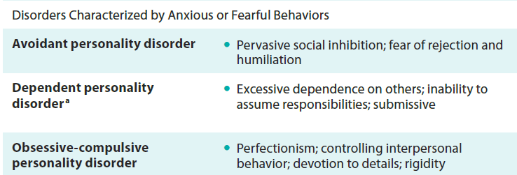
Personality Disorders: Cluster C
Notes:
IMAGE: [© Cengage Learning] (Sue, p. 472)
Personality Disorders: 6 of 7
The remaining cluster of personality disorders is characterized by anxious or fearful behaviors. This category includes the avoidant, dependent, and obsessive-compulsive
personality disorders.
The essential features of avoidant personality disorder are a “pervasive pattern of social inhibition, feelings of inadequacy, and hypersensitivity to negative evaluation” (APA, 2013, p. 672). As in Deb’s situation, fear of rejection and humiliation produce a reluctance to enter into social relationships. People with this disorder tend to have a negative sense of self, low self-esteem, and a strong sense of inadequacy. They tend to avoid social situations and relationships and are often socially inept, shy, and withdrawn. They fear humiliation, are overly sensitive to criticism, blame themselves for things that go wrong, and seem to find little pleasure in life.
Dependent personality disorder is a condition in which an individual shows a “pervasive and excessive need to be taken care of that leads to submissive and clinging behavior and fear of separation” (APA, 2013, p. 675).
Obsessive-compulsive personality disorder (OCPD) involves a “pervasive pattern of preoccupation with orderliness, perfectionism, and mental and interpersonal control, at the expense of flexibility, openness, and efficiency” (APA, 2013, p. 676). The person’s preoccupation with details and rules leads to an inability to see the big picture. There is a heightened focus on being in control over aspects of one’s own life and one’s emotions; additionally, there is a strong devotion to minor details and a need to control other people. Individuals with OCPD lack flexibility and their rigid behaviors can significantly impair their occupational and social functioning and affect their quality of life (Pinto, Steinglass, Greene, Weber, & Simpson, 2013).
OCPD is distinct from obsessive-compulsive disorder (OCD), discussed in Chapter 5. The two disorders have similar names, but their clinical manifestations are quite different. Individuals with OCD experience unwanted intrusive thoughts orurges that cause significant distress. On the other hand, OCPD is a pervasive personality and character disturbance. People with OCPD genuinely see their way of functioning as the correct way. They relate to the world though a lens incorporating their own strict standards.

Slide 38
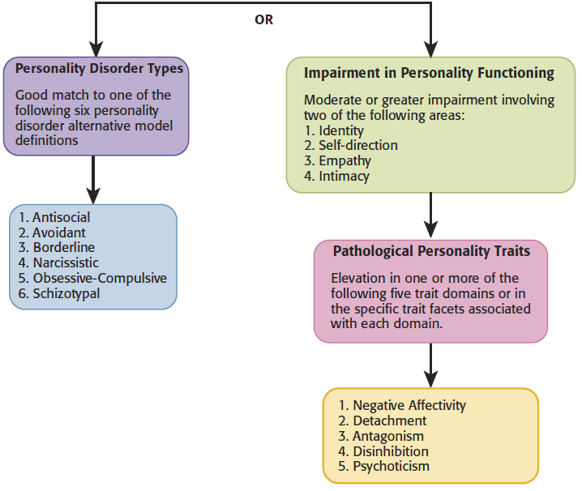
The DSM-5 Alternative Model:
Two Paths to Diagnosis
Notes:
IMAGE: [© Cengage Learning 2014] (Sue, Figure 15.3, p. 497)
Personality Disorders: 7 of 7
Figure 15.3 Two Paths to Personality Disorder Diagnosis Using the DSM-5 Alternative Model
With the DSM-5 alternative personality model, a diagnosis of personality disorder can be made through two different routes:
1. evidence that the client’s pattern of personality traits matches characteristics from one of six specific personality disorder types (antisocial, avoidant, borderline,
narcissistic, obsessive-compulsive, or schizotypal); or
2. evidence of at least moderate impairment in two key domains of personality functioning (identity, self-direction, empathy, or intimacy) combined with
certain specific pathological personality traits.
With both routes, the personality disorder or descriptive personality traits must be pathological and result in at least moderate impairment in personal or interpersonal
functioning. When using the DSM-5 alternative system to diagnose a personality disorder, clinicians first ask the following questions: Does the person have impairment in personality functioning? If so, how severe is the impairment? To answer these questions, the clinician begins by carefully assessing four key areas related to personal and interpersonal personality functioning:
Identity—sense of personal uniqueness, with clear boundaries between oneself and others; capacity to regulate one’s emotions; accurate self-appraisal and stable self-esteem
Self-direction—focus on meaningful goals, using self-reflection and positive standards of behavior
Empathy—understanding of and tolerance for others’ feelings and perspectives; comprehension of the effects of one’s behavior on others
Intimacy—capacity and desire for interpersonal closeness and deep connection with others; respectful interpersonal behavior

Slide 39
Disorders of Childhood and Adolescence
This section covers:
  Autism spectrum disorder
  Attention deficit hyperactivity disorder
Notes:
IMAGE: [© Britt Erlanson/The Image Bank/Getty Images] (Mash/Wolfe, p. 234)
Disorders of Childhood 1 of 3
Sitting through a class lesson is hard for a child with ADHD. ADHD has no distinct physical symptoms that can be seen in an x-ray or a lab test. It can only be identified by characteristic behaviors that vary considerably from child to child. As we shall discuss, ADHD has become a blanket term used to describe several different patterns of behavior that likely have different causes.
This section covers:
Autism spectrum disorder
Attention deficit hyperactivity disorder

Slide 40
Autism Spectrum Disorder
Characterized by impairment in social communication and social interaction; and restricted, repetitive patterns of behavior, interests, or activities
Notes:
IMAGE: [© M. Scott Brauer/Alamy] (Mash/Wolfe, p. 157)
Disorders of Childhood 2 of 3
Children with ASD behave in unusual and frequently puzzling ways, like exhibiting odd interests in the sensory aspects of the environment, atypical facial expressions,
and a lack of interest in others.
In 1943, psychiatrist Leo Kanner identified three major areas of disturbance in a group of children: social relatedness, communication, and ritualistic behavior.
Kanner’s observations form the basis of our current diagnostic criteria for autism spectrum disorder.
Autism represents a spectrum because the severity of the observed deficits can vary widely from individual to individual.
Adjustment can range from relatively normal, allowing independent living, to intellectual disability, requiring living with parents or in institutional settings.
Rates of autism have been increasing rapidly over the last two decades.
2013 estimates from the Centers for Disease Control and Prevention suggest an average of 1 in 50 U.S. school children has an autism spectrum disorder diagnosis
Although the presence of some currently unknown environmental trigger has not been completely ruled out, it is also possible that rising prevalence rates are the result of increased awareness of the disorder among parents and health care providers, relaxed applications of the diagnostic criteria, and the increased availability of services for children with the disorder.
Males are far more likely to be diagnosed with autism than females, possibly by a factor of 4 to 1.
Problems with social relatedness are at the core of this disorder, regardless of the individual’s level of intelligence and adjustment.
Beginning in infancy, most children with autism do not make eye contact or take pleasure in reciprocal games like “peek-a-boo.”
Insight into the thoughts and points of view of others is particularly lacking.
Language skills of individuals with autism can vary widely, from having no language abilities at all to delayed acquisition of language to normal skills
Even when language skills are relatively normal, individuals with autism spectrum disorder usually experience difficulty maintaining conversation with others because of their deficits in social skills.
Individuals with autism often object strenuously to changes in the environment and show a high level of repetitive, routine behavior.
Rituals may include repetitive movements, such as rocking, hand-flapping, head-banging, and twirling.
Other individuals may engage in extremely limited preoccupations, such as learning all models of cars ever made by Ford.
One possible source of this ritualistic behavior is a general dysfunction in sensory networks.
Most individuals with autism show unusually increased or decreased sensitivity to stimuli.
They may be relatively insensitive to pain or cold, but very distressed by normal sound levels.
Ritualistic behavior may serve to control or override these disparate sensations.
Although the causes of autism remain somewhat mysterious, and probably show variable patterns from case to case, scientists are making progress.
Parental age appears to provide one risk factor, with older parents more likely than younger parents to give birth to a child with autism.
Family and twin studies provide strong evidence that autism is influenced by genetics.
Abnormalities in cortical development might lead to unusual minicolumns, vertical arrays of neurons perpendicular to the surface of the cerebral cortex that represent the smallest processing units of the brain.
Individuals with autism have narrower and more numerous minicolumns than healthy individuals
Environmental factors undoubtedly play a part in autism.
Environ-mental factors are likely to interact with genetics, especially during sensitive periods of prenatal brain development
One of the unfortunate consequences of the uncertainty surrounding the causes of autism has been the vulnerability of concerned parents seeking answers.
In a paper later retracted by the British medical journal Lancet, unsubstantiated claims that the routine measles/mumps/rubella vaccination caused autism were published.
Similar controversies in the United States about a type of mercury preservative in vaccinations ensued, promoted by well-known figures such as model Jenny McCarthy and members of Congress.
The weight of the scientific evidence shows that vaccinations play no part in the development of autism.
The introduction of the DSM-5 in 2013 led to a change in how some developmental disorders were classified.
Individuals that were previously diagnosed with Asperger’s Syndrome now fall under the umbrella of Autism Spectrum Disorder.
Some of the diagnostic criteria used to make a diagnosis were also changed.
These changes were implemented to produce greater consistency in how diagnoses are made and allow clinicians to better describe the specific symptoms observed.

Slide 41
Attention Deficit Hyperactivity Disorder
Characterized by inattention, hyperactivity, and impulsivity
Notes:
IMAGE: [© Suzanne Tucker/Shutterstock] (Cacioppo, p. 545)
Disorders of Childhood 3 of 3
Attention deficit hyperactivity disorder (ADHD) is perhaps one of the most contentious categories described in the DSM.
The criteria for the disorder are difficult to distinguish from the behaviors of many typical young children.
Because most children diagnosed with ADHD will be treated with medication, the stakes for accurately diagnosing the condition are high indeed.
ADHD involves inattention and hyperactivity.
Some individuals show both inattention and hyperactivity, but a large number of inattentive people show no hyperactivity at all
The core feature of inattention is the inability to maintain sustained attention, or on-task behavior, for an age-appropriate length of time.
This problem is evidenced in the diagnostic criteria for inattention, such as difficulties in following instructions, in organizing and completing work, and in avoiding careless mistakes.
Children with hyperactivity express a high level of motor activity and find engaging in structured activities, such as waiting in line or sitting quietly in class, very challenging.
These children are noisy, active, and boisterous, and often appear to take action without thinking it through.
Even as adults, individuals who were diagnosed with ADHD as children have more traffic accidents than people without the disorder
Many of these behaviors are seen in children who do not have any psychological disorders.
Although the DSM attempts to provide guidelines about making a distinction between normal and abnormal inattentiveness and hyperactivity, fewer than 40% of surveyed pediatricians reported using the DSM criteria to evaluate cases of ADHD
Estimates of the prevalence rate for ADHD range widely in both childhood and adulthood.
A survey of parents conducted by the Centers for Disease Control and Prevention found that 7.74% of children between the ages of 4 and 17 had been diagnosed with ADHD .
About 57% of these children had been treated with medication.
This amounts to 4.4 million children in the United States diagnosed with ADHD, with some 2.5 million receiving medication
The National Institutes of Health concluded that “scientists are not sure what causes ADHD.”
However, twin and adoption studies support a significant role for genetics in the development of ADHD.
Heritability may be as high as 76%
The frontal lobes may be underactive in cases of ADHD
Because the frontal lobes inhibit unwanted behavior, lower activity in this part of the brain may lead to hyperactivity and impulsivity.
The frontal lobes, and the prefrontal areas in particular, appear to mature more slowly in children with ADHD than in healthy controls.
Peak cortical thickness, a measure of brain maturity, occurred in healthy controls around the age of 7.5 years, but not until the age of 10.5 years in children with ADHD.
The caudate nucleus, part of the basal ganglia, also shows delayed development in ADHD.
White matter circuits connecting the basal ganglia and the frontal lobes appear to mature differently in people with and without ADHD.
The parts of the brain implicated in ADHD, such as the prefrontal cortex and the basal ganglia, feature large amounts of dopamine activity.
Most of the medications used to treat ADHD, such as Ritalin or Adderall, act by boosting the activity of dopamine, suggesting that dopamine activity might be lower than usual in cases of ADHD.

