Slide 1
Intelligence
This section covers:
  Assessing intelligence
  Conceptualizations of intelligence
  Biological influences on intelligence
  Extremes of intelligence
Notes:
IMAGE: [© Bob Daemmrich/The Image Works] (Coon, p. 330): Modern intelligence tests are widely used to measure intellectual abilities. When properly administered, such tests provide an operational definition of intelligence.
Intelligence 1 of 11
This section covers:
Assessing intelligence
Conceptualizations of intelligence
Biological influences on intelligence
Extremes of intelligence

Slide 2
History of Assessing Intelligence
Alfred Binet
Theodore Simon
Mental age vs. chronological age
Notes:
IMAGE: [© Albert Harling/Roger-Viollet/The Image Works] (Cacioppo, p. 384): Along with Théodore Simon, Alfred Binet devised a test aimed at identifying schoolchildren with intellectual disability. Binet and Simon’s test laid the groundwork for today’s intelligence testing.
Intelligence 2 of 11
Today, many psychologists view intelligence broadly as having abilities that allow you to adapt to your environment and behave in a goal-directed way.
But over the years, psychologists have found that developing a precise definition of intelligence is not as easy as it may seem, and our conception of intelligence has undergone several revisions.
Equally challenging has been finding ways of measuring intelligence.
The modern intelligence test is credited to Alfred Binet (1857–1911).
In 1904, the French government appointed Alfred Binet and psychiatrist Théodore Simon to a commission charged with developing a means of measuring the intelligence of French schoolchildren so that the government could identify children who would not likely profit from traditional education.
Binet saw intelligence as the capacity to find and maintain a purpose, adopt a strategy to reach that purpose, and evaluate the strategy so it can be adjusted as necessary.
In essence, Binet suggested that having intelligence makes one a good problem solver.
As such, he developed an intelligence test that assessed general cognitive abilities such as the individual’s attention, judgment, and reasoning skills.
Binet prepared a set of 30 tasks that measured these skills and arranged them in order of difficulty, with the easiest questions first and the hardest questions last.
Not surprisingly, the brighter students could answer more of the questions than the not-so-bright students could.
Also, not surprisingly, the older children tended to answer more questions correctly than the younger children.
In fact, Binet noticed that the brighter younger children could sometimes answer correctly as many questions as the average child of an older age.
For example, a very smart 6-year-old might be able to answer as many questions as the average 10-year-old child could.
So Binet began to quantify children’s intelligence in terms of mental age, or the age that reflects a child’s mental abilities in comparison to the “average” child.
In Binet’s scheme, a mental age that exceeds one’s chronological age indicates above-average intelligence, and a mental age that is below a child’s actual age indicates a below- average level of intelligence.
Binet’s concept of mental age became the foundation for the IQ score, and his test became the basis for modern intelligence tests.

Slide 3
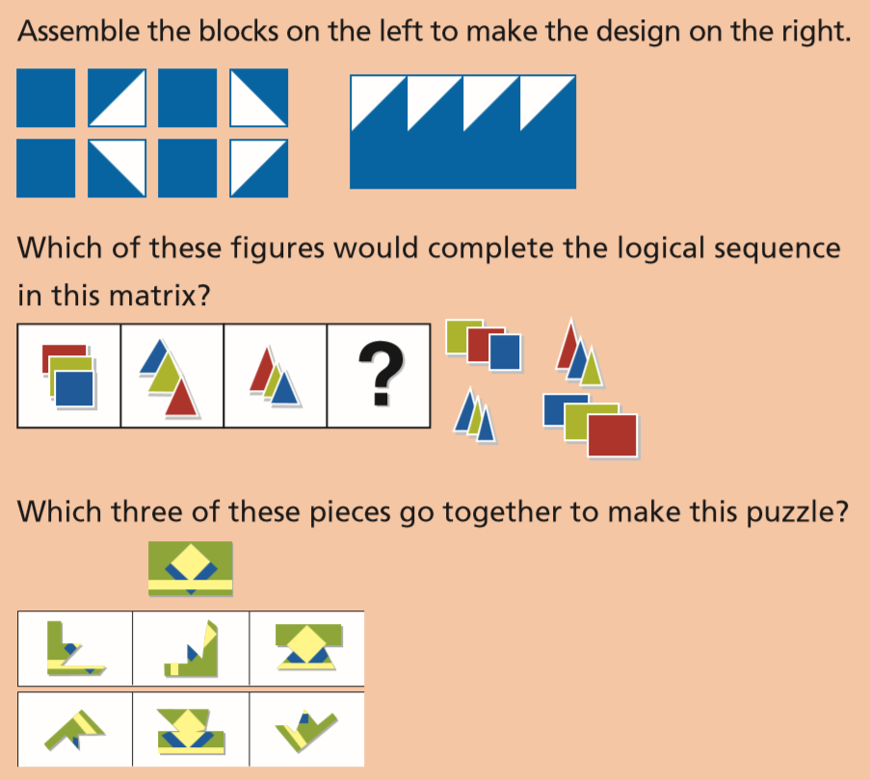
Modern Forms of Assessing Intelligence
Stanford-Binet
Wechsler Intelligence Sclaes
Notes:
IMAGE: [© Cengage Learning] (Pastorino, portion of Table 8.3, p. 331): The Wechsler Adult Intelligence Scale (WAIS-IV) and Its Subscales NOTE: The test items shown are examples—they do not appear in the actual test.
Intelligence 3 of 11
In 1916, Stanford psychologist Lewis Terman completed an American revision of the intelligence test that Binet and Simon had developed.
He named his version of the test the Stanford Revision of the Binet-Simon Scale, which became known as the Stanford-Binet.
The Stanford-Binet is an example of a standardized test— a test that uses a standard set of questions, procedures, and scoring methods for all test takers.
In standardizing the Stanford-Binet, Terman gave the test to a large number of people and calculated the average test scores that people of different ages made on the test.
These norms allowed Terman to establish mental age scores for people taking the Stanford-Binet.
Perhaps Terman’s most significant contribution to the test was to popularize the use of an intelligence quotient, or IQ, as the measure of an individual’s intelligence.
Terman defined the IQ score as a person’s mental age divided by his or her chronological age, then multiplied by 100.
Using the concept of an IQ, a person of average abilities has, by definition, an IQ of 100 or, in other words, a mental age equal to her or his actual age.
IQs over 100 indicate above-average intelligence, and IQs below 100 indicate below-average intelligence.
The Stanford-Binet has undergone four major revisions since 1916 and is still in wide use today.
The most recent edition, the Stanford-Binet Intelligence Scales, Fifth Edition (SB5), was released in 2003.
However, a modern IQ test developed by psychologist David Wechsler (1896–1981) and first released in 1939 has greatly challenged the popularity of the Stanford-Binet.
Wechsler developed his intelligence test in response to shortcomings he saw in the Stanford-Binet.
Wechsler objected to the fact that the Stanford-Binet test tried to sum up intelligence in a single score.
He believed that one number could not adequately express something as complex as intelligence.
Furthermore, Wechsler objected to the use of the mental age concept for adults.
After all, would you necessarily expect a 40-year-old to correctly answer more questions than a 35-year-old?
The concept of mental age doesn’t apply as well to adults as it does to children because adults do not change as much from year to year as children do.
Therefore, mental age has little significance in adulthood.
To correct these problems, Wechsler developed an intelligence test that yields scores on individual subscales that measure different mental abilities.
Furthermore, instead of using mental age to determine IQ, Wechsler’s tests compare a participant’s performance to the average person’s performance to determine IQ.
The Wechsler tests are standardized tests that are devised so that an average person’s performance on the test results in an IQ of 100.
Using this number as a benchmark, people who score above average on the test are given IQ scores above 100, and people who perform below average are given IQ scores below 100.
Most people can expect to score near this average IQ, somewhere in the range of 85–115
Today there are three separate Wechsler intelligence tests. The Wechsler Preschool and Primary Scale of Intelligence, Fourth Edition (WPPSI-IV), is administered to children ages 21/2 to 7. The Wechsler Intelligence Scale for Children, Fourth Edition (WISC-IV), is used for children ages 6–16. The Wechsler Adult Intelligence Scale, Fourth Edition (WAIS-IV), is used for people ages 16–90.
These days, many intelligence tests are scored by comparing a person’s performance to a relevant population.
A person performing at the 50th percentile (better than 50% of the population) has a score of 100.
Someone performing at the 90th percentile has a score around 120.

Slide 4
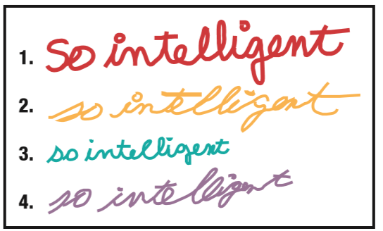
What Makes a Good Intelligence Test
Reliability
Validity
Notes:
IMAGE: [© Cengage Learning 2013] (Plotnik, p. 316).
Intelligence 4 of 11
Before a test is used to make decisions about anyone’s life, the test itself must be tested and evaluated.
Psychologists must be assured that the test is both reliable and valid before it can be put into widespread use.
Based on the handwriting in the illustration, who would you say is most intelligent?
It happens that the same person wrote all of the samples.
Handwriting analysis is fun, but it is a very poor intelligence test because it lacks validity, which is one of the two characteristics of a good test.
The reliability of a test refers to the degree to which the test yields consistent measurements over time.
Although intelligence can change over time, it usually does so very slowly.
In general, if you are intelligent today, you will be intelligent 6 months from now.
So, if we use a test to measure your IQ today and then again in 6 months, the scores should be comparable.
This doesn’t mean that the test has to yield exactly the same score, but the scores should be close.
Establishing the reliability of an intelligence test is very important, but the validity of the test is an equally important characteristic.
Validity is the degree to which the test measures what it was designed to measure.
In the case of an intelligence test, one must show that the test actually measures intelligence!
One way to establish a test’s validity is to show that scores on the test reliably predict future behavior.
For example, if we expect that intelligence is related to doing well in school, then scores on a valid IQ test should predict who does well in school and who does not.
If the test is valid, IQ and GPA should correlate.
Students with higher IQ scores should tend to also have higher GPAs and students with lower IQ scores should tend to have lower GPAs.
If they do not, the IQ test is not a valid predictor of academic success, and it should not be used as such.

Slide 5
Conceptualizations of Intelligence
Single factor
Collection of abilities
Multiple intelligences
Triarchic intelligence
Emotional intelligence
Notes:
IMAGE: [© Vladimir Godnik/Getty Images] (Coon, p. 334): A child may be gifted in many ways. Many schools now offer Gifted and Talented Education programs for students who have a variety of special abilities—not just for those who score well on IQ tests.
Intelligence 5 of 11
One enduring controversy within psychology is how intelligence should be defined. Originally, it was thought that intelligence was a single trait involved in a range of abilities.
Some psychologists sought to break down intelligence into its core features by identifying these abilities.
More recently, psychologists have suggested that people have different forms of intelligence. If you ask people about their abilities, many will report being intelligent in some areas, but not others.
The precise number and form of these intelligences has also been vigorously debated within the field.

Slide 6
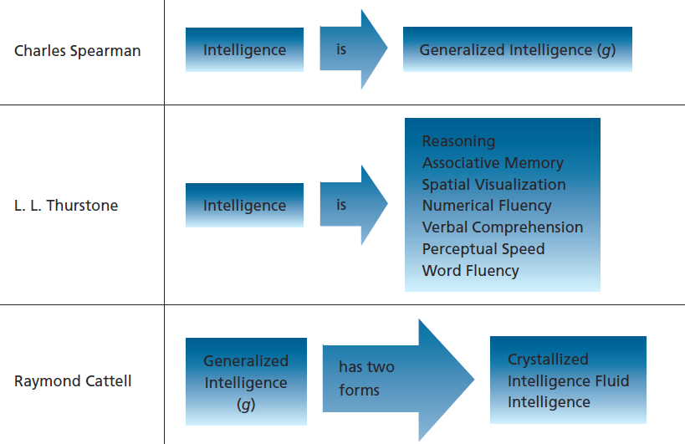
The Nature of Intelligence
Notes:
IMAGE: [© Cengage Learning] (Pastorino, p. 337)
Intelligence 6 of 11
A century ago, British statistician Charles Spearman argued that because test scores of separate mental abilities (such as verbal skills, mathematical ability, deductive reasoning skills) tend to correlate, there must be one general level of intelligence that underlies these separate mental abilities.
Spearman referred to this general intelligence as g.
In Spearman’s view, one’s level of g would determine how well he or she functioned on any number of cognitive tasks.
He conceded that intelligence may be reflected in different kinds of tasks, but argued that a person’s scores on different tests were likely to be correlated with one another, reflecting a general mental ability.
The idea that intelligence is a single, unitary factor helped lead to the rapid expansion of intelligence testing in schools, the workplace, and the military.
But the notion of g would soon be challenged.
By the 1930s, some theorists were beginning to challenge the idea of a single intelligence.
The notion of g fell from favor as psychologists proposed theories that described intelligence as a set of abilities rather than a single trait.
In 1938, psychologist L. L. Thurstone argued that intelligence was made up of seven distinct mental abilities: reasoning, associative memory, spatial visualization, numerical fluency, verbal comprehension, perceptual speed, and word fluency.
Others would eventually propose as many as 120 different factors underlying intelligence.
However, not everyone was convinced that intelligence was made up of many different factors.
In the 1960s, Raymond Cattell (1963) revived the idea of g.
Cattell proposed that g does exist, but in two different forms, which he called crystallized intelligence and fluid intelligence.
Crystallized intelligence refers to our accumulation of knowledge.
For example, your knowledge of psychology is part of your crystallized intelligence.
Fluid intelligence refers to the speed and efficiency with which we learn new information and solve problems.
There is both good and bad news when it comes to our levels of fluid and crystallized intelligence over a lifetime.
The evidence shows that crystallized intelligence can continue to grow well into late adulthood, but fluid intelligence tends to decrease across adulthood.
The degree to which we retain these abilities throughout life is affected by our environment and our physical well-being, although environment is much more important in the case of crystallized intelligence.

Slide 7
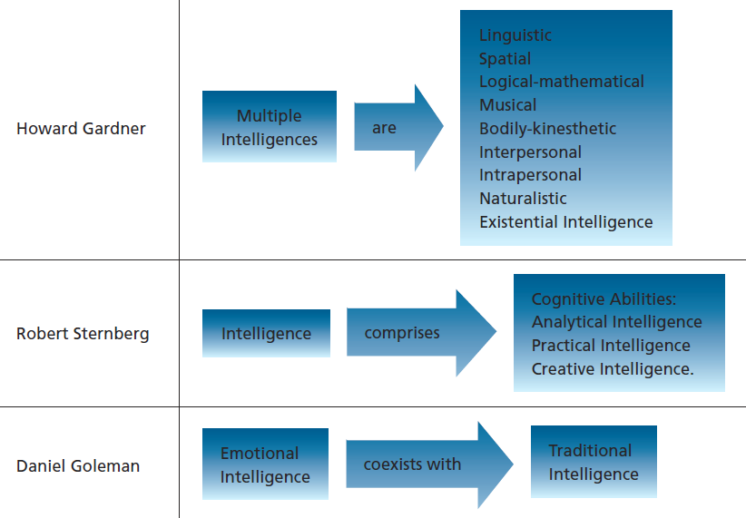
The Nature of Intelligence (cont’d.)
Notes:
IMAGE: [© Cengage Learning] (Pastorino, p. 337)
Intelligence 7 of 11
In the early 1980s, Harvard psychologist Howard Gardner proposed a theory of intelligence that views humans as possessing many different.
According to Gardner, an intelligence is “a biopsychological potential to process information that can be activated in a cultural setting to solve problems or create products that are of value in a culture.”
This definition emphasizes the fact that intelligence allows us to function efficiently in our own environment, and it also highlights the fact that different cultures and environments place different demands on our intelligence.
For example, in the United States today, we might consider the ability to understand and predict fluctuations in the stock market as a sign of intelligence.
In an unindustrialized, nomadic culture, however, the ability to seek out a source of water may be a more highly valued intelligence.
After carefully considering the different human abilities that allow us to function in our environment, Gardner developed a strict set of criteria for identifying an intelligence.
Using these criteria, Gardner has identified nine different intelligences and allowed for the possibility that more may someday be identified.
Gardner’s multiple intelligences include linguistic intelligence, spatial intelligence, musical intelligence, logical-mathematical intelligence, bodily-kinesthetic intelligence, interpersonal intelligence, intrapersonal intelligence, naturalistic intelligence, and existential intelligence.
Sternberg suggests that successful intelligence, or intelligence that helps us function in our world, is composed of three types of cognitive abilities.
Accordingly, Sternberg calls his theory the triarchic theory of intelligence .
According to the triarchic theory, intelligence is composed of analytical, practical, and creative abilities that help us adapt successfully to our environment.
Analytical intelligence is seen in our ability to use logic to reason our way through problems—for example, finding a way to fix your car when it breaks down.
Analytical intelligence is also important as we implement and evaluate problem-solving strategies, allowing us to evaluate whether a particular problem- solving strategy is working well.
Practical intelligence is our ability to adapt to our environment.
This is the type of intelligence that we see in people who have a great deal of common sense.
People who are high in practical intelligence exhibit savvy; they know how to function efficiently within their environment.
Creative intelligence is our ability to use our knowledge of the world in novel situations.
For example, suppose you found yourself in a foreign culture where you did not know the language or the customs. Would you be able to function?
People who are high in creative intelligence can adapt what they know about the world to meet the unique demands of new situations.
Yet another way of conceptualizing intelligence comes from psychologist Daniel Goleman.
In his best-selling book Emotional Intelligence, Goleman argues that a concept of intelligence that is based solely on cognitive abilities is too limiting.
He notes that even people with relatively high IQs can fail to succeed in life and sometimes do things that appear to be downright unintelligent.
In Goleman’s view, emotional intelligence includes awareness of your own emotional states, accurate assessment of your own abilities, self-confidence, self-control, trustworthiness, conscientiousness, the ability to adapt to changes, innovation or creativity, achievement motivation, commitment to completing goals, initiative or self-motivation, and a sense of optimism.
In other words, an emotionally intelligent person is a confident self-starter who is ethical and adaptable—the kind of person who sets a goal and works toward it without letting minor obstacles derail his or her progress.

Slide 8
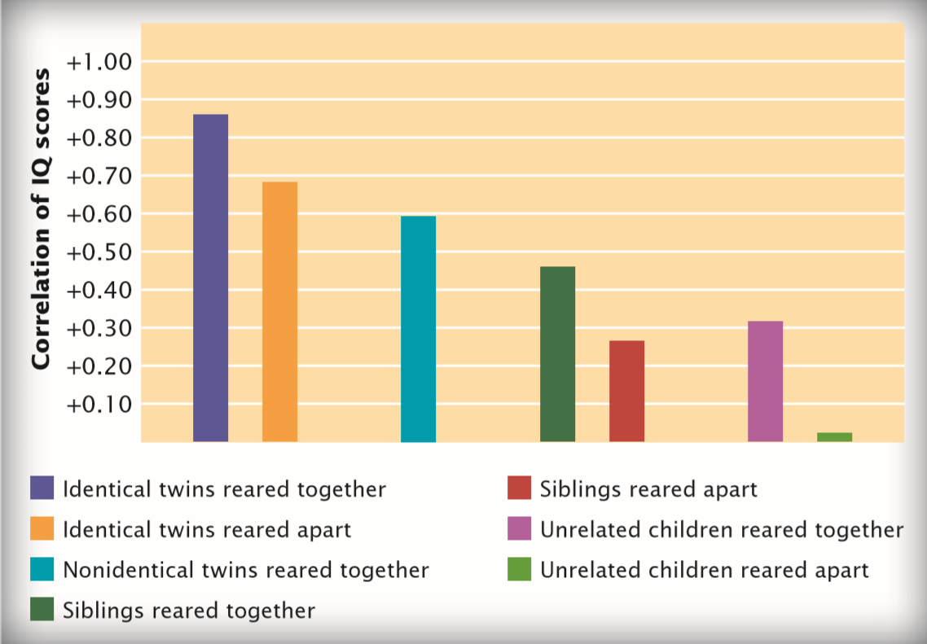
Biological Influences on Intelligence
Brain structures and activity
Heritability of intelligence
Notes:
IMAGE: [© Cengage Learning] (Bernstein, Figure 8.3, p. 268): Correlations of IQ Scores: The correlation in IQ between pairs increases with increasing similarity in heredity or environment.
Intelligence 8 of 11
Brain imaging studies demonstrate that standard measures of intelligence positively correlate with overall brain volume.
More precisely, intelligence measures are positively correlated with the thickness of the cerebral cortex, particularly in the prefrontal cortex and temporal lobes.
Because intelligence is such a broad concept, it is unlikely that we have “intelligence centers” in the brain.
Instead, scientists have suggested that intelligent brains enjoy quick, efficient communication of information from one area to another along axon pathways.
This possibility has led to studies investigating white matter health, which also shows positive correlations with measures of intelligence.
Studies of people with brain damage indicate that fluid intelligence, but not crystallized intelligence, is negatively affected by damage to the frontal lobes.
These observations are complemented by studies showing high levels of frontal lobe activity during diverse tests believed to demonstrate fluid intelligence
Different brain architectures may underlie intelligence in men and women
In men, IQ was most strongly correlated with the amount of gray matter located in both frontal lobes and the left parietal lobe.
In women, IQ was highly correlated with the volume of gray matter in the right frontal lobe and Broca’s area and with the volume of white matter throughout the brain.
According to these researchers, general intelligence was more likely linked to gray matter in men, but white matter in women.
These structural differences help to explain why males and females differ in brain size and structure, but do not differ significantly in measures of general intelligence.
Apparently, males and females follow different paths to intelligent behavior, which reinforces the complexity of this topic.
Measures of brain activity during tasks requiring intelligence have also demonstrated individual differences.
The brains of people with high scores on standard intelligence measures do not have to work as hard as the brains of people with lower scores to solve the same problem.
This research supports the view of intelligence as processing information quickly and efficiently
Intelligence also seems to be related to the timing of brain development.
As children approach puberty, the gray matter of the brain experiences a period of growth that slows down again later in adolescence.
Children with average IQ scores showed a peak thickening of cortical gray matter around the age of 8, but children with superior IQ scores experienced a much later peak thickening at around age 13.
Simple either/or thinking about nature and nurture is rarely correct when considering human behavior, including intelligence.
The influences of heredity (nature) interact intimately with experience and other environmental factors (nurture) to produce a result.
For example, infants who are breastfed have higher IQs than those who are not.
However, the experience of being breastfed increases IQ only in children with one variation of a gene, but it has no effect on IQ in children with another variation of the same gene
Heritability estimates how much of the variability in a characteristic observed in a population, such as variations in adult height, is due to genes.
If genes play no role in this variation, such as the likelihood that people have tattoos, heritability is zero, and when a condition is completely genetic, like Huntington’s disease, heritability is 1.0.
The heritability of adult intelligence as measured by IQ tests is usually reported to be about .75.
When we say that the heritability of intelligence is .75, we are saying that 75% of the variance in intelligence observed in the population can be attributed to genetics, not that 75% of an individual’s intelligence is due to his or her genes.
Both overall brain size and the proportion of gray matter are correlated with intelligence, and both are approximately 85% heritable, based on comparisons of identical and fraternal twins.
Although many genes are known to influence brain development, none has been conclusively linked to high IQ performance.
It is very likely that a very large number of genes, each having a small impact and interacting with the individual’s environment, contribute to the development of the brain.
The fact that a trait demonstrates high heritability does not imply that change or improvement is impossible.
A case in point is the highly heritable condition of phenylketonuria (PKU), in which a person cannot properly metabolize a particular amino acid found in many foods.
Left unchecked, the condition leads to intellectual disability.
However, if a child with PKU is given an appropriate diet in which problem foods are avoided until maturity, intellectual development proceeds normally.

Slide 9
Environmental Influences on Intelligence
The Flynn effect
Positive vs. negative influences
Differences based on socioeconomic status
Notes:
IMAGE: [© AP Images/Mike Derer] (Kail/Cavanaugh, p. 208) High-quality preschool programs provide stimulating environments that can increase children’s scores on intelligence tests and improve their school performance.
Intelligence 9 of 11
The presence of data showing that IQ is heritable does not mean we “give up” on anybody’s intellectual development.
An increase in average IQ in recent decades, known as the Flynn Effect, suggest that inherited characteristics are not necessarily fixed.
This change has occurred too quickly to represent genetic changes.
Instead, the Flynn Effect is much more likely to have resulted from environmental change, particularly improvements in health.
Using information from the World Health Organization, researchers have identified strong correlations between a nation’s freedom from serious infectious diseases and its citizens’ average IQ.
As nations become wealthier and more capable of battling disease, their citizens’ IQs increase
A favorable environment can improve a child’s performance somewhat, even if the inherited influences on that child’s IQ are negative.
Nutrition, medical care, sensory and intellectual stimulation, educational experiences, interpersonal relations, and influences on motivation are all significant features of the environment. IQs have risen among children who are adopted into homes that offer a stimulating, enriching environment.
This intelligence is partly determined by a genetic component that in turn contributes to their children’s IQ.
Second, parents’ income affects their children’s environment in ways that can increase or decrease IQ.
Third, motivational differences may play a role. Parents in upper- and middle-income families tend to provide more financial and psychological support for their children’s motivation to succeed and excel in academic endeavors.
There is also evidence that living in an impoverished environment can impair the development of cognitive skills and that environmental influences can magnify the effects of genetic influences.
Being in a lower socioeconomic status (SES) is associated with several factors that can impact cognitive performance:
Children in such environments often have less exposure and access to books than their counterparts in higher SES levels.
Teachers and schools in lower SES areas tend to have fewer supplies and instructional materials.
A lower SES is associated with increased risk of malnutrition and reduced access to adequate health care.
Even when race is factored out, children from lower SES levels tend to score about 15 points lower than middle-class children, on average.

Slide 10
Extremes of Intelligence
Intellectual disability
Notes:
IMAGE: [© DAVE YODER KRT/Newscom] (Cacioppo, p. 387): Individuals with Williams syndrome provide examples of how general intellect can diverge from other abilities and talents. Gloria Lenhoff (right), has a tested IQ score of 55 but has performed as a lyric soprano and has played her accordion with Aerosmith.
Intelligence 10 of 11
Approximately 1 to 3% of the population will score 70 or below on a standardized IQ test.
Although such a score points toward a diagnosis of intellectual disability, it is not a hard and fast rule, and several other factors must be considered.
To be diagnosed with intellectual disability, individuals must demonstrate problems with adaptive behaviors, or life skills.
These behaviors might include the ability to balance a checkbook, receive correct change from a cashier, read a bus schedule, buy groceries, maintain personal hygiene, and other skills required for independent living.
Intellectual disability is usually divided into categories of mild, moderate, severe, and profound based level of adaptive functioning.
Persons diagnosed with these levels of severity often show IQ scores within a particular range, but these scores should be viewed as general descriptors rather than diagnostic criteria.
Mild intellectual disability is typically accompanied by IQ scores of 55 to 70, or between 2 and 3 standard deviations from the mean of 100.
With proper intervention, individuals in this group will be able to master the sixth-grade curriculum, although it will typically take them until age 18 to do so.
Most individuals in this group will live independently, and many work, marry, and have families.
The causal factors for mild intellectual disability provide both good news and bad news.
The good news is that mild intellectual disability is typically not the result of genetic or medical problems.
Poverty is an obvious risk factor for this condition, as poor parents may be unable to obtain the health care and diet and other environmental benefits needed to produce healthy children
IQ scores between 40 and 55, or between 3 and 4 standard deviations from the mean, indicate moderate intellectual disability.
Unlike mild cases, moderate intellectual disability typically results from genetic or medical conditions rather than familial factors.
Genetic conditions such as trisomy 21, or Down syndrome, are very likely to produce disability in this range.
The academic attainment of most individuals in this category will be limited to the second-grade curriculum, and once again, most will not achieve this level until about the age of 18 years.
Most of these individuals will need some type of assisted living, although the type and extent of needed services vary widely among affected individuals.
Severe intellectual disability is diagnosed in individuals with IQ scores between 25 and 40, or 4 to 5 standard deviations below the mean, while profound intellectual disability is diagnosed in individuals with IQ scores below 25.
Both severe and profound intellectual disability generally result from serious medical conditions and are identified at birth or very early in infancy.
Individuals with severe intellectual disability can learn a few high-priority words, such as “stop” or “hot.”
Individuals with profound intellectual disability can learn some basic self-care skills, such as feeding themselves or washing their hands.
Depending on the nature of the medical problems, these individuals will require significant assistance and supervision.
Individuals with intellectual disability face a number of common problems.
Many children with intellectual disability form insecure attachments with their caregivers.
Depending on the severity of the intellectual disability, language skills are typically impacted.
Children with intellectual disability have problems expressing themselves clearly, although they may understand a great deal that is said to them.
In conjunction with typically poor social skills, these language deficits may result in peer rejection.
Consequently, successful intervention programs address language and social skills in addition to academic and life skill work.
Between 10 and 40% of individuals with intellectual disability experience some type of emotional or behavioral disorder.
Anxiety, impulsiveness, and mood disorders are the most common disorders seen in this population.
When intellectual disability is more severe, individuals may engage in pica, or the eating of nonedibles, or self-injurious behaviors, such as banging the head against the floor or wall.

Slide 11
Extremes of Intelligence (cont’d.)
Giftedness and genius
Notes:
IMAGE: [© NG Images/Alamy] (Cacioppo, p. 393): These teens, standing with former astronaut and NASA administrator Charles Bolden, are not satisfied by finding the “right answer” to teachers’ questions. Instead, they tackled tough problems to compete in the White House Science Fair.
Intelligence 11 of 11
Just as variations occur on the low side of the IQ distribution, so they do on the upper tail.
Intellectually gifted individuals, who make up approximately 1 to 3% of the population, score 2 or more standard deviations above the mean, or more than 130 on a standardized IQ test.
Genius combines unusually high intelligence with creativity and achievement.
Having a high IQ provides some significant advantages to individuals in many aspects of life.
One of the longest running studies in psychology is a longitudinal examination of gifted children initiated in 1921.
The original participants were children who were selected because of their very high IQs, averaging 150.
Through adulthood, the gifted participants not only maintained their high IQs but also enjoyed better physical health, emotional stability, occupational attainment, and social satisfaction throughout their adult lives.
High intellect, particularly as measured by an IQ score, does not capture completely what we mean by genius.
In spite of their successes, the gifted participants in the longitudinal study just cited did not produce “genius” work.
Nor do all remarkable thinkers possess particularly high IQs.
Nobel laureate Richard Feynman was disappointed to learn that his IQ was “only” 124.
Like individuals on the lower extreme of IQ scores, children with unusually high IQ scores benefit from educational opportunities tailored to their abilities.
Unfortunately, the structure of public education in the United States, with its emphasis on grade levels based on age, rarely provides optimum learning for gifted children.
A report by the U.S. Department of Education noted that children with IQs of 140 or above typically know at least half of a grade’s curriculum even before the school year begins, and those with IQs of 170 or above know virtually all of it.
Their time in school is subsequently wasted, and the material is so easy that it encourages poor learning habits ill-suited to later educational challenges.
Ideally, we could begin to offer education targeted to an individual’s intellectual strengths and weaknesses.

