Slide 1
Dealing with the Aftermath of Suicide
Picking up the Pieces
Dr. Shawn Talbot
Branch County Sheriff’s Office

Slide 2
This Afternoon’s Goals
Identify the Nature of Suicide
Discuss issues related to the normal grieving process v. suicide
Recognize response sets to avoid
Become familiar with what can be done or offered.
Review possible resources for the first responder.

Slide 3
Disclosure of Sources
Michigan Association of Suicidologists (MAS)
Michigan Association of Suicide Prevention (MASP)
Elizabeth Kubler-Ross, 1983
Department of Justice, Federal Bureau of Intelligence
Dr. Steve Band & Sp. Agent George Deshazor
Michael McMains (San Antonio Police Department)
Wayman Mullins (Southwest State University)

Slide 4
Why Prepare?
“The psychological states of emergency response personnel can have a direct effect on the mental and physical health of survivors of a trauma or disaster”
(Glasser, W. 1956)

Slide 5
Nature of Suicide
MI. Prevalence (since 2001):
1,000 per year succeed
25,000 more attempts/gestures
Michigan currently ranks 32nd among other states.
PINs
Depression
Lack of Control Over the Situation
Male & Female Differences
Women are 3x’s as likely to attempt
Men are 4x’s as likely to complete
Other Trends
Increasing in children (increased by 70% since 1981)
3rd leading cause of death for 15 – 19 year olds
Increasing in African Americans
Highest with the Native American culture
*MAS, MASP, National Vital Statistics Report, 2007

Slide 6
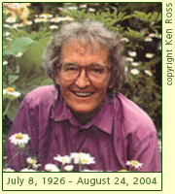
Nature of Grief
Grief v. Bereavement
Stages of Grief
Denial
Anger
Bargaining
Depression
Acceptance
Kubler-Ross, E.

Slide 7
How does the dynamic of suicide affect this grief process?
Theory 1: Suicide intensifies the grieving process (nature of the stressor).
Theory 2: Suicide changes the grieving process due to the confusion often times surrounding it.

Slide 8
Stages of Grieving (revised)
Denial Shock or Disbelief
Anger Guilt or Rage
Bargaining
Depression Helplessness/ Hypervigilance
Acceptance

Slide 9
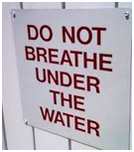
What to Avoid In Our Responses

Slide 10
What to Avoid In Our Responses
Feigning Sympathy
Over Empathizing (“I know how you are feeling.”)
Ignore their pain or the pain in the situation.
Using descriptive terms for the death (e.g. mode of death).
Blaming the deceased.
Trying to relieve their pain.
Asking if there is anything they need or anything you can do (instead offer your availability).

Slide 11
What Can We Do?
Understand the potential dynamics of suicide.
Be prepared (e.g. 3 ring binder of resources, cards etc…).
Demonstrate a professional level of empathy, understanding and respect (understanding your unique role, expressing condolences).
Assess the situation for the possible need, either now or within the next few days, of professional mental health intervention (offering practical assistance) and assuring them that such can be helpful.
Provide assurance in your mutual concern for understanding the situation and also providing supportive services (via referrals or the offering of available resources).
Encourage the support of family and friends and discourage isolation.
Let them know that healing can take place, but that it will take time (and that they have been through a traumatic event).
Have resources available as/if needed.
U.S. Department of Justice, Federal Bureau of Intelligence

Slide 12
Resources
Suicide Support Groups
The following link to suicide support groups comes from Suicide.org, http://www.suicide.org/suicide-support-groups.html. Click on the state to be directed to a list of suicide survivor support groups in that state. There is also a link to suicide support groups in Canada.

Slide 13
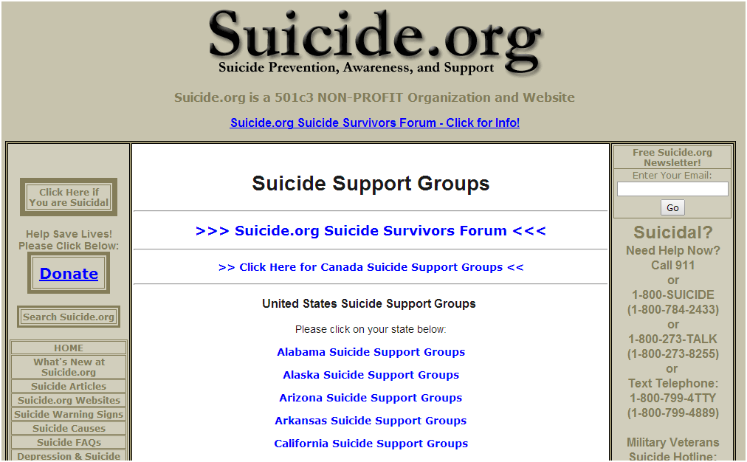

Slide 14
Kalamazoo Gryphon Place 1104 South Westnedge Kalamazoo, MI 49008 Name of Group: Survivors of Suicide Contact Person: Judy Whitehurst, LCSW (616) 381-4357 Meetings per Month: One - last Thursday of each month Fee: No Lansing Name of Group: Survivors of Suicide Child & Family Services, Capital Area 4287 Five Oaks Drive Lansing, MI 48911 Contact Person: Kathy Davis (517) 882-3506 Meetings per Month: One Fee: No

Slide 15
Resources
Suicide Support Groups
The following link to suicide support groups comes from Suicide.org, http://www.suicide.org/suicide-support-groups.html. Click on the state to be directed to a list of suicide survivor support groups in that state. There is also a link to suicide support groups in Canada.
Websites for Suicide Survivors
Listed here are a few websites that may be helpful for suicide survivors:
• For Suicide Survivors – http://forsuicidesurvivors.com/index.html, devoted to those who are grieving the loss of a loved one by suicide.
• Suicide Survivors.org – http://www.suicidesurvivors.org/, survivors of suicide help and information, Judy Raphael Kletter.
• Survivors of Suicide – http://www.survivorsofsuicide.com/index.html
• Surviving Suicide – http://www.survivingsuicide.com/cope.htm, provided by the surviving suicide support group of the Central Christian Church

Slide 16
Resources (continued)
Recommended Books for Suicide Survivors
• What Children Need When They Grieve: The Four Essentials: Routine, Love, Honesty and Security, by Julia Wilcox Rathkey.
• Helping Children Grieve: When Someone They Love Dies (Revised Edition), by Theresa Huntley.
• Helping Children Cope With the Loss of a Loved One: A Guide For Grownups, by William C. Kroen and Pamela Espeland.
• Guiding Your Child Through Grief, by James P. Emswiler and Mary Ann Emswiler.
• Grieving Child, by Helen Fitsgerald.
• Breaking the Silence: A Guide to Help Children with Complicated Grief-Suicide, Homicide, AIDS, Violence and Abuse, by Linda Goldman.
Books for children about suicide include:
• After A Parent’s Suicide: Helping Children Heal, by Margo Requarth.
• After A Suicide: A Workbook For Grieving Kids, developed by the Dougy Center for Grieving Children.
• But I Didn’t Say Goodbye: For Parents and Professionals Helping Child Suicide Survivors, by Barbara Rubel.
• Someone I Love Died by Suicide: A Story for Child Survivors and Those Who Care for Them, by Doreen Cammarata.
General guidelines on suicide are covered in the following books:
• After Suicide: A Ray of Hope for Those Left Behind, by E. Betsy Ross and Joseph Richman.
• After Suicide: Help for the Bereaved, by Dr. Sheila Clark.
• Healing After the Suicide of a Loved One, by Ann Smolin and John Guinan.
• Silent Grief: Living in the Wake of Suicide, by Christopher Lucas and Henry M. Seiden.
• Touched by Suicide: Hope and Healing After Loss, by Michael F. Myers and Carla Fine.
• Aftershock: Help, Hope and Healing in the Wake of Suicide, by Candy Neely Arrington and David Cox.
• After Suicide, by John H. Hewett.

Slide 17
Questions?

Slide 18
Thank You
Contact Information:
Dr. Shawn Talbot
517.677.9224 (cell)
269.965.3931 ext. 2220
talbots@kellogg.edu

